Slide 1



Docker-Kubernetes
Vikas
Notes:
Independent and standardized “application packages”.

Slide 2
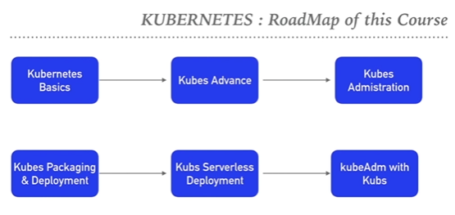
Notes:
Hi, I am Vikas, and I will be your instructor for this course.
I have 12 + industry experience and currently working as Cloud Automation DevOps Engineer @MNC, India.
This Course helps you to understand DevOps lifecycle.
After completion you will be able to Understand, Deploy, Use and Manage Docker container from scratch to advance level.
Do container orchestration using Docker Swarm and Kubernetes.
Stateful and stateless application in K8s.
HELM Package to administer and package-deploy application on production scale.
https://github.com/vikas99341/Kubernetes_Devops.git

Slide 3
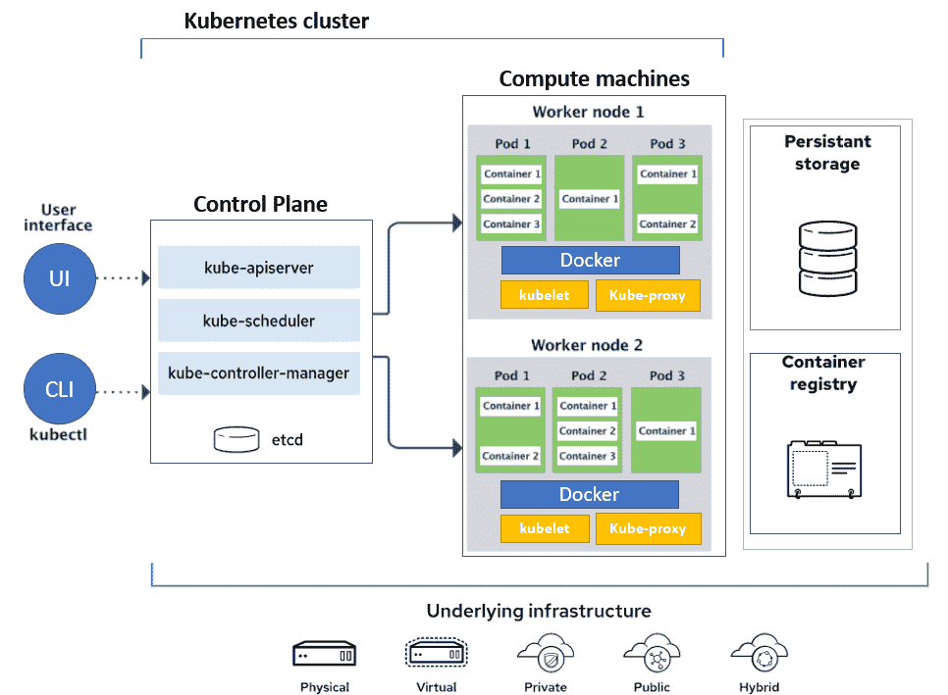
Notes:
Kubernetes is an open-source container orchestration system for automating software deployment, scaling, and management. Google originally designed Kubernetes, but the Cloud Native Computing Foundation now maintains the project.
Master Node : Responsible for the management of Kubernetes cluster. Entry point for all administrative tasks.
--------------------------------------------------------------------------------------------------------------------------
API Server : API server is the entry point for all the REST commands used to control the cluster. Interaction Point with Kubernetes cluster.
Etcd : Distributed key-value store which stores the cluster state. Used as Back-End for K8s. Provides high availability of Data related to Cluster State.
Scheduler : Regulates the tasks on slave nodes. Stores the resource usage information for each slave node.
Controller : Runs multiple Controller utility in single process. Carry on Automated tasks in K8s Cluster.
Worker Node : It’s a physical server or you can say a VM where the container managed by the Cluster Run. Worker nodes contain all the necessary services to manage the networking between the containers, communicate with the master node, and assign resources to the scheduled containers.
-----------------------------------------------------------------------------------------------------------------------------------------------------------------------------------------------
Kubelet : K8s Agent executed on the worker nodes. Kubelet gets the configuration of a Pod from the API server and ensures that the described containers are up and running.
Pods : Is a group of one or more containers with shared storage/network, and a specification for how to run the containers. Share the Same Shared content and same IP but reach other Pods via Local Host. Single Pod can Run on Multiple Machines and Single Machine can Run Multiple Pods.
Kube-Proxy : Kube-proxy runs on each node to deal with individual host sub-netting and ensure that the services are available to external parties. Kube-proxy acts as a network proxy and a load balancer for a service on a single worker node
https://kubernetes.io/blog/2015/04/borg-predecessor-to-kubernetes/

Slide 4
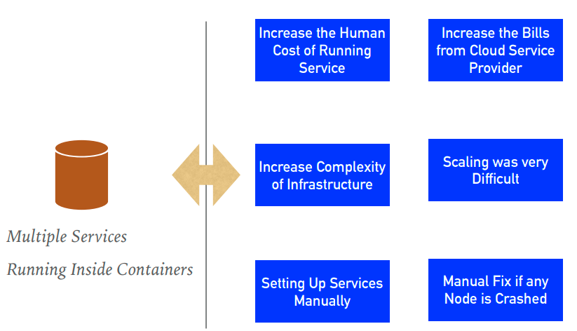
Notes:
Features of Kubernetes:
=======================
➤ Kubernetes is a platform that eliminates the manual processes involved in deploying containerized applications.
➤ Kubernetes used to manage the State of Containers. Start Containers on Specific Nodes. Restart Containers when gets Killed. Move containers one Node to Another.
➤ Automated Scheduling : Kubernetes provides advanced scheduler to launch container on cluster nodes based on their resource requirements and other constraints.
➤ Healing Capabilities : Kubernetes allows to replaces and reschedules containers when nodes die. Kubernetes doesn’t allow Containers to use, until they get ready.
➤ Auto Upgrade and Rollback : Kubernetes rolls out changes to the application or its configuration. Monitoring Application ensure that Kubernetes doesn’t kill all Instance at that time. If something goes wrong, with Kubernetes you can rollback the change.
➤ Horizontal Scaling : Kubernetes can scale up and scale down the application as per the requirements with a simple command, using a UI, or automatically based on CPU usage.
➤ Storage Orchestration : With Kubernetes, you can mount the storage system of your choice. You can either opt for local storage or choose a public cloud provider.
➤ Secret & Configuration Management : Kubernetes can help you deploy and update secrets and application configuration without rebuilding your image and without exposing secrets in your stack configuration.

Slide 5
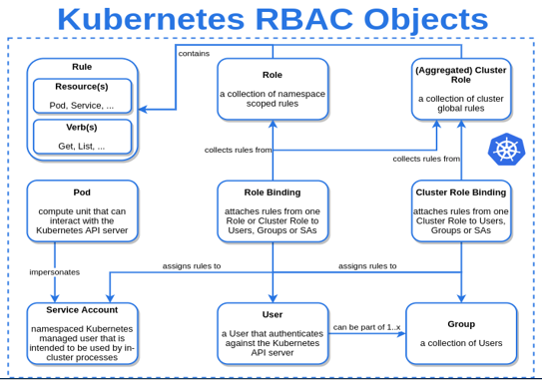
Notes:
Namespaces are virtual Cluster backed by the same Physical Cluster. It’s a ways to separate and organize Objects in k8s, such as pods and containers which live here .

Slide 6
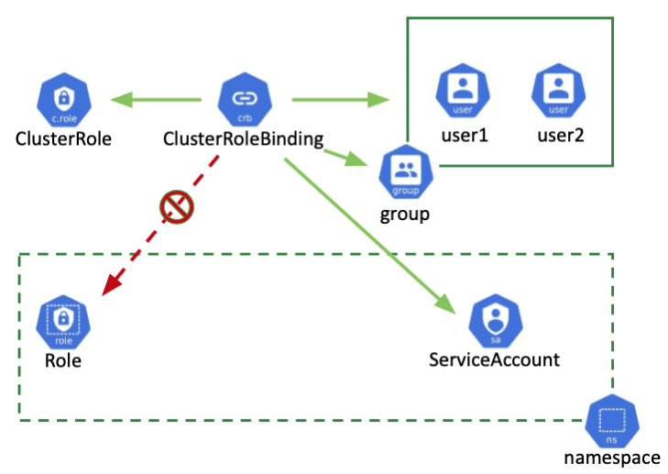
Notes:
A role binding grants the permissions defined in a role to a user or set of users. It holds a list of subjects (users, groups, or service accounts), and a reference to the role being granted. A Role Binding grants permissions within a specific namespace whereas a Cluster Role Binding grants that access cluster-wide.
RBAC-cmd

Slide 7
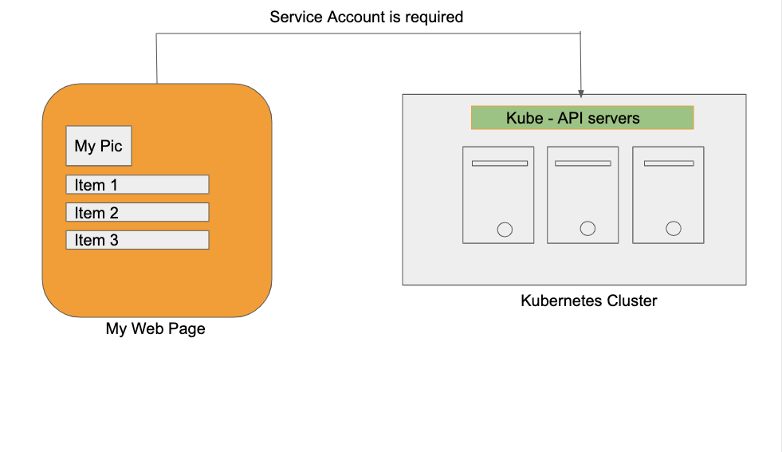
Notes:
Kubernetes service accounts are Kubernetes resources, created and managed using the Kubernetes API, meant to be used by in-cluster Kubernetes-created entities, such as Pods, to authenticate to the Kubernetes API server or external services.
In K8s, Service Account are used by container process to Authenticate with K8s API’s. If Pods needs to communicate with K8s APIs. User need to setup service account to control the access.
Service Account Access also manage by RBAC. Bind Service Accounts with Cluster Role or Cluster Role Binding to provide access to Cluster APIs.
vi my-serviceaccount.yml
kubectl apply -f my-serviceaccount.yml
kubectl get serviceaccounts -n development
vi service-account-binding.yml
kubectl apply -f service-account-binding.yml
kubectl get rolebinding -n development

Slide 8
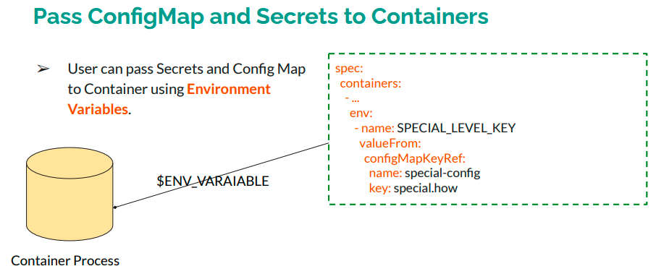
Notes:
Kubernetes allows user to pass dynamic configuration values to application at Runtime that are settings that influence the operation of an application.
ConfigMap : Keep the Non-Sensitive Data in ConfigMap, which can be passed to Container Application. Config Map Store Data in Key-Value format. ConfigMaps allow you to separate your configurations from your Pods and components. which makes configurations easier to change and manage and prevents hardcoding configuration data to Pod specifications.
Secrets are like ConfigMap but designed to keep the Sensitive Data.

Slide 9
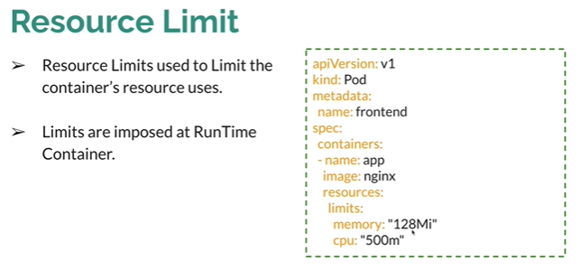
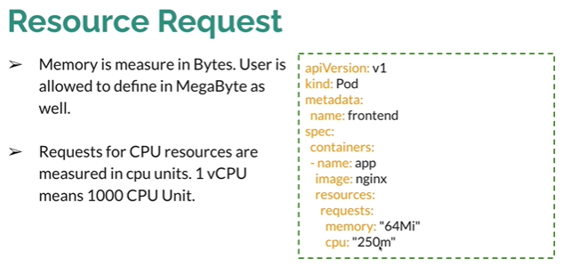
Notes:
Resource request – How much resource a particular container can request from k8s cluster.
Resource limit – Limit on container which can be defined on k8s.This is imposed @ run time only when application is running .

Slide 10
Notes:
Code repo : https://github.com/vikas99341/node-js

Slide 11
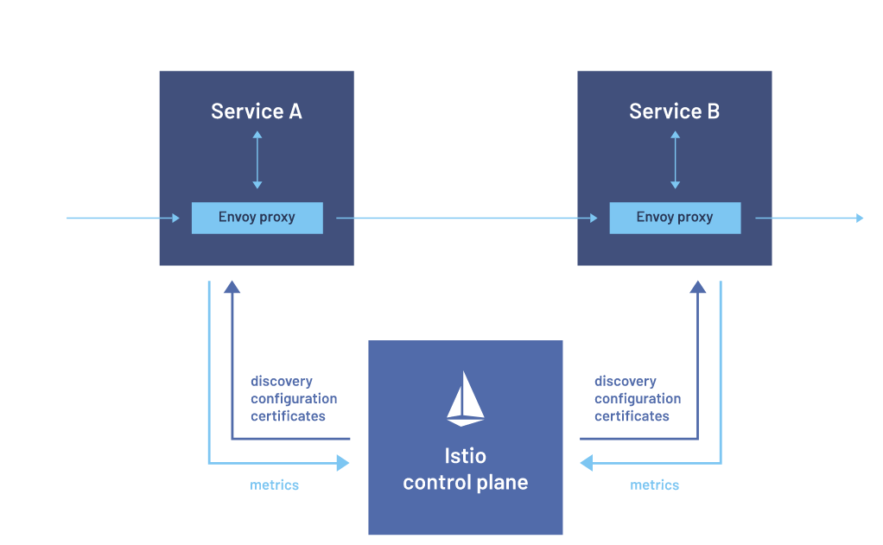
Notes:
Challenges with microservices:
No encryption
No routing policy & LB
No failover and retry
No access control to the services
No Load Metrics & logs
Service Mesh manages microservice communication.

Slide 13
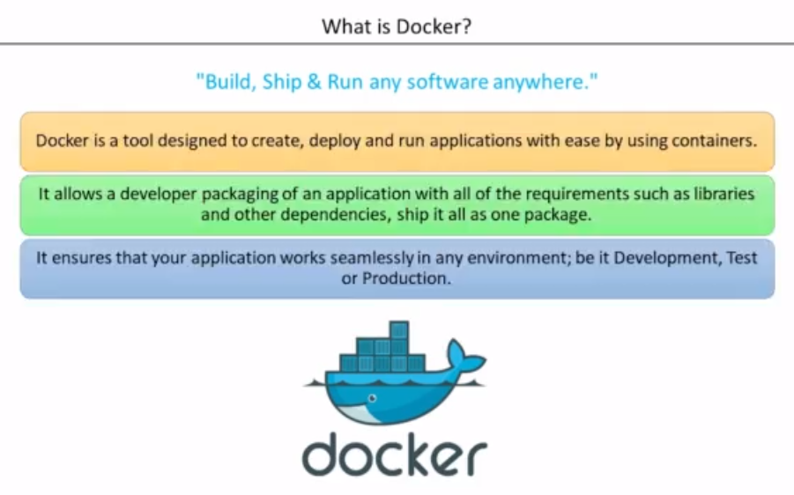
Notes:
Why do we need docker ?
Smoothens the s/w installation process .
Docker is a platform for developing ,shipping and running application using an open-source container-based technology launched in 2013 as an open-source Docker Engine in isolated environment .
A tool for creating and managing containers (OS Level virtualization).
Run everywhere – physical ,virtual or cloud
Run anything – if it can on host , it can run on container .
App runs same is all environment
Benefits :
Docker is designated to make it easier to create , deploy and run applications by using containers .
Light weight alternative to VM and it uses host OS .
You don’t have to pre allocate any RAM in containers .
netstat -tupln

Slide 14
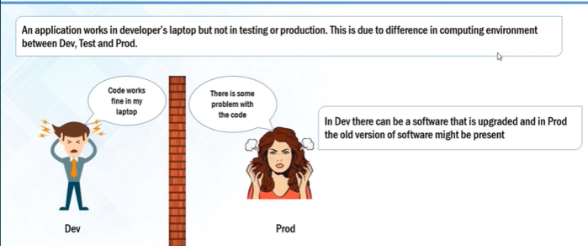
Notes:
User concerns :
Developer /Tester
.Portable runtime environment
. Missing Dependencies and package
. Run tests faster
2. Sys-Admin
.Cost & Performance
. Efficient ,consistent & repeatable
. Speed , reliable of CICD .

Slide 15
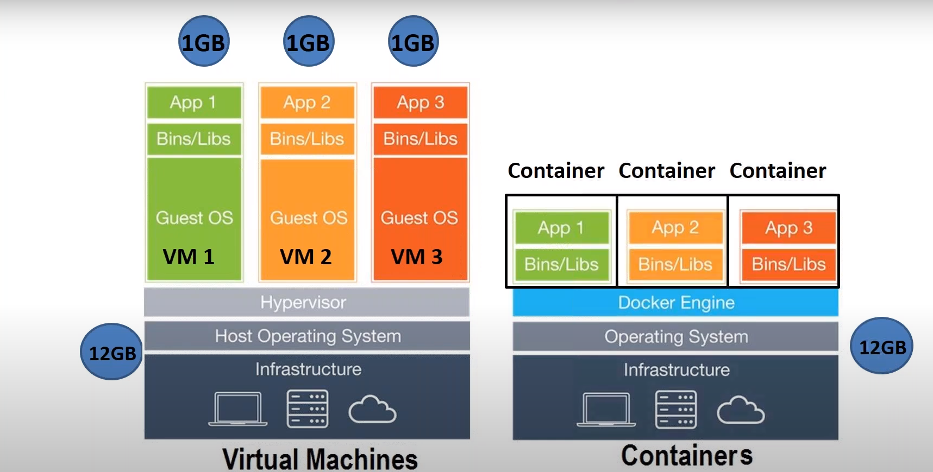
DOCKER CONTAINERS VS VIRTUALIZATION
Notes:
Docker is a lightweight ,stand-alone, executable package of a piece of software that includes everything needed to run it : code ,run time, system tools, system libraries ,settings . These are ideal to run all major linux , windows ,VM or any cloud .Containers isolate application from one another and from the underlying infrastructure ,Hence secure to use .

Slide 16
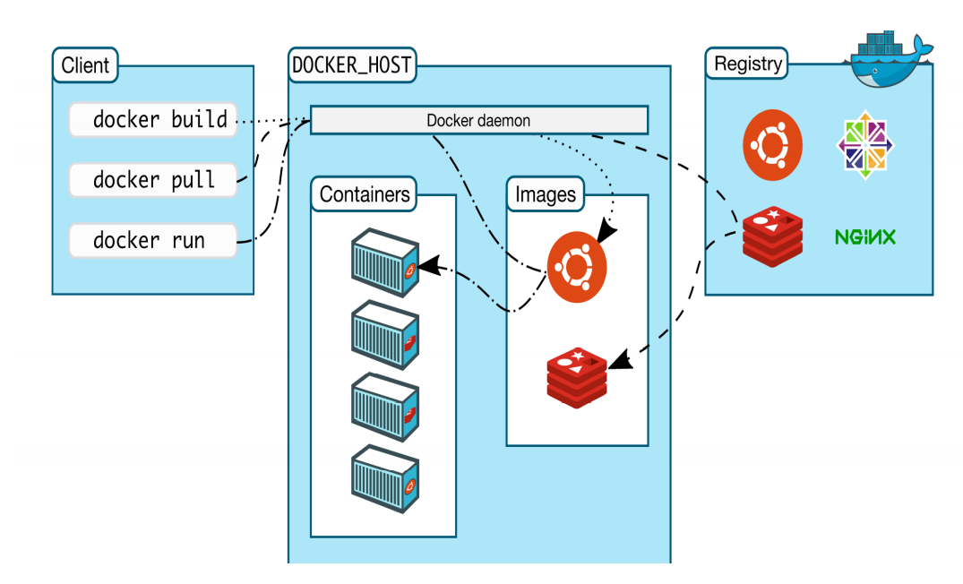
Notes:
Docker Architecture :
Docker Client – provides a UI to run API Calls
Docker Daemon - run Docker commands
Docker Registry –

Slide 17
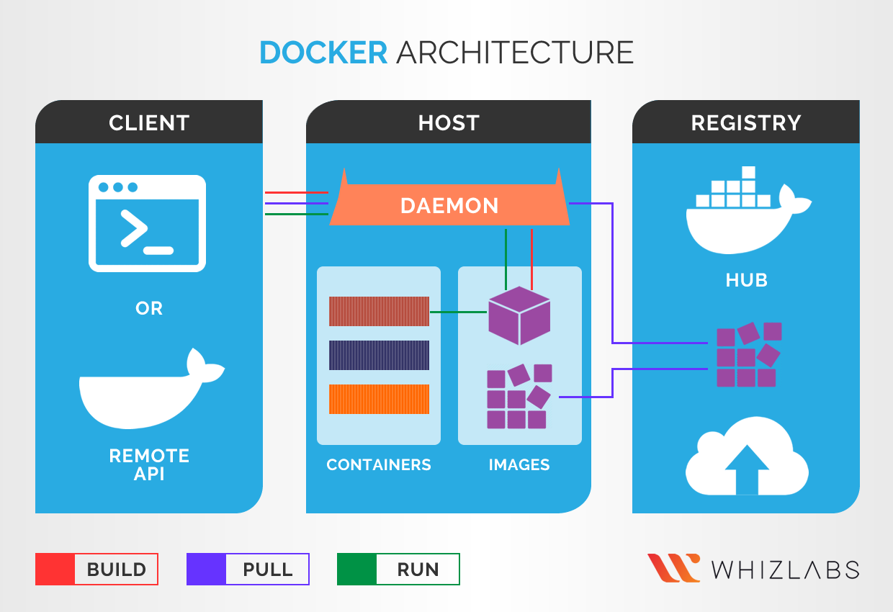

Slide 18
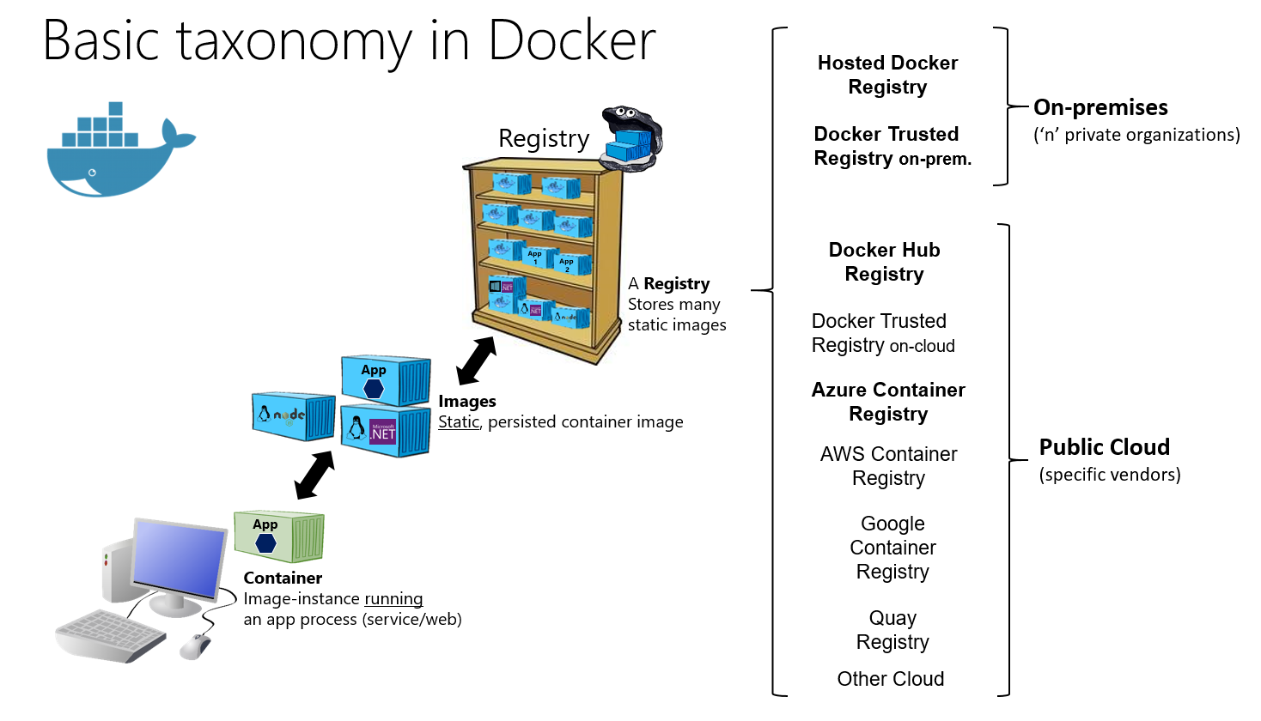

Slide 20
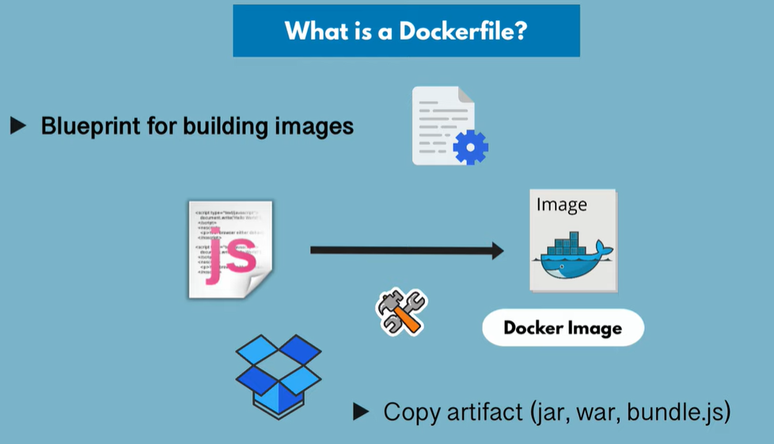

Slide 21
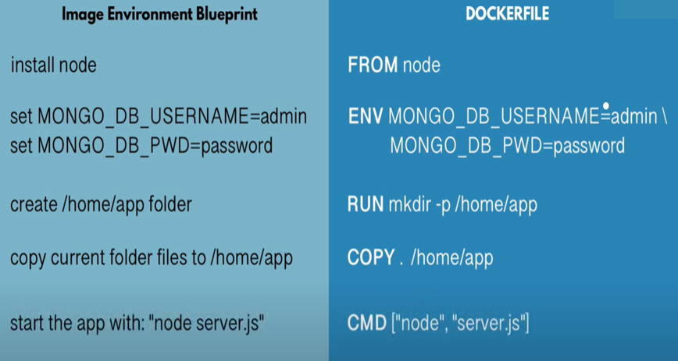
Notes:
Docker file is a blueprint for building image
Keywords:
FROM : Talks about the base image
ENV : Optional as environment variables are defined here .
RUN - Execute any Linux command .Execution will happen inside the container .
COPY - Source can be local, and destination is inside container
CMD – Always part of docker file . Execute entry point Linux command .
Multiple RUN commands can be there but only one CMD command .
docker ps -a | grep my-app

Slide 23
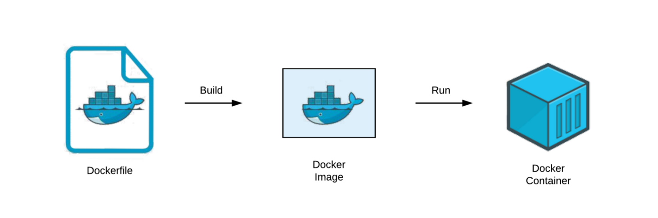
Docker file
Notes:
A Dockerfile is a text document that contains all the commands a user could call on the command line to assemble an image and build images automatically by reading the instructions from a Dockerfile. A Docker image consists of read-only layers each of which represents a Dockerfile instruction.
FROM: The FROM instruction initializes a new build stage and sets the Base Image for subsequent instructions. Base Image can be any valid image.
LABEL : LABEL added to image to organize images by project, record licensing information. Eg: LABEL com.example.version=“0.0.1-beta“
RUN : RUN instruction will execute any commands in a new layer on top of the current image and commit the results.
CMD : CMD instruction should be used to run the software contained by your image, along with any arguments. There can only be one CMD instruction in a Dockerfile. If you list more than one CMD then only the last CMD will take effect. The main purpose of a CMD is to provide defaults for an executing container.
EXPOSE : EXPOSE instruction indicates the ports on which a container listens for connections.
ENV : ENV instruction sets the environment variable
ADD : ADD instruction copies new files, directories or remote file URLs from and adds them to the filesystem of the image at the path .
VOLUME : VOLUME instruction should be used to expose any database storage area, configuration storage, or files/ folders created by your docker container.
WORKDIR : WORKDIR instruction sets the working directory for any RUN, CMD, ADD instructions that follow it in the Dockerfile.
Extend Docker Official Nginx Image.
https://kubernetes.io/docs/tutorials/kubernetes-basics/create-cluster/cluster-interactive/

Slide 24
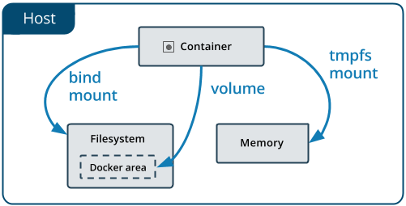
Data Persistence
Notes:
Volumes : Volumes are stored in a part of the host filesystem which is managed by Docker.
eg: docker container run -d - -name mysql –e MYSQL_ALLOW_EMPTY_PASSWORD=True -v mysql-db:/var/lib/mysql mysql
eg: Run My SQL with named Volume
docker container run -d - -name mysql –e MYSQL_ALLOW_EMPTY_PASSWORD=True - -mount source=mysql-db, target=/var/lib/mysql mysql
Bind mounts may be stored anywhere on the host system and non-docker processes on the Docker host or a Docker container can modify them at any time, but it can’t be use in DockerFile.
Eg : docker container run -d - -name nginx - -mount type=bind, source=$ (pwd),target=/app nginx
docker pull -- > docker inspect -- >

Slide 25
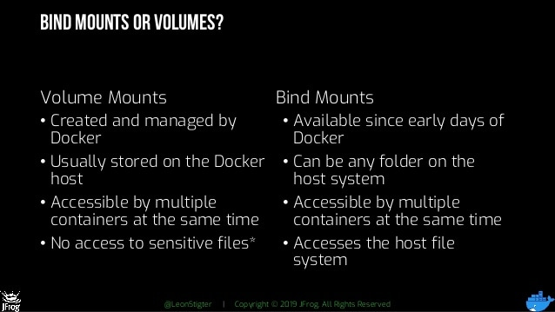
Notes:
docker run -u root -d --name jenkins -p 8080:8080 --mount type=volume,source=jenkins_backup,target=/var/jenkins_home jenkins/jenkins:lts-jdk11
/var/lib/docker/volumes/
docker run -u root -d --name jenkins -p 8080:8080 --mount type=bind,source=/tmp,target=/var/jenkins_home jenkins/jenkins:lts-jdk11

