Slide 1
CSC4630 — ADVANCED SOFTWARE ENGINEERING
Cafe Restaurant
POS System
A Unified Process build: Inception → Elaboration → Construction
N
G
P
K
H
Nathan
Guba
Peter
Kalebalika
Henry
Team Lead
Member
Member
Member
Member
Cafe Restaurant POS System • CSC4630 Advanced Software Engineering
1

Slide 2
OVERVIEW
What We'll Cover
1
The Problem
2
Methodology
Why a small café needs a POS system
Larman's Unified Process across four phases
3
Architecture
4
Tech Stack
Layered, offline-first design from Elaboration
React (Vite) + Supabase for Construction
5
Live System
6
Quality
Walkthrough of every built screen
Automated tests and defect tracking
Cafe Restaurant POS System • CSC4630 Advanced Software Engineering
2

Slide 3
INCEPTION — BUSINESS CASE
Why This System Exists
Small café and restaurant operations run order-taking, kitchen coordination, and inventory tracking as separate, manual, disconnected steps. That gap is where orders get lost, stock runs out unnoticed, and revenue is hard to reconcile.
INCEPTION ANSWERED
Should this
project exist?
Assess whether a small café genuinely needs a POS system in day-to-day operation
Yes — validated through a vision document, feasibility study, and risk analysis before any design work began.
Track orders end-to-end: placed → preparing → ready → served
Give management real-time visibility into revenue and stock levels
Methodology: Craig Larman's Unified Process
(as taught in class)
Cafe Restaurant POS System • CSC4630 Advanced Software Engineering
3

Slide 4
APPROACH
The Unified Process, Phase by Phase
✓
✓
✓
4
Inception
Elaboration
Construction
Transition
Vision, feasibility,
risk analysis, use cases
Domain model, architecture
proof-of-concept, UI prototypes
Iterative build of all
prioritized features
Final demo &
submission
COMPLETE
COMPLETE
COMPLETE
UPCOMING
We are here: Construction is complete and verified — this presentation is part of Transition.
Cafe Restaurant POS System • CSC4630 Advanced Software Engineering
4

Slide 5
PHASE 1
Inception — What We Delivered
1
2
3
Vision Document
Feasibility Study
Risk Analysis
Product purpose, scope, and stakeholders
Technical and operational viability
Key project and technical risks identified early
4
5
6
Use Case Diagram
Business Case
Glossary
Actors: Cashier, Waiter, Kitchen Staff, Manager
Justifying the system against manual operations
Shared vocabulary across the whole team
Cafe Restaurant POS System • CSC4630 Advanced Software Engineering
5

Slide 6
PHASE 2
Elaboration — Architecture Proof of Concept
A layered, offline-first architecture: the UI never talks to the remote database directly, and a dedicated synchronization layer reconciles local and remote state when connectivity returns.
Order UI
Order Management
Payment Processing
Local Database
Synchronization
Remote Database
sync when connectivity is detected
Also delivered in Elaboration: complete design class diagrams, UI prototypes for every screen, system sequence diagrams, and an updated risk list.
Cafe Restaurant POS System • CSC4630 Advanced Software Engineering
6

Slide 7
PHASE 3
Construction — Technology Stack
1
React (Vite)
2
Supabase Postgres
Component-based UI with fast local dev builds; role-based routing drives which screen each staff member sees.
Relational schema of 10 tables — roles, users, orders, line items, payments, inventory — matching the Elaboration domain model.
3
Supabase Auth
4
Supabase Realtime
Email/password staff login, mapped to roles (Cashier, Waiter, KitchenStaff, Manager, Administrator).
Live order-status updates pushed to Kitchen Display and Active Orders without polling or manual refresh.
Cafe Restaurant POS System • CSC4630 Advanced Software Engineering
7

Slide 8
SYSTEM DESIGN
One Login, Five Role-Driven Screens
Cashier / Waiter
Order Entry
Build an order from the menu, choose Counter or Dine-in, take payment
Kitchen Staff
Kitchen Display
See every active order across all tables, move it through prep
Waiter
Active Orders
See orders marked Ready and mark them Served
Manager / Administrator
Manager Dashboard
Revenue, order status counts, and low-stock alerts
Cafe Restaurant POS System • CSC4630 Advanced Software Engineering
8

Slide 9
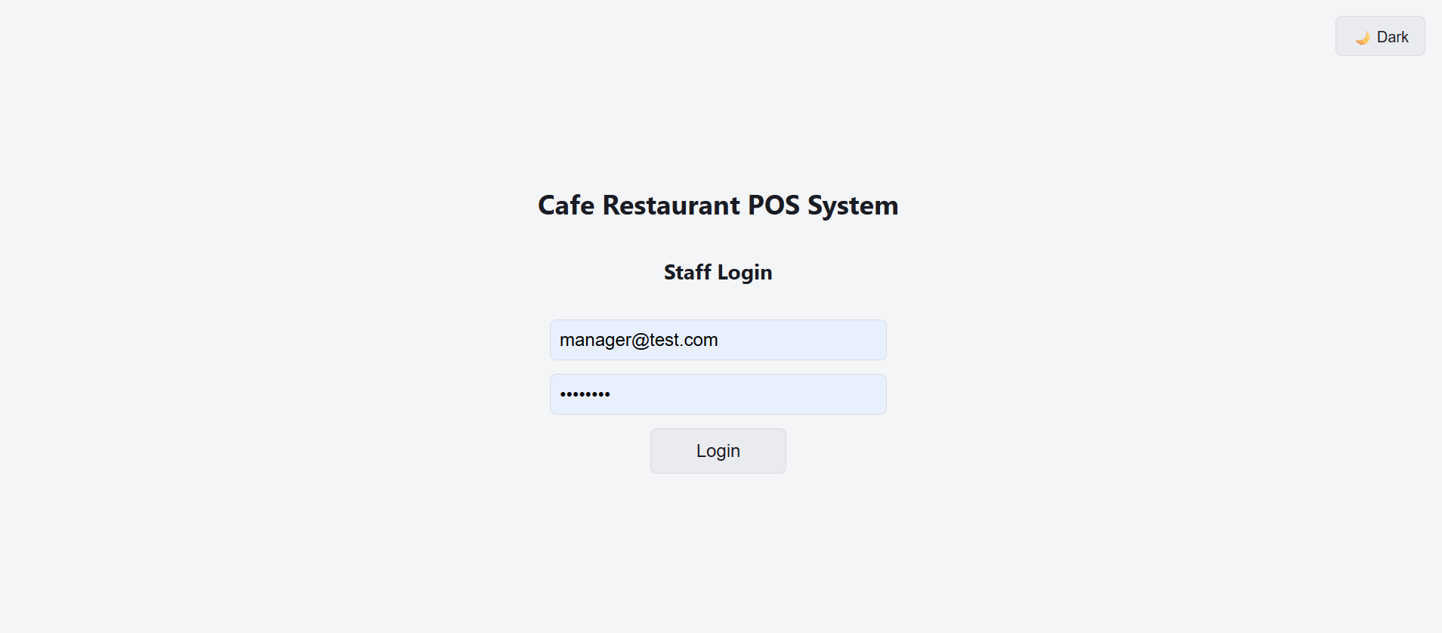
FEATURE 1 OF 5
Login & Role-Based Routing
A single staff login screen backed by Supabase Auth. Once authenticated, the app looks up the user's role and routes them straight to the screen built for their job — no menus to hunt through.
Email + password against Supabase Auth
Role fetched from the users → roles relationship
Cashier/Waiter → Order Entry, Kitchen Staff → Kitchen Display,
Manager/Administrator → Manager Dashboard
Cafe Restaurant POS System • CSC4630 Advanced Software Engineering
9

Slide 10
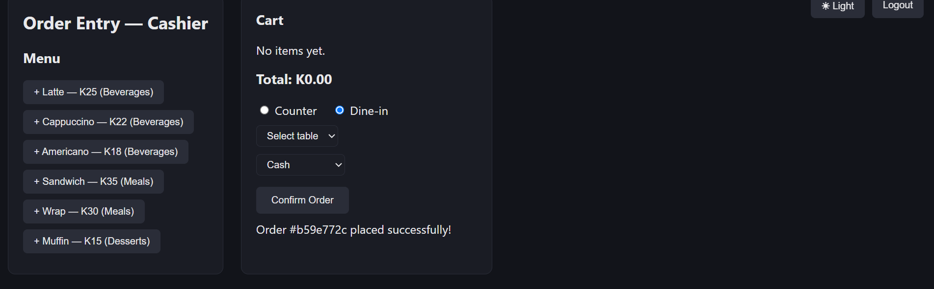
FEATURE 2 OF 5
Order Entry
Cashiers and waiters build an order from the live menu, choose Counter or Dine-in (with table selection), pick a payment method, and confirm — writing an order, its line items, and a payment record to Supabase in one flow.
Cart totals update live as items are added
Dine-in orders are tied to a specific table
Cart resets automatically after a successful order,
ready for the next customer
Cafe Restaurant POS System • CSC4630 Advanced Software Engineering
10

Slide 11
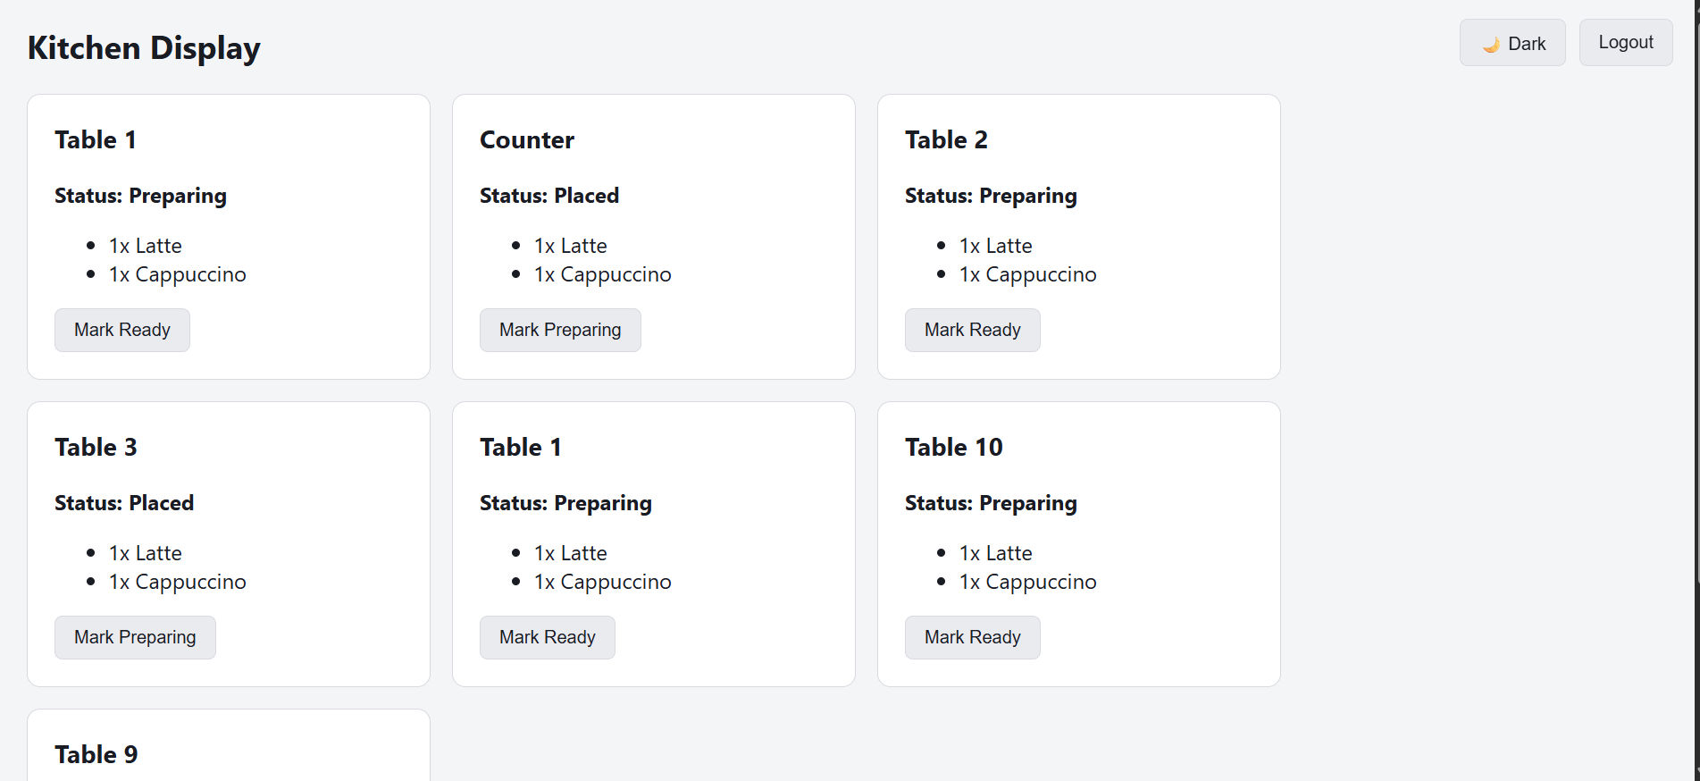
FEATURE 3 OF 5
Kitchen Display
Kitchen staff see every active order across every table on one live board, grouped by status, updated in real time through Supabase Realtime as new orders come in.
Every order shows its table and items at a glance
One tap moves an order: Placed → Preparing → Ready
No polling or manual refresh — updates push automatically
Cafe Restaurant POS System • CSC4630 Advanced Software Engineering
11

Slide 12
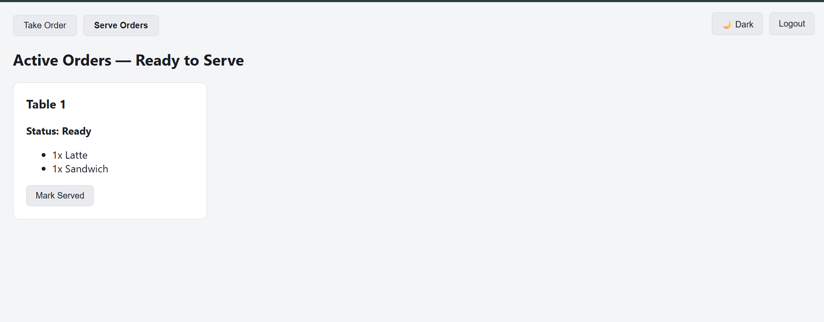
FEATURE 4 OF 5
Active Orders — Waiter View
Once the kitchen marks an order Ready, it appears here for the waiter to deliver. Marking it Served closes the loop and updates the order's status for the Manager Dashboard.
Filtered to only orders that are actually Ready
Shows table number and the exact items to deliver
“Mark Served” updates status instantly for reporting
Cafe Restaurant POS System • CSC4630 Advanced Software Engineering
12

Slide 13
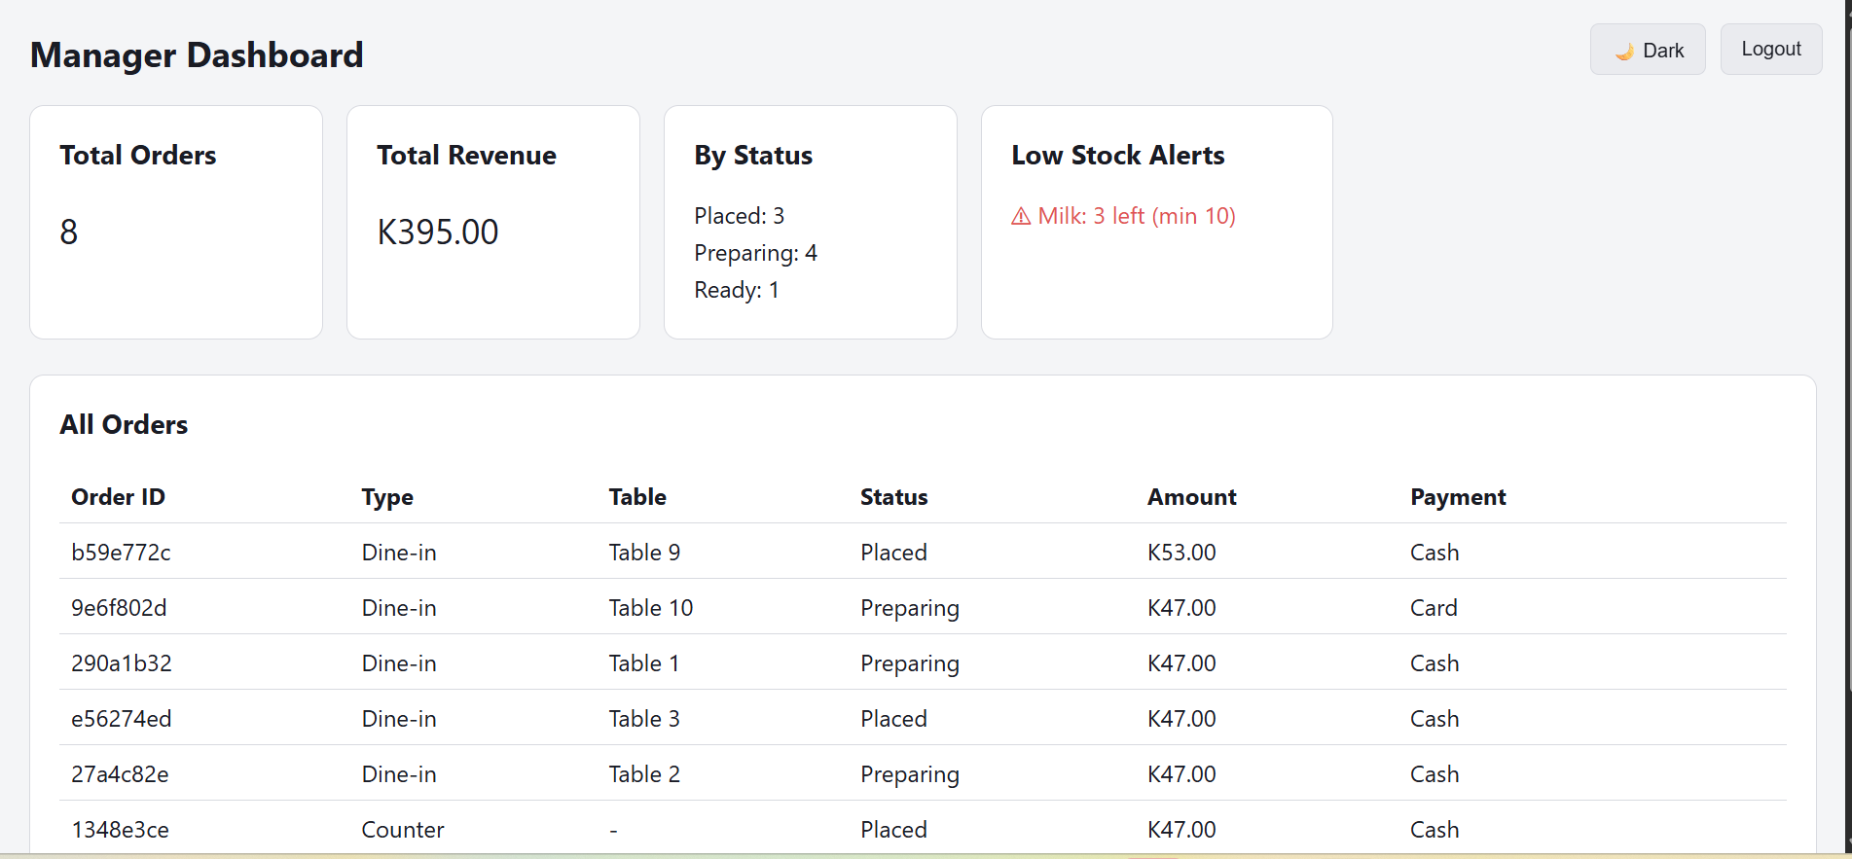
FEATURE 5 OF 5
Manager Dashboard
A real-time operational view for managers: total orders, total revenue, a live breakdown by status, and automatic low-stock alerts pulled from the inventory table.
Cafe Restaurant POS System • CSC4630 Advanced Software Engineering
13

Slide 14
VERIFICATION
Testing & Defect Tracking
13
10
3
Automated tests passing
(unit + integration)
Database tables
modeled from Elaboration
Real defects found,
fixed, and logged
ID | Description | Severity | Status
D001 | Empty placeholder components crashed the app on load (missing default export) | High | Resolved
D002 | Row Level Security enabled with no policies — all reads silently returned 0 rows | High | Resolved
D003 | Active Orders still held placeholder code — waiter view showed no ready orders | Medium | Resolved
Cafe Restaurant POS System • CSC4630 Advanced Software Engineering
14

Slide 15
THANK YOU
A complete, tested, and
documented Construction phase.
Login · Order Entry · Kitchen Display · Active Orders · Manager Dashboard — built on React (Vite) + Supabase, verified against 13 automated tests, with every defect found, fixed, and documented.
N
G
P
K
H
Nathan
Guba
Peter
Kalebalika
Henry
Team Lead
Member
Member
Member
Member
Questions?
Cafe Restaurant POS System • CSC4630 Advanced Software Engineering
15

