Slide 1

How safe is the Big Apple !!

Slide 2
Traffic Safety Analysis for NYC
Team : Girls of North America
Sunny Wang (Edmonton, Canada)
Janna Fung (Edmonton, Canada)
Chaorong Duan (Philadelphia, PA, USA)
Sharda Nandula (Raleigh, NC, USA)

Slide 3
Table of Contents
Problem Analysis
Analysis, Planning and Design
Implementation
Presentation

Slide 4
Problem Analysis
We wanted to identify areas of improvement for the NYC DMV in terms of road intersections and speed limits. This was done by analyzing data provided by the NYPD through the Databricks Marketplace.

Slide 5
Analysis, Planning & Design
MarketPlace Data from NYPD was used in this effort.
We brainstormed ideas on what useful questions could this data answer.
We also discussed what kind of data would be useful for displaying on the dashboard.

Slide 6
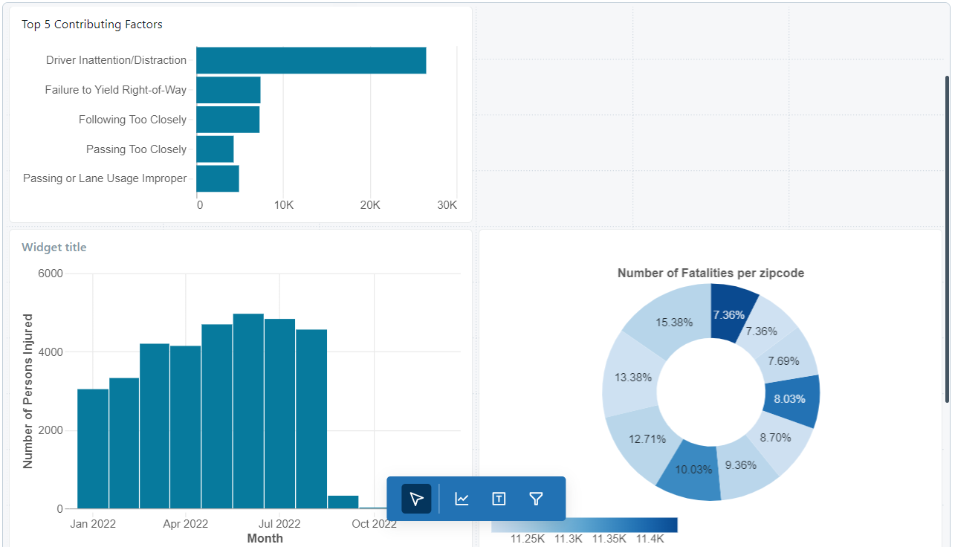
NYC DMV Dash Board

Slide 7
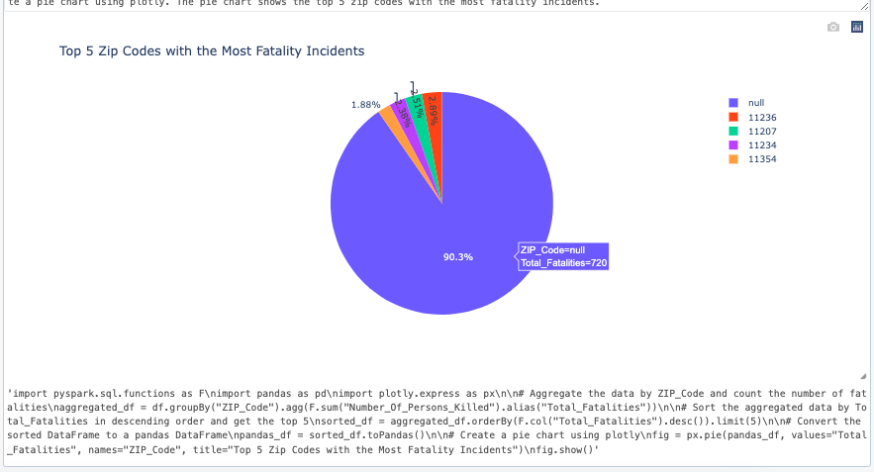
AI Implementation
PySpark AI to take the user questions and answering them in a meaningful manner.

