Slide 1


Analysis of Career Trajectories and Salaries
Using Advanced Excel, SQL and Tableau
Name: Govind Singh Shekhawat

Slide 2
Aim of the Project
Data Cleaning – Ensuring accuracy and consistency in Excel. Data Extraction – Identifying trends and storing data in MySQL. Trend Analysis – Analyzing salary patterns and key factors.
Visualization – Creating a dynamic Tableau dashboard for insights.

Slide 3
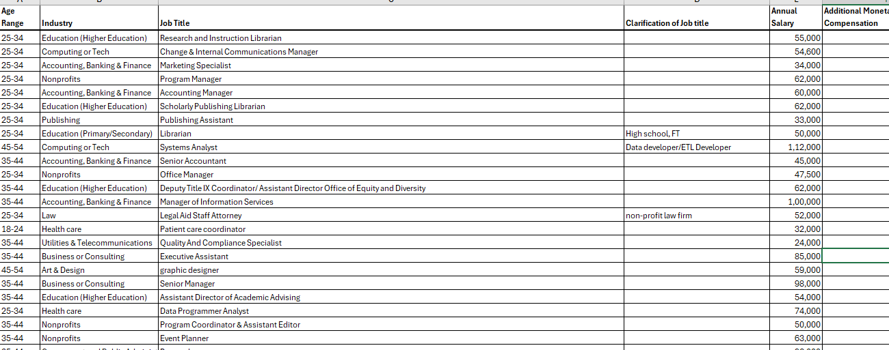

Dataset Overview : The dataset includes 28104 Rows & 16 attributes influencing salaries.

Slide 4
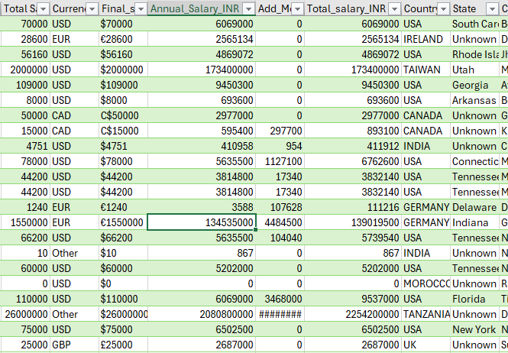
Data Preprocessing using Excel
Removed duplicate entries.
Addressed missing values. Standardized data formats. Added new columns.
Handled Outliers present in data.
Ensured Data integrity to avoid wrong outcomes.
BACK TO AGENDA PAGE

Slide 5

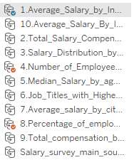
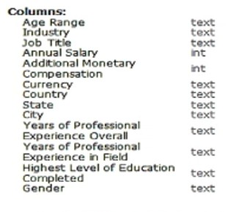
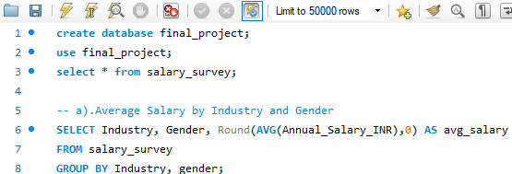
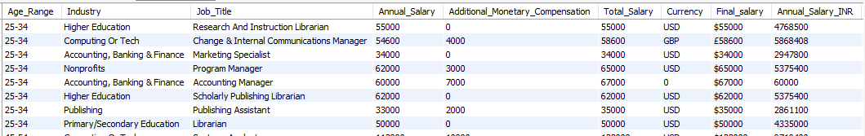
Data transforming and Data storing using SQL
Imported the cleaned dataset Executed complex queries
Generated CSV outputs for visualization
BACK TO AGENDA PAGE

Slide 6
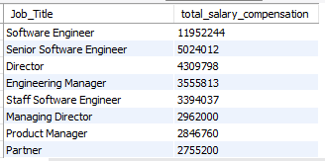

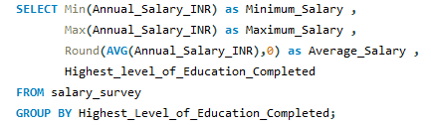
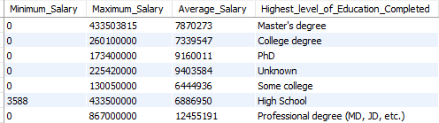

SQL Queries
Output
Total Salary Compensation by Job Title
Salary Distribution by Education Level
Output
BACK TO AGENDA PAGE

Slide 7
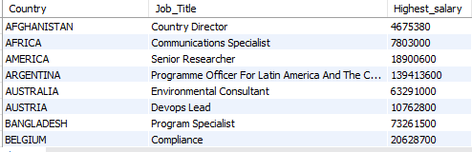
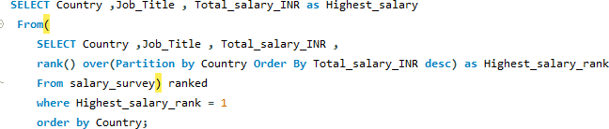
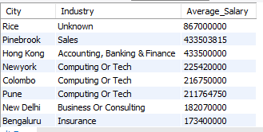

SQL Queries
Output
Job Titles with the Highest Salary in Each Country
Output
Average Salary by City and Industry
BACK TO AGENDA PAGE

Slide 8
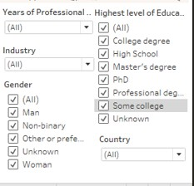
Data Visualization using Tableau
Dashboard Overview :
Tableau dashboard is designed to provide an intuitive and interactive user experience:
Key Metrics Displayed:
Average Salary : 7781556 INR Highest Salary: 867000000 INR Total Salary INR: 238463068352
Interactive Filters:
Total Compensation: 253250667 INR
Total Employees: 27920
Year of professional experience, gender,industry,country,Highesh level of Education

Slide 9
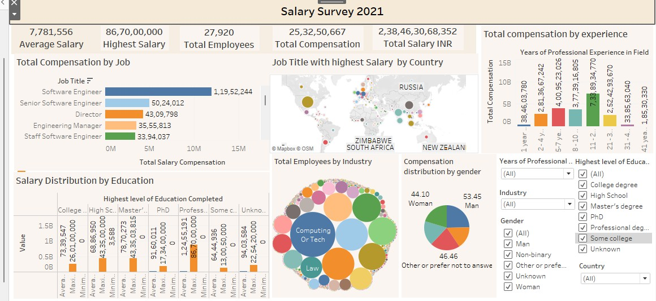
Dynamic Dashboard Using Tableau

Slide 10
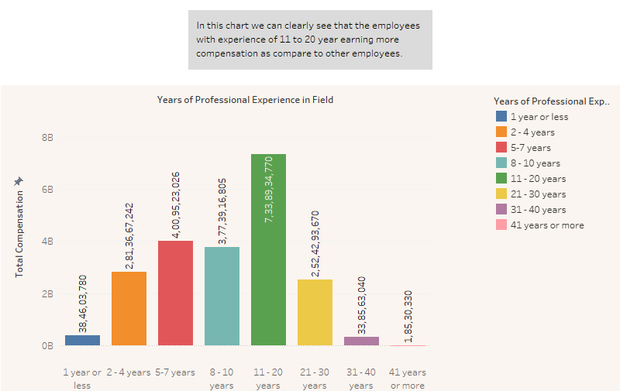
Some visuals with story telling

Slide 11
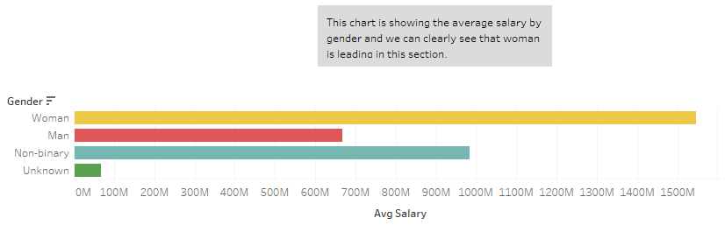
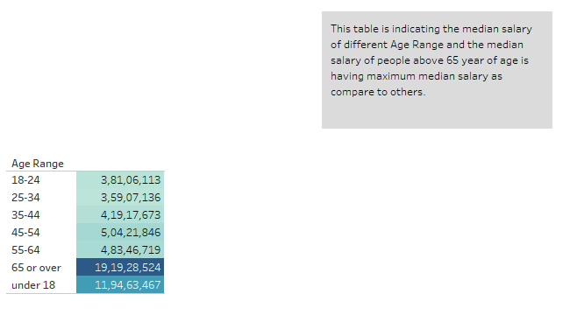
Some Visuals with story telling

Slide 12
Key Insights and Conclusion
Software Engineer have the highest overall compensation.
People with more professional skills and experience earn more.
The tech field consists of a maximum number of employees.
Men are getting more compensation than other genders.
Countries like the USA, Switzerland , and Australia tend to offer higher salaries for the same job role as compared to other countries

Slide 13


