Slide 1
Employees Attrition Analysis
Using Power BI
Name: Govind Singh Shekhawat

Slide 2

Dataset Overview
1
Total Records: 1,029 , Total Features: 35 (job details, demographics, satisfaction levels, etc.)
2
Includes employee details like age, department, and years at the company.
Features job-related factors such as salary, promotions, and work-life balance.
3
4
Contains attrition status to study employee retention trends.

Slide 3
Aim of the Project
1
Identify Attrition Patterns: Analyze factors influencing employee turnover.
Predict Employee Retention: Use data to forecast potential attrition risks.
2
3
Improve HR Strategies: Provide insights for better employee engagement and retention.
4
Optimise Workforce Planning: Help businesses make data-driven staffing decisions.

Slide 4
DAX Functions
DAX Functions: They enable complex calculations and dynamic measures for deeper insights.
Calculated Columns

Slide 5
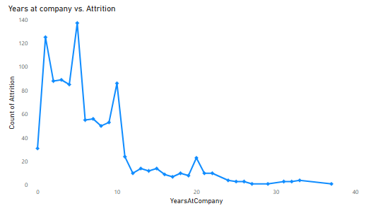
Insights and trends
Purpose: Identify peak attrition periods.
Shows: High attrition in early years, then declines.

Slide 6
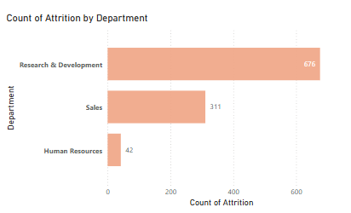
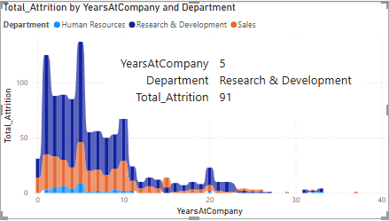
Purpose: Research & Development has the highest attrition.
Shows: Identify departments with high turnover risk.
Purpose: IIdentify department-wise attrition trends..
Shows: Early attrition is highest across departments.

Slide 7
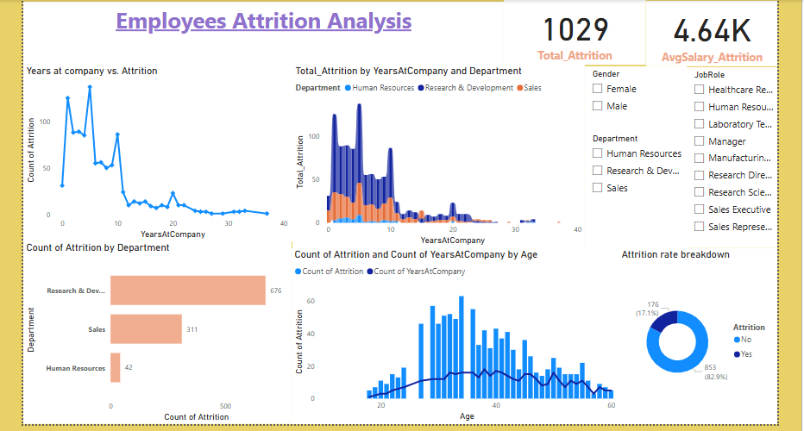
Dashboard Overview

Slide 8
Recommendations
1
Strengthen Onboarding: Provide tailored support to new hires to reduce early attrition.
Enhance Work-Life Balance: Offer flexible policies to boost job satisfaction.
2
Review Compensation & Growth: Ensure competitive pay and clear career paths to retain talent.
3
4
Target High-Turnover Roles: Focus retention strategies on departments like R&D with higher turnover.

Slide 9
Conclusion
1
Early Tenure Risk: Most employees leave within their first few years.
2
Department Disparities: R&D sees the highest attrition rates.
Significant Turnover: Sales also contributes notably to overall attrition.
3
Data-Driven Insight: Factors like satisfaction and compensation strongly influence attrition.
4

