Slide 1

IMDB Dataset Analysis using Advanced SQL
Name: GOVIND SINGH SHEKHAWAT
DATE: 19-01-2025
BATCH: JULY ONLINE DA & DS

Slide 2
DATASET OVERVIEW
The database is a simplified IMDb dataset capturing key movie details, including:
Movie: Basic info (title, year, duration, country, income, languages, production company).
Genre: Movie genres.
Director Mapping: Links movies to directors.
Role Mapping: Maps actors, directors, and producers to movies.
Names: Stores people’s details (birthdate, height, known movies).
Ratings: Contains average rating, total votes, and median rating.

Slide 3
AIM OF THE PROJECT
The primary objective of this project is to:
• Reinforce key SQL concepts such as joins, aggregation, filtering, and grouping.
• Analyze and extract meaningful insights from a real-world movie dataset.
• Document, present, and improve communication skills by creating a detailed report and a presentation of findings.

Slide 4
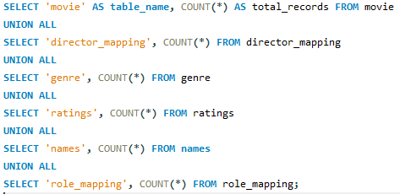
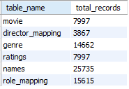
QUERIES AND OUTCOMES
The total number of records in each table of the database
Query
Output

Slide 5
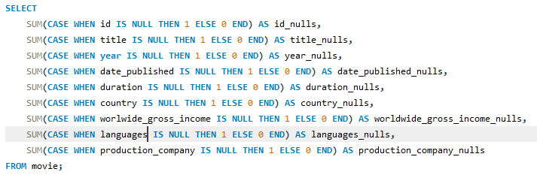
2. Identifying the columns in the movie table that contain null values
Query
Output

Slide 6


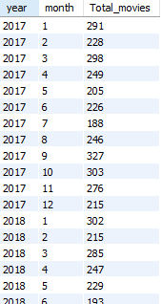

3. Determine the total number of movies released each year, and analyze how the trend changes month-wise.
Output
Query

Slide 7


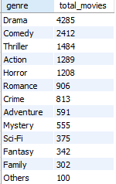

4.How many movies were produced in either the USA or India in the year 2019?
Query
Output
5. List the unique genres in the dataset, and count how many movies belong exclusively to one genre
Output
Query

Slide 8


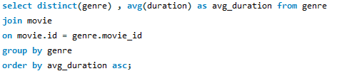
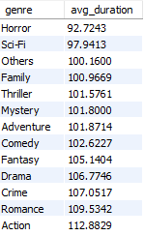
6. Which genre has the highest total number of movies produced?
Query
Output
7. Calculate the average movie duration for each genre.
Query
Output

Slide 9
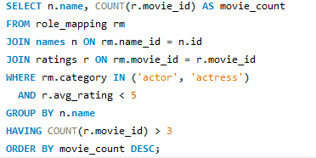
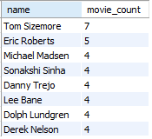
8.Identify actors or actresses who have appeared in more than three movies with an average rating below 5.
Query
Output

Slide 10

9. Find the minimum and maximum values for each column in the ratings table, excluding the movie_id column.
Query
Output

Slide 11
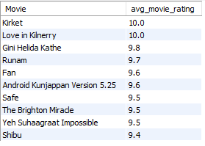
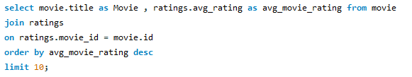
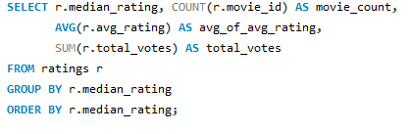
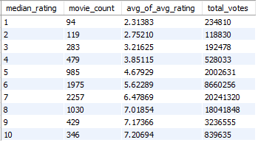
10. Which are the top 10 movies based on their average rating?
Output
Query
11. Summarize the ratings table by grouping movies based on their median ratings.
Output
Query

Slide 12
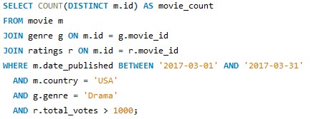

12. How many movies, released in March 2017 in the USA within a specific genre, had more than 1000 votes?
Query
Output

Slide 13
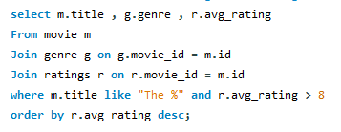
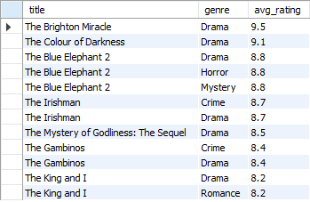
13. Find movies from each genre that begin with the word “The” and have an average rating greater than 8?
Query
Output

Slide 14


14.calculate the count Of the movies released between April 1, 2018, and April 1, 2019, how many received a median rating of 8?
Query
Output

Slide 15
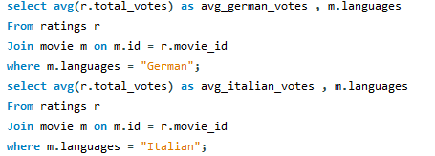


15. Do German movies receive more votes on average than Italian movies?
Query
Output

Slide 16
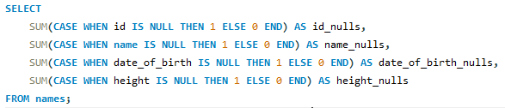

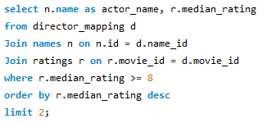

16. Identify the columns in the names table that contain null values.
Query
Output
17. Who are the top two actors whose movies have a median rating of 8 or higher?
Query
Output

Slide 17
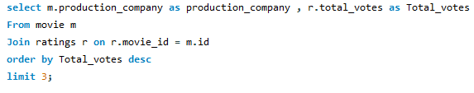

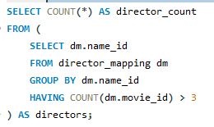

18. Which are the top three production companies based on the total number of votes their movies received?
Query
Output
19. How many directors have worked on more than three movies?
Query
Output

Slide 18
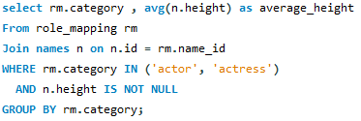

20. Calculate the average height of actors and actresses separately.
Query
Output

Slide 19
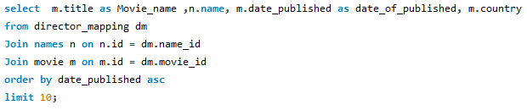
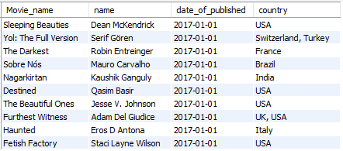
21. List the 10 oldest movies in the dataset along with their title, country, and director.
Query
Output

Slide 20
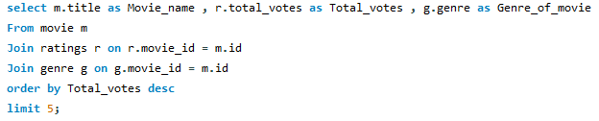
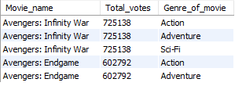
22. List the top 5 movies with the highest total votes, along with their genres.
Query
Output

Slide 21
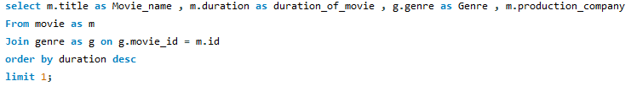

23. Identify the movie with the longest duration, along with its genre and production company.
Query
Output

Slide 22
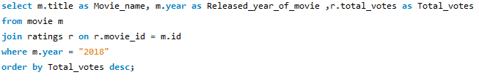
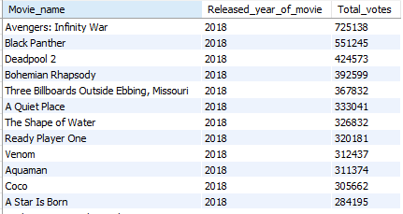
24. Determine the total number of votes for each movie released in 2018.
Query
Output

Slide 23


25. What is the most common language in which movies were produced?
Query
Output

