Slide 1

Advanced Excel Project: Sales Dataset Analysis
Name : Govind Shekhawat
Date: 30-12-2024

Slide 2
Project Overview & Objectives
Project objective: To analyze sales data to identify trends, understand sales performance, and provide actionable business insights.
Goals: The key goals of the analysis are:
Analyze sales trends over time.
Identify high-performing products and ship mode.
Determine the impact of returns and discounts.
Create a dynamic dashboard with key metrics.

Slide 3
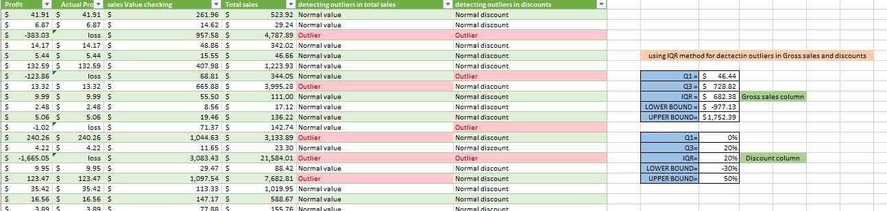
Data Description and Preparation
Dataset Overview: This is a superstore sales dataset containing 9995 rows and 21 columns such as: CustomerID, OrderID, ProductID , Sales , Quantity etc.
Data cleaning: The steps for cleaning data is given below:-
Removing the duplicates and blank rows.
Handling the missing values and negative values.
Detecting outliers and handling them efficiently.
Adding necessary custom and calculated columns.

Slide 4
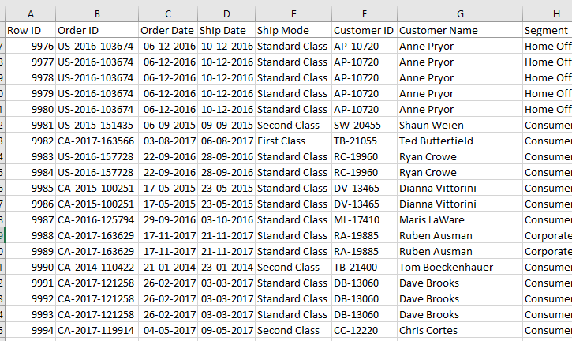
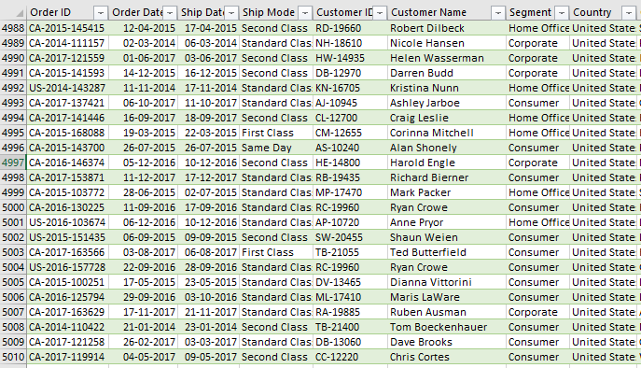
Before
After

Slide 5
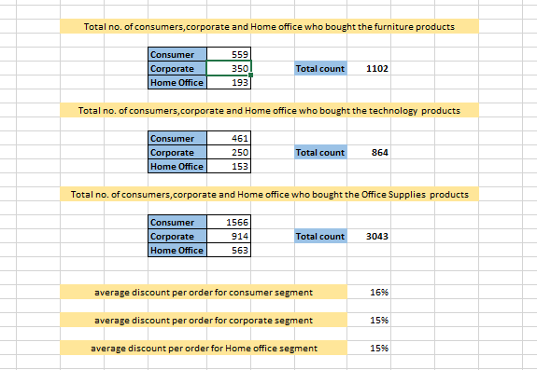
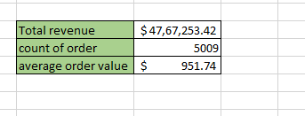
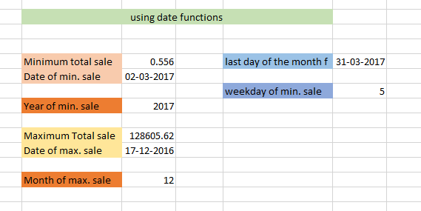
Key Metrics Calculation and Data Analysis
Important calculations: The key metrics calculated using Excel functions such as: Total sales/revenue, average order value , count of orders , average discounts etc.

Slide 6
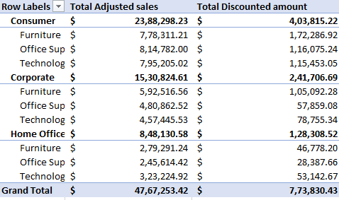
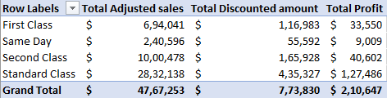
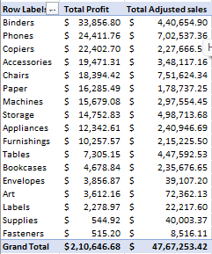
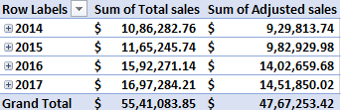
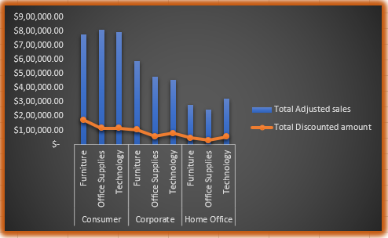
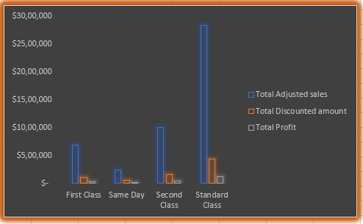
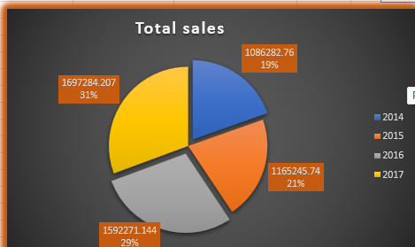
Pivot Tables and Pivot Charts

Slide 7
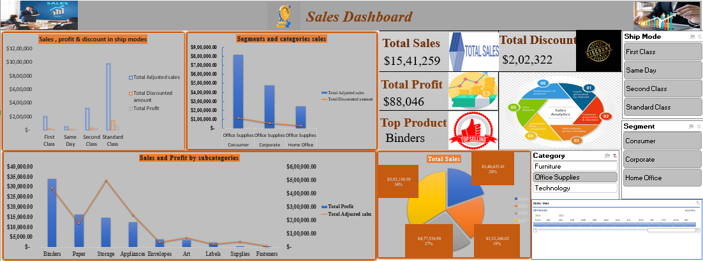
Dashboard Overview

Slide 8
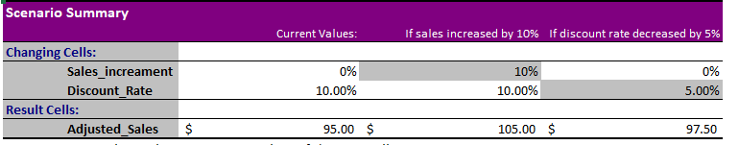
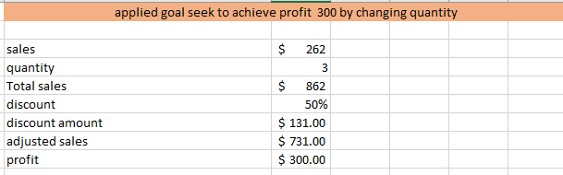
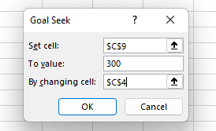
What-if-analysis and Goal seek
What-if-analysis: Created a scenario manager which shows how the changes in discount rate and sales impact total revenue.
Goal seek: Used it to get desired profit by changing some factors(eg. Quantity).

Slide 9
Macros and Automation
Macro Recording: Using macros is an effective way to automate repetitive tasks and streamline workflows.
Action: Created a macro that:
Formatted the columns and freeze the top row.
Highlighted headers & changed specific column data types.
Generated summary tables and charts.
Inserted a button named “run macros” for running macros.
Automation Benefits: The benefits are mentioned below:
Time Saved: Reduced task completion time by up to 90%.
Cost Savings: Freed up resources that could be reallocated to other projects or tasks.
Reliability: Delivered consistent outputs that improved stakeholder confidence in the analysis.

Slide 10
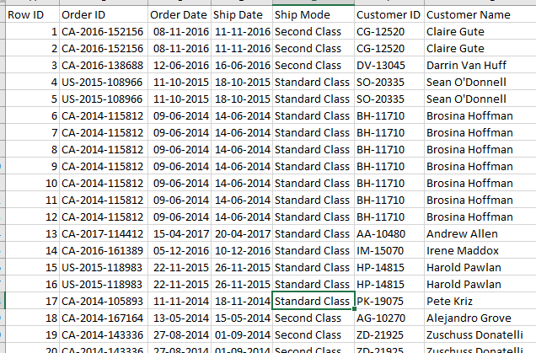
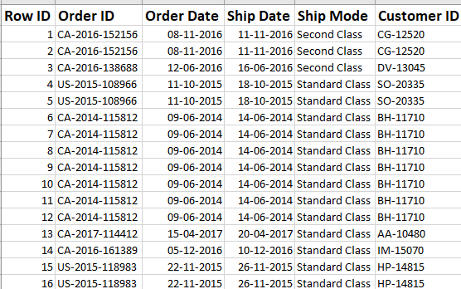

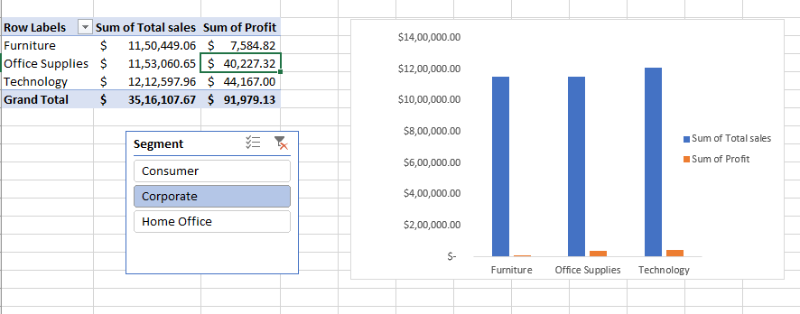
Before
After
Click

Slide 11
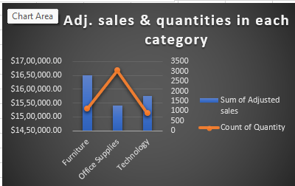
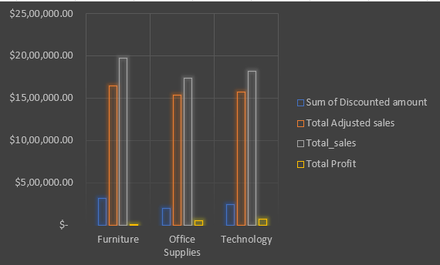
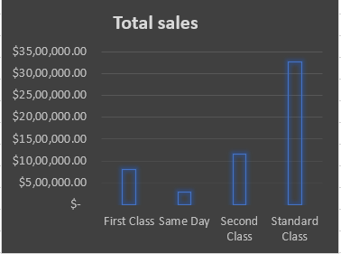
Insights and Recommendations
Furniture has high revenue but low profitability due to high discounts. We need to reduce these discounts by region and segment.
Offer promotions for customers using standard shipping and highlight "Free standard shipping" to boost order sizes.
Implement contingency plans to avoid delays during high-demand periods.

Slide 12
Conclusion
Reduce high furniture discounts to improve profitability.
Promote "Free Standard Shipping" to boost order sizes.
Implement contingency plans to avoid delays during peak periods.
Optimize pricing and costs across categories for better profitability.

Slide 13


