Slide 1
DR. BABASAHEB AMBEDKAR TECHNOLOGICAL UNIVERSITY, LONERE
Department of Computer Engineering
TOKEN
A UNIVERSAL BOOKING APP
Guided by
Dr. A. W. Kiwelekar
Group Members
Anurag Nandaghale
Gourav Kolhatkar

Slide 2
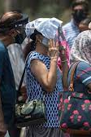
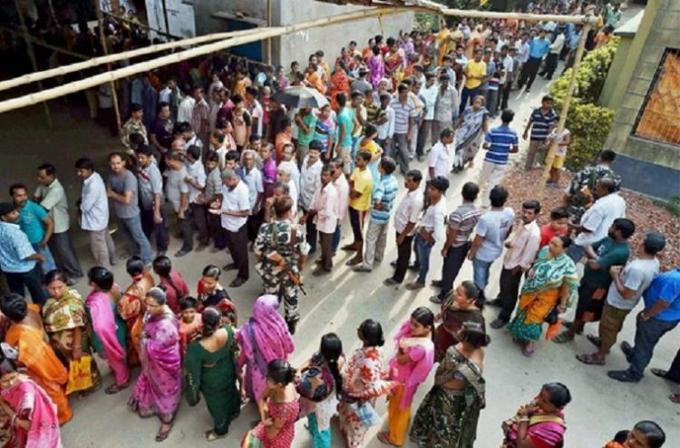
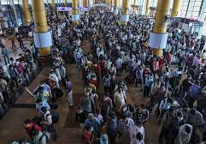
Queue - The Problem
Waste of Time
Spread of Diseases
Infrastructure
Environment

Slide 3
UNDERSTANDING THE APPLICATION

Slide 4
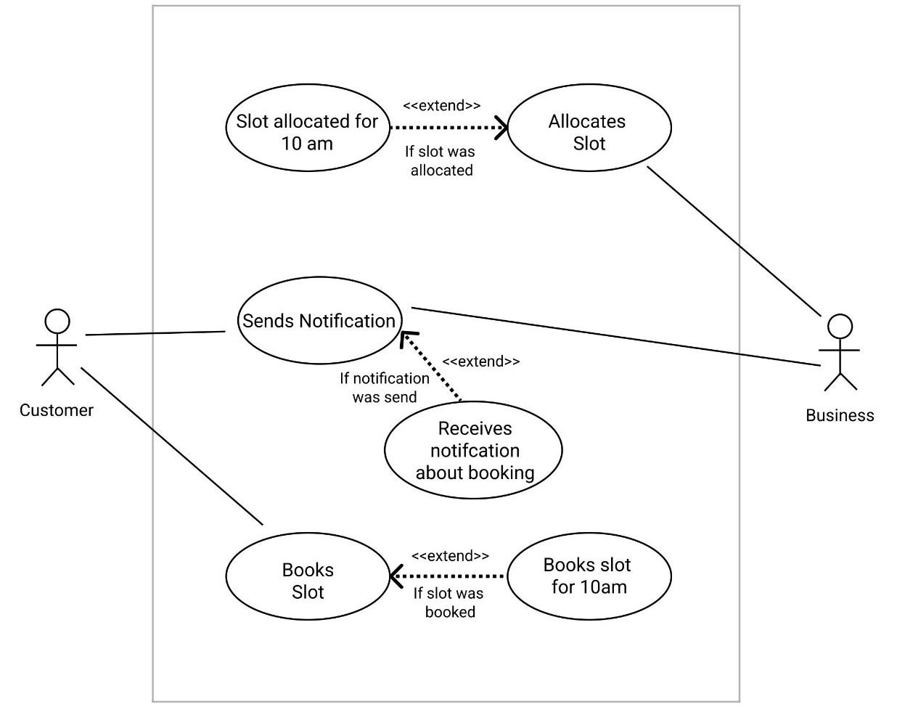
Use-case Diagram

Slide 5
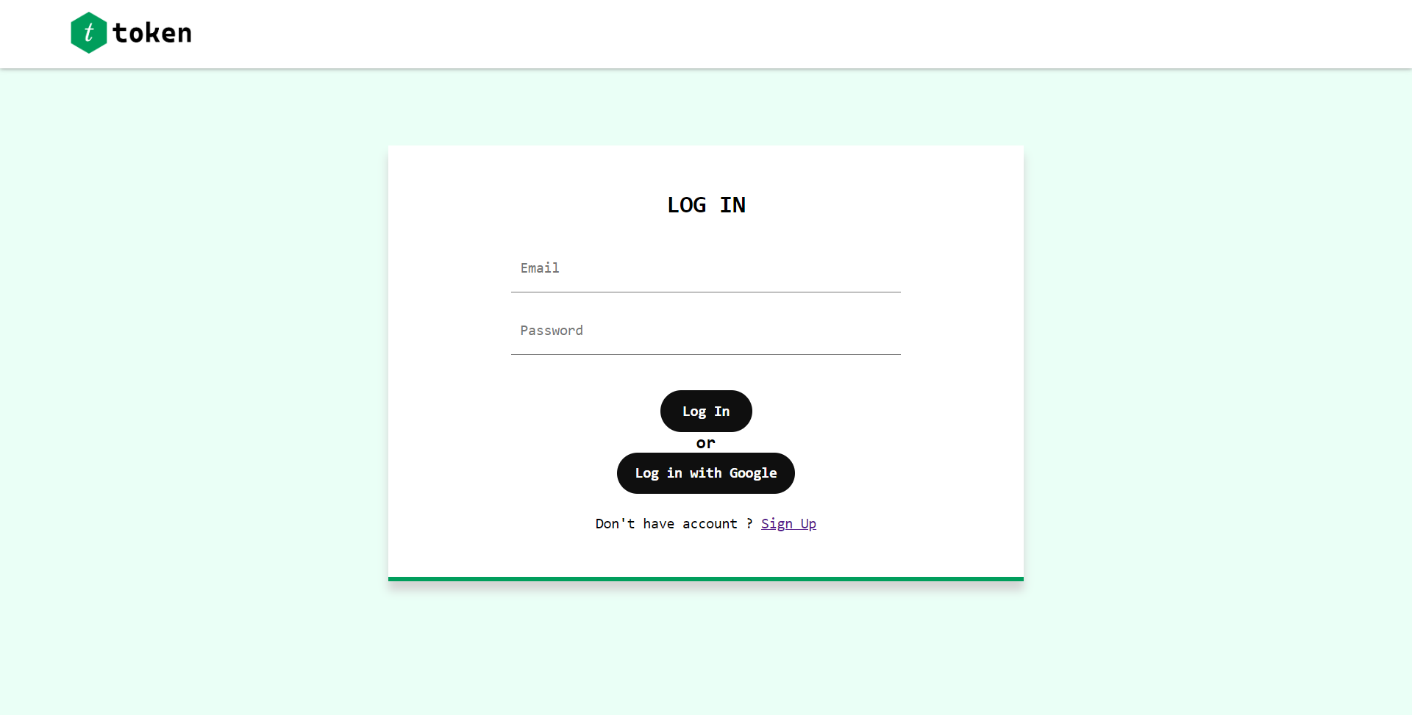
Authentication

Slide 6
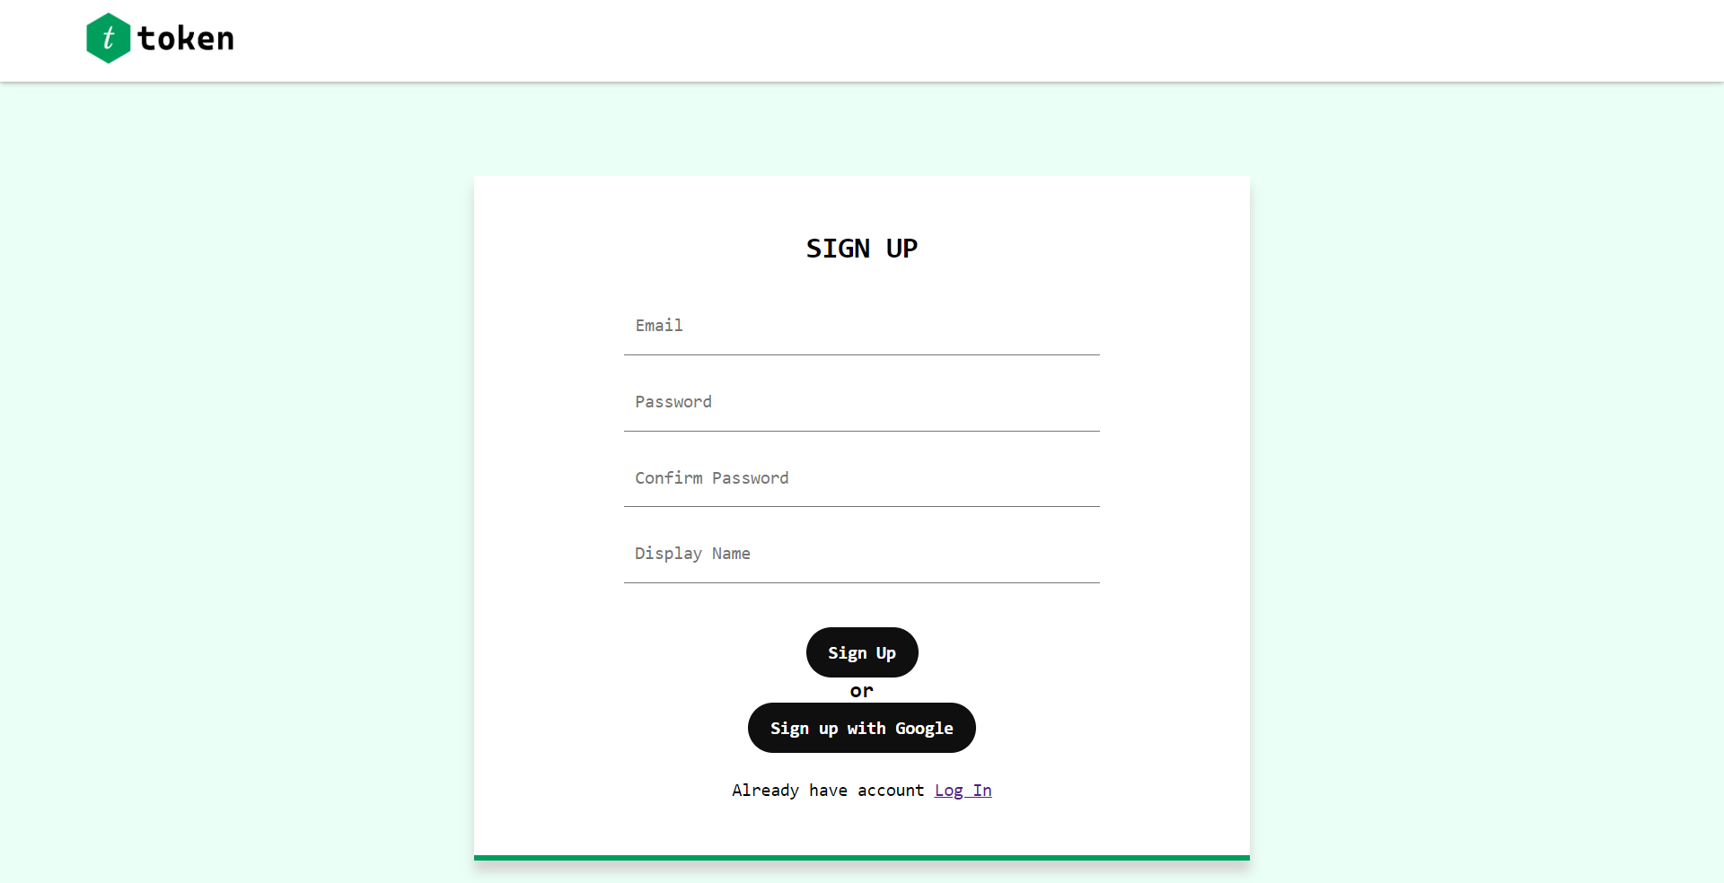

Slide 7
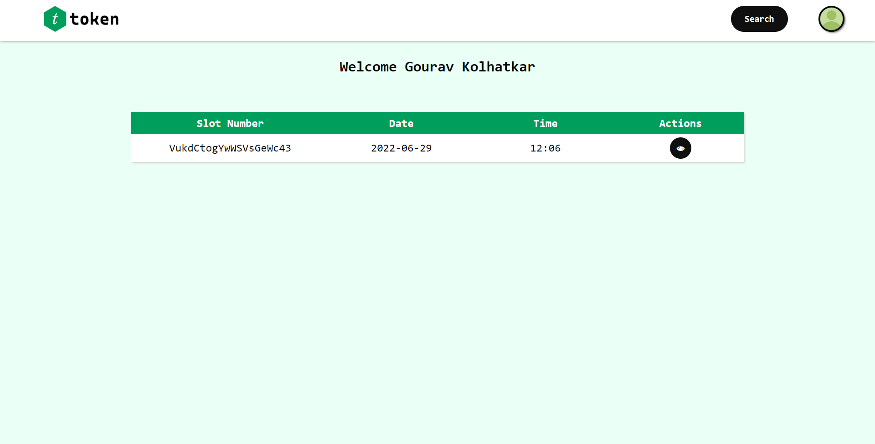
Dashboard

Slide 8
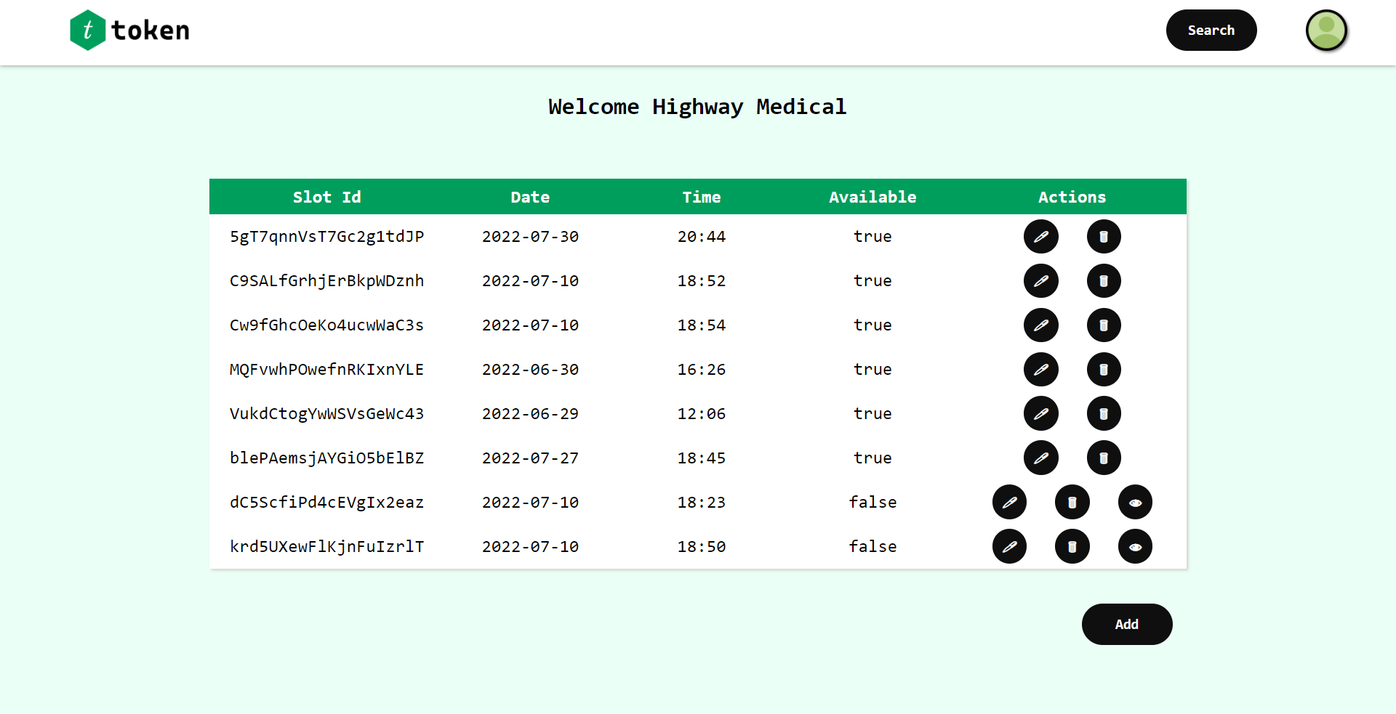

Slide 9
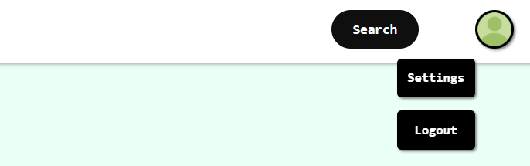
Profile Menu

Slide 10
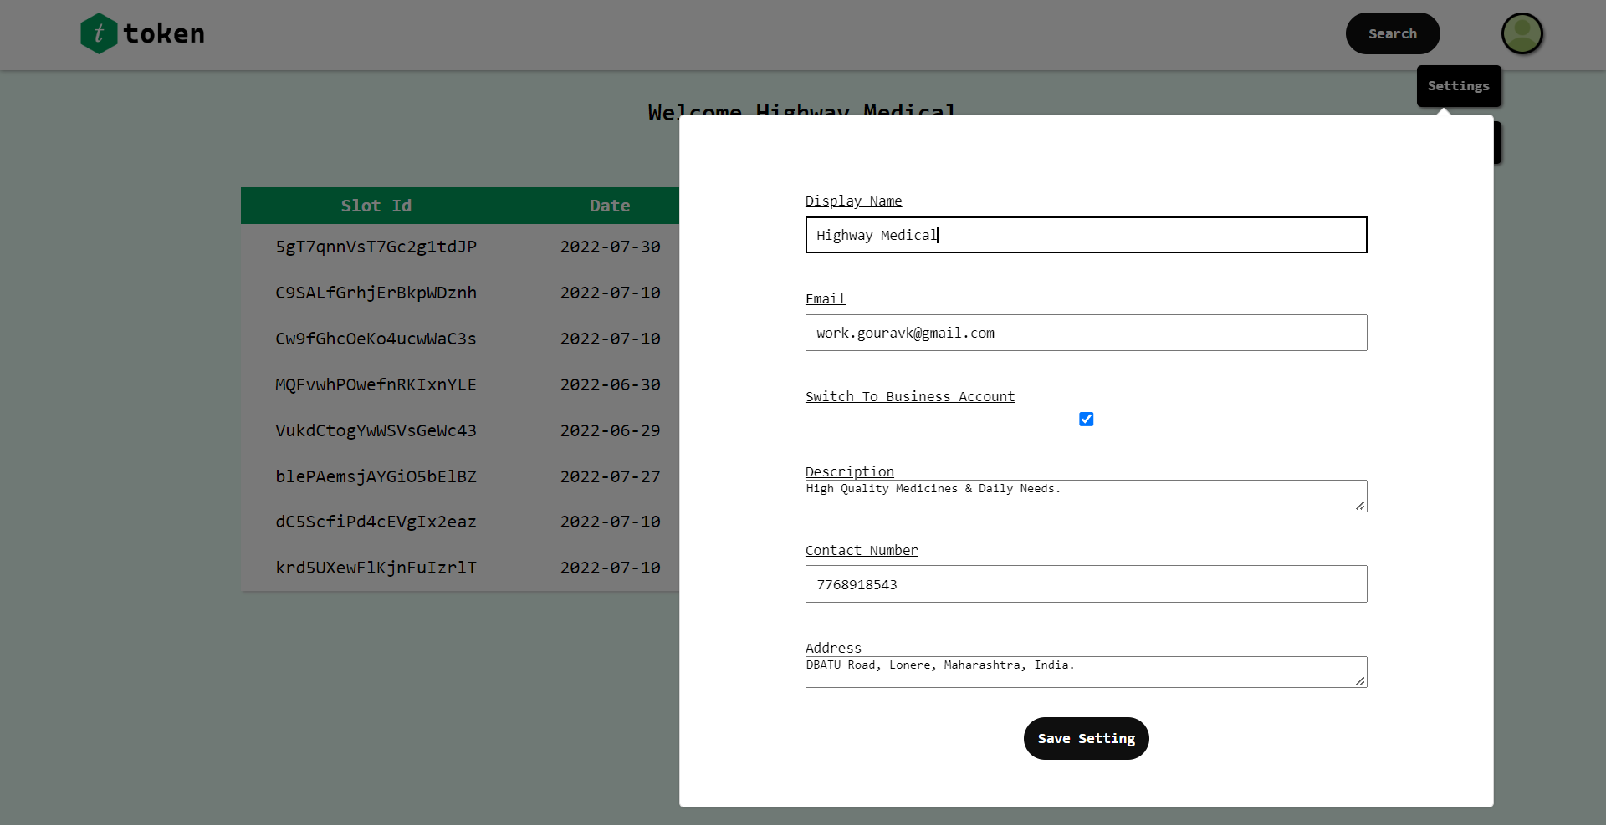
Settings

Slide 11
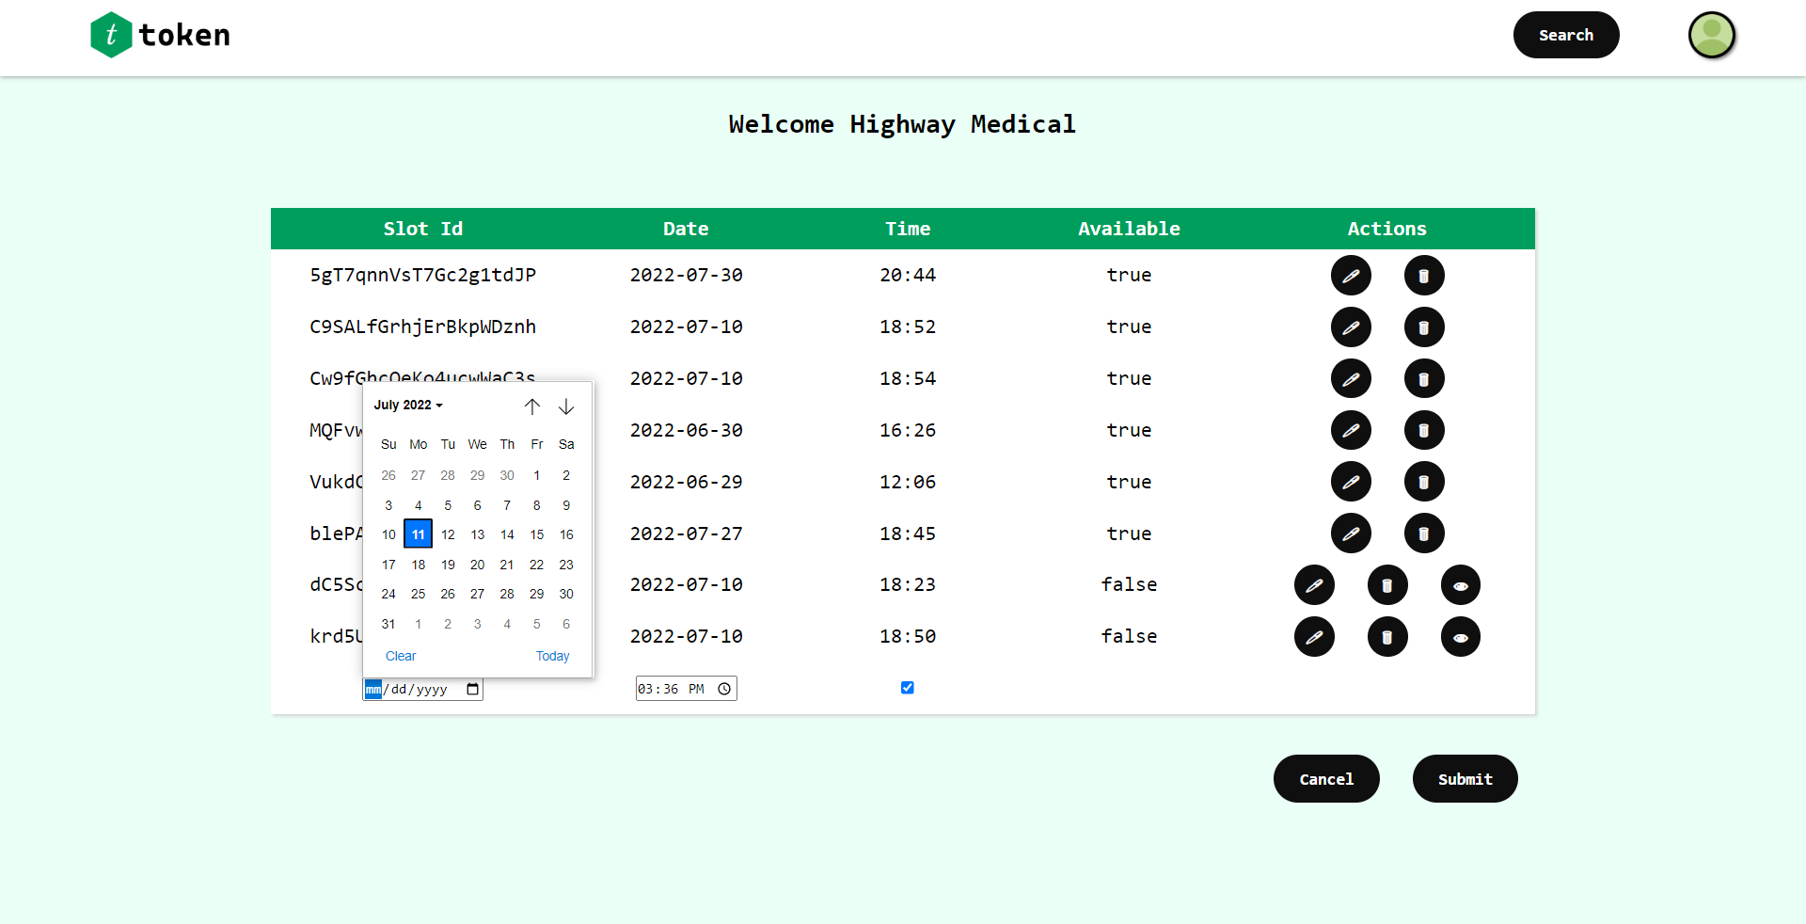
Slot Allocation Terminal

Slide 12
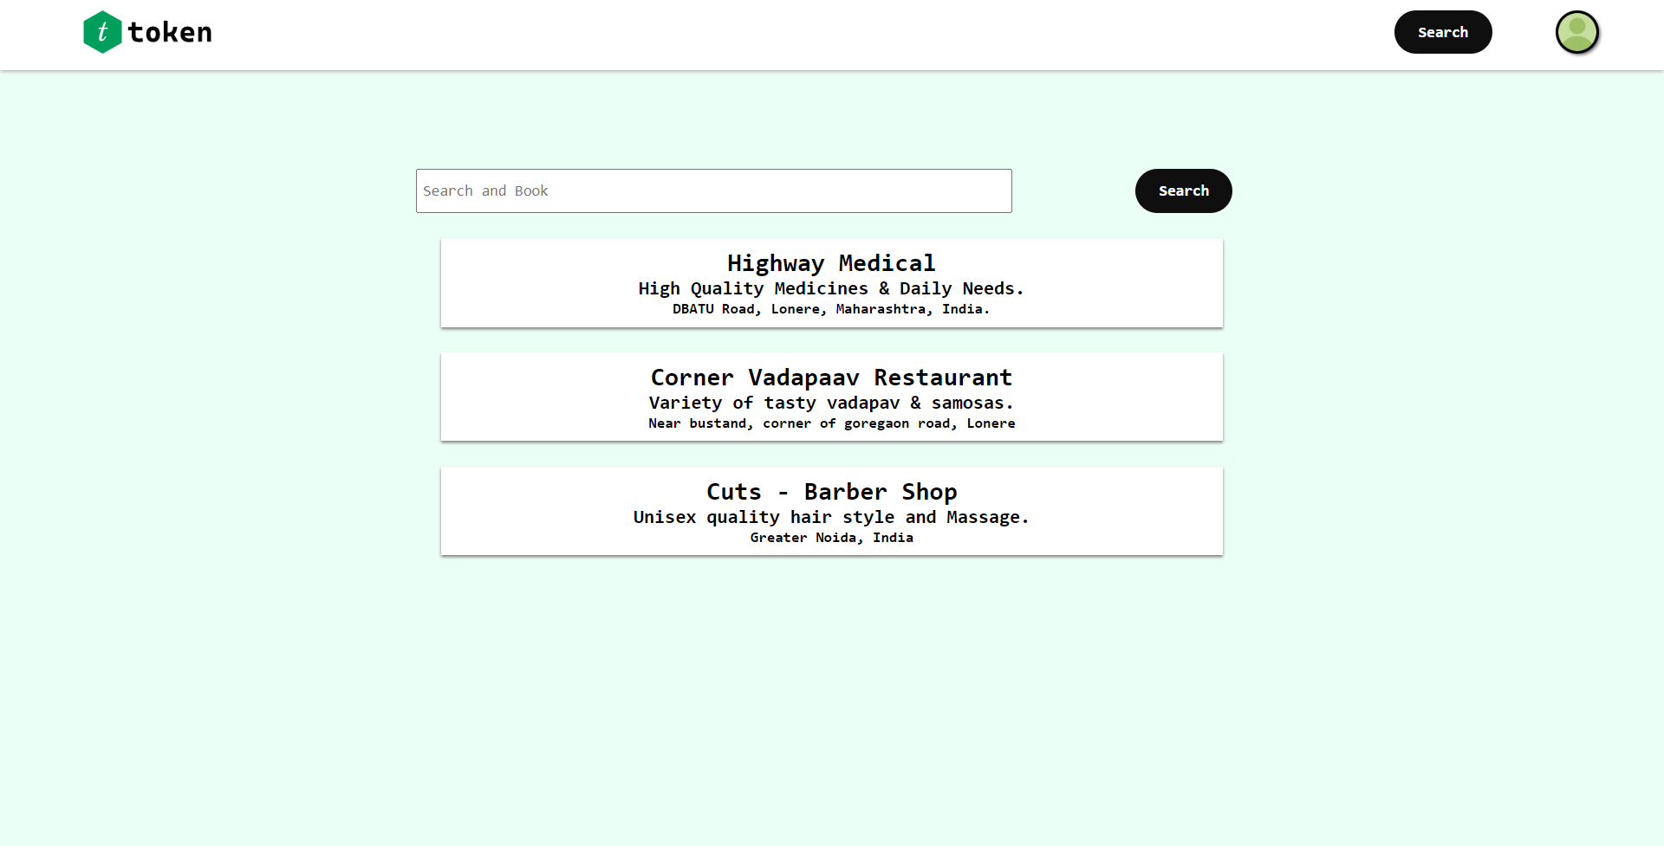
Search Page

Slide 13
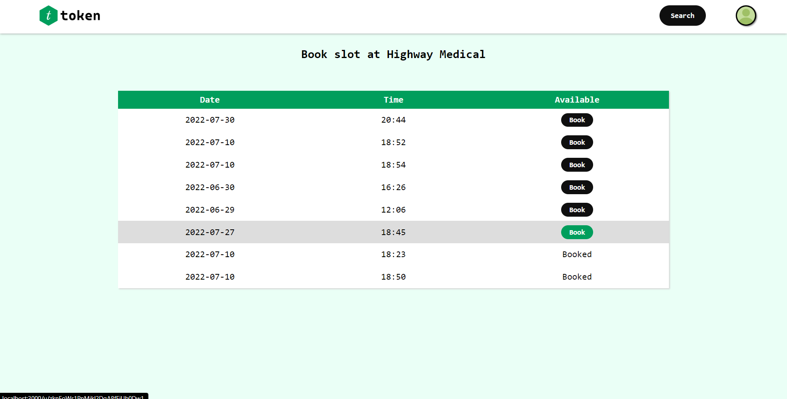
Slot Booking Terminal

Slide 14
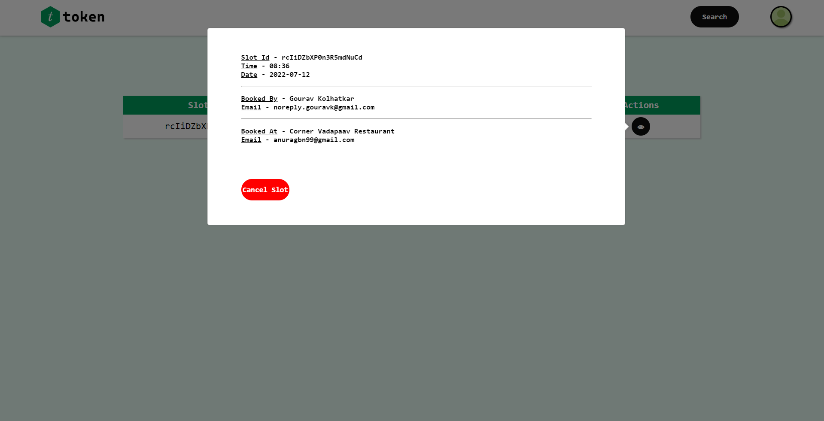
Booking Detail Receipt

Slide 15
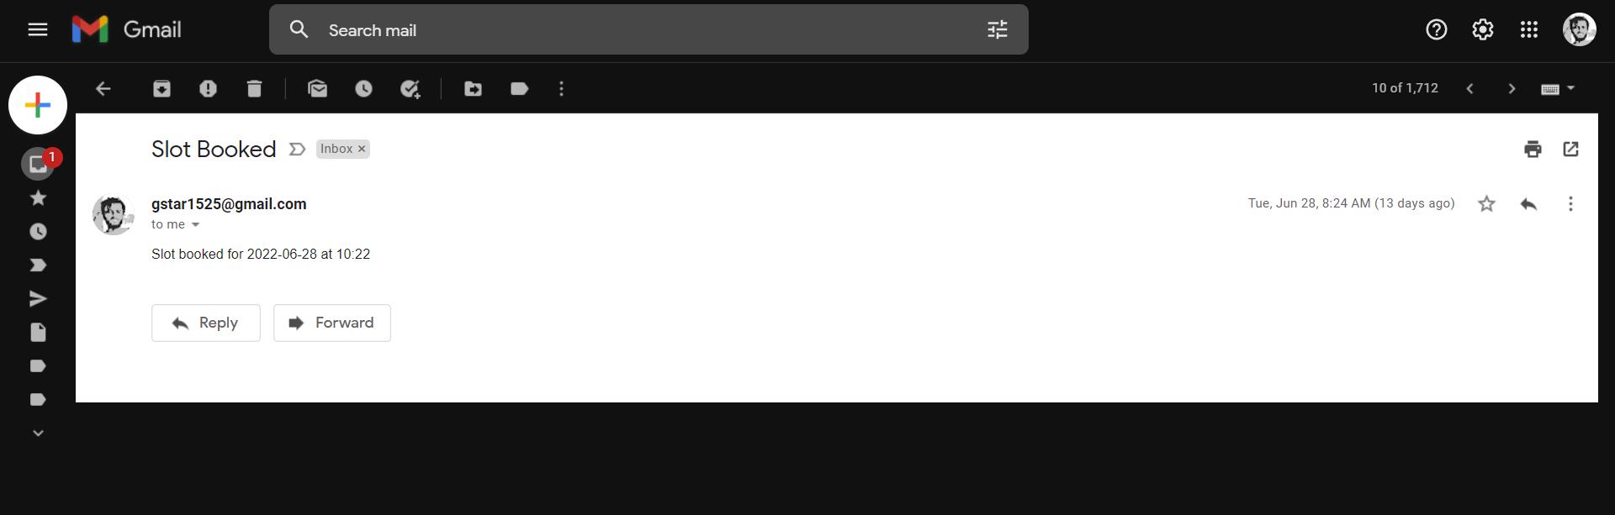
Email verification for Booking

Slide 16
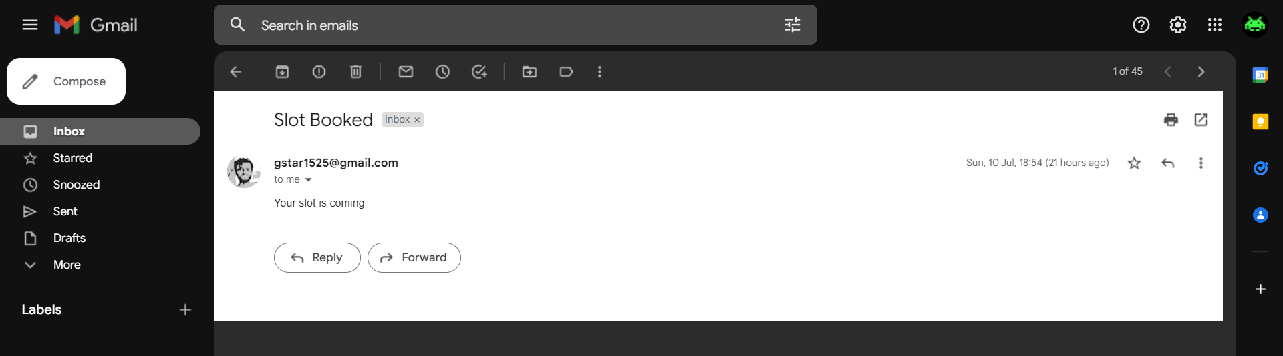
Notification about upcoming Slots

Slide 17
TECH STACK

Slide 18



Front End
ReactJS
JavaScript
CSS

Slide 19


API
ExpressJS
NodeJS

Slide 20



Back End
Firestore
Firebase Auth
Firebase

Slide 21
REAL WORLD
APPLICATIONS

Slide 22
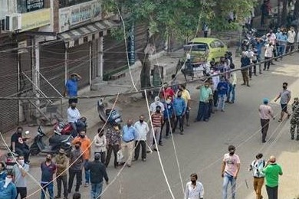
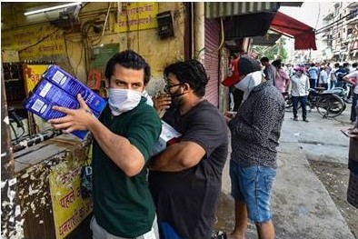
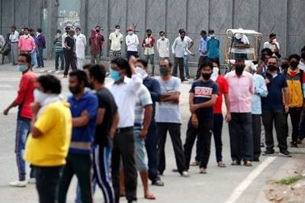
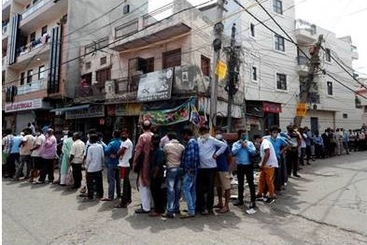
HOSPITALS
EDUCATION INSTITUTIONS
SMALL & LARGE BUSINESSES
TICKIT COUNTERS
EVERY PLACES WITH QUEUES

Slide 23
Future Scope

Slide 24
Multidevice Support.
Help to grow & advertise, Businesses and Institutions.
Location and MAPs Feature.
Feedback and Review System.
It can be made decentralized using Blockchain and Web3.

Slide 25
THANK YOU

Slide 26
WORKING OF APPLICATION

