Slide 1



Project WEB
Group 8 :
ZAMOUCHE Nadir
TALEB Nabil
GUELLATI Mohamed
MERAKEB Lyes

Slide 2

TABLE OF CONTENT
01
Work Environment
02
General Organization
03
Data Modeling
04
Site Modeling
05
Companion Application
06
Simulation

Slide 3

INTRODUCTION

Slide 4

Work Environment

Slide 5




Work Environment
IDE
SGDBR
Notepad++
AGL
CI
MySQL
Visual Paradigm
GitHub

Slide 6


General Organization

Slide 7
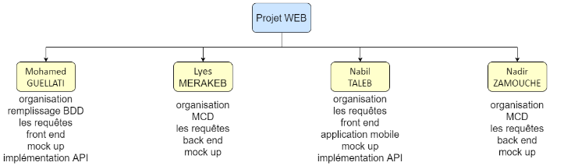
OBS diagram

Slide 8
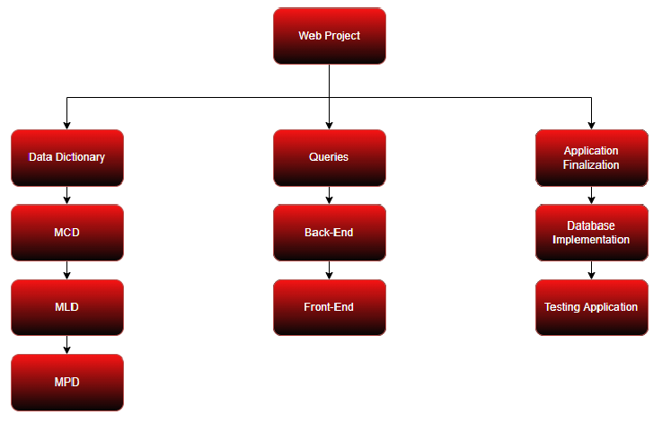
WBS diagram

Slide 9

Data Modeling

Slide 10
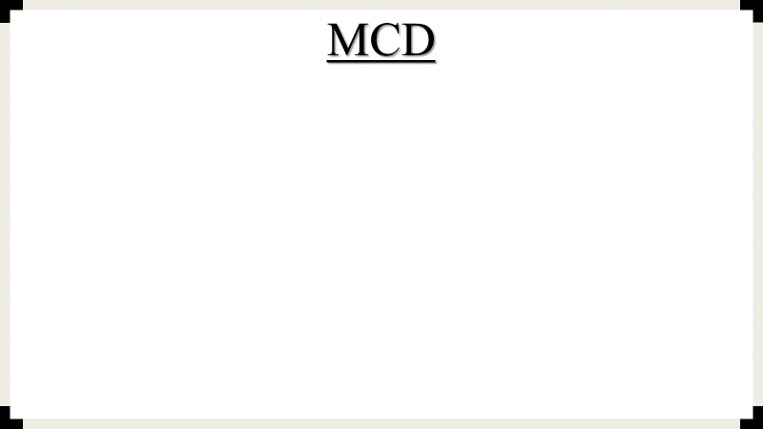
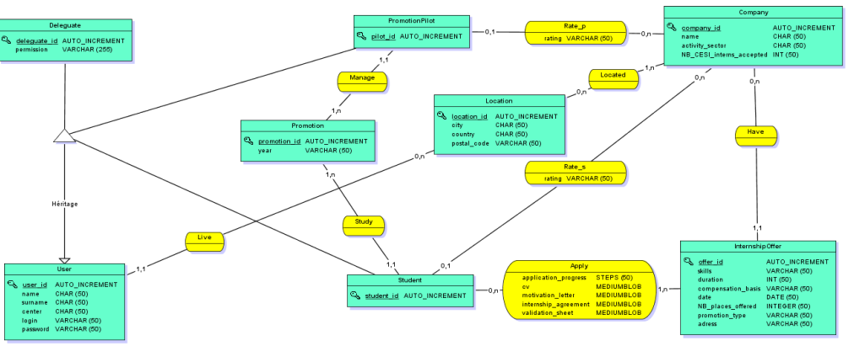

Slide 11
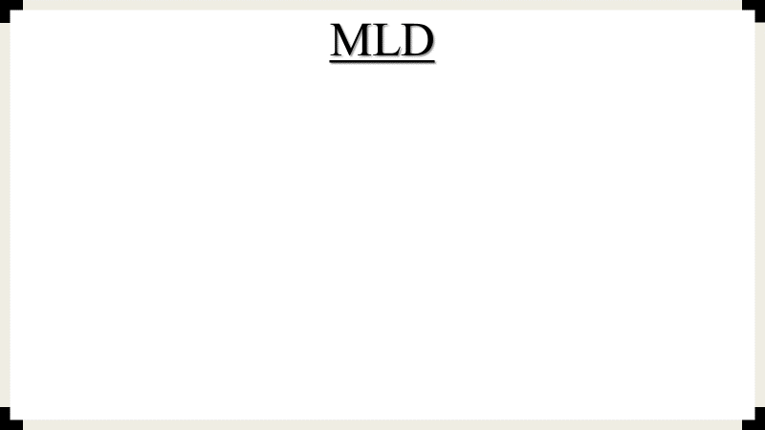
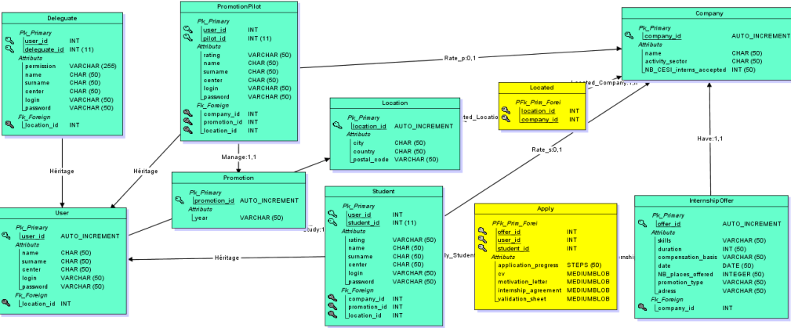

Slide 12

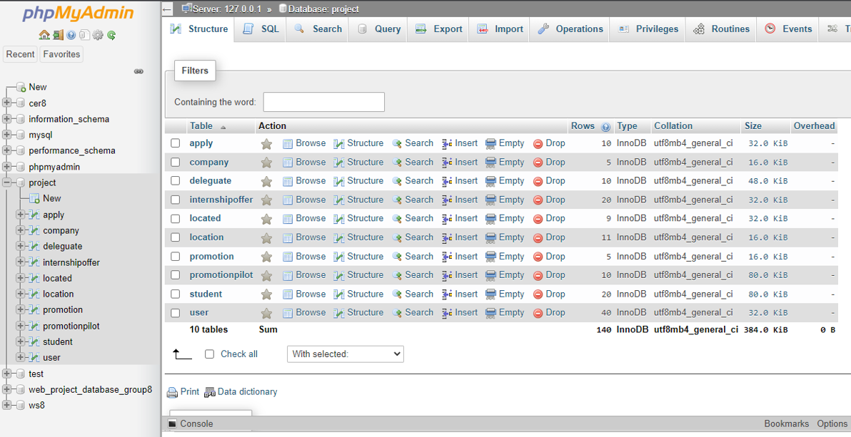
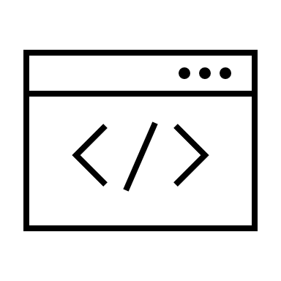

Data Base
MPD implementation on phpMyAdmin

Slide 13
Site Modeling

Slide 14




FRONT-END
Animation
Style
JavaScript
Form
CSS
Animation
HTML
Bootsrap

Slide 15

Home Page

Slide 16


Back-End
Form
IDE
Data Base
PHP
Visual Studio Code
MySQL

Slide 17
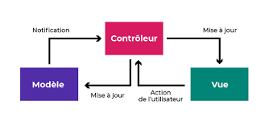
MVC Architecture

Slide 18

Companion Application

Slide 19
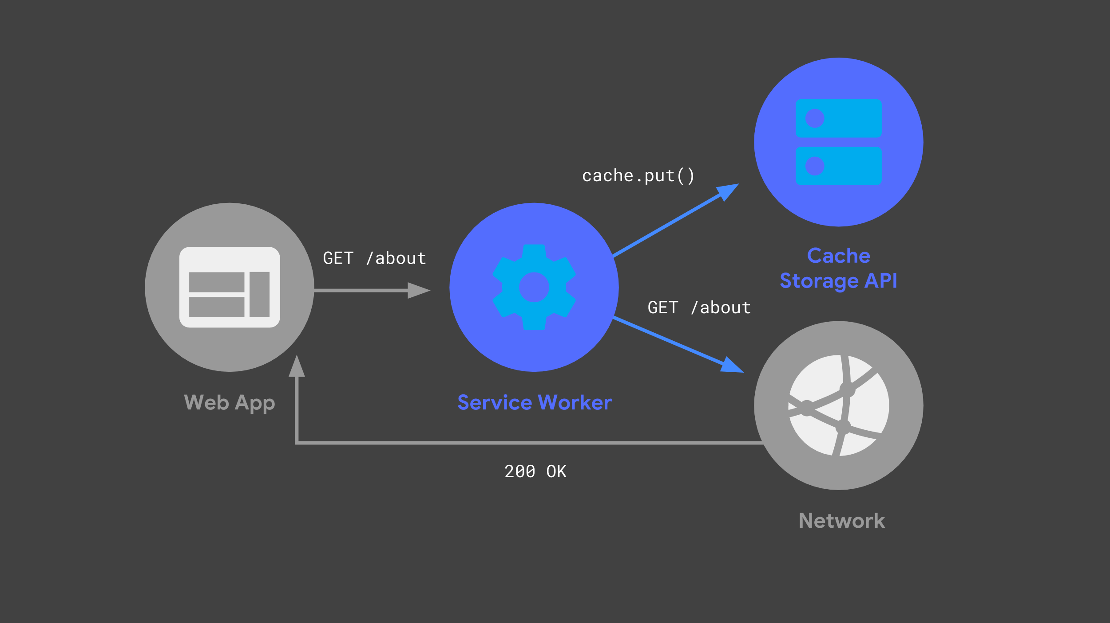

Slide 20

Simulation

Slide 21

Conclusion

Slide 22



Q&A

