Slide 1



Slide 2
Group members
Nadir Zamouche
Afnane Messaoui
Mohamed Guellati
Zakaria Alizouaoui

Slide 3
Table of Contents
Introduction
Situation
Map
Tools used
Metaheuristic
Algorithm chosen
Demo
Conclusion
Q&A

Slide 4

Introduction

Slide 5
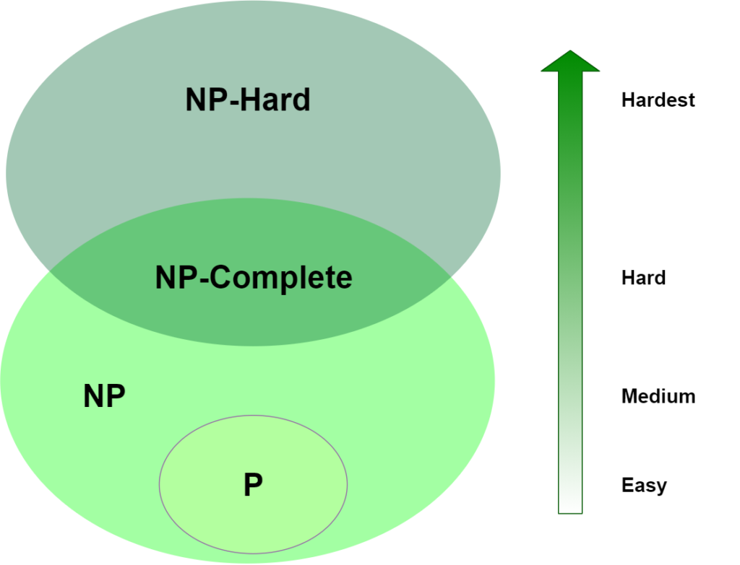
Complexity

Slide 6


Tools used

Slide 7
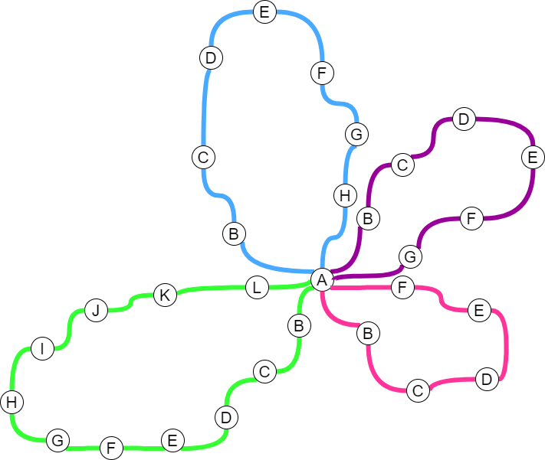
Situation

Slide 8
Constraint used
K number of trucks to diminish the time of delivery
Variation of trafic progressively by time

Slide 9



Metaheuristic

Slide 10
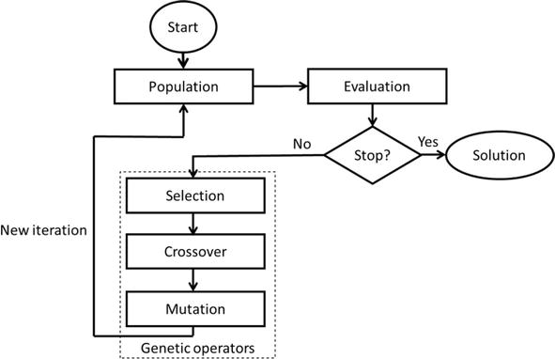
Genetic algorithm

Slide 11
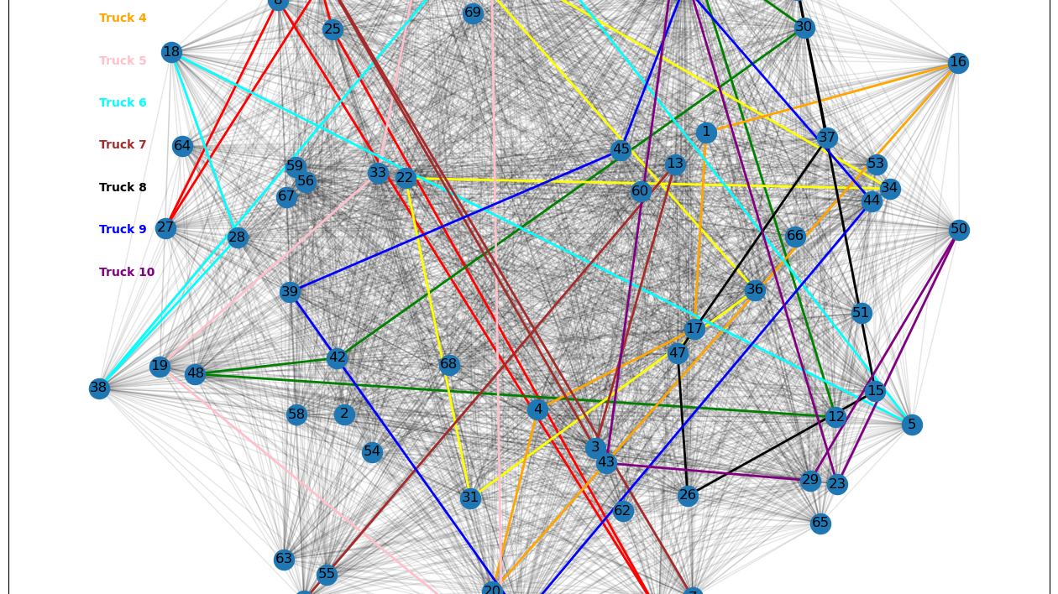
Demo

Slide 12

Conclution

