Slide 1

Project Title -Seasonal Agriculture Performance Analysis
Joshal Fernandes
Mangalore Institute of Technology & Engineering
AICTE STU ID : STU676c00dee8b631735131358

Slide 2

PROBLEM STATEMENT
Agricultural activities are influenced by seasonal variations in environmental conditions, farming practices, resource availability and market conditions. As a result, agricultural performance may differ from one season to another. However, raw agricultural data does not clearly explain how agricultural performance changes across seasons or what patterns can be observed in different seasonal conditions. The problem is to analyze the given agricultural dataset and investigate seasonal differences in agricultural performance by identifying meaningful patterns, trends, relationships and variations within the available data.

Slide 3
Project Description Analyzed agricultural data across different seasons to identify patterns, trends, and variations in agricultural performance. Cleaned and prepared the dataset, performed statistical analysis, and created visualizations to compare seasonal outcomes. Derived data-driven insights and recommendations to support better agricultural planning.

Slide 4

WHO ARE THE END USERS?
Farmers – to understand seasonal performance and improve farming decisions.
Agricultural planners – to support seasonal agricultural planning.
Agricultural researchers – to study seasonal patterns and trends.
Government/agricultural organizations – to support evidence-based decision-making and resource planning.
Agricultural analysts – to analyze crop, resource, environmental, and economic performance.

Slide 5

Technology Used
Python
Google Colab
Pandas
NumPy
Matplotlib
Seaborn

Slide 6
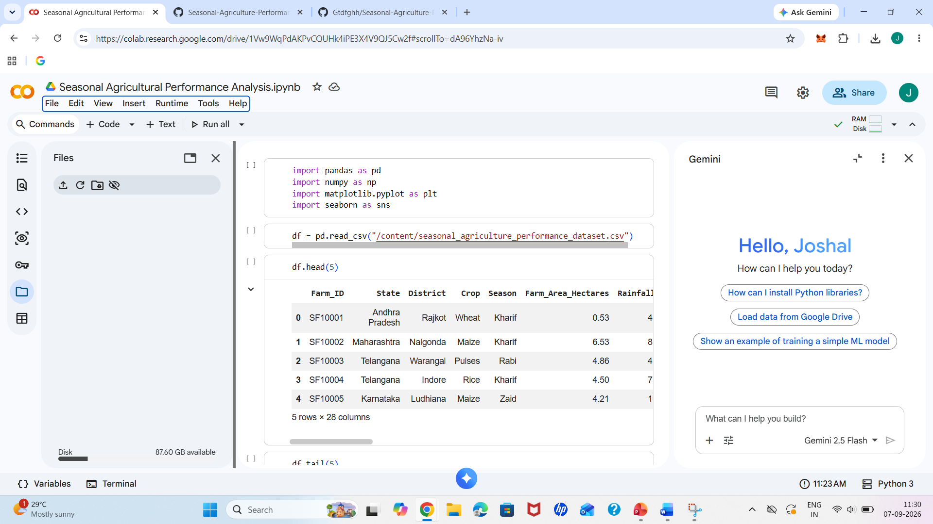
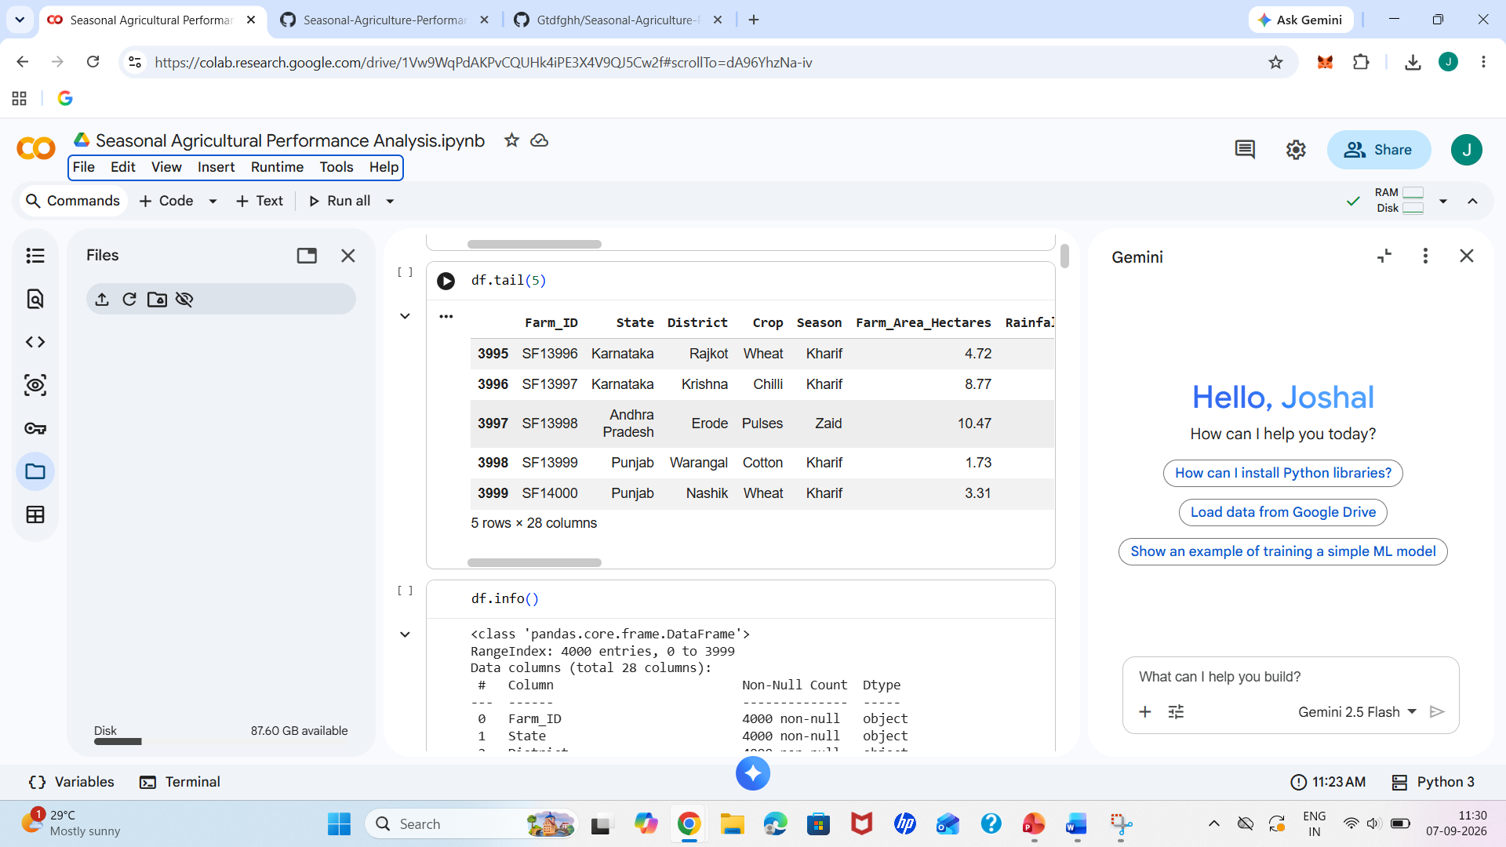
RESULTS
[Add screen shots of your code ]

Slide 7
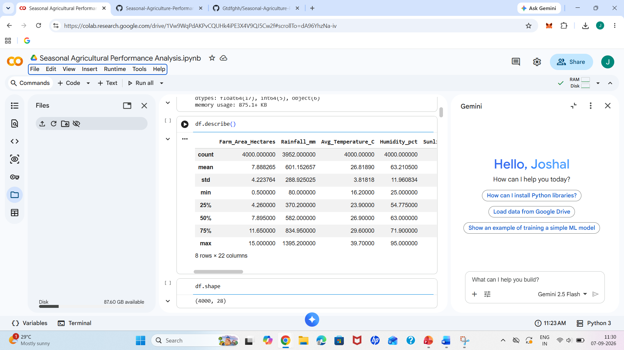
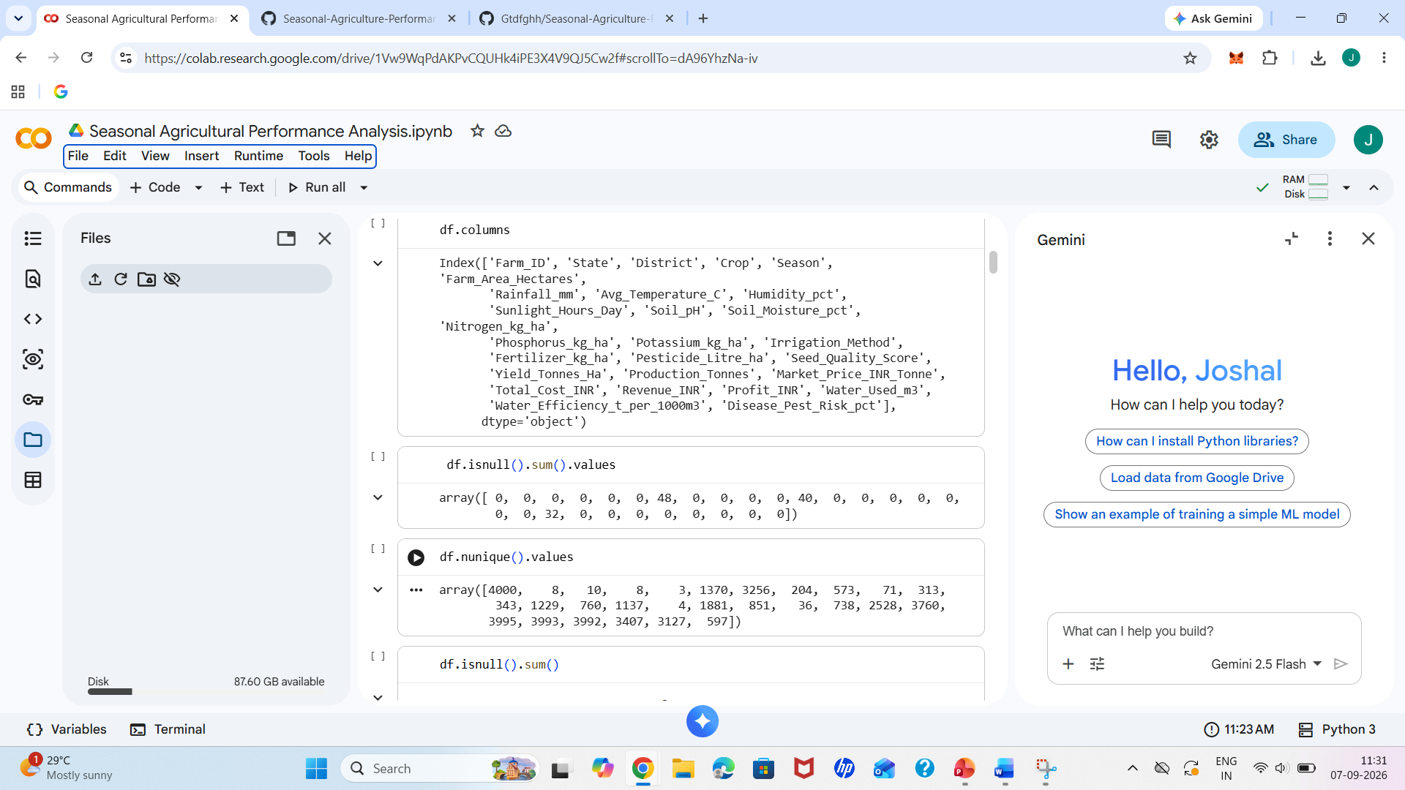
RESULTS
[Add screen shots of your code ]

Slide 8
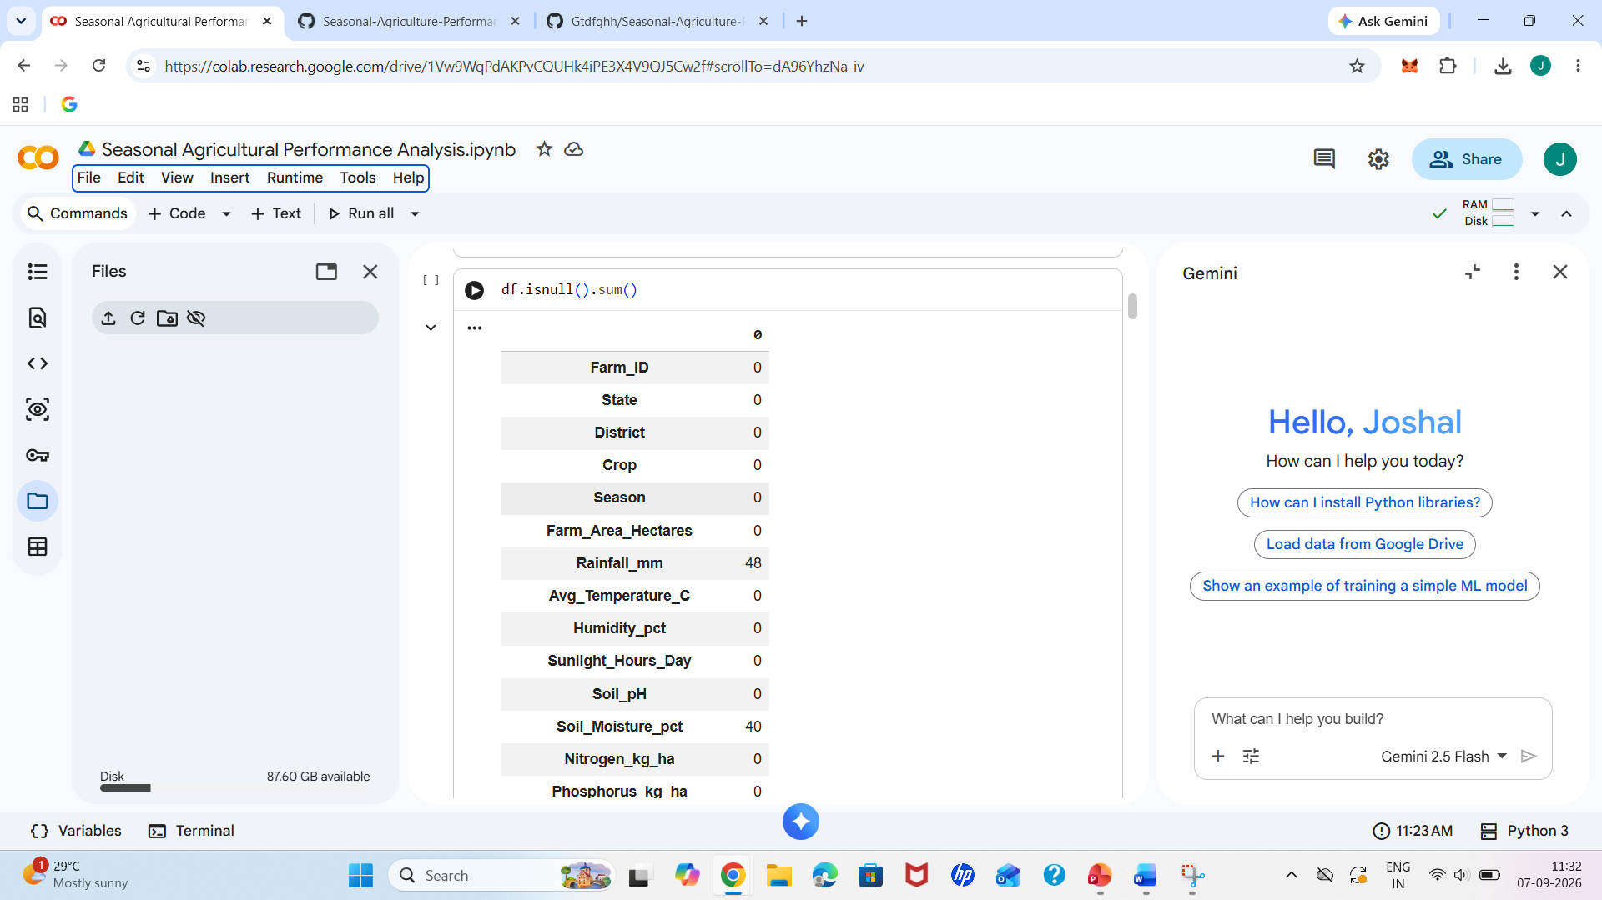
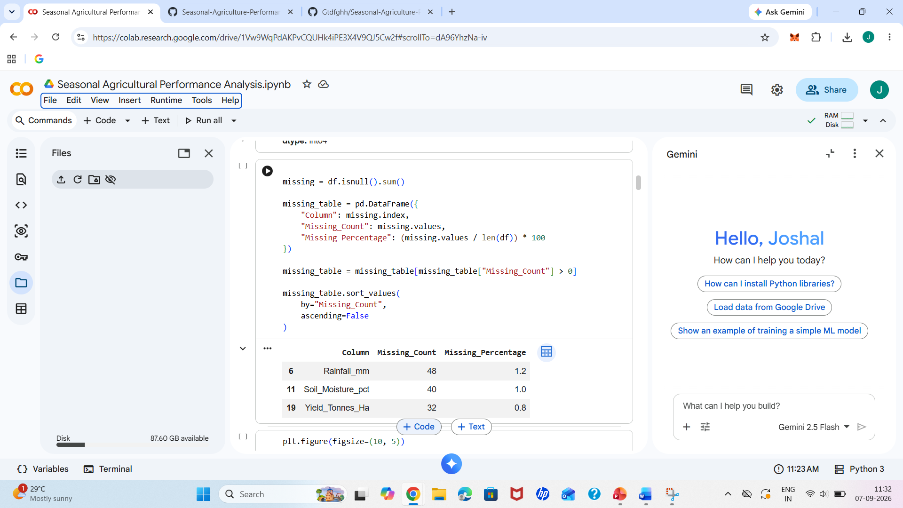
RESULTS
[Add screen shots of your code ]

Slide 9
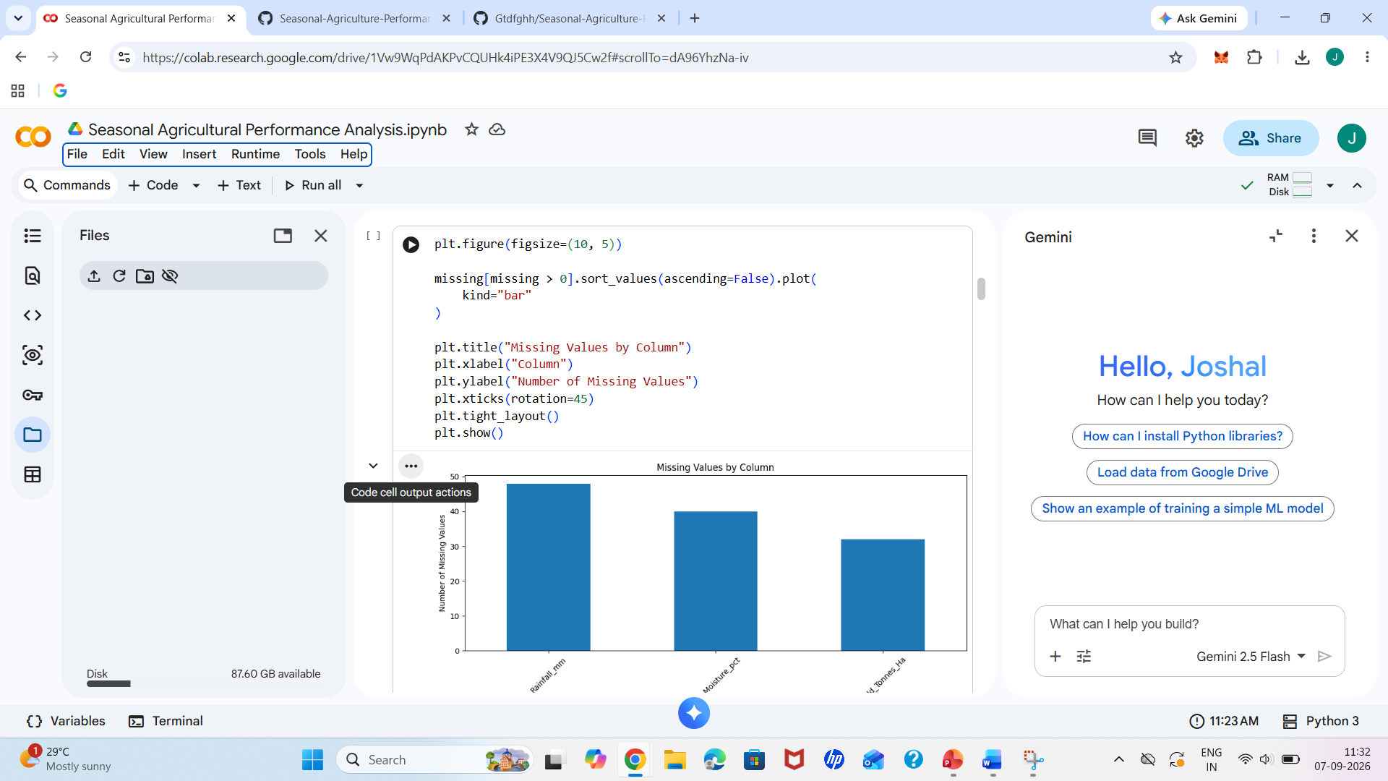
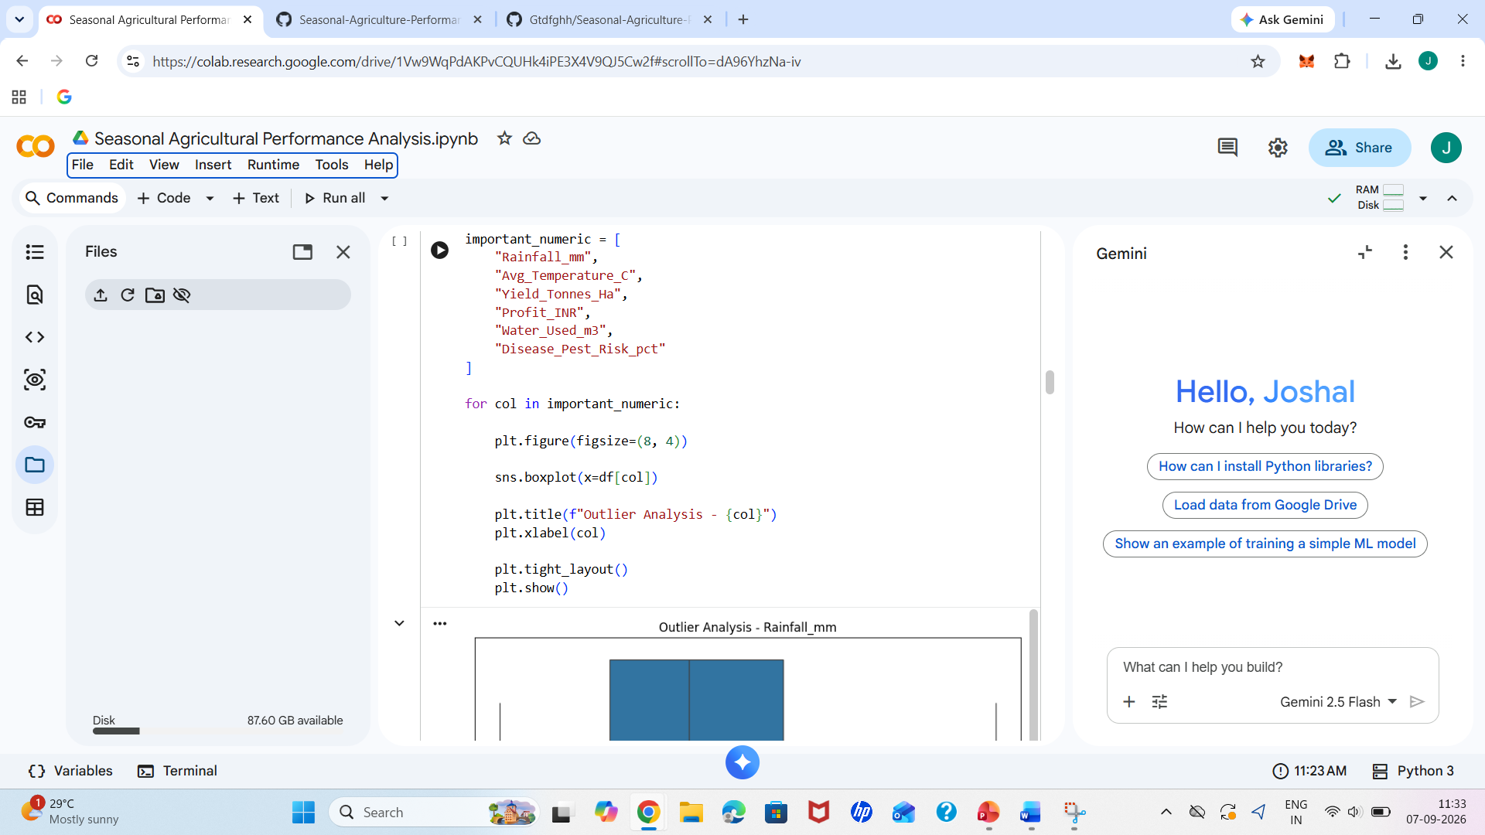
RESULTS
[Add screen shots of your code ]

Slide 10
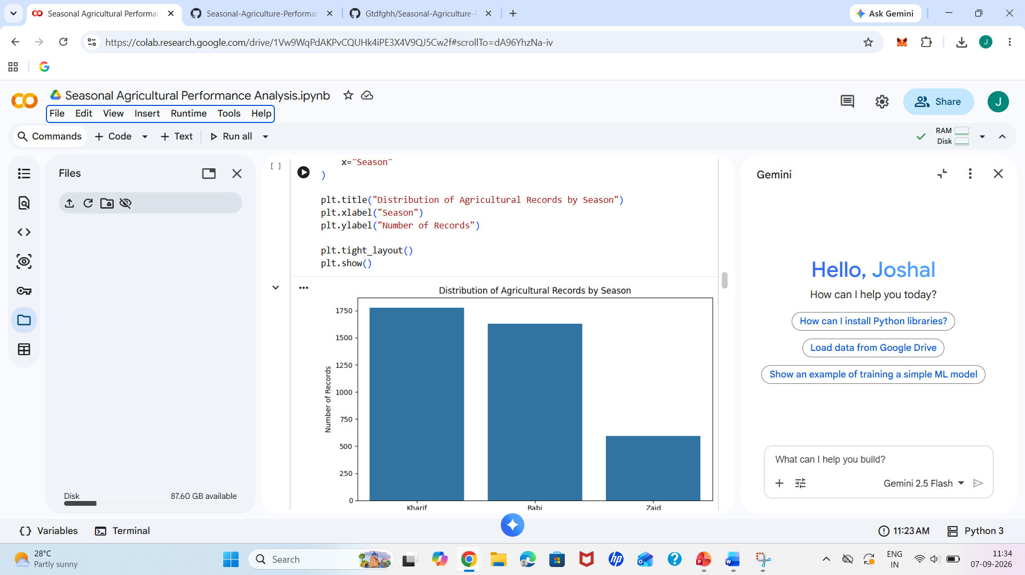
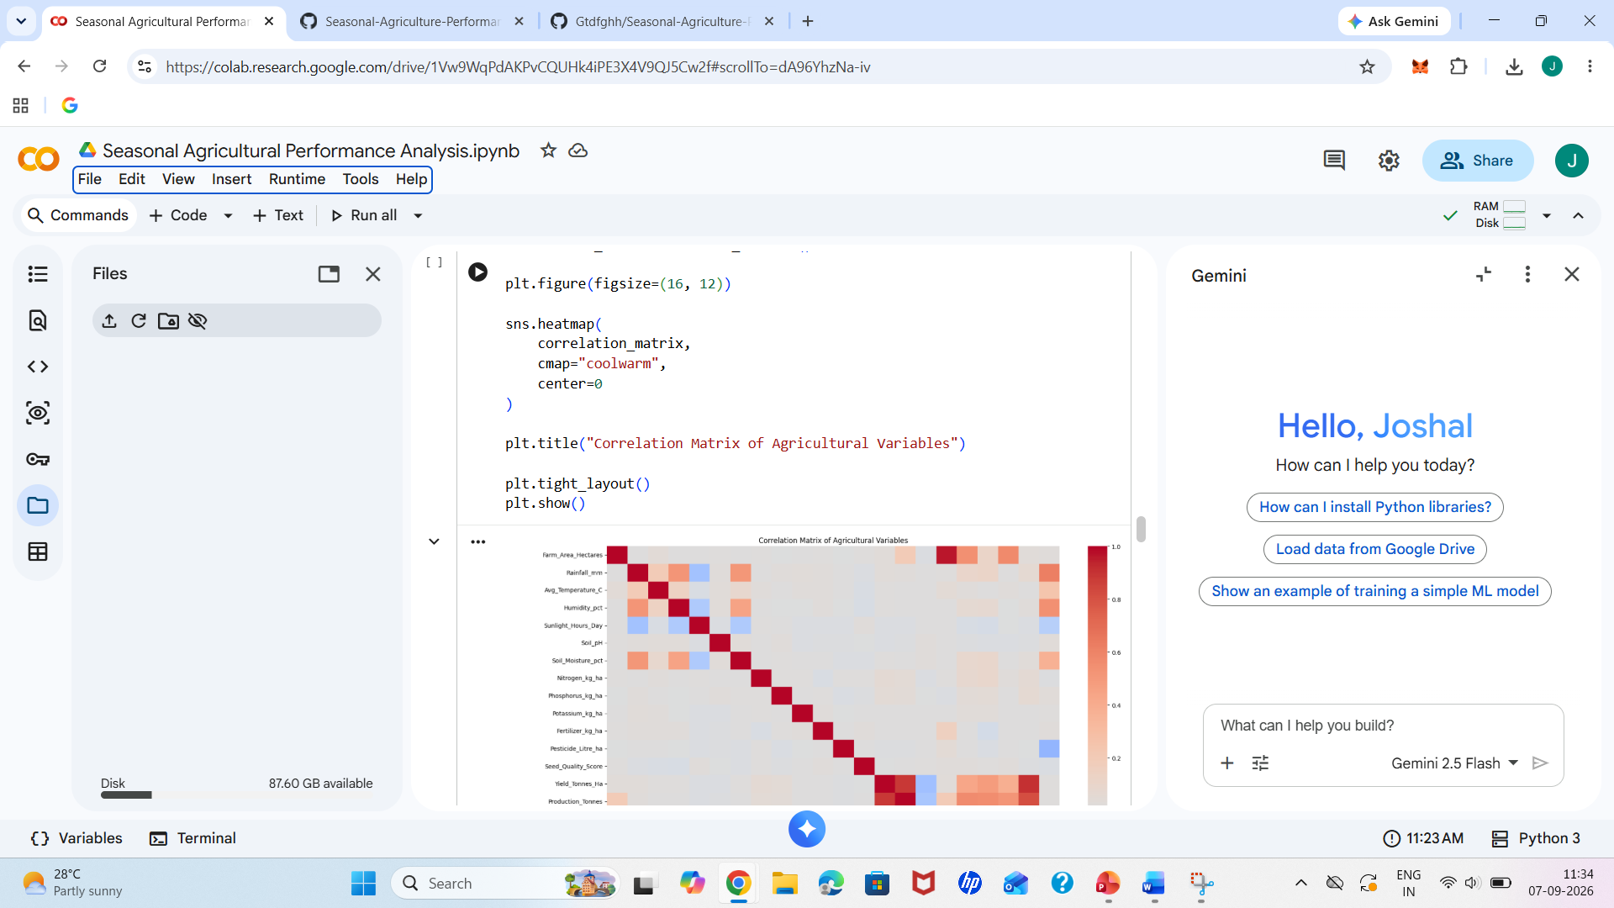
RESULTS
[Add screen shots of your code ]

Slide 11
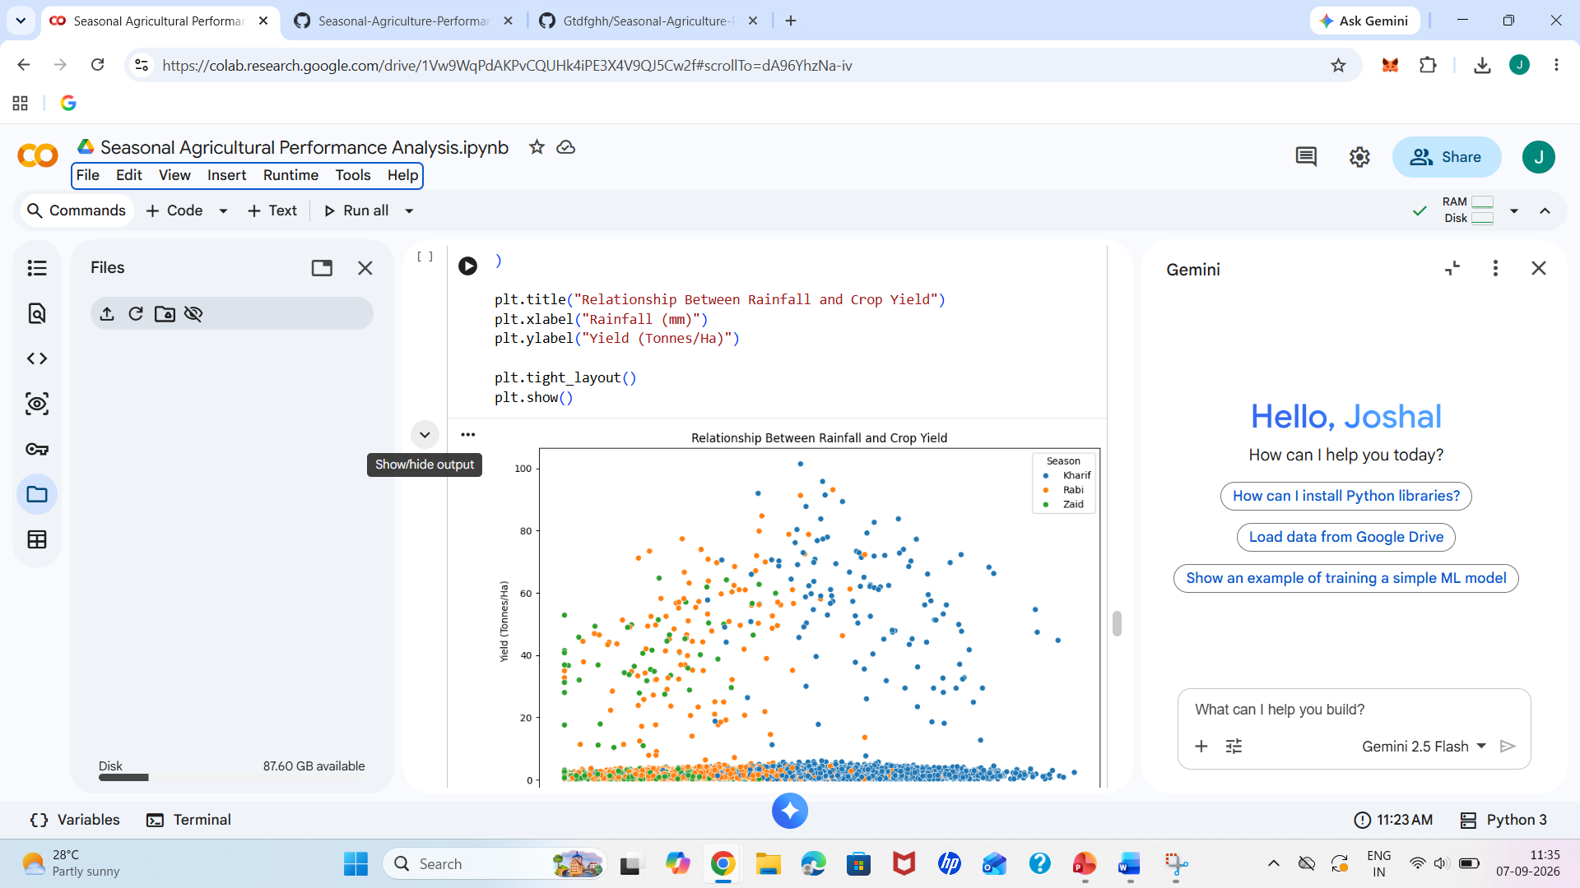
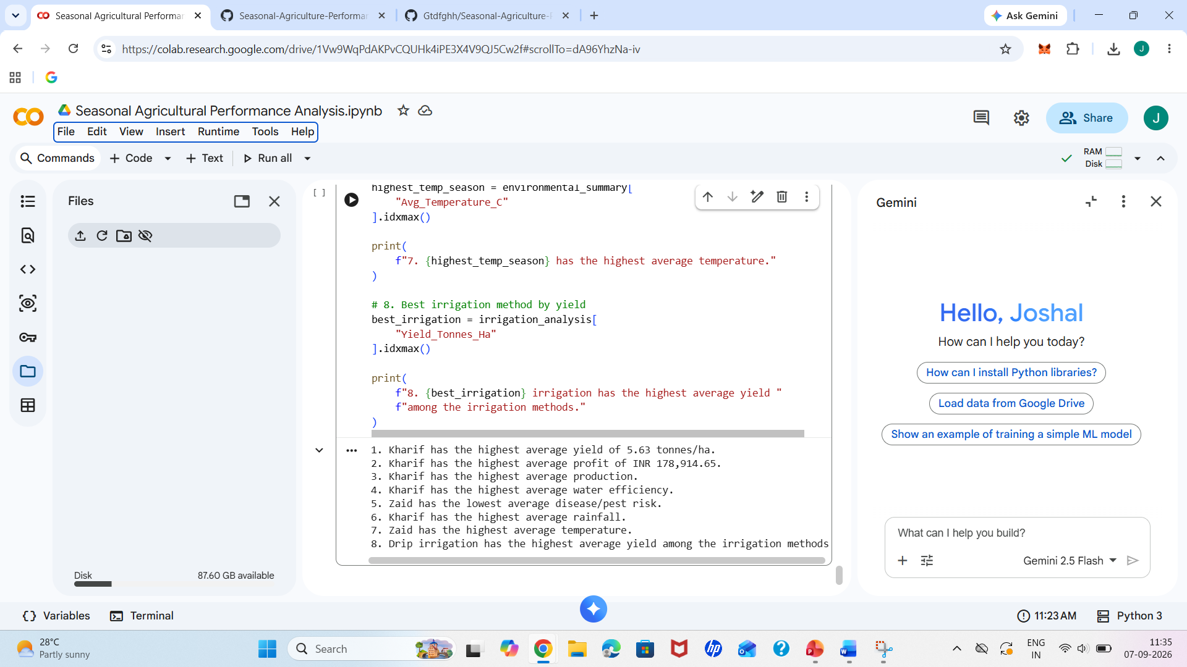
RESULTS
[Add screen shots of your code ]

Slide 12
Future scope Develop predictive models to forecast agricultural performance for upcoming seasons. Analyze regional and crop-specific trends in greater detail. Integrate real-time weather and environmental data for better analysis. Build an interactive dashboard for farmers and agricultural planners. Use the insights to support better resource allocation and seasonal planning.

Slide 13
GitHub Link
https://github.com/Gtdfghh/Seasonal-Agriculture-Performance-Analysis-.git

Slide 14

VOIS Course completion certificate - Course name- Data Visualization

Slide 15
Thank you
.
.

