Slide 1
3회차
모각코

Slide 2
STARLIGHT
index
1. Bufferd reader
2. Bufferd writer

Slide 3
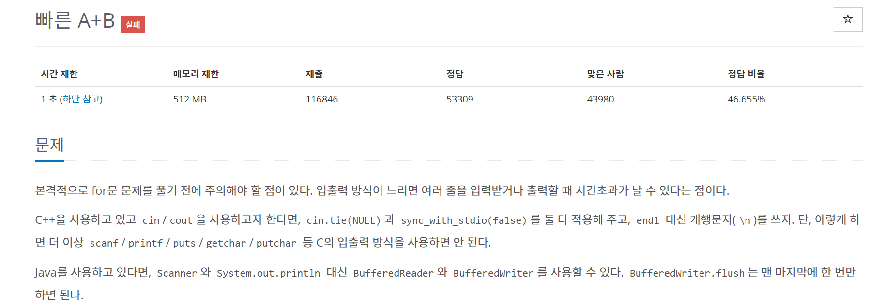
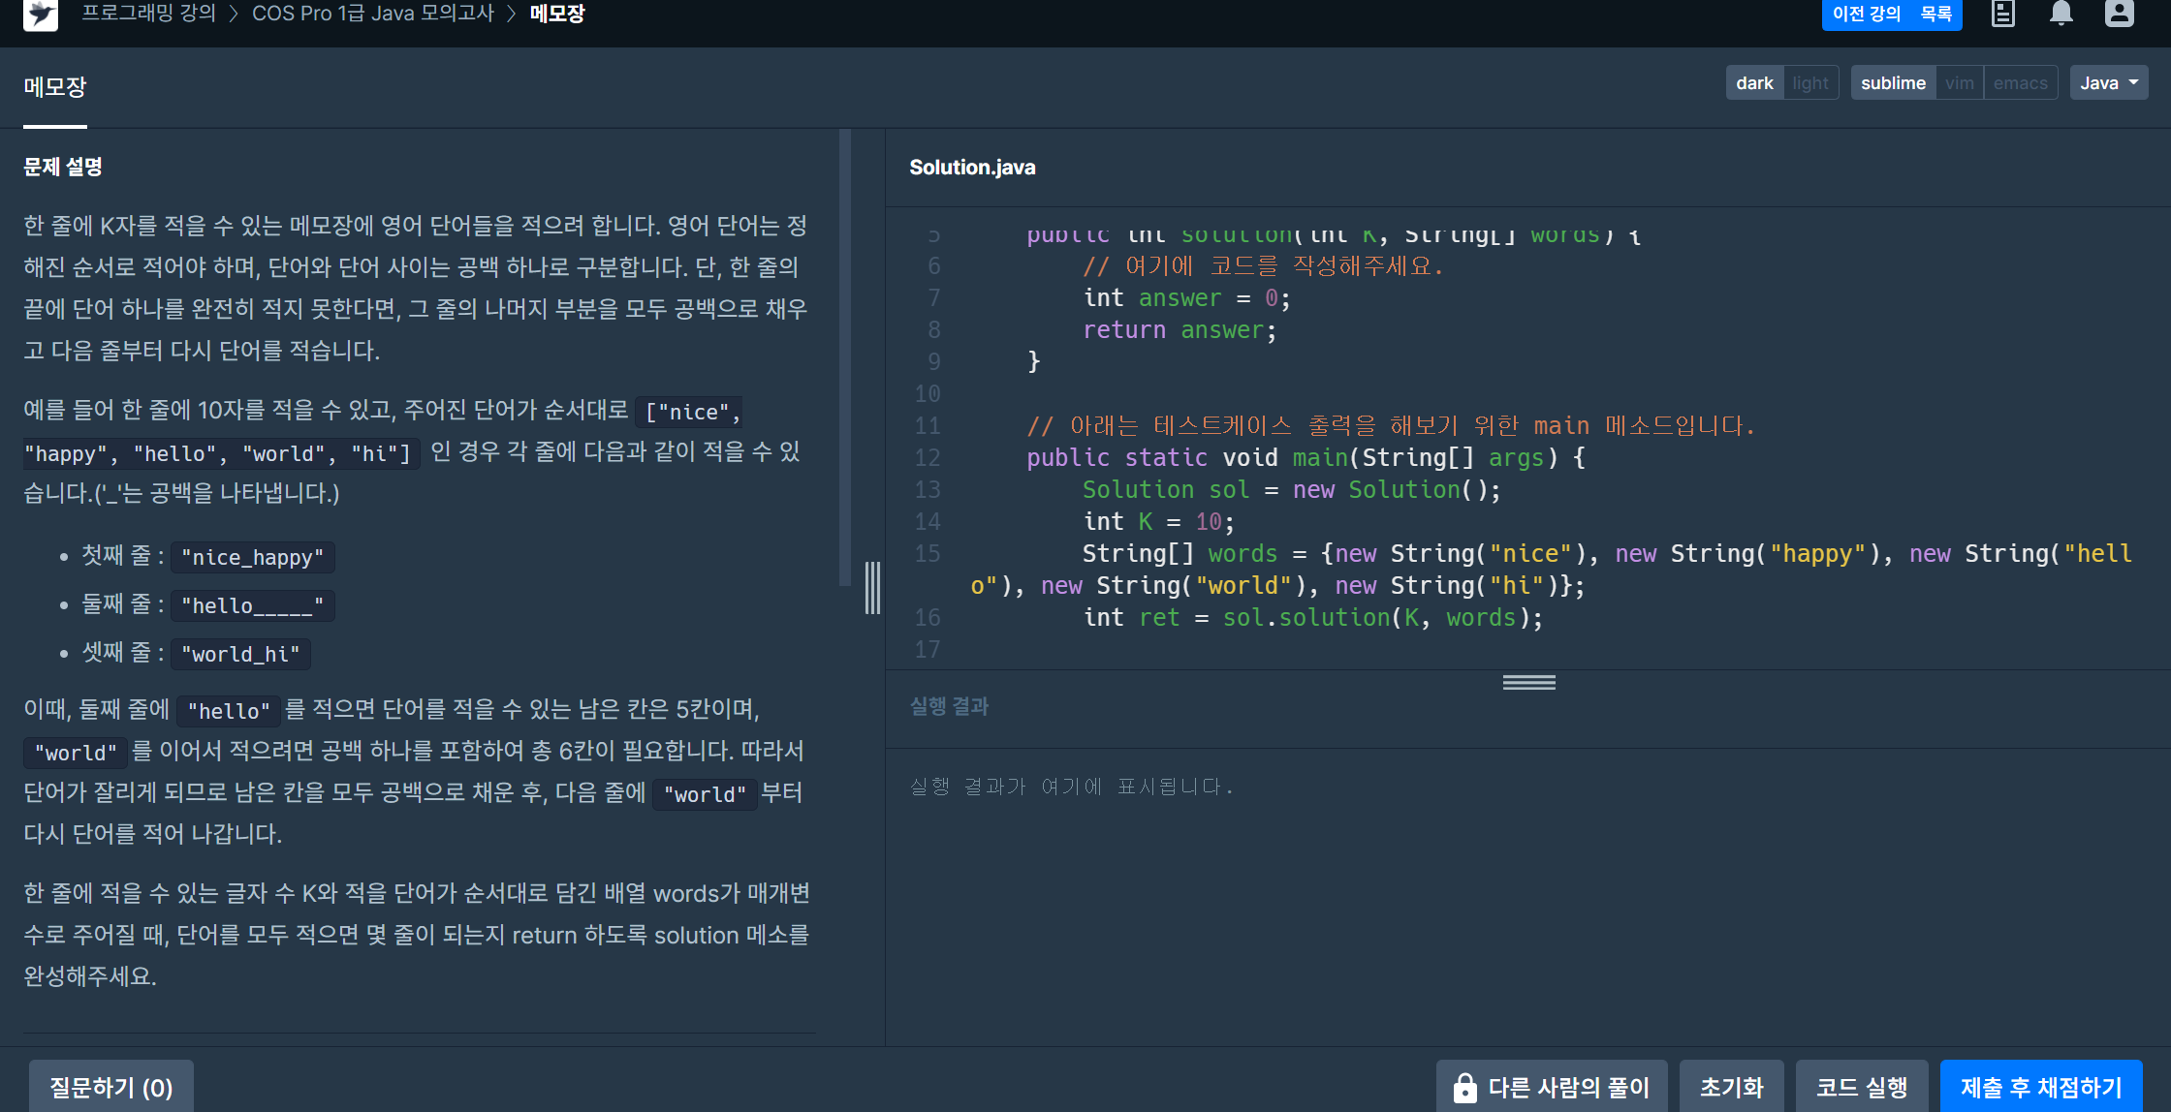
Why should we use BufferedReader and Writer?

Slide 4

Bufferd reader

Slide 5
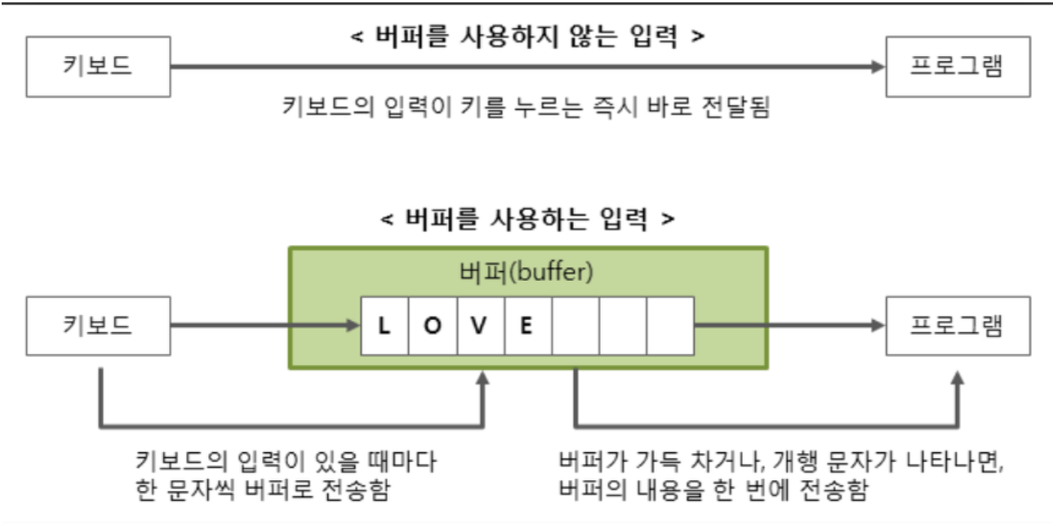

Slide 6
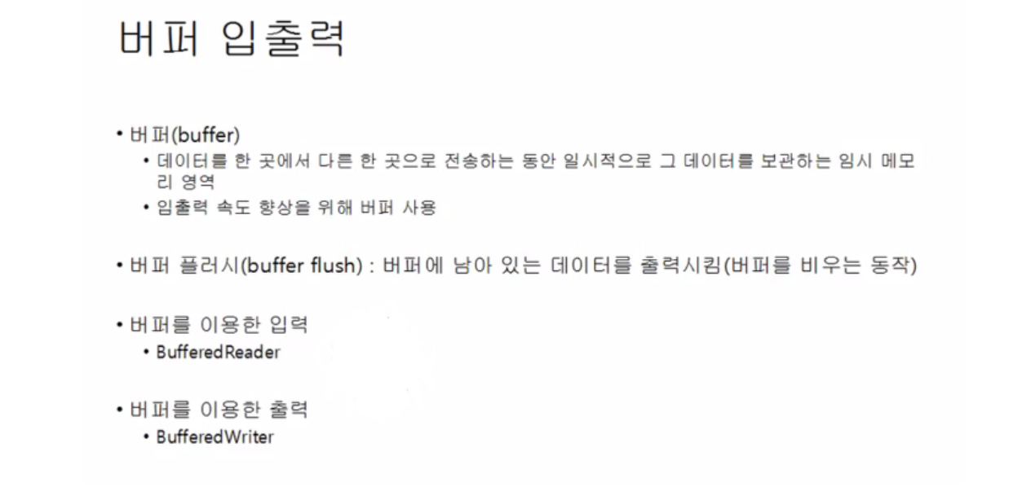

Slide 7
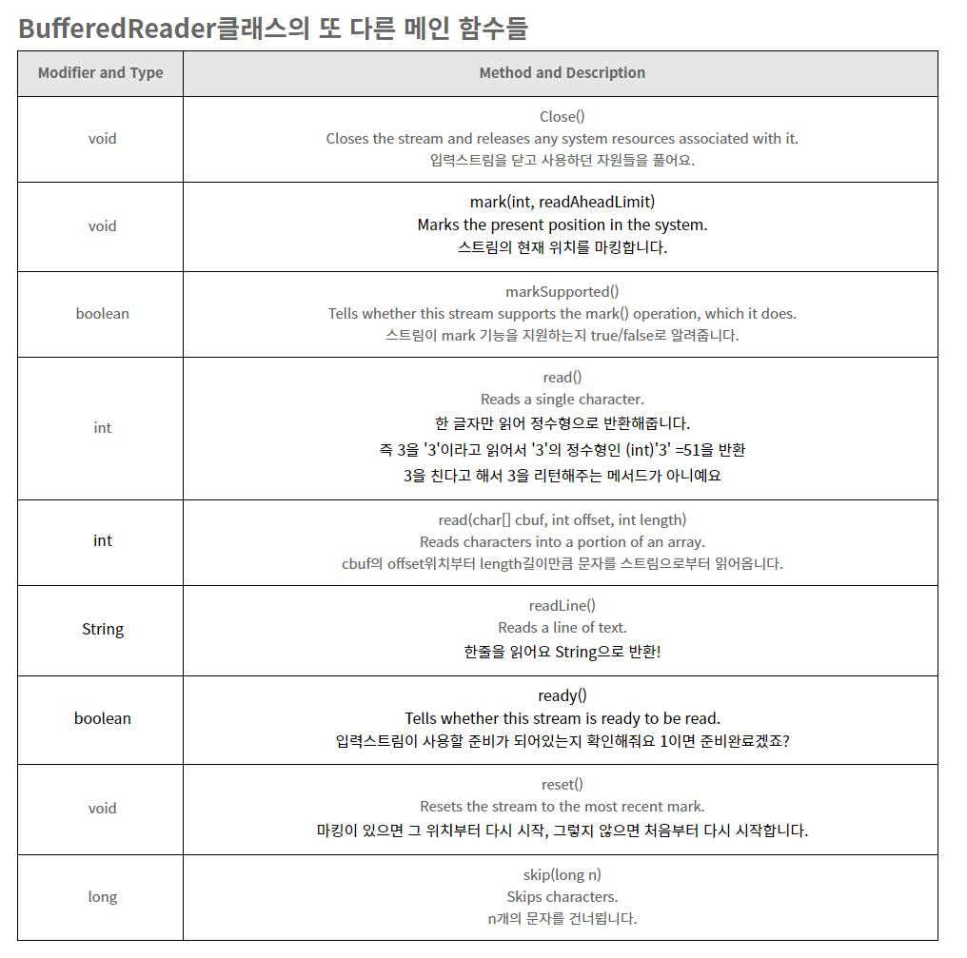

Slide 8
Bufferd writer

Slide 9
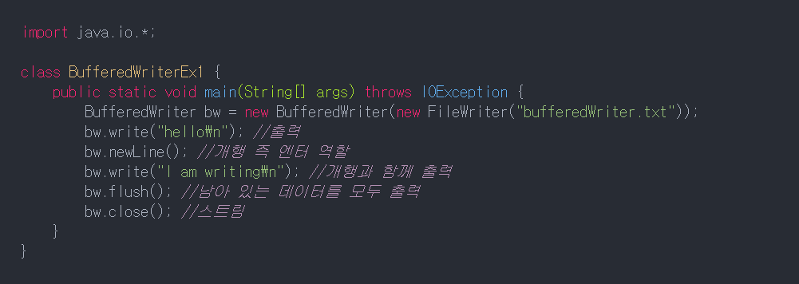

Slide 10
