Slide 1

Health Insurance cost Prediction

Slide 2
Health Insurance cost Prediction
By
Sagar B
Navyashree
Saranya
Sachin G T

Slide 3
Outcomes
Outline
Background and Motivation
Future Directions
Example application
Decision Support System
Conclusions

Slide 4
Health Insurance cost Prediction
Abstract.
Introductions.
Coding PDF using Software.
Results.
Conclusion & future scope.
References.

Slide 5
Abstract:
According to the Economic Survey 2023, the share of government expenditure in Total Health Expenditure has increased over time from 28.6% in (2013-14) to 40.6% in (2018-19). However, OOPE is still higher at 48.2% of the total expenditure. 20 years, worldwide public health spending has nearly doubled along with inflation, reaching 10.8% of global GDP in 2022. Around 60% of comprehensive medical procedures and 70% of outpatient care are provided by multinational multi- private sectors, who charge people exorbitant prices. Health insurance is becoming into a necessity for everyone due to the rising cost of high-quality healthcare, rising life expectancy, and the epidemiological shift toward non-communicable diseases. In the previous ten years, there has been a significant increase in insurance data, and carriers now have access to it. To improve outcomes, the health insurance system looks into predictive modelling.

Slide 6
Health Insurance cost Prediction Introductions:
Health Insurance is a type of insurance that covers medical expenses. A person who has taken a health insurance policy gets health insurance cover by paying a particular amount. There are a lot of factors that determine the cost of health insurance.
The amount of the premium for a health insurance policy depends from person to person, as many factors affect the amount of the cost for a health insurance policy. Let’s say age, a young person is very less likely to have major health problems compared to an older person. Thus, treating an older person will be expensive compared to a young one. That is why an older person is required to pay a high amount compared to a young person.

Slide 7
Health Insurance cost Prediction
Just like age, many other factors affect the Health Insurance cost Prediction. Hope you now have understood what health insurance is and how the Health Insurance cost Prediction is determined. In the section below PDF i will take you through the task of Health Insurance cost Prediction with Linear Regression Method.

Slide 8
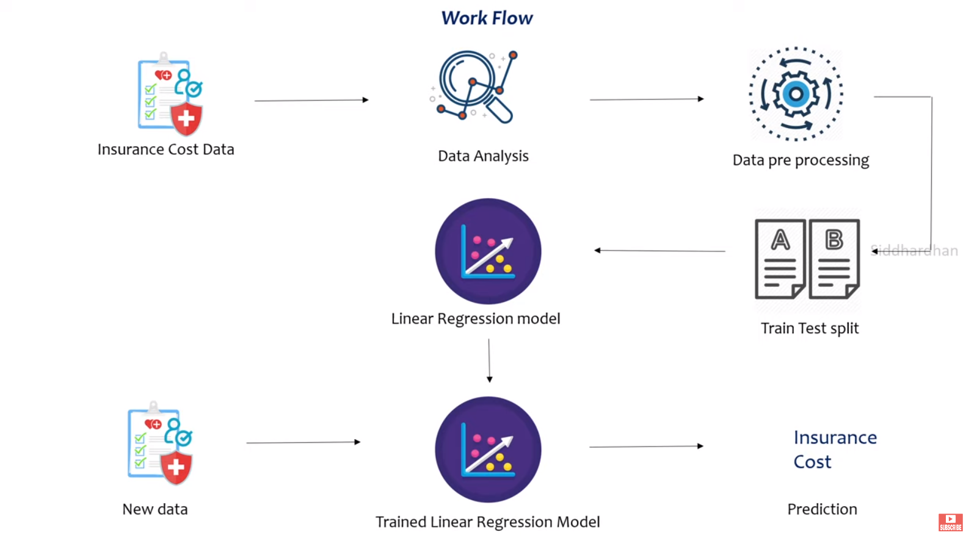
Work Flow :

Slide 9
Coding PDF using Software.

Slide 10
Results:
We see that the accuracy of predicted amount was seen best
Model giving highest percentage of accuracy taking input of all four attributes was selected to be the best model which eventually came out to be Linear_Regression.
Figure : Accuracy in percentage (%)

Slide 11
Conclusion & future scope:
Various factors were used and their effect on predicted amount was examined. It was observed that a persons age and smoking status affects the prediction most in every algorithm applied. Attributes which had no effect on the prediction were removed from the feature
The effect of various independent variables on the amount was also checked. The attributes also in combination were checked for better accuracy results.
Cost Prediction focuses on persons own health rather than other companys insurance terms and conditions. The models can be applied to the data collected in coming years to predict the cost. This can help not only people but also insurance companies to work in tandem for better and more health centric insurance amount.

Slide 12


Journals:

Slide 13
References:
https://www.sciencedirect.com/science/article/pii/S1532046419300310
https://en.wikipedia.org/wiki/Healthcare_in_India
https://www.kaggle.com/code/subhakarks/medical-insurance-cost-analysis-and-prediction/notebook
https://economictimes.indiatimes.com/wealth/insure/what-you-need-to- before-buying-health- insurance/articleshow/47983447.cms?from=mdr
https://statistics.laerd.com/spss-tutorials/multiple-regression-using- statistics.php
https://www.zdnet.com/article/the-true-costs-and-roi-of-implementing-
Authors: Mukund Kulkarni, Dhammadeep D. Meshram, Bhagyesh Patil, Rahul More, Mridul Sharma, Pravin Patange
https://www.saedsayad.com/decision_tree_reg.htm
http://www.statsoft.com/Textbook/Boosting-Trees-Regression- Classification

