Slide 1
Chapter 6
The Inclusion-Exclusion Principle and Applications

Slide 2
Summary
The inclusion-exclusion principle
Combinations with repetition
Derangements
Permutations with forbidden positions
Another forbidden position problem

Slide 3
Section 6.1
The inclusion-exclusion principle

Slide 4
Examples for review
Ex.1 Count the permutations of {1,2,…,n} in which 1 is not in the first position.
Direct: (n-1) x (n-1)!
Indirect: If 1 is in the first position, the permutation number is (n-1)!. Hence the answer is n! – (n-1)!
Ex.2 Count the number of integers between 1 and 600 which are not divisible by 6.

Slide 5
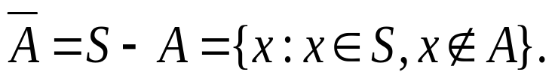
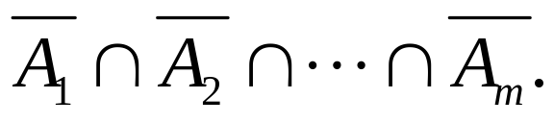
Complement
The complement of a subset A of a set S is the set consisting of those objects in S which are not in A. Denoted by
Let P₁, P₂, …, P_{m} be m properties referring to the objects in S and let A_{i} ={x: x in S and x has property P_{i}}, (i=1,2,…,m).
Then, A_{i} ∩ A_{j} is the subset of objects which have both properties P_{i} and P_{j} (and possibly others). The subset of objects having none of the properties is

Slide 6
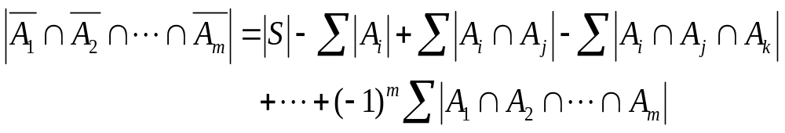
The inclusion-exclusion principle (IEP)
The number of objects in S which have none of the properties P₁, P₂, …., P_{m} is given by
where the first sum is over all 1-combination {i} of {1,2,3…,m}, the second sum is over all 2-combinations {i, j} of {1,2,..,m}, the third sum is over all 3-combinations {i, j, k} of {1,2,…,m}, and so on.

Slide 7
证明
证明要点：任何元素 x，如果不具有任何性质，则对等式右边计数贡献为１，否则为０
证 设 x不具有性质 P₁, P₂, … , P_{m} ,
x∉A_{i} , i = 1, 2, … , m
x∉A_{i}∩A_{j} , 1≤ i < j ≤ m
…
x∉A₁∩A₂∩…∩A_{m} ,
x 对右边计数贡献为
1 − 0 + 0 − 0 + … + (−1)^{m} · 0 = 1

Slide 8
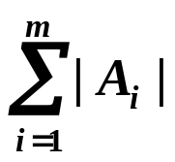
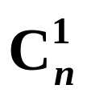
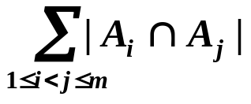
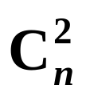
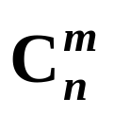
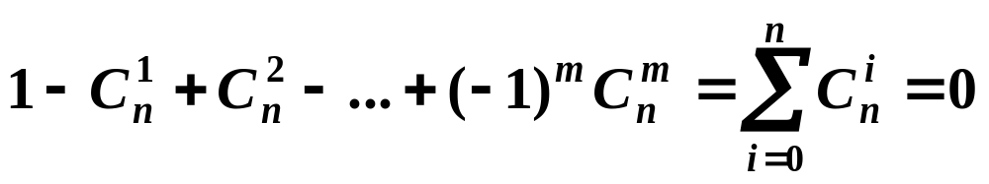
证明（续）
设 x具有 n 条性质，1≤n≤m
x 对 |S| 贡献为 1
x 对 贡献为
x 对 贡献为
….
x 对 | A₁∩A₂∩…∩A_{m}| 贡献为
x 对右边计数贡献为

Slide 9
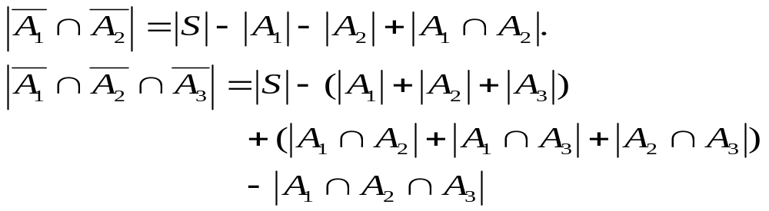
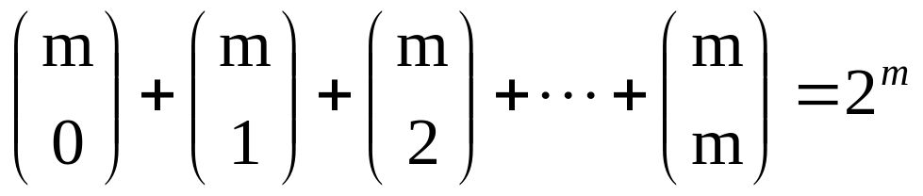
Special Case
Generally, the number of terms on the right side of the equality is

Slide 10
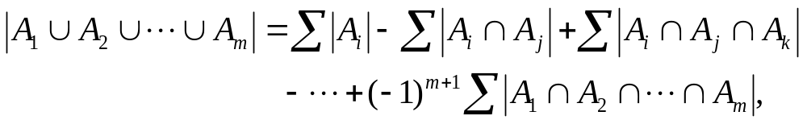
A corollary of IEP
The number of objects of S which have at least one of the properties P₁, P₂, …, P_{m} is given by
where the summations are as specified in IEP.

Slide 11
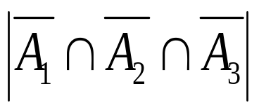
Examples
Find the number of integers between 1 and 1000, inclusive, which are divisible by none of 5, 6, and 8.
1. Let P₁ be the property that an integer is divisible by 5, P₂ the property that an integer is divisible by 6, and P₃ the property that an integer is divisible by 8. Let S be the set consisting of the first 1000 positive integers. For i=1, 2, 3 let A_{i} be the set consisting of those integers in S with property P_{i}. We wish to find the number of integers in
2. Integers in the set A₁∩A₂ are divisible by both 5 and 6. An integer is divisible by both 5 and 6 iff it is divisible by lcm{5,6} (the least common multiple of 5 and 6).

Slide 12
Exercise
Count the number of integers between 1 and 1000, inclusive, which are divisible by 4, 5 or 6.
How many permutations of the letters M, A, T, H, I, S, F, U, N are there such that none of the words MATH, IS and FUN occur as consecutive letters?

Slide 13
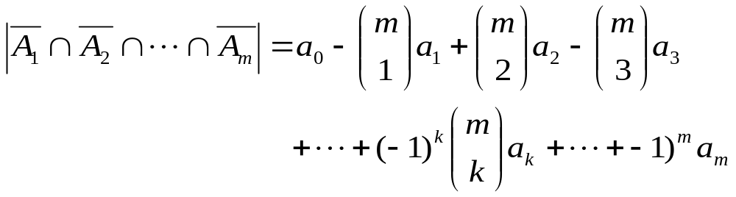
Special case for IEP
Assume that the size of the set A_{i1} ∩ A_{i2} ∩ … ∩ A_{ik} that occurs in the IEP depends only on k and not on which k sets are used in the intersection. Then
where a_{k} = |A_{i1} ∩ A_{i2} ∩ … ∩ A_{ik}|. This is because the kth summation that occurs in the IEP contains C(m, k) summands each equal to a_{k}.

Slide 14
Example
How many integers between 0 and 99,999 (inclusive) have among their digits each of 2,5 and 8?
Let S be the integers between 0 and 99,999. P₁ (resp., P₂ and P₃) be the property that an integer does not contain the digit 2 (resp., 5 and 8). Let A_{i} be the set consisting of those integers in S with property P_{i}. We wish to count the number of integers in

Slide 15
Example (cont’d)
S (resp., A_{i}) is the 5-permutations of the multiset in which each digit 0, 1, 2, …, 9 (resp., 0, 1, 3, …, 9; 0, 1, 2, 3, 4, 6, 7, 8, 9; 0, 1, 2, …, 7, 9) has repetition number 5 or greater. Hence,
a₀ = 10⁵, a₁ = 9⁵, a₂=8⁵, a₃ = 7⁵ and the answer is 10⁵ – 3×9^{５}＋３×8⁵ – 7⁵.

Slide 16
Section 6.2
Combinations with repetition

Slide 17
Review
The number of r-combinations of a set of n distinct elements is C(n, r) = n!/r!(n-r)!
The number of r-combinations of a multiset with k distinct objects each with an infinite repetition number equals
C(r+k-1, r).

Slide 18
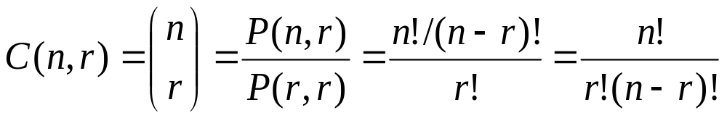
Review: r-combinations
An r-combination of elements of a set S is simply a subset T⊆S with r members, |T|=r.
The number of r-combinations of a set with n=|S| elements is
Note that C(n,r) = C(n, n−r)
  Because choosing the r members of T is the same thing as choosing the n−r non-members of T.

Slide 19
Review: Combinations of Multisets
If S is a multiset, then an r-combination of S is an unordered selection of r of the objects of S. Thus an r-combination is itself a multiset, a submultiset of S.
Example. If S = {2{a}, 1{b}, 3{c}}, then the 3-combinations of S are {2{a}, 1{b}}, {2.a, 1.c}, {1.a, 1.b, 1.c}, {1.a, 2.c}, {1.b,2.c}, {3.c}.

Slide 20
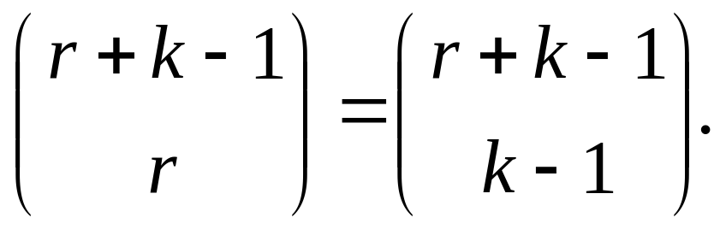
Review: r-combinations
Let S be a multiset with objects of k different types where each has an infinite repetition number (or the repetition number is greater than r). Then the number of r-combinations of S equals
It corresponds to the number of non-negative integral solutions of equation x₁+x₂+…+x_{k}=r.

Slide 21
About repetition number
Suppose T is a multiset and an object x of T of the a certain type has repetition number which is greater than r. Then the number of r-combinations of T equals the number of r-combinations of the multiset obtained from T by replacing the repetition number of x by r.
Furthermore, any repetition number which is greater than r can be replaced by r.

Slide 22
Example
The number of 8-combinations of the multiset {3{a}, ∞{b}, 6{c}, 10{d}, ∞{e}} is the same as the number of 8-combinations of the multiset {3{a}, 8{b}, 6{c}, 10{d}, 8{e}}.

Slide 23
Combinations with repetition
Example 1: Determine the number of 10-combinations of the multiset T = {3{a}, 4{b}, 5{c}}.
Hint: Let T* = {∞{a}, ∞{b}, ∞{c}}, P₁ (resp., P₂, and P₃) be the property that a 10-combination of T* has more than 3 a’s (resp., 4 b’s and 5 c’s) and A₁ (resp., A₂ and A₃) be the 10—combinations of T* which have property P₁ (resp., P₂ and P₃). We wish to determine the size of the set

Slide 24
Hint (cont’d)
The set A₁ consists of all 10-conbinations of T* in which a occurs at least 4 times. If we take any one of these 10-combinations in A₁ and remove 4 a’s, we are left with a 6-combination of T*. Conversely, if we take a 6-combination of T* and add 4 a’s to it, we get a 10-combination of T* in which a occurs at least 4 times. Thus the number of 10-combinations in A₁ equals the number of 6-combinations of T*. Hence, |A₁| = C(6+3-1,6) = 28. Similarly, A₂ (resp., A₃) equals the number of 5 (resp., 4)-combinations of T*. Hence, |A₂| = C(5+3-1,5)=21, |A₃| = C(4+3-1,4)=15.

Slide 25
Hints (cont’d)
The set A₁∩A₂ consists of all 10-combinations of T* in which a occurs at least 4 times and b occurs at least 5 times. By above analysis, |A₁∩A₂ | equals the number of 1-combinations of T*, so that |A₁∩A₂ | = C(1+3-1, 1) =3. Similarly, |A₂∩A₃|=0, |A₁∩A₃|=1 and |A₁ ∩ A₂∩A₂|=0. Putting all these results into the IEP, we obtain = 6.

Slide 26
r-combination and integral solution
The number of r-combinations of the multiset {n₁*a₁, n₂*a₂,…,n_{k}*a_{k}} equals the number of integral solutions of the equation
x₁+x₂+…+x_{k}=r
which satisfy 0≤x_{i}≤n_{i} (i=1,2,…,k).
The number of these solutions can be calculated by the method just illustrated.

Slide 27
Combinations with repetition
Example 2: What is the number of integral solutions of the equation x₁ + x₂ +x₃ +x₄ = 18 which satisfy 1≤x₁≤5, -2≤x₂≤4, 0≤x₃≤5, 3≤x₄≤9?
Hint: The equation equivalent to y₁ + y₂ +y₃ +y₄ = 16 which satisfy 0≤y₁≤4, 0≤y₂≤6, 0≤y₃≤5, 0≤y₄≤6? The following solution similar to example 1.

Slide 28
Second solution
Let S be the set of all non-negative integral solutions of the above equation, P₁ (P₂, P₃ and P₄) be the property that y₁ ≥ 5 (y₂ ≥ 7, y₃≥6 and y₄≥7) and A_{i} be the subset of S consisting of the solutions satisfying property P_{i}(i = 1, 2, 3, 4). Let z₁ = y₁ – 5, z₂ = y₂ ,z₃ = y₃ and z₄ = y₄. Then the number of solutions in A₁ is the same as the number of non-negative integral solutions of z₁ +z₂+z₃+z₄=11. Hence, |A₁| = C(11+4-1, 11).
CONTINUE BY YOURSELF.

