Slide 1

FAST FOURIER TRANSFORM
Dr. Zhenyu He
Shenzhen Graduate School, Harbin Institute of Technology
Autumn 2013

Slide 2
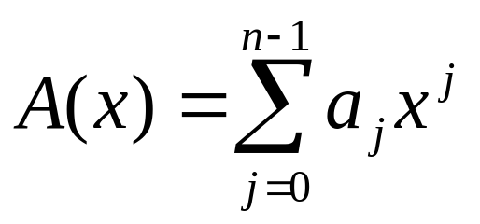
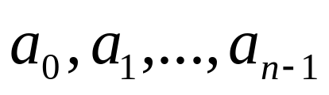

Polynomials
A polynomial in the variable x over an algebraic field F is a representation of a function A(x) as a formal sum,
Where,
are the coefficients of the polynomial.
Degree of A(x) is k if the highest nonzero coefficient is .
Obviously, n is the degree bound of A(x).

Slide 3
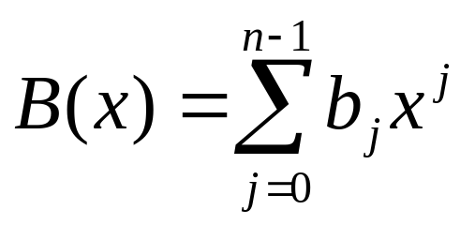
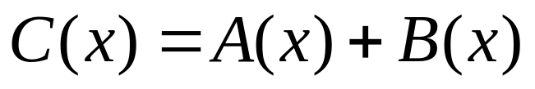
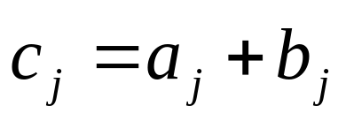
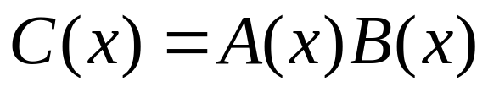
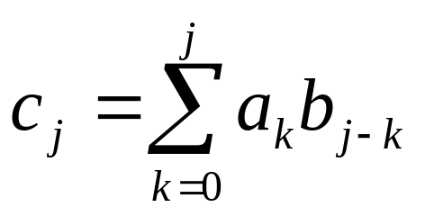
Polynomial addition and multiplication
and
If
,then
If
,then

Slide 4
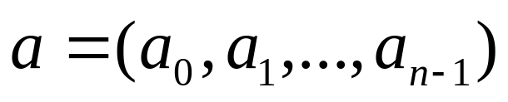
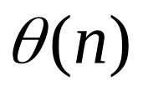
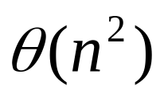
Coefficient representation of Polynomial
Coefficient vector
The operation of evaluating A(x) at a given point x₀
The complexity of Polynomial addition:
The complexity of Polynomial multiplication:

Slide 5
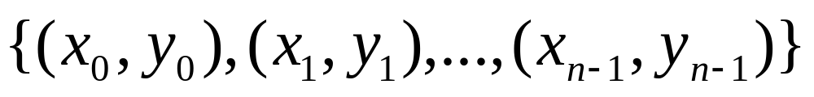
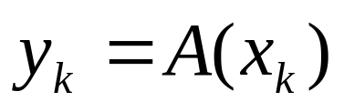
Point-value representation of Polynomial
Point-value representation of Polynomial A(x) is,
such that all of the x_{k} are distinct and

Slide 6
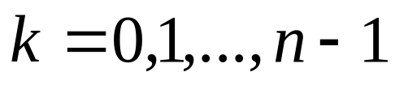
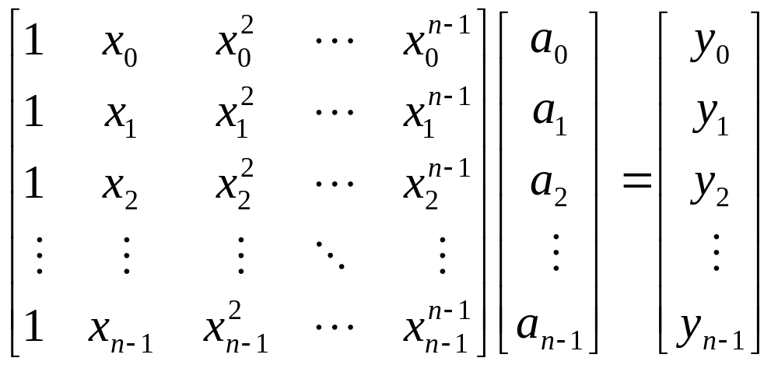
Theorem 30.1 Uniqueness of an interpolating polynomial
For any set
of n point-value pairs such that all the x_{k} value are distinct, there is a unique polynomial A(x) of degree-bound n such that for
Proof:

Slide 7

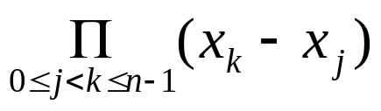
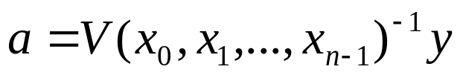
Uniqueness of an interpolating polynomial
The matrix on the left id denoted as , and is known as a Vandermonde matrix, of which the determinant is
The matrix is invertible if the x_{k} are distinct.
Thus, the coefficients can be solved for uniquely given the point-value representation.

Slide 8
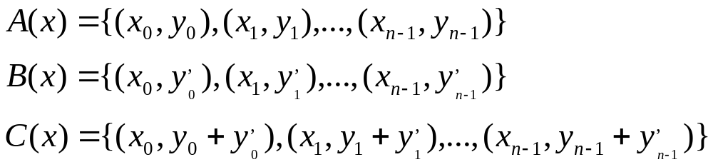
Addition of point-value representation
The complexity of Polynomial addition:

Slide 9
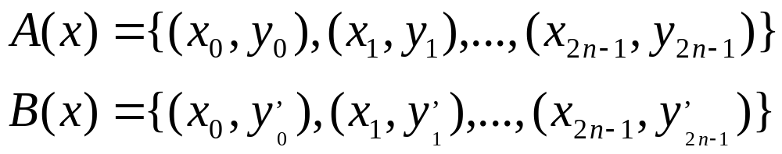
Multiplication of point-value representation
Since the degree-bound of C is 2n,we need 2n point-value pairs for a point-value presentation of C.
Extend point-value of A and B to
The a point-value representation of C is
The complexity of Polynomial multiplication:

Slide 10
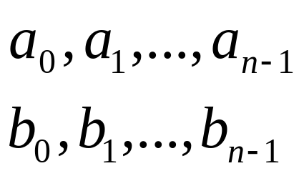
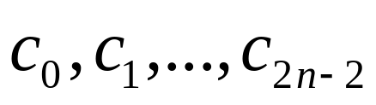

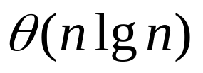

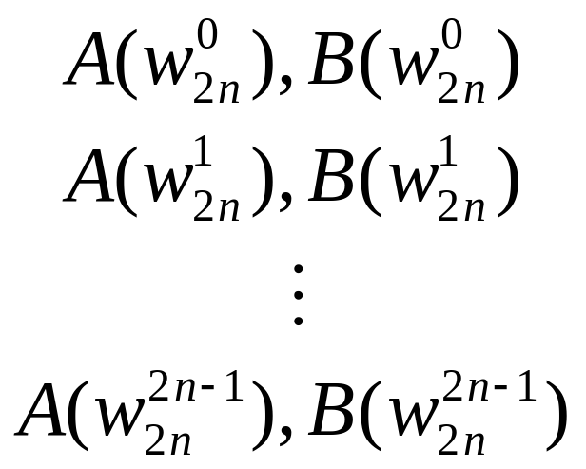
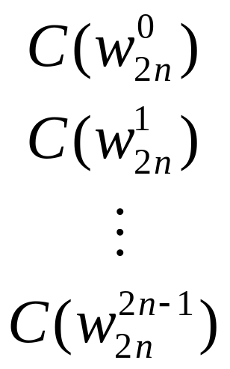

Graphical outline of efficient polynomial multiplication
Ordinary multiplication
Time
Interpolation
Evaluation
Time
Time
Pointwise multiplication
Time

Slide 11
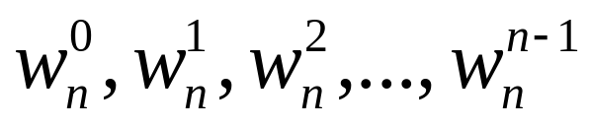
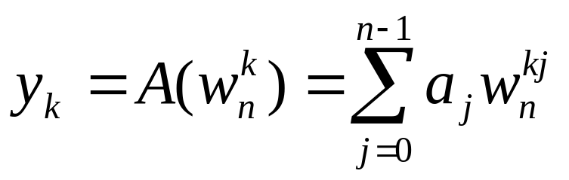
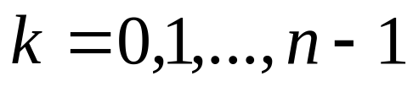
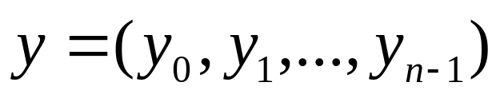

DFT
Evaluating a polynomial,
of degree bound n at
The vector is the discrete Fourier transform of the coefficient vector .

Slide 12
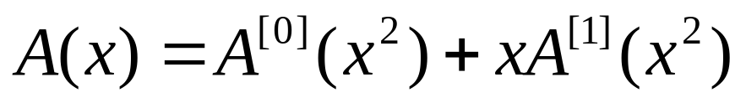
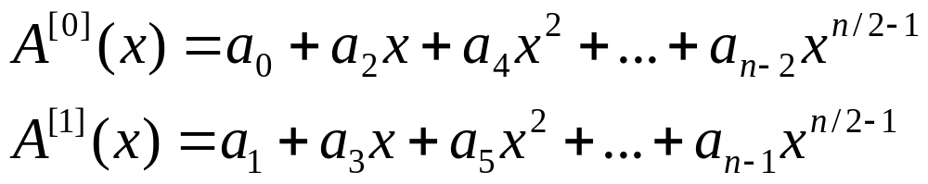
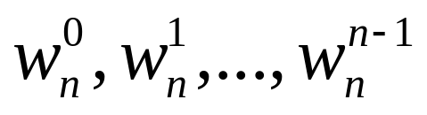
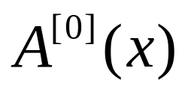
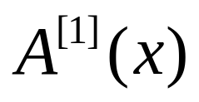
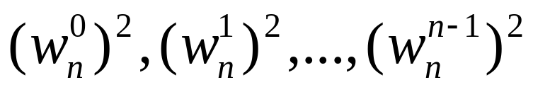
Framework of FFT
The FFT method employs a divide-and-conquer strategy.
Where,
So that, the problem of evaluating A(x) at
reduces to
.
(1)
Evaluating the degree-bound n/2 polynomial
and at

Slide 13
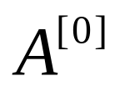
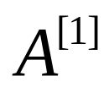
Framework of FFT
(2)
Combing the result.
According to having lemma, the polynomials and
of degree-bound n/2 are recursively evaluated at the n/2 complex (n/2)th roots of unity.
The recurrence for the running time is,
.

Slide 14
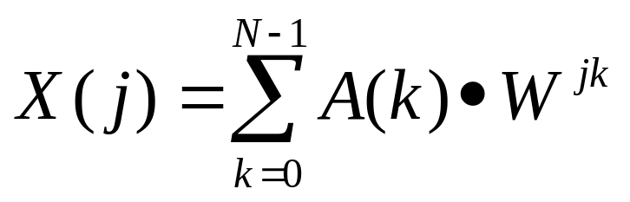
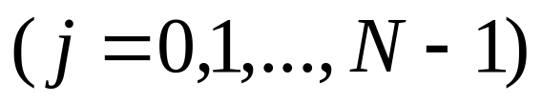
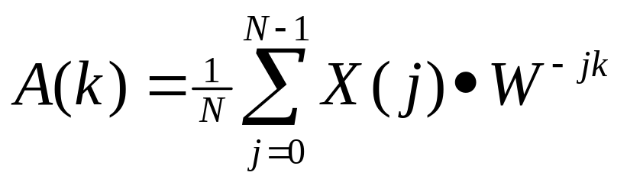
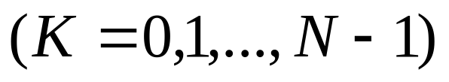
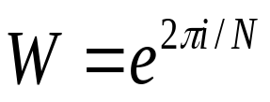
1-D discrete Fourier transform
(1)
(2)
Where,
.

Slide 15
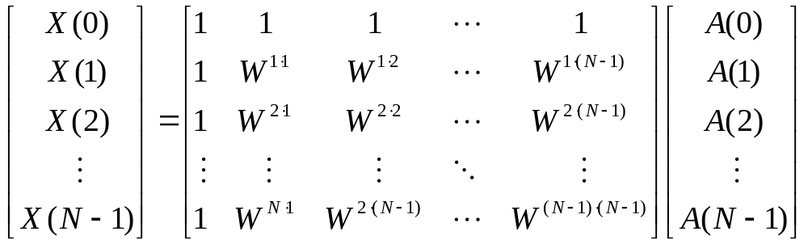

Eq.(1) can be rewritten in matrix form as
(3)
Eq.(3) can be simply denoted as
.

Slide 16
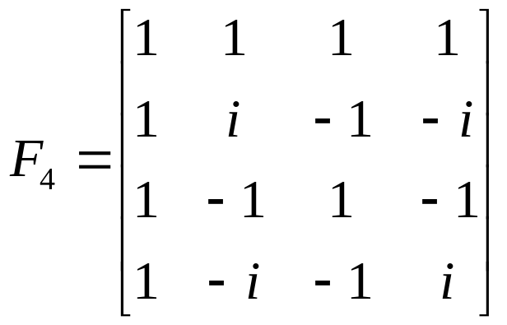
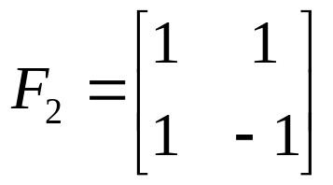



Examples
Please note that,
(a)
(b)

Slide 17
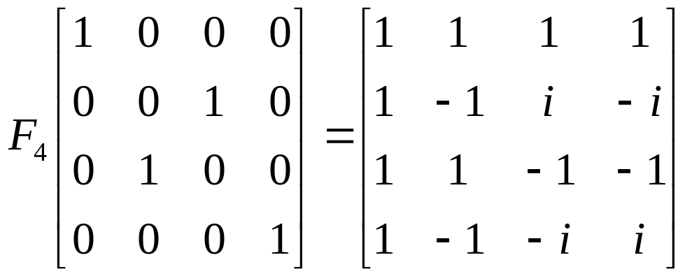
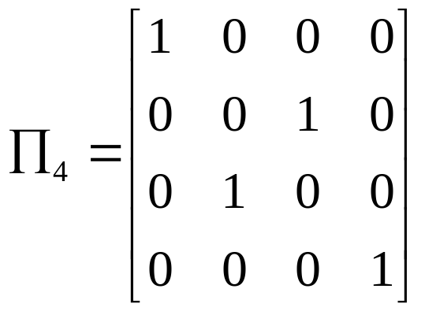
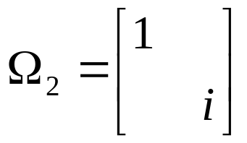
Idea of Fast Fourier Transform (FFT)
By exchanging the 2nd and 3rd column of F₄, we have
Denote,

Slide 18
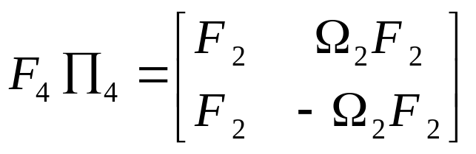
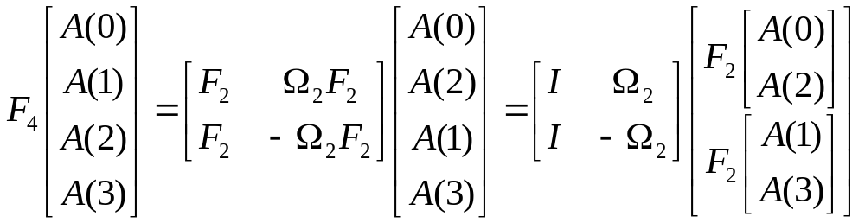
Idea of Fast Fourier Transform (FFT) (con’t)
Then, we have
(4)
Thus,
(5)

Slide 19
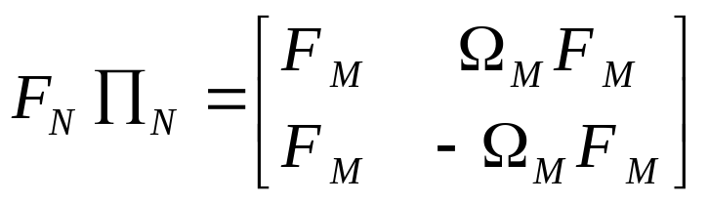

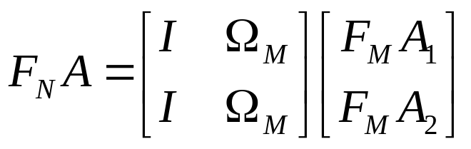


Idea of Fast Fourier Transform (FFT) (con’t)
Similarly, if N=2M,
(6)
Here,
So,
(7)
Here,
and

Slide 20
Idea of Fast Fourier Transform (FFT) (con’t)
One example
If N=8
0,1,2,3,4,5,6,7
0,2,4,6
1,3,5,7
0, 4
2, 6
1, 5
3, 7
0
4
2
6
1
5
3
7

Slide 21





Implementation of FFT
Set
(8)
Here,
and

Slide 22







Implementation of FFT (con’t)
Set
(9)
Then,
(10)
DFT with N points;
DFT with N/2 points.

Slide 23





















Implementation of FFT (con’t)

Slide 24




Implementation of FFT (con’t)
Here,
and

Slide 25





Implementation of FFT (con’t)
Set
Then

Slide 26




Implementation of FFT (con’t)
Similarly, set
Then

Slide 27












Implementation of FFT (con’t)
If N=8, then
all are DFT with 2 points.

Slide 28
















Implementation of FFT (con’t)
bit-reverse
Original index 1, binary code (001)→ (100), output index 4.

