Slide 1
Distributed Systems
Instructor: Hongwei Du

Slide 2
Class Description
Instructor
  Hongwei Du（堵宏伟）
  Email: hwdu@hit.edu.cn
Tutor
  Chuang Liu (刘闯）
  Email: chuangliuhit@gmail.com
  Mobile: 18565753995
  QQ Group: 542352158
Schedule Time:
(Online 雨课堂/腾讯会议)

Slide 3
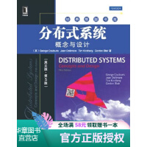
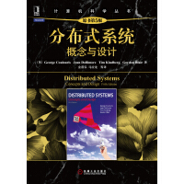
Textbook
Distributed Systems: Concepts and Design
George Coulouris, Jean Dollimore, Tim Kindberg and Gordan Blair(5th edition)
Distributed Systems: Principles and Paradigms, Andrew Tanenbaum and Maarten Steen (2nd edition)
Lecture notes
Pre-requirement:
Principles of networks
Operating systems
Java/c programming

Slide 4
Topics
Introduction
Distributed Systems models
Distributed Time and Clock Synchronization
Socket Communication
Remote Method Invocation(RMI)
Group Communication
Mutual exclusion & election algorithms
Replication
…………..

Slide 5
Grading
Assignments 作业 (10%)
Course projects 课程设计(20 %)
Final Exam 期末考试(70 %)

Slide 6
Motivation
Resource sharing
  Computers connected by the network and share resources.
  Hardware sharing, software sharing, data sharing, service sharing.
  media stream sharing.
Collaborative computing
  Parallel computing, distributed computing

Slide 7
Definition
Distributed application
Software application (Middleware)
Computer……..Computer
Message passing
Network
What is
a distributed system?
A distributed system is defined as one in which components at networked computers communicate and coordinate their actions only by passing messages.

Slide 8
Distributed Application
Middleware (Distributed core layer)
  RMI, CORBA, DCOM….
Network
  Mobile phone networks, corporate networks, factory networks, campus networks, home networks, in-car networks, wireless sensor networks, etc.

Slide 9
Distributed Applications
Finance and commerce | eCommerce e.g. Amazon and eBay, PayPal, online banking and trading
The information society | Web information and search engines, ebooks, Wikipedia; social networking: Facebook and MySpace.
Creative industries and entertainment | online gaming, music and film in the home, user-generated content, e.g. YouTube, Flickr
Healthcare | health informatics, on online patient records, monitoring patients
Education | e-learning, virtual learning environments; distance learning
Transport and logistics | GPS in route finding systems, map services: Google Maps, Google Earth
Science | The Grid as an enabling technology for collaboration between scientists
Environmental management | sensor technology to monitor earthquakes, floods or tsunamis

Slide 10
Features
The distributed system features.
Concurrency
  Multi-process and multi-threads concurrently execute, share resources.
No global clock
  Program coordination depend on message passing.
Independent failure
  Some processes failure, can not be known by other processes.

Slide 11
Examples of Distributed Systems
The Large-scale Distributed System
The Internet & Intranet
Typical Distributed System
  DNS service
  Distributed file system
  Global position system (GPS)
New trend Distributed System
  Mobile computing
  P2P (BT, Emule)
  Cloud computing

Slide 12
Examples of Distributed Systems (Internet)
intranet
☎
ISP
☎
☎
☎
backbone
satellite link
desktop computer:
server:
network link:

Slide 13
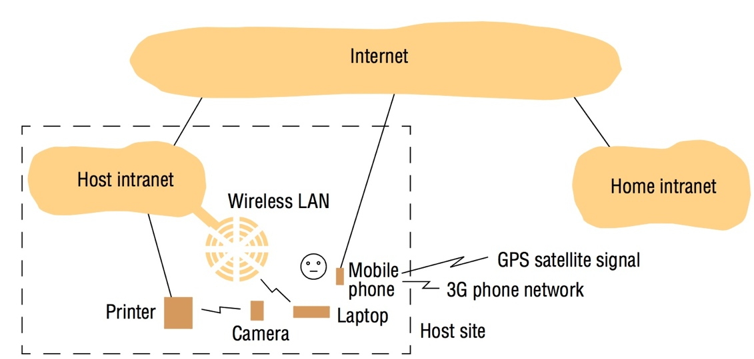
Examples of Distributed Systems (Mobile Computing)

Slide 14
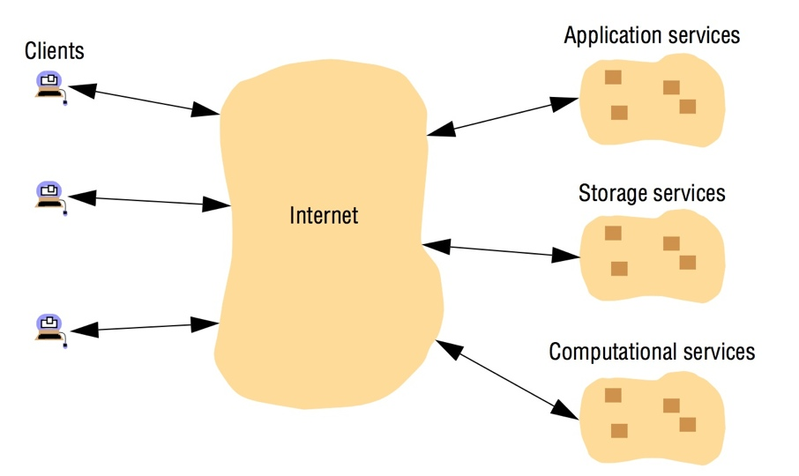
Examples of Distributed Systems (Cloud computing)

Slide 15
Challenges-Heterogeneity
Middleware
  Apply to a software layer that provides a program abstraction as well as masking the heterogeneity of the underlying layers (networks, hardware, operating systems and programming languages).
  Example: Java RMI
Mobile code
  Program code that can transferred from one computer to another and run at the destination. Example: Java Applet.
  The Java virtual machine (JVM) provide a way of making code executable on a variety of host computers.

Slide 16
Challenges-Openness
Computer System Openness
  Determines whether the system can be extended and reimplemented in various ways. For example: UNIX.
Distributed System Openness
  The degree to which new resource-sharing services can be added and be made available for use by a variety of client programs.
  RFC (‘Request For Comments’)

Slide 17
Challenges-Security
Confidentiality(机密性）
  Protection against disclosure to unauthorized individuals.
Integrity （完整性）
  Protection against alteration or corruption.
  e.g. Checksum (校验和）
Availability（可用性）
  Protection against interference with the means to access the resources.

Slide 18
Challenges-Scalability
Controlling the cost of physical resources
  As the demand for a resource grows, it should be possible to extend the system, at reasonable cost, to meet it.
Controlling the performance loss
  Consider the management of a set of data whose size is proportional to the number of users or resources in the system.
Preventing software resources running out
  IPv4, IPv6…..
Avoiding performance bottlenecks
  In general, algorithms should be decentralized to avoid having performance bottlenecks.

Slide 19
Challenges-Scalability
Date
Computers
Web servers
Percentage
1993, July
1,776,000
130
0.008
1995, July
6,642,000
23,500
0.4
1997, July
19,540,000
1,203,096
6
1999, July
56,218,000
6,598,697
12
2001, July
125,888,197
31,299,592
25
2003, July
~200,000,000
42,298,371
21
2005, July
353,284,187
67,571,581
19

Slide 20
Challenges-Failure handling
Detecting failures
  Some failure can be detected.
Masking failures
  Some failure that have been detected can be hidden or made less severe.
Tolerating failures
  Most of the services in the Internet do exhibit failures.
Recovering from failures
  Recovery involves the design of software so that the state of permanent data can be recovered or ‘roll back’ after a server has crashed.
Redundancy
  Services can be made to tolerate failures by the use of redundant components.

Slide 21
Challenges-Concurrency
Consistent
  Multi-thread concurrent access the sharing resource.
Performance

Slide 22
Challenges-Transparency
Access transparency: enables local and remote resources to be accessed using identical operations.
Location transparency: enables resources to be accessed without knowledge of their physical or network location (for example, which building or IP address).
Concurrency transparency: enables several processes to operate concurrently using shared resources without interference between them.
Replication transparency: enables multiple instances of resources to be used to increase reliability and performance without knowledge of the replicas by users or application programmers.

Slide 23
Challenges-Transparency
Failure transparency: enables the concealment of faults, allowing users and application programs to complete their tasks despite the failure of hardware or software components.
Mobility transparency: allows the movement of resources and clients within a system without affecting the operation of users or programs.
Performance transparency: allows the system to be reconfigured to improve performance as loads vary.
Scaling transparency: allows the system and applications to expand in scale without change to the system structure or the application algorithms.

Slide 24
Challenges-Quality of Service
Reliability
Security
Performance
Adaptability

Slide 25
Conclusion
Distributed system is everywhere.
The motivation of constructing a distributed system is resource sharing and collaborative computing
Distributed system features.
  Concurrency
  No global clock
  Independent failure
Distributed system challenges.
  Heterogeneity
  Openness
  Security
  Scalability
  Failure handling
  Concurrency
  Transparency
  Quality of Service

Slide 26
List the three main software components that may fail when a client process invokes a method in a server object, giving an example of a failure in each case. To what extent are these failures independent of one another? Suggest how the components can be made to tolerate one another’s failures.

