Slide 1
Distributed Systems
分布式系统
Consistency and Replication
一致性和复制

Slide 2
Replication of data
Why?
To enhance reliability
To improve performance in a large scale system
Replicas must be consistent
Modifications have to be carried out on all copies
Problems with network performance
It is needed to handling concurrency…
Different consistency models
A consistency model is a set of rules that process obeys accessing data

Slide 3
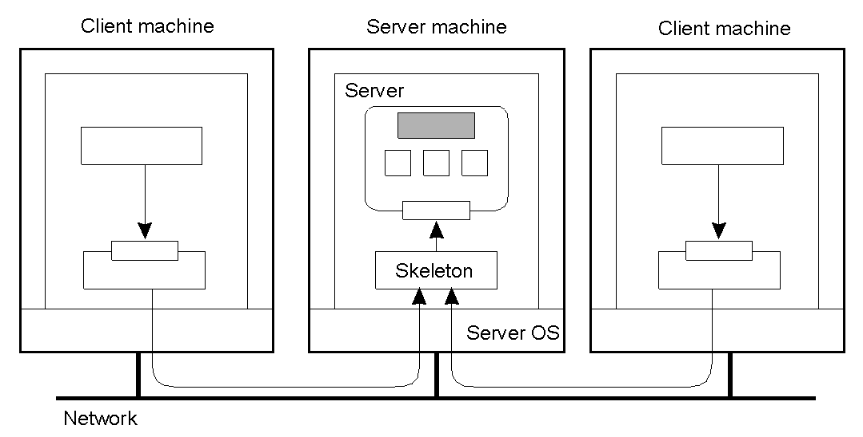
Object Replication
How can we protect objects against multiple clients access?
Synchronization...
A distributed remote object shared by different clients.

Slide 4
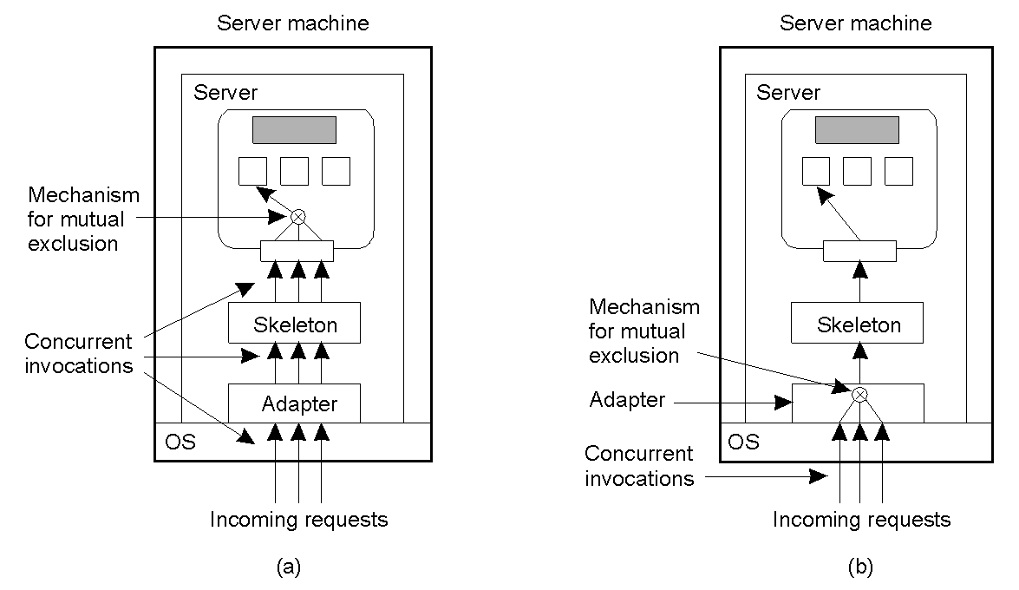
Object Replication
A remote object capable of handling concurrent invocations on its own.
A remote object for which an object adapter is required to handle concurrent invocations

Slide 5
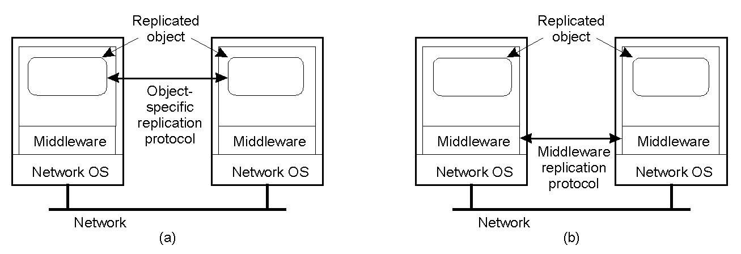
Object Replication
Replicas need more synchronization to ensure that concurrent
invocations lead to consistent results
A distributed system for replication-aware distributed objects.
A distributed system responsible for replica management (simpler for application developers), it ensures that concurrent invocation are passed to the replicas in the correct order

Slide 6
Replication and Scaling
Replication and caching are widely used in scaling technique, but
Keeping replicas up to date needs networks use
Update needs to be atomic ( transaction)
Replicas need to be synchronized (time consuming)
Loose Consistency
In this case copies are not always the same everywhere.

Slide 7
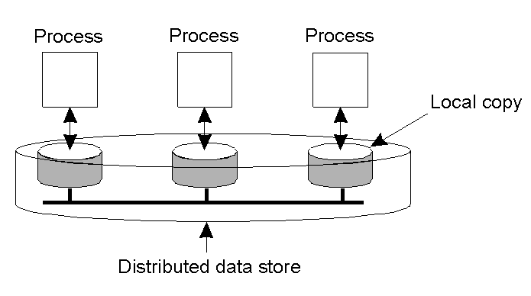
Data-Centric Consistency Models
The general organization of a logical data store, physically distributed and replicated across multiple machines.
Each process that can access data has its own local copy
Write operations are propagated to the other copies

Slide 8

Strict Consistency 严格一致性
Any read on a data item x returns a value corresponding to the result of the most recent write on x two operations in the same time interval are said to conflict if they operate on the same data and one of them is a write operation
Behavior of two processes, operating on the same data item.
A strictly consistent store.
A store that is not strictly consistent.
Strict consistency is the ideal model but it is impossible to implement in a distributed system
It is based on absolute global time.

Slide 9

Linearizability and Sequential Consistency (1)
Sequential Consistency it is a weaker consistency model than strict consistency
The result of any execution is the same as if the read and write operations by all processes on the data store were executed in some sequential order and the operations of each individual process appear in this sequence in the order specified by its program
All processes see the same interleaving of operations
A sequentially consistent data store.
A data store that is not sequentially consistent.
No reference to the timing of the operations

Slide 10
Linearizability and Sequential Consistency (2)
Linearizability is weaker than strict consistency but stronger than sequential consistency
The result of any execution is the same as if the read and write operations by all processes on the data store were executed in some sequential order and the operations of each individual process appear in this sequence in the order specified by its program. In addition, if ts_{OP1}(x) < ts_{OP2}(y), then operation OP1(x) should precede OP2(y) in this sequence
Operations receive a timestamp using a global clock, but with finite precision
Process P1 | Process P2 | Process P3
x = 1; print ( y, z); | y = 1; print (x, z); | z = 1; write print (x, y); read
Example : three concurrently executing processes; (x, y, z) are data store items
Various (90) interleaved execution sequences are possible

Slide 11
Linearizability and Sequential Consistency (3)
x = 1; print (y, z); y = 1; print (x, z); z = 1; print (x, y); Prints: 001011 Signature: 001011 (a) | x = 1; y = 1; print (x,z); print(y, z); z = 1; print (x, y); Prints: 101011 Signature: 101011 (b) | y = 1; z = 1; print (x, y); print (x, z); x = 1; print (y, z); Prints: 010111 Signature: 110101 (c) | y = 1; x = 1; z = 1; print (x, z); print (y, z); print (x, y); Prints: 111111 Signature: 111111 (d)
Not all signature pattern are allowed : 000000 not permitted, 001001 not permitted
Constraints:
Program order must be maintained
Data coherence must be respected
Data coherence : any read must return the most recently written value of the data (relatively to the single data item, without regard to other data)

Slide 12
Causal Consistency (1)
When there is a read followed by a write, the two events are potentially causally related
Operation not causally related are said concurrent
Necessary condition:
Writes that are potentially causally related must be seen by all processes in the same order. Concurrent writes may be seen in a different order on different machines.

Slide 13

Causal Consistency (2)
This sequence is allowed with a causally-consistent store, but not with sequentially or strictly consistent store.
Note that the writes W₂(x)b and W₁(x)c are concurrent
Causal consistency requires keeping tracks of which processes have seen which writes

Slide 14

Causal Consistency (3)
A violation of a casually-consistent store. W₂(x)b may be related to W₁(x)a
A correct sequence of events in a casually-consistent store. W₁(x)a and W₂(x)b are concurrent

Slide 15
FIFO Consistency (1)
Relaxing consistency requirements we drop causality
Necessary Condition:
Writes done by a single process are seen by all other processes in the order in which they were issued, but writes from different processes may be seen in a different order by different processes.
All writes generated by different processes are considered concurrent
It is easy to implement

Slide 16

FIFO Consistency (2)
A valid sequence of events of FIFO consistency. It is not valid for causal consistency

Slide 17
FIFO Consistency (3)
Process P1 | Process P2 | Process P3
x = 1; print ( y, z); | y = 1; print (x, z); | z = 1; write print (x, y); read
x = 1; print (y, z); y = 1; print(x, z); z = 1; print (x, y); Prints: 00 (a) | x = 1; y = 1; print(x, z); print ( y, z); z = 1; print (x, y); Prints: 10 (b) | y = 1; print (x, z); z = 1; print (x, y); x = 1; print (y, z); Prints: 01 (c)
The statements in bold are the ones that generate the output shown. Their concatenated output is 001001, that is incompatible with sequential consistency

Slide 18
FIFO Consistency (4)
Different processes can see the operations in different order
Process P1 | Process P2
x = 1; if (y == 0) kill (P2); | y = 1; if (x == 0) kill (P1);
The result of this two concurrent processes can be also that both processes are killed.

Slide 19
Weak Consistency
We can release the requirements of writes within the same process seen in order everywhere introducing a synchronization variable.
A synchronization operation synchronize all local copies of the data store.
Properties of weak consistency:
Accesses to synchronization variables associated with a data store are sequentially consistent
No operation on a synchronization variable is allowed to be performed until all previous writes have been completed everywhere
No read or write operation on data items are allowed to be performed until all previous operations to synchronization variables have been performed.
It forces consistency on a group of operations, not on individual write and read
It limits the time when consistency holds, not the form of consistency.

Slide 20

Weak Consistency
A valid sequence of events for weak consistency.
An invalid sequence for weak consistency.

Slide 21

Release Consistency
If it is possible to know the difference between entering a critical region or leaving it, a more efficient implementation might be possible.
To do that, two kinds of synchronization variables are needed.
Release consistency : acquire operation to tell that a critical region is being entered; release operation when a critical region is to be exited
A valid event sequence for release consistency.
Shared data kept consistent are called protected

Slide 22
Release Consistency
Rules:
Before a read or write operation on shared data is performed, all previous acquires done by the process must have completed successfully.
Before a release is allowed to be performed, all previous reads and writes by the process must have completed
Accesses to synchronization variables are FIFO consistent (sequential consistency is not required).
Explicit acquire and release calls are required

Slide 23
Entry Consistency
Many synchronization variables associated with each shared data
Conditions:
An acquire access of a synchronization variable is not allowed to perform with respect to a process until all updates to the guarded shared data have been performed with respect to that process.
Before an exclusive mode access to a synchronization variable by a process is allowed to perform with respect to that process, no other process may hold the synchronization variable, not even in nonexclusive mode.
After an exclusive mode access to a synchronization variable has been performed, any other process's next nonexclusive mode access to that synchronization variable may not be performed until it has performed with respect to that variable's owner.

Slide 24

Entry Consistency (1)
A valid event sequence for entry consistency. Lock are associated with each data item

Slide 25
Summary of Consistency Models
Consistency | Description
Strict | Absolute time ordering of all shared accesses matters.
Linearizability | All processes must see all shared accesses in the same order. Accesses are furthermore ordered according to a (nonunique) global timestamp
Sequential | All processes see all shared accesses in the same order. Accesses are not ordered in time
Causal | All processes see causally-related shared accesses in the same order.
FIFO | All processes see writes from each other in the order they were used. Writes from different processes may not always be seen in that order
 | (a)
Consistency | Description
Weak | Shared data can be counted on to be consistent only after a synchronization is done
Release | Shared data are made consistent when a critical region is exited
Entry | Shared data pertaining to a critical region are made consistent when a critical region is entered.
 | (b)
Consistency models not using synchronization operations.
Models with synchronization operations.

Slide 26
Client Centric Consistency
In many cases concurrency appears only in restricted form.
In many applications most processes only read data
Some degrees of inconsistency can be tolerate
In some cases if for a long time no update takes place all replicas gradually become consistent
Eventual consistency

Slide 27
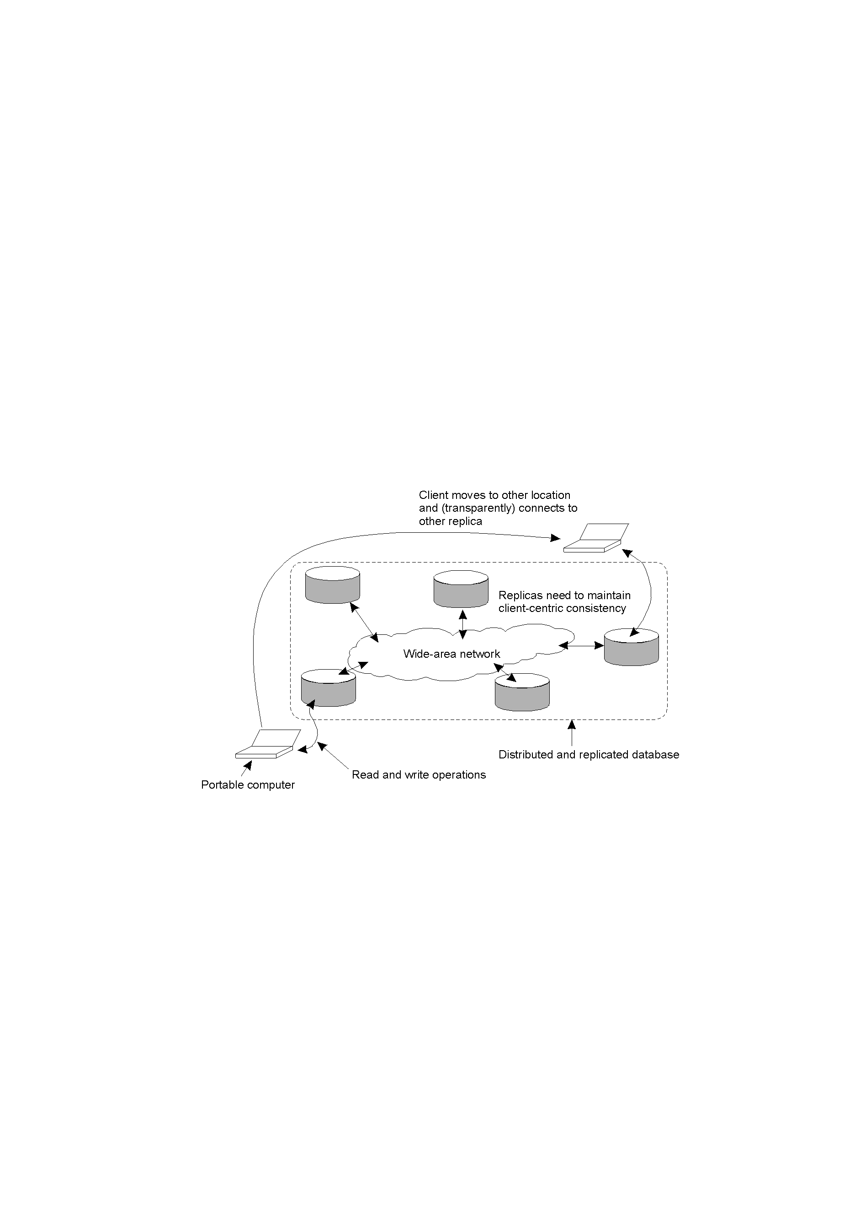
Eventual Consistency eventual consistency for replicated data is fine if clients always access the same replica
Client centric consistency provides consistency guarantees for a single client with respect to the data stored by that client
A mobile user accessing different replicas of a distributed database has problems with eventual consistency.

Slide 28
Client centric models
Clients access distributed data store using, generally, the local copy. Updates are eventually propagated to other copies.
Monotonic read （单调读）
If a process reads the value of a data item x, any successive read operation on x by that process will always return that same value or a more recent value
Monotonic write（单调写）
A write operation by a process on a data item x is completed before any successive write operation on x by the same process
Read your writes（读写一致性）
The effect of a write operation by a process on a data item x will always be seen by a successive read operation on x by the same process
Writes follow reads（写读一致性）
A write operation by a process on a data item x following a previous read operation on x by the same process, is guaranteed to take place on the same or more recent values of x that was read

Slide 29
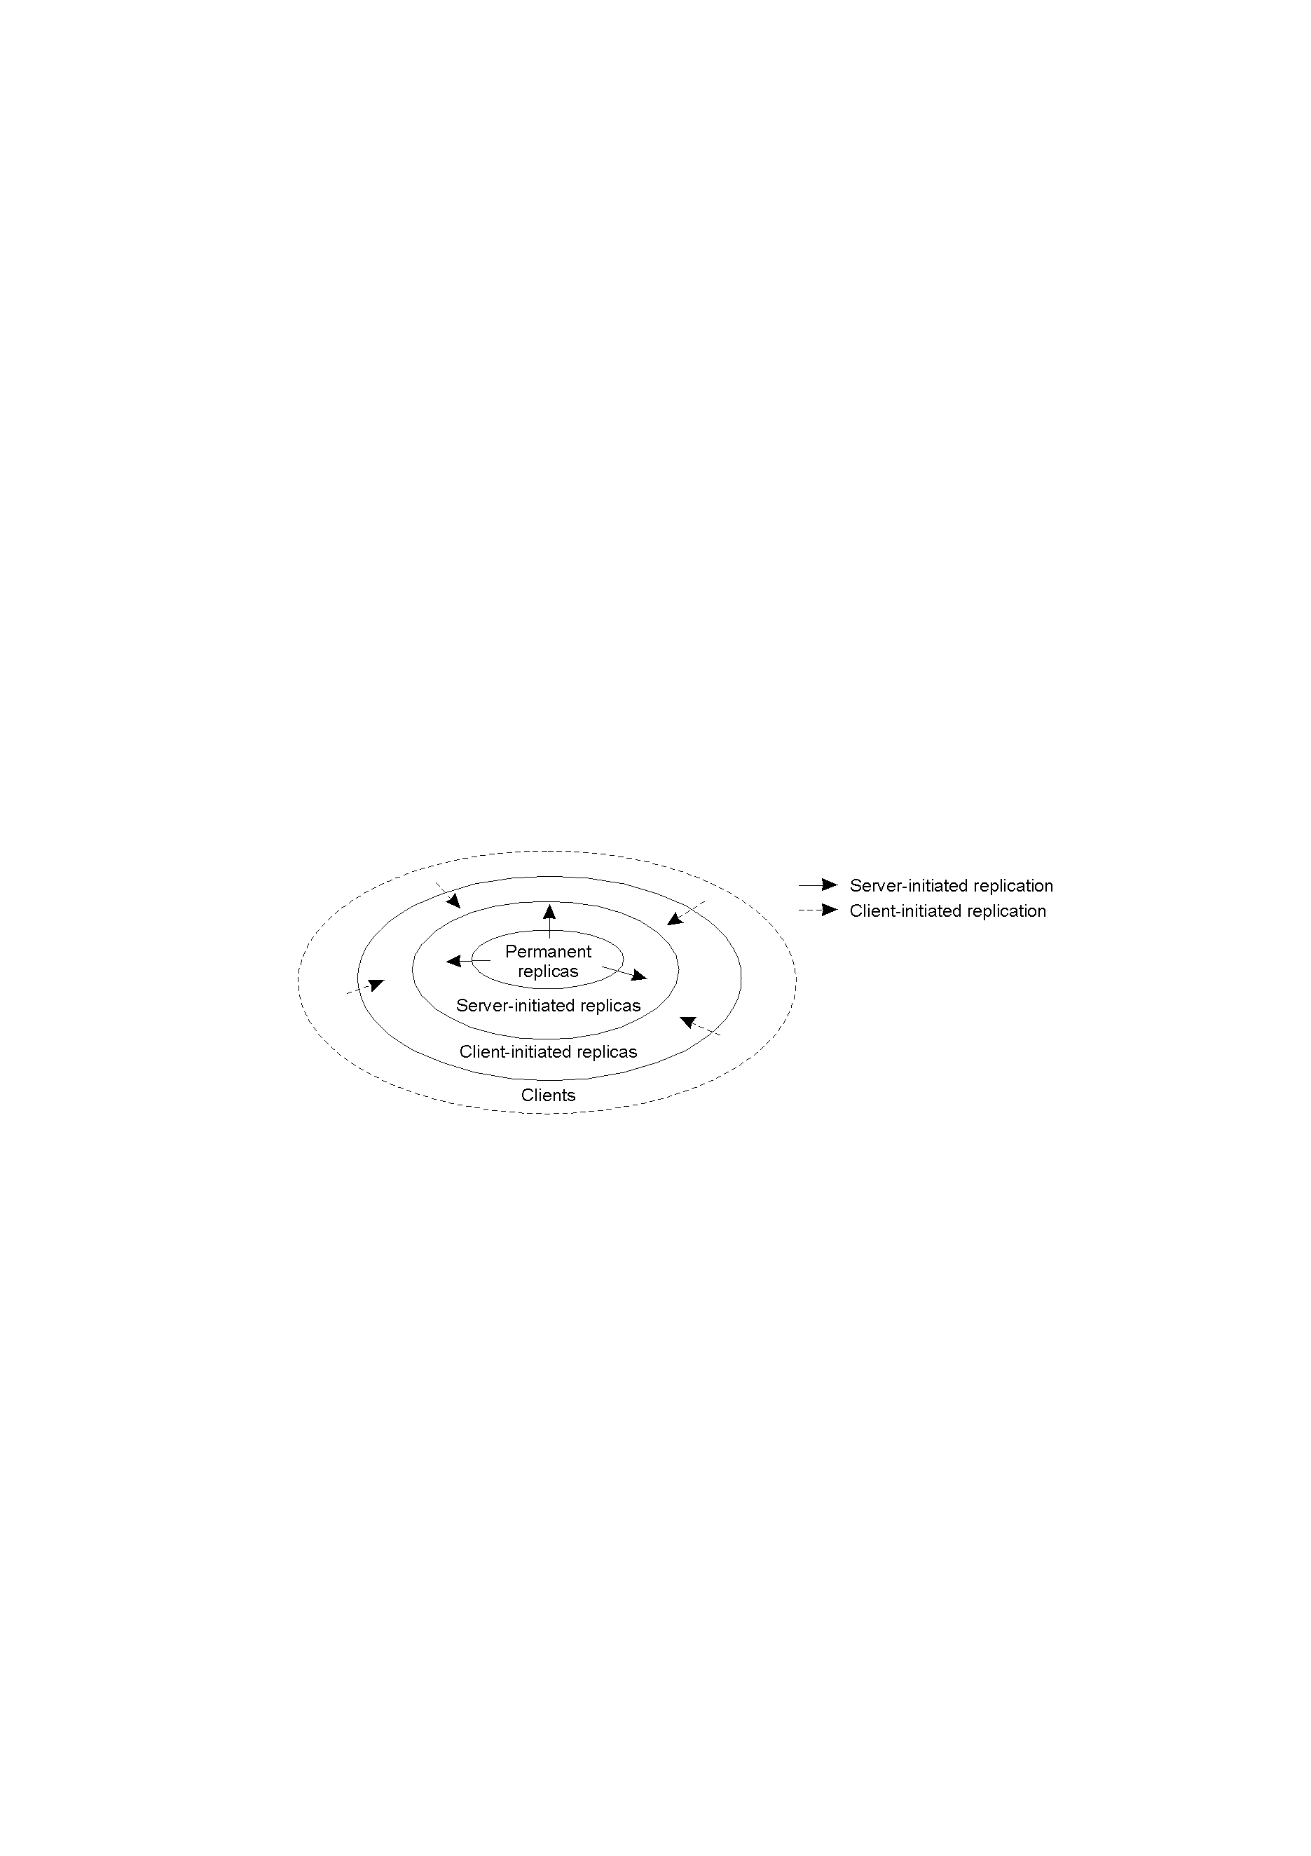
Distribution Protocols
Replica Placement
Where, when, by whom copies of data are to be placed?
The logical organization of different kinds of copies of a data store into three concentric rings.

Slide 30
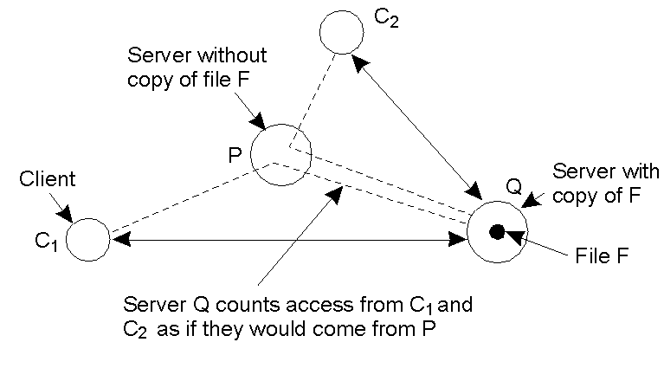
Server-Initiated Replicas
Push cache
Web case. Counting access requests from different clients.

Slide 31
Update propagation
What is to be propagated?
Propagate only a notification of an update
(Invalidation protocols) - R/W ratio: low
Transfer data from one copy to another - R/W ratio: high
Propagate the update operation to other copies
(Active replication)

Slide 32
Pull versus Push Protocols
How is it to be propagated?
Push (or server) based protocols
update are propagated to other replicas without request when
a high consistency degree is needed
I.e. Permanent to server initiated replicas
Pull (or client) based protocols
update are propagated to other replicas on request
I.e. Web cache

Slide 33
Pull versus Push Protocols
Issue | Push-based | Pull-based
State at server | List of client replicas and caches | None
Messages sent | Update (and possibly fetch update later for invalidation protocols) | Poll and update
Response time at client | Immediate (or fetch-update time) | Fetch-update time
Hybrid propagation : lease (in a lease servers push updates with expiration time)
What kind of communication can be used?
Unicast ( pull based approach)
Multicast (push based approach)

Slide 34
Epidemic propagation
It is used with eventual consistency and the main goal is to propagate updates with a few messages.
The infective server holds an update, the susceptible server
will to be updated
Anti-entropy model:
Three approaches:
P pushes its updates to Q
Q pulls new updates from P
P and Q send their updates each other
Gossiping

Slide 35
Consistency Protocols
Primary-based protocols
Each data item x in the data store has an associated primary, which is responsible for coordinating write operations on x
Replicated write protocols
Write operations can be carried out at multiple replicas instead of only one
Cache-coherence protocols
Controlled by clients instead of servers

Slide 36
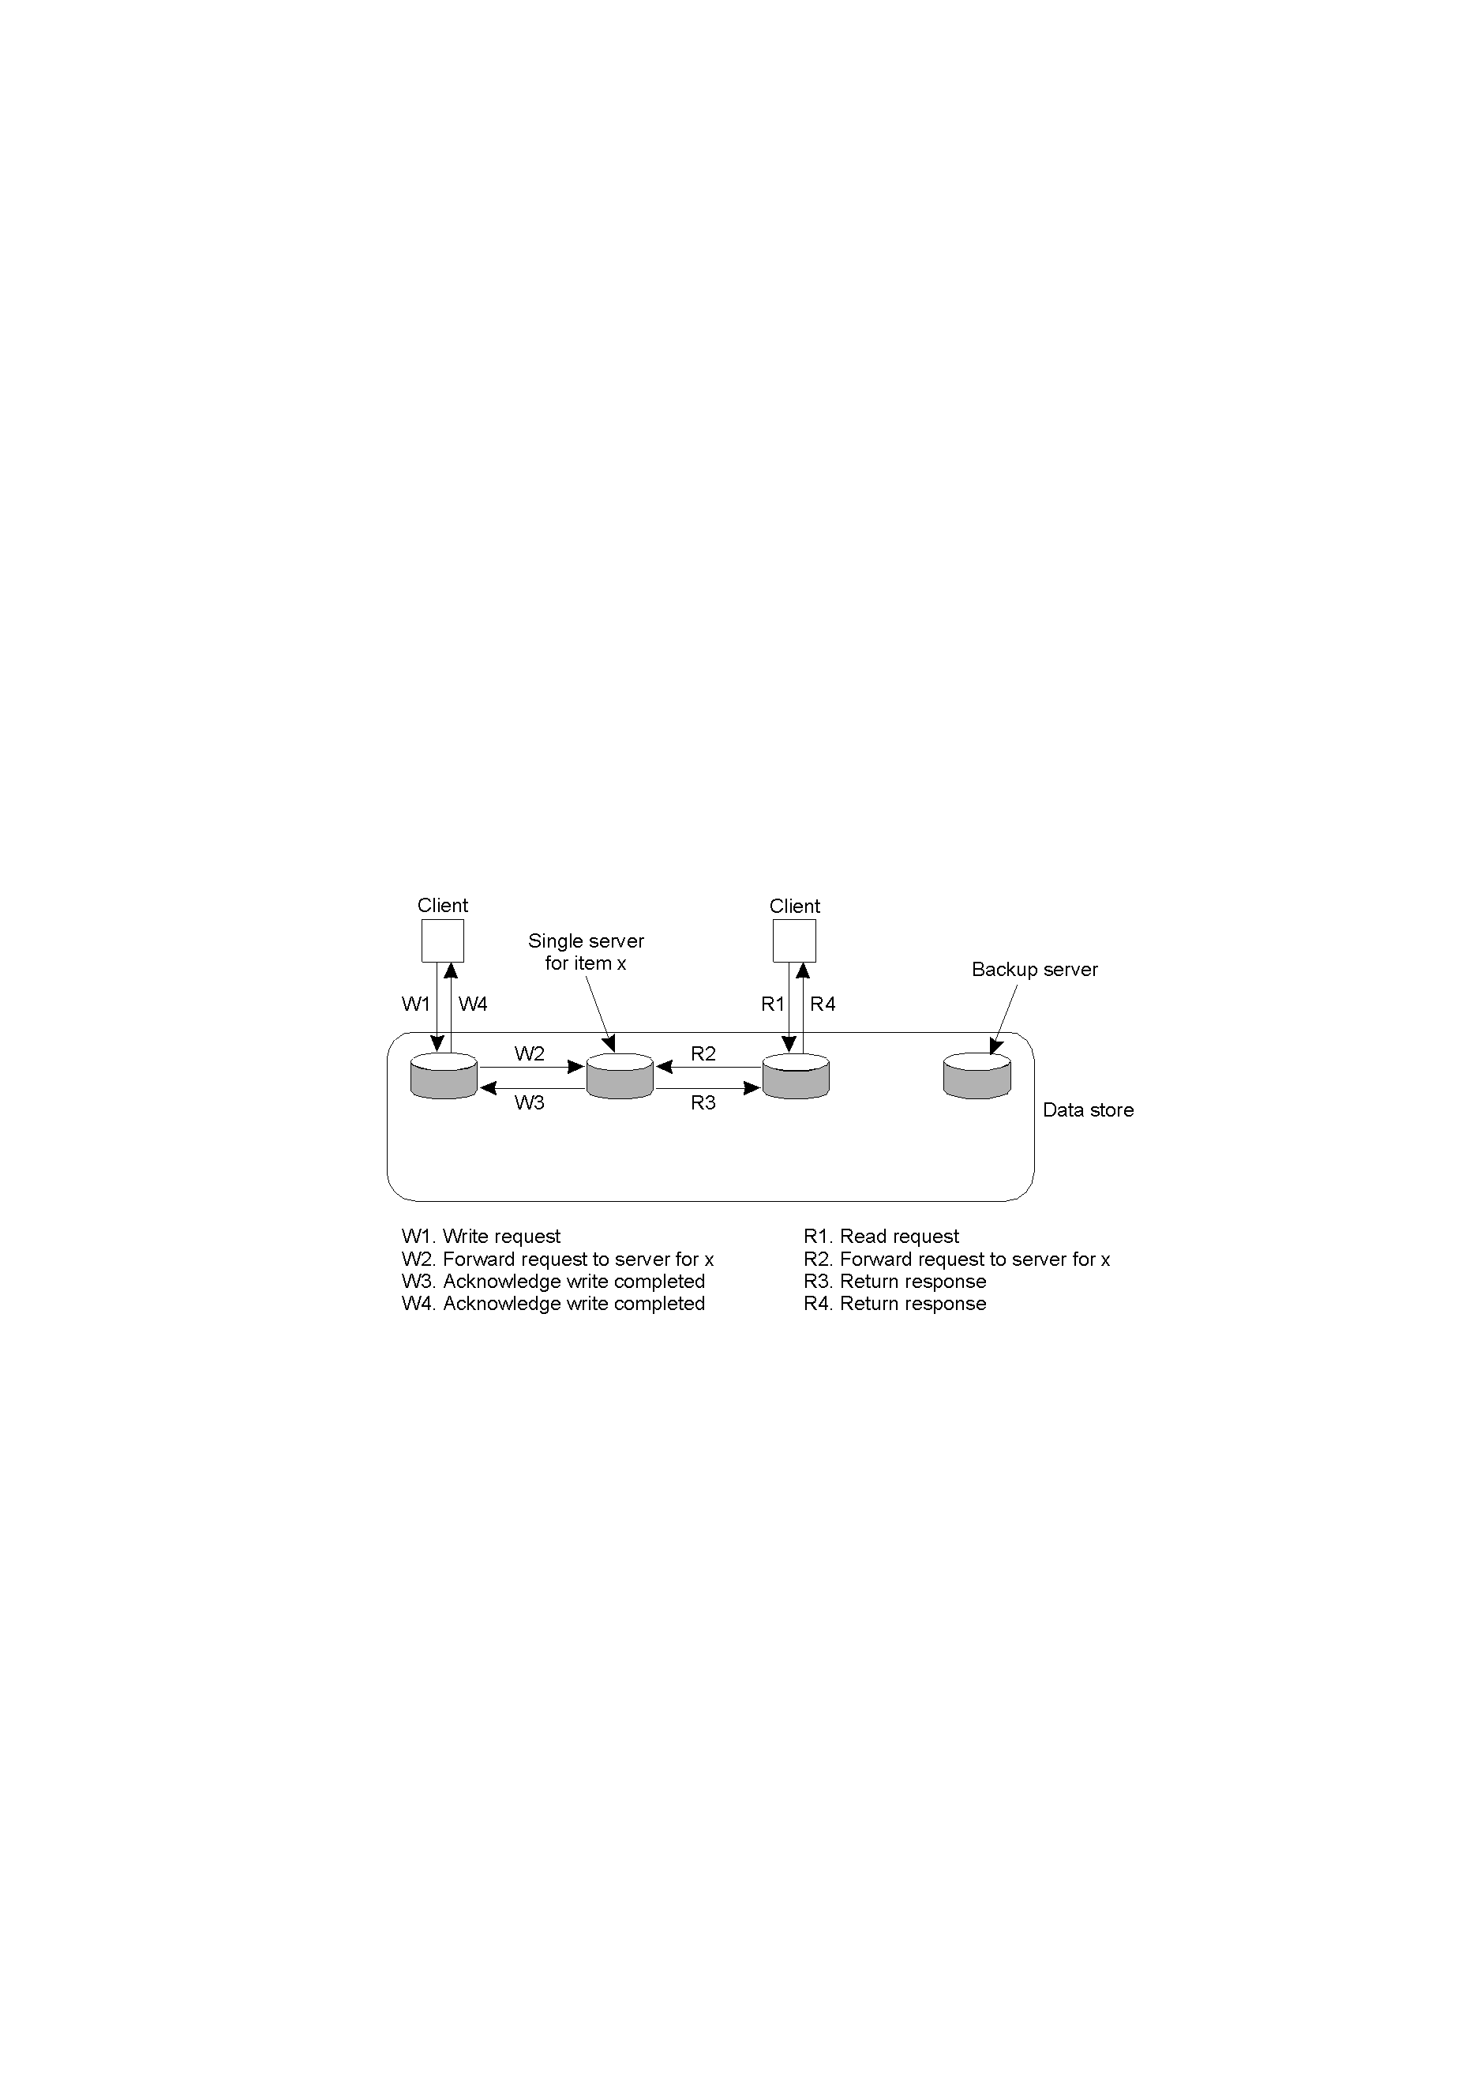
Remote-Write Protocols
Primary-based remote-write protocol with a fixed server to which all read and write operations are forwarded. Data can be distributed, but they are not replicated (really simple!).

Slide 37
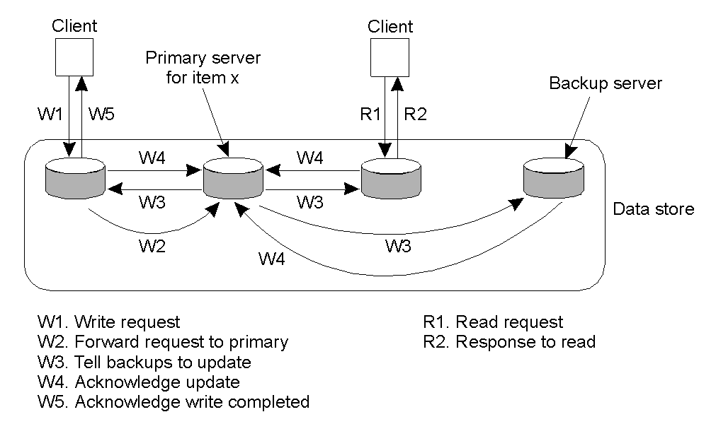
Remote-Write Protocols
The principle of primary-backup protocol (time consuming). It implements sequential consistency if done as a blocking operation.

Slide 38
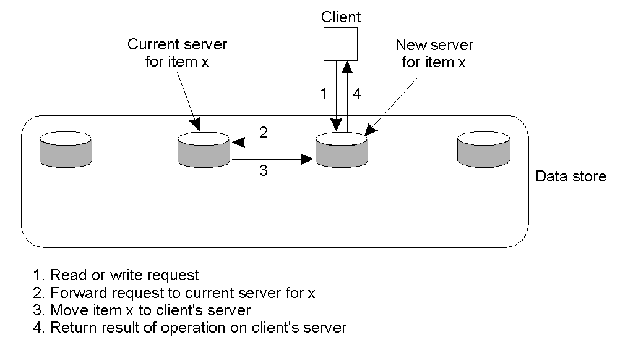
Local-Write Protocols
Primary-based local-write protocol in which a single copy is migrated between processes (fully distributed non-replicated version of the data store).
Location information is the main problem in a widely distributed data store.

Slide 39
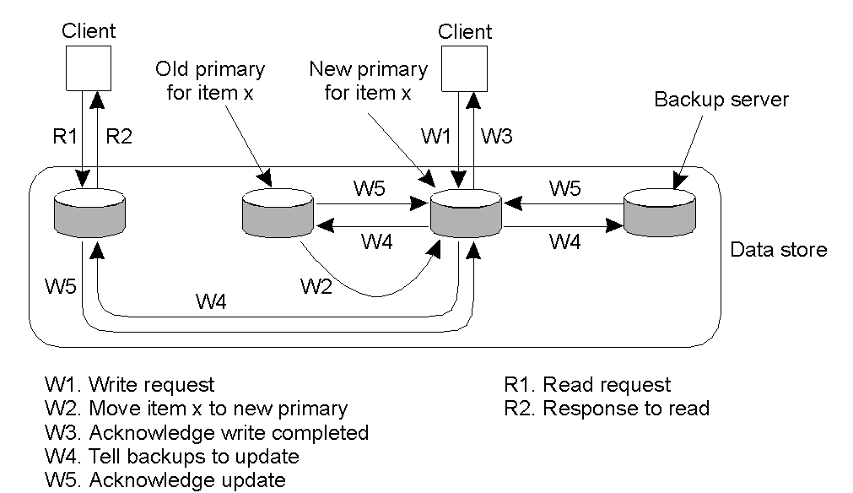
Local-Write Protocols
Primary-backup protocol in which the primary migrates to the process wanting to perform an update.
Write operations performed locally. Useful for a disconnected mobile computer

Slide 40
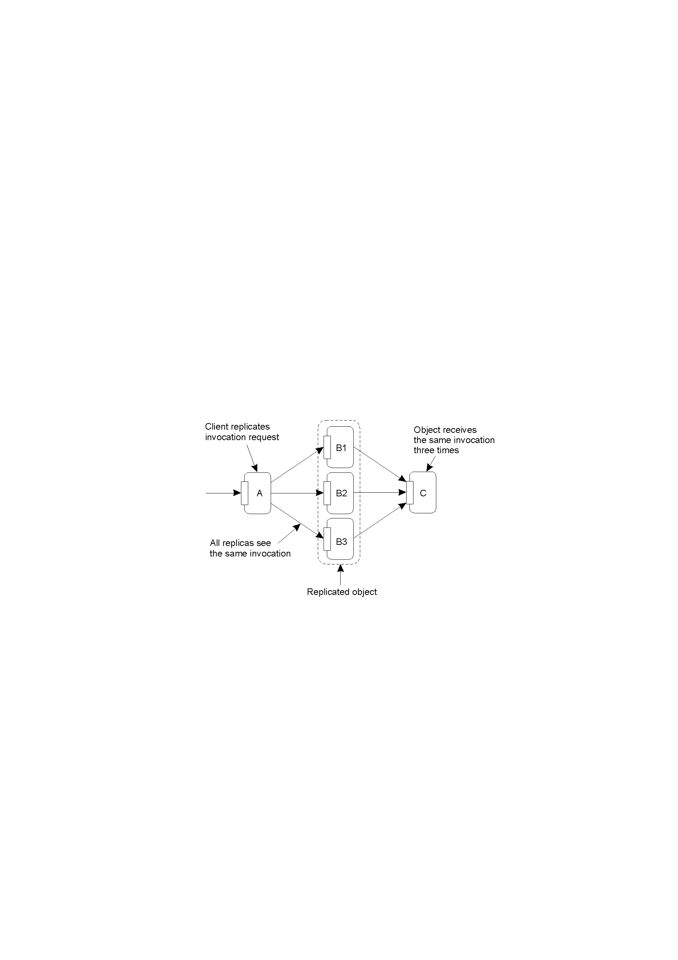
Replicated Write Protocols
Active Replication
Each replica has an associated process that carries out update operations.
Updates are propagated by means of the write operation that causes the update Upgrades need to maintain operations order (Lamport timestamps or coordinator);
Problems of replicated invocations: multiple invocations of the same object can produce errors

Slide 41
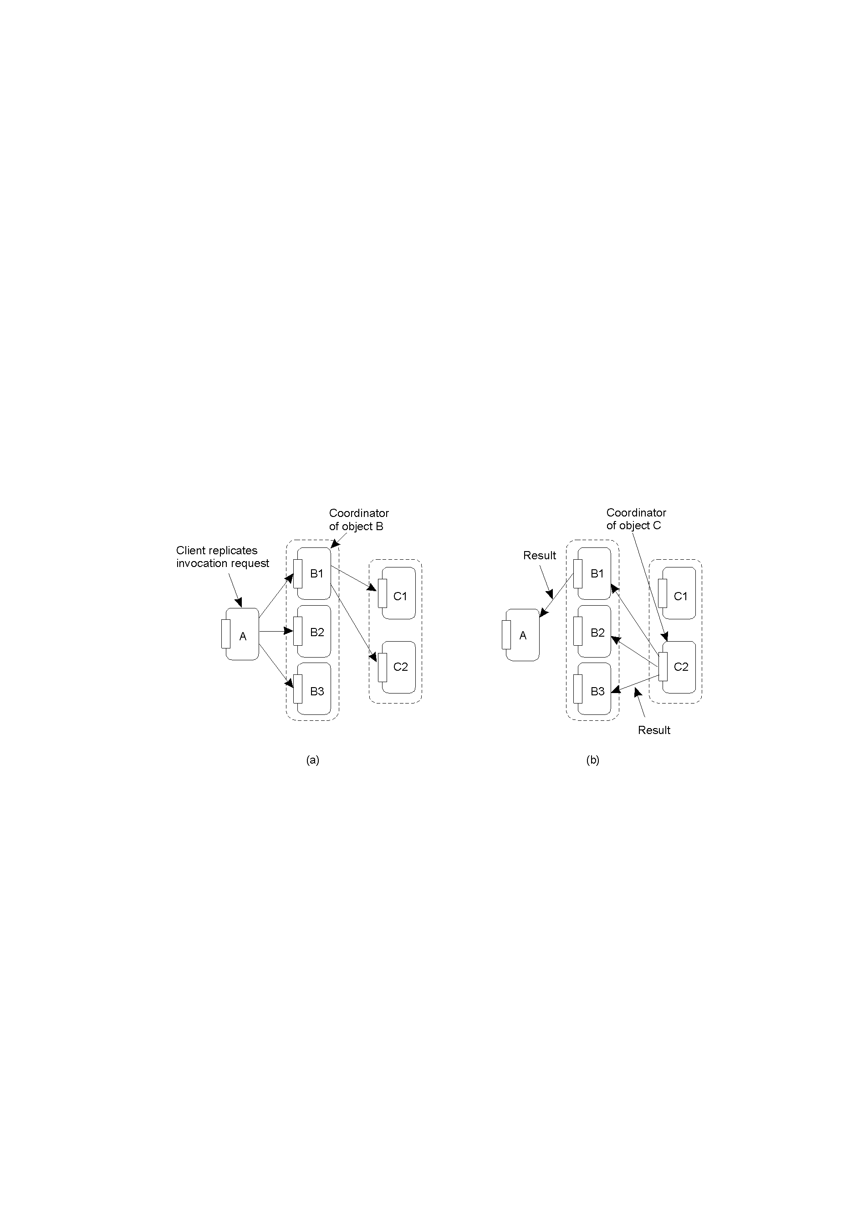
Active Replication
Forwarding an invocation request from a replicated object (via unique ID) .
Returning a reply to a replicated object from a replicated object.

Slide 42
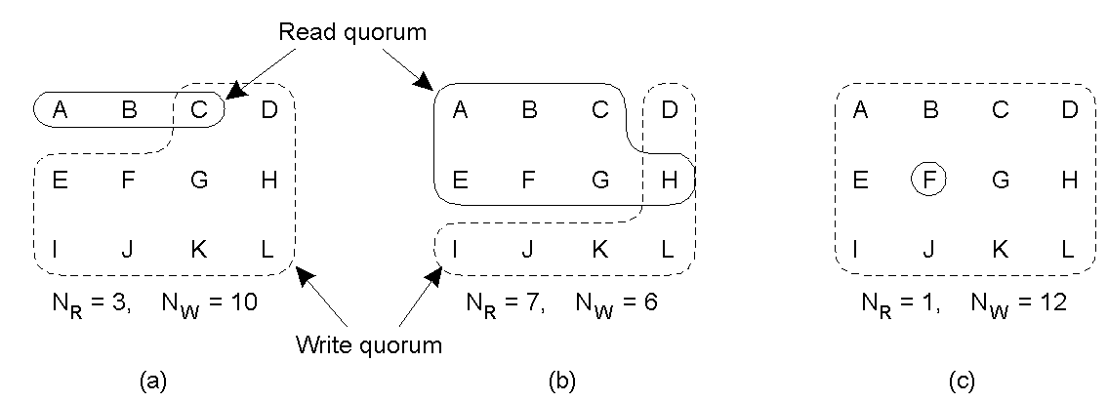
Replicated Write Protocols
Quorum-Based Protocols clients request and acquire permission of multiple server before accessing data
N_{R} +N _{W} > N N _{W} > N /2
Three examples of the voting algorithm:
A correct choice of read and write set
A choice that may lead to write-write conflicts ( N_{W} = N/2)
A correct choice, known as ROWA (read one, write all)

Slide 43
Cache Coherence Protocols
Caching can be analyzed according to different parameters
Coherence detection strategy (when)相关性检测策略
verification of consistency before cached data accessed
no verification : data are assumed consistent
verification after cached data used
Coherence enforcement strategy (how)相关性实施策略
no cached shared data (only at servers)
servers send invalidation messages to all caches
servers propagate updates
Write-through cache直写式高速缓存
clients modify cached data and forward updates to servers

