Slide 1
Distributed Systems
分布式系统
Distributed Time and Clock Synchronization (1)
Physical Time
物理时间

Slide 2
Why Timestamps in Systems?
Precise performance measurements
Guarantee “up-to-date” or recentness of data
Temporal ordering of events produced by concurrent processes
Synchronization between senders and receivers of messages
Coordination of joint activities
Serialization of concurrent accesses to shared objects
……
Notes:
2 types of clocks in computer: physical clocks (telling u accurate time of day) and logical clocks (for event ordering).
The purpose lists both…

Slide 3

Physical time
Solar time
1 sec = 1 day / 86400
Problem: days are of different lengths (due to tidal friction, etc.)
mean solar second: averaged over many days
Greenwich Mean Time (GMT)
The mean solar time at Royal Observatory in Greenwich, London
Greenwich located at longitude 0, the line that divides east and west
Notes:
? Hong long is 1 second? -> determined by solar day -> clock of 1 second is adjusted to match the length of 1 solar-second.
Solar-day: noon to noon (the sun at the highest point in the sky from a certain point on earth)
GMT time measured at Greenwich, which is located at longitude 0 line (similar to the equator line dividing north and south)

Slide 4
Coordinated Universal Time (UTC)
International atomic time (TAI) 国际原子时间
1 sec ≡ time for Cesium-133 atom to make 9,192,631,770 state transitions.
TAI time is simply the number of Cesium-133 transitions since midnight on Jan 1, 1958.
Accuracy: better than 1 second in six million years
Problem: Atomic clocks do not keep in step with solar time
Coordinated Universal Time (UTC) 通用协调时间
Based on the atomic time (TAI) and introduced from 1 Jan 1972
A leap second is occasionally inserted or deleted to keep in step with solar time when the difference btw a solar-day and a TAI-day is over 800ms
Notes:
A TAI-day is about 3 msec shorter than a solar day
A leap second is occasionally inserted if the difference between a solar day and a TAI-day is more than 800msec

Slide 5
Computer Clocks
CMOS clock circuit driven by a quartz oscillator
  battery backup to continue measuring time when power is off
The circuit has a counter（计数器） and a register（寄存器）. The counter decrements by 1 for each oscillation; an interrupt（中断） is generated when it reaches 0 and the number in the register is loaded to the counter. Then, it repeats…
OS catches interrupt signals to maintain a computer clock
  e.g., 60 or 100 interrupts per second
  Programmable Interrupt Controller (PIC)
  Interrupt service routine increments the “clock” by 1 for each interrupt
CPU
counter
register
Notes:
Circuit register can be set, to make frequency of clock interrupt high / low

Slide 6
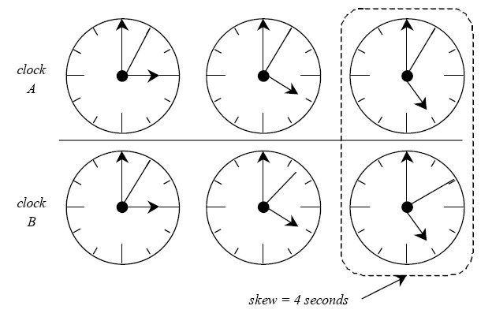
Clock drift and clock skew
Clock Drift 时钟漂移
  Clocks tick at different rates
    Ordinary quartz clocks drift by ~ 1sec in 11-12 days. (10⁻⁶ secs/sec).
    High precision quartz clocks drift rate is ~ 10⁻⁷ or 10⁻⁸ secs/sec
  Create ever-widening gap in perceived time
Clock Skew (offset) 时钟偏移
  Difference between two clocks at one point in time
Notes:
Getting two systems to agree on time
Two clocks hardly ever agree

Slide 7
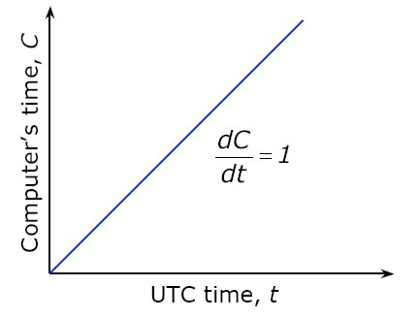
Perfect clock
Notes:
X axis: UTC time, Y-axis: computer time.
If computer clock matches UTC time, it’s perfect unity line.

Slide 8
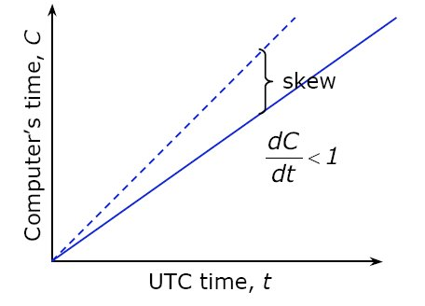
Drift with a slow computer clock
Notes:
Look x, y value of a point. UTC time is larger the computer time.

Slide 9
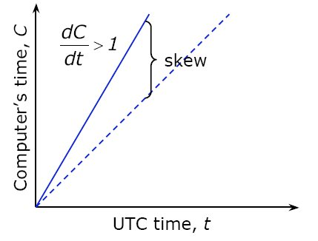
Drift with a fast computer clock

Slide 10
Dealing with drift
No good to set a clock backward
  Illusion of time moving backwards can confuse message ordering and software development environments
Go for gradual clock correction
  If fast: Make clock run slower until it synchronizes
  If slow: Make clock run faster until it synchronizes
Notes:
Two rules of clock adjustment

Slide 11
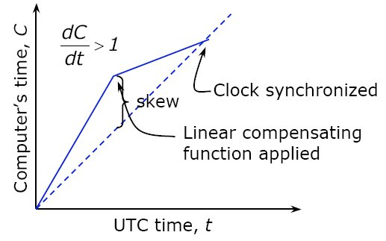
Linear compensating function
OS can do this: Change the frequency of clock interrupts
  e.g.: if the system generates an interrupt every 17 ms but clock is too slow: generates an interrupt at (e.g.) 15 ms
Adjustment changes slope of system time: Linear compensating function （线性补偿函数）
Notes:
One-time compensation: local time + offset (used by NTP), NO good!
Linear compensation: gradual correction
? After synchronized…

Slide 12
Resynchronization
After synchronization period is reached
  Resynchronize periodically, or
  The skew is beyond a threshold
Keep track of adjustments and apply continuously
  UNIX adjtime system call:
  int adjtime(struct timeval *delta, struct timeval *old-delta)
  adjusts the system's notion of the current time, advancing or retarding it, by the amount of time specified in the struct timeval pointed to by delta. “old-delta”, output parameter, returns time left uncorrected since last call of “adjtime”
Notes:
In UNIX shell, “man adjtime” to see this command.
delta has two fields: seconds or micro-seconds. When delta (input parameter) is positive, it advances clock; negative, slows down clock;
old-delta is an output parameter, it returns # of seconds/micro-s left uncorrected from the previous “adjtime”.
See timeval in /usr/include/sys/time.h

Slide 13
Getting UTC from Top Sources
Attach GPS receiver to each computer
  ± 1 ms of UTC
Attach WWV (http://tf.nist.gov) radio receiver
  Obtain time broadcasts from Boulder or DC
  ± 3 ms of UTC (depending on distance)
Attach GOES receiver (Geostationary Operational Environmental Satellites, http://www.goes.noaa.gov/)
  ± 0.1 ms of UTC
Not practical for every machine
– Cost, size, convenience, environment
Notes:
Clock synchronization of satellites jointly providing accurate GPS services.
In our daily life applications, there’re 3 ways to obtain accurate time: GPS is more accurate, but it cannot work indoors; WWV can be used for indoor clocks (auto-adjustment)
View http://tf.nist.gov and click “internet time service” for details of NTP
http://www.goes.noaa.gov/ click satellite service division (but NO time service)

Slide 14
Getting UTC for Client Computers
Synchronize clock of a client to a time server that
  with a more accurate clock, or
  connected to UTC time source
Also called external clock synchronization

Slide 15
Synchronizing Clocks by using RPC
Simplest synchronization technique
  Make an RPC to obtain time from the server
  Set the local clock to the server time
Does not count network or processing latency
_{What’s the time?}
_{client}
_{server}
_{10:25:18}
Notes:
Since it’s by using RPC, the server only returns a time. it won’t record the time for receiving request and the time for dispatching reply (as NTP later).
What’s a more accurate method? By considering the network delay ->

Slide 16
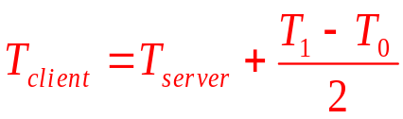
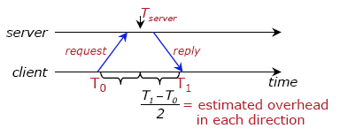
Cristian’s algorithm
Compensate for network delays (assuming symmetric)
client sends a request at T₀
server replies with the current clock value T_{server}
client receives response at T₁
client sets its clock to:
Notes:
Cristian’s algo: Set client’s clock to the server’s clock as close as possible.

Slide 17
Cristian’s algorithm: example
Send request at 5:08:15.100 (T₀)
Receive response at 5:08:15.900 (T₁)
  Response contains 5:09:25.300 (T_{server})
Round-trip time is T₁ − T₀
  5:08:15.900 - 5:08:15.100 = 800 ms
Best guess: timestamp was generated 400 ms ago
Set the local time to T_{server} + round-trip-time/2
  5:09:25.300 + 400 = 5:09.25.700
Accuracy: ± round-trip-time/2
T_{server}
server
client
T₀
T₁
Notes:
Use the diagram to explain the error
How to improve the accuracy: 1) the protocol often makes several measurements, and take the one with least round trip
2) ->

Slide 18
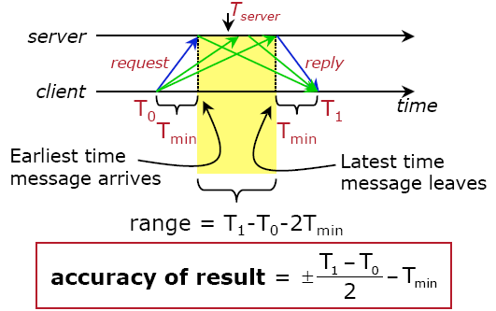
Cristian’s algorithm: error bound
T_{min:} Minimum message travel time
( )
Notes:
? Given Tmin, explain the protocol, what’s the time client set?

Slide 19
Problems with Cristian’s algorithm
Server might fail
Subject to malicious interference
Notes:
They’ll be fixed by NTP.

Slide 20
Berkeley Algorithm
Proposed by Gusella & Zatti, 1989 and implemented in BSD version of UNIX
Aim: synchronize clocks of a group of machines as close as possible (also called internal synchronization)
Assumes no machine has an accurate time source (i.e., no differentiation of client and server)
Obtains average from participating computers
Synchronizes all clocks to average
Notes:
Cristian algo: sync a client -> server, but berkeley is different

Slide 21
Berkeley Algorithm
One machine is elected (or designated) as the master; others are slaves:
Master polls all slaves periodically, asking for their time
  Cristian’s algorithm can be used to obtain more accurate clock values from other machines by counting network latency
When results are collected, compute the average
  Including master’s time
Send each slave the offset that its clock need be adjusted
  Avoids problems with network delays by sending “offset” instead of “timestamp”
Notes:
Machines run time dæmon Process that implements protocol

Slide 22
Berkeley Algorithm
Algorithm has provisions for ignoring readings from clocks whose skew is too large
  Compute a fault-tolerant average
Any slave can take over the master if master fails

Slide 23
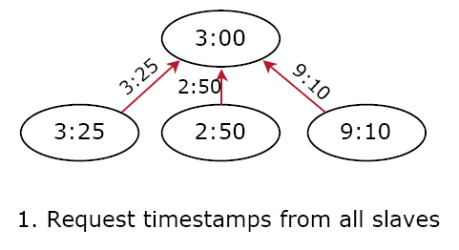
Berkeley Algorithm: example

Slide 24
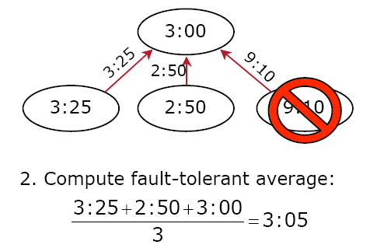
Berkeley Algorithm: example

Slide 25
Berkeley Algorithm: example
+0:05
3:00
-0:20
+0:15
-6:05
3:25
2:50
9:10
3. Send offset to each client
Notes:
Notice: only offset sent out! (offset to itself is wrong, should be +0.05).

Slide 26
Network Time Protocol (NTP)
NTP is the most commonly used Internet time protocol and the one provides best accuracy (RFC 1305, http://tf.nist.gov/service/its.htm ).
Computers often include NTP software in OS. The client software periodically gets updates from one or more servers (average them).
Time servers listen to NTP requests on port 123, and reply a UDP/IP data packet in NTP format, which is a 64-bit timestamp in UTC seconds since Jan 1, 1900 with a resolution of 200 pico-s.
Many NTP client software for PC only gets time from a single server (no averaging). The client is called SNTP (Simple Network Time Protocol, RFC 2030), a simple version of NTP.
Notes:
See http://tf.nist.gov/service/its.htm for NTP
The Network Time Protocol (NTP) is the most commonly used Internet time protocol, and the one that provides the best performance. Large computers and workstations often include NTP software with their operating systems.

Slide 27
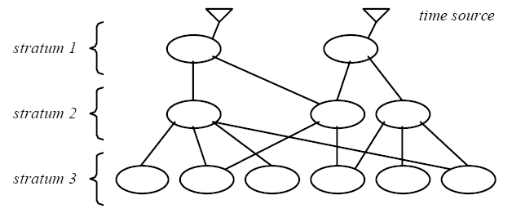
NTP synchronization subnet
1st stratum: machines connected directly to accurate time source
2nd stratum: machines synchronized from 1st stratum machines
…
Notes:
Multipath/multi-server!

Slide 28
NTP goals
Enable clients across Internet to be accurately synchronized to UTC despite message delays
  Use statistical techniques to filter data and improve quality of results
Provide reliable service
  Survive lengthy losses of connectivity
  Redundant paths
  Redundant servers
Enable clients to synchronize frequently
  Adjustment of clocks by using offset (for symmetric mode)
Provide protection against interference
  Authenticate source of data
Notes:
Filter technique: throw away time from bad-servers.
Good quality of results: server’s stratum, min-round trip time, etc.

Slide 29
NTP Synchronization Modes
Multicast (for quick LANs, low accuracy)
  server periodically multicasts its time to its clients in the subnet
Remote Procedure Call (medium accuracy)
  server responds to client requests with its actual timestamp
  like Cristian’s algorithm
Symmetric mode (high accuracy)
  used to synchronize between the time servers (peer-peer)
All messages delivered unreliably with UDP
Notes:
RPC mode was discussed before.

Slide 30
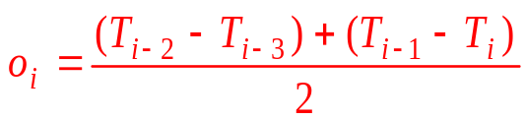
Symmetric mode
The delay between the arrival of a request (at server B) and the dispatch of the reply is NOT negligible:
Delay = total transmission time of the two messages
  d_{i} = (T_{i} – T_{i-3} ) – (T_{i-1}– T_{i-2})
Offset of clock A relative to clock B:
  Offset of clock A:
  Set clock A: T_{i} + o_{i}
  Accuracy bound: d_{i} /2
_{Server B}
T_{i-2}
T_{i-1}
_{m}
_{m’}
_{Server A}
T_{i-3}
T_{i}
_{time}
Notes:
Why called symmetric: server B can also serve its time on A (peer-peer in the same stratum).
“Ti + oi” is easy for clock adjustment, with the current local clock value and offset. The local clock can take “linear adjustment”!!!
Next slide is easy to understand, but hard for clock adjustment. Tute question has a more mathematical explanation.

Slide 31

Symmetric mode (another expression)
_{Server B}
T_{i-2}
T_{i-1}
_{m}
Delay = total transmission time of the two messages
  d_{i} = (T_{i} – T_{i-3} ) – (T_{i-1}– T_{i-2})
Clock A should set its time to (the best estimate of B’s time at T_{i}):
T_{i-1} + d_{i}/2, which is the same as T_{i} + o_{i}
_{m’}
_{Server A}
T_{i-3}
T_{i}
_{time}
Notes:
“T_{i-1} + d_{i}/2” is hard for clock A to adjust, bcs T_{i-1} is server’s clock value. It cannot do “linear adjustment”!!!

Slide 32
Symmetric NTP example
_{Server B}
T_{i-2} =800
T_{i-1} =850
_{m}
_{m’}
_{Server A}
T_{i-3} =1100
T_{i} =1200
_{time}
Offset o_{i}=((800 – 1100) + (850 – 1200))/2 = – 325
Set clock A to: T_{i} + o_{i} = 1200 – 325 = 875
Note: Server A need to adjusts it current clock (1200ms)
by gradual slowdown its pace until -325ms is compensated.
Notes:
Note: 1) A cannot turn its clock backward; 2) A cannot jump its clock to a correct reading in one blow.
Guess what’s A’s time: using my method: T_{i-1} + d/2 (but not good for A’s adjust clock bcs it’s base value is T_{i-1})

Slide 33
Improving accuracy
Data filtering from a single source
  Retain the multiple most recent pairs < o_{i}, d_{i} >
  Filter dispersion: choose o_{j} corresponding to the smallest d_{j}
Peer-selection: synchronize with lower stratum servers
  lower stratum numbers, lower synchronization dispersion
The stratum of a server is dynamically changing, depending on which server it synchronize with
Notes:
With smaller di, more accurate (note the error is di/2).

Slide 34
Simple Network Time Protocol (SNTP) RFC 2030
Targeted for machines that have no need of full NTP implementation, particularly for machines at the end of synchronization subnet (client nodes)
SNTP operate in one of the following modes:
  Unicast mode, the client sends a request to a designated server
  Multicast mode, the server periodically broadcast/multicast its time to the subnet and does not serve any requests from clients
  Anycast mode, the client broadcast/multicast a request to the local subnet and takes the first response for time synchronization
Notes:
summary: cristian, Berkeley, NTP.

