Slide 1
Distributed Systems
分布式系统
Distributed Time and Clock Synchronization (2)
分布式时间和时间同步
Logical Time
逻辑时间

Slide 2
Motivation of logical clocks
Cannot synchronize physical clocks perfectly in distributed systems. [Lamport 1978]
Main function of computer clocks – order events
  If two processes don’t interact, there is no need to sync clocks.
  This observation leads to “causality”

Slide 3
Causality（因果性）
Order events with happened-before (→) relation
  a → b
    a could have affected the outcome of b
  a || b
    a and b take place in different processes that don’t exchange data
    Their relative ordering does not matter (they are concurrent)

Slide 4
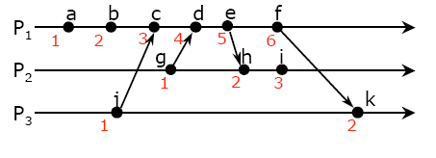
Definition of happened-before
Definition of “→” relationship:
If a and b take place in the same process
  a comes before b, then a → b
If a and b take place in the different processes
  a is a “send” and b is the corresponding “receive”, then a → b
Transitive: if a → b and b → c, then a → c
Partial ordering – unordered events are concurrent
Notes:
With rules 1 – 3, you can deduce relationship of any two events.
e.g., event a, g (concurrent);
Event a, i (->), and event j and i (->)

Slide 5
Logical Clocks
A logical clock is a monotonically increasing software counter. It need not relate to a physical clock.
  Corrections to a clock must be made by adding, not subtracting
Rule for assigning “time” values to events
  if a → b then clock(a) < clock(b)
Notes:
Rule of logical clocks: if a -> b then clock(a) < clock(b)

Slide 6
Event counting example
Three processes: P₀, P₁, P₂, events a, b, c, …
A local event counter in each process.
Processes occasionally communicate with each other, where inconsistency occurs, …
Bad ordering: e → h, f → k

Slide 7
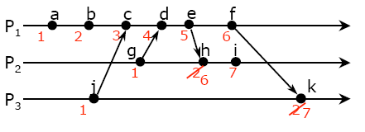
Lamport’s algorithm, 1978
Each process P_{i} has a logical clock L_{i}. Clock synchronization algorithm:
L_{i} is initialized to 0;
Update L_{i}:
  LC1: L_{i} is incremented by 1 for each new event happened in P_{i}
  LC2: when P_{i} sends message m, it attaches t = L_{i} to m
  LC3: when P_{j} receives (m,t) it sets L_{j} := max{L_{j}, t} , and then applies LC1 to increment L_{j} for event receive(m)
Notes:
Purpose of logical clock synchronization: a -> b, then c(a) < c(b)
!!!important feature: For any two events: if a → b, then L(a) < L(b). Why?

Slide 8
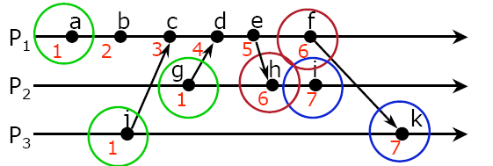
Problem: Identical timestamps
Concurrent events (e.g., a, g) may have the same timestamp

Slide 9
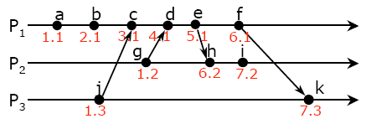
Make timestamps unique
Append the process ID (or system ID) to the clock value after the decimal point:
  e.g. if P₁, P₂ both have L₁ = L₂ = 40, make L₁ = 40.1, L₂ = 40.2

Slide 10
Problem: Detecting causal relations
If a → b, then L(a) < L(b), however:
If L(a) < L(b), we cannot conclude that a → b
It is not very useful in distributed systems.
Solution: use vector clocks
L(g) < L(c ), but g || c
Notes:
Prove: if a-> b, then L(a) < L(b).

Slide 11
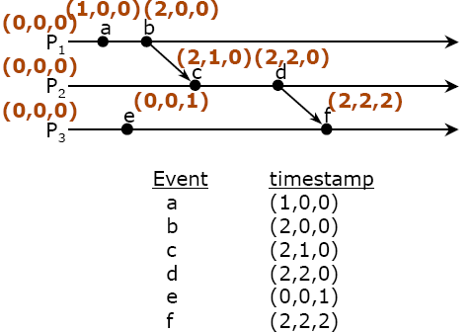
Vector of Timestamps
Suppose there are a group of people and each needs to keep track of events happened to others.
Requirement: Given two events, you need to tell whether they are sequential or concurrent.
Solution: you need to have a vector of timestamps, one element for each member.
(3,0,0)
(?,?,?)
Notes:
When I receive a msg from a student, update his component to his value. That means I know all his info by that time… So, this vector is a chart showing by which extent I know each of your info.
f knows a;
Does f know g (new event at p1)?
What is (?,?,?)

Slide 12
Vector clocks （向量时钟）
Each process P_{i} keeps a clock V_{i} which is a vector of N integers
Initialization: for 1 ≤ i ≤ N and 1 ≤ k ≤ N, V_{i}[k] := 0
Update V_{i} :
  VC1: when there is a new event in P_{i}, it sets V_{i}[i] := V_{i}[i] +1
  VC2: when P_{i} sends a message m out, it attaches t = V_{i} to m
  VC3: when P_{j} receives (m,t), for 1 ≤ k ≤ N, it sets V_{j}[k] := max{V_{j}[k], t[k]}, then applies VC1 to increment V_{j}[j] for event receive(m,t)
Note: V_{i}[j] is a timestamp indicating that P_{i} knows all events that happened in P_{j} upto this time.
Notes:
Generalize vector of clocks for a group of processes, Vi, Pi;
Meaning of Vi[j]: Pi knows events of Pj upto this value of time (Vi[j]). ??? This value from pi’s clock or pj’s clock?

Slide 13
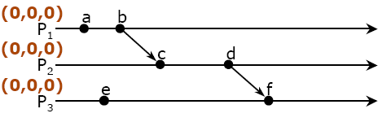
Vector timestamps: example
Notes:
Initialization.

Slide 14
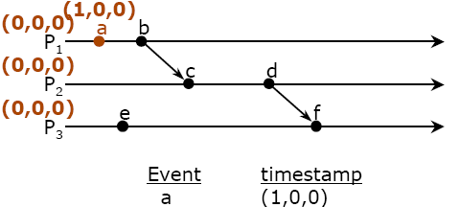
Vector timestamps: example

Slide 15
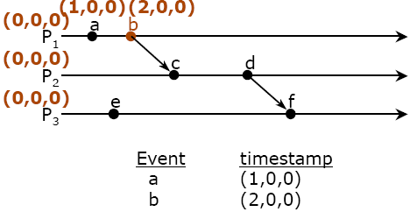
Vector timestamps: example
Notes:
P1 piggy back vector timestamp with message to p2.

Slide 16
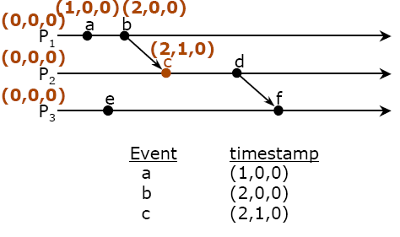
Vector timestamps: example
Notes:
P2 updates its vector.

Slide 17
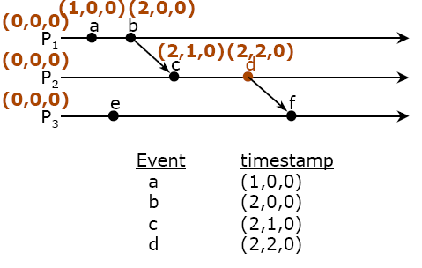
Vector timestamps: example
Notes:
P2 progress…

Slide 18
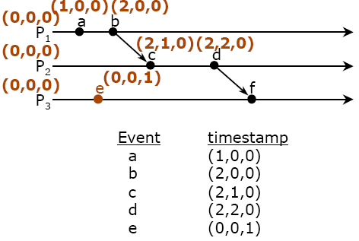
Vector timestamps: example

Slide 19
Vector timestamps: example
Notes:
At f, p3 knows p1 upto 2 and p2 upto 2…
Conclude: what does a vector of timestamps mean?
It’s a chart showing how much recent data he knows from each of other processes. E.g, vector of event f.
Event relationship a-> f; b||e; ??? How to tell their relationship from timestamp vectors ->

Slide 20
Detecting “→” or “||” events by time vectors
Define
    V = V’ iff V[i] = V’[i] for i = 1, …, N
    V ≤ V’ iff V[i] ≤ V’[i] for i = 1, …, N
    V < V’ iff V ≤ V’ and V ≠ V’
V(e) ≡ timestamp vector of an event e
For any two events a and b,
  a → b iff V(a) < V(b), a ≠ b
  a || b iff neither V(a) ≤ V(b) nor V(b) ≤ V(a)
Notes:
“iff” feature is very important, particularly V(e) < V(e’) leads to e-> e’ is very useful for distributed system to determine order of two events!
Think about if a → b then V(a) < V(b);
And if V(a) < V(b), then a-> b

Slide 21
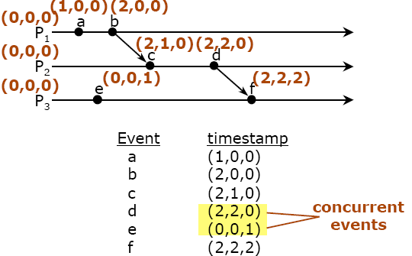
Detecting “→” or “||” events: an example
Notes:
It’s clear to see:
if e → e’ then V(e) < V(e’);
if V(e) < V(e’), then e-> e’. Proof: by contridictory.

Slide 22
Summary on vector timestamps
No need to synchronize physical clocks
Able to order causal events
Able to identify concurrent events (but cannot order them)

Slide 23
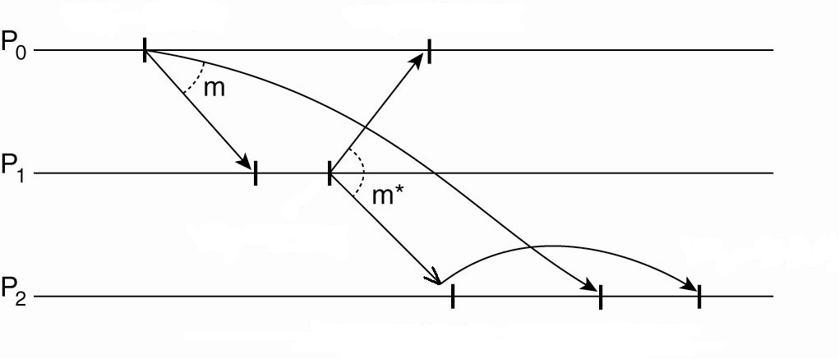
An Application of Timestamp Vectors: causally-ordered multicast
Multicast: a sender sends a message to a group of receivers. Every message must be received by all group members.
Causally ordered multicast: if m₁ → m₂, m₁ must be received before m₂ by all receivers.
(1,0,0)
(2,2,0)
(0,0,0)
(1,2,0)
(0,0,0)
(1,1,0)
(0,0,0)
(1,0,1)
(1,2,2)
Notes:
Causal multicast is very useful for consistency / concurrency control: banking example: deposit -> withdraw
Different network delays cause out of order at a destination.
Delay the delivery of message to application layer.
? Think about the Algorithm -> use timestamp vector to check if any messages (that’d arrive before) are missing

Slide 24
Algorithm of Causally-Ordered Multicast
Each group member keeps a timestamp vector of n components (n group members), all initialized to 0.
When P_{i} multicasts a message m, it increments i-th component of its time vector V_{i} and attaches V_{i} to m.
When P_{j} with V_{j} receives (m, V_{i}) from P_{i}:
if (V_{j} [k] ≥ V_{i}[k] for all k, k≠ i), then
V_{j} [i] := V_{i} [i]; // V_{i} [i] is always greater than V_{j} [i]
V_{j} [j] := V_{j} [j] + 1;
Deliver m;
otherwise
Delay m until “if” is met.
(1,0,0)
(2,2,0)
(3,2,0)
(0,0,0)
(1,2,0)
(0,0,0)
(1,1,0)
(3,3,0)
?
(0,0,0)
(1,0,1)
(1,2,2)
Notes:
timestamp vector is used to identify causality of messages! Timestamp (message) == timestamp (event)
Note: 1) Multicast delivery needs to check timestamps, but VC synchronization doesn’t, this’s bcs every messages before this one must be delivered before this. 2) It only needs to update the component of source-node (i.e., i-th), same reason for 1).
?.

Slide 25
Causal-Order Preserved
If m₁ → m₂, m₁ is received by (delivered to) all recipients before m₂.
If m₁ || m₂, m₁ and m₂ can be received in arbitrary order by recipients.
Total ordered multicast（全序组播）: for case of m₁ || m₂, m₁ and m₂ must be received in the same order by all recipients (i.e., either all m₁ before m₂, or all m₂ before m₁).
(1,0,0)
(2,2,0)
(3,2,0)
(0,0,0)
(1,3,0)
(1,2,0)
(1,1,0)
(3,4,0)
(0,0,0)
?
(3,3,4)
(0,0,0)
(1,0,1)
(1,2,2)
Notes:
See diagram to explain causal order first (m and m* at P2)
Concurrent messages: p0 and p1 new msgs.
?(???)

Slide 26
Question
. Suppose a group of process P0 -P5 and timestamp vector is used to represent logical times. P0 sends out a message m₁ with timestamp vector T₀ = {5,7,2,3,4,8}:
a) what is the event number of P0?
b) what is the event number of the last event that P0 knows about P4?
c) suppose P4 sends a message m₂ with vector T₄ = {5,7,3,3,6,8}. What is relationship between m₁ and m₂?

