Slide 1
Distributed Systems
分布式系统
Mutual Exclusion & Election Algorithms
互斥算法 & 选举算法

Slide 2
Process Synchronization
Techniques to coordinate execution among processes
  One process may have to wait for another
  Shared resource (e.g. critical section) may require exclusive access

Slide 3
Requirements of Mutual Exclusion Algorithms
A mutual exclusion algorithm should satisfy the following properties:
Safety Property: The safety property states that at any instant, only one process can execute the critical section.
Liveness Property: This property states the absence of deadlock and starvation.
Fairness: Fairness in the context of mutual exclusion means that each process gets a fair chance to execute the critical section.

Slide 4
Centralized Systems
Achieve Mutual exclusion via:
  Test & set in hardware
  Semaphores
  Messages(inter-process)
  Condition variables

Slide 5
Distributed Mutual Exclusion
Assume there is agreement on how a resource is identified
  Pass identifier with requests
  e.g., lock(“printer”), lock(“table:employees”),
  lock(“table:employees;row:15”)
…and every process can identify itself uniquely
Goal:
Create an algorithm to allow a process to obtain exclusive access to a resource that is available on the network

Slide 6
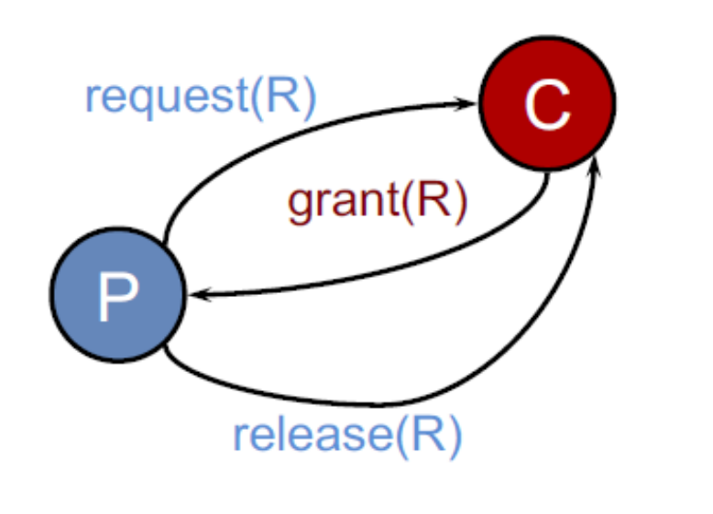
Centralized algorithm（集中式算法）
Mimic single processor system
One process elected as coordinator
Request resource
Wait for response
Receive grant
Access resource
Release resource

Slide 7
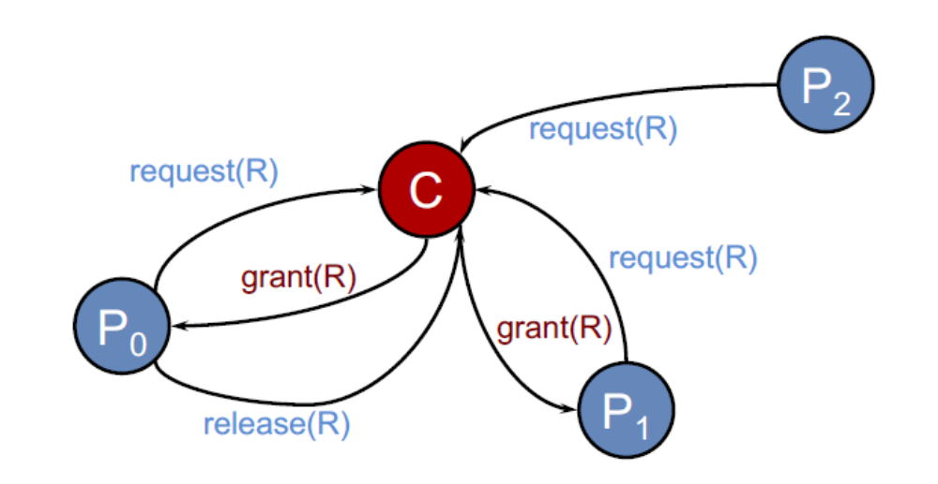
Centralized algorithm （集中式算法）
If another process claimed resource:
  – Coordinator does not reply until release
  – Maintain queue
      Service requests in FIFO order

Slide 8
Centralized algorithm （集中式算法）
Benefits
  Fair: All requests processed in order
  Easy to implement, understand, verify
  Processes do not need to know group members – just the coordinator
Problems
  Process cannot distinguish being blocked from a dead coordinator – single point of failure
  Centralized server can be a bottleneck

Slide 9
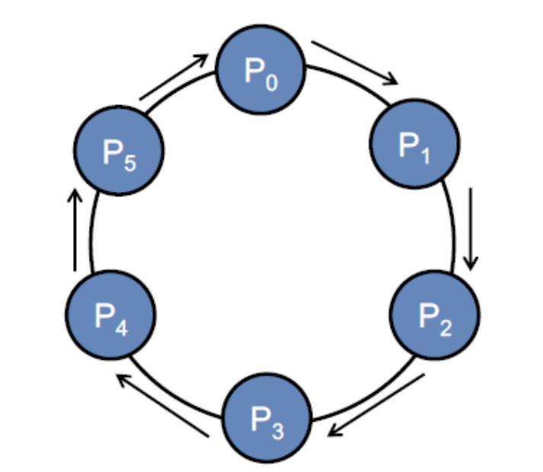
Token Ring algorithm（令牌环算法）
Assume known group of processes
  Some ordering can be imposed on group (unique process IDs)
  Construct logical ring in software
  Process communicates with its neighbor

Slide 10
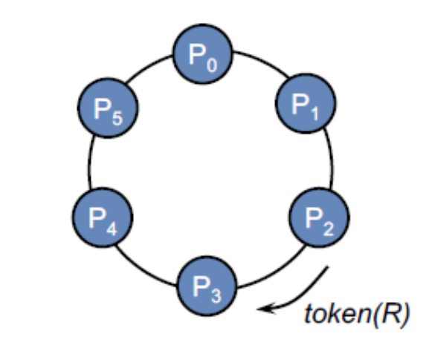
Token Ring algorithm （令牌环算法）
Initialization
  Process 0 creates a token for resource R
Token circulates around ring
  From Pi to P(i+1)mod N
When process acquires token
  Checks to see if it needs to enter critical section
  If no, send ring to neighbor
  If yes, access resource
    Hold token until done

Slide 11

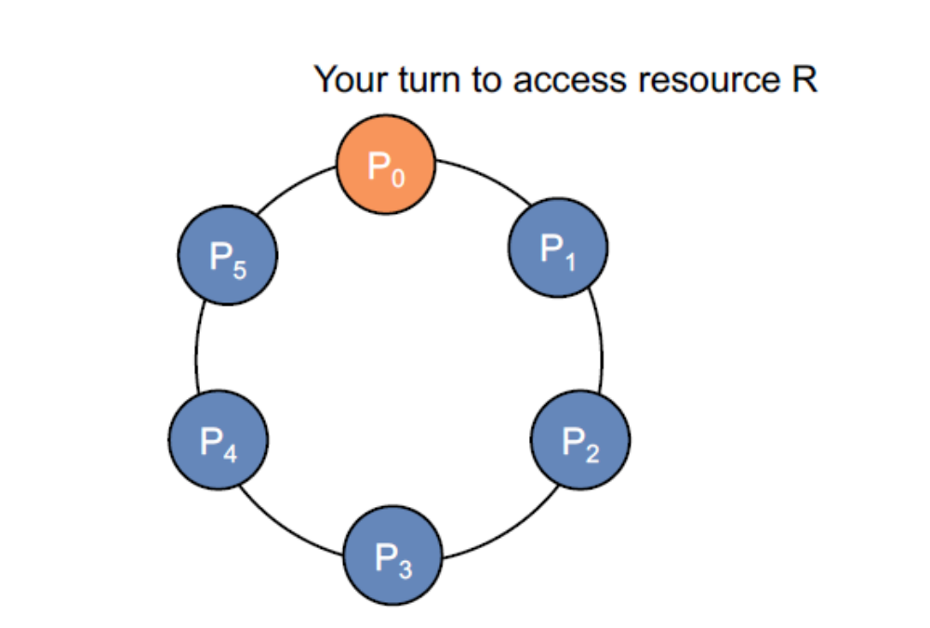
Token Ring algorithm （令牌环算法）

Slide 12
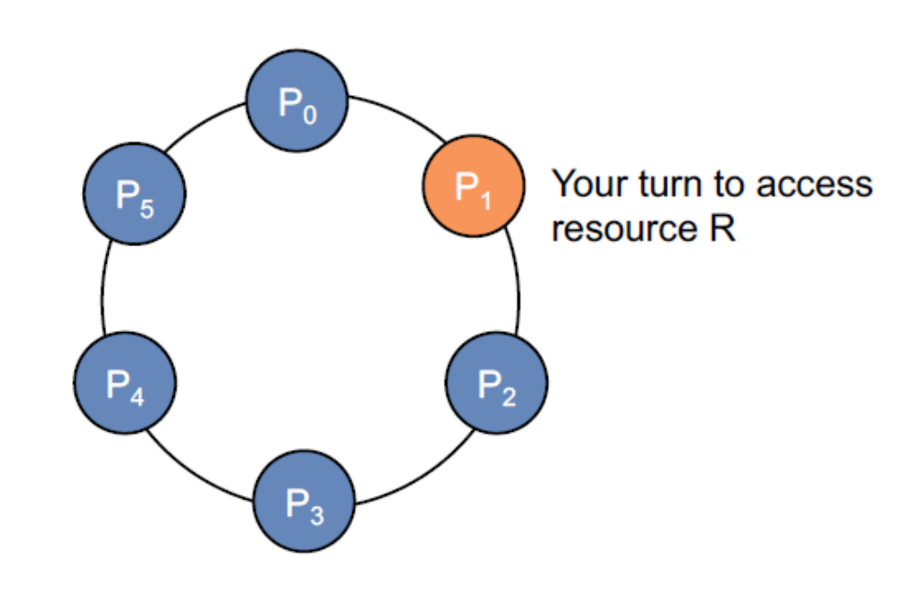
Token Ring algorithm （令牌环算法）

Slide 13
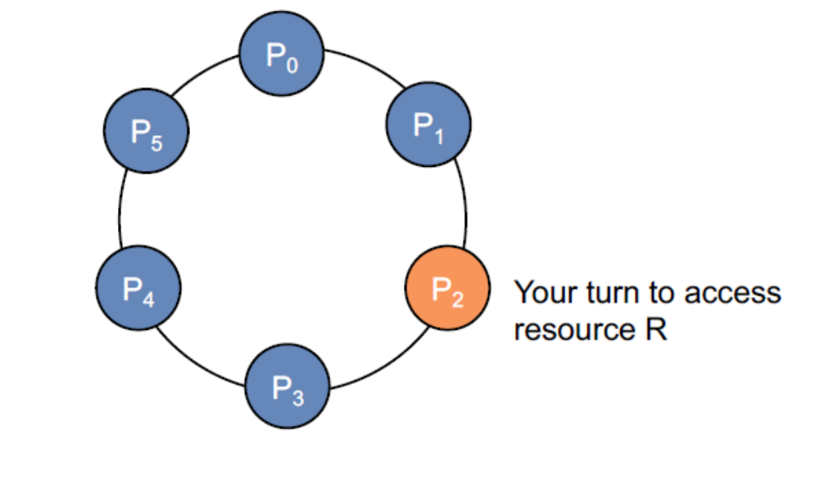
Token Ring algorithm （令牌环算法）

Slide 14
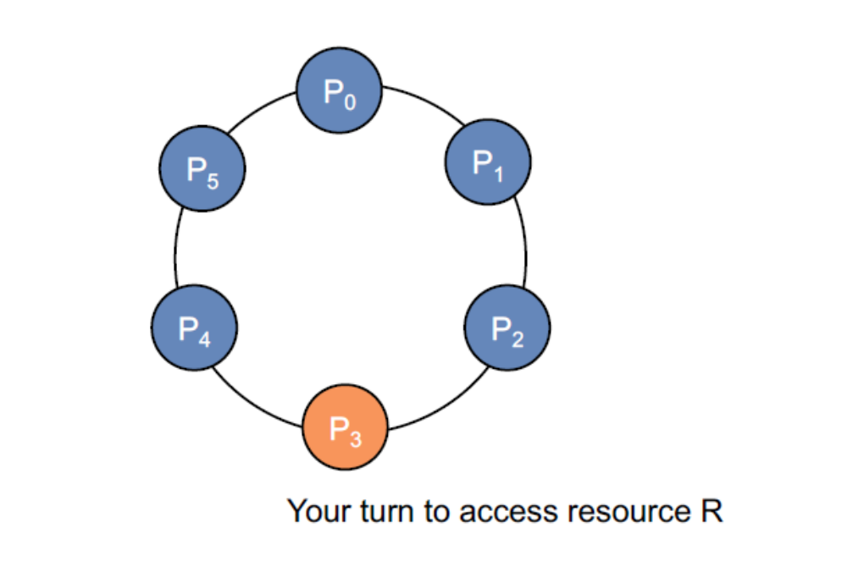
Token Ring algorithm （令牌环算法）

Slide 15
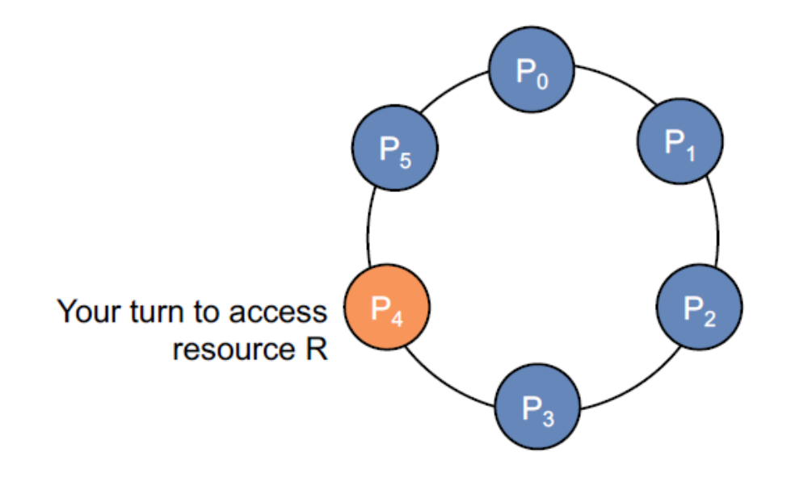
Token Ring algorithm （令牌环算法）

Slide 16
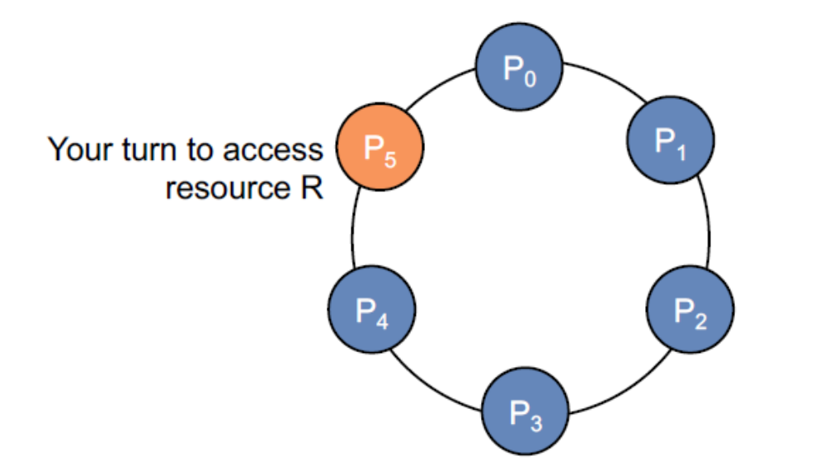
Token Ring algorithm （令牌环算法）

Slide 17
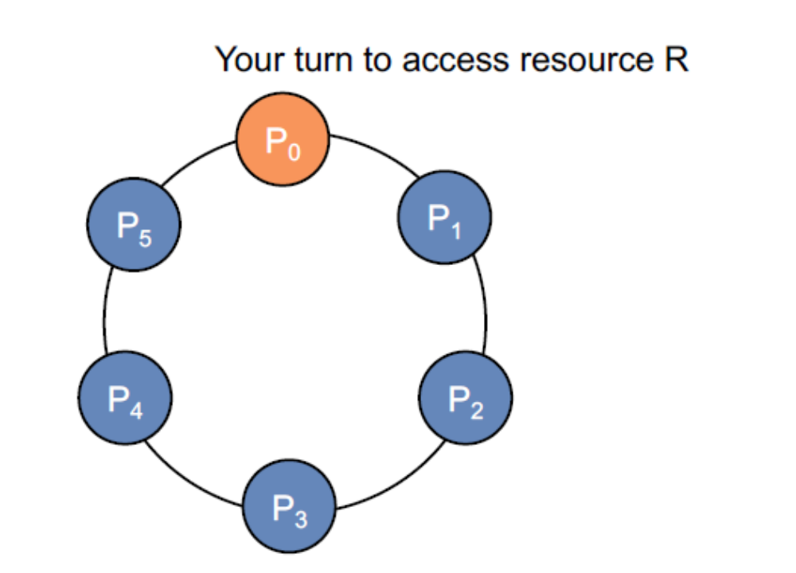
Token Ring algorithm （令牌环算法）

Slide 18
Token Ring algorithm summary
Only one process at a time has token
  Mutual exclusion guaranteed
Order well-defined (but not necessarily first-come, first-served)
  Starvation cannot occur
  Lack of FCFS ordering may be undesirable sometimes
Problems
  Token loss (e.g., process died)
    It will have to be regenerated
    Detecting loss may be a problem(is the token lost or in just use by someone?)
  Process loss: what if you can't talk to your neighbor?

Slide 19
Ricart & Agrawala algorithm
Distributed algorithm using reliable multicast and logical clocks
Process wants to enter critical section:
  Compose message containing:
    Identifier (machine ID, process ID)
    Name of resource
    Timestamp (totally-ordered Lamport）
  Send request to all processes in group
  Wait until everyone gives permission
  Enter critical section / use resource

Slide 20
Ricart & Agrawala algorithm
When process receives request:
  If receiver not interested:
    Send OK to sender
  If receiver is in critical section
    Do not reply; add request to queue
  If receiver just sent a request as well:
    Compare timestamps: received & sent messages
    Earliest wins
    If receiver is loser, send OK
    If receiver is winner, do not reply, queue
  When done with critical section
    Send OK to all queued requests

Slide 21
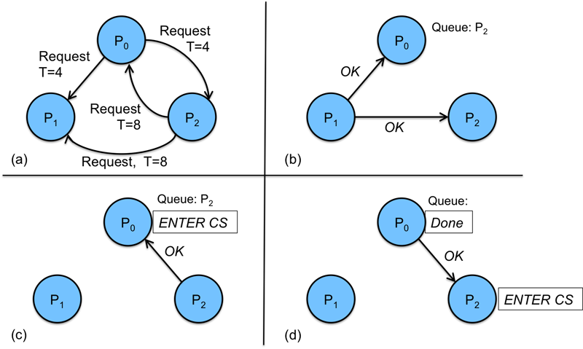
Example for Ricart & Agrawala algorithm

Slide 22
Ricart & Agrawala algorithm
N points of failure
A lot of messaging traffic
Demonstrates that a fully distributed algorithm is possible

Slide 23
Lamport’s Mutual Exclusion
Each process maintains request queue
  Contains mutual exclusion requests
Requesting critical section
  Process Pi sends request(i, Ti) to all nodes
  Places request on its own queue
  When a process Pj receives a
  request, it returns a timestamped ack
Lamport time

Slide 24
Lamport’s Mutual Exclusion
Entering critical section (accessing resource):
  Pi received a message (ack or release) from every other process with a timestamp larger than Ti
  Pi’s request has the earliest timestamp in its queue
Difference from Ricart-Agrawala:
  Everyone responds (acks) … always - no hold-back
  Process decides to go based on whether its request is the earliest in its queue

Slide 25
Lamport’s Mutual Exclusion
Releasing critical section
  Remove request from its own queue
  Send a timestamped release message
  When a process receives a release message
    Removes request for that process from its queue
    This may cause its own entry have the earliest timestamp in the queue, enabling it to access the critical section

Slide 26
Election algorithms (选举算法）

Slide 27
Elections
Need one process to act as coordinator
Processes have no distinguishing characteristics
Each process has a unique ID to identify itself

Slide 28
Bully algorithm （霸道选举算法)
• Select process with largest ID as coordinator
• When process P detects dead coordinator:
  – Send election message to all processes with higher IDs.
• If nobody responds, P wins and takes over.
• If any process responds, P’s job is done.
  – Optional: Let all nodes with lower IDs know an election is taking place.
• If process receives an election message
  – Send OK message back
  – Hold election (unless it is already holding one)

Slide 29
Bully algorithm （霸道选举算法)
• A process announces victory by sending all processes a
message telling them that it is the new coordinator
• If a dead process recovers, it holds an election to find the
coordinator.

Slide 30
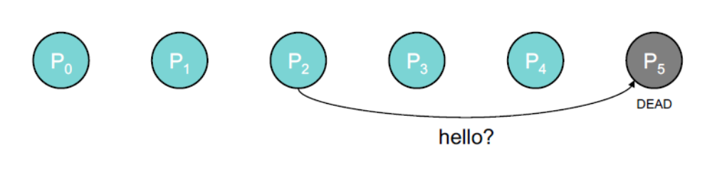
Bully algorithm （霸道选举算法)
Rule: highest # process is the leader
Suppose P5 dies
P2 detects P5 is not responding

Slide 31
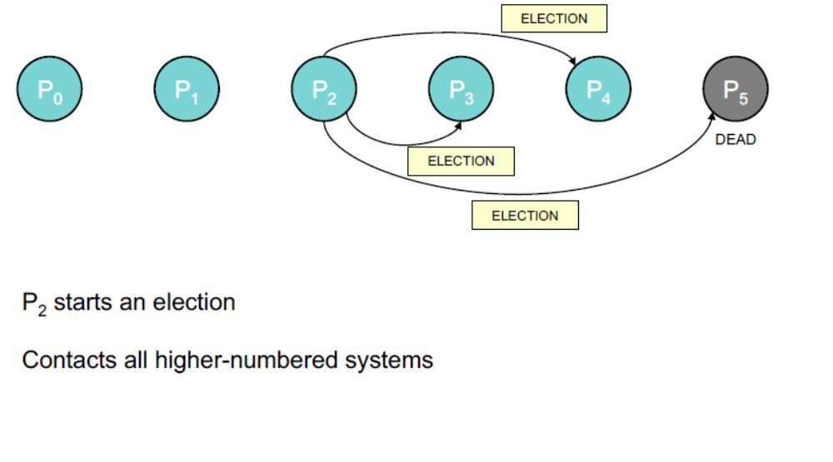
Bully algorithm （霸道选举算法)

Slide 32
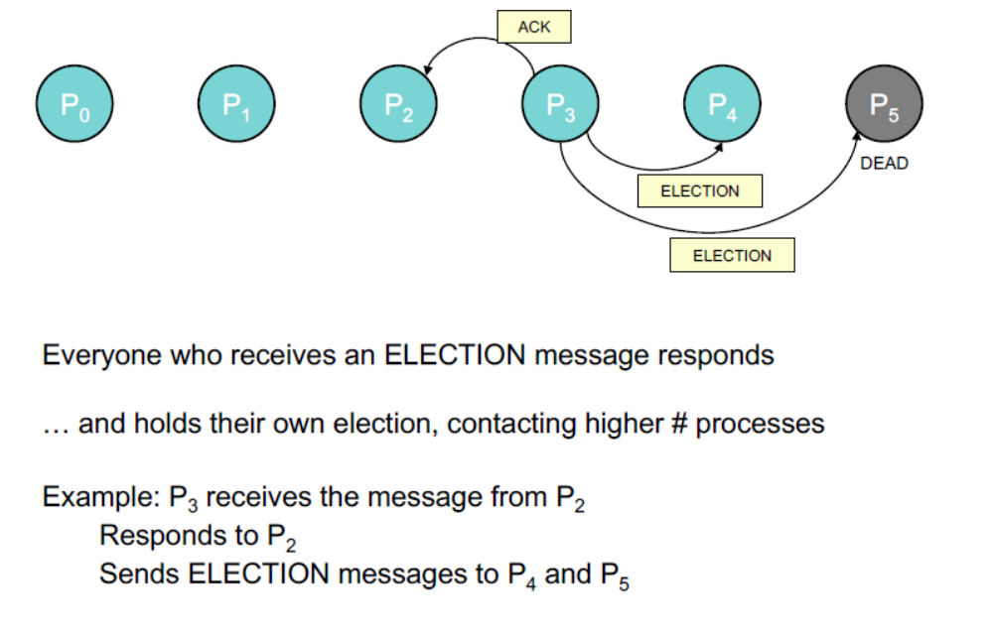
Bully algorithm （霸道选举算法)

Slide 33
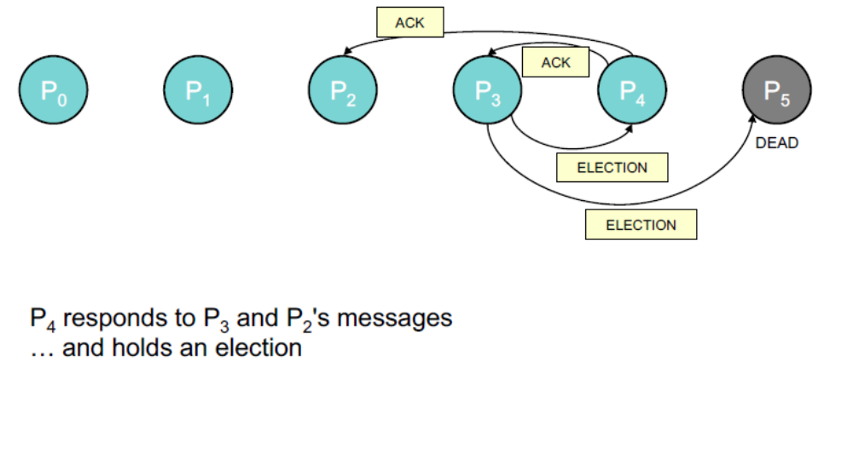
Bully algorithm （霸道选举算法)

Slide 34
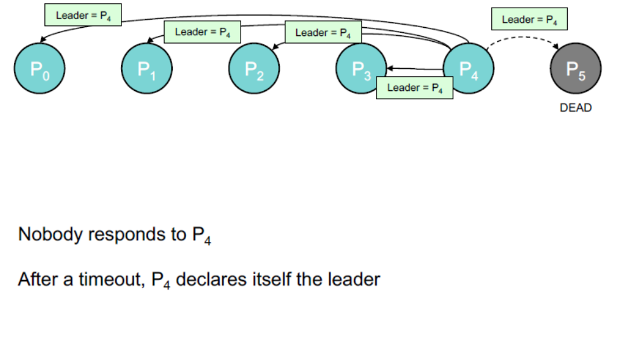
Bully algorithm （霸道选举算法)

Slide 35
Ring algorithm （环选举算法）
• Ring arrangement of processes
• If any process detects failure of coordinator
  – Construct election message with process ID and send to next process
  – If successor is down, skip over
  – Repeat until a running process is located
• Upon receiving an election message
  – Process forwards the message, adding its process ID to the body

Slide 36
Ring algorithm （环选举算法）
Eventually message returns to originator
  – Process sees its ID on list
  – Circulates (or multicasts) a coordinator message announcing coordinator
• E.g. lowest numbered process

Slide 37
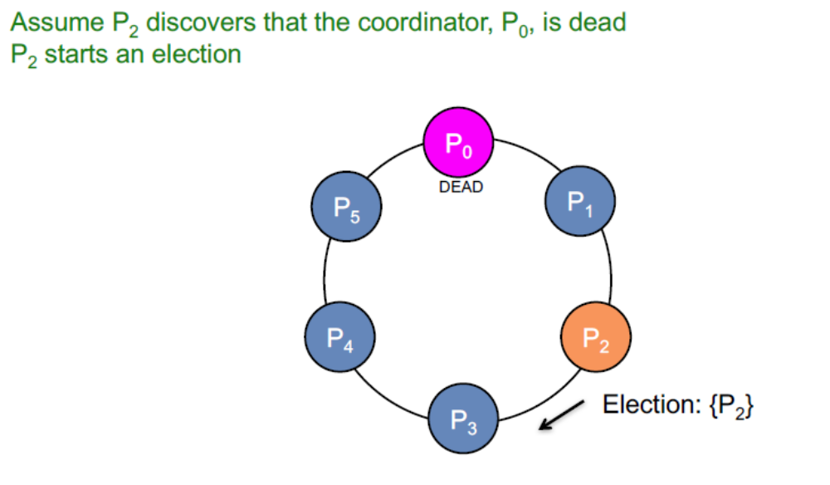
Ring algorithm （环选举算法）

Slide 38
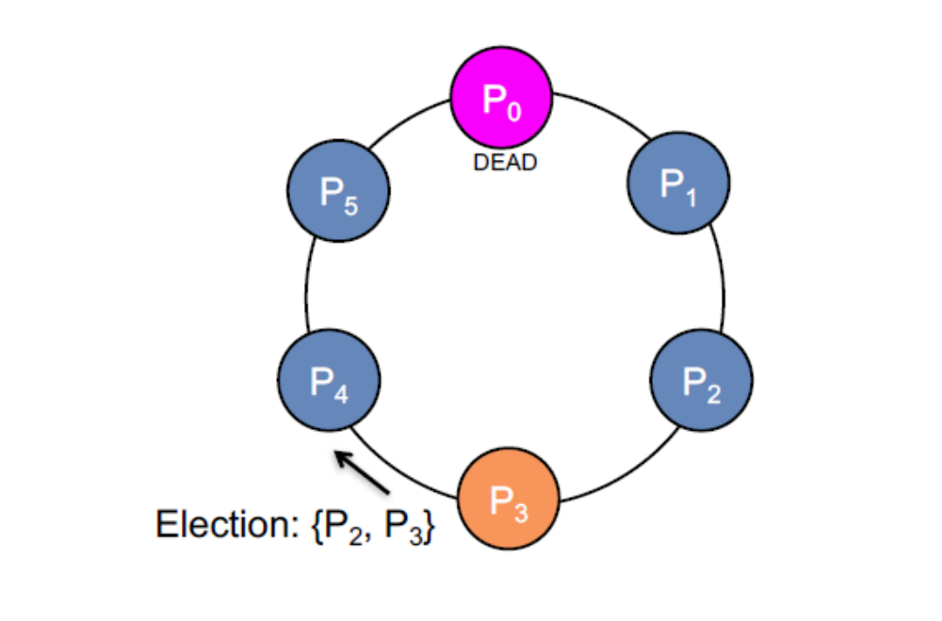
Ring algorithm （环选举算法）

Slide 39
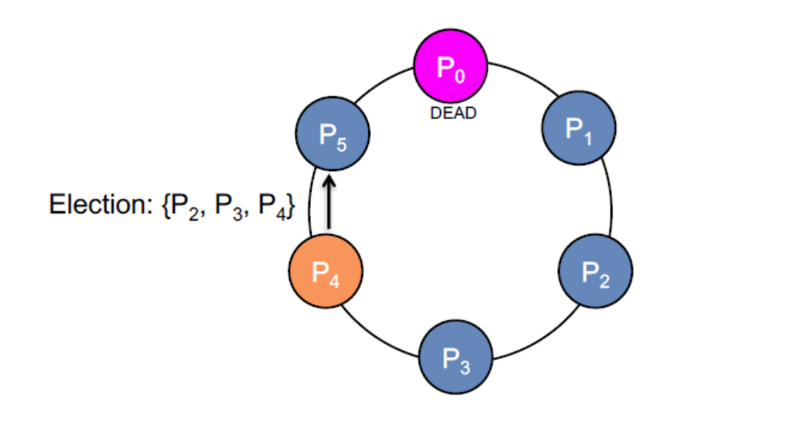
Ring algorithm （环选举算法）

Slide 40
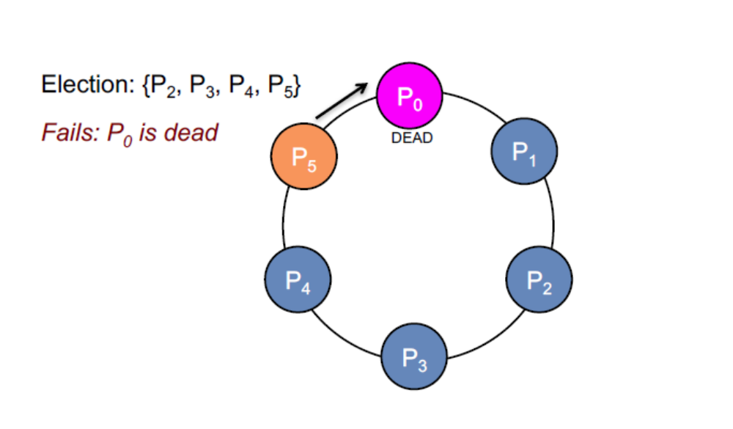
Ring algorithm （环选举算法）

Slide 41
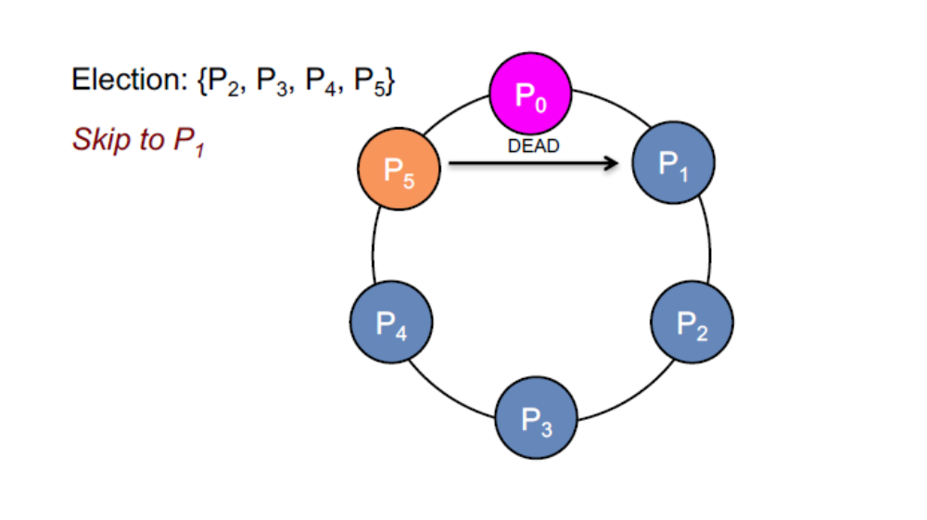
Ring algorithm （环选举算法）

Slide 42
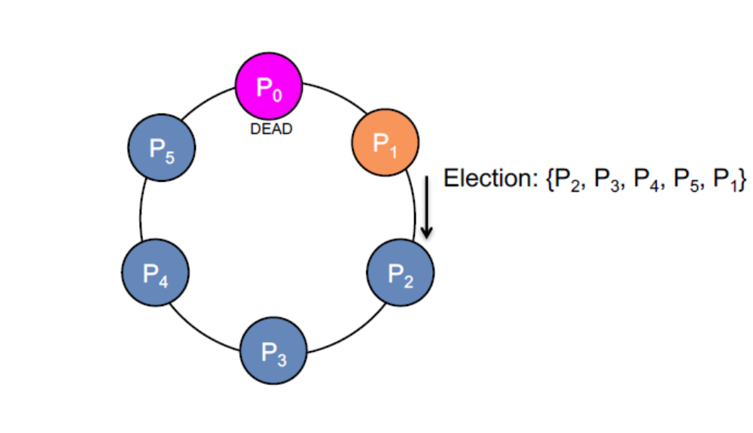
Ring algorithm （环选举算法）

Slide 43
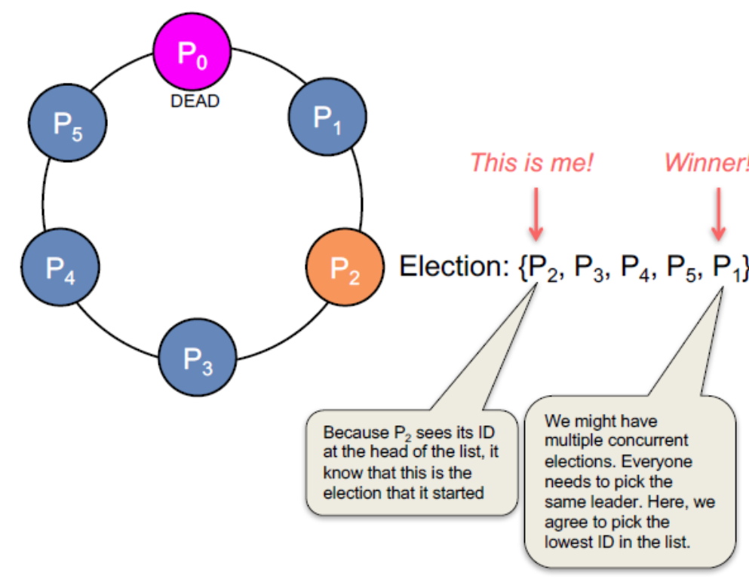
Ring algorithm （环选举算法）
P2 receives the election message that it initiated
P2 now picks a leader (e.g., lowest or highest ID)

Slide 44
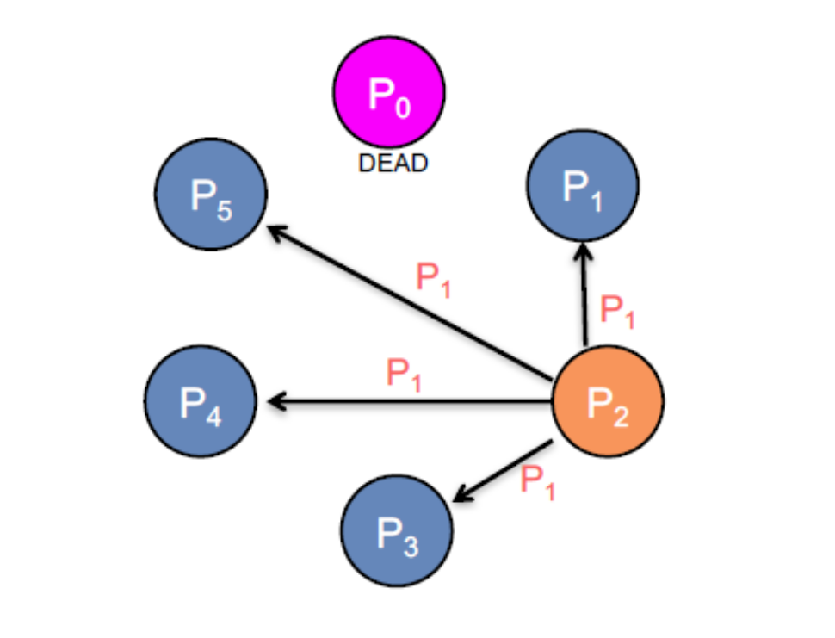
Ring algorithm （环选举算法）
P2 announces the new coordinator to the group

Slide 45
Chang & Roberts Ring Algorithm
Optimize the ring
– Message always contains one process ID
– Avoid multiple circulating elections
– If a process sends a message, it marks its state as a participant
Upon receiving an election message:
If PID(message) > PID(process)
forward the message – higher ID will always win over a lower one
If PID(message) < PID(process)
replace PID in message with PID(process)
forward the new message – we have a higher ID number; use it
If PID(message) < PID(process) AND process is participant
discard the message – we're already circulating our ID
If PID(message) == PID(process)
the process is now the leader – message circulated: announce winner

Slide 46
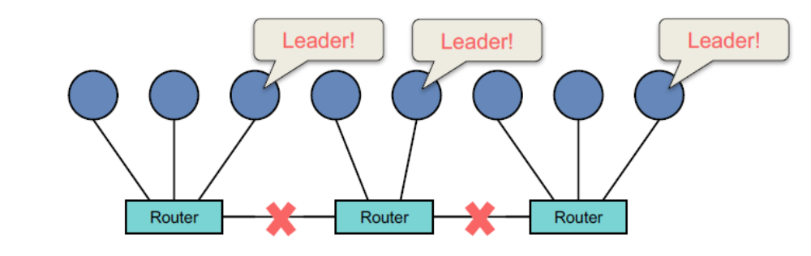
Network Partitioning: Split Brain （脑裂）
Network partitioning (segmentation)
– Split brain
– Multiple nodes may decide they’re the leader
Dealing with partitioning
– Insist on a majority → if no majority, the system will not function
– Rely on alternate communication mechanism to validate failure
• Redundant network, shared disk, serial line, SCSI

