Slide 1
Distributed Systems
分布式系统
Internetworking
网际互联

Slide 2
Internet Structure: Network of Networks
Internet is in a hierarchical structure
National/ International Backbone Providers (NBP)
  e.g. BBN/GTE, Sprint, AT&T, IBM, UUNet
  interconnect (peer) with each other privately, or at public Network Access Point (NAPs)
Regional ISPs
  connect into NBPs
Local ISP
  connect into regional ISPs
local
ISP
regional ISP
NBP B
NAP
NAP
NBP A
regional ISP
local
ISP
Notes:
NAP interconnects NBPs

Slide 3
Internet Protocol (IP)
The IP protocol, defined in RFC 791 (1981) at Layer 3, specifies:
Internet packet format
Internet addressing
Internet routing
Notes:
We focus on two issues: 1) solve Internet address shortage; 2) Internet routing

Slide 4

Internet Packets
An IP packet, called IP datagram, consists of two parts:
Header
  Contains source and destination address
  Fixed-size fields
Data Area (Payload)
  Variable size up to 64K
  No minimum size
Notes:
We’re at Internet layer: it’s upper layer: TCP/UDP, it’s lower layer: datalink

Slide 5
IPv4 datagram format
IP protocol version
number
32 bits
total datagram
length (bytes)
header length
(bytes)
head.
len
type of
service
ver
length
for
fragmentation/
reassembly
“type” of data
flgs
fragment
offset
16-bit identifier
max number
remaining hops
(decremented at
each router)
time to
live
upper
protocol
header
checksum
32 bit source IP address
32 bit destination IP address
upper layer protocol
to deliver payload to
Option part (0 or more words)
e.g. timestamp,
record route
taken, specify
list of routers
to visit.
data
(variable length,
typically a TCP
or UDP segment)
Notes:
Header has 5*4 bytes fixed size + optional part;
Version, upper protocol, and sour / dest IP addr

Slide 6
IP Address Details
An IPv4 address has 32 bits (4 bytes) – written like 192.0.2.53
  It consists of two parts: prefix identifies network and suffix identifies host
  It was announced in Jan 2011 that all IPv4 addresses were allocated out.
An IPv6 address is 128 bits, written in hexadecimal. It looks like
  2001:0db8::53. The mark “::” means all zeros in between. So 2001:0db8::53 is 2001:0db8:0000:0000:0000:0000:0000:53
Global authority assigns unique prefix to network (ICANN)
  Internet Corporation for Assigned Names and Numbers http://www.icann.org/
Local administrator assigns unique suffix to host
Notes:
Ipv4 = 32 bits (a group of 4 numbers, one byte for each); ipv6 = 128 bits (8 numbers, each in 16bits (4 hex-digits)).

Slide 7
IPv4 Addresses
The Classful Addressing:
class
A
0
network
host
1.0.0.0 to
127.255.255.255
B
10
network
host
128.0.0.0 to
191.255.255.255
C
110
network
host
192.0.0.0 to
223.255.255.255
D
1110
multicast address
224.0.0.0 to
239.255.255.255
32 bits
Notes:
classID + networkAddr + hostAddr
address class usage is not balanced

Slide 8
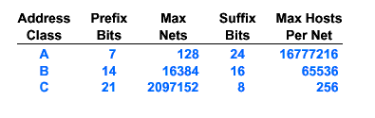
Classes and Network Sizes
Network size is determined by number of bits for hosts
  Class A large
  Class B medium
  Class C small
Notes:
Prefix-bits = net-addr-bits

Slide 9
Are there enough addresses?
Unfortunately No!
  32 bits → 4 billion unique addresses.
  but addresses are assigned in chunks, most of them are not used (particularly class D addresses for multicast).
  techniques, such as CIDR, NAT, and DHCP are introduced to relief the shortage of IP addresses.
Expanding the address space!
  IPv6 128 bit addresses
  Difficult to deploy (require changes to the core of the Internet)
  The transition from IPv4 to IPv6 is very slow
Notes:
Class B runs out quickly!
Classful address is not efficient, why IP addresses are classful ? ->

Slide 10
IP address allocation by Geographical Regions
To simplify routing tables, since 1993, IP address allocation follows the geographical regions:
194.0.0.0 to 195.255.255.255 for Europe
198.0.0.0 to 199.255.255.255 for North America
200.0.0.0 to 201.255.255.255 for Central & South America
202.0.0.0 to 203.255.255.255 for Asia Pacific
Routing table size can be greatly reduced, e.g., routers outside Europe can have a single table entry for range: 194.0.0.0 - 195.255.255.255 to be routed to the nearest Europe gateway.
Notes:
But, bcs this policy only starts after 1993, the addresses allocated out before 1993 have no indication of location.
So it doesn’t help reducing table size that much.

Slide 11
Subnets and Subnet Masks
Subnets allow a big organization (e.g., university), who received a class A or B network address, to further divide its hosts into subnets (LANs):
The host portion of address is further partitioned into subnet number and host number.
Each LAN is assigned a subnet number (subnet address).
To route an IP packet, its dest-IP addr is AND-ed with the subnet-mask, obtaining a subnet number. It is forwarded to the router of the dest-subnet:
The dest-subnet router routes the packet to dest-host using host #.
10 | Network | Subnet | Host
Subnet
mask
1 1 1 1 1 1 1 1 1 1 1 1 1 1 1 1 1 1 1 1 1 0 0 0 0 0 0 0 0 0 0
Notes:
See Tanenbaum, “computer Networks”.
Before introducing CIDR, we need to talk about subnetting. Each subnet for a Dept.
Two purpose of subnetting: 1) further subdivide a class B address into subnets (LANs, one for each dept) in a big organization. This subneting is for internal use only and to outside it’s still a class B address. This’s the main difference between subneting and CIDR (for Internet);
2) Reduce routing table size of subnet-routers (only need to mask the subnet #, no need to keep all host addr in the organization).

Slide 12
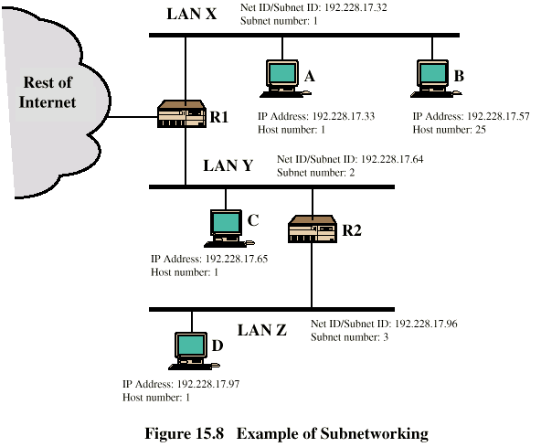
Routing Using Subnets
Notes:
Subnet ID 192.228.17.32 is 192.228.17.32/27. Note: this’s a class C addr (see the 1st 3 bytes of LAN addr are the same). So, the IP addr has 24 bits for the network, 3 bits for subnets and 5 bits for hosts).
Host IP addr = subnet ID + host-number. Note: last byte for subnet -.-.-.32, is 0010000; for-.-.-.64 is 01000000; for -.-.-.96 is 01100000, each time +32 (2**5).
A host IP addr on the subnet is “subnet #” + “host #”.
In fact, it’s switch (not router) that is used to connect several LANs together.
Swithes switch packets based on Ethernet addresses at datalink layer (NOT on IP addresses as routers at Internetwork layer).
Switches don’t see (understand) IP addresses.

Slide 13
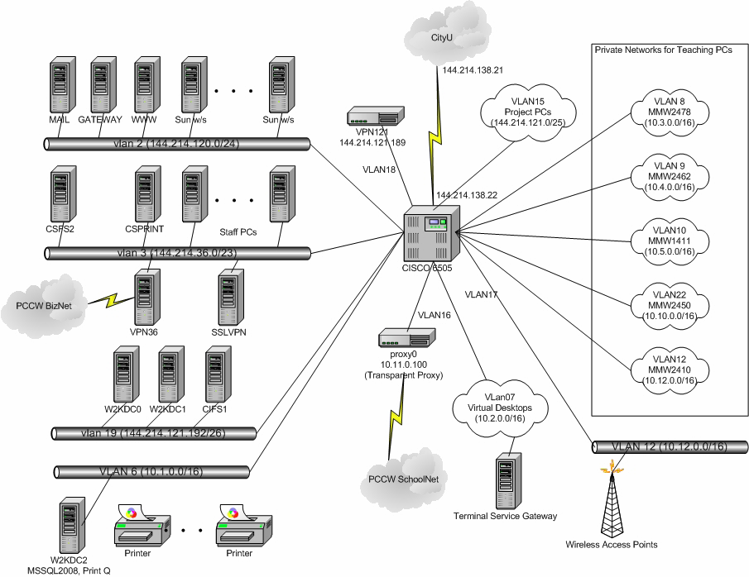
Cslab Subnet Interconnction

Slide 14
Routing Table in CSlab
CSlab has 22 LANs connected to a single router. The router is connected to CSC’s router.
The routing table is very small, only contains 22 VLANs and an entry pointing to CSC router 144.214.138.21 (0.0.0.0 for default routing).
S 169.254.0.0/16 is directly connected, Null0
172.18.0.0/24 is subnetted, 1 subnets
C 172.18.120.0 is directly connected, Vlan21
144.214.0.0/16 is variably subnetted, 8 subnets, 4 masks
C 144.214.122.0/26 is directly connected, Vlan5
C 144.214.121.0/25 is directly connected, Vlan15
……. (8 subnets)
C 144.214.121.192/26 is directly connected, Vlan19
10.0.0.0/8, unregistered address, variably subnetted, 11 subnets, 2 masks
C 10.10.0.0/16 is directly connected, Vlan22
C 10.9.0.0/16 is directly connected, Vlan14
…….. (11 subnets)
S* 0.0.0.0/0 [1/0] via 144.214.138.21 // default router
Default routing
Notes:
Use unix cmd to see local machine routing table:
sf4800a% netstat –r
“C 144.214.122.0/26 is directly connected, Vlan5” says any IP packets by masking 26 bits and matching base-addr 144.214.122.0 go to router Vlan5.
Below is route from CSlab core router c6506a. The information is static (won’t change for years).
I need to ask special permission to login c6506a (this machine name is not known to any rlogin or /etc/hosts).
c6506a>sh ip route //show ip route. Note: “sh ip” cmd is not available on any other machine!
Codes: C - connected, S - static, I - IGRP, R - RIP, M - mobile, B - BGP
D - EIGRP, EX - EIGRP external, O - OSPF, IA - OSPF inter area
N1 - OSPF NSSA external type 1, N2 - OSPF NSSA external type 2
E1 - OSPF external type 1, E2 - OSPF external type 2, E - EGP
i - IS-IS, L1 - IS-IS level-1, L2 - IS-IS level-2, ia - IS-IS inter area
* - candidate default, U - per-user static route, o - ODR
P - periodic downloaded static route
Gateway of last resort is 144.214.138.21 to network 0.0.0.0
// the following line says “net-addr” is routed to “VlanXX”
S 169.254.0.0/16 is directly connected, Null0 // any addr in 169.254.0.0 is dropped out (i.e., its outlink is “Null0”).
// 169.254.0.0 is an address for a stand alone machine to itself to. It cannot be routed.
172.18.0.0/24 is subnetted, 1 subnets
C 172.18.120.0 is directly connected, Vlan21 // 172.18.120.0 is for IP phone, which is processed by Vlan21
144.214.0.0/16 is variably subnetted, 8 subnets, 4 masks
C 144.214.122.0/26 is directly connected, Vlan5
C 144.214.120.0/24 is directly connected, Vlan2
C 144.214.121.0/25 is directly connected, Vlan15
C 144.214.36.0/24 is directly connected, Vlan36
C 144.214.37.0/24 is directly connected, Vlan37
C 144.214.121.128/26 is directly connected, Vlan18
C 144.214.138.16/29 is directly connected, Vlan4
C 144.214.121.192/26 is directly connected, Vlan19
10.0.0.0/8 is variably subnetted, 11 subnets, 2 masks
C 10.10.0.0/16 is directly connected, Vlan22
C 10.9.0.0/16 is directly connected, Vlan14
C 10.2.0.0/16 is directly connected, Vlan7
C 10.0.2.0/24 is directly connected, Vlan17
C 10.3.0.0/16 is directly connected, Vlan8
C 10.0.1.0/24 is directly connected, Vlan16
C 10.1.0.0/16 is directly connected, Vlan6
C 10.6.0.0/16 is directly connected, Vlan11
C 10.7.0.0/16 is directly connected, Vlan12
C 10.4.0.0/16 is directly connected, Vlan9
C 10.5.0.0/16 is directly connected, Vlan10
C 192.168.1.0/24 is directly connected, Vlan1
S* 0.0.0.0/0 [1/0] via 144.214.138.21 // all packets don’t match above go to default router 144.214.138.21 (in CSC)!!!
S 192.168.0.0/16 is directly connected, Null0 // other 192.168.0.0 packets are dropped out. Addr in 192.168.0.0 are for dynamic allocation.

Slide 15
CIDR-Classless InterDomain Routing无类别域间路由
The classful addressing
  inefficient in use of address space, resulting in address space exhaustion
  e.g., it has to allocate a class B net address (for up to 65K hosts) to a network with only 1K host.
CIDR: subdivide a network addr (class A, B or C) into any length to make efficient use of IP addr space (this subdividing is visible to entire Internet).
  network portion of address of arbitrary length
  address format: a.b.c.d/x, where x is # of bits for network address
Example of CIDR subdividing a class B net address: 194.24.0.0
University | Base address | Last address | # of hosts | Written as
Cambridge | 194.24.0.0 | 194.24.7.255 | 2048 | 194.24.0.0/21
Edinburgh | 194.24.8.0 | 194.24.11.255 | 1024 | 194.24.8.0/22
Oxford | 194.24.16.0 | 194.24.31.255 | 4096 | 194.24.16.0/20
Notes:
Subnet is a technique to divide host addr into subnet and host within an organization. This’s for internal use (outside cannot see subnets)
→ We look how the Internet to take this method to save IP address usage: CIDR
The difficult is that CIDR is an incremental change of IP protocol. It is compatible with existing protocol.
The authority allocates CIDR addr to organizations.
But, existing router would take 194.24 as a net-addr, and forward whatever 194.24.XXX.XXX to the same router (in fact, they’re used for different organizations!)
Put subnet mask into routing table (note: this routing table is for Internet, not for a LAN inside an organization)
Draw onboard: net addr of Cambridge, Edinburgh: given base-addr and # of hosts, ?net addr-format? Last-addr?

Slide 16
CIDR Routing无类别域间路由
Each entry in CIDR routing table contains a base address and a subnet mask (same as routing in subnets).
For routing an IP packet, its destination IP addr is Boolean ANDed with the subnet mask to see if it matches the entry’s base addr (the longest match is used if multiple matches found).
The packet is routed out via the matched entry’s outgoing link.
Not all routers perform CIDR. (if all routers adopt CIDR, network portion of addresses can be of any length!)
 | Base address | Mask | Out link
C | 194.24.0.0/21 | ff.ff.f8.00 | Cambridge’s router
E | 194.24.8.0/22 | ff.ff.fc.00 | Edinburgh’s router
O | 194.24.16.0/20 | ff.ff.f0.00 | Oxford’s router
Routing table
Notes:
Different from subnet within an organization, which uses the same # of bits for subnet number.
But, CIDR uses arbitrary subnet number for different organizations. That’s why you need to find match in routing table (match the longest subnet-addr if there’re multiple matchings).
CIDR doesn’t consider re-cycle use /duplicate use of IP address (they still for one-machine one IP addr).
However, in an organization, no need for every machine to have an IP addr (most of traffic are internal), like internal phone # → NAT

Slide 17
NAT- Network Address Translation
网络地址转换
To relief the shortage of IP addresses, NAT technique uses only a small number of external IP addresses for communicating with outside, and hide local IP addresses from outside (so these local IP addresses can be re-used elsewhere):
All Internet traffic to outside has to go through a NAT box, where the internal IP address (the source IP addr) is replaced by an external IP address.
The source port # field in the IP packet is replaced by the index pointing to the entry in the NAT box’s translation table. This entry contains the internal IP addr and the original source port #.
When an outside IP packet arrives at the NAT box, its destination port # is extracted and used as an index to the translation table, where the original IP addr and port # are extracted and placed back to the packet.
1048
IP: 10.0.0.1
Port: 3333
10.0.0.1
3333
IP: 202.123.211.25
Port: 1048
NAT Table
Notes:
Purpose of NAT: organization uses only a few external IP address, with many local IP address (similar to staff internal phone numbers in cityU).
? How about an outsider initiates a packet to an internal machine. -> Note: the standard port # in NAT table still map to the standard ports of well known servers, such as HTTP, etc. So, both direction traffics are fine. An outside node won’t initiate an IP packet to a non-server internal node!

Slide 18
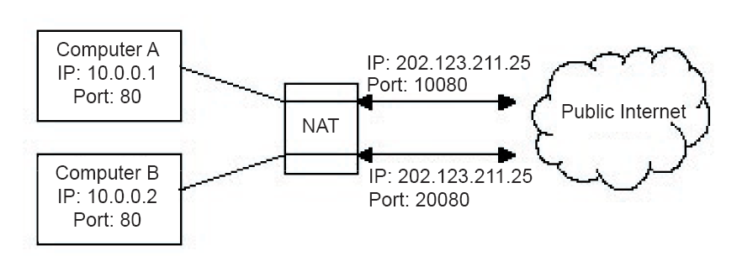
NAT in operation
网络地址转换
Translate addresses when packets traverse through NAT.
Use port numbers to identify internal IP users.
This is a dirty way to fix the problem and only works for TCP/UDP traffic.
10080
20080
Notes:
There’s NO need to allocate an IP address to a device that is turned off. We can allocate IP addr to a device when it’s on → dynamic ip addr allocation (DHCP)
(internal port# 80 is not a good example, bcs web-server never initiates a packet out ☺ this pic is copied from the book).

Slide 19
Dynamic Host Configuration Protocol (DHCP)
动态主机设置协议
To make NAT work, three ranges of IP addresses have been declared for private use (called unregistered addresses):
10.0.0.0 – 10.255.255.255/8
172.16.0.0 – 172.31.255.255/12
192.168.0.0 – 192.168.255.255/16
The allocation of the private IP addresses is done by Dynamic Host Configuration Protocol, a service running on a router:
lease IP addresses for short time period (particularly for mobile users)
hosts may refresh addresses periodically
Notes:
DHCP was evolved from RARP -> BOOTP -> DHCP, originally for the purpose of reverse addr mapping from Ethernet-addr to IP-addr.
DHCP is particularly suitable for wireless / mobile users.
In a wireless access point, allocate IP addr to mobile users and claim back when they leave.
There’s no need to give a permanent addr to a device that is only temporary login.
Theoretically, NAT doesn’t need DHCP. But, DHCP can be used to allocate internal IP addr for NAT.
DHCP doesn’t necessarily need NAT method, bcs DHCP could allocate world-wide unique IP addr (but dynamically).
In fact, from CSlab’s DHCP data, we can see DHCP can allocate any IP addresses (but mostly in 10.0.0.0 range), not necessarily in the three ranges declared by IETF.
CS Lab use the core router to distribute DHCP IP
> sh ip dhcp b
and a list of distributed IP will be show
---CUT---
c6506a>sh ip dhcp b
IP address Hardware address Lease expiration Type
10.2.0.2 0100.1500.1cf1.72 Feb 28 2006 06:09 PM Automatic
10.2.0.6 0100.0e35.b6c3.42 Feb 28 2006 06:18 PM Automatic
10.4.0.1 0100.0bdb.7261.52 Mar 01 2006 04:59 PM Automatic
10.4.0.2 0100.0bdb.725d.b6 Mar 01 2006 04:58 PM Automatic
10.4.0.3 0100.0bdb.725e.d4 Mar 01 2006 05:13 PM Automatic
10.4.0.4 0100.0bdb.7261.df Mar 01 2006 05:31 PM Automatic
10.4.0.5 0100.0bdb.7265.93 Mar 01 2006 05:35 PM Automatic
10.7.0.1 0100.0bdb.7217.8a Mar 01 2006 04:43 PM Automatic
10.7.0.2 0100.0874.16a4.8a Mar 01 2006 04:40 PM Automatic
10.7.0.3 0100.0874.1698.55 Mar 01 2006 04:41 PM Automatic
10.7.0.4 0100.0bdb.725e.56 Mar 01 2006 04:41 PM Automatic
10.7.0.5 0100.0bdb.7268.d8 Mar 01 2006 05:04 PM Automatic
10.7.0.6 0100.0874.16a2.ae Mar 01 2006 05:07 PM Automatic
10.7.0.7 0100.0874.16a1.3c Mar 01 2006 05:15 PM Automatic

Slide 20
DHCP in Operation
A DHCP server may serve multiple LANs (subnets).
A DHCP relay-agent is needed on each LAN to enable hosts on this LAN to reach DHCP server via a broadcast message.
When a device (host) is booted up, it broadcasts a DHCP discover packet (to request / discover an IP address).
DHCP discover packet is intercepted by the DHCP agent on the same LAN and forwarded to the DHCP server.
Newly-booted
device
DHCP
Relay-agent
Router
DHCP
server
Other
networks
0
DHCP Discover
Packet (broadcast)
Notes:
?difficult of DHCP: when a machine bootsup and it doesn’t have an IP add, it has no knowledge about network / dhcp svr: how can it sends a request to DHCP?
Explain fig, purpose of newly bootup machine: obtain a dynamic IP addr from DHCP from scratch.
?why every lan must have a DHCP or its agent? A host request doesn’t have an IP addr, so the req cannot be ROUTED.
Summary: CIDR, NAT, DHCP.

Slide 21
Address Resolution Problem
IP layer specifies the next hop router (destination) by IP addresses. When it gives an IP packet to the underlying network (e.g., Ethernet) for transmission, it needs to insert the “physical addresses” to the packet:
How to determine the MAC addr of an IP addr?
Notes:
Router: at Internetwork layer, route packets according to IP addresses
Switch: at Datalink layer, switch packets among LANs according to network card “physical addresses”.
Switch is used to connect LANs together. It uses ARP to resolve IP addresses → “physical addresses”.
Ethernet 以太网

Slide 22
Network Card Hardware Address
(Ethernet address)
Ethernet addresses (48-bits), in the format of:
0e: 3c: 24: 3a: 03: 06
are hard-wired into network cards at factories.
IEEE allocates Ethernet addr to manufactures to ensure the uniqueness of Ethernet addr.
Most network cards understand only hardware addr, not IP addr at all.
Notes:
Format of writing Ethernet Addr HH:HH:HH:HH:HH:HH, 6 bytes in hex number.

Slide 23
ARP- Address Resolution Protocol
地址解析协议
ARP provides a mapping from IP addr to physical addr. Suppose A knows B's IP addr and wants to know B’s physical addr:
A broadcasts ARP query packet, containing B's IP address
  all machines on the LAN receive ARP query
B receives ARP packet, replies to A with its (B's) physical layer address
A caches (saves) IP-to-physical address pairs until information becomes old (times out)
  soft state: information that times out (goes away) unless refreshed
ARP shell command: arp
Notes:
> arp –a // list all physical address of all hosts

Slide 24
ARP Cache and RARP
逆地址解析协议
ARP maintains a cache of the recent IP to physical address mappings to make address translation fast
Each entry is aged (usually the lifetime is 20 minutes) forcing periodic updates of the cache
ARP replies are often broadcast so that all hosts can update their caches
RARP (Reverse ARP) protocol allows a newly booted-up host to find its own IP address from its physical address (RARP was largely replaced by DHCP).
Notes:
DHCP was evolved from RARP -> BOOTP -> DHCP, originally for the purpose of reverse addr mapping from Ethernet-addr to IP-addr.
Now, DHCP largely replaced RARP or BOOTP.

Slide 25
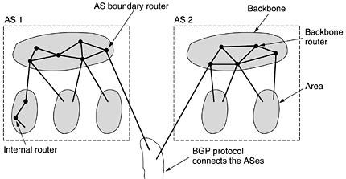
OSPF-Interior Gateway Routing Protocol
Internet consists of a large number of ASes (autonomous systems). Each AS, operated by an organization (or university), can use its own routing algorithm inside. Nevertheless, OSPF (open shortest path first) is a de facto routing standard for intra-AS routing.
An AS is often divided into numbered areas (a subnet or a set of contiguous subnets).
Each AS has a backbone, called area 0. At least one router in each area is connected to the backbone routers.
Some backbone routers (called AS boundary routers) are connected to other ASes for inter-AS routing.
Notes:
Internet has two levels of routing. Inter-AS routing and Intra-AS routing.

Slide 26
OSPF Algorithm
开放式最短路径优先
OSPF abstracts the routers within the AS into a connected graph and assign weight to each edge (distance, delay, etc).
Each router periodically floods Link-State-Update message to its adjacent routers, thus each router knows the topology within the area.
Intra-area routing: each router uses the link state database and runs the shortest path to the destination router.
Inter-area routing: the source router → backbone → the destination area → destination router
Inter-AS routing, the source router → backbone → AS boundary router → destination AS boundary router (via BGP) → dest-router
Notes:
See, AS, backbone, Area.
Within area, link state routing! (BGP uses distance vector)
Inter-AS: BGP ->

Slide 27
BGP – Exterior Gateway Routing Protocol
边界网关协议
Inter-AS traffics are routed by BGP (Border Gateway Protocol):
Exterior gateway protocol concerns more on routing policies, such as no transit traffic through certain ASes, no relay for certain ASes, etc.
BGP is a distance vector protocol. Each entry in routing table contains: dest, next-hop-to-dest, distance (# of hops). It always chooses the next hop neighbor with the shortest distance to a destination to forward the packet, called next-hop-routing.
Each BGP router exchanges routing info with its neighbors (distances & next-hop to all destinations). After collecting the info from neighbors, a BGP router can update (build up) its own routing table.
Notes:
Distance vector requires much less cost to maintain (good for large networks), compared with link state method (good for small networks).

