Slide 1
Distributed Systems
分布式系统
Group Communication
群组通信

Slide 2
Modes of communication
One-to-One
  Unicast
    1←→1
    Point-to-point
  Anycast
    1→nearest 1 of several identical nodes
    Introduced with IPv6; used with BGP routing protocol
One-to-many
  Multicast
    1→many
    Group communication
  Broadcast
    1→all

Slide 3
Groups
Groups allow us to deal with
a collection of processes as one abstraction
Send message to one entity
  Deliver to entire group
Groups are dynamic
  Created and destroyed
  Processes can join or leave
    May belong to 0 or more groups
Primitives
  join_group, leave_group, send_to_group, query_membership(sometimes)

Slide 4
Design Issues
Closed vs. Open
  Closed: only group members can sent messages
Peer vs. Hierarchical
  Peer: each member communicates with the entire group
  Hierarchical: go through coordinator(s)
    Root coordinator: forwards message to appropriate subgroup coordinators
Managing membership & group creation/deletion
  Distributed vs. centralized
Leaving & joining must be synchronous
Fault tolerance (容错性）
  Reliable message delivery? What about missing members?

Slide 5
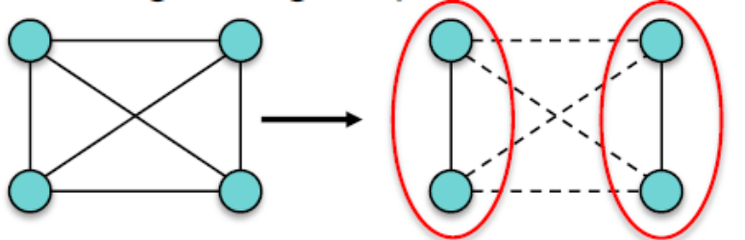
Failure considerations
The same things bite us with unicast communication
Crash failure
  –Process stops communicating
Omission failure (typically due to network)
  Send omission: A process fails to send messages
  Receive omission: A process fails to receive messages
Byzantine failure
  Some messages are faulty
Partition failure
  The network may get segmented, dividing the group into two or more unreachable sub-groups

Slide 6
Implementing Group
Communication Mechanisms

Slide 7
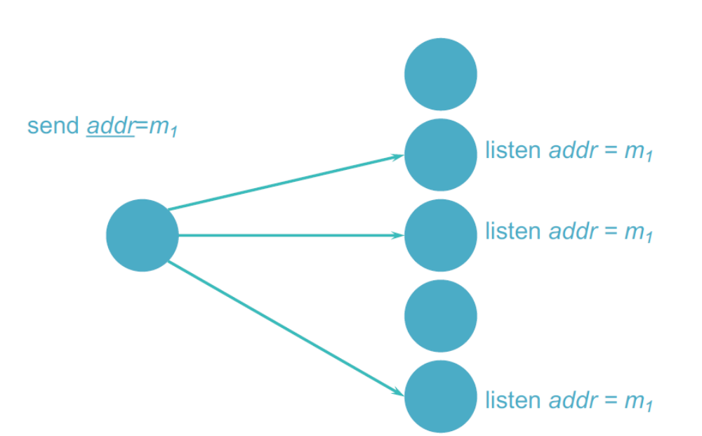
Hardware multicast
If we have hardware support for multicast
  Group members listen on network address

Slide 8
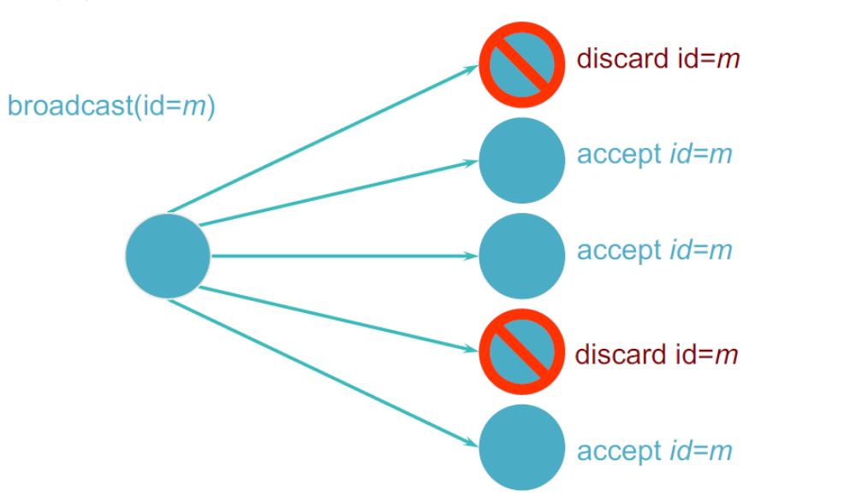
Broadcast
Diffusion group: send to all clients & then filter
  Software filters incoming multicast address
  May use auxiliary address (not in the network address header) to identify group

Slide 9
Hardware multicast & broadcast
Ethernet supports both multicast & broadcast
Limited to local area networks

Slide 10
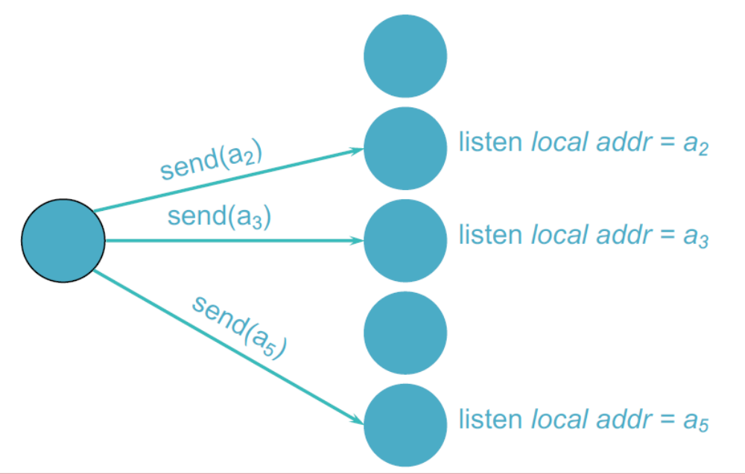
Software implementation: multiple unicasts
Sender knows group members

Slide 11
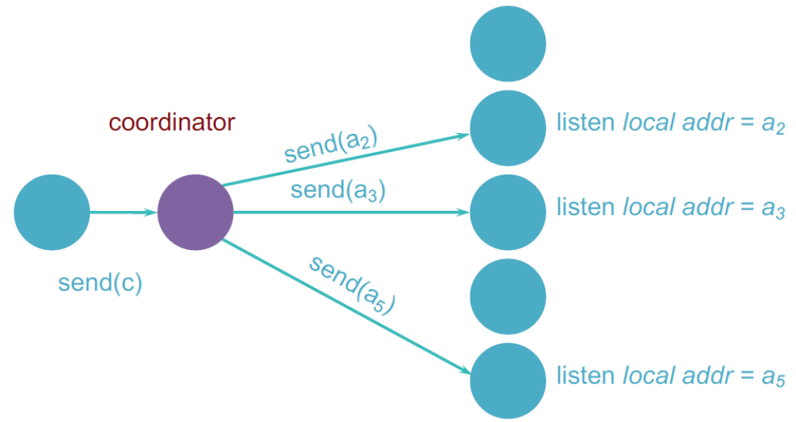
Software implementation: hierarchical
Multiple unicasts via group coordinator
  Coordinator knows group members
  Coordinator iterates through group members
  May support a hierarchy of coordinators

Slide 12
Reliability of multicasts 组播可靠性

Slide 13
Atomic multicast
Atomicity （原子性）
  Message sent to a group arrives at all group members
  If it fails to arrive at any member, no member will process it
Problems
  Unreliable network
  Each message should be acknowledged
  Acknowledgements can be lost
  Message sender might die

Slide 14
Achieving atomicity
General idea
  Ensure that every recipient acknowledges receipt of the message
  Only then allow the application to process the message
  If we give up on a recipient
    then no recipient can process that received message
Easier said than done!
  What if a recipient dies after acknowledging the message?
    Is it obligated to restart?
    If it restarts, will it know to process the message?
  What if the sender (or coordinator) dies partway through the protocol?

Slide 15
Achieving atomicity–example 1
Retry through network failures & system downtime
Sender & receivers maintain a persistent log
Each message has a unique ID so we can discard duplicates
Sender
  Send message to all group members
  Write message to log
  Wait for acknowledgement from each group member
  Write acknowledgement to log
  If timeout on waiting for an acknowledgement, retransmit to group member
Receiver
  Log received non-duplicate message to persistent log
  Send acknowledgement
NEVER GIVE UP!
  Assume that dead senders or receivers will be rebooted and will restart where they left off

Slide 16
Achieving atomicity–example 2
Redefine the group
If some members failed to receive the message:
  Remove the failed members from the group
  Then allow existing members to process the message
But still need to account for the death of the sender
  Surviving group members may need to take over to ensure all current group members receive the message
This is the approach used in virtual synchrony

Slide 17
Reliable multicast
All non-faulty group members will receive the message
  Assume sender & recipients will remain alive
  Network may have glitches
    Try to retransmit undelivered messages ... but eventually give up
  It’s OK if some group members don’t get the message
Acknowledgements
  Send message to each group member
  Wait for acknowledgement from each group member
  Retransmit to non-responding members
  Subject to feedback implosion

Slide 18
Optimizing Acknowledgements
Easiest thing is to wait for an ACK before sending the next message
  But that incurs a round-trip delay
Optimizations
  Pipelining
    Send multiple messages –receive ACKs asynchronously
    Set timeout –retransmit message for missing ACKs
  Cumulative ACKs
    Wait a little while before sending an ACK
    If you receive others, then send one ACK for everything
  Piggybacked ACKs
    Send an ACK along with a return message
  Negative ACKs
    Use a sequence # on each message
    Receiver requests retransmission of a missed message
    More efficient but requires sender to buffer messages indefinitely
TCP does the first three of these
...but now we have to do this for each recipient

Slide 19
Unreliable multicast (best effort)
Basic multicast
Hope it gets there

Slide 20
Message ordering 消息顺序

Slide 21
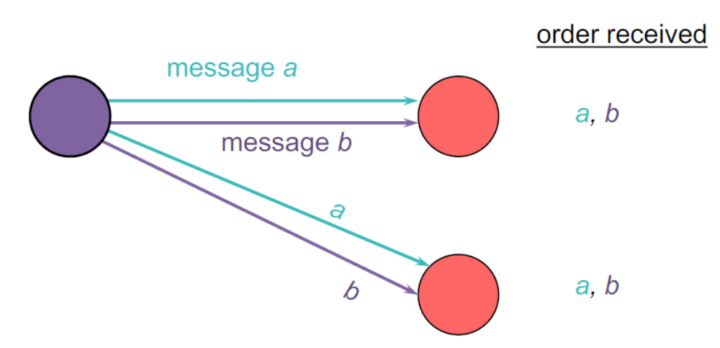
Good Ordering

Slide 22
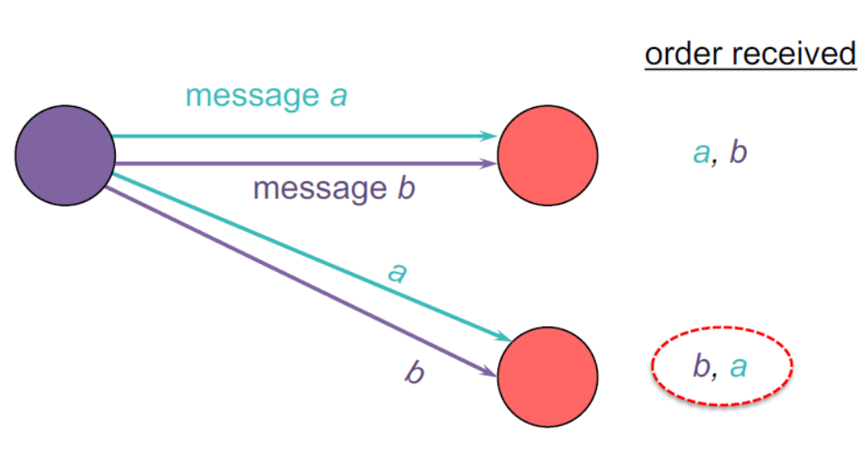
Bad Ordering

Slide 23
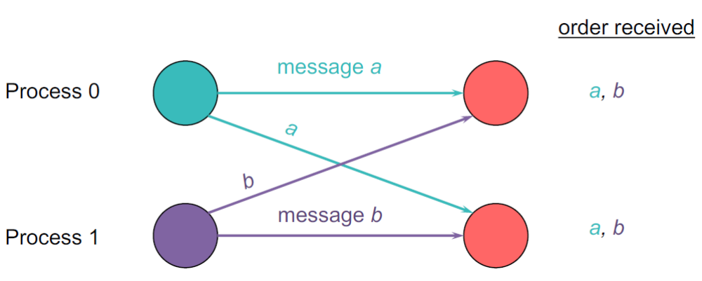
Good Ordering

Slide 24
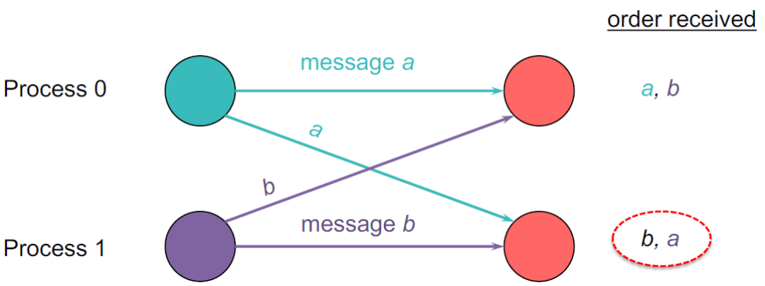
Bad Ordering

Slide 25
Sending vs. Receiving vs. Delivering
Multicast receiver algorithm decides when to deliver a message to the process.
A received message may be:
  Delivered immediately
  (put on a delivery queue that the process reads)
  Placed on a hold-back queue
  (because we need to wait for an earlier message)
  Rejected/discarded
  (duplicate or earlier message that we no longer want)

Slide 26
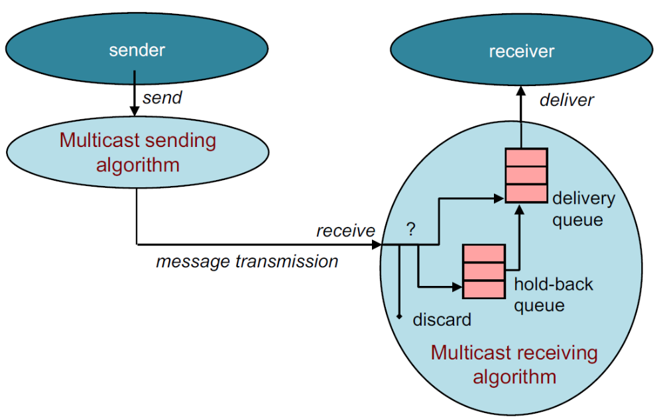
Sending, delivering, holding back

Slide 27
Global time ordering
All messages are delivered in exact order sent
Assumes two events never happen at the exact same time!
Difficult (impossible) to achieve
Not viable

Slide 28
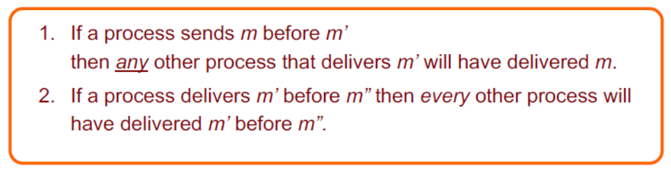
Total ordering （全序）
Consistent ordering at all receivers
All messages are delivered at all group members in the same order
  They are sorted in the same order in the delivery queue
Implementation:
  Attach unique totally sequenced message ID
  Receiver delivers a message to the application only if it has received all messages with a smaller ID

Slide 29
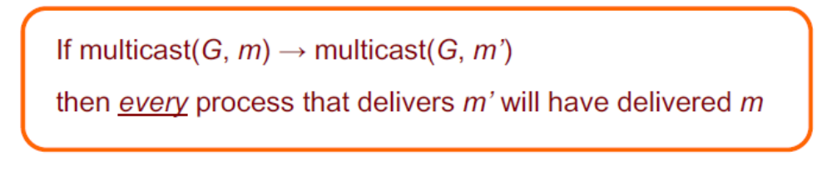
Causal ordering
Also known as partial ordering 偏序
  Messages sequenced by Lamport or Vector timestamps
If message m’ is causally dependent on message m, all processes must deliver m before m’.

Slide 30
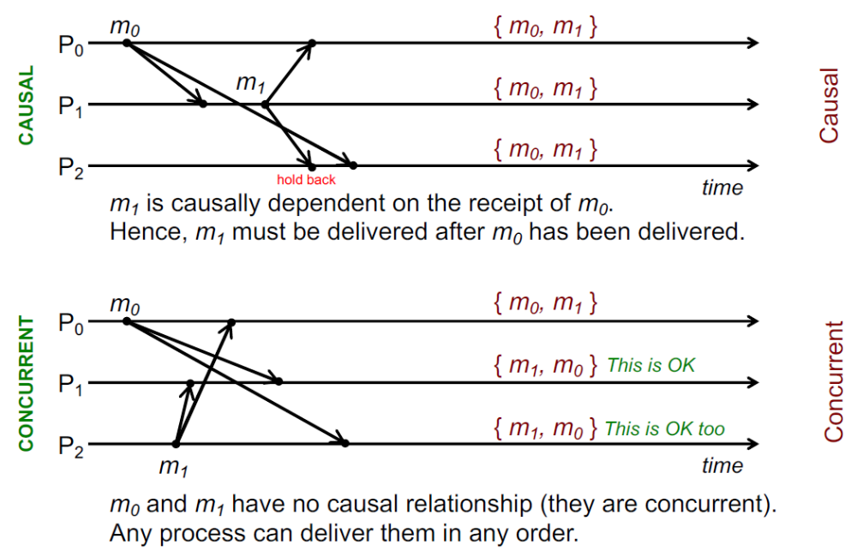
Causal ordering example

Slide 31
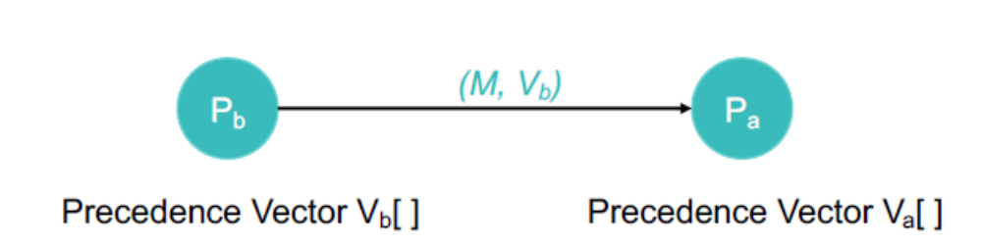
Causal ordering –implementation
Implementation: Pa receives a message from Pb
Each process keeps a precedence vector
(similar to vector timestamp)
Vector is updated on multicast send and receive events
  Each entry = # of latest message from the corresponding group member that causally precedes the event

Slide 32
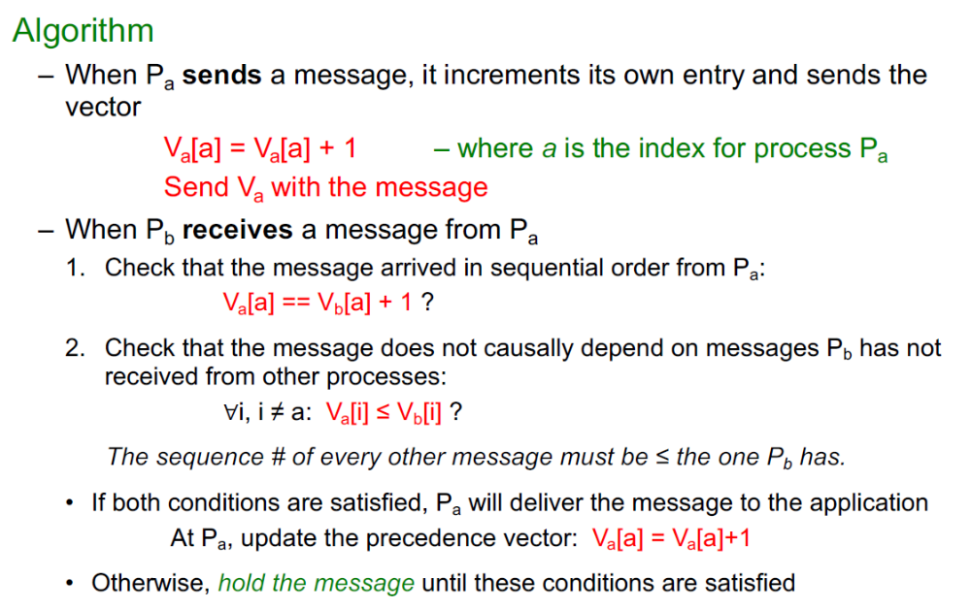
Causal ordering –implementation

Slide 33
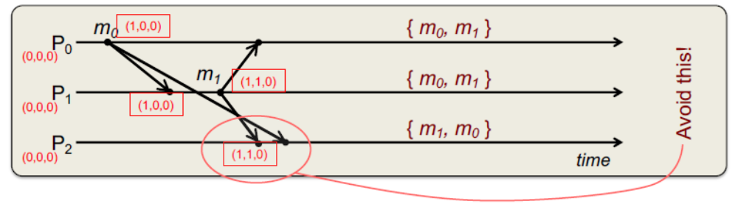
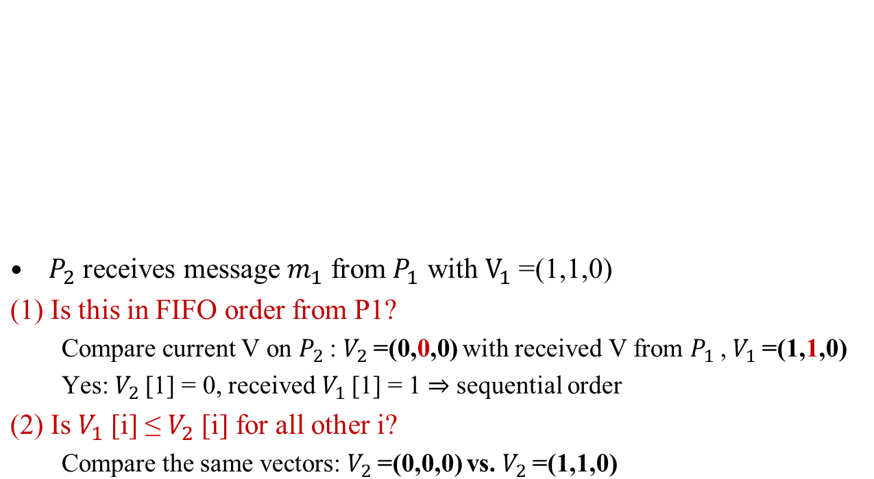
Causal Ordering: Example

Slide 34
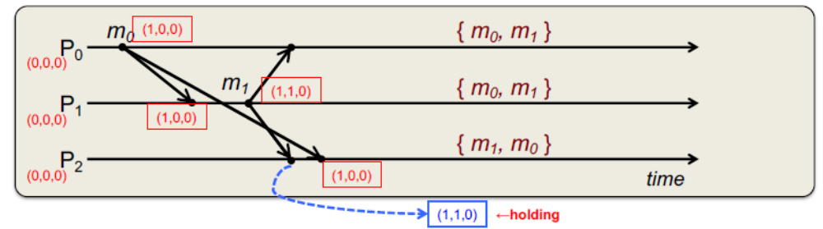
Causal Ordering: Example
P₂ receives message m₀ from P₀ with V=(1,0,0)
  (1) Is this in FIFO order from P₀?
    Compare current V on P₂: V₂=(0,0,0) with received V from P₂, V₂=(1,0,0)
    Yes: V₂[0] = 0, received V₁[0] = 1 ⇒ sequential
  (2) Is V₀[i] ≤ V₂[i] for all other i?
    Yes. (0 ≤ 0), (0 ≤ 0).
  Deliver m₀. Update precedence vector from (0, 0, 0) to (1, 0, 0)
  Now check hold-back queue. Can we deliver m₁?

Slide 35
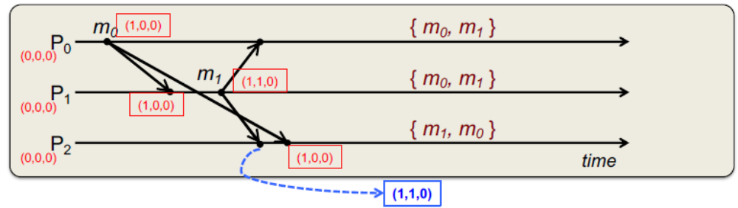
Causal Ordering: Example
  (1) Is the held-back message m₁ in FIFO order from P₀?
    Compare current V on P₂: V₂=(1,0,0) with held-back V from P₀, V₁=(1,1,0)
    Yes: (current V₂[1] = 0) vs. (received V₁[1] = 1) ⇒ sequential
  (2) Is V₀[i] ≤ V₂[i] for all other i?
    Now yes. (V₀[0] = 1) ≤ (V₂[0] = 1) and element 2: (V₀[2] = 0) ≤ (V₂[2] = 0)
  Deliver m₁.
  Causal ordering can be implemented more efficiently than total ordering:
    No need for a global sequencer.
    Expect reliable delivery but we may not need to send immediate
    acknowledgements.

Slide 36
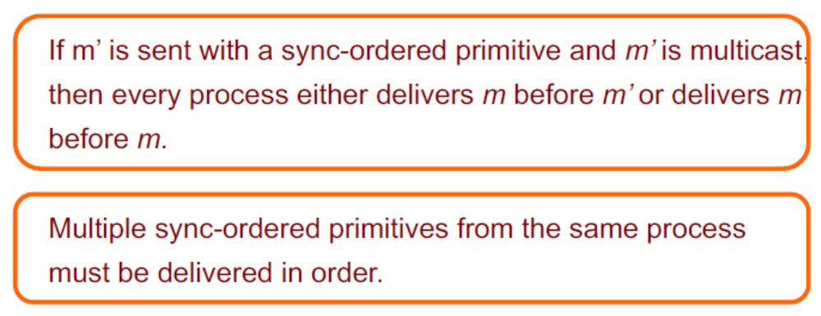
Sync ordering
Messages can arrive in any order
Special message type
  Synchronization primitive
  Ensure all pending messages are delivered before any additional (post-sync) messages are accepted

Slide 37
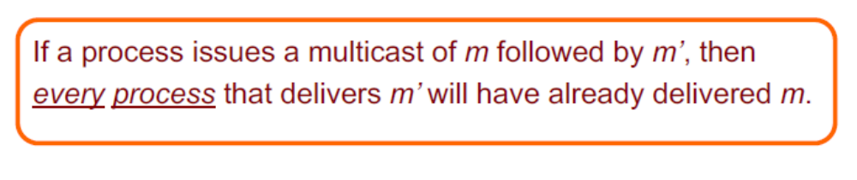
Single Source FIFO (SSF) ordering
Messages from the same source are delivered in the order they were sent.
Message m must be delivered before message m’ iff m was sent before m’ from the same host

Slide 38
Unordered multicast
Messages can be delivered in different order to different members
Order per-source does not matter.

Slide 39
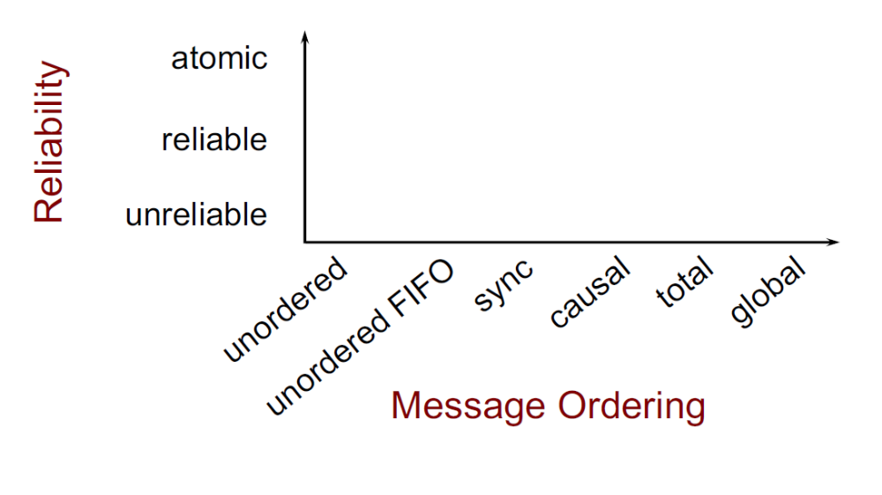
Multicasting considerations

Slide 40
IP multicast routing

Slide 41
IP multicast routing
Deliver messages to a subset of nodes
  Send to a multicast address
How do we identify the recipients?
  Enumerate them in the header?
    What if we don’t know?
    What if we have thousands of recipients?
Use a special address to identify a group of receivers
  A copy of the packet is delivered to all receivers associated with that group
  IPv4: Class D multicast IP address
    32-bit address that starts with 1110
    (224.0.0.0/4 = 224.0.0.0 – 239.255.255.255 )
  IPv6: 128-bit address with high-order bits 8 bits all 1
  Host group = set of machines listening to a particular multicast address
    A copy of the message is delivered to all receivers associated with that group

Slide 42
IP multicasting
Can span multiple physical networks
Dynamic membership
  Machine can join or leave at any time
No restriction on number of hosts in a group
Machine does not need to be a member to send messages
Efficient: Packets are replicated only when necessary
Like IP, no delivery guarantees

Slide 43
IP multicast addresses
Addresses chosen arbitrarily for an application
Well-known addresses assigned by IANA
Internet Assigned Numbers Authority
IPv4 addresses: http://www.iana.org/assignments/multicast-addresses/multicast-addresses.xml
IPv6 addresses: https://www.iana.org/assignments/ipv6-multicast-addresses/ipv6-multicast-addresses.xhtml
  Similar to ports – service-based allocation
    For ports, we have:
      FTP: port 21, SMTP: port 25, HTTP: port 80
  For multicast, we have:
  224.0.0.1: all systems on this subnet
  224.0.0.2: all multicast routers on subnet
  224.0.23.173: Philips Health
  224.0.23.52: Amex Market Data
  224.0.12.0-63: Microsoft & MSNBC
  FF02:0:0:0:0:0:0:9: RIP routers

Slide 44
IGMP 因特网组管理协议
Internet Group Management Protocol (IGMP)
  Operates between a host and its attached router
  Goal: allow a router to determine to which of its networks to forward IP multicast traffic
  IP protocol (IP protocol number 2)
Three message types
  Membership_query
    Sent by a router to all hosts on an interface to determine the set of all multicast groups that have been joined by the hosts on that interface
  Membership_report
    Host response to a query or an initial join or a group
  Leave_group
    Host indicates that it is no longer interested
    Optional: router infers this if the host does not respond to a query

Slide 45
Multicast Forwarding
IGMP allows a host to subscribe to receive a multicast stream
What about the source?
  There is no protocol for the source!
  It just sends one message to a class D address
  Routers have to do the work

Slide 46
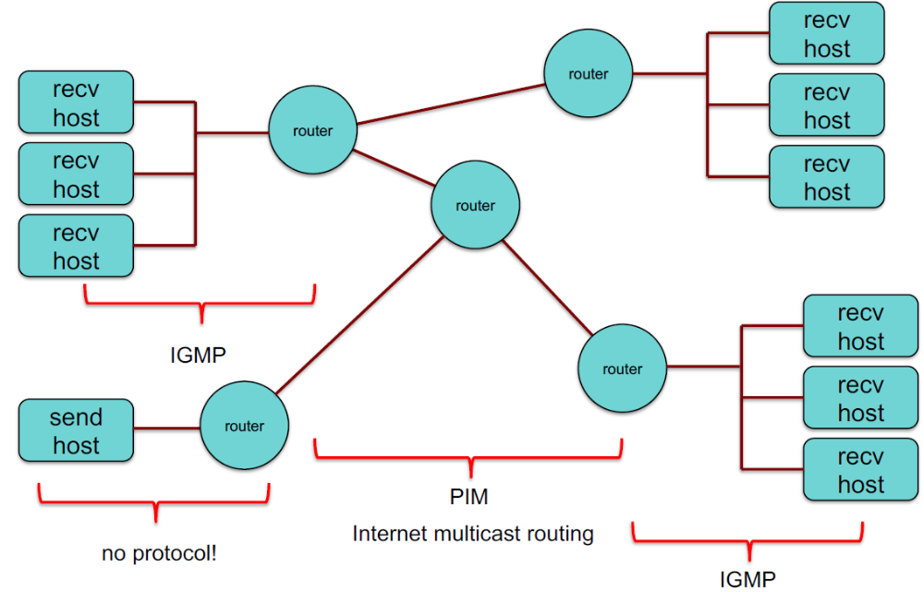
IGMP & Wide-Area Multicast Routing

Slide 47
Multicast Forwarding
IGMP: Internet Group Management Protocol 因特网组管理协议
  Designed for routers to talk with hosts on directly connected networks
PIM: Protocol Independent Multicast 独立组播协议
  Multicast Routing Protocol for delivering packets across routers
  Topology discovery is handled by other protocols
  Two forms:
    1. Dense Mode (PIM-DM) 密集模式
    2. Sparse Mode (PIM-SM) 稀疏模式

Slide 48
Flooding: Dense Mode Multicast (PIM-DM)
Relay multicast packet to all connected routers
  Use a spanning tree and reverse path forwarding (RPF) to avoid loops
  Feedback & cut off if there are no interested receivers on a link
    A router sends a prune message.
    Periodically, routers send messages to refresh the prune state
  Flooding is initiated by the sender’s router
Reverse path forwarding (RPF) : avoid routing loops
（逆向路径转发）
  Packet is duplicated & forwarded ONLY IF it was received via the link that is the shortest path to the sender
  Shortest path is found by checking the router’s forwarding table to the source address

Slide 49
Flooding: Dense Mode Multicast
Advantage:
  Simple
  Good if the packet is desired in most locations
Disadvantage:
  wasteful on the network, wasteful extra state & packet duplication on routers

Slide 50
Sparse Mode Multicast (PIM-SM)
Initiated by the routers at each receiver
Each router needs to ask for a multicast feed with a PIM Join message
  Initiated by a router at the destination that gets an IGMP join
  Rendezvous Point: meeting place between receivers & source
    Join messages propagate to a defined rendezvous point (RP)
    Sender transmits only to the rendezvous point
    RP announcement messages inform edge routes of rendezvous points
  A Prune message stops a feed
Advantage
  Packets go only where needed
  Creates extra state in routers only where needed

Slide 51
IP Multicast in use
Initially exciting:
  – Internet radio, NASA shuttle missions, collaborative gaming
But:
  Few ISPs enabled it
  For the user, required tapping into existing streams
    (not good for on-demand content)
  Industry embraced unicast instead

Slide 52
IP Multicast in use: IPTV
IPTV has emerged as the biggest user of IP multicast
  Cable TV networks have migrated (or are migrating) to IP delivery
Cable TV systems: aggregate bandwidth ~ 4.5 Gbps
  Video streams: MPEG-2 or MPEG-4 (H.264)
  MPEG-2 HD: ~30 Mbps ⇒ 150 channels = ~4.5 Gbps
  MPEG-4 HD: ~6-9 Mbps; DVD quality: ~2 Mbps
Multicast
  Reduces the number of servers needed
  Reduces the number of duplicate network streams

Slide 53
IP Multicast in use: IPTV
Multicast allows one stream of data to be sent to multiple subscribers using a single address
IGMP from the client
  Subscribe to a TV channel
  Change channels
Use unicast for video on demand

Slide 54
The end

