Slide 1

Desarrollo Basado en Plataformas
Unidad II: Plataformas Web
Dra. Regina Paola TICONA HERRERA
Arequipa - 2017

Slide 2

Desarrollo Basado en Plataformas
Indice
Taxonomia de IRIs
IRIs como objetos del mundo real
Propuestas para identificar objetos del mundo real
Identificación de IRIs
Capa de Red
Capa de Datos
Marco de RDF
Ejemplos basados en RDF sobra aplicación de IRIs
Regina Ticona-Herrera
2

Slide 3
Taxonomy of IRIs types
IRI
IRI Using Convention
IRI Owner Naming
Implementation IRI
Naming Resources IRI
Resource IRI
Page IRI
Data IRI
Ontology IRI
Document IRI
Document Representation IRI
Concept IRI
Id IRI
Information IRI
Non-Information IRI
IRI identity
user-defined classification
Type Resources
* The links are IsA relationship

Slide 4
IRIs for Real-World Objects (Semantic Web IRIs) [6]
Be on the Web
Given only a IRI, machines and people should be able to retrieve a description about the resource identified by the IRI from the Web
Machines should get RDF data and humans should get a readable representation, such as HTML
Be unambiguous
There should be no confusion between identifiers for Web documents and identifiers for other resources
Resource Identifier (IRI)
ID
for semantic web applications
for web browsers
RDF
HTML
RDF document IRI
HTML document IRI

Slide 5
Proposals for identifying Real-World Objects (Semantic Web IRIs)
We can identify the real-world object based on two layers:
Network layer
Uses the HTTP protocol to identify the real-world object
There are two solutions for this layer [6] :
Hash IRIs
303 IRIs [7]
Data layer
Identifying assertions that serve to constraint the denoted resource’s identity
Helping to infer the meaning of the IRI as a set of assertions
There are two architectural approaches for specifying and using such assertions [8]:
Competing definitions
IRI declarations

Slide 6
Taxonomy of IRI Identification
IRI
Identification
Network Layer Identification IRI
Data Layer Identification IRI
Hash IRIs
303 IRIs
IRI Declaration
Competing Definitions
owner-defined
* The links are IsA relationship

Slide 7
Solution 1 (Network Layer): Hash URIs (1)
Using a fragment, a special part that is separated from the rest of the URI by a hash symbol (“#”)
Dereferencing the racine in search of the IRI definition
Ex: http://www.example.com/about#sebastien
Should be preferred for rather small and stable sets of resources that evolve together (e.g., RDF schema vocabularies and OWL ontologies)
racine
definition

Slide 8
Solution 1 (Network Layer): Hash URIs (2)
http://www.example.com/about#sebastien
Person
Automatic truncation of fragment
http://www.example.com/about
application/rdf+xml wins
content negotiation
text/html wins
RDF
HTML
Content-Location:
http://www.example.com/about.rdf
Content-Location:
http://www.example.com/about.html

Slide 9
Solution 2 (Network Layer): 303 URI
303 URIs forwarding to Document(s)
To use a special HTTP status code, 303 See Other HTTP header [7], to give an indication that the requested resource is not a regular Web document
Dereferencing the IRI itself to obtain a new IRI, which in turn is dereferenced in search of a IRI definition
Ex: http://www.example.com/id/sebastien
dereferencing to http://www.example.com/doc/sebastien
Used for large sets of data
This approach is divided as:
Forwarding to one Generic Document
Forwarding to different documents

Slide 10
303 URI forwarding to one Generic Document
http://www.example.com/id/sebastien
Person
303 redirect
http://www.example.com/doc/sebastien
Generic Document
application/rdf+xml wins
content negotiation
text/html wins
RDF
HTML
Content-Location:
http://www.example.com/doc/sebastien.rdf
Content-Location:
http://www.example.com/doc/sebastien.html

Slide 11
303 URI forwarding to different documents
http://www.example.com/id/sebastien
Person
application/rdf+xml wins
303 redirect with content negotiation
text/html wins
RDF
HTML
Content-Location:
http://www.example.com/data/sebastien
Content-Location:
http://www.example.com/people/sebastien.html

Slide 12
Pros and Cons in the proposals of the Network Layer
 | Hash IRI | 303 IRI
Pros | Reduce the number of necessary HTTP round-trips Reduce access latency Family of IRIs can share the same non-hash part | Very fexible Redirection target can be configured separately for each resource For ontologies, network delay can reuce a client’s performance considerable
Cons | Inadvertenly load the data for al other resources, because they are in the same file | The large number of redirects may cause higher latency May be tempted to download all data using many request

Slide 13

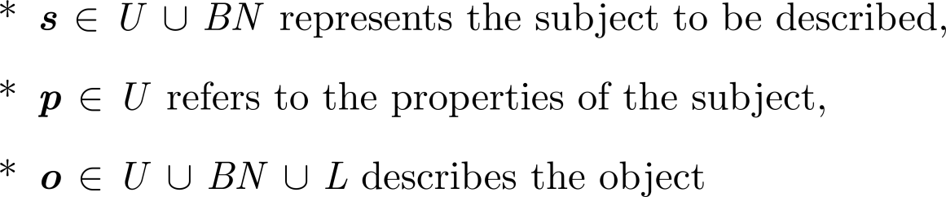
Overview of RDF statement (1)
Expresses a relationship (edge) between two resources (nodes), two blank nodes or one resource and blanck node
Atomic structure consisting of a triple with a subject (s), a predicate (p) and an object (o)
where:
RDF extended statement
Is a more expressive representation of an RDF statement
Denoted by:

Slide 14

Overview of RDF statement (2)
IRI path content of the IRI
BN – Literal textual values
lang – dt textual values
Node
(IRI, BN)
Edge
(IRI)
Node
(IRI, BN, Literal)

Slide 15
Example 1 (Data layer): Competing Definitions
All the assertions are created equal
The community or marketplace decide which assertions become the prevailing definition of a particular IRI
Ex:
St₁: <http://dbpedia.org/resource/Luxembourg, owl:sameAs, http://es.dbpedia.org/resource/Luxemburgo>
St₂: <http://dbpedia.org/resource/Luxembourg, wdrs:describedby, http://dbpedia.org/data/Luxembourg.nt>
“When I use a IRI it means just what I choose it to mean”

Slide 16
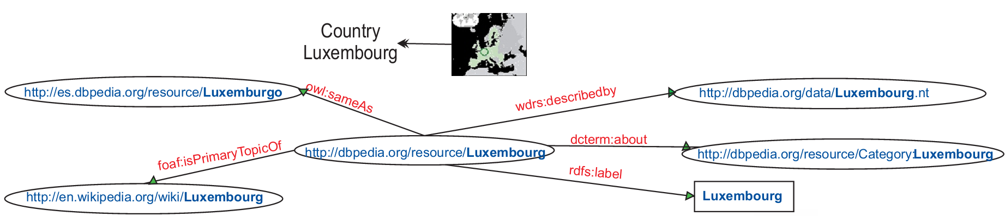
Example: Competing Definitions
Fig. 11. RDF Graph 3

Slide 17
Example 2 (Data layer): IRI Declaration
All the assertions are not created equal: some are special from the outset (core assertions)
Use a IRI implies agreement with its follow-your-nose definition (identifying assertions that IRI contains)
Should be consistently used as the IRI’s definition in all statements
Ex: (See Graph 1)
St₁: <http://www.univ-pau.fr, ex1:lab, http://www.univ-pau.fr/live/>
“When I use a IRI it means just what the IRI owner chose it to mean” or “When I mint a IRI it means just what I choose it to mean”

Slide 18
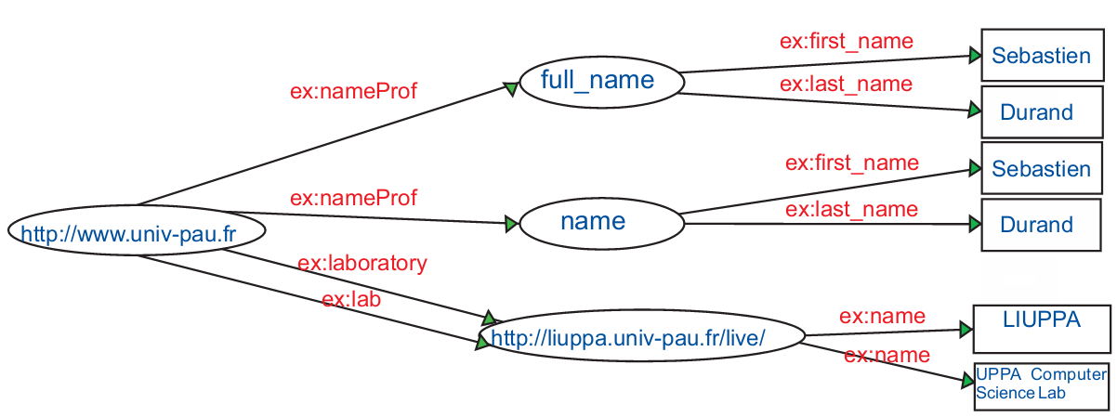
Example: IRI declaration
Fig. 12. RDF Graph I

Slide 19
Desarrollo Basado en Plataformas
Referencias
1. Berners-Lee, T., R. Fielding, and L. Masinter, Uniform resource identifier (URI): Generic syntax, 2004.
2. Halpin, H., The Semantic Web, in Social Semantics2013, Springer US. p. 51-83.
3. Dürst, M. and M. Suignard, Internationalized resource identifiers (IRIs), 2004.
4. Biron, P., A. Malhotra, and W.W.W. Consortium, XML schema part 2: Datatypes. World Wide Web Consortium Recommendation REC-xmlschema-2-20041028, 2004.
5. Booth, D., Four Uses of a URL: Name, Concept, Web Location and Document Instance. Retrieved January, 2003. 28: p. 2003.
6. Ayers, D. and M. Völkel, Cool uris for the semantic web. Woking Draft. W3C, 2008.
7. Fielding, R.T., httpRange-14. Resolved.[Online]. http://lists.w3.org/Archives/Public/www-tag/2005Jun/0039.html, 2003.
8. Booth, D. Why URI Declarations? A Comparison of Architectural Approaches. in IRSW. 2008.
9. Jaffri, A., H. Glaser, and I. Millard. Uri identity management for semantic web data integration and linkage. in On the Move to Meaningful Internet Systems 2007: OTM 2007 Workshops. 2007. Springer.
10. Glaser, H., A. Jaffri, and I. Millard, Managing co-reference on the semantic web. 2009.
11. Glaser, H., I.C. Millard, and A. Jaffri, RKBExplorer. com: a knowledge driven infrastructure for linked data providers2008: Springer.
12. Bouquet, P., et al. OkkaM: Towards a Solution to the “Identity Crisis” on the Semantic Web. in SWAP. 2006.
13. Bouquet, P., H. Stoermer, and D. Giacomuzzi, OKKAM: Enabling a Web of Entities. I3, 2007. 5: p. 7.
14. Stoermer, H., OKKAM: Enabling Entity-centric Information Integration in the Semantic Web. 2008.
15. Tekli (waiting for the aceptation of the journal)
Regina Ticona-Herrera
19

Slide 20
FIN

