Slide 1
Multiple Linear Regression

Slide 2
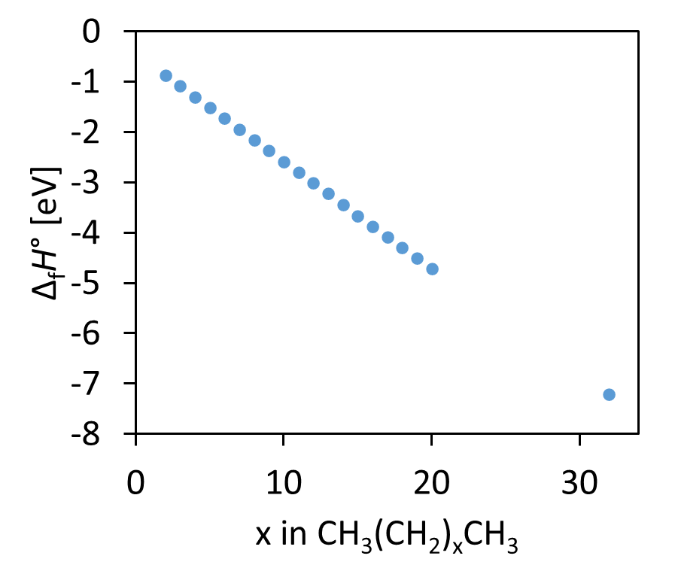
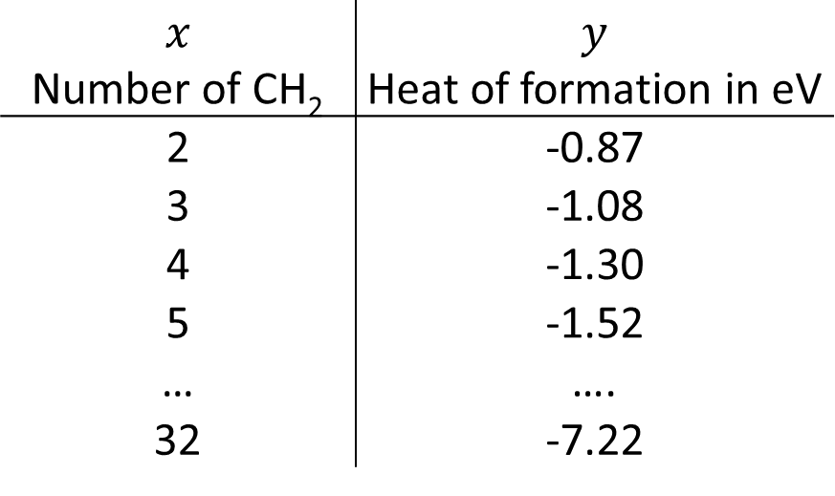
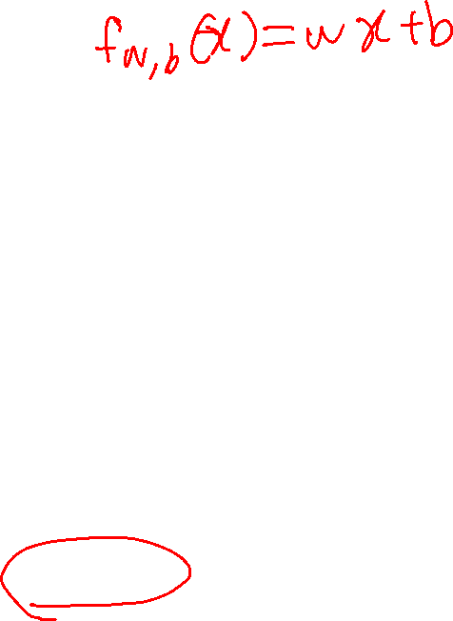
Linear Regression
Heat of Formation, Δ_{f}H°, of Linear Alkane
Data
$$x$$ Number of CH₂ | $$y$$ Heat of formation in eV
2 | -0.87
3 | -1.08
4 | -1.30
5 | -1.52
… | ….
32 | -7.22
One feature

Slide 3

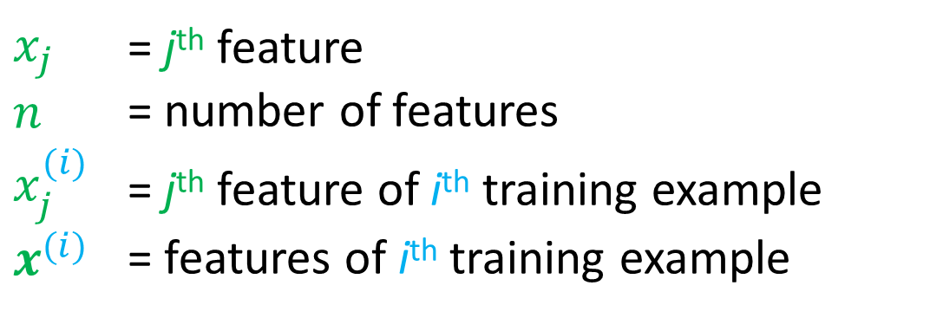
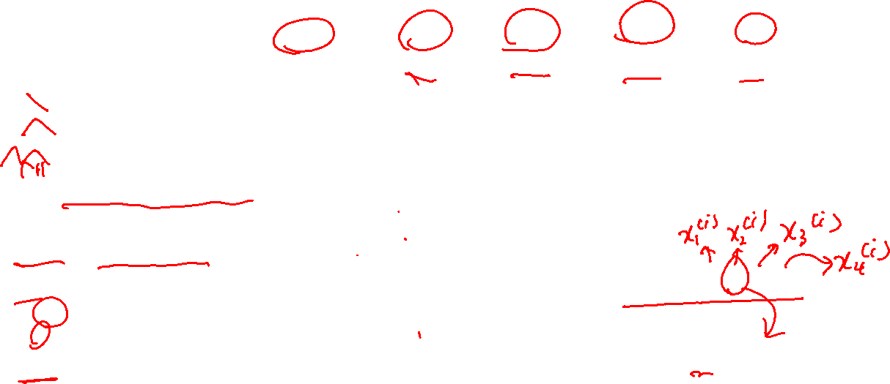

Multiple Linear Regression - Notations
Heat of Formation of Alkane (includes nonlinear alkane)
Molecule | Δ_{f}H° y | CH₃ x₁ | CH₂ x₂ | CH x₃ | C x₄
Ethane | -0.87 | 2 | 0 | 0 | 0
Propane | -1.08 | 2 | 1 | 0 | 0
3-methyl-Pentane | -1.78 | 3 | 2 | 1 | 0
3,3-dimethyl-Hexane | -2.28 | 4 | 3 | 0 | 1
… | …. | …. | …. | …. | ….
$x_{j}$ = j^{th} feature
$n$ = number of features
$x_{j}^{(i)}$ = j^{th} feature of i^{th} training example
$x^{(i)}$ = features of i^{th} training example
$$x^{(i)}=[2 0 0 0]$$
$$x_{2}^{(i)}=0$$

Slide 4
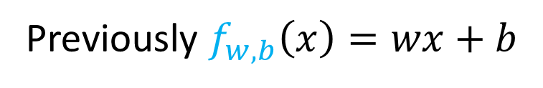
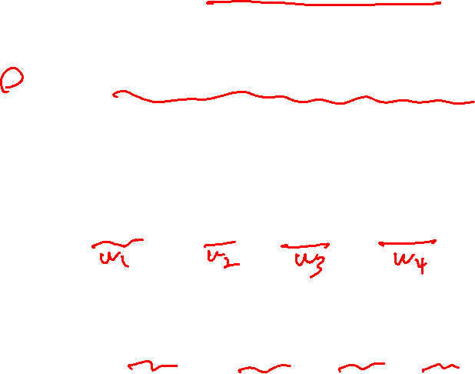
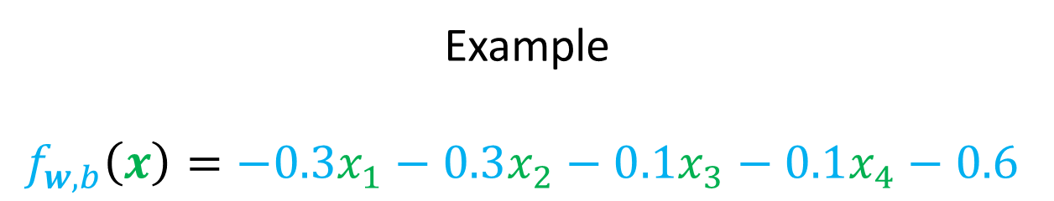
Model Comparison
Previously $f_{w,b}\left(x\right)=wx+b$
$$f_{w,b}\left(x\right)=w_{1}x_{1}+w_{2}x_{2}+w_{3}x_{3}+w_{4}x_{4}+b$$
Example
$$f_{w,b}\left(x\right)=−0.3x_{1}−0.3x_{2}−0.1x_{3}−0.1x_{4}−0.6$$
# CH₃
# CH₂
# CH
# C
Base energy

Slide 5

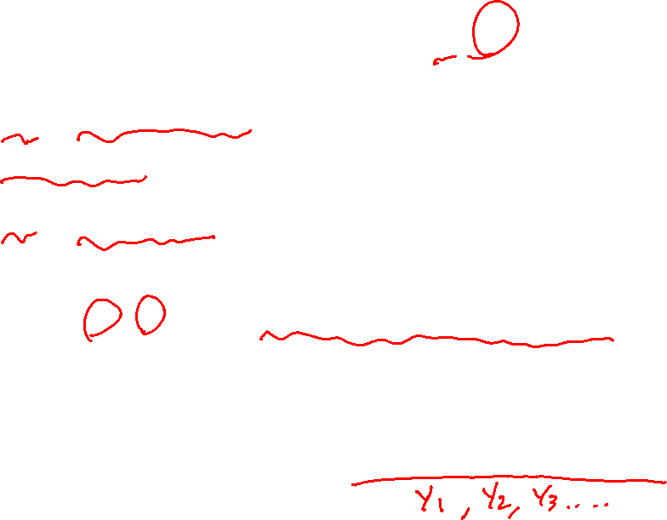

Vector representation
$$f_{w,b}\left(x\right)=w_{1}x_{1}+w_{2}x_{2}+…+w_{n}x_{n}+b$$
$w=[w_{1} w_{2} …w_{n}]$
parameters of the model
b is a number
$x=[x_{1} x_{2} …x_{n}]$
$$f_{w,b}\left(x\right)=w∙x+b=w_{1}x_{1}+w_{2}x_{2}+…+w_{n}x_{n}+b$$
dot product
Multiple linear regression
(Not multivariate linear regression)

Slide 6


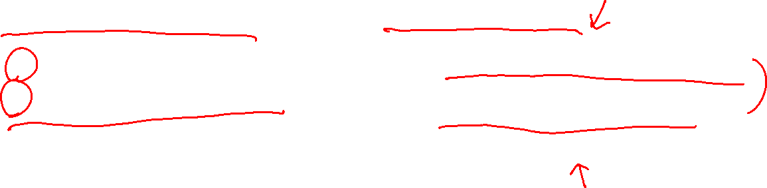
Linear algebra and numpy
Linear algebra counts from 1
Python counts from 0
w[0]
w[1]
w[2]
$w=[w_{1} w_{2} w_{3}]$
w = np.array([1.0, 1.5, -2.3])
b = 4
x = np.array([5, -3, 15])
$x=[x_{1} x_{2} x_{3}]$
x[0]
x[1]
x[2]

Slide 7

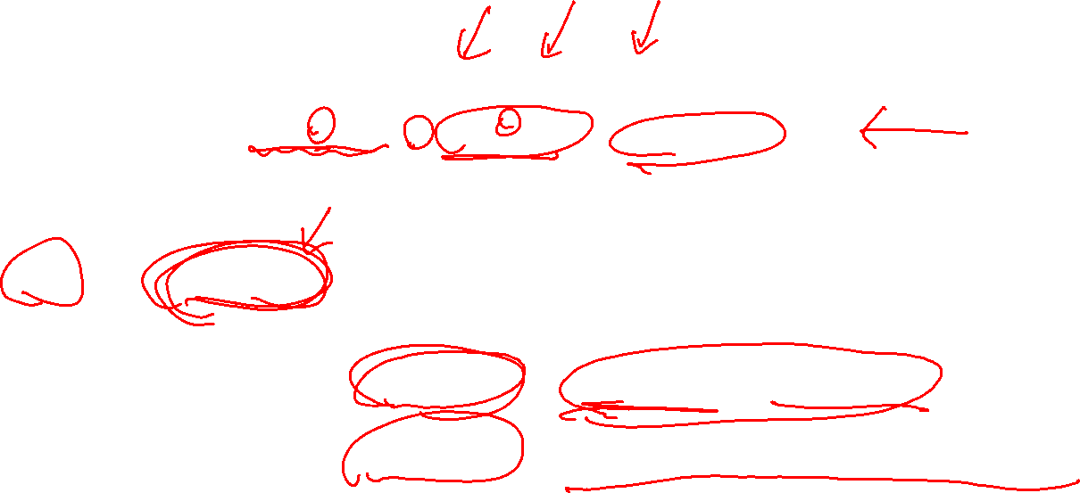
Without vectorization
$$f_{w,b}\left(x\right)=w_{1}x_{1}+w_{2}x_{2}+w_{3}x_{3}+b$$
f = w[0]*x[0] + w[1]*x[1] + w[2]*x[2] + b
Processing Units
(1)
w[0]*x[0]
Order of operation
(2)
(3)
Python
w[1]*x[1]
w[0]*x[0] + w[1]*x[1]
(4)
(5)
w[2]*x[2]
w[0]*x[0] + w[1]*x[1] + w[2]*x[2]
(6)
w[0]*x[0] + w[1]*x[1] + w[2]*x[2] + b

Slide 8
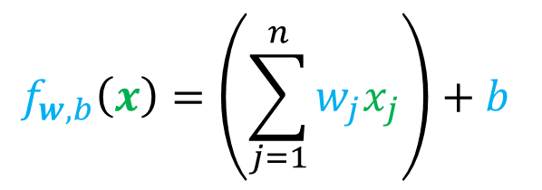
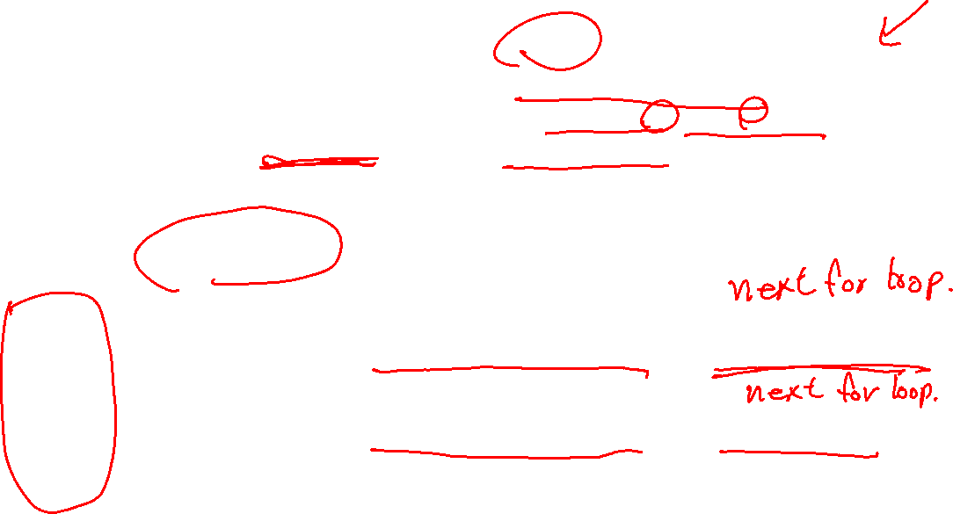
Without vectorization
f = 0
for j in range(n):
f = f + w[j]*x[j]
f = f + b
$$f_{w,b}\left(x\right)=\left(\sum_{j=1}^{n}{w_{j}x_{j}}\right)+b$$
Processing Units
(1)
w[0]*x[0]
Order of operation
(2)
(3)
Python
f = f + w[0]*x[0]
w[1]*x[1]
(4)
(5)
f = f + w[1]*x[1]
w[2]*x[2]
(6)
(7)
f = f + w[2]*x[2]
f = f + b
The operations will not run until the proceeding runs are finished

Slide 9

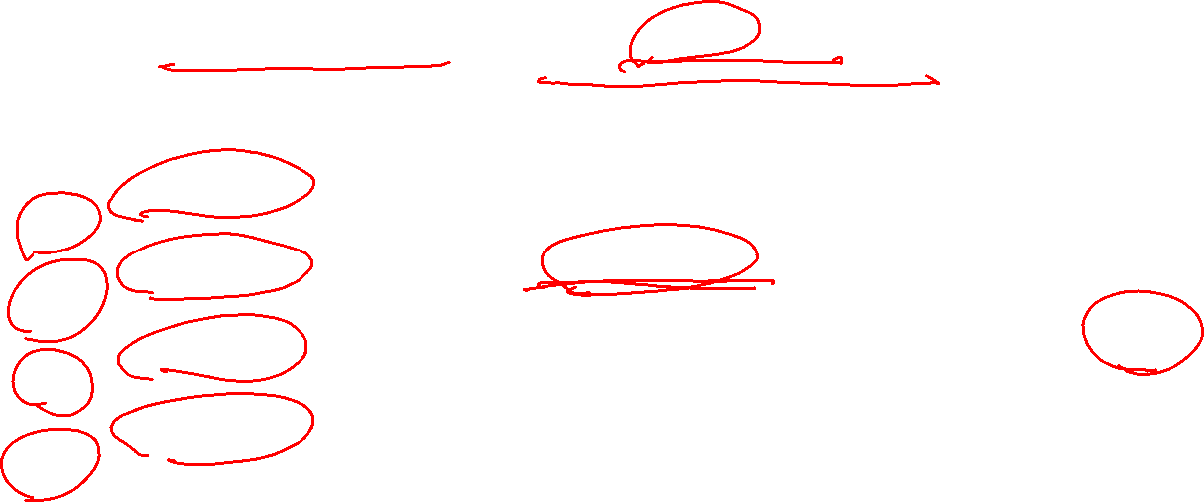
With vectorization
$$f_{w,b}\left(x\right)=w∙x+b$$
f = np.dot(w,x) + b
Processing Units
w[0]*x[0]
w[1]*x[1]
np.dot(w,x)
Order of operation
Python
f = np.dot(w,x) + b
…
w[n]*x[n]
np.dot is one operation that distribute the calculations over the processing units. Jobs are run in parallel.

Slide 10
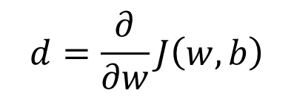



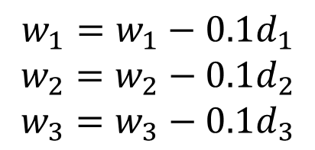
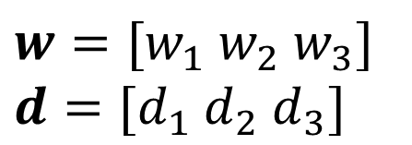
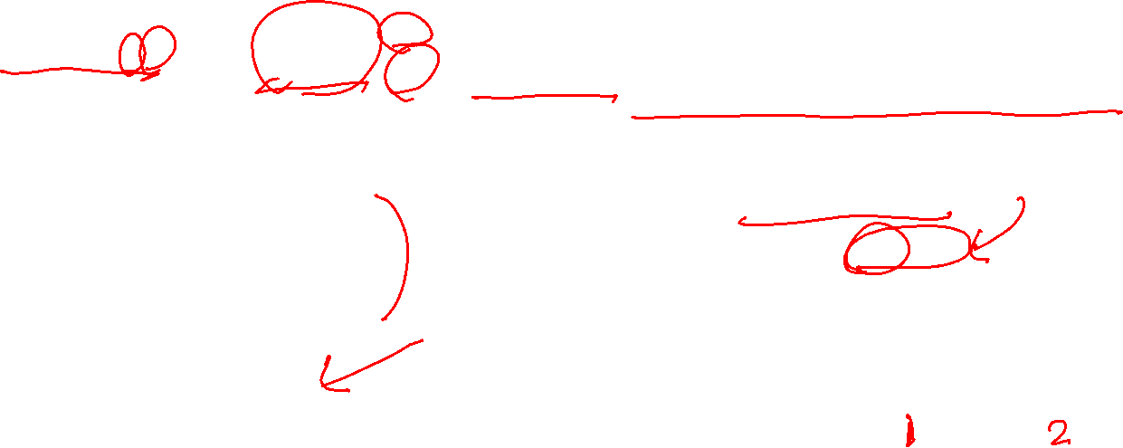
With vectorization – Gradient Descent
$$d=\frac{∂}{∂w}J\left(w,b\right)$$
$w=[w_{1} w_{2} w_{3}]$
$d=[d_{1} d_{2} d_{3}]$
w = np.array([0.5, 1.3, -1.2])
d = np.array([0.2, 0.3, 0.1])
$$w=w−αd$$
$$α=0.1$$
Without vectorization
With vectorization (via broadcasting)
$$w=w−0.1d$$
$$w_{1}=w_{1}−0.1d_{1}$$
$$w_{2}=w_{2}−0.1d_{2}$$
$$w_{3}=w_{3}−0.1d_{3}$$
w = w – 0.1 *d
(1)
0.1*
0.1*
0.1*
d[0]
d[1]
d[2]
for j in range(3):
w[j] = w[j] – 0.1 * d[j]
(2)
0.1*d[0]
0.1*d[0]
0.1*d[0]
-
-
-
w[0]
w[1]
w[2]

Slide 11
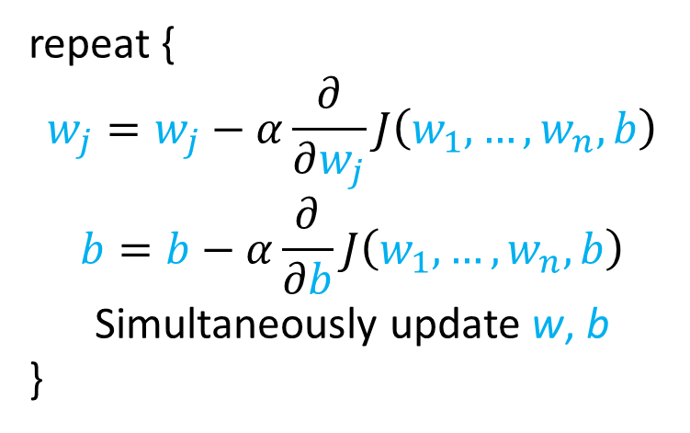






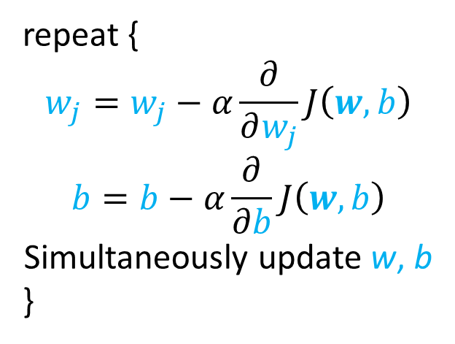
Gradient descent for multiple linear regression
Previous notation
Vector notation
Parameters
$$w_{1},…,w_{n}$$
$w=[w_{1} w_{2} …w_{n}]$
Model
$$f_{w,b}\left(x\right)=w_{1}x_{1}+…+w_{n}x_{n}+b$$
$$f_{w,b}\left(x\right)=w∙x+b$$
Cost function
$$J(w_{1},…,w_{n},b )$$
$$J(w,b )$$
Gradient descent
repeat {
$$w_{j}=w_{j}−α\frac{∂}{∂w_{j}}J\left(w_{1},…,w_{n},b\right)$$
$$b=b−α\frac{∂}{∂b}J\left(w_{1},…,w_{n},b\right)$$
Simultaneously update w, b
}
repeat {
$$w_{j}=w_{j}−α\frac{∂}{∂w_{j}}J\left(w,b\right)$$
$$b=b−α\frac{∂}{∂b}J\left(w,b\right)$$
Simultaneously update w, b
}

Slide 12
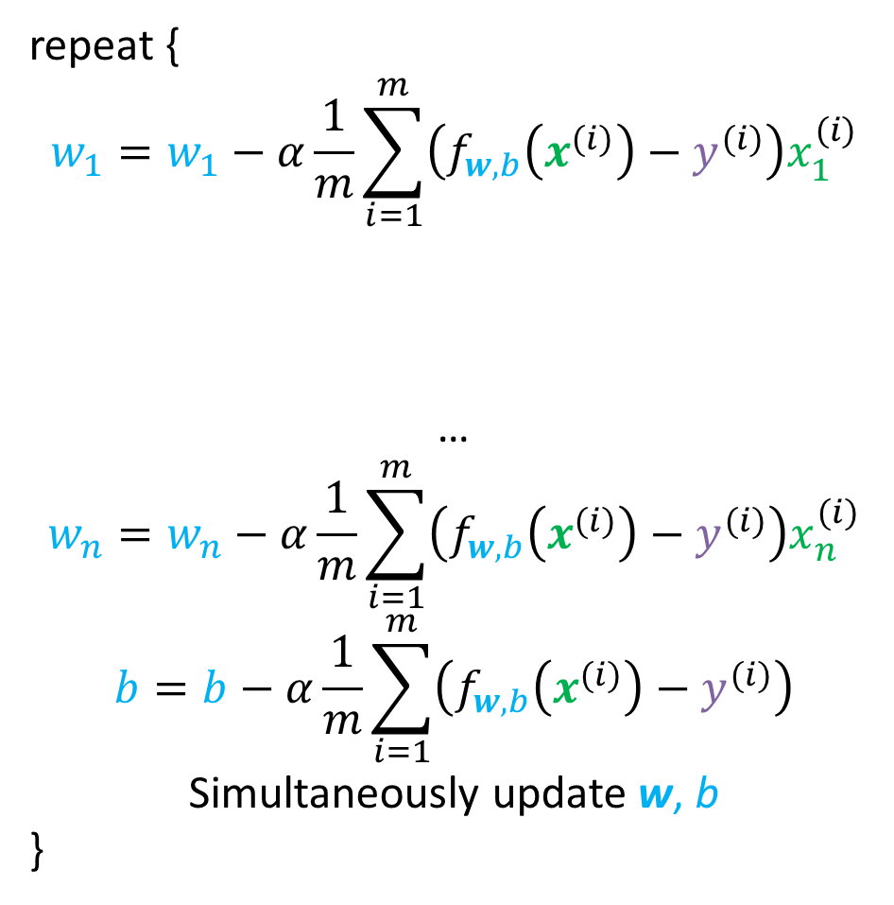
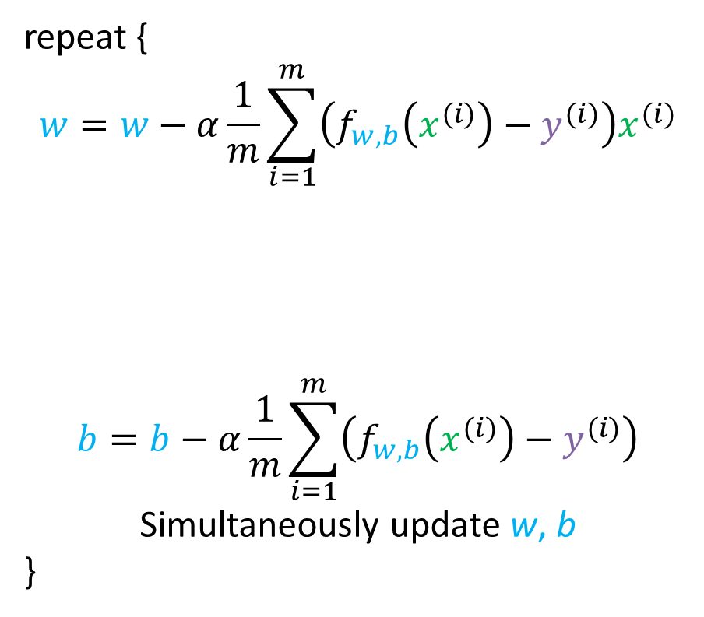


Gradient descent for multiple linear regression
One feature
n feature (n>1)
repeat {
$$w=w−α\frac{1}{m}\sum_{i=1}^{m}{\left(f_{w,b}\left(x^{(i)}\right)−y^{(i)}\right)x^{(i)}}$$
$$b=b−α\frac{1}{m}\sum_{i=1}^{m}{\left(f_{w,b}\left(x^{(i)}\right)−y^{(i)}\right)}$$
Simultaneously update w, b
}
repeat {
$$w_{1}=w_{1}−α\frac{1}{m}\sum_{i=1}^{m}{\left(f_{w,b}\left(x^{(i)}\right)−y^{(i)}\right)x_{1}^{(i)}}$$
…
$$w_{n}=w_{n}−α\frac{1}{m}\sum_{i=1}^{m}{\left(f_{w,b}\left(x^{(i)}\right)−y^{(i)}\right)x_{n}^{(i)}}$$
$$b=b−α\frac{1}{m}\sum_{i=1}^{m}{\left(f_{w,b}\left(x^{(i)}\right)−y^{(i)}\right)}$$
Simultaneously update w, b
}
$$\frac{∂}{∂w}J\left(w,b\right)$$
$$\frac{∂}{∂w_{1}}J\left(w,b\right)$$

Slide 13
Feature Scaling

Slide 14
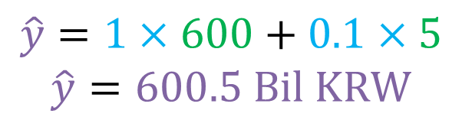
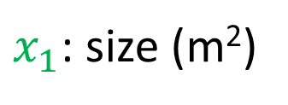



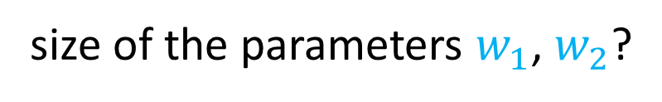

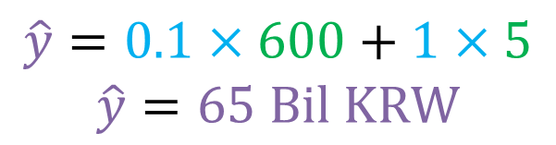
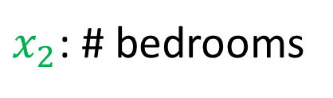

Feature and parameter values
$$\hat{y}=w_{1}x_{1}+w_{2}x_{2}$$
$x_{1}$: size (m²)
$x_{2}$: # bedrooms
range: 15 - 600
range: 0 - 5
House Price
House: $x_{1}=600,x_{2}=5,y =100 Bil KRW$
size of the parameters $w_{1}$, $w_{2}$?
$$w_{1}=1, w_{2}=0.1$$
$$w_{1}=0.1, w_{2}=1$$
$$\hat{y}=1×600+0.1×5$$
$$\hat{y}=600.5 Bil KRW$$
$$\hat{y}=0.1×600+1×5$$
$$\hat{y}=65 Bil KRW$$
Too large
More reasonable
w_{j} of the feature with larger range will tend to be small and vice versa

Slide 15


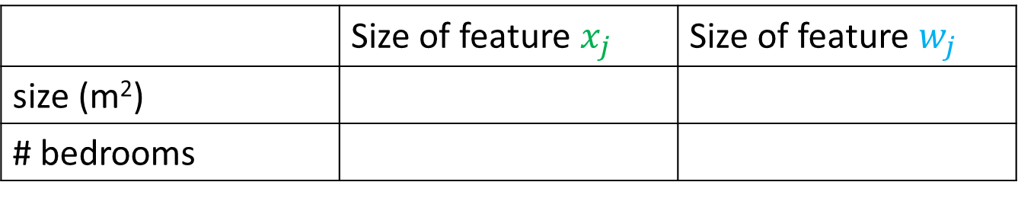




Feature and parameter values
 | Size of feature $x_{j}$ | Size of feature $w_{j}$
size (m²)
# bedrooms
$$J\left(w\right)$$
$$x_{2}$$
$$w_{2}$$
Contour plot
# bedrooms
5
0
15
600
$$x_{1}$$
$$w_{1}$$
size (m²)

Slide 16
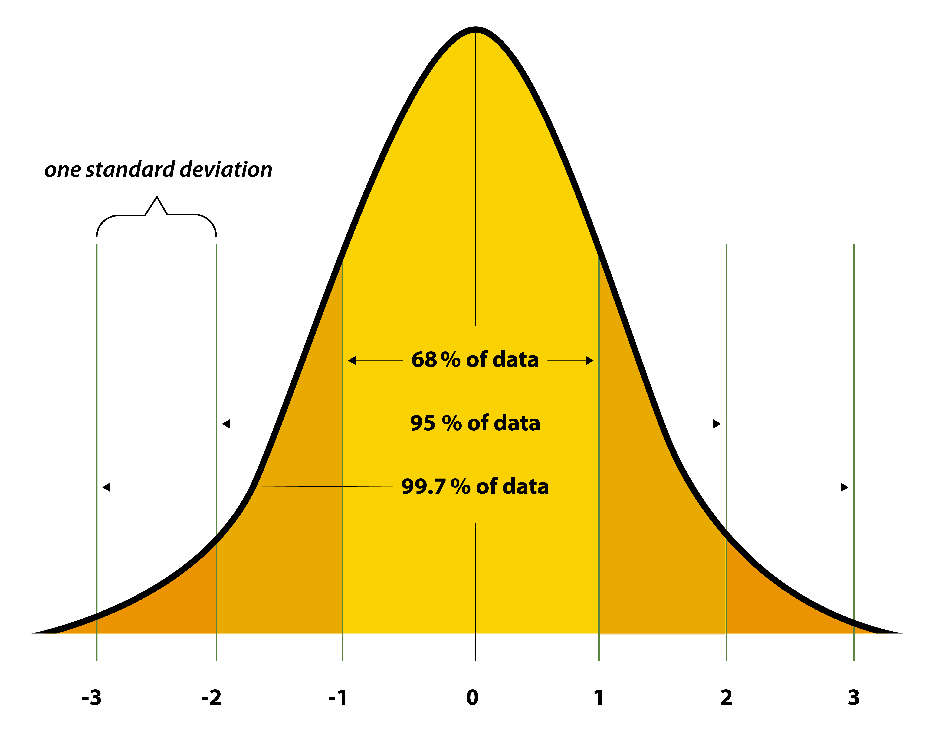


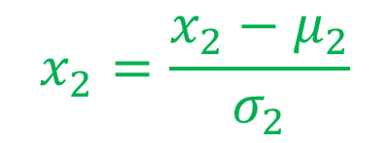




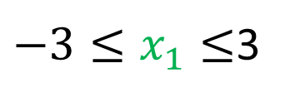


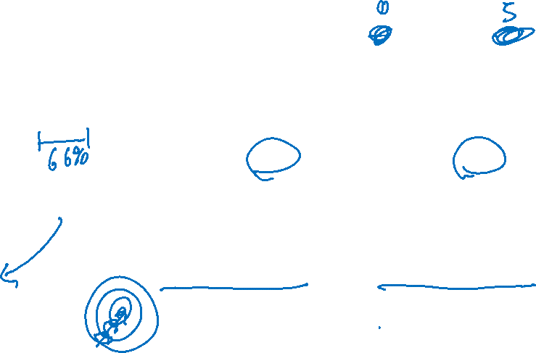
Z-score normalization
$$x_{2}$$
$$15≤x_{1}≤600$$
$$0≤x_{2}≤5$$
# bedrooms
5
$$x_{2}=\frac{x_{2}−μ_{2}}{σ_{2}}$$
$$x_{1}=\frac{x_{1}−μ_{1}}{σ_{1}}$$
0
15
600
$$x_{1}$$
size (m²)
$$x_{2}$$
normalized
# bedrooms
3
$−3≤x_{1}≤$3
$$−3≤x_{2}≤3$$
$$x_{1}$$
normalized
size (m²)
-3
3
-3
Feature scaling is typically done for all features

Slide 17






Feature size and gradient descent
$$x_{2}$$
$$w_{2}$$
$$J\left(w\right)$$
# bedrooms
5
0
15
600
$$x_{1}$$
size (m²)
$$w_{1}$$
$$x_{2}$$
normalized
# bedrooms
$$w_{2}$$
$$J\left(w\right)$$
3
$$x_{1}$$
normalized
size (m²)
-3
3
-3
$$w_{1}$$

Slide 18
Practical Gradient Descent

Slide 19


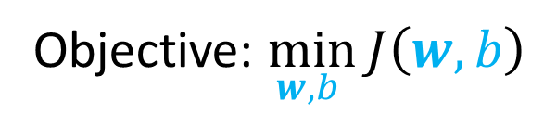
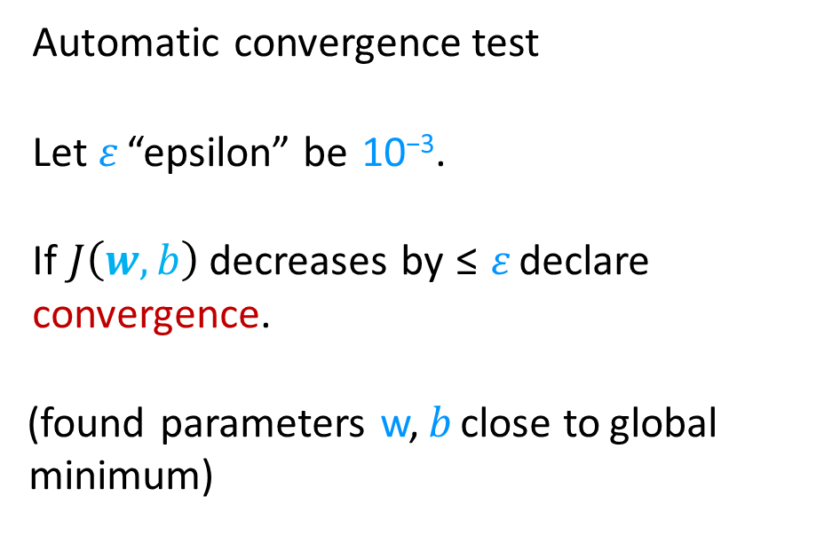

Making sure the gradient descent is working correctly
Objective: $\min_{w,b }{J\left(w,b\right)}$
$J\left(w,b\right)$ should decrease after every iteration
Automatic convergence test
Let 𝜀 “epsilon” be 10⁻³.
If $J\left(w,b\right)$ decreases by ≤ 𝜀 declare convergence.
(found parameters w, 𝑏 close to global minimum)
$$J\left(w,b\right)$$
100
200
300
400
# iteration

Slide 20



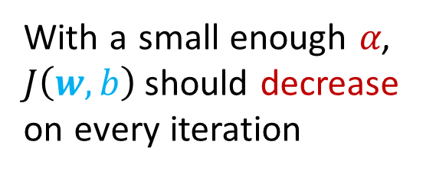


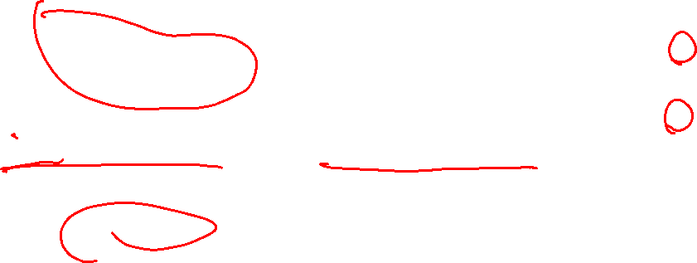

Identify problem with gradient descent
Identify problem with gradient descent
Bug in the code or the learning rate is too large
$$J\left(w,b\right)$$
$$J\left(w,b\right)$$
𝑤₁ = 𝑤₁ + 𝛼𝑑₁
use a minus sign
𝑤₁ = 𝑤₁ − 𝛼𝑑₁
# iterations
# iterations
Adjust learning rate
With a small enough 𝛼, $J\left(w,b\right)$ should decrease on every iteration
𝛼 is too big
Use smaller 𝛼
$$J\left(w,b\right)$$
$$J\left(w,b\right)$$
If 𝛼 is too small, gradient descent takes a lot more iterations to converge
$$w_{1}$$
$$w_{1}$$

Slide 21

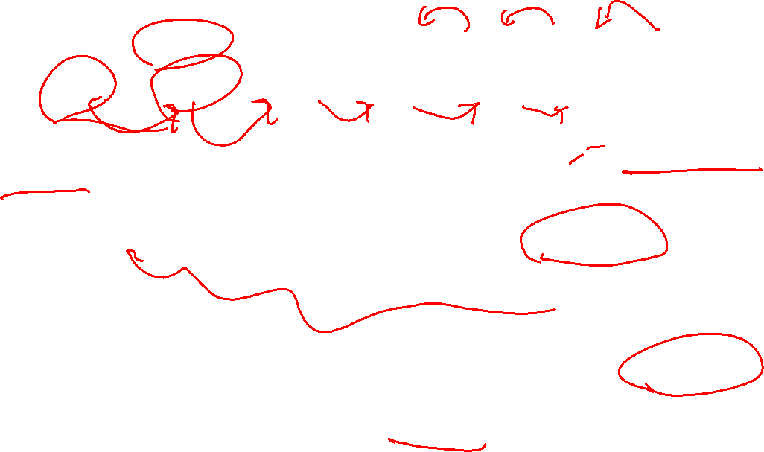
Values of learning rate to try
…
0.0001
0.0003
0.001
0.003
0.01
0.03
0.1
…
10⁻⁴
10^{-3.5}
10^{-3.0}
10^{-2.5}
10⁻²
10^{-1.5}
10⁻¹
𝛼 too large
$$J\left(w,b\right)$$
𝛼 too small
𝛼 too large
𝛼 just right
# iterations

Slide 22
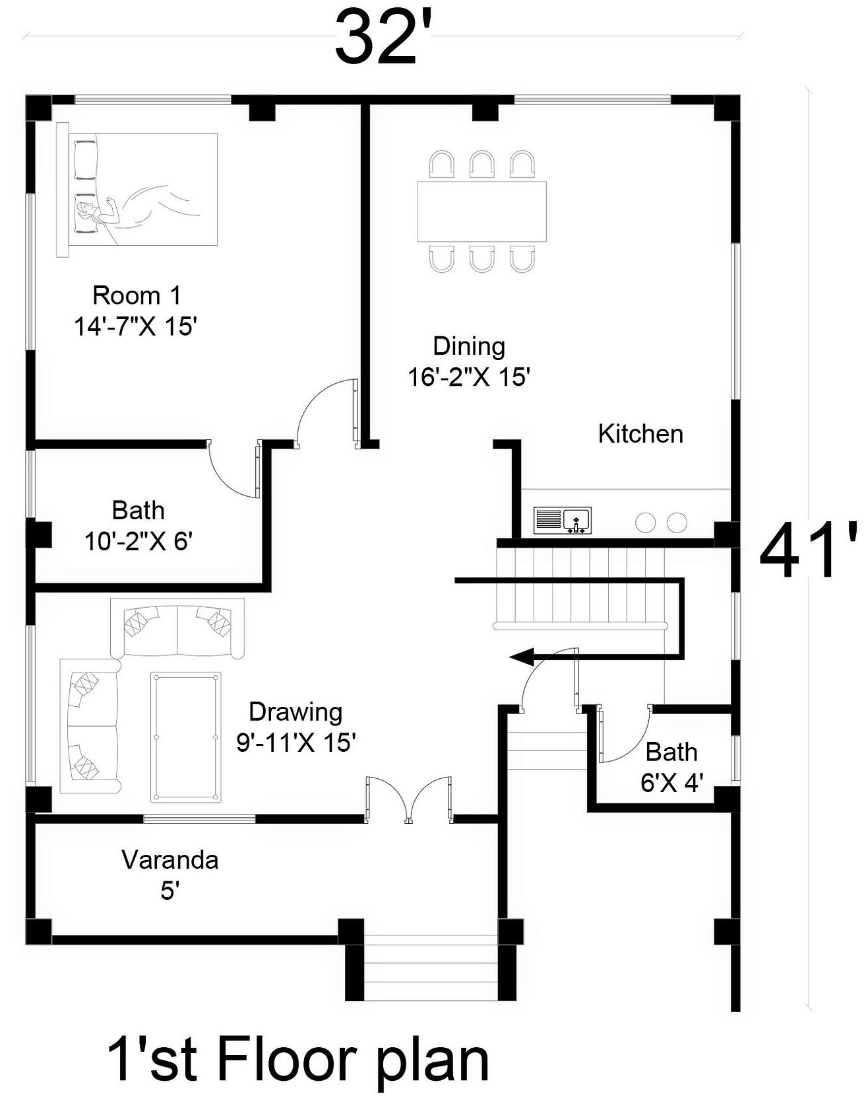
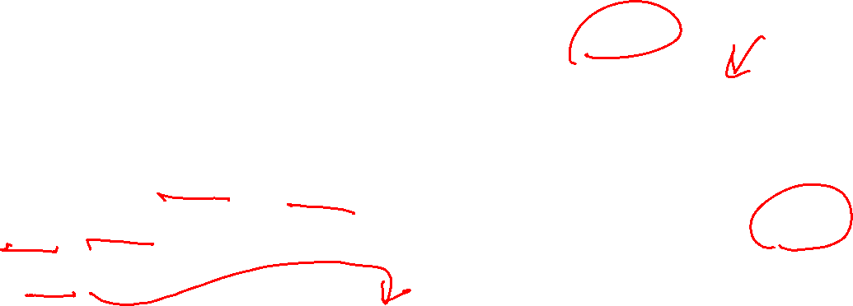



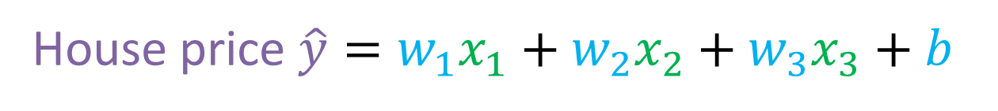
Feature Engineering
Use your intuition and knowledge to design new features, by transforming or combining original features.
width
House price $\hat{y}=w_{1}x_{1}+w_{2}x_{2}+b$
width
depth
depth
$$area=width×depth$$
$$x_{3}=x_{1}x_{2}$$
House price $\hat{y}=w_{1}x_{1}+w_{2}x_{2}+w_{3}x_{3}+b$

