Slide 1
The Problem of Underfitting and Overfitting

Slide 2


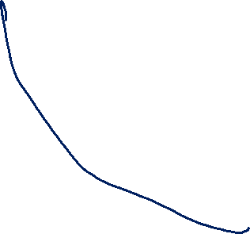
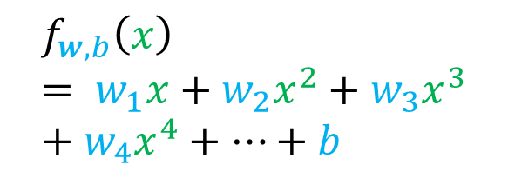
Regression example
Underfitting
Just right
Overfitting
y
y
y
Training samples are described well, but it does not capture the trend
Little imperfection,
But that’s okay
x
x
x
$$f_{w,b}(x)= w_{1}x+b$$
$$f_{w,b}\left(x\right)= w_{1}x+w_{2}x^{2}+b$$
$$f_{w,b}\left(x\right)= w_{1}x+w_{2}x^{2}+w_{3}x^{3}+w_{4}x^{4}+…+b$$

Slide 3
































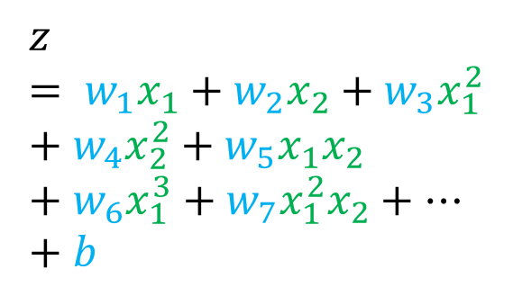

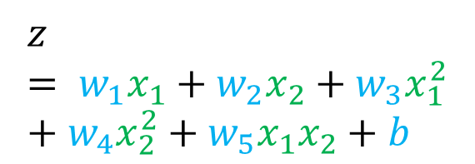





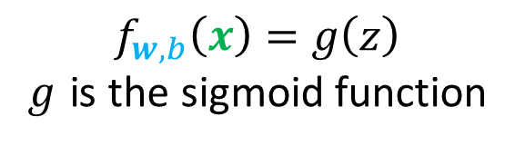


Classification example
Underfitting
Just right
Overfitting
$$x_{2}$$
$$x_{2}$$
$$x_{2}$$
$$x_{1}$$
$$x_{1}$$
$$x_{1}$$
$$z= w_{1}x_{1}+w_{2}x_{2}+w_{3}x_{1}^{2}+w_{4}x_{2}^{2}+w_{5}x_{1}x_{2}+w_{6}x_{1}^{3}+w_{7}x_{1}^{2}x_{2}+…+b$$
$$z= w_{1}x_{1}+w_{2}x_{2}+b$$
$$z= w_{1}x_{1}+w_{2}x_{2}+w_{3}x_{1}^{2}+w_{4}x_{2}^{2}+w_{5}x_{1}x_{2}+b$$
$$f_{w,b}\left(x\right)=g\left(z\right)$$
𝑔 is the sigmoid function

Slide 4

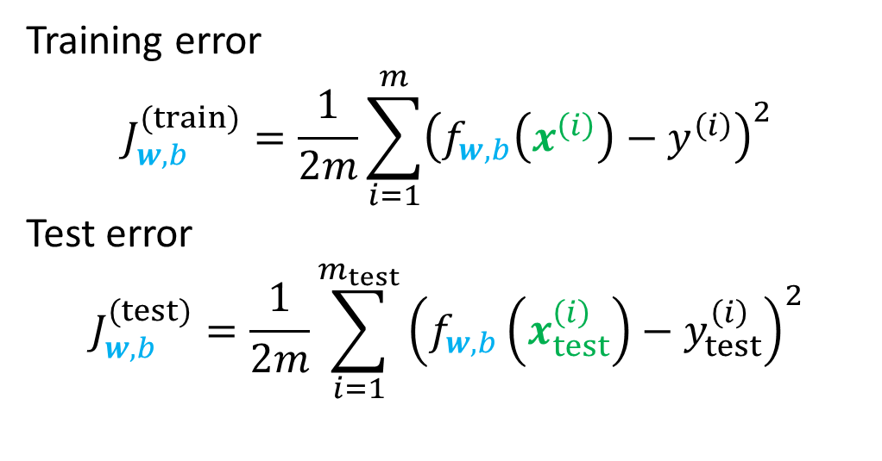
Testing to see if you have overfitting
Training error
$$J_{w,b}^{(train)}=\frac{1}{2m}\sum_{i=1}^{m}{{\left(f_{w,b}\left(x^{\left(i\right)}\right)−y^{\left(i\right)}\right)}^{2}}$$
Test error
$$J_{w,b}^{(test)}=\frac{1}{2m}\sum_{i=1}^{m_{test}}{{\left(f_{w,b}\left(x_{test}^{\left(i\right)}\right)−y_{test}^{\left(i\right)}\right)}^{2}}$$
Used to get $w,b$ with gradient descent
Used to test the model

Slide 5
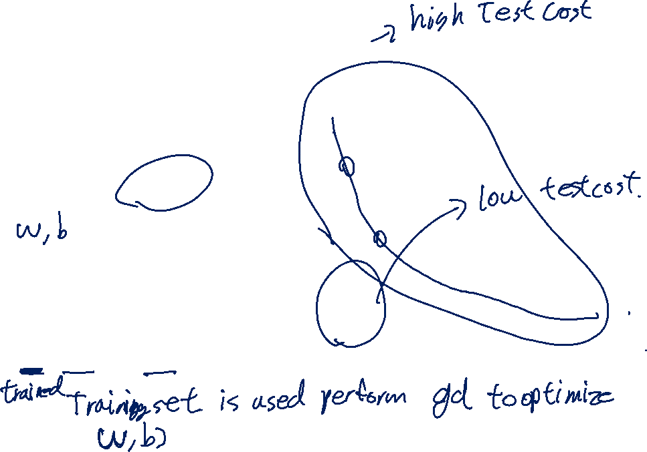
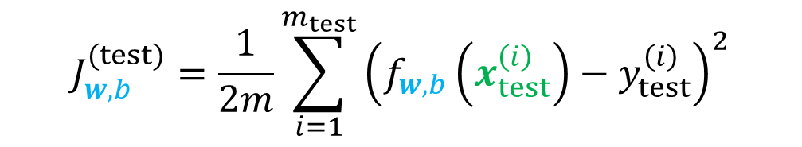
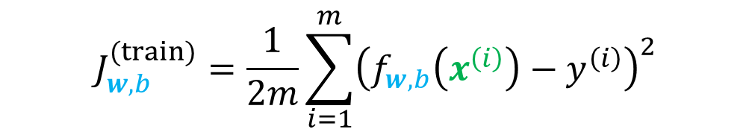
Testing for Overfitting
Overfitting
model
All data
Training set
y
Test set
Training set
Test set
60 - 80%
10 - 20%
$$J_{w,b}^{(train)}=\frac{1}{2m}\sum_{i=1}^{m}{{\left(f_{w,b}\left(x^{\left(i\right)}\right)−y^{\left(i\right)}\right)}^{2}}$$
Just right model
$$J_{w,b}^{(test)}=\frac{1}{2m}\sum_{i=1}^{m_{test}}{{\left(f_{w,b}\left(x_{test}^{\left(i\right)}\right)−y_{test}^{\left(i\right)}\right)}^{2}}$$
x

Slide 6
Addressing Overfitting

Slide 7
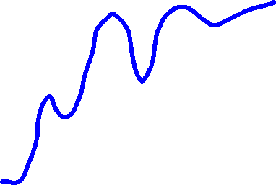
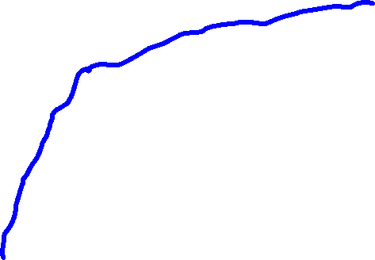
Collect more data
Overfitting
Collect more data
y
y
x
x

Slide 8
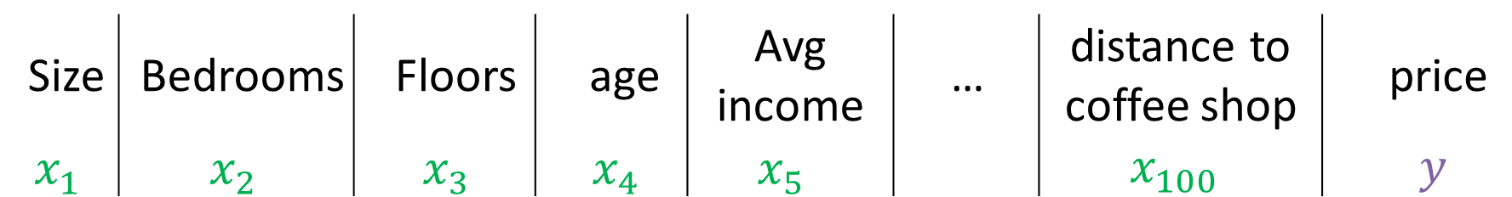
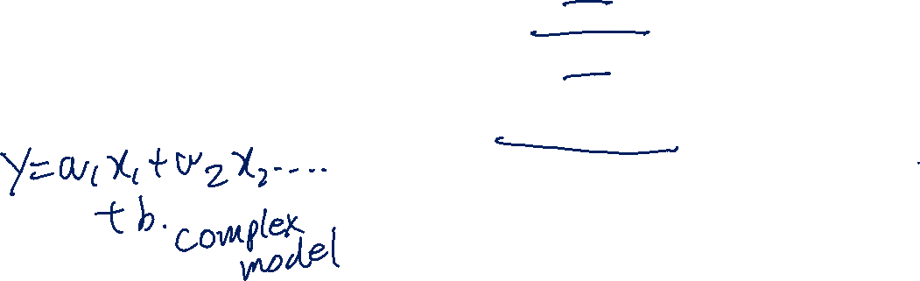
Select Features to include/exclude
Size | Bedrooms | Floors | age | Avg income | … | distance to coffee shop | price
$$x_{1}$$ | $$x_{2}$$ | $$x_{3}$$ | $$x_{4}$$ | $$x_{5}$$ |  | $$x_{100}$$ | $$y$$
all features
+
insufficient data
=
Overfitting
selected features
Size
Bedrooms
Age
=
Just right model
Disadvantage
useful features could be lost

Slide 9
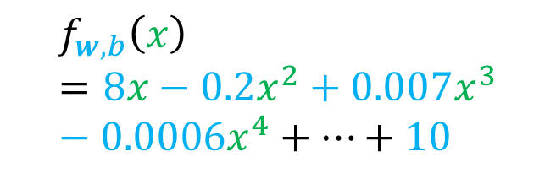
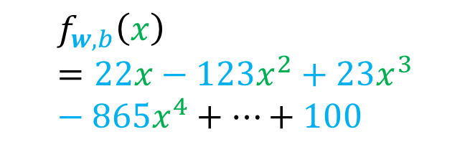
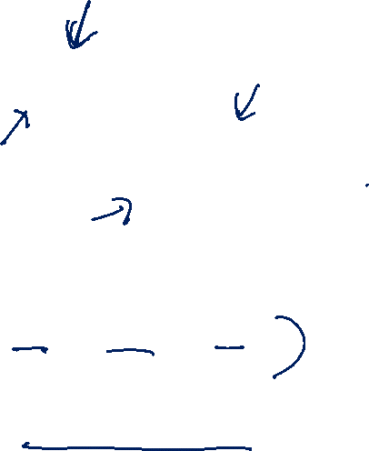
Regularization
Reduce the size of parameters w
y
y
x
x
$$f_{w,b}\left(x\right)=22x−123x^{2}+23x^{3}−865x^{4}+…+100$$
$$f_{w,b}\left(x\right)=8x−0.2x^{2}+0.007x^{3}−0.0006x^{4}+…+10$$
Large values of w_{j}
Smaller values of w_{j}
Or even eliminate some features

Slide 10
Regularization

Slide 11

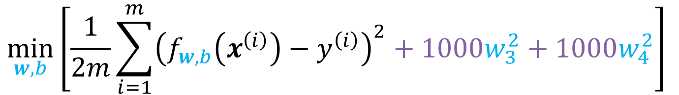


Intuition on Regularization
y
y
x
x
$$f_{w,b}\left(x\right)= w_{1}x+w_{2}x^{2}+w_{3}x^{3}+w_{4}x^{4}+b$$
$$f_{w,b}\left(x\right)= w_{1}x+w_{2}x^{2}+b$$
$$≈0$$
$$≈0$$
Make w₃ and w₄ small by penalizing it in the cost function
$$\min_{w,b}\left[\frac{1}{2m}\sum_{i=1}^{m}{{\left(f_{w,b}\left(x^{\left(i\right)}\right)−y^{\left(i\right)}\right)}^{2}}+1000w_{3}^{2}+1000w_{4}^{2}\right]$$
0.001
0.001

Slide 12
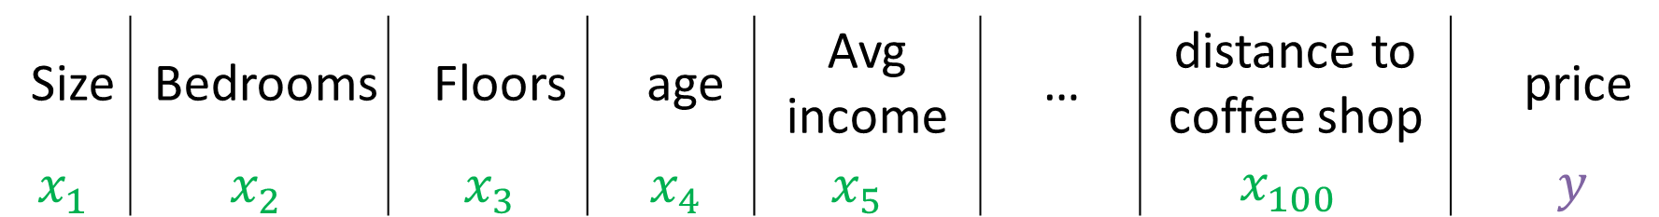
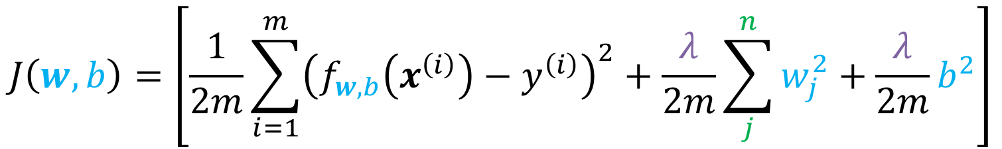

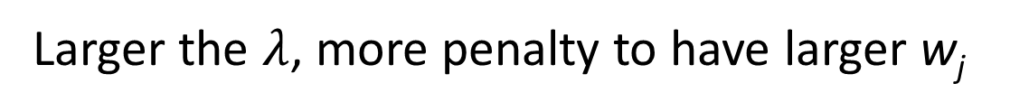
Regularization
Small values w₁, w₂, …, w_{n}, b. Simpler model less likely to overfit
Size | Bedrooms | Floors | age | Avg income | … | distance to coffee shop | price
$$x_{1}$$ | $$x_{2}$$ | $$x_{3}$$ | $$x_{4}$$ | $$x_{5}$$ |  | $$x_{100}$$ | $$y$$
w₁, w₂, …, w_{n}, b
n features
n = 100
“Lambda” Regularization parameter
$$J\left(w,b\right)=\left[\frac{1}{2m}\sum_{i=1}^{m}{{\left(f_{w,b}\left(x^{\left(i\right)}\right)−y^{\left(i\right)}\right)}^{2}}+\frac{λ}{2m}\sum_{j}^{n}{w_{j}^{2}}+\frac{λ}{2m}b^{2}\right]$$
Regularization terms
Larger the $λ$, more penalty to have larger w_{j}

Slide 13



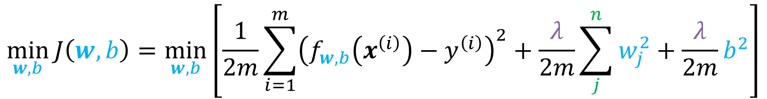



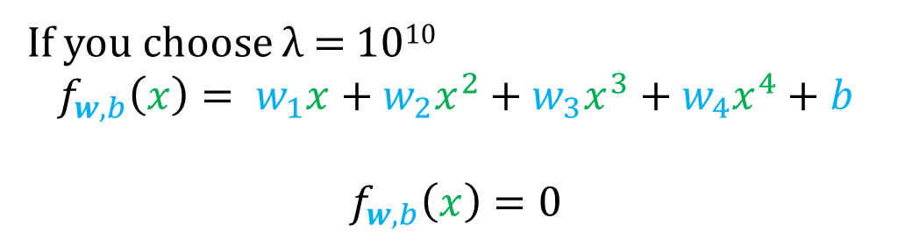

Regularization
Mean squared error
Regularization terms
$$\min_{w,b}{J\left(w,b\right)}=\min_{w,b}\left[\frac{1}{2m}\sum_{i=1}^{m}{{\left(f_{w,b}\left(x^{\left(i\right)}\right)−y^{\left(i\right)}\right)}^{2}}+\frac{λ}{2m}\sum_{j}^{n}{w_{j}^{2}}+\frac{λ}{2m}b^{2}\right]$$
Goal (1) Fit Data
Goal (2) Keep w_{j} small
y
$λ=$just right
λ = 0
If you choose λ = 10¹⁰
$$f_{w,b}\left(x\right)= w_{1}x+w_{2}x^{2}+w_{3}x^{3}+w_{4}x^{4}+b$$
$$f_{w,b}\left(x\right)=0$$
$$≈0$$
$$≈0$$
$$≈0$$
$$≈0$$
$$≈0$$
x
How do we choose λ?
$$λ=∞$$

Slide 14
Regularized regression

Slide 15

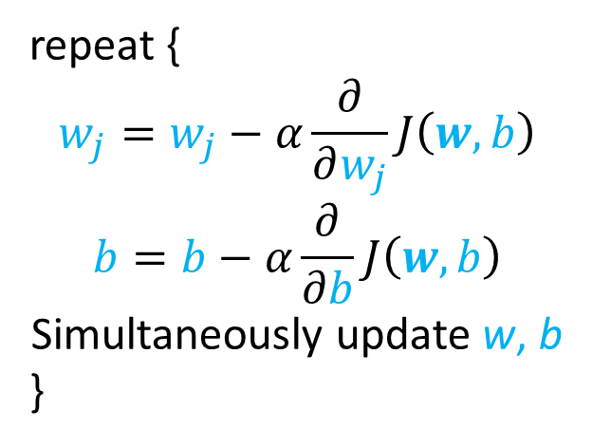
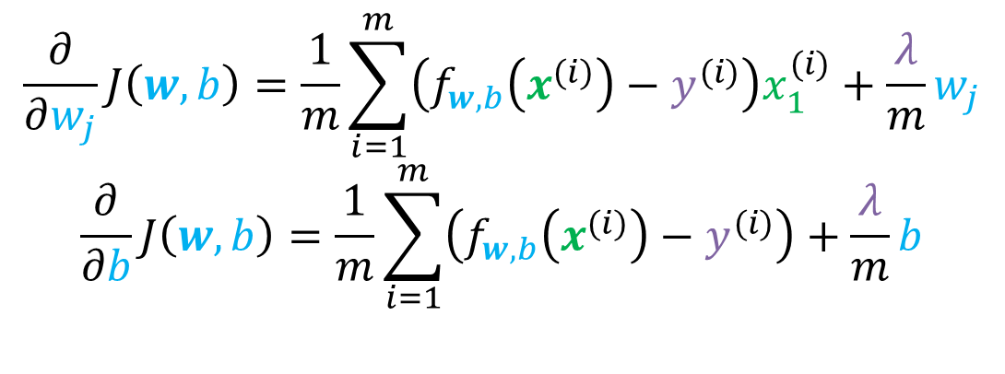
Implementing regularized linear regression
$$\min_{w,b}{J\left(w,b\right)}=\min_{w,b}\left[\frac{1}{2m}\sum_{i=1}^{m}{{\left(f_{w,b}\left(x^{\left(i\right)}\right)−y^{\left(i\right)}\right)}^{2}}+\frac{λ}{2m}\sum_{j}^{n}{w_{j}^{2}}+\frac{λ}{2m}b^{2}\right]$$
Gradient descent
repeat {
$$w_{j}=w_{j}−α\frac{∂}{∂w_{j}}J\left(w,b\right)$$
$$b=b−α\frac{∂}{∂b}J\left(w,b\right)$$
Simultaneously update w, b
}
$$\frac{∂}{∂w_{j}}J\left(w,b\right)=\frac{1}{m}\sum_{i=1}^{m}{\left(f_{w,b}\left(x^{(i)}\right)−y^{(i)}\right)x_{1}^{(i)}}+\frac{λ}{m}w_{j}$$
$$\frac{∂}{∂b}J\left(w,b\right)=\frac{1}{m}\sum_{i=1}^{m}{\left(f_{w,b}\left(x^{(i)}\right)−y^{(i)}\right)}+\frac{λ}{m}b$$

Slide 16
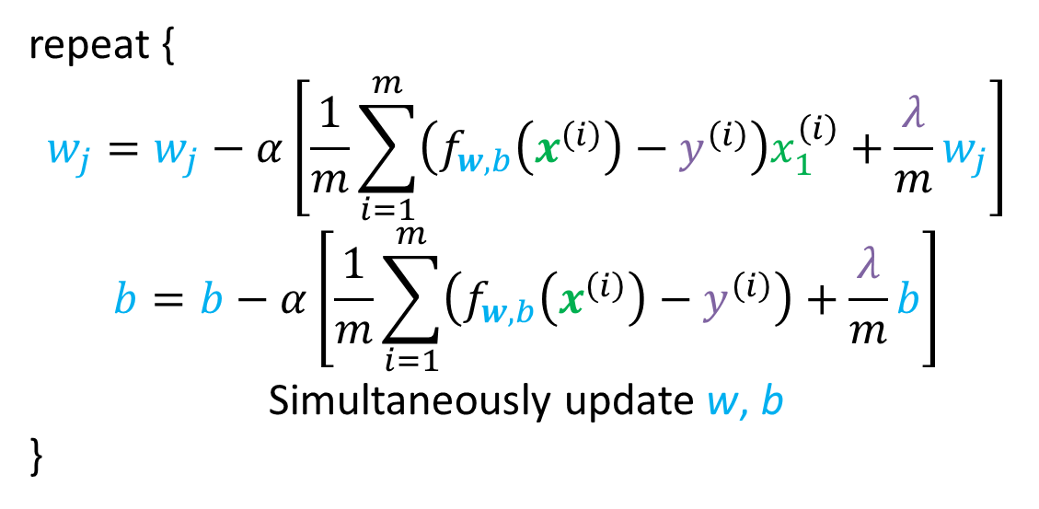
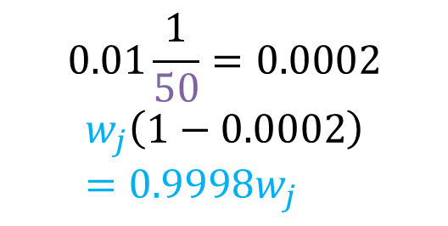
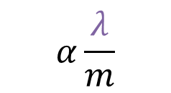

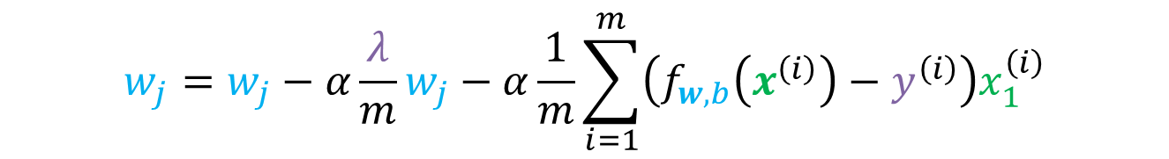
Implementing regularized linear regression
repeat {
$$w_{j}=w_{j}−α\left[\frac{1}{m}\sum_{i=1}^{m}{\left(f_{w,b}\left(x^{\left(i\right)}\right)−y^{\left(i\right)}\right)x_{1}^{\left(i\right)}}+\frac{λ}{m}w_{j}\right]$$
$$b=b−α\left[\frac{1}{m}\sum_{i=1}^{m}{\left(f_{w,b}\left(x^{\left(i\right)}\right)−y^{\left(i\right)}\right)}+\frac{λ}{m}b\right]$$
Simultaneously update w, b
}
$$α\frac{λ}{m}$$
$$w_{j}=w_{j}−α\frac{λ}{m}w_{j}−α\frac{1}{m}\sum_{i=1}^{m}{\left(f_{w,b}\left(x^{\left(i\right)}\right)−y^{\left(i\right)}\right)x_{1}^{\left(i\right)}}$$
$$0.01\frac{1}{50}=0.0002$$
$$w_{j}\left(1−0.0002\right)=0.9998w_{j}$$
$$w_{j}\left(1−α\frac{λ}{m}\right)$$
Usual update
Shrink w_{j}

Slide 17
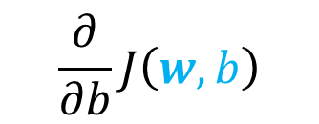
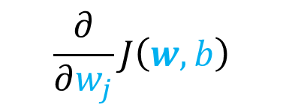
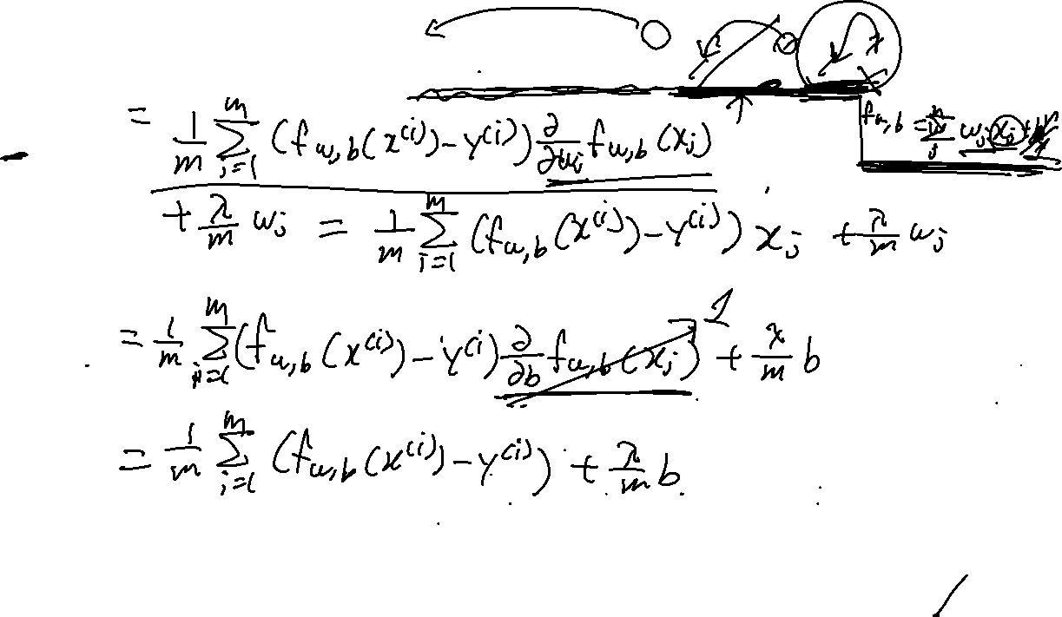
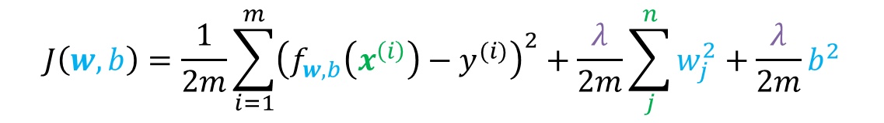
Partial Derivative
$$J\left(w,b\right)=\frac{1}{2m}\sum_{i=1}^{m}{{\left(f_{w,b}\left(x^{\left(i\right)}\right)−y^{(i)}\right)}^{2}}+\frac{λ}{2m}\sum_{j}^{n}{w_{j}^{2}}+\frac{λ}{2m}b^{2}$$
$$\frac{∂}{∂w_{j}}J\left(w,b\right)$$
$$\frac{∂}{∂b}J\left(w,b\right)$$

Slide 18


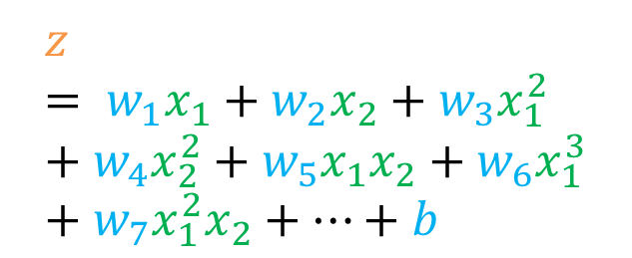
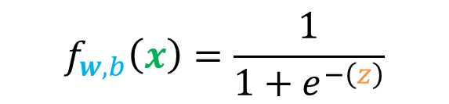

Regularized logistic regression
$$z= w_{1}x_{1}+w_{2}x_{2}+w_{3}x_{1}^{2}+w_{4}x_{2}^{2}+w_{5}x_{1}x_{2}+w_{6}x_{1}^{3}+w_{7}x_{1}^{2}x_{2}+…+b$$
$$f_{w,b}\left(x\right)=\frac{1}{1+e^{−\left(z\right)}}$$
$$x_{2}$$
$$x_{1}$$
$$J\left(w,b\right)=−\frac{1}{m}\sum_{i=1}^{m}{\left[y^{\left(i\right)}\log\left(f_{w,b}\left(x^{\left(i\right)}\right)\right)+\left(1−y^{\left(i\right)}\right)\log\left(1−f_{w,b}\left(x^{\left(i\right)}\right)\right)\right]}+\frac{λ}{2m}\sum_{j}^{n}{w_{j}^{2}}+\frac{λ}{2m}b^{2}$$
$$\min_{w,b}{J\left(w,b\right)}$$

Slide 19
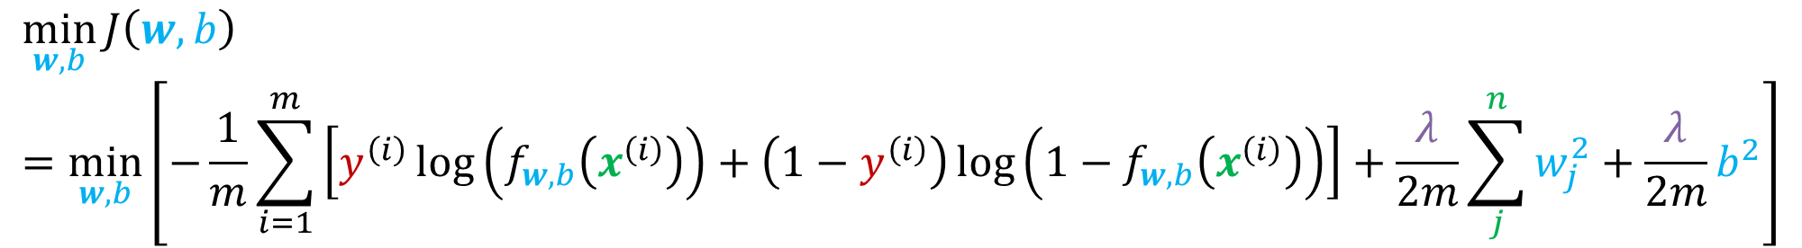
Implementing regularized linear regression
$$\min_{w,b}{J\left(w,b\right)}=\min_{w,b}\left[−\frac{1}{m}\sum_{i=1}^{m}{\left[y^{\left(i\right)}\log\left(f_{w,b}\left(x^{\left(i\right)}\right)\right)+\left(1−y^{\left(i\right)}\right)\log\left(1−f_{w,b}\left(x^{\left(i\right)}\right)\right)\right]}+\frac{λ}{2m}\sum_{j}^{n}{w_{j}^{2}}+\frac{λ}{2m}b^{2}\right]$$
Gradient descent
repeat {
$$w_{j}=w_{j}−α\frac{∂}{∂w_{j}}J\left(w,b\right)$$
$$b=b−α\frac{∂}{∂b}J\left(w,b\right)$$
Simultaneously update w, b
}
$$\frac{∂}{∂w_{j}}J\left(w,b\right)=\frac{1}{m}\sum_{i=1}^{m}{\left(f_{w,b}\left(x^{(i)}\right)−y^{(i)}\right)x_{1}^{(i)}}+\frac{λ}{m}w_{j}$$
$$\frac{∂}{∂b}J\left(w,b\right)=\frac{1}{m}\sum_{i=1}^{m}{\left(f_{w,b}\left(x^{(i)}\right)−y^{(i)}\right)}+\frac{λ}{m}b$$

Slide 20
Model selection

Slide 21
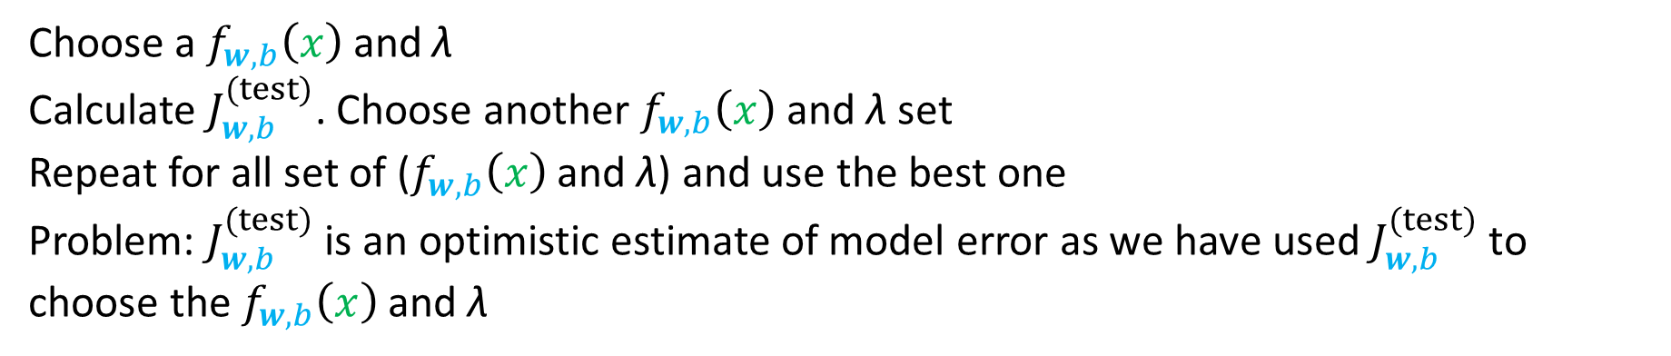
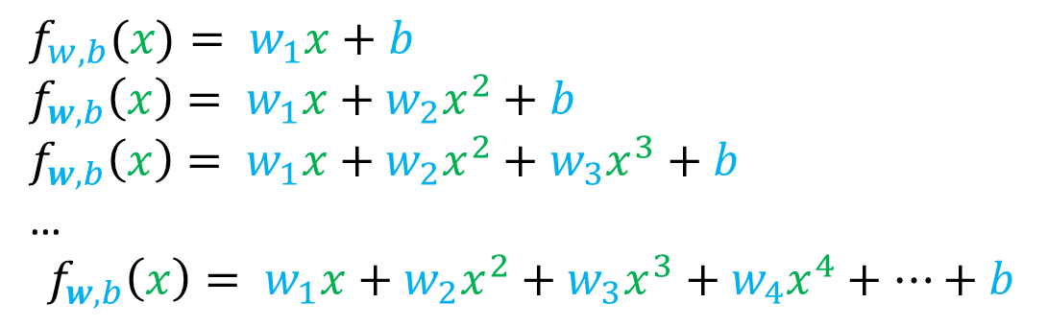
Model selection
Various model we can test
Various λ we can test
λ = 1.0
λ = 0.3
λ = 0.1
λ = 0.03
…
$f_{w,b}(x)= w_{1}x+b$
$f_{w,b}\left(x\right)= w_{1}x+w_{2}x^{2}+b$
$f_{w,b}\left(x\right)= w_{1}x+w_{2}x^{2}+w_{3}x^{3}+b$
…
$$f_{w,b}\left(x\right)= w_{1}x+w_{2}x^{2}+w_{3}x^{3}+w_{4}x^{4}+…+b$$
Choose a $f_{w,b}\left(x\right)$ and λ
Calculate $J_{w,b}^{(test)}$. Choose another $f_{w,b}\left(x\right)$ and λ set
Repeat for all set of ($f_{w,b}\left(x\right)$ and λ) and use the best one
Problem: $J_{w,b}^{(test)}$ is an optimistic estimate of model error as we have used $J_{w,b}^{(test)}$ to choose the $f_{w,b}\left(x\right)$ and λ

Slide 22

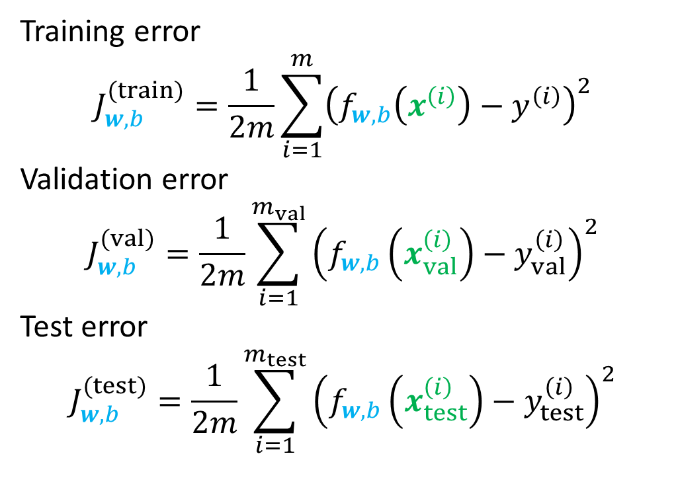
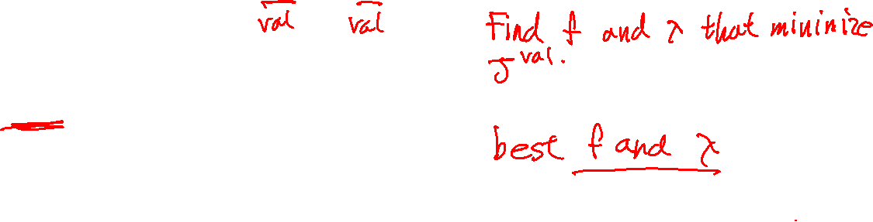
Possible models
Training error
$$J_{w,b}^{(train)}=\frac{1}{2m}\sum_{i=1}^{m}{{\left(f_{w,b}\left(x^{\left(i\right)}\right)−y^{\left(i\right)}\right)}^{2}}$$
Validation error
$$J_{w,b}^{(val)}=\frac{1}{2m}\sum_{i=1}^{m_{val}}{{\left(f_{w,b}\left(x_{val}^{\left(i\right)}\right)−y_{val}^{\left(i\right)}\right)}^{2}}$$
Test error
$$J_{w,b}^{(test)}=\frac{1}{2m}\sum_{i=1}^{m_{test}}{{\left(f_{w,b}\left(x_{test}^{\left(i\right)}\right)−y_{test}^{\left(i\right)}\right)}^{2}}$$
Used to get $w,b$
Used to get select model
Used to test the best model

Slide 23
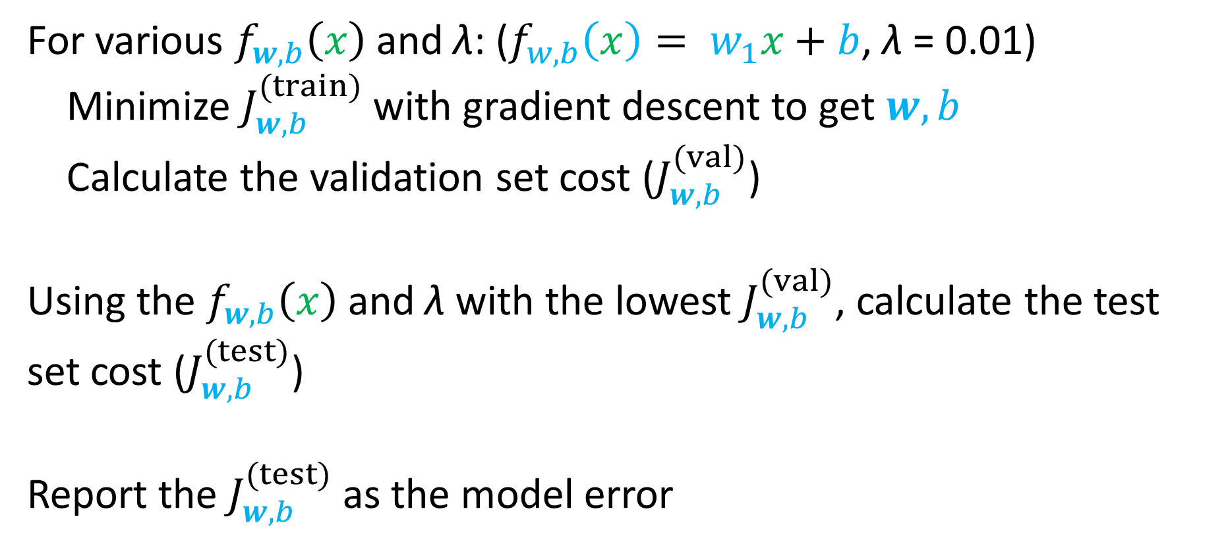
Pseudocode of the model selection
For various $f_{w,b}\left(x\right)$ and λ: ($f_{w,b}\left(x\right)= w_{1}x+b$, λ = 0.01)
Minimize $J_{w,b}^{(train)}$ with gradient descent to get $w,b$
Calculate the validation set cost ($J_{w,b}^{(val)}$)
Using the $f_{w,b}\left(x\right)$ and λ with the lowest $J_{w,b}^{(val)}$, calculate the test set cost ($J_{w,b}^{(test)}$)
Report the $J_{w,b}^{(test)}$ as the model error

Slide 24

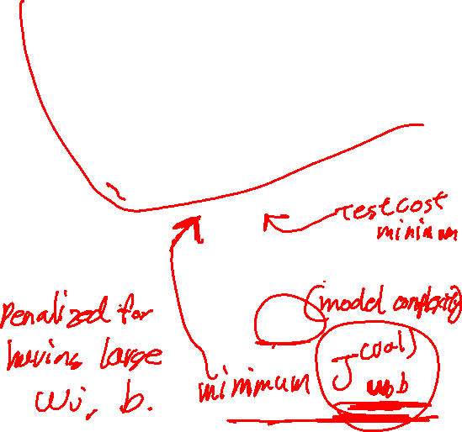
Optimizing Regularization Strength
Just right
All data
Underfitting
Overfitting
Test Set Cost
Cost function
Training set
Validation set
Test set
Validation Set Cost
60 - 80%
10 - 20%
10 - 20%
Training Set Cost
$$1/λ$$

Slide 25
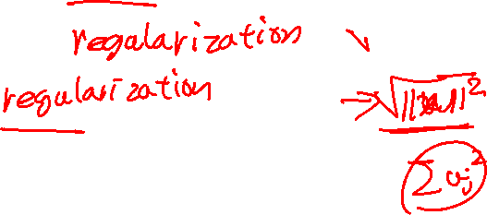
Should you simplify the model or use L2 regularization?
If your model is already simple, then L₂ regularization could help more.
If your model is very complex, then maybe it’s better to simplify the model
In practice, you need combine both of them. Start with a complex model, add regularization, then gradually simplify the model as needed while continuing to adjust the regularization strength
We will come back again on this later!

