Slide 1
Pytorch

Slide 2

Pytorch
A machine learning library.
A lot of similar syntax as numpy, but with more capability
Major differences are
PyTorch can use GPU to perform operations
PyTorch performs backpropagation automatically
Many additional functions to make machine learning easy.

Slide 3
Numpy and Pytorch
Numpy
Pytorch
import numpy as np
x = np.array([1,2,3])
x = np.random.rand(1,2,3)
x.mean(axis=0)
import torch
x = torch.tensor([1,2,3])
x = torch.rand(1,2,3)
x.mean(dim=0)
axis used to specify dimension
dim used to specify dimension

Slide 4
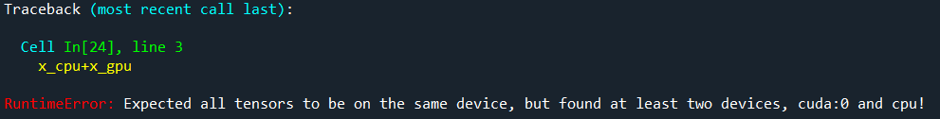
Pytorch
default is cpu
Specifying the device
x = torch.tensor([1,2,3], device='cpu')
x = torch.tensor([1,2,3], device='cuda')
Sending to difference device
x = torch.tensor([1,2,3], device='cpu')
x = x.to('cuda')
Specifying the device
x_cpu = torch.tensor([1,2,3], device='cpu')
x_gpu = torch.tensor([1,2,3], device='cuda')
x_cpu+x_gpu

Slide 5
Time comparison
Numpy
from time import time
a = np.random.rand(128, 10000)
a2 = np.random.rand(128, 10000)
t0 = time()
for _ in range(1000):
a @ a2.T
print(f'elapsed time: {time()-t0}')
elapsed time: 1.0919227600097656
Pytorch - cpu
Pytorch - gpu
from time import time
a = torch.rand(128, 10000, device='cpu')
a2 = torch.rand(128, 10000, device='cpu')
t0 = time()
for _ in range(1000):
a @ a2.T
print(f'elapsed time: {time()-t0}')
from time import time
a = torch.rand(128, 10000, device='cuda')
a2 = torch.rand(128, 10000, device='cuda')
t0 = time()
for _ in range(1000):
a @ a2.T
print(f'elapsed time: {time()-t0}')
elapsed time: 0.7405338287353516
elapsed time: 0.06447196006774902

Slide 6
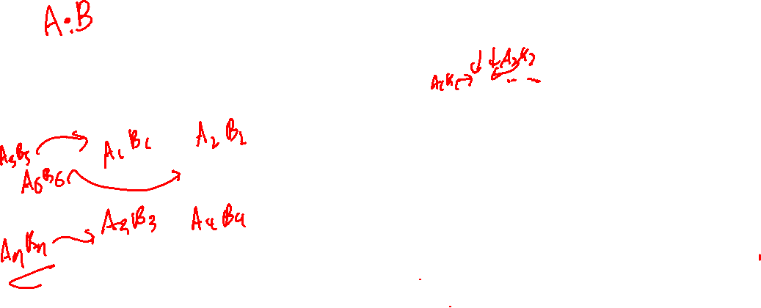
CPU vs. GPU
GPU
(hundreds cores)
CPU
(multiple cores)

Slide 7
Constructing a neural network with pytorch

Slide 8
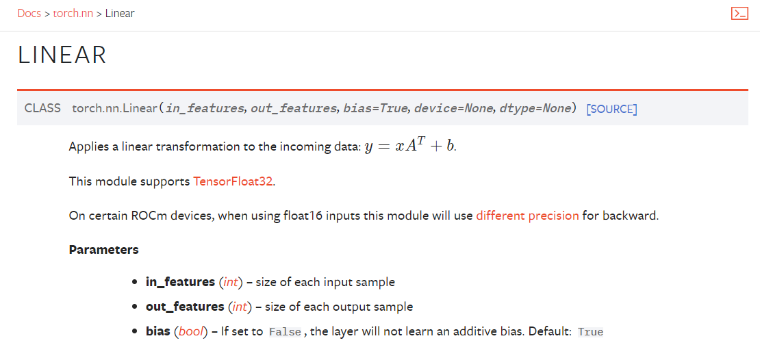




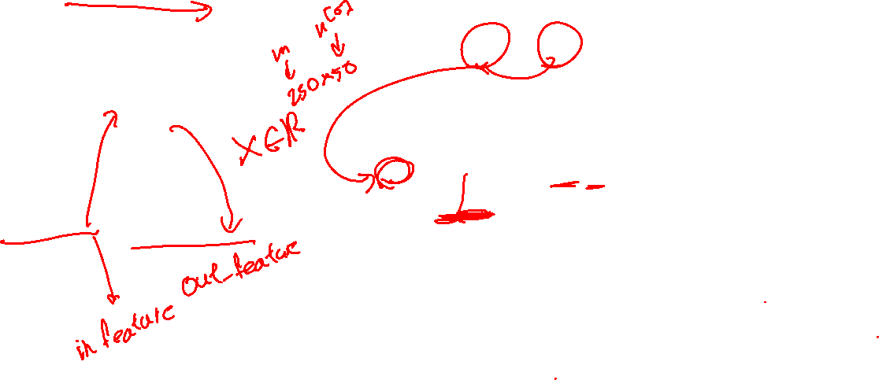


Constructing a linear multiplication
$$A^{\left[1\right]}$$
$Z^{\left[1\right]}=XW^{\left[1\right]}+b^{\left[1\right]}$
Define parameters and forward behavior.
Parameter initialization is automatic
$$X$$
$$Z^{\left[1\right]}$$
import torch
import torch.nn as nn
X = torch.rand(250,50)
L1 = nn.Linear(50,3)
Z1 = L1(X)
50 features
3 units
Perform forward
$$n^{[0]}=50$$
$$n^{[1]}=3$$
$$m=250$$
https://pytorch.org/docs/stable/generated/torch.nn.Linear.html

Slide 9




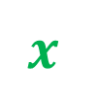
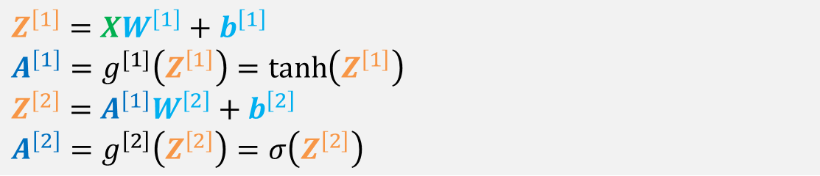




Constructing a neural network
$$A^{\left[1\right]}$$
$$A^{\left[2\right]}$$
$Z^{\left[1\right]}=XW^{\left[1\right]}+b^{\left[1\right]}$
$A^{\left[1\right]}=g^{[1]}\left(Z^{\left[1\right]}\right)=\tanh\left(Z^{\left[1\right]}\right)$
$Z^{\left[2\right]}=A^{\left[1\right]}W^{\left[2\right]}+b^{\left[2\right]}$
$A^{\left[2\right]}=g^{\left[2\right]}\left(Z^{\left[2\right]}\right)=σ\left(Z^{\left[2\right]}\right)$
$$x$$
$$\hat{y}$$
50 features
1 units
$$n^{[2]}=1$$
import torch
import torch.nn as nn
X = torch.rand(250,50)
L1 = nn.Linear(50,3)
L2 = nn.Linear(3,1)
Z1 = L1(X)
A1 = torch.tanh(Z1)
Z2 = L2(A1)
A2 = torch.sigmoid(Z2)
3 units
$$n^{[0]}=50$$
$$n^{[1]}=3$$
$$m=250$$
Parameters
Forward

Slide 10




Constructing a module
Module offers a more compact neural network object to carry around
$$A^{\left[1\right]}$$
import torch
import torch.nn as nn
class Model(nn.Module):
def __init__(self):
super().__init__()
self.L1 = nn.Linear(50,3)
self.L2 = nn.Linear(3,1)
def forward(self, X):
Z1 = self.L1(X)
A1 = torch.tanh(Z1)
Z2 = self.L2(A1)
A2 = torch.sigmoid(Z2)
return A2
NN = Model()
X = torch.rand(250,50)
A2 = NN(X)
$$A^{\left[2\right]}$$
Inherit nn.module
$$x$$
$$\hat{y}$$
initialize parent class
50 features
1 units
Parameters
3 units
$$n^{[2]}=1$$
$$n^{[0]}=50$$
$$n^{[1]}=3$$
$$m=250$$
Define forward behavior

Slide 11
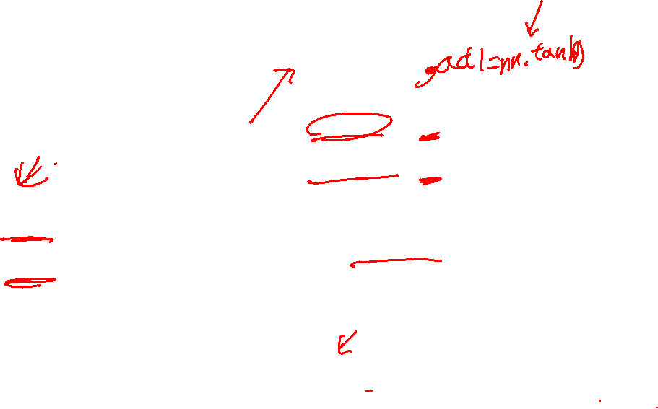
Constructing a module
import torch
import torch.nn as nn
class Model(nn.Module):
def __init__(self):
super().__init__()
self.L1 = nn.Linear(50,3)
self.L2 = nn.Linear(3,1)
def forward(self, X):
Z1 = self.L1(X)
A1 = torch.tanh(Z1)
Z2 = self.L2(A1)
A2 = torch.sigmoid(Z2)
return A2
NN = Model()
X = torch.rand(250,50)
A2 = NN(X)
import torch
import torch.nn as nn
class Model(nn.Module):
def __init__(self):
super().__init__()
self.L1 = nn.Linear(50,3)
self.act1 = nn.tanh()
self.L2 = nn.Linear(3,1)
self.act2 = nn.sigmoid()
def forward(self, X):
Z1 = self.L1(X)
A1 = self.act1(Z1)
Z2 = self.L2(A1)
A2 = self.act2(Z2)
return A2
NN = Model()
X = torch.rand(250,50)
A2 = NN(X)
You can also define the activation as a class attribute. You need to use nn.tanh in this case

Slide 12

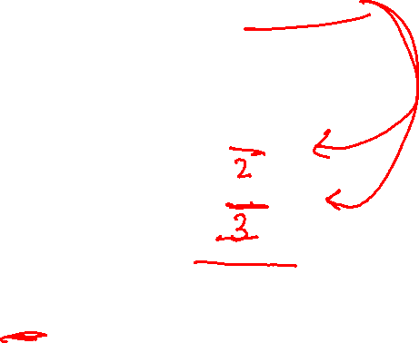









Complex Model
import torch
import torch.nn as nn
class Model(nn.Module):
def __init__(self):
super().__init__()
self.L1 = nn.Linear(50,3)
self.L2 = nn.Linear(3,4)
self.L3 = nn.Linear(4,1)
self.act1 = nn.tanh()
self.act2 = nn.sigmoid()
def forward(self, X):
Z1 = self.L1(X)
A1 = self.act1(Z1)
Z2 = self.L2(A1)
A2 = self.act1(Z2)
Z3 = self.L3(A2)
A3 = self.act2(Z3)
return A3
NN = Model()
X = torch.rand(250,50)
A2 = NN(X)
tanh
tanh
sigmoid
$$A^{\left[1\right]}$$
$$A^{\left[2\right]}$$
$$A^{\left[3\right]}$$
$$X$$
$$\hat{y}$$
50 features
$$n^{[0]}=50$$
$$m=250$$
$$n^{\left[1\right]}=3$$
$$n^{\left[2\right]}=4$$
$$n^{\left[1\right]}=1$$
3 units
layer 1
4 units
layer 2
1 units
layer 5

Slide 13
Training a neural network model

Slide 14
Training a Module
import torch
import torch.nn as nn
X = torch.rand(250,50)
Y = torch.randint(0,2,(250,1),dtype=torch.float32)
class Model(nn.Module):
def __init__(self):
super().__init__()
self.L1 = nn.Linear(50,3)
self.L2 = nn.Linear(3,1)
def forward(self, X):
Z1 = self.L1(X)
A1 = torch.tanh(Z1)
Z2 = self.L2(A1)
A2 = torch.sigmoid(Z2)
return A2
NN = Model()
Just for testing
Inherit nn.module
initialize parent class
Parameters
Define forward behavior
Construct the model object

Slide 15
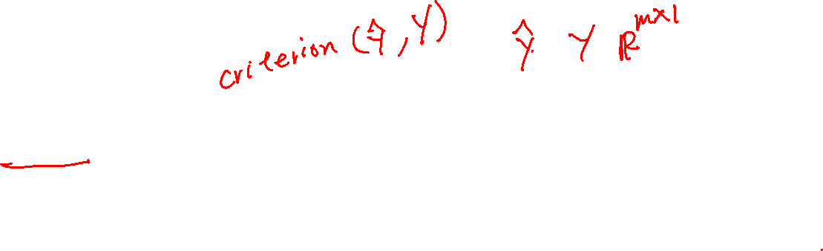
Training a Module
Objects that calculates cross entropy loss
import torch.optim as optim
criterion = nn.BCELoss()
optimizer = optim.SGD(NN.parameters(), lr=0.001)
for i in range(10000):
y_hat = NN(X)
optimizer.zero_grad()
loss = criterion(y_hat,Y)
loss.backward()
optimizer.step()
if i % 2000 == 0:
print(f'{i} loss: {loss:.3f}')
Object to perform gradient descent
lr: learning rate
calculate y_hat
Reset partial derivative values
Calculate cost function
Perform back propagation
Perform gradient descent
Helpful printing

Slide 16
Roundoff errors in cross entropy loss

Slide 17
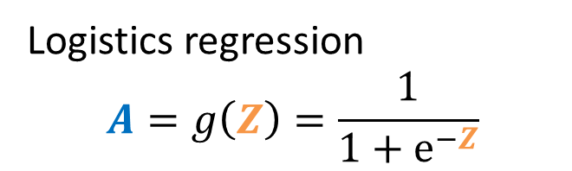
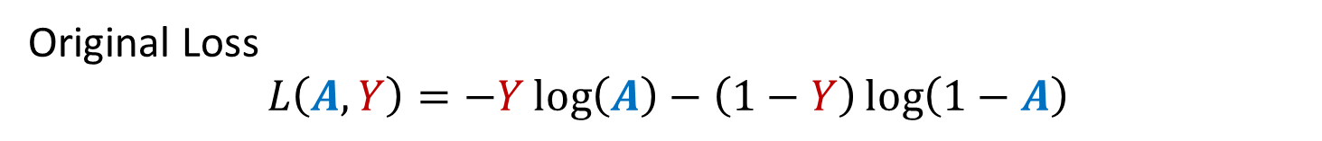
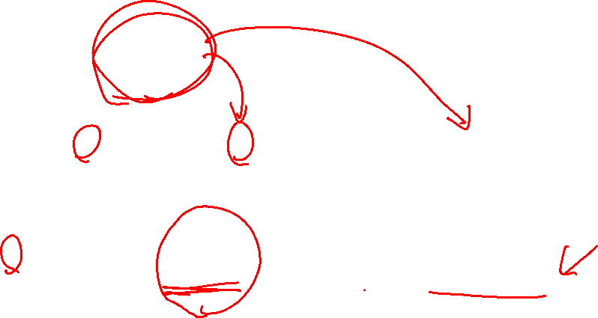
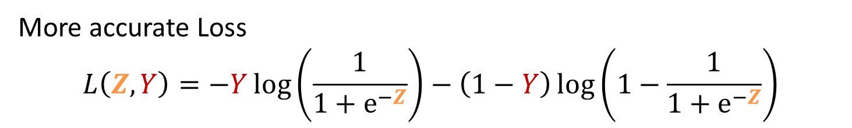
Numerical roundoff error
Logistics regression
$$A=g\left(Z\right)=\frac{1}{1+e^{−Z}}$$
Original Loss
$$L\left(A,Y\right)=−Y\log\left(A\right)−\left(1−Y\right)\log\left(1−A\right)$$
More accurate Loss
$$L\left(Z,Y\right)=−Y\log\left(\frac{1}{1+e^{−Z}}\right)−\left(1−Y\right)\log\left(1−\frac{1}{1+e^{−Z}}\right)$$

Slide 18
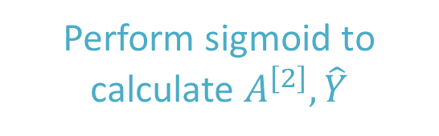
Numerical roundoff error
import torch
import torch.nn as nn
X = torch.rand(250,50)
Y = torch.randint(0,2,(250,1))
Y = Y.type(torch.float32)
class Model(nn.Module):
def __init__(self):
super().__init__()
self.L1 = nn.Linear(50,3)
self.L2 = nn.Linear(3,1)
def forward(self, X):
Z1 = self.L1(X)
A1 = torch.tanh(Z1)
Z2 = self.L2(A1)
A2 = torch.sigmoid(Z2)
return Z2
Logits = Z
NN = Model()
import torch.optim as optim
criterion = nn.BCELoss()
criterion = nn.BCEWithLogitsLoss()
optimizer = optim.SGD(NN.parameters(), lr=0.001)
for i in range(10000):
Z = NN(X)
optimizer.zero_grad()
loss = criterion(Z,Y)
loss.backward()
optimizer.step()
if i % 2000 == 0:
print(f'{i} loss: {loss:.3f}’)
Z = NN(X)
A = torch.sigmoid(Z)
Perform sigmoid to calculate $A^{\left[2\right]},\hat{Y}$

Slide 19
Multi-label classification (optional)

Slide 20
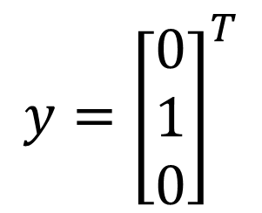

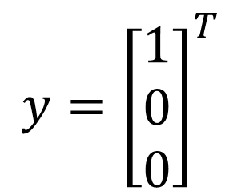

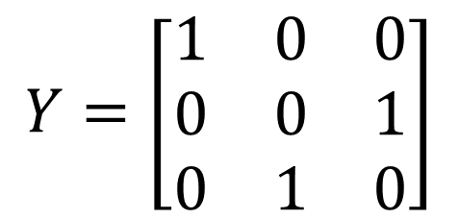
Multi-label classification
One hot encoding
Is a material insulator?
Is a material semi-conductor?
Is a material conductor?
Yes
No
No
$$y={\left[\begin{matrix}1 \\ 0 \\ 0\end{matrix}\right]}^{T}$$
No
Yes
No
$$y={\left[\begin{matrix}0 \\ 1 \\ 0\end{matrix}\right]}^{T}$$
One hot encoding
semi-conductor
insulator
conductor
number of class
$$Y=\left[\begin{matrix}1 & 0 & 0 \\ 0 & 0 & 1 \\ 0 & 1 & 0\end{matrix}\right]$$
Training example 1
Training example 2
$$Y∈ℝ^{m×C}$$
Training example 3

Slide 21





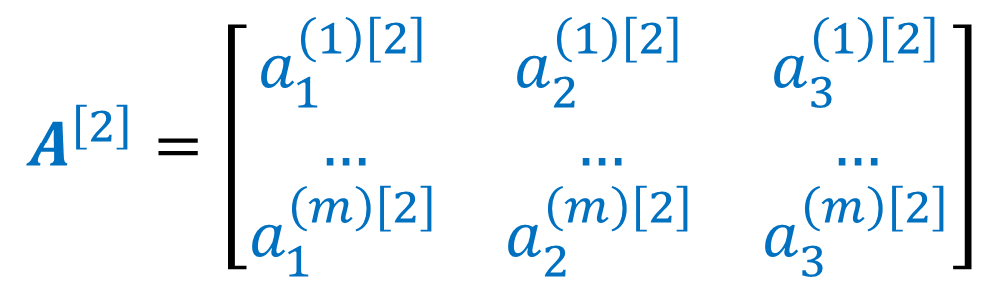







Constructing a neural network
Train one network for each
$$A^{\left[1\right]}$$
$$A^{\left[1\right]}$$
$$A^{\left[1\right]}$$
$$A^{\left[2\right]}$$
$$A^{\left[2\right]}$$
$$A^{\left[2\right]}$$
semi-conductor
$$X$$
…
insulator
$$X$$
…
$$X$$
…
conductor
Alternatively, train one neural network with three outputs
$$A^{\left[1\right]}$$
semi-conductor
insulator
conductor
$$A^{\left[2\right]}$$
$$A^{\left[2\right]}=\left[\begin{matrix}a_{1}^{\left(1\right)\left[2\right]} & a_{2}^{\left(1\right)\left[2\right]} & a_{3}^{\left(1\right)\left[2\right]} \\ … & … & … \\ a_{1}^{\left(m\right)\left[2\right]} & a_{2}^{\left(m\right)\left[2\right]} & a_{3}^{\left(m\right)\left[2\right]}\end{matrix}\right]$$
$$X$$
…
Softmax activations

Slide 22
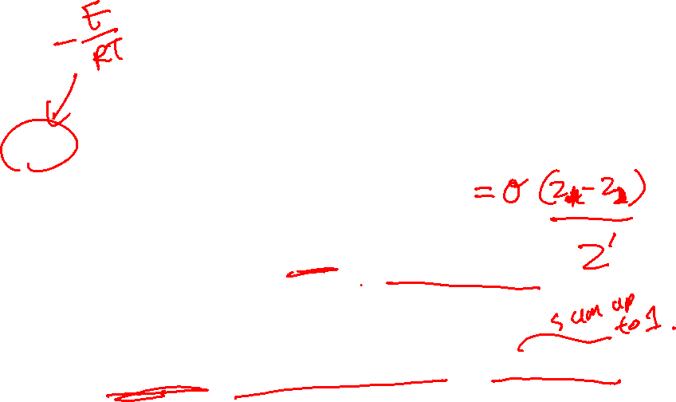
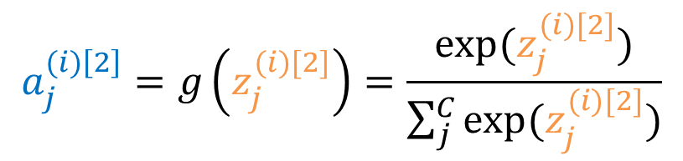
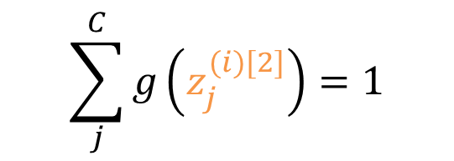
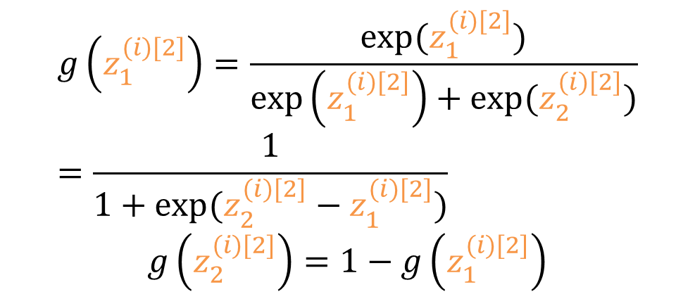
Softmax
With C = 2, softmax essentially becomes sigmoid
class i with total of C classes
$$g\left(z_{1}^{(i)[2]}\right)=\frac{exp⁡(z_{1}^{(i)[2]})}{\exp\left(z_{1}^{(i)[2]}\right)+exp⁡(z_{2}^{(i)[2]})}=\frac{1}{1+exp⁡(z_{2}^{(i)[2]}−z_{1}^{(i)[2]})}$$
$$g\left(z_{2}^{(i)[2]}\right)=1−g\left(z_{1}^{(i)[2]}\right)$$
$$a_{j}^{(i)\left[2\right]}=g\left(z_{j}^{(i)[2]}\right)=\frac{exp⁡(z_{j}^{(i)[2]})}{\sum_{j}^{C}{exp⁡(z_{j}^{(i)[2]})}}$$
Summed over for each datum
$$\sum_{j}^{C}{g\left(z_{j}^{(i)[2]}\right)}=1$$
Softmax Probability
$$g\left(z^{(i)\left[2\right]}\right)=\left[a_{1}^{(i)\left[2\right]},a_{2}^{(i)\left[2\right]},a_{3}^{(i)\left[2\right]}\right]=\left[0.1, 0.2, 0.7 \right]$$
class 1
class 3
class 2

Slide 23

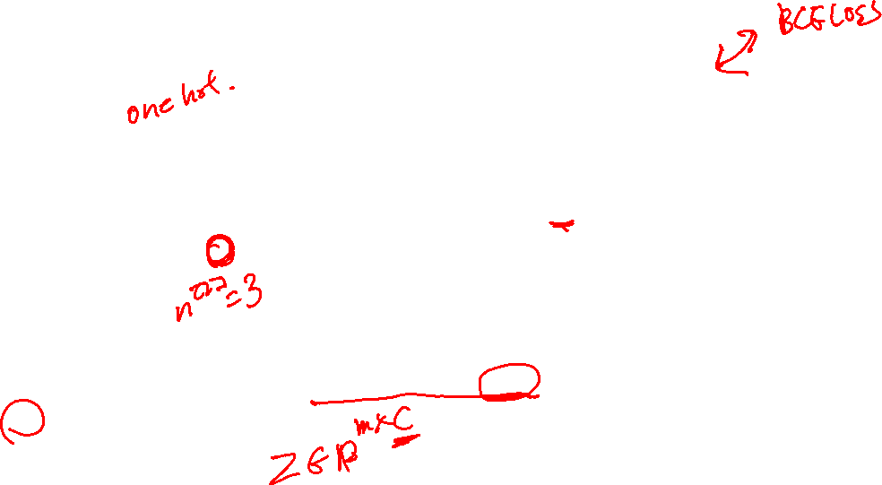
Pytorch implementation
import torch
import torch.nn as nn
X = torch.rand(250,50)
Y = torch.randint(0,3,(250,))
Y = nn.functional.one_hot(Y)
class Model(nn.Module):
def __init__(self):
super().__init__()
self.L1 = nn.Linear(50,3)
self.L2 = nn.Linear(3,3)
def forward(self, X):
Z1 = self.L1(X)
A1 = torch.tanh(Z1)
Z2 = self.L2(A1)
return Z2
Logits is used
NN = Model()
import torch.optim as optim
criterion = nn.CrossEntropyLoss()
optimizer = optim.SGD(NN.parameters(), lr=0.001)
for i in range(10000):
Z = NN(X)
optimizer.zero_grad()
loss = criterion(Z,Y)
loss.backward()
optimizer.step()
if i % 2000 == 0:
print(f'{i} loss: {loss:.3f}’)
Z = NN(X)
A = torch.softmax(Z,dim=1)
Perform softmax after
softmax dimension

