Slide 1
Vanishing and exploding gradient

Slide 2
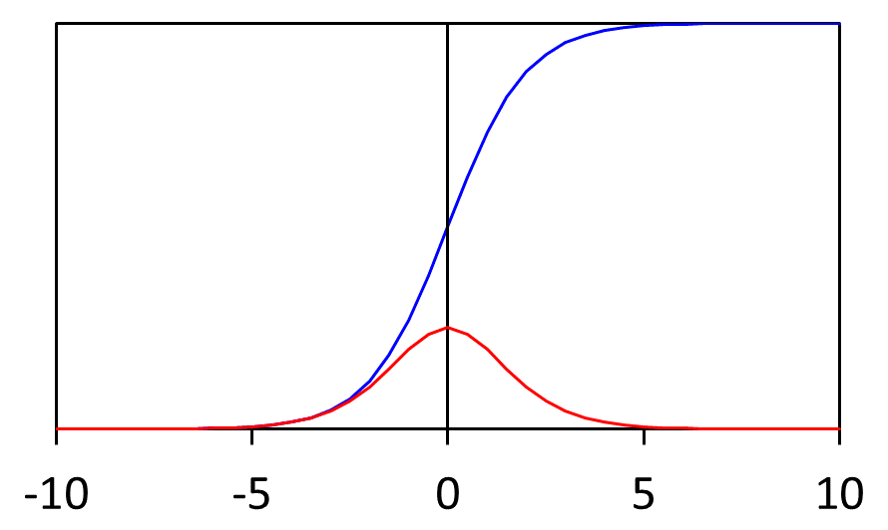
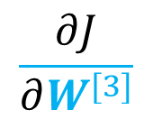

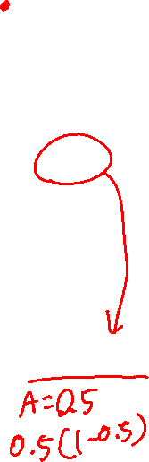

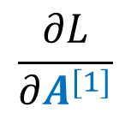
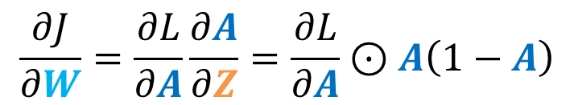



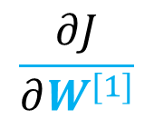

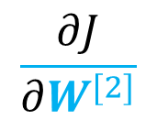

Backpropagaion: Vanishing Gradient
Derivatives and gradients gets smaller for deeper parameters
1
$$\frac{∂L}{∂A^{[1]}}$$
$$g^{[1]}=σ$$
$$\frac{∂J}{∂W^{[2]}}$$
$$g^{[2]}=σ$$
sigmoid
derivative of sigmoid
$$\frac{∂J}{∂W^{[1]}}$$
$$\frac{∂L}{∂A^{[2]}}$$
-0.0008
0
$$\frac{∂J}{∂W^{[3]}}$$
-0.0003
0.0039
$$x_{1}$$
0.0066
The maximum of sigmoid derivative is 0.25
0.0007
-0.0052
0.0029
-0.0291
0.0005
0.0015
0.0041
-0.0500
$$\frac{∂L}{∂A^{[3]}}$$
-0.0015
-0.0039
-0.0087
$$x_{2}$$
-0.0228
$$g^{[3]}=σ$$
0.0004
0.0010
-0.0054
$$\frac{∂J}{∂W}=\frac{∂L}{∂A}\frac{∂A}{∂Z}=\frac{∂L}{∂A}⊙A\left(1−A\right)$$
-0.0010
Serious problem that made early neural networks unsuccessful

Slide 3
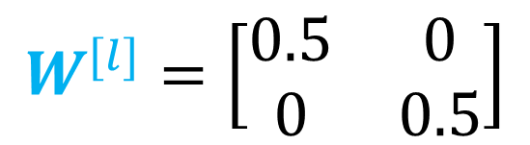





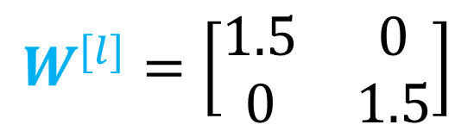




Vanishing/Exploding Gradient
$$x_{1}$$
$$\hat{y}$$
$$x_{2}$$
$$g\left(Z\right)=Z$$
$$b=0$$
$$a^{[2]}$$
$$\hat{y}=W^{[l]}W^{[l−1]}W^{[l−2]}…W^{[3]}W^{[2]}W^{[1]}x$$
$$a^{[1]}$$
$$W^{[l]}=\left[\begin{matrix}1.5 & 0 \\ 0 & 1.5\end{matrix}\right]$$
$$\hat{y}={1.5}^{l}x$$
Exploding gradient
$$W^{[l]}=\left[\begin{matrix}0.5 & 0 \\ 0 & 0.5\end{matrix}\right]$$
$$\hat{y}={0.5}^{l}x$$
Vanishing gradient

Slide 4
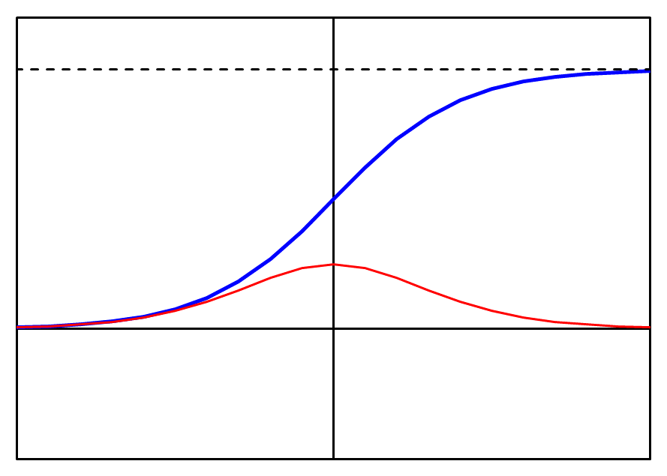
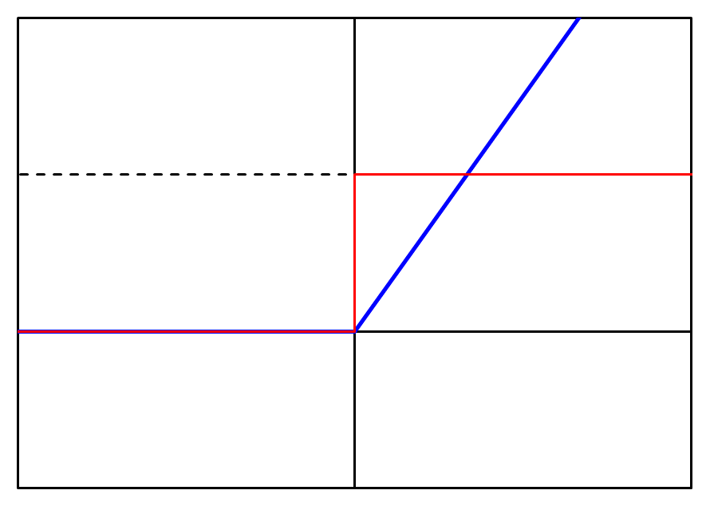
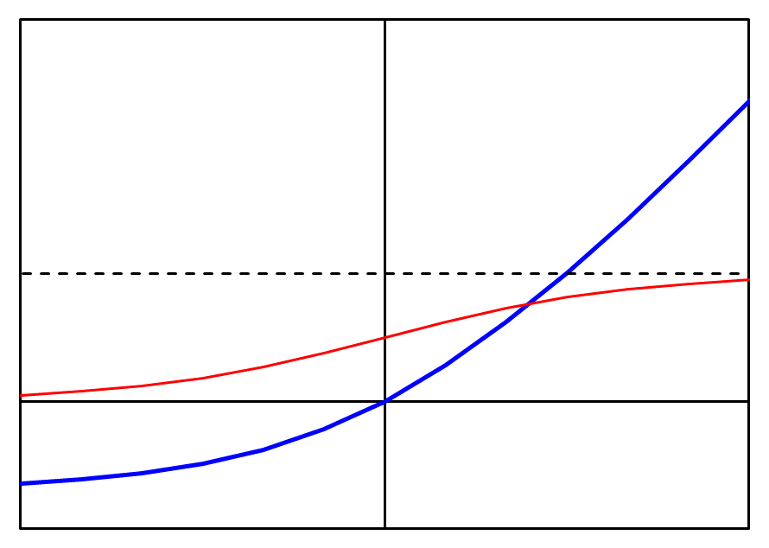
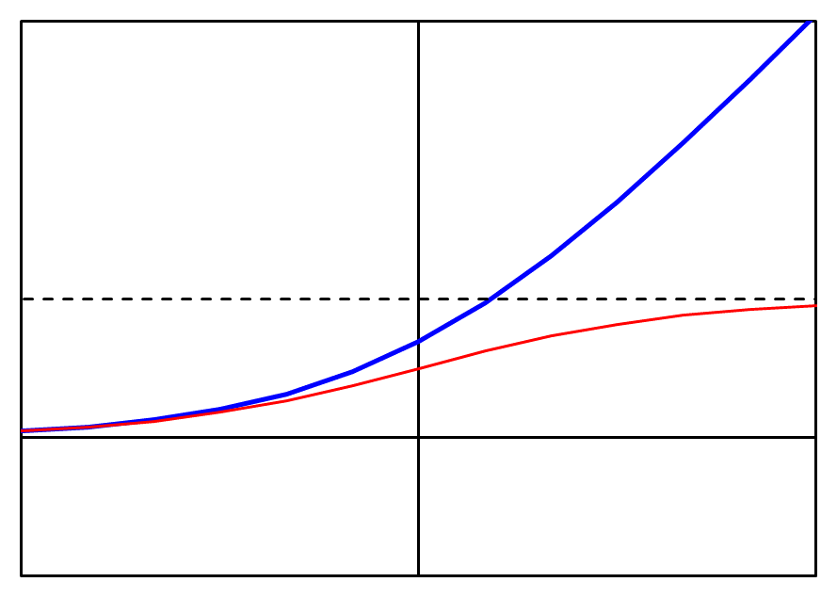
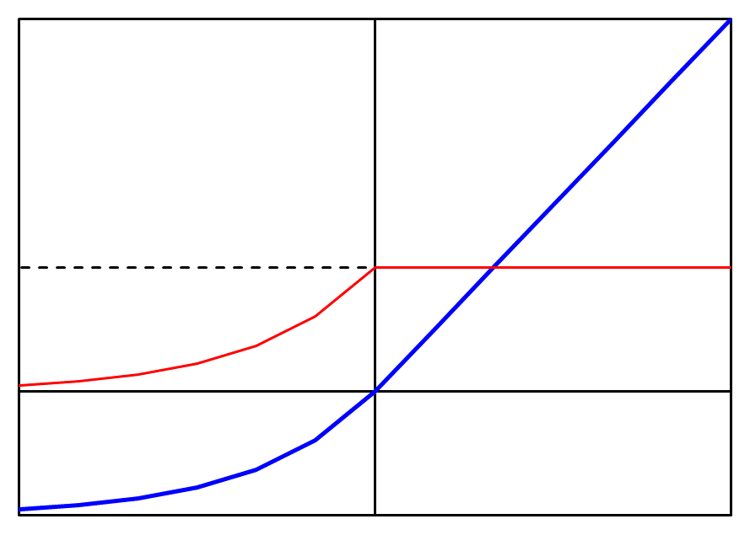
Mitigation 1. Use Other Activation Function
Sigmoid
Rectified Linear (ReLU)
1
$$g\left(z\right)=\frac{1}{1+e^{−z}}$$
g
$$g\left(z\right)=max⁡(0,z)$$
g
1
g’
g’
Vanishing Gradient
Discontinuity in gradient
Shifted Softplus
Softplus
ELU
$$g\left(z\right)=log⁡(0.5+0.5\exp\left(z\right))$$
$$g\left(z\right)=log⁡(1+\exp\left(z\right))$$
g
$$g\left(z\right)=$$
$$\left\{\begin{aligned}z, \\ \exp\left(z\right)−1,\end{aligned}\begin{matrix}if z>0 \\ if z≤0\end{matrix}\right.$$
g
1
g
1
Output mean is always positive
1
g’
g’
g’
Brings output mean towards zero

Slide 5



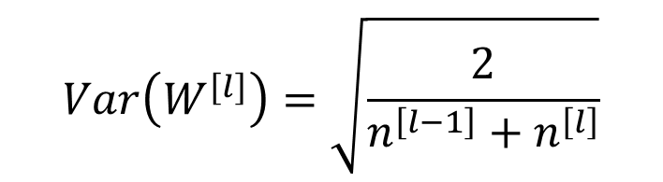

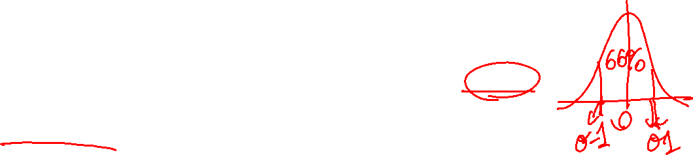
Mitigation 2. Weight initialization
Single neuron example
$$a^{\left[1\right]}$$
$$Z=w_{1}x_{1}+w_{2}x_{2}+…+w_{n}x_{n}+b$$
$$x$$
$$\hat{y}$$
Idea: large n → smaller w
$$w_{i}\sim N(0,Var(w_{i}))$$
The optimal initialization depends on the activation
For majority of the case:
Tensorflow/PyTorch chooses the optimal ones automatically in the background
Xavier normal initialization
$$Var\left(W^{[l]}\right)=\sqrt{\frac{2}{n^{\left[l−1\right]}+n^{\left[l\right]}}}$$

Slide 6

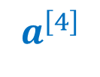
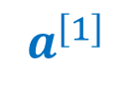
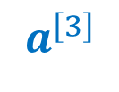
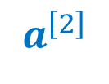
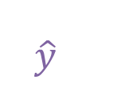
Mitigation 3. Skip Connection
Back 2
$$a^{\left[1\right]}$$
$$a^{\left[2\right]}$$
$$a^{\left[3\right]}$$
$$a^{\left[4\right]}$$
$$x$$
…
…
…
$$\hat{y}$$
+
Back 4
Back 3
Back 2
Back 1
Addition
Initial layers will “feel” the back propagation early

Slide 7
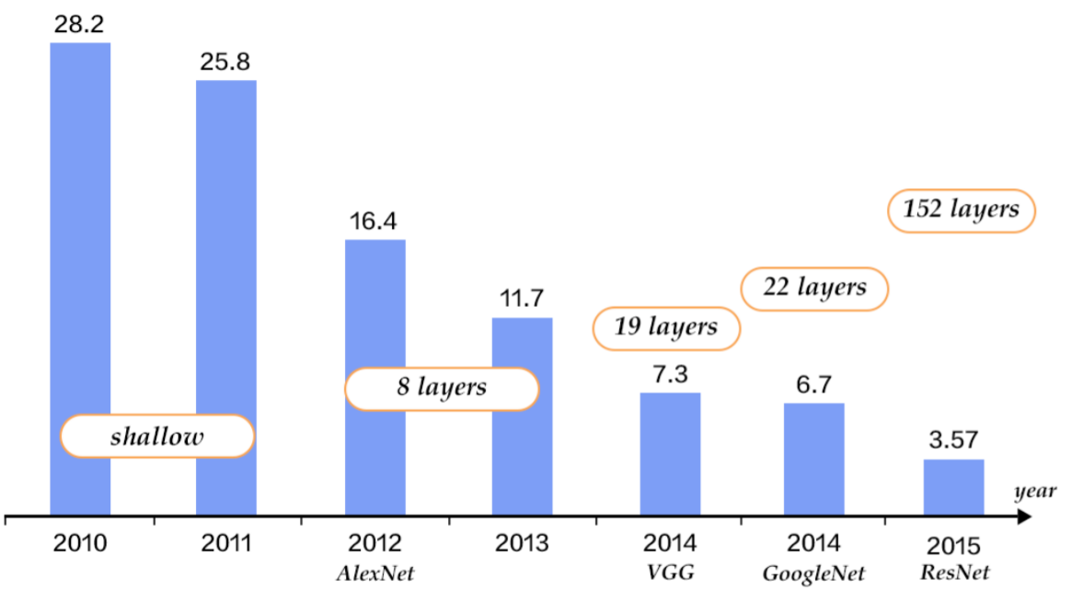
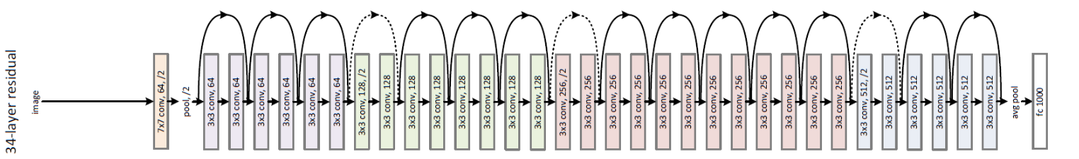
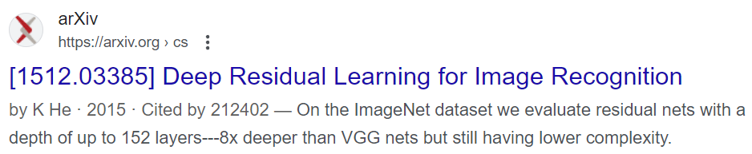
Resnet
Image Classification Challenge

Slide 8
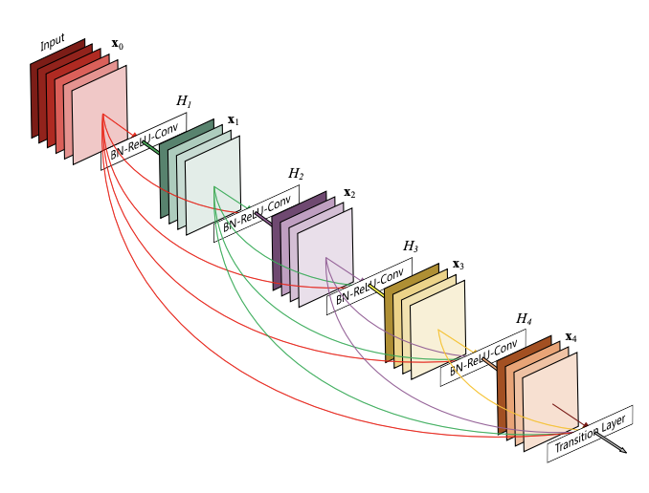
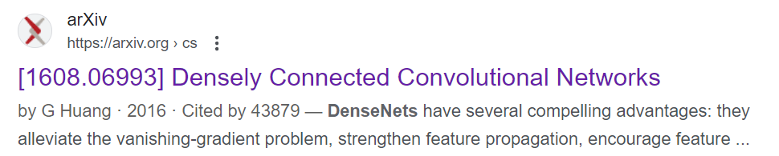
Densenet

Slide 9






Skip Connection Implementation
Back 2
$$a^{\left[1\right]}$$
$$a^{\left[2\right]}$$
$$a^{\left[3\right]}$$
class Model(nn.Module):
def __init__(self,n_0,n_1,n_2,n_3):
super().__init__()
self.L1 = nn.Linear(n_0,n_1)
self.L2 = nn.Linear(n_1,n_2)
self.L3 = nn.Linear(n_2,n_3)
self.L4 = nn.Linear(n_3,n_4)
self.act1 = nn.ReLU()
def forward(self, X):
Z1 = self.L1(X)
A1 = self.act1(Z1)
Z2 = self.L2(A1)
A2 = self.act1(Z2)
Z3 = self.L3(A2)
A3 = self.act1(Z3)
A3 = A3 + A1
Z4 = self.L3(A3)
return Z4
$$a^{\left[4\right]}$$
$$x$$
…
…
…
+
$$\hat{y}$$
Back 4
Back 3
Back 2
Back 1
Addition
Error here! Retake the video

Slide 10
Minibatches

Slide 11
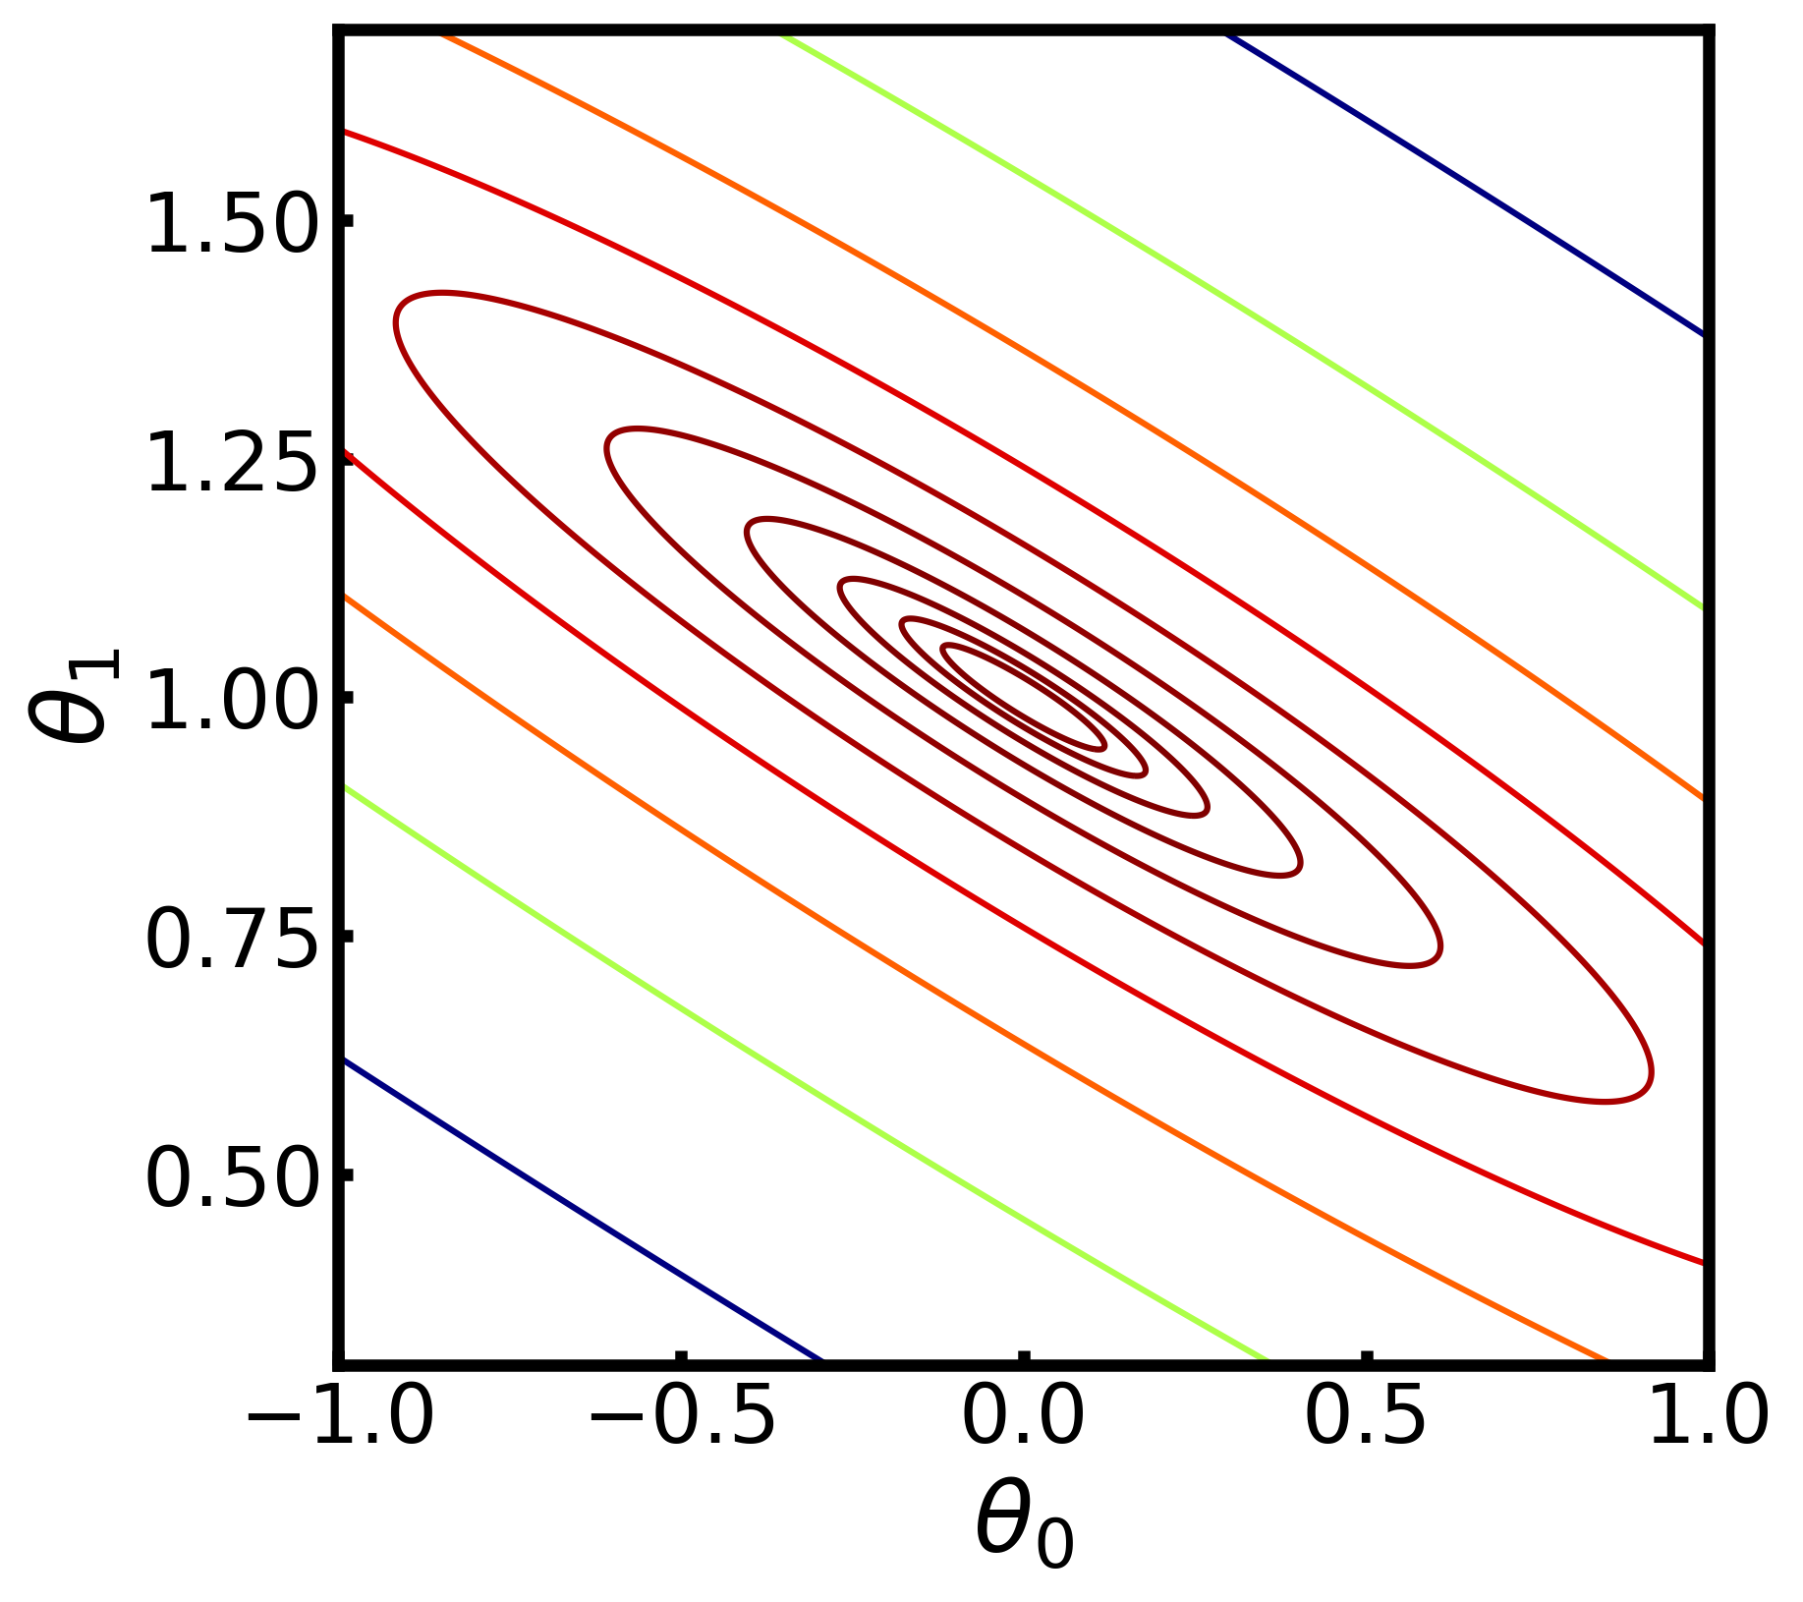
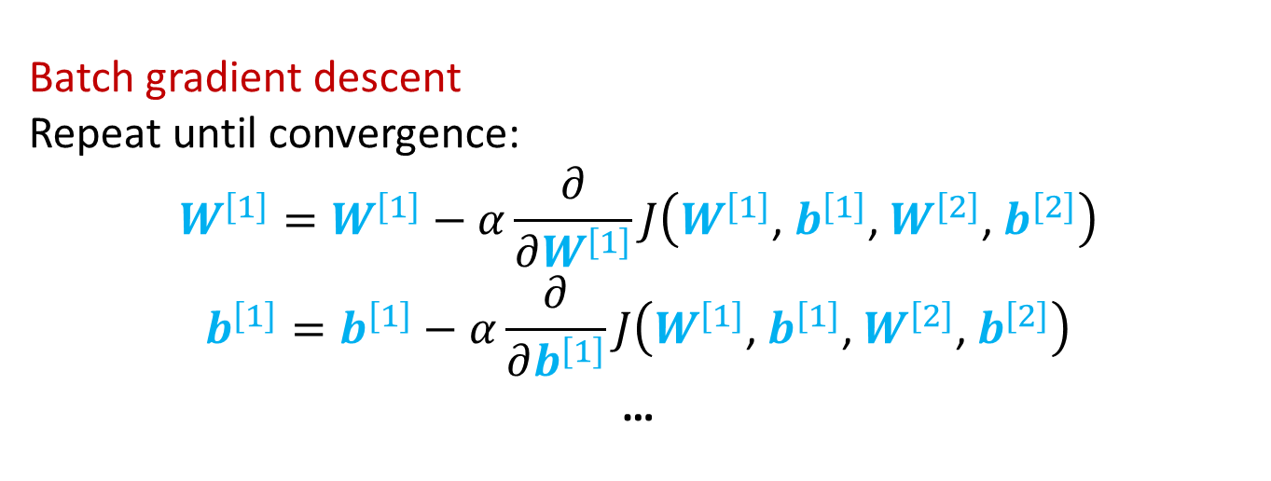
Mini Batches
Batch gradient descent
Repeat until convergence:
$$W^{\left[1\right]}=W^{\left[1\right]}−α\frac{∂}{∂W^{\left[1\right]}}J\left(W^{\left[1\right]}\text{, }b^{\left[1\right]}\text{,} W^{\left[2\right]}\text{, }b^{\left[2\right]}\right)$$
$$b^{\left[1\right]}=b^{\left[1\right]}−α\frac{∂}{∂b^{\left[1\right]}}J\left(W^{\left[1\right]}\text{, }b^{\left[1\right]}\text{,} W^{\left[2\right]}\text{, }b^{\left[2\right]}\right)$$
…
Cost function
gradient descent step
What if m = 100,000? Parameter update is infrequent

Slide 12
Mini-batches
Batch
(y⁽¹⁾,x⁽¹⁾), (y⁽²⁾,x⁽²⁾), (y⁽³⁾,x⁽³⁾), (y⁽⁴⁾,x⁽⁴⁾), (y⁽⁵⁾,x⁽⁵⁾), … (y^{(m-1)},x^{(m-1)}), (y^{(m)},x^{(m)})
Mini batches
(batch size 100)
(y⁽¹⁾,x⁽¹⁾),…(y⁽¹⁰⁰⁾,x⁽¹⁰⁰⁾)
(y⁽¹⁰¹⁾,x⁽¹⁰¹⁾),…(y⁽²⁰⁰⁾,x⁽²⁰⁰⁾)
…
(y^{(m-100)},x^{(m-100)}),…(y^{(m)},x^{(m)})
An Epoch
Allowing the algorithm to get updated with small data speeds up the training dramatically
if m = 5,000,000, and mini-batch size is 5,000, then you have 1,000 mini-batch
for epoch = 1 to 100
for mini-batch in mini-batches
Forward propagation
Back propagation
Gradient desecnt

Slide 13
Pytorch implementation: Dataset
Pytorch offers codes to make minibatches easily. First let’s look at the Dataset.
Dataset makes handling the data less messy:
from torch.utils.data import Dataset
import numpy as np
import pandas as pd
import torch
class MaterialsDataset(Dataset):
def __init__(self, path):
df = pd.read_csv(path)
data = df.to_numpy()
data = torch.tensor(data,dtype=torch.float32)
self.Y = data[:,:1]
self.X = data[:,1:]
def __len__(self):
return self.Y.shape[0]
def __getitem__(self, idx):
return self.X[idx,:], self.Y[idx,:]
data = MaterialsDataset('HW12.csv')
Loading and preprocessing the data
This method is called when len() is used
e.g. len(data)
This must return the length of the data
This must return the data with index of idx
This method is called when squared bracket is used
e.g. data[idx]

Slide 14
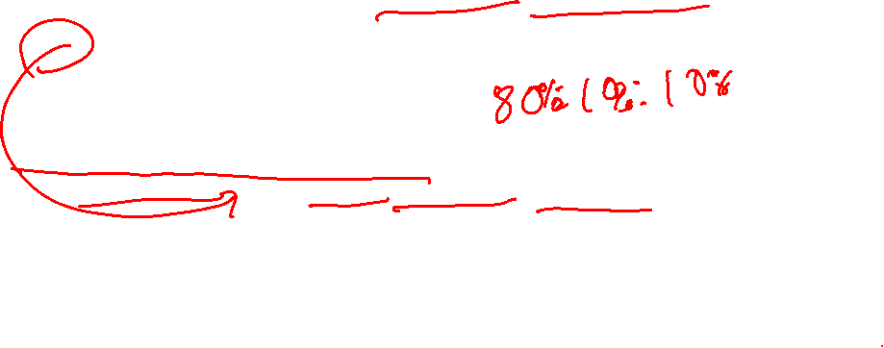
Pytorch implementation: Data Loader
DataLoader allows you to make mini batches
from torch.utils.data import DataLoader, random_split
data = MaterialsDataset('HW12.csv’)
ntrain = 0.8
nval = 0.1
ntest = 0.1
data_train, data_val, data_test = random_split(data,[ntrain,nval,ntest])
dataloader_train = DataLoader(data_train, batch_size=64, shuffle=True)
dataloader_val = DataLoader(data_val, batch_size=64, shuffle=True)
dataloader_test = DataLoader(data_test, batch_size=64, shuffle=True)
Made from the class in the previous slide
Split data into train, validation, and test set
Make Data loader

Slide 15
Pytorch implementation: Obtaining minibatches
You need to iterate over dataloader to get minibatches
import torch.optim as optim
NN = Model(n_0,n_1,n_2,n_3)
criterion = nn.BCEWithLogitsLoss()
optimizer = optim.SGD(NN.parameters(), lr=0.1)
for i in range(1000):
for X, Y in dataloader_train:
Z= NN(X)
optimizer.zero_grad()
loss = criterion(Z,Y)
loss.backward()
optimizer.step()
1000 epochs
These are minibatches with 64 data points

Slide 16
Adam optimizer

Slide 17
Mini Batches
Batch gradient descent
Mini batch gradient descent
Cost
Cost
# iteration
mini batch #

Slide 18
Choosing minibatch size
mini-batch size = m : Batch gradient descent
mini-batch size = 1 : Stochastic gradient descent
1 < mini-batch size < m : Minibatch gradient descent
Stochastic
gradient descent
↓
Lose speed from vector parallelization
In-between minibatch size
↓
benefit from parallelization
frequent Iteration
Batch
gradient descent
↓
Lose speed from infrequent iteration
typical minibatch size: 32, 64, 128, 256, 512 (speed up from binary-based hardware)

Slide 19
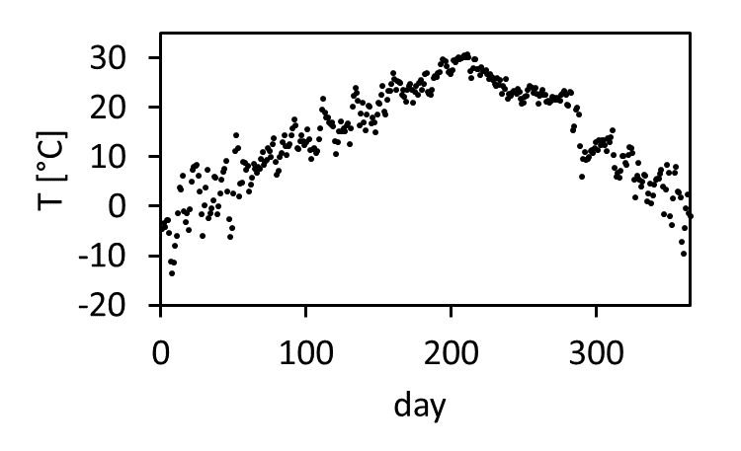
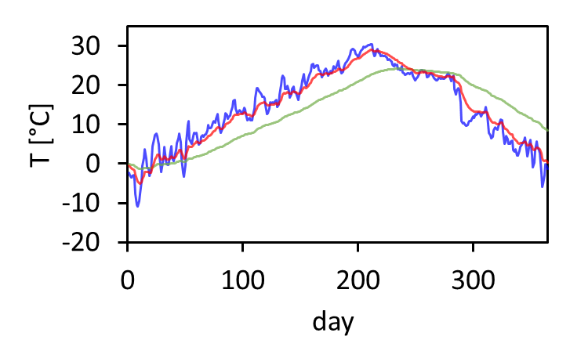
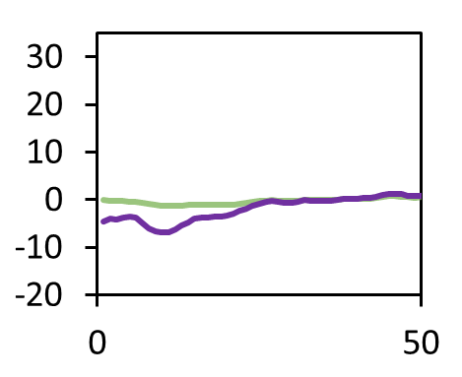
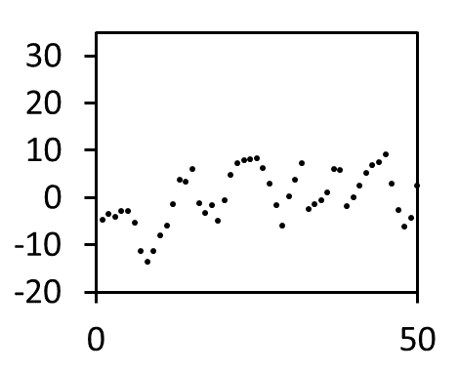
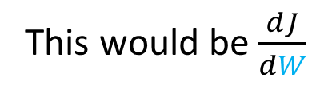
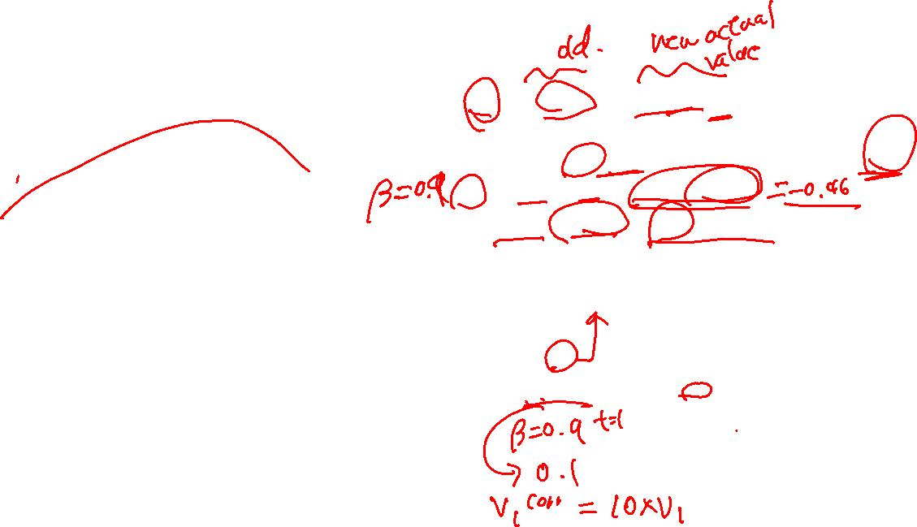
Dealing with noise: Exponentially weighted averages
2021 Daejeon temperature
Averaged value at t
Value at t
e.g.
$θ_{1}=−4.6 ℃$
$$v_{t}=βv_{t−1}+\left(1−β\right)θ_{t}$$
e.g.
$$v_{0}=0$$
$$v_{1}=0.9×0+0.1×−4.6$$
$$v_{2}=0.9×−0.46+0.1×−3.5$$
…
This would be $\frac{dJ}{dW}$
$β=0.9$ ~ 10 days
$β=0.98$ ~ 50 days
$β=0.5$ ~ 2 days
Bias correction
$$v_{t}^{corrected}=\frac{v_{t}}{1−β^{t}}$$
uncorrected
corrected

Slide 20
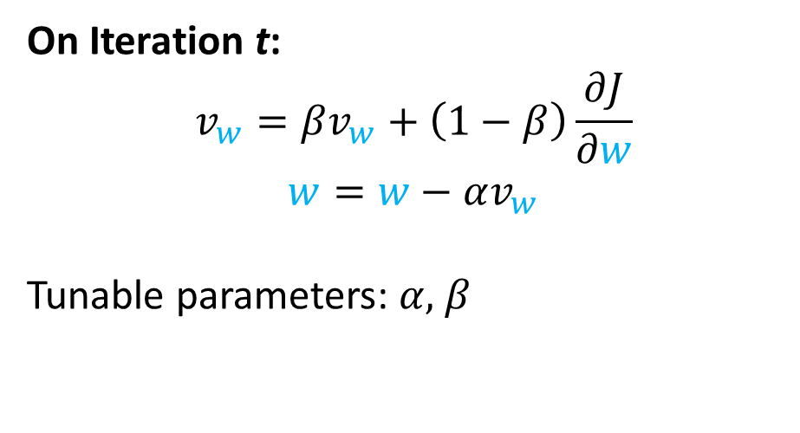
Gradient Descent with Momentum
Minibatch Gradient Descent
Gradient Descent with momentum
On Iteration t:
$$v_{w}=βv_{w}+\left(1−β\right)\frac{∂J}{∂w}$$
$$w=w−αv_{w}$$
Tunable parameters: $α,$ $β$

Slide 21

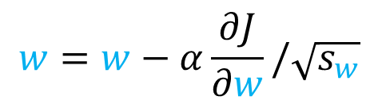
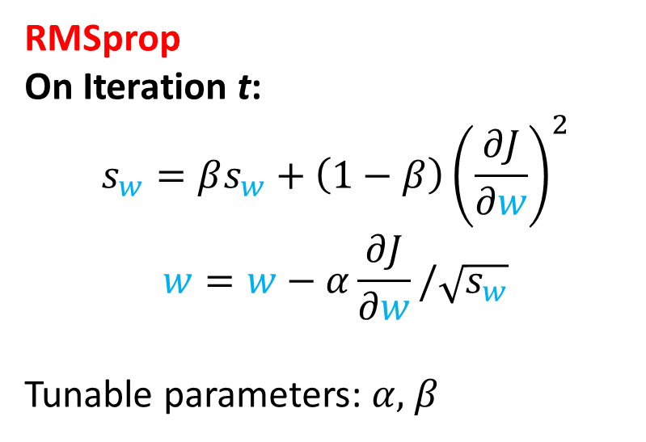
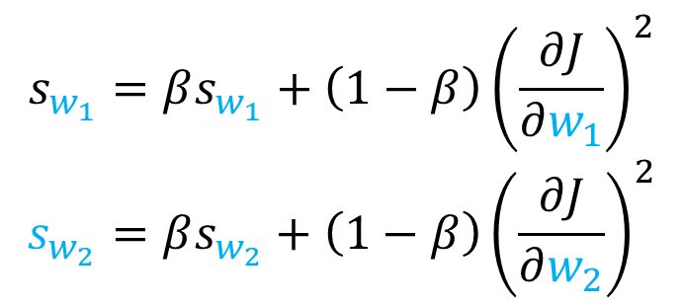
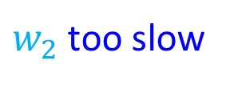

RMSprop optimization
Original Gradient Descent
$$w_{1}$$
too
fast
$w_{2}$ too slow
We want to slow down in $w_{1}$ direction and speed up in $w_{2}$
RMSprop
On Iteration t:
$$s_{w}=βs_{w}+\left(1−β\right){\left(\frac{∂J}{∂w}\right)}^{2}$$
$$w=w−α\frac{∂J}{∂w}/\sqrt{s_{w}}$$
Tunable parameters: $α,$ $β$
$$s_{w_{1}}=βs_{w_{1}}+\left(1−β\right){\left(\frac{∂J}{∂w_{1}}\right)}^{2}$$
$$s_{w_{2}}=βs_{w_{2}}+\left(1−β\right){\left(\frac{∂J}{∂w_{2}}\right)}^{2}$$
large (damping)
small
$$w=w−α\frac{∂J}{∂w}/\sqrt{s_{w}}$$

Slide 22
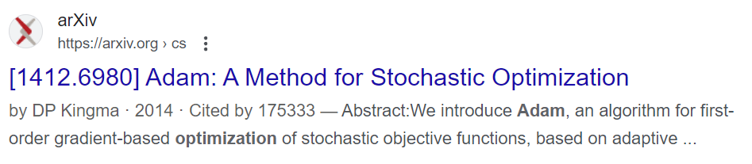
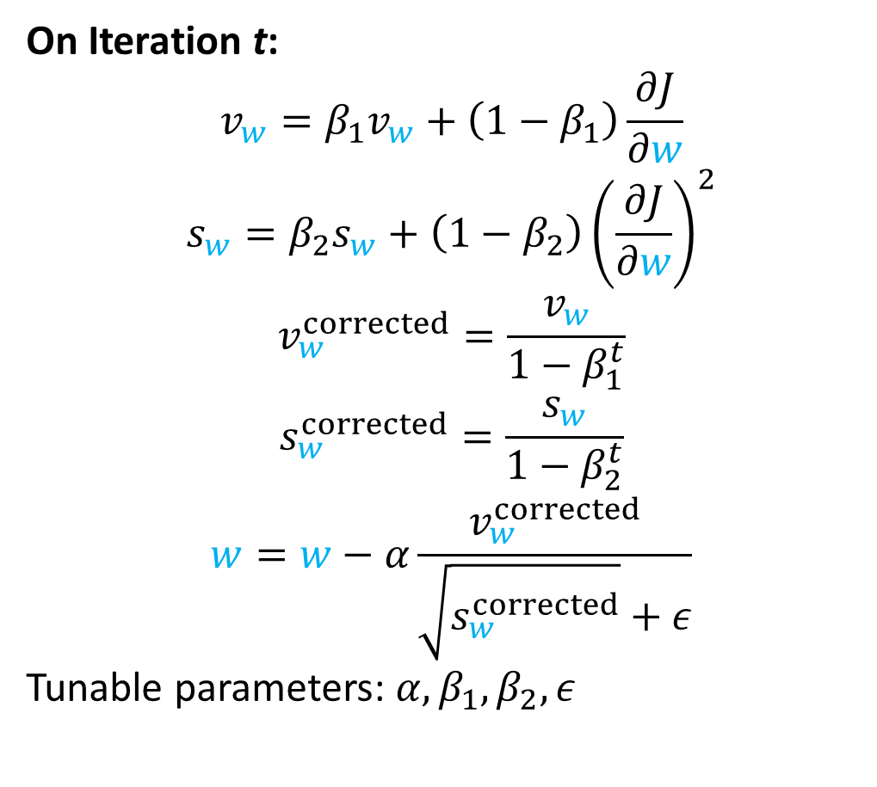
Adam optimization
On Iteration t:
$$v_{w}=β_{1}v_{w}+\left(1−β_{1}\right)\frac{∂J}{∂w}$$
$$s_{w}=β_{2}s_{w}+\left(1−β_{2}\right){\left(\frac{∂J}{∂w}\right)}^{2}$$
$$v_{w}^{corrected}=\frac{v_{w}}{1−β_{1}^{t}}$$
$$s_{w}^{corrected}=\frac{s_{w}}{1−β_{2}^{t}}$$
$$w=w−α\frac{v_{w}^{corrected}}{\sqrt{s_{w}^{corrected}}+ε}$$
Tunable parameters: $α,β_{1},β_{2},ε$
Gradient Descent with Momentum+ RMSprop
Every modern models use Adam or its derivatives
Default parameters on pyTorch usually works well
Momentum
RMSprop
Bias correction
prevents division by 0

Slide 23
Pytorch Implementation
import torch.optim as optim
NN = Model(n_0,n_1,n_2,n_3)
criterion = nn.BCEWithLogitsLoss()
optimizer = optim.Adam(NN.parameters(), lr=0.1)
for i in range(1000):
for X, Y in dataloader_train:
y_hat = NN(X)
optimizer.zero_grad()
loss = criterion(Z,Y)
loss.backward()
optimizer.step()

