Slide 1
Convolutional Neural Network

Slide 2
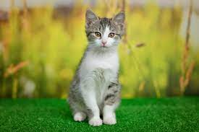

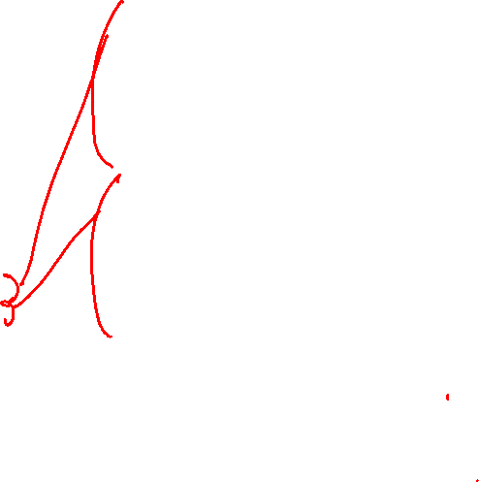
Using Simple Neural Network
Featurization
Flatten
…
…
…
…

Slide 3
Convolutional Neural Network
Same weights used for each set of pixels
Kernel (filter)
Significantly reduces number of parameters
https://medium.datadriveninvestor.com/convolutional-neural-networks-3b241a5da51e

Slide 4
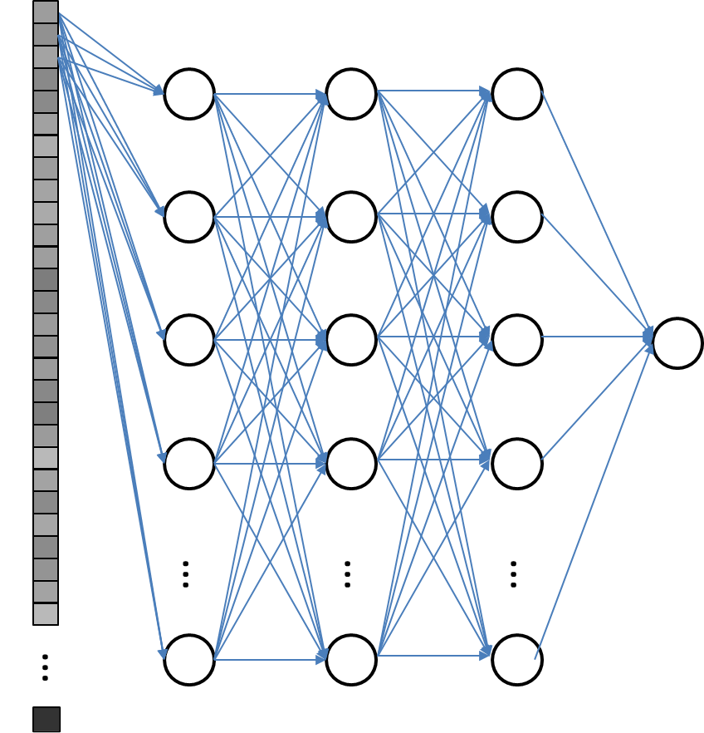
Convolutional Neural Network
c
For fully connected layer, the NN has to learn the cat’s face at all possible location

Slide 5
Convolutional Neural Network
c
…
…
…
…
For CNN, the neural network is applied to local images repeatedly, so neural network utilizes the data better

Slide 6
CNN Hyperparameters

Slide 7
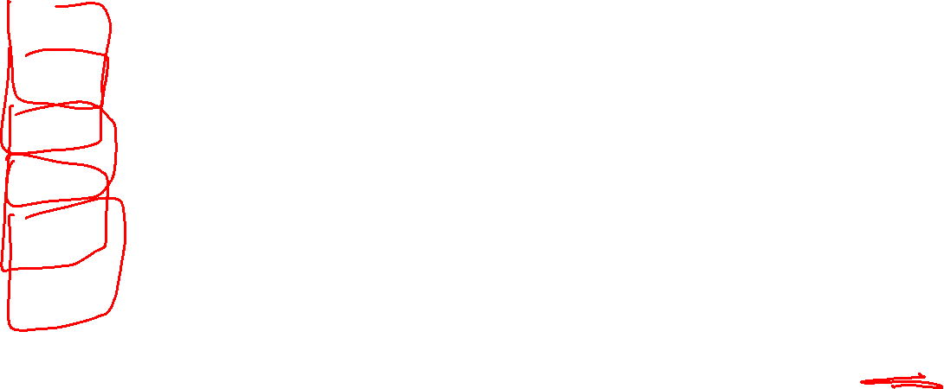
Kernel size
1 | 0 | 1 | 0 | 1 | 0
0 | 1 | 1 | 0 | 1 | 1
1 | 0 | 1 | 0 | 1 | 0
1 | 0 | 1 | 1 | 1 | 0
0 | 1 | 1 | 0 | 1 | 1
1 | 0 | 1 | 0 | 1 | 0
1 | 0
0 | 1
1 | 2
3 | 4
5
×
Image patch
2×2 Kernel
(filter)
Output
(5×5)
Input image patch
(6×6)

Slide 8
Kernel size
1 | 0 | 1 | 0 | 1 | 0
0 | 1 | 1 | 0 | 1 | 1
1 | 0 | 1 | 0 | 1 | 0
1 | 0 | 1 | 1 | 1 | 0
0 | 1 | 1 | 0 | 1 | 1
1 | 0 | 1 | 0 | 1 | 0
1 | 0 | 1
0 | 1 | 1
1 | 0 | 1
1 | 2 | 3
4 | 5 | 6
7 | 8 | 9
31
×
Image patch
3×3 Kernel
(filter)
Output
(4×4)
Input image patch
(6×6)

Slide 9
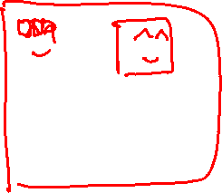
Kernel size
1 | 0 | 1 | 0 | 1 | 0
0 | 1 | 1 | 0 | 1 | 1
1 | 0 | 1 | 0 | 1 | 0
1 | 0 | 1 | 1 | 1 | 0
0 | 1 | 1 | 0 | 1 | 1
1 | 0 | 1 | 0 | 1 | 0
1 | 2 | 3 | 4
5 | 6 | 7 | 8
9 | 10 | 11 | 12
13 | 14 | 15 | 16
80
1 | 0 | 1 | 0
0 | 1 | 1 | 0
1 | 0 | 1 | 0
1 | 0 | 1 | 1
×
Image patch
4×4 Kernel
(filter)
Output
(3×3)
Input image patch
(6×6)

Slide 10
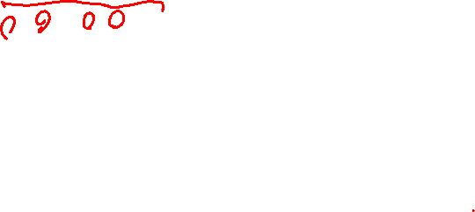
Padding
0 | 0 | 0 | 0 | 0 | 0 | 0 | 0
0 | 1 | 0 | 1 | 0 | 1 | 0 | 0
0 | 0 | 1 | 1 | 0 | 1 | 1 | 0
0 | 1 | 0 | 1 | 0 | 1 | 0 | 0
0 | 1 | 0 | 1 | 1 | 1 | 0 | 0
0 | 0 | 1 | 1 | 0 | 1 | 1 | 0
0 | 1 | 0 | 1 | 0 | 1 | 0 | 0
0 | 0 | 0 | 0 | 0 | 0 | 0 | 0
0 | 0 | 0
0 | 1 | 0
0 | 0 | 1
1 | 2 | 3
4 | 5 | 6
7 | 8 | 9
14
×
Image patch
3×3 Kernel
(filter)
padded input image patch
(6×6)
Output
(6×6)
Padding can be used to control output size

Slide 11
Stride
Stride of 1
1 | 0 | 1 | 0 | 1 | 0
0 | 1 | 1 | 0 | 1 | 1
1 | 0 | 1 | 0 | 1 | 0
1 | 0 | 1 | 1 | 1 | 0
0 | 1 | 1 | 0 | 1 | 1
1 | 0 | 1 | 0 | 1 | 0
1 | 0
0 | 1
1 | 2
3 | 4
5 | 9
×
Image patch
2×2 Kernel
(filter)
0 | 1
1 | 1
1 | 2
3 | 4
×
Image patch
2×2 Kernel
(filter)
Output
(5×5)
Input image patch
(6×6)

Slide 12
Stride
Stride of 2
1 | 0 | 1 | 0 | 1 | 0
0 | 1 | 1 | 0 | 1 | 1
1 | 0 | 1 | 0 | 1 | 0
1 | 0 | 1 | 1 | 1 | 0
0 | 1 | 1 | 0 | 1 | 1
1 | 0 | 1 | 0 | 1 | 0
1 | 0
0 | 1
1 | 2
3 | 4
5 | 4
×
Image patch
2×2 Kernel
(filter)
Output
(3×3)
1 | 0
1 | 0
1 | 2
3 | 4
×
Image patch
2×2 Kernel
(filter)
Input image patch
(6×6)

Slide 13
Dilation
Dilation of 2
1 | 0 | 1 | 0 | 1 | 0
0 | 1 | 1 | 0 | 1 | 1
1 | 0 | 1 | 0 | 1 | 0
1 | 0 | 1 | 1 | 1 | 0
0 | 1 | 1 | 0 | 1 | 1
1 | 0 | 1 | 0 | 1 | 0
1 | 1
1 | 1
1 | 2
3 | 4
10
×
diluted patch
2×2 Kernel
(filter)
Output
(4×4)
Input image patch
(6×6)

Slide 14
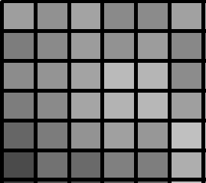
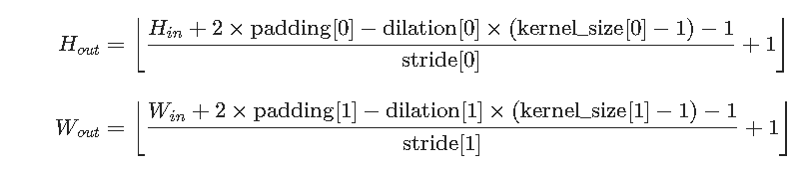
All Together
Stride 1
Stride 2
Output Image Size
Kernel size 3
Kernel size 2
Padding 1
Padding 0
Dilution 1
Dilution2

Slide 15
CNN Application

Slide 16
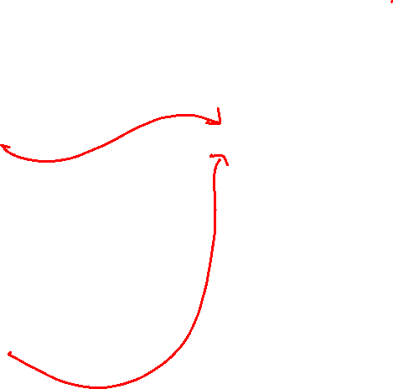





Multiple filters
Input Image
CNN
Multiple filters
$$1×H×W$$
$$n_{in}×n_{out}×K_{H}×K_{W}$$
$$n_{out}×H^{′}×W^{′}$$
or
$$3×H×W$$
$$C×H^{′}×W^{′}$$
(rgb)

Slide 17
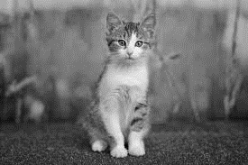

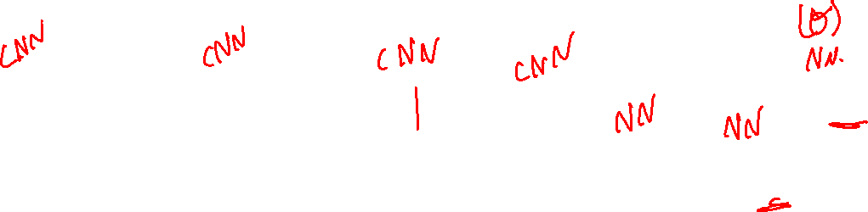







Example Convolutional Neural network
Cat or no Cat?
Input Image
…
$$\hat{y}$$
$$1×64×64$$
$$32×64×64$$
$$64×16×16$$
$$128×4×4$$
$$256×1×1$$
$$256$$
$$1$$

Slide 18
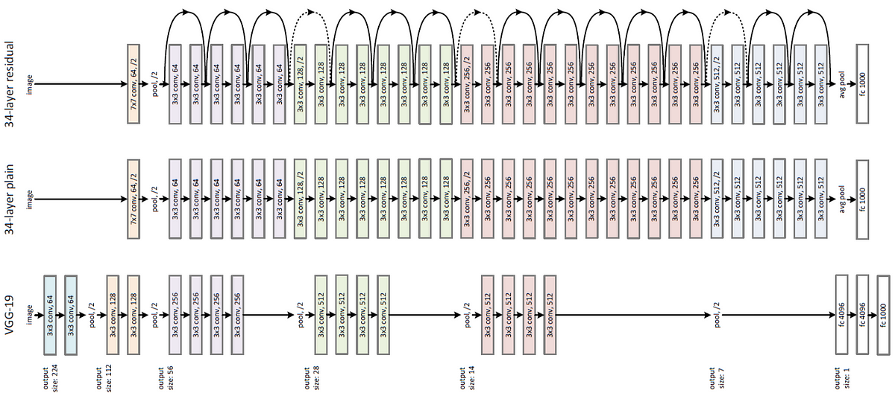
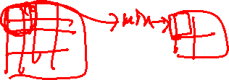
ResNet

Slide 19
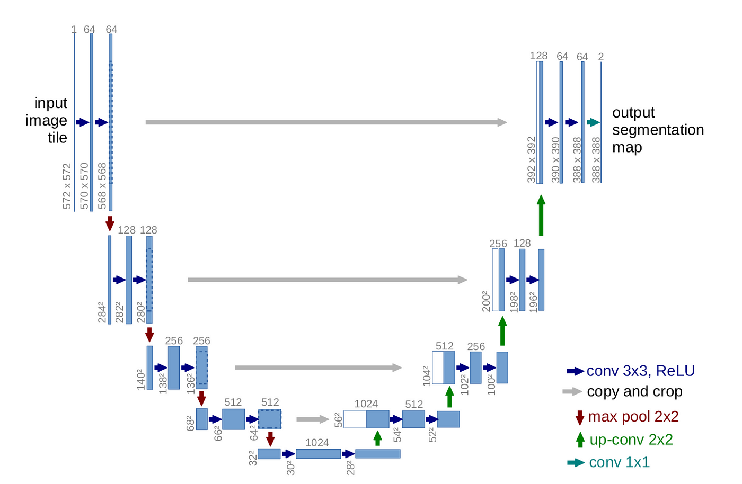
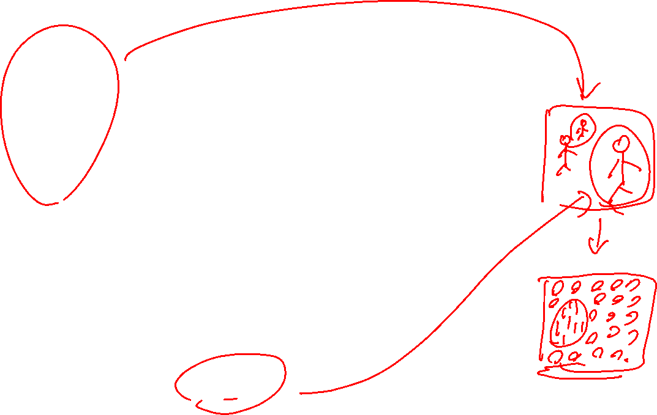
Unet

Slide 20

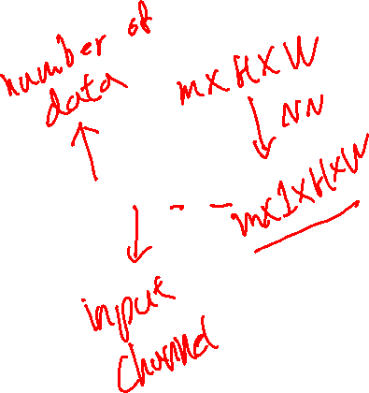
Dataset
from torch.utils.data import Dataset
import numpy as np
import pandas as pd
import torch
class ImageDataset(Dataset):
def __init__(self):
# loading data
def __len__(self):
return # returns number of data
def __getitem__(self, idx):
x = self.X[idx,:,:,:]
y = self.Y[idx,:]
return x, y
data = ImageDataset()
$$X∈ℝ^{m×C×H×W}$$

Slide 21
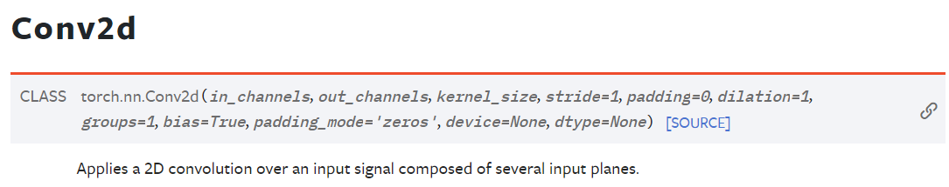

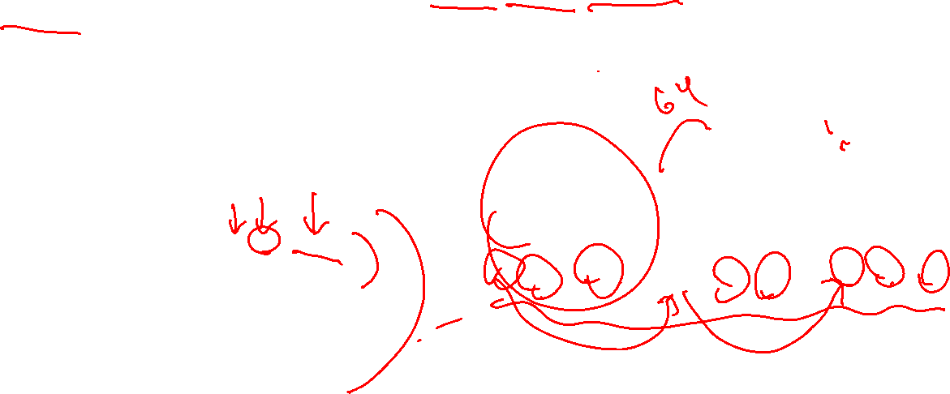


Constructing a module
import torch
import torch.nn as nn
class Model(nn.Module):
def __init__(self):
super().__init__()
self.L1 = nn.Conv2d(1,64,(3,3))
self.L2 = nn.Conv2d(64,1, (3,3))
def forward(self, X):
Z1 = self.L1(X)
A1 = torch.(Z1)
Z2 = self.L2(A1)
return A2
$$1×64×64$$
$$64×62×62$$
$$1×60×60$$

