Slide 1
Logistic Regression

Slide 2
Classification
Question | Answer
Is the material metallic? | No Yes
Is the material superconductive? | No Yes
Does it have catalytic activity? | No Yes
𝑦 can only be one of two values
“binary classification”
false true
0 1
“negative class”
“positive class”

Slide 3
Classification Data
(Metal) 1
(Insulator) 0
Electrical conductivity
Metal
Insulator

Slide 4


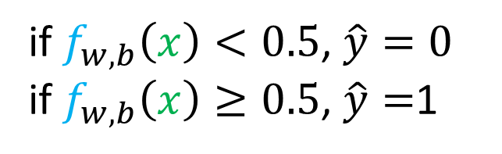

Linear regression for classification
decision boundary
$$f_{w,b}\left(x\right)=wx+b$$
(Metal) 1
$$f_{w,b}\left(x\right)=wx+b$$
threshold
0.5
(Insulator) 0
Electrical conductivity
if $f_{w,b}\left(x\right)<0.5$, $\hat{y}=0$
if $f_{w,b}\left(x\right)≥0.5$, $\hat{y}=$1

Slide 5
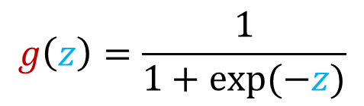
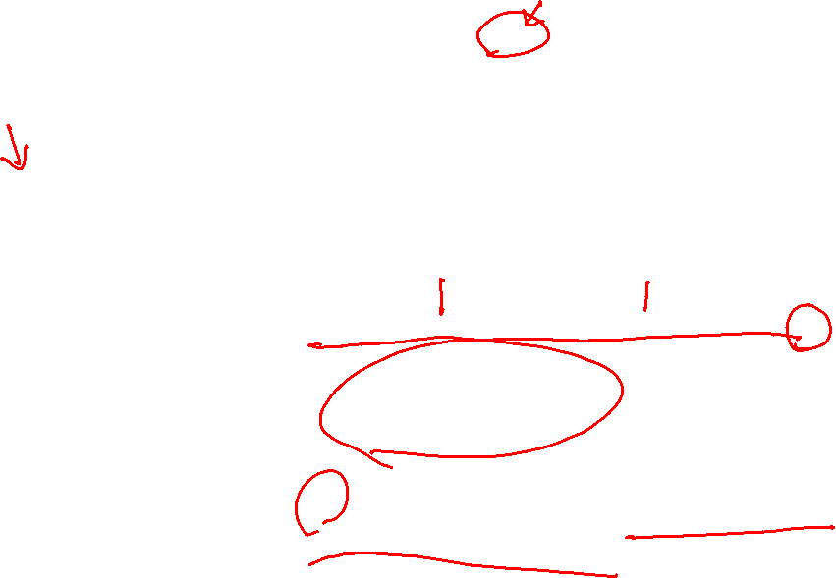

logistic regression with feature input
Output between 0 and 1
g(z)
1.0
(Metal) 1
0.5
(Insulator) 0
-3.0
0.0
3.0
z
Electrical conductivity
sigmoid function
logistic function
$$g\left(z\right)=\frac{1}{1+exp⁡(−z)}$$
$$0<g\left(z\right)<1$$
Notes:
Show example of the g(z) calculation at various z value

Slide 6

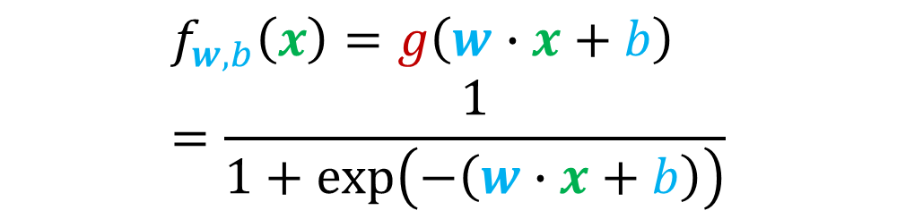
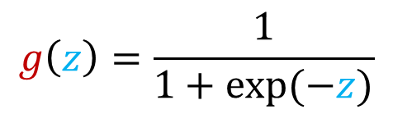
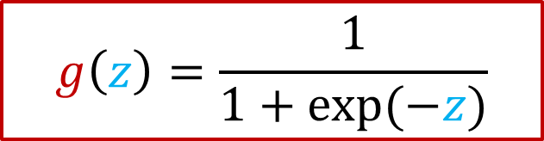


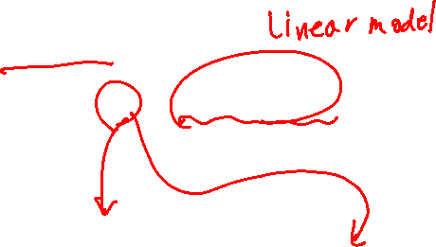
Logistic regression
Output between 0 and 1
g(z)
$$f_{w,b}\left(x\right)$$
1.0
$$z=w∙x+b$$
0.5
$$g\left(z\right)=\frac{1}{1+exp⁡(−z)}$$
-3.0
0.0
3.0
z
$$f_{w,b}\left(x\right)=g\left(w∙x+b\right)=\frac{1}{1+\exp\left(−\left(w∙x+b\right)\right)}$$
sigmoid function
logistic function
$$g\left(z\right)=\frac{1}{1+exp⁡(−z)}$$
$$0<g\left(z\right)<1$$

Slide 7
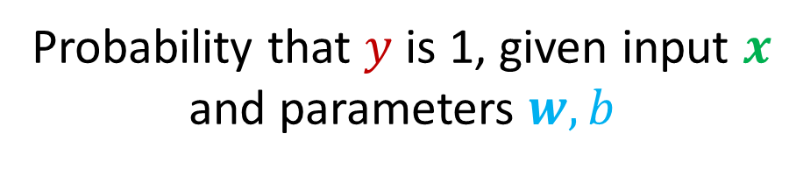

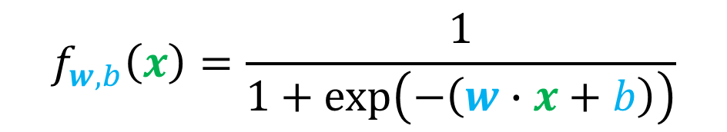

Logistic regression as probability
$$f_{w,b}\left(x\right)=\frac{1}{1+\exp\left(−\left(w∙x+b\right)\right)}$$
Probability that class is 1 (positive)
Probability that $y$ is 1, given input $x$
and parameters $w,b$
$$f_{w,b}\left(x\right)=P\left(y=1 | x;w,b\right)$$
if the probability that class is 1 is 70 %, the probability that class is 0 is 30%
$$P\left(y=1\right)+P\left(y=0\right)=1$$
$$f_{w,b}\left(x\right)=0.7$$
70% chance that $y$ is 1

Slide 8
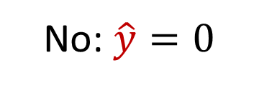

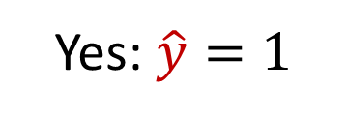


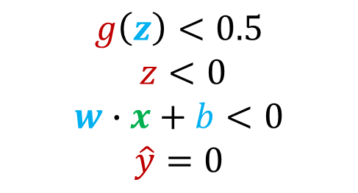
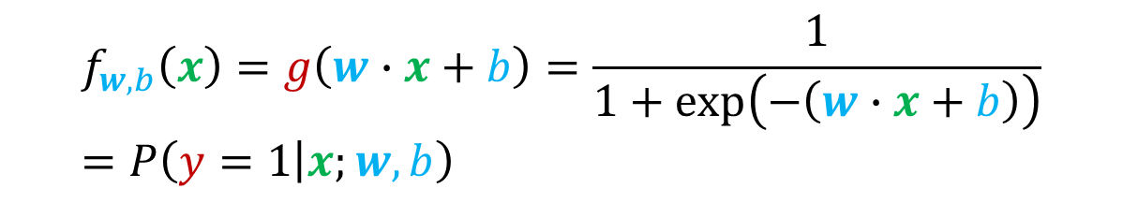
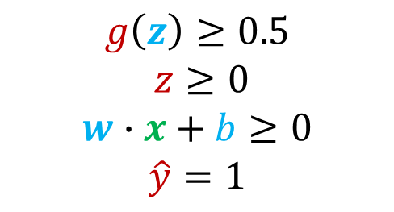


Decision boundary
g(z)
1.0
$$f_{w,b}\left(x\right)=g\left(w∙x+b\right)=\frac{1}{1+\exp\left(−\left(w∙x+b\right)\right)}=P\left(y=1 | x;w,b\right)$$
0.5
z
is $f_{w,b}\left(x\right)≥0.5$?
-3.0
0.0
3.0
$$f_{w,b}\left(x\right)$$
Yes: $\hat{y}=1$
No: $\hat{y}=0$
$$z=w∙x+b$$
When is $f_{w,b}\left(x\right)≥0.5$?
$$g\left(z\right)=\frac{1}{1+exp⁡(−z)}$$
$$g\left(z\right)≥0.5$$
$z≥0$
$$w∙x+b≥0$$
$$\hat{y}=1$$
$$g\left(z\right)<0.5$$
$z<0$
$$w∙x+b<0$$
$$\hat{y}=0$$

Slide 9
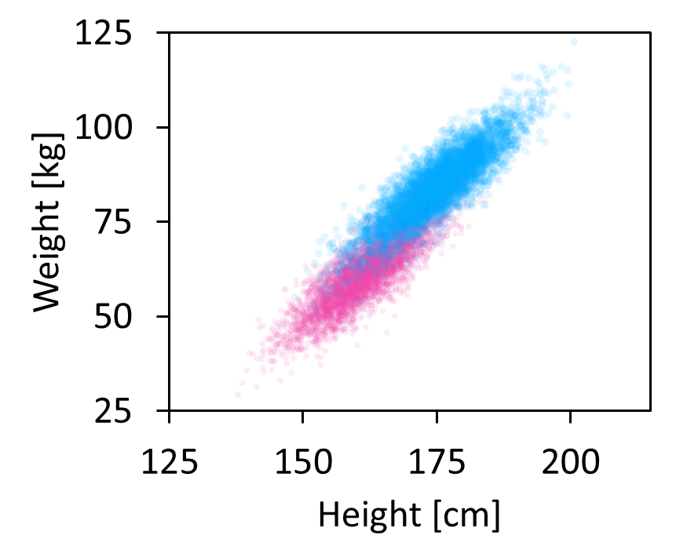




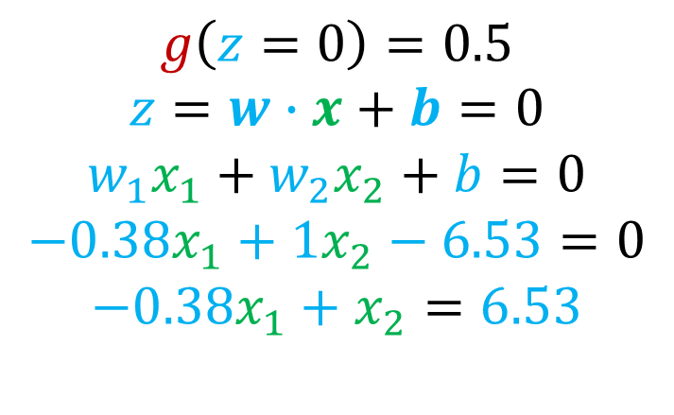
Decision Boundary
$$x_{2}$$
$$f_{w,b}\left(x\right)=g\left(z\right)=g\left(w_{1}x_{1}+w_{1}x_{1}+b\right)$$
$−0.38x_{1}+x_{2}≥$ $6.53$
Decision Boundary
Male
$$g\left(z=0\right)=0.5$$
$$z=w∙x+b=0$$
$$w_{1}x_{1}+w_{2}x_{2}+b=0$$
$$−0.38x_{1}+1x_{2}−6.53=0$$
$$−0.38x_{1}+x_{2}=6.53$$
Female
$−0.38x_{1}+x_{2}<$ $6.53$
$$x_{1}$$

Slide 10
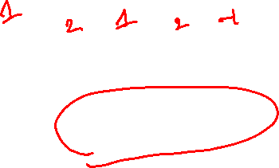

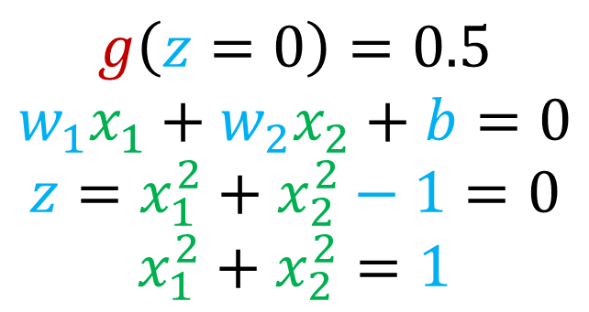
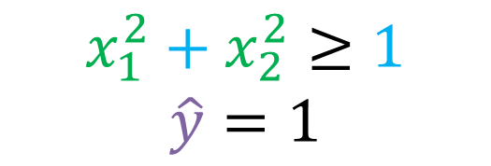

Non-linear decision boundaries
$$x_{1}^{2}+x_{2}^{2}≥1$$
$$\hat{y}=1$$
$$x_{2}$$
1
$$g\left(z=0\right)=0.5$$
$$w_{1}x_{1}+w_{2}x_{2}+b=0$$
$$z=x_{1}^{2}+x_{2}^{2}−1=0$$
$$x_{1}^{2}+x_{2}^{2}=1$$
Decision Boundary
-1
1
$$x_{1}$$
-1
Notes:
Show example of the g(z) calculation at various z value

Slide 11
Cost function for Logistic Regression

Slide 12
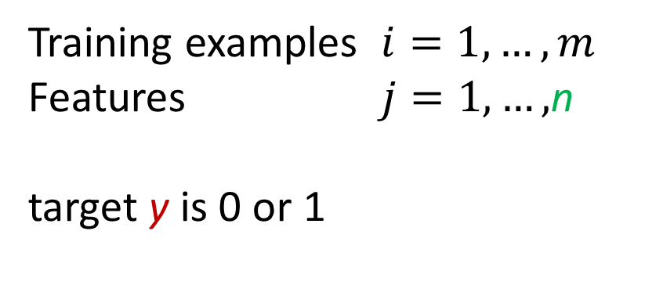
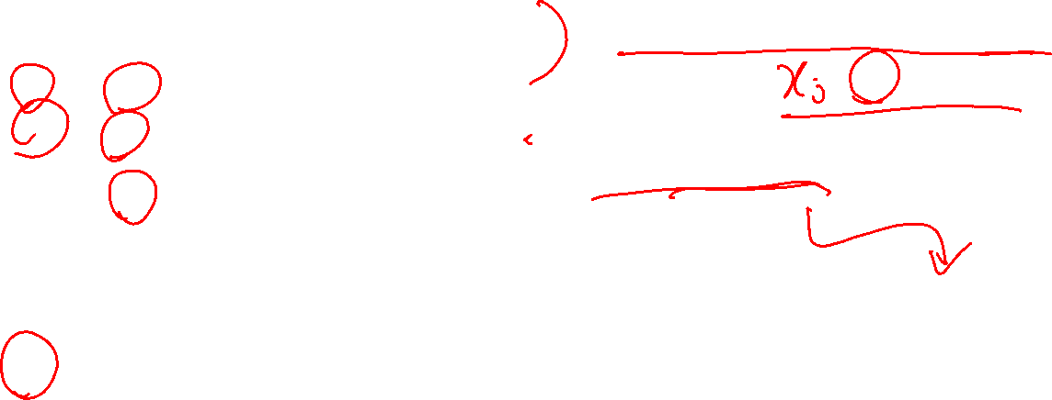
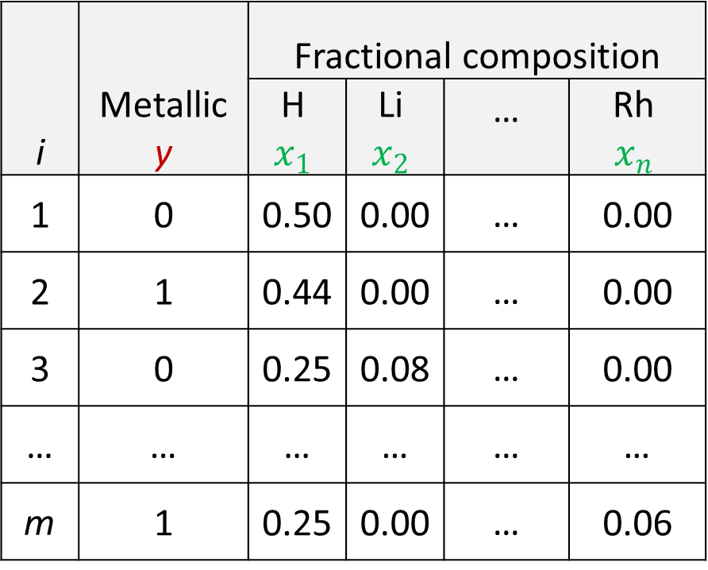

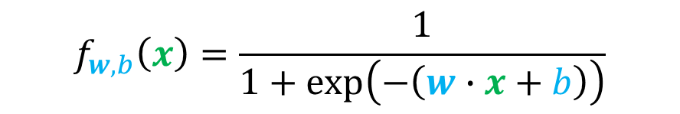
Notation
i | Metallic y | Fractional composition
 |  | H $$x_{1}$$ | Li $$x_{2}$$ | … | Rh $$x_{n}$$
1 | 0 | 0.50 | 0.00 | … | 0.00
2 | 1 | 0.44 | 0.00 | … | 0.00
3 | 0 | 0.25 | 0.08 | … | 0.00
… | … | … | … | … | …
m | 1 | 0.25 | 0.00 | … | 0.06
Training examples $i=1,…,m$
Features $j=1,…,$n
target y is 0 or 1
$$f_{w,b}\left(x\right)=\frac{1}{1+\exp\left(−\left(w∙x+b\right)\right)}$$
How to choose $w=[w_{1} w_{2} …w_{n}]$ and b?

Slide 13


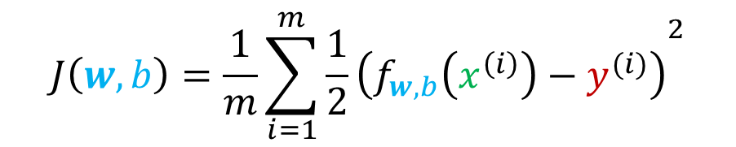



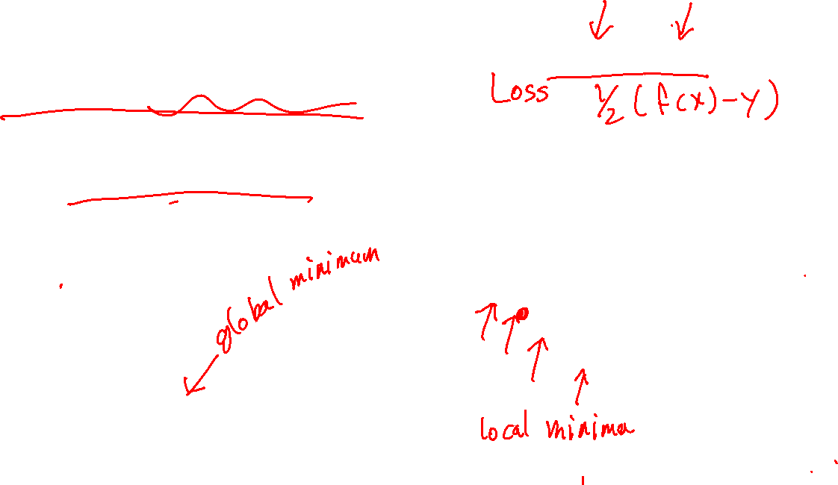

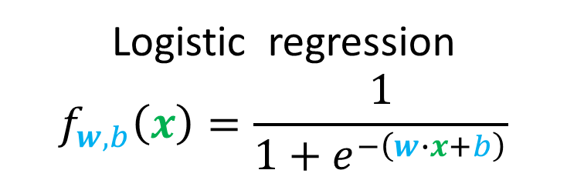
Squared error cost
$$J\left(w,b\right)=\frac{1}{m}\sum_{i=1}^{m}{{\frac{1}{2}\left(f_{w,b}\left(x^{\left(i\right)}\right)−y^{(i)}\right)}^{2}}$$
$$L\left(f_{w,b}\left(x^{\left(i\right)}\right),y^{\left(i\right)}\right)$$
Linear regression
$$f_{w,b}\left(x\right)=w∙x+b$$
Logistic regression
$$f_{w,b}\left(x\right)=\frac{1}{1+e^{−\left(w∙x+b\right)}}$$
$$J\left(w,b\right)$$
$$J\left(w,b\right)$$
convex
Nonconvex
$$w,b$$
$$w,b$$

Slide 14



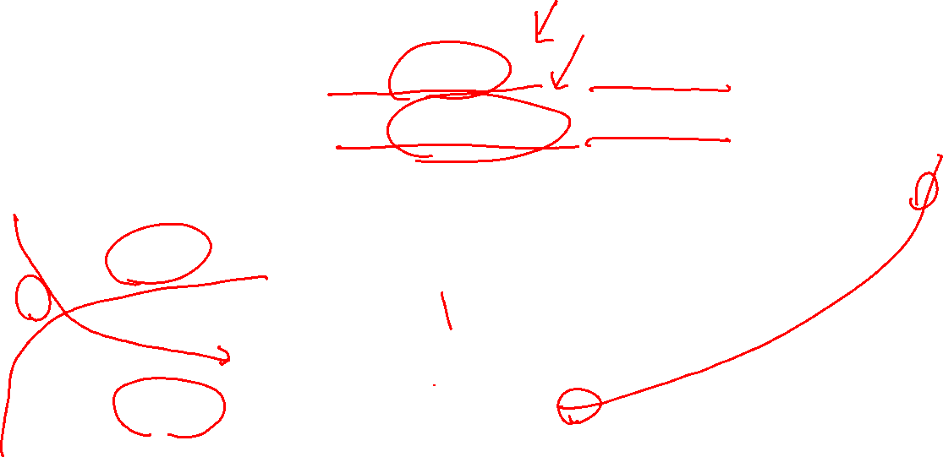
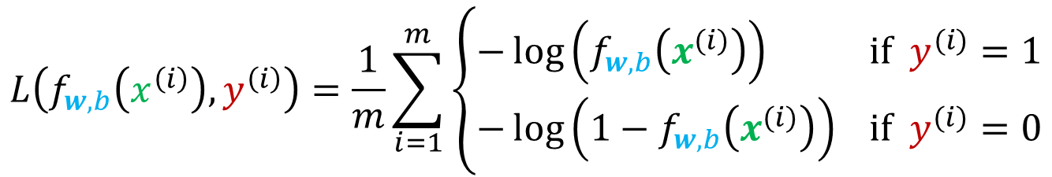
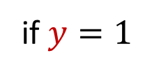

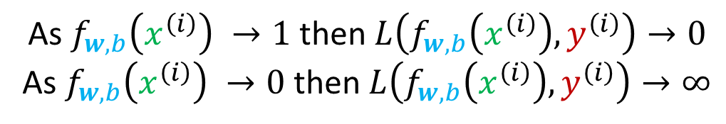


Logistic loss function
$$L\left(f_{w,b}\left(x^{\left(i\right)}\right),y^{\left(i\right)}\right)=\frac{1}{m}\sum_{i=1}^{m}{\left\{\begin{aligned}−\log\left(f_{w,b}\left(x^{(i)}\right)\right) if y^{(i)}=1 \\ −\log\left(1−f_{w,b}\left(x^{(i)}\right)\right) if y^{(i)}=0\end{aligned}\right.}$$
$$L\left(f_{w,b}\left(x^{\left(i\right)}\right),y^{\left(i\right)}\right)$$
$$\log\left(v\right)$$
if $y=1$
1
v
$$−log\left(v\right)$$
$$0$$
$$f_{w,b}\left(x^{\left(i\right)}\right)$$
$$1$$
As $f_{w,b}\left(x^{\left(i\right)}\right) →1$ then $L\left(f_{w,b}\left(x^{\left(i\right)}\right),y^{\left(i\right)}\right)→0$
As $f_{w,b}\left(x^{\left(i\right)}\right) →0$ then $L\left(f_{w,b}\left(x^{\left(i\right)}\right),y^{\left(i\right)}\right)→∞$

Slide 15

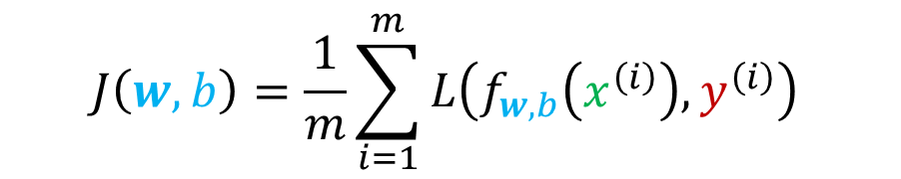

Cost function and Loss function
$$J\left(w,b\right)=\frac{1}{m}\sum_{i=1}^{m}{L\left(f_{w,b}\left(x^{\left(i\right)}\right),y^{\left(i\right)}\right) }$$
$$L\left(f_{w,b}\left(x^{\left(i\right)}\right),y^{\left(i\right)}\right)=\frac{1}{m}\sum_{i=1}^{m}{\left\{\begin{aligned}−\log\left(f_{w,b}\left(x^{(i)}\right)\right) if y^{(i)}=1 \\ −\log\left(1−f_{w,b}\left(x^{(i)}\right)\right) if y^{(i)}=0\end{aligned}\right.}$$
Convex cost function. Parameters can reach a global minimum

Slide 16
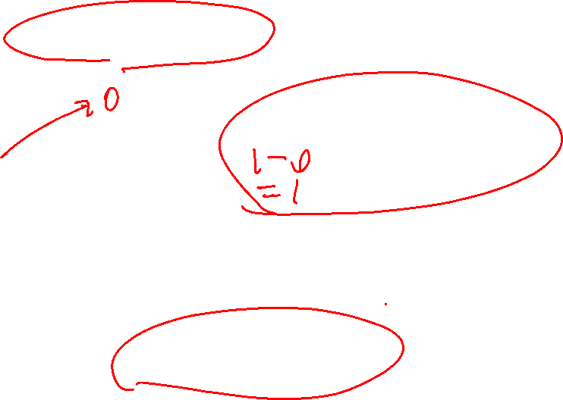
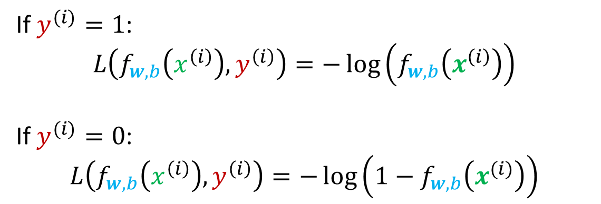
Simplified loss function
$$L\left(f_{w,b}\left(x^{\left(i\right)}\right),y^{\left(i\right)}\right)=\frac{1}{m}\sum_{i=1}^{m}{\left\{\begin{aligned}−\log\left(f_{w,b}\left(x^{(i)}\right)\right) if y^{(i)}=1 \\ −\log\left(1−f_{w,b}\left(x^{(i)}\right)\right) if y^{(i)}=0\end{aligned}\right.}$$
Implementing this in python will result in inefficiency
$$L\left(f_{w,b}\left(x^{\left(i\right)}\right),y^{\left(i\right)}\right)=−y^{(i)}\log\left(f_{w,b}\left(x^{(i)}\right)\right)−\left(1−y^{(i)}\right)\log\left(1−f_{w,b}\left(x^{(i)}\right)\right)$$
If $y^{(i)}=1$:
$$L\left(f_{w,b}\left(x^{\left(i\right)}\right),y^{\left(i\right)}\right)=−\log\left(f_{w,b}\left(x^{\left(i\right)}\right)\right)$$
If $y^{(i)}=0$:
$$L\left(f_{w,b}\left(x^{\left(i\right)}\right),y^{\left(i\right)}\right)=−\log\left(1−f_{w,b}\left(x^{(i)}\right)\right)$$

Slide 17
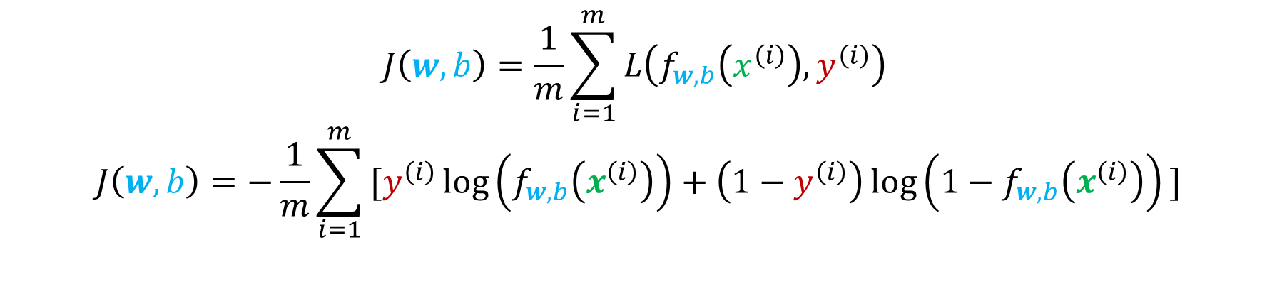

Simplified cost function
$$L\left(f_{w,b}\left(x^{\left(i\right)}\right),y^{\left(i\right)}\right)=−y^{(i)}\log\left(f_{w,b}\left(x^{(i)}\right)\right)−\left(1−y^{(i)}\right)\log\left(1−f_{w,b}\left(x^{(i)}\right)\right)$$
$$J\left(w,b\right)=\frac{1}{m}\sum_{i=1}^{m}{L\left(f_{w,b}\left(x^{\left(i\right)}\right),y^{\left(i\right)}\right) }$$
$$J\left(w,b\right)=−\frac{1}{m}\sum_{i=1}^{m}{\text{[}y^{\left(i\right)}\log\left(f_{w,b}\left(x^{\left(i\right)}\right)\right)+\left(1−y^{\left(i\right)}\right)\log\left(1−f_{w,b}\left(x^{\left(i\right)}\right)\right)\text{]}}$$

Slide 18
Gradient Descent

Slide 19
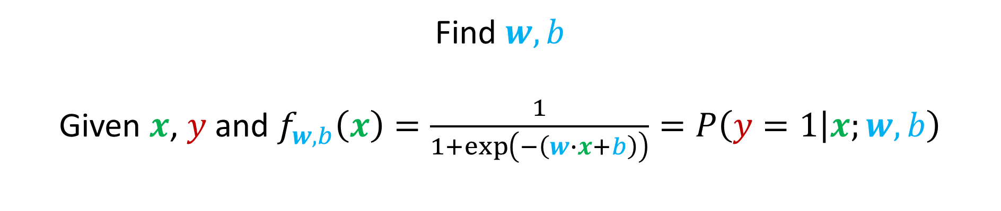
Training logistic regression
Find $w,b$
Given $x$, $y$ and $f_{w,b}\left(x\right)=\frac{1}{1+\exp\left(−\left(w∙x+b\right)\right)}=P\left(y=1 | x;w,b\right)$

Slide 20
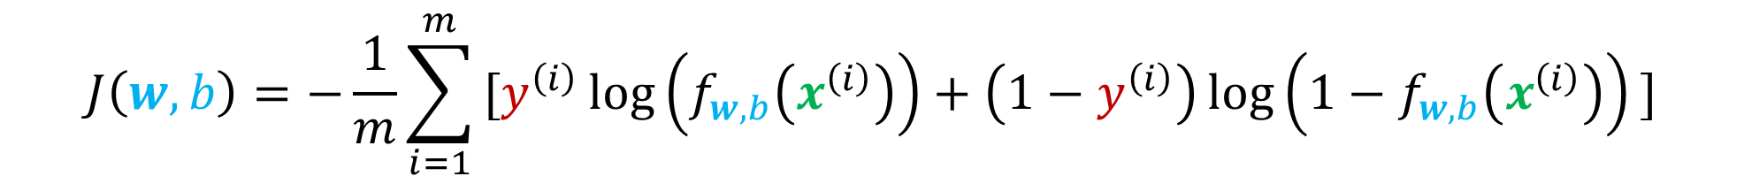
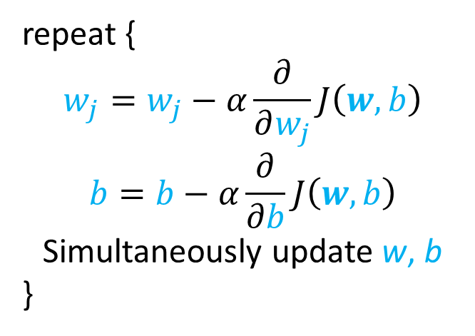
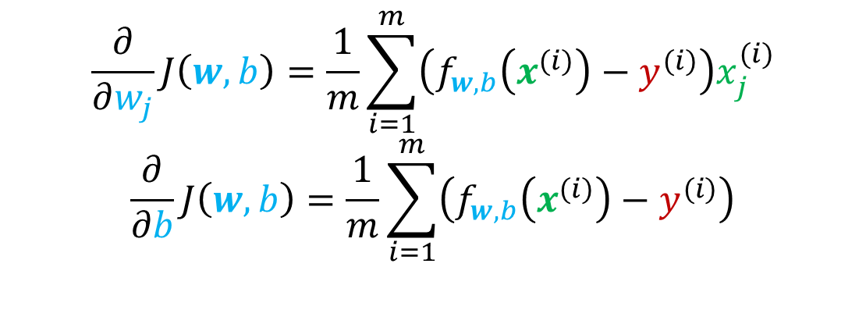
Gradient descent for logistic regression
$$J\left(w,b\right)=−\frac{1}{m}\sum_{i=1}^{m}{\text{[}y^{\left(i\right)}\log\left(f_{w,b}\left(x^{\left(i\right)}\right)\right)+\left(1−y^{\left(i\right)}\right)\log\left(1−f_{w,b}\left(x^{\left(i\right)}\right)\right)\text{]}}$$
repeat {
$$w_{j}=w_{j}−α\frac{∂}{∂w_{j}}J\left(w,b\right)$$
$$b=b−α\frac{∂}{∂b}J\left(w,b\right)$$
Simultaneously update w, b
}
$$\frac{∂}{∂w_{j}}J\left(w,b\right)=\frac{1}{m}\sum_{i=1}^{m}{\left(f_{w,b}\left(x^{(i)}\right)−y^{(i)}\right)x_{j}^{(i)}}$$
$$\frac{∂}{∂b}J\left(w,b\right)=\frac{1}{m}\sum_{i=1}^{m}{\left(f_{w,b}\left(x^{(i)}\right)−y^{(i)}\right)}$$

Slide 21
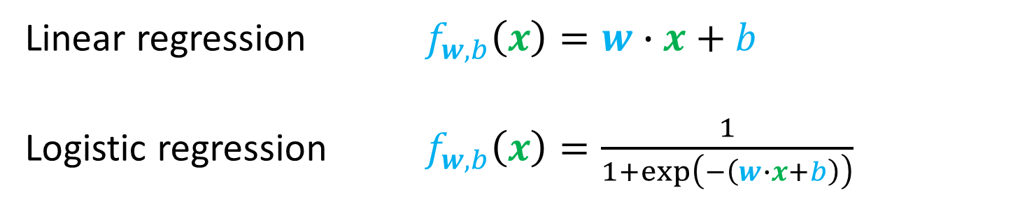
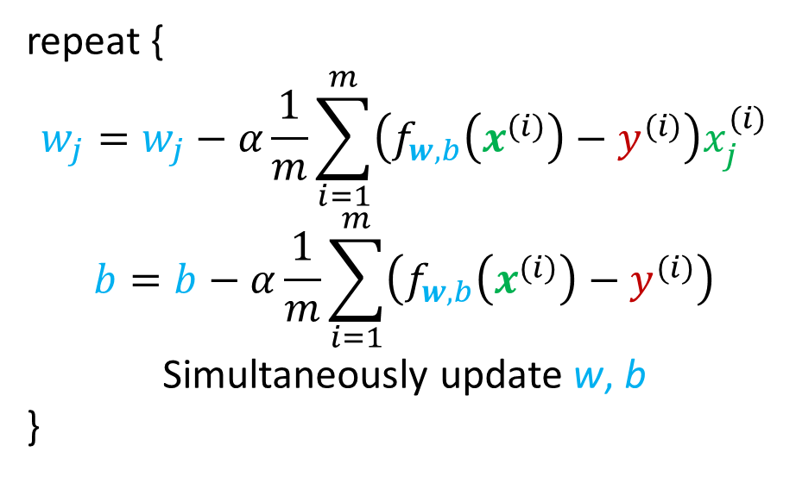
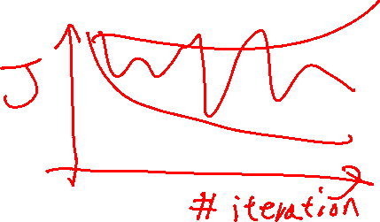
Gradient descent for logistic regression
repeat {
$$w_{j}=w_{j}−α\frac{1}{m}\sum_{i=1}^{m}{\left(f_{w,b}\left(x^{(i)}\right)−y^{(i)}\right)x_{j}^{(i)}}$$
$$b=b−α\frac{1}{m}\sum_{i=1}^{m}{\left(f_{w,b}\left(x^{(i)}\right)−y^{(i)}\right)}$$
Simultaneously update w, b
}
Same concepts:
Monitor gradient descent with learning curve
Vectorized implementation
Feature scaling
Linear regression $f_{w,b}\left(x\right)=w∙x+b$
Logistic regression $f_{w,b}\left(x\right)=\frac{1}{1+\exp\left(−\left(w∙x+b\right)\right)}$

