Slide 1
Neural Network Representation

Slide 2
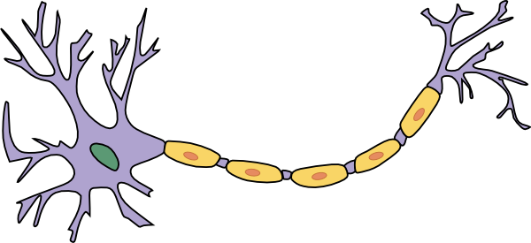
Neuron in Brain
Dendrite (input)
Axon terminal
(output)
Cell body
(process)
Axon

Slide 3
Neuron Communication
Input
Process
Output
Input

Slide 4


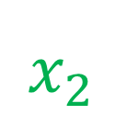





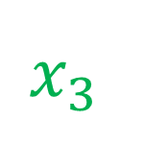

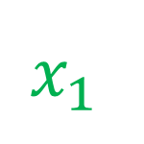
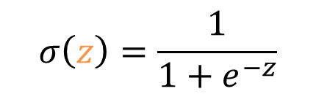

Mimicking a Neuron
$$x_{1}$$
$$x$$
$$a$$
$$x_{2}$$
$$a$$
$$\hat{y}$$
$$\hat{y}$$
$$σ\left(z\right)=\frac{1}{1+e^{−z}}$$
$$x_{3}$$
$$x$$
$$w$$
$$b$$
$$z=w∙x+b$$
$$a=σ\left(z\right)$$
$$\hat{y}=a$$

Slide 5




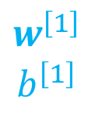

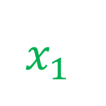






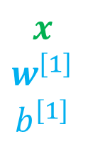

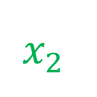

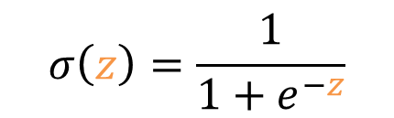

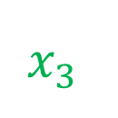

Mimicking a Neuron
Layer number
$$a^{\left[1\right]}=[a_{1}^{\left[1\right]},a_{2}^{\left[1\right]},a_{3}^{\left[1\right]}]$$
$$x_{1}$$
$$a_{1}^{\left[1\right]}$$
$$x_{2}$$
$$a_{2}^{\left[1\right]}$$
$$a_{1}^{\left[2\right]}$$
$$x$$
$$a^{\left[1\right]}$$
$$a^{\left[2\right]}$$
$$\hat{y}$$
$$\hat{y}$$
$$x_{3}$$
$$a_{3}^{\left[1\right]}$$
$$σ\left(z\right)=\frac{1}{1+e^{−z}}$$
$$x$$
$$w^{\left[1\right]}$$
$$b^{\left[1\right]}$$
$$z^{\left[1\right]}=w^{\left[1\right]}∙x+b^{\left[1\right]}$$
$$a^{\left[1\right]}=σ\left(z^{\left[1\right]}\right)$$
$$z^{\left[2\right]}=w^{\left[2\right]}∙a^{\left[1\right]}+b^{\left[2\right]}$$
$$a^{\left[2\right]}=σ\left(z^{\left[2\right]}\right)$$
$$\hat{y}=a^{\left[2\right]}$$
$$w^{\left[1\right]}$$
$$b^{\left[1\right]}$$

Slide 6
Mimicking a Neuron
$$x_{1}$$
$$a_{1}^{\left[1\right]}$$
$$x_{2}$$
$$a_{2}^{\left[1\right]}$$
$$a_{1}^{\left[2\right]}$$
$$x$$
$$a^{\left[1\right]}$$
$$a^{\left[2\right]}$$
$$\hat{y}$$
$$\hat{y}$$
$$x_{3}$$
$$a_{3}^{\left[1\right]}$$
Input layer
Hidden layer
Output layer
Input layer
Hidden layer
Output layer
“2 layer Neural Network”

Slide 7
How could a neural network work?

Slide 8
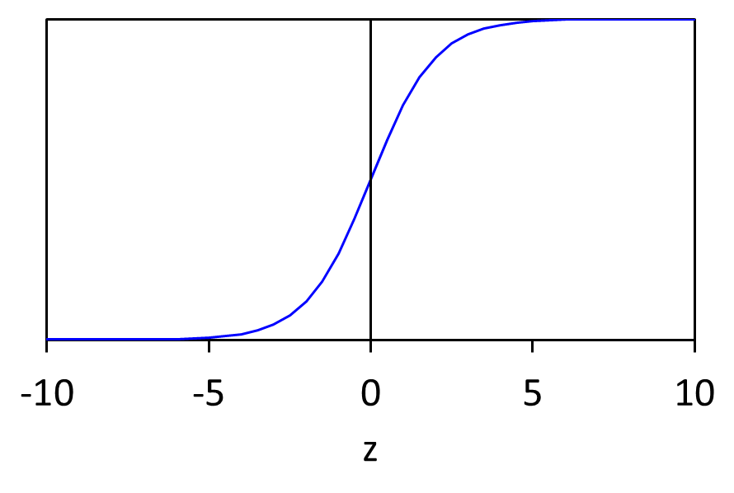
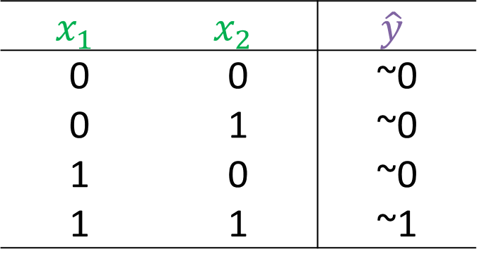
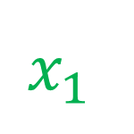

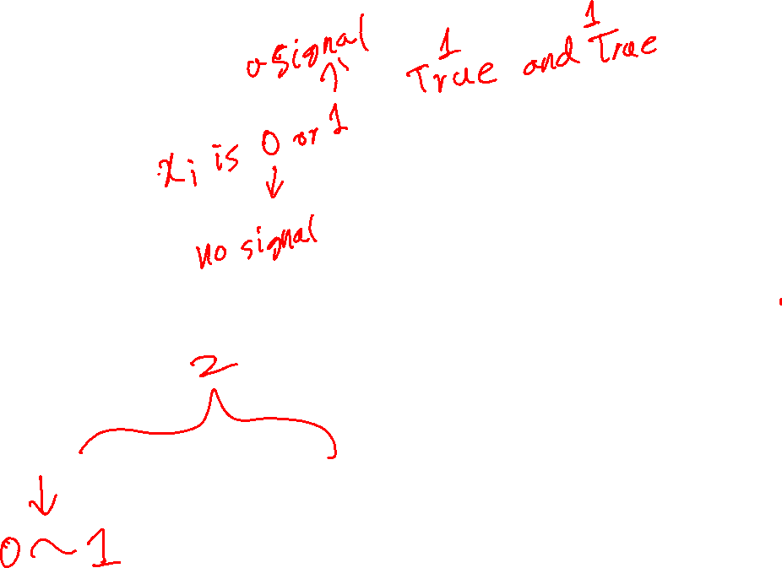

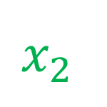

AND logic gate
$$x=[x_{1},x_{2}]$$
$$x_{1}$$
~0.99
~0.01
$$\hat{y}$$
$$x_{1}$$ | $$x_{2}$$ | $$\hat{y}$$
0 | 0 | ~0
0 | 1 | ~0
1 | 0 | ~0
1 | 1 | ~1
$$x_{2}$$
$$\hat{y}=σ\left(20x_{1}+20x_{2}−30\right)$$

Slide 9
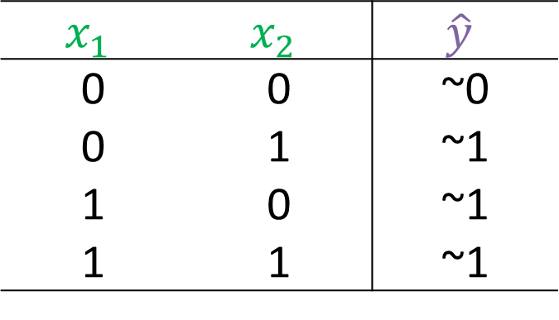

OR logic gate
$$x=[x_{1},x_{2}]$$
$$x_{1}$$
~0.99
~0.01
$$\hat{y}$$
$$x_{1}$$ | $$x_{2}$$ | $$\hat{y}$$
0 | 0 | ~0
0 | 1 | ~1
1 | 0 | ~1
1 | 1 | ~1
$$x_{2}$$
$$\hat{y}=σ\left(20x_{1}+20x_{2}−10\right)$$

Slide 10
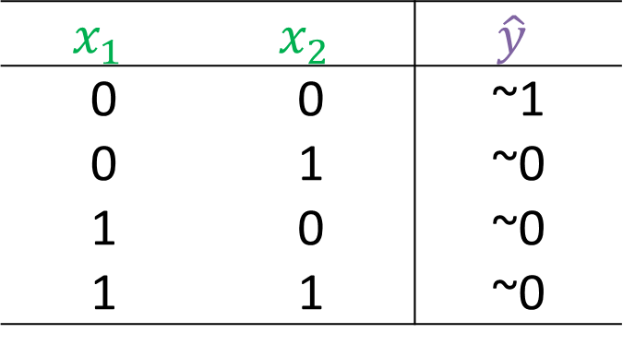


NOT and NOT logic gate
$$x=[x_{1},x_{2}]$$
$$x_{1}$$
~0.99
~0.01
$$\hat{y}$$
$$x_{1}$$ | $$x_{2}$$ | $$\hat{y}$$
0 | 0 | ~1
0 | 1 | ~0
1 | 0 | ~0
1 | 1 | ~0
$$x_{2}$$
$$\hat{y}=σ\left(−20x_{1}−20x_{2}+10\right)$$

Slide 11

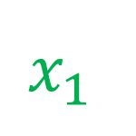


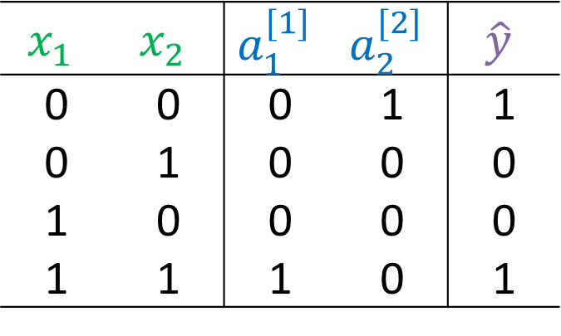
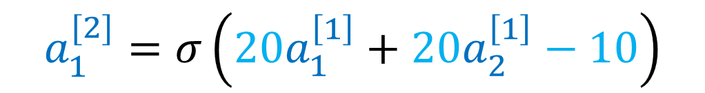


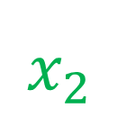

x1 XNOR x2
$$\hat{y}=σ\left(20x_{1}+20x_{2}−30\right)$$
x₁ and x₂
$$a_{1}^{[2]}=σ\left(20a_{1}^{\left[1\right]}+20a_{2}^{\left[1\right]}−10\right)$$
$$x_{1}$$
$$a_{1}^{[1]}$$
a₁^{[1]} or a₂^{[2]}
$$a_{1}^{[2]}$$
$$\hat{y}$$
$$x_{2}$$
$$a_{2}^{[1]}$$
$$x_{1}$$ | $$x_{2}$$ | $$a_{1}^{[1]}$$ | $$a_{2}^{[2]}$$ | $$\hat{y}$$
0 | 0 | 0 | 1 | 1
0 | 1 | 0 | 0 | 0
1 | 0 | 0 | 0 | 0
1 | 1 | 1 | 0 | 1
(not x₁) and (not x₂)
$$\hat{y}=σ\left(−20x_{1}−20x_{2}+10\right)$$

Slide 12


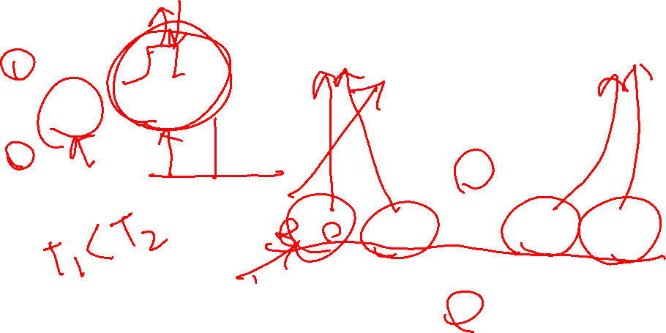
Universal Approximation Theorem
Simple 3 perceptron generating a square pulse
Arbitrarly nonlinear function
$$\hat{y}$$
T₁
x
+
x
+
T₁
T₂
x
$$x$$
-
+
…
T₂
x
x

Slide 13
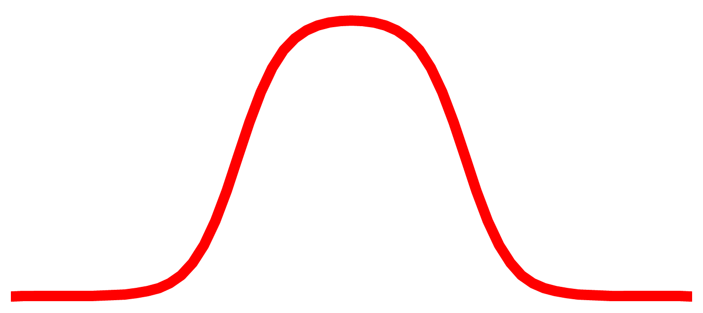


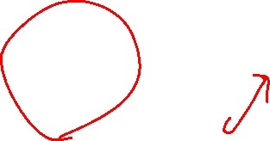
Universal Approximation Theorem
Sigmoid Function
Arbitrarly nonlinear function
$$\hat{y}$$
T₁
x
+
x
+
T₁
T₂
x
$$x$$
-
+
…
T₂
x
x

Slide 14


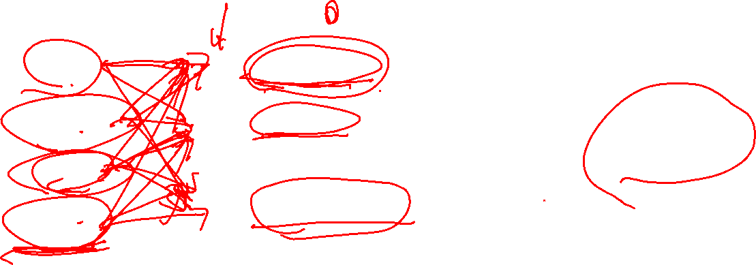
Example
Activation:
1 if yes, 0 if false
Price
Affordability
Shipping cost
$$a^{\left[1\right]}$$
$$a^{\left[2\right]}$$
awareness
Probability of being top seller
Marketing
Quality
perceived quality

Slide 15
Neural network in detail

Slide 16

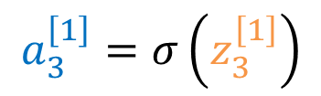





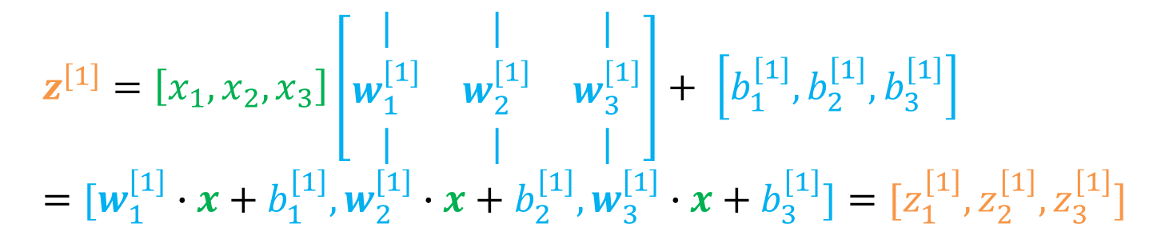
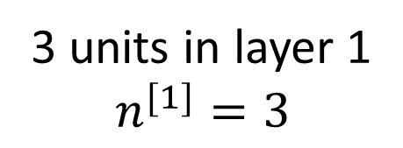
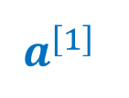
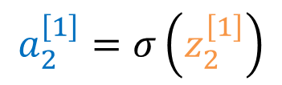





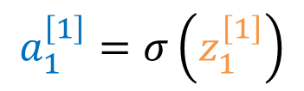

Neural Network layer with detailed math
$$a^{\left[1\right]}$$
$$a^{\left[1\right]}$$
$$z_{1}^{\left[1\right]}=w_{1}^{\left[1\right]}∙x+b_{1}^{\left[1\right]}$$
$$a_{1}^{\left[1\right]}=σ\left(z_{1}^{\left[1\right]}\right)$$
$$a^{\left[2\right]}$$
$$x$$
$$\hat{y}$$
$$x$$
$$z_{2}^{\left[1\right]}=w_{2}^{\left[1\right]}∙x+b_{2}^{\left[1\right]}$$
$$a_{2}^{\left[1\right]}=σ\left(z_{2}^{\left[1\right]}\right)$$
$$z_{3}^{\left[1\right]}=w_{3}^{\left[1\right]}∙x+b_{3}^{\left[1\right]}$$
$$a_{3}^{\left[1\right]}=σ\left(z_{3}^{\left[1\right]}\right)$$
3 units in layer 1
$$n^{[1]}=3$$
$$z^{\left[1\right]}=\left[x_{1},x_{2},x_{3}\right]\left[\begin{matrix}| & | & | \\ w_{1}^{[1]} & w_{2}^{[1]} & w_{3}^{[1]} \\ | & | & |\end{matrix}\right]+ \left[b_{1}^{\left[1\right]},b_{2}^{\left[1\right]},b_{3}^{\left[1\right]}\right]=[w_{1}^{\left[1\right]}∙x+b_{1}^{\left[1\right]},w_{2}^{\left[1\right]}∙x+b_{2}^{\left[1\right]},w_{3}^{\left[1\right]}∙x+b_{3}^{\left[1\right]}]=[z_{1}^{\left[1\right]},z_{2}^{\left[1\right]},z_{3}^{\left[1\right]}]$$
$$z^{\left[1\right]}=xw^{\left[1\right]}+b^{\left[1\right]}$$
$$z^{\left[1\right]}∈ℝ^{n^{[1]}}$$
$$a^{\left[1\right]}=σ\left(z^{\left[1\right]}\right)$$
$$a^{\left[1\right]}= \left[σ\left(z_{1}^{\left[1\right]}\right),σ\left(z_{2}^{\left[1\right]}\right),σ\left(z_{3}^{\left[1\right]}\right)\right]=\left[a_{1}^{\left[1\right]},a_{2}^{\left[1\right]},a_{3}^{\left[1\right]}\right]$$
$$a^{\left[1\right]}∈ℝ^{n^{[1]}}$$

Slide 17

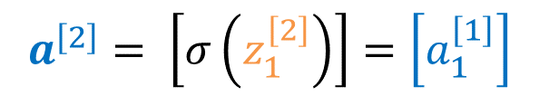

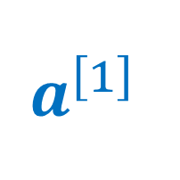
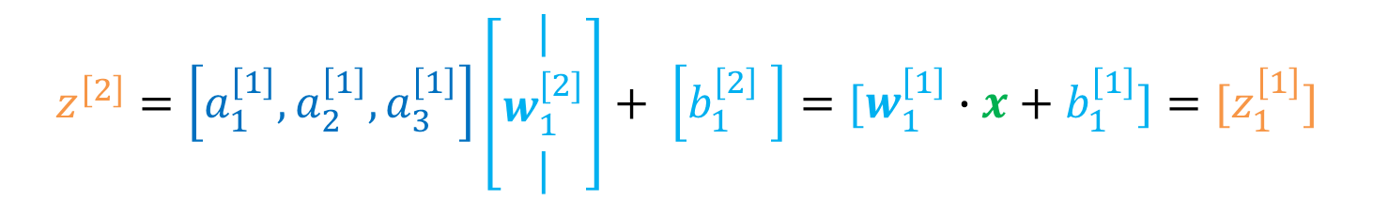






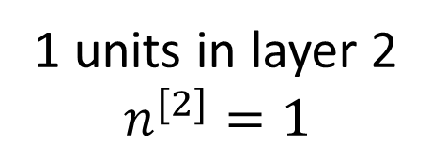
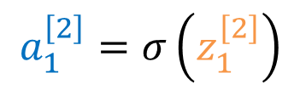

Neural Network layer with detailed math
$$a^{\left[1\right]}$$
$$a^{\left[2\right]}$$
$$a^{[2]}$$
$$x$$
$$\hat{y}$$
$$a^{\left[1\right]}$$
$$z_{1}^{\left[2\right]}=w_{1}^{\left[2\right]}∙a^{\left[1\right]}+b_{1}^{\left[2\right]}$$
$$a_{1}^{\left[2\right]}=σ\left(z_{1}^{\left[2\right]}\right)$$
1 units in layer 2
$$n^{[2]}=1$$
$$z^{\left[2\right]}∈ℝ^{n^{[2]}}$$
$$z^{\left[2\right]}=\left[a_{1}^{\left[1\right]},a_{2}^{\left[1\right]},a_{3}^{\left[1\right]}\right]\left[\begin{matrix}| \\ w_{1}^{[2]} \\ |\end{matrix}\right]+ \left[b_{1}^{\left[2\right]} \right]=[w_{1}^{\left[1\right]}∙x+b_{1}^{\left[1\right]}]=[z_{1}^{\left[1\right]}]$$
$$z^{\left[2\right]}=a^{\left[1\right]}w^{\left[2\right]}+b^{\left[2\right]}$$
is $a_{1}^{\left[2\right]}$ ≥ 0.5?
$$a^{\left[2\right]}=σ\left(z^{\left[2\right]}\right)$$
$$a^{\left[2\right]}= \left[σ\left(z_{1}^{\left[2\right]}\right)\right]=\left[a_{1}^{\left[1\right]}\right]$$
Yes
No
$$a^{\left[2\right]}∈ℝ^{n^{[2]}}$$
$$\hat{y}=1$$
$$\hat{y}=0$$

Slide 18












Multilayer perceptron
$$a^{\left[1\right]}$$
$$a^{\left[2\right]}$$
$$a^{\left[3\right]}$$
$$a^{\left[4\right]}$$
$$a^{\left[5\right]}$$
$$x$$
$$\hat{y}$$
$$n^{\left[1\right]}=3$$
$$n^{\left[2\right]}=4$$
$$n^{\left[3\right]}=4$$
$$n^{\left[4\right]}=3$$
$$n^{\left[5\right]}=1$$
3 units
layer 1
4 units
layer 2
4 units
layer 3
3 units
layer 4
1 units
layer 5

Slide 19
Vectorizing over multiple examples

Slide 20

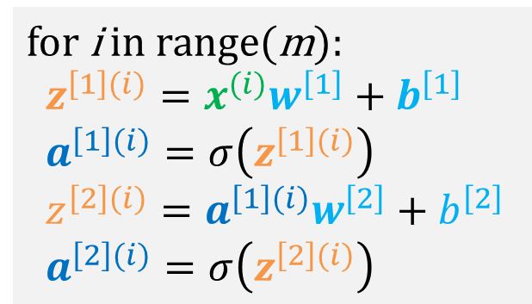



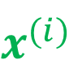








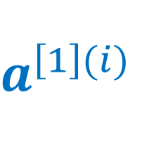
Neural network layer with a training example
$$a^{\left[1\right](i)}$$
$$a_{1}^{\left[1\right](i)}=σ\left(z_{1}^{\left[1\right](i)}\right)$$
$$z_{1}^{\left[1\right](i)}=w_{1}^{\left[1\right]}∙x^{(i)}+b_{1}^{\left[1\right]}$$
$$a^{\left[2\right](i)}$$
$$x^{(i)}$$
$$x^{(i)}$$
$$z_{2}^{\left[1\right](i)}=w_{2}^{\left[1\right]}∙x^{(i)}+b_{2}^{\left[1\right]}$$
$$a_{2}^{\left[1\right](i)}=σ\left(z_{2}^{\left[1\right](i)}\right)$$
$$\hat{y}$$
$$z_{3}^{\left[1\right](i)}=w_{3}^{\left[1\right]}∙x^{(i)}+b_{3}^{\left[1\right]}$$
$$a_{3}^{\left[1\right](i)}=σ\left(z_{3}^{\left[1\right](i)}\right)$$
$$a^{\left[1\right](i)}$$
$$z_{1}^{\left[2\right](i)}=w_{1}^{\left[2\right]}∙a^{\left[1\right](i)}+b_{1}^{\left[2\right]}$$
$$a_{1}^{\left[2\right](i)}=σ\left(z_{1}^{\left[2\right](i)}\right)$$
Layer #
example #
$$a^{\left[1\right](i)}$$
for i in range(m):
$z^{\left[1\right](i)}=x^{(i)}w^{\left[1\right]}+b^{\left[1\right]}$
$a^{\left[1\right](i)}=σ\left(z^{\left[1\right](i)}\right)$
$z^{\left[2\right](i)}=a^{\left[1\right](i)}w^{\left[2\right]}+b^{\left[2\right]}$
$a^{\left[2\right](i)}=σ\left(z^{\left[2\right](i)}\right)$
is $a_{1}^{\left[2\right]}$ ≥ 0.5?
Yes
No
$$\hat{y}=1$$
$$\hat{y}=0$$

Slide 21

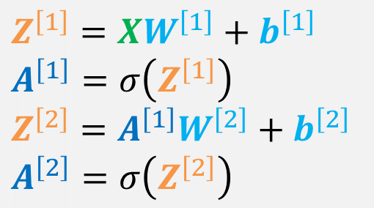
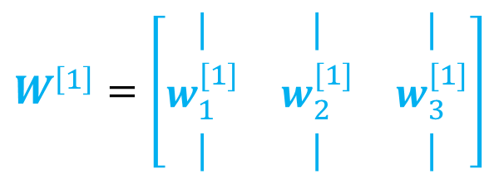
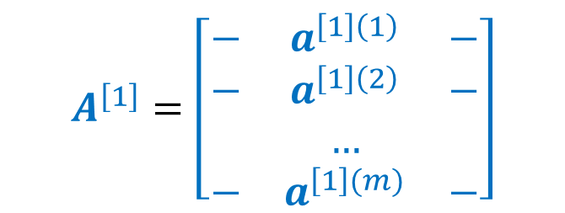


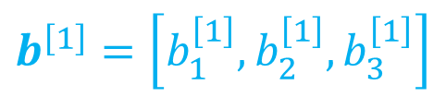

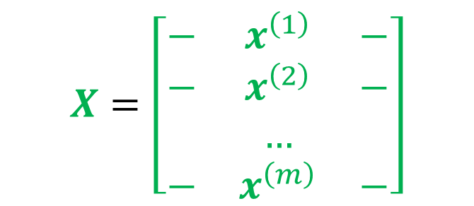
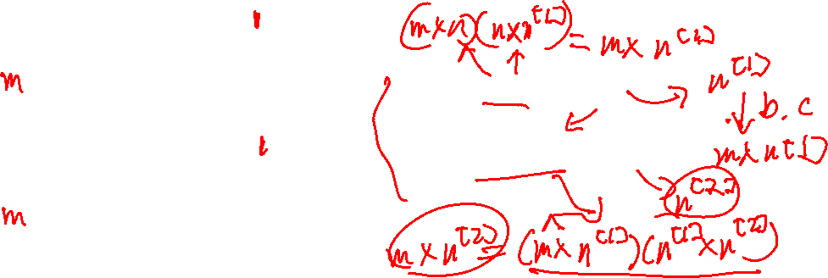

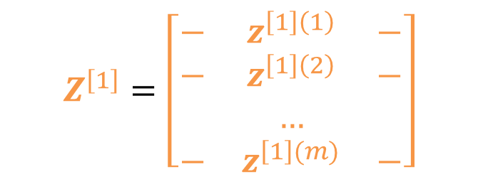

Vectorized neural network layers
$$X=\left[\begin{matrix}− & x^{\left(1\right)} & − \\ − & x^{\left(2\right)} & − \\ & … & \\ − & x^{\left(m\right)} & −\end{matrix}\right]$$
for i in range(m):
$z^{\left[1\right](i)}=x^{(i)}w^{\left[1\right]}+b^{\left[1\right]}$
$a^{\left[1\right](i)}=σ\left(z^{\left[1\right](i)}\right)$
$z^{\left[2\right](i)}=a^{\left[1\right](i)}w^{\left[2\right]}+b^{\left[2\right]}$
$a^{\left[2\right](i)}=σ\left(z^{\left[2\right](i)}\right)$
$$W^{\left[1\right]}=\left[\begin{matrix}| & | & | \\ w_{1}^{[1]} & w_{2}^{[1]} & w_{3}^{[1]} \\ | & | & |\end{matrix}\right]$$
$$W^{\left[1\right]}∈ℝ^{n×n^{[1]}}$$
$$X∈ℝ^{m×n}$$
$$b^{\left[1\right]}=\left[b_{1}^{\left[1\right]},b_{2}^{\left[1\right]},b_{3}^{\left[1\right]}\right]$$
$$Z^{\left[1\right]}=\left[\begin{matrix}− & z^{\left[1\right]\left(1\right)} & − \\ − & z^{\left[1\right]\left(2\right)} & − \\ & … & \\ − & z^{\left[1\right](m)} & −\end{matrix}\right]$$
$$b^{\left[1\right]}∈ℝ^{n^{[1]}}$$
$$Z^{\left[1\right]}∈ℝ^{m×n^{[1]}}$$
$Z^{\left[1\right]}=XW^{\left[1\right]}+b^{\left[1\right]}$
$A^{\left[1\right]}=σ\left(Z^{\left[1\right]}\right)$
$Z^{\left[2\right]}=A^{\left[1\right]}W^{\left[2\right]}+b^{\left[2\right]}$
$A^{\left[2\right]}=σ\left(Z^{\left[2\right]}\right)$
$$A^{\left[1\right]}=\left[\begin{matrix}− & a^{\left[1\right]\left(1\right)} & − \\ − & a^{\left[1\right]\left(2\right)} & − \\ & … & \\ − & a^{\left[1\right](m)} & −\end{matrix}\right]$$
$$A^{\left[1\right]}∈ℝ^{m×n^{[1]}}$$

Slide 22
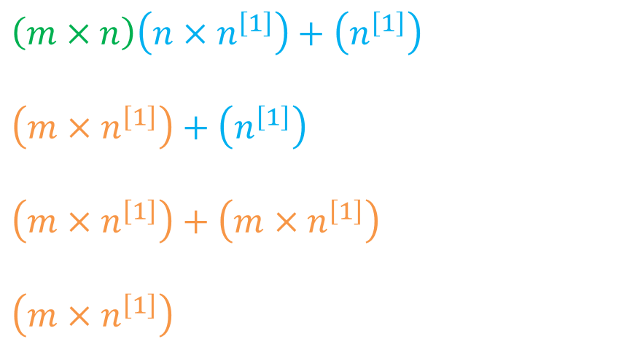
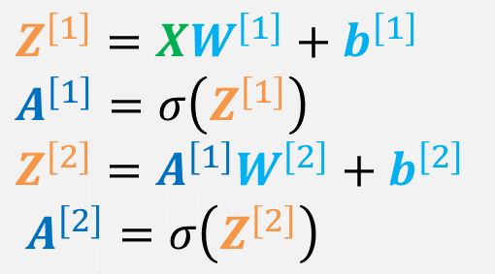

Vectorized neural network layers in code 1
$Z^{\left[1\right]}=XW^{\left[1\right]}+b^{\left[1\right]}$
$A^{\left[1\right]}=σ\left(Z^{\left[1\right]}\right)$
$Z^{\left[2\right]}=A^{\left[1\right]}W^{\left[2\right]}+b^{\left[2\right]}$
$A^{\left[2\right]}=σ\left(Z^{\left[2\right]}\right)$
Z1 = X@W1+b1
$\left(m×n\right)\left(n×n^{\left[1\right]}\right)+\left(n^{\left[1\right]}\right)$
$\left(m×n^{\left[1\right]}\right)+\left(n^{\left[1\right]}\right)$
$\left(m×n^{\left[1\right]}\right)+\left(m×n^{\left[1\right]}\right)$
$\left(m×n^{\left[1\right]}\right)$
matrix multiplication
Broadcasting
Z1 = X@W1+b1
A1 = 1/(1+np.exp(Z1))
Z2 = A1@W2+ b2
A2 = 1/(1+np.exp(Z2))
y_hat = A2>=0.5
Broadcasting
A1 = 1/(1+np.exp(Z1))

Slide 23
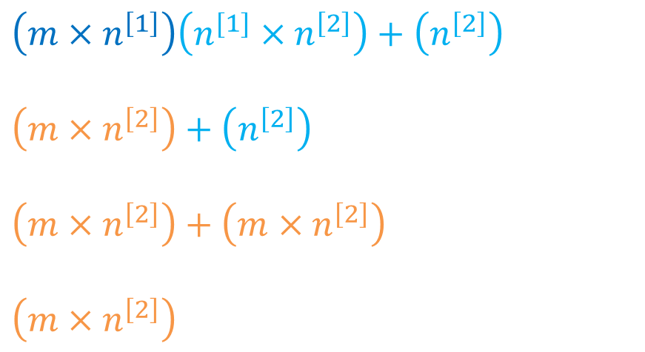
Vectorized neural network layers in code 2
$Z^{\left[1\right]}=XW^{\left[1\right]}+b^{\left[1\right]}$
$A^{\left[1\right]}=σ\left(Z^{\left[1\right]}\right)$
$Z^{\left[2\right]}=A^{\left[1\right]}W^{\left[2\right]}+b^{\left[2\right]}$
$A^{\left[2\right]}=σ\left(Z^{\left[2\right]}\right)$
Z2 = A1@W2+ b2
$\left(m×n^{\left[1\right]}\right)\left(n^{[1]}×n^{\left[2\right]}\right)+\left(n^{\left[2\right]}\right)$
$\left(m×n^{\left[2\right]}\right)+\left(n^{\left[2\right]}\right)$
$\left(m×n^{\left[2\right]}\right)+\left(m×n^{\left[2\right]}\right)$
$\left(m×n^{\left[2\right]}\right)$
matrix multiplication
Broadcasting
Z1 = X@W1+b1
A1 = 1/(1+np.exp(Z1))
Z2 = A1@W2+ b2
A2 = 1/(1+np.exp(Z2))
y_hat = A2>=0.5
Broadcasting
A2 = 1/(1+np.exp(Z2))

Slide 24






Multilayer perceptron
$$a^{\left[1\right]}$$
$$a^{\left[2\right]}$$
$$x$$
$$\hat{y}$$
$$n^{\left[1\right]}=4$$
$$n^{\left[2\right]}=1$$
4 units
layer 1
1 units
layer 2

