Slide 1





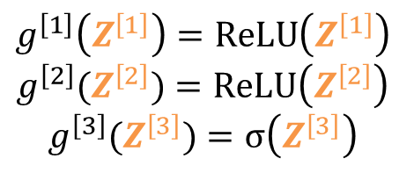




Complex Model
$$g^{\left[1\right]}\left(Z^{\left[1\right]}\right)=\operatorname{ReLU}\left(Z^{\left[1\right]}\right)$$
$$g^{\left[2\right]}(Z^{\left[2\right]})=\operatorname{ReLU}\left(Z^{\left[2\right]}\right)$$
$$g^{\left[3\right]}(Z^{\left[3\right]})=σ\left(Z^{\left[3\right]}\right)$$
$$A^{\left[1\right]}$$
$$A^{\left[2\right]}$$
$$A^{\left[3\right]}$$
$$X$$
…
…
$$\hat{y}$$
79 features
$$n^{\left[1\right]}=1$$
$$n^{[0]}=79$$
1 units
layer 3
$$n^{\left[1\right]}=64$$
$$n^{\left[2\right]}=32$$
64 units
layer 1
32 units
layer 2

