Slide 1
Batch and Layer Normalization

Slide 2
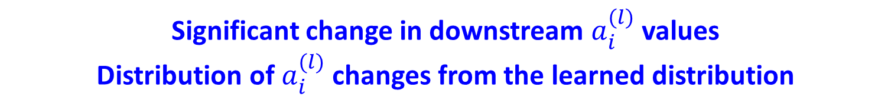

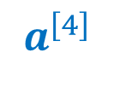
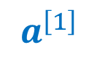
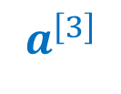
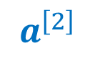
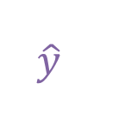
Shifting Hidden Layer Distribution
$$a^{\left[1\right]}$$
$$a^{\left[2\right]}$$
$$a^{\left[3\right]}$$
$$a^{\left[4\right]}$$
$$x$$
…
…
…
$$\hat{y}$$
Update
Significant change in downstream $a_{i}^{(l)}$ values
Distribution of $a_{i}^{(l)}$ changes from the learned distribution

Slide 3


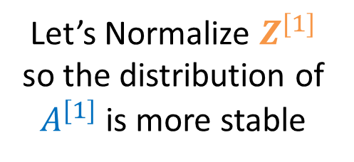

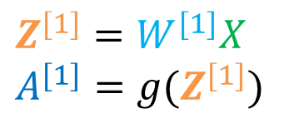
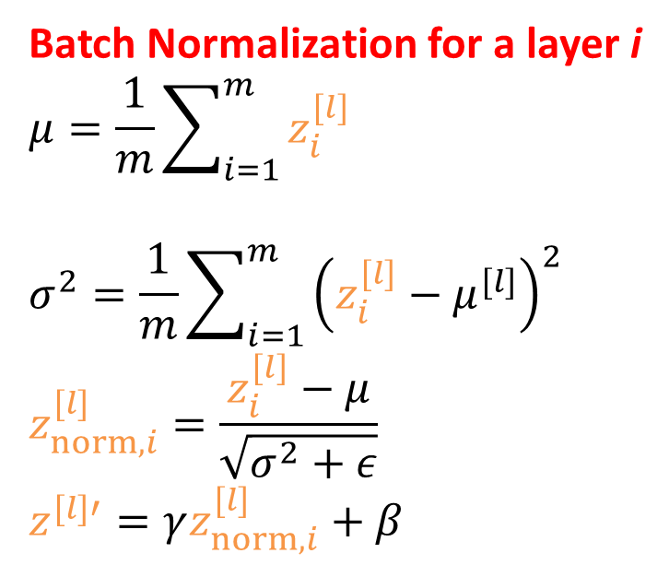

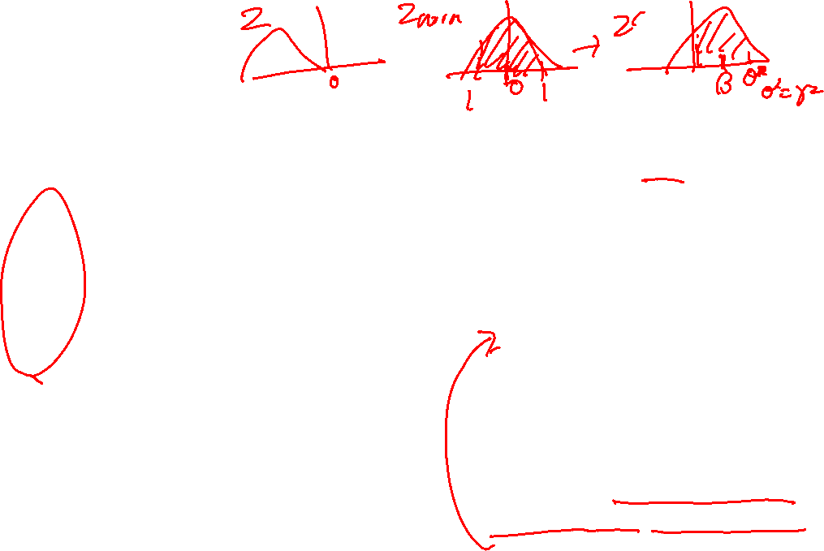
Batch Normalization
Batch Normalization for a layer i
$$μ=\frac{1}{m}\sum_{i=1}^{m}{z_{i}^{[l]}}$$
$$σ^{2}=\frac{1}{m}\sum_{i=1}^{m}{{\left(z_{i}^{[l]}−μ^{[l]}\right)}^{2}}$$
$$z_{norm,i}^{[l]}=\frac{z_{i}^{[l]}−μ}{\sqrt{σ^{2}+ε}}$$
$$z^{[l]′}=γz_{norm,i}^{[l]}+β$$
$$a^{\left[4\right]}$$
$$x$$
…
…
…
$$\hat{y}$$
Let’s Normalize $Z^{[1]}$ so the distribution of $A^{[1]}$is more stable
$$Z^{[1]}=W^{[1]}X$$
$$A^{[1]}=g(Z^{[1]})$$
Learnable parameters
changes the z distribution from $μ=0,σ^{2}=1$ to $μ=β,σ^{2}=γ^{2}$

Slide 4
Controversies of Batch Normalization
The positive effect of batch normalization is evident.
Dramatically reduces the number of steps to converge deep networks.
But… the working mechanism is not entirely clear.
Some suggest that batch normalization actually makes the distribution change worse.
Some suggest that cost function becomes smoother.
Some suggest that batch normalization has a slight regularization effect.
Some people apply batch normalization after activation.
Does not work well for small batch size

Slide 5
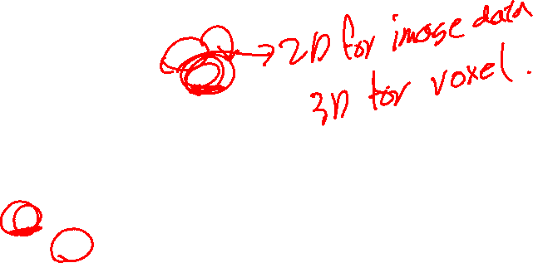
Pytorch Implementation
import torch.nn as nn
class Model(nn.Module):
def __init__(self,n_0,n_1,n_2,n_3):
super().__init__()
self.L1 = nn.Linear(n_0,n_1)
self.bn1 = nn.BatchNorm1d(n_1)
self.L2 = nn.Linear(n_1,n_2)
self.L3 = nn.Linear(n_2,n_3)
self.act1 = nn.ReLU()
def forward(self, X):
Z1 = self.L1(X)
Z1 = self.bn1(Z1)
A1 = self.act1(Z1)
Z2 = self.L2(A1)
A2 = self.act1(Z2)
Z3 = self.L3(A2)
return Z3

Slide 6
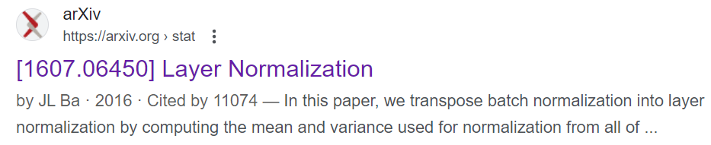
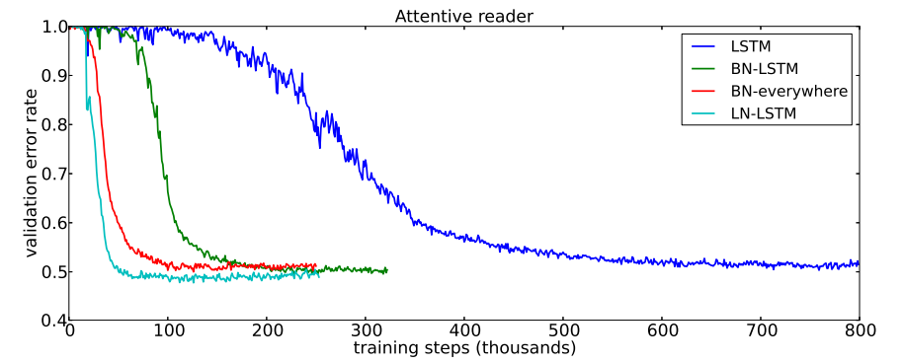
Layer Normalization
Batch normalization
Layer normalization
Feature
Feature
Mean
Std
1
3
0
2
1
3
0
2
0.75
0.83
3
2
0
4
3
2
0
4
4.00
3.08
3
0
6
8
3
0
6
8
4.50
2.60
Batch
Batch
6
3
0
6
5.25
1.09
6
3
0
6
3
7
2
5
3
7
2
5
4.75
1.48
5
0
0
2
5
0
0
2
3.50
2.60
Mean
3.83
3.50
3.67
4.17
Std
2.03
2.93
2.69
2.54

Slide 7
Parameters and Hyperparameters

Slide 8
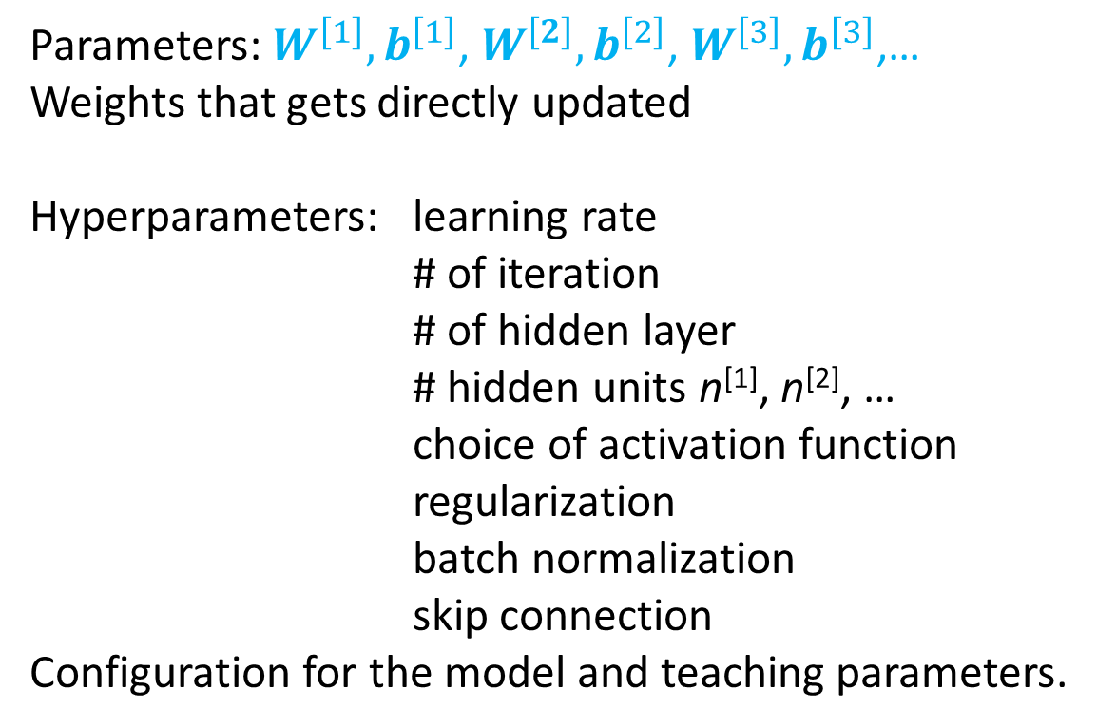
What are hyperparameters?
Parameters: $W^{\left[1\right]},b^{\left[1\right]}$, $W^{\left[2\right]},b^{\left[2\right]}$, $W^{\left[3\right]},b^{\left[3\right]}$,…
Weights that gets directly updated
Hyperparameters: learning rate
# of iteration
# of hidden layer
# hidden units n^{[1]}, n^{[2]}, …
choice of activation function
regularization
batch normalization
skip connection
Configuration for the model and teaching parameters.

Slide 9
Deep learning is a very empirical process
α = 0.01
α = 0.05
Regularization
More layer…
Idea
Cost J
Code
Experiment
# of iteration

Slide 10
Train/Validation/Test set

Slide 11
Applied ML is a highly iterative process
Hyperparameters
learning rate
# of iteration
# of hidden layer
# hidden units n^{[1]}, n^{[2]},…
choice of activation function…
regularization
…
Idea
Code
Experiment

Slide 12
Train/Validation/Test sets
All data
Training set
Validation set
hold-out set
cross validation set
Dev set…
Test set
Used to train parameter
Used to select hyperparameters
In the old days (small data set): 70%/15%/15%; 60%/20%/20%
In the big data era: > 1,000,000 data points. 10,000 validation/test set may be enough. It’s already big and is enough to have statistical significance. (98%/1%/1%, 99.5%/0.25%/0.25%)

Slide 13
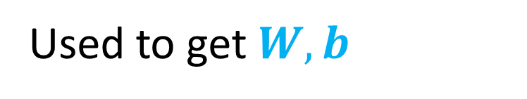
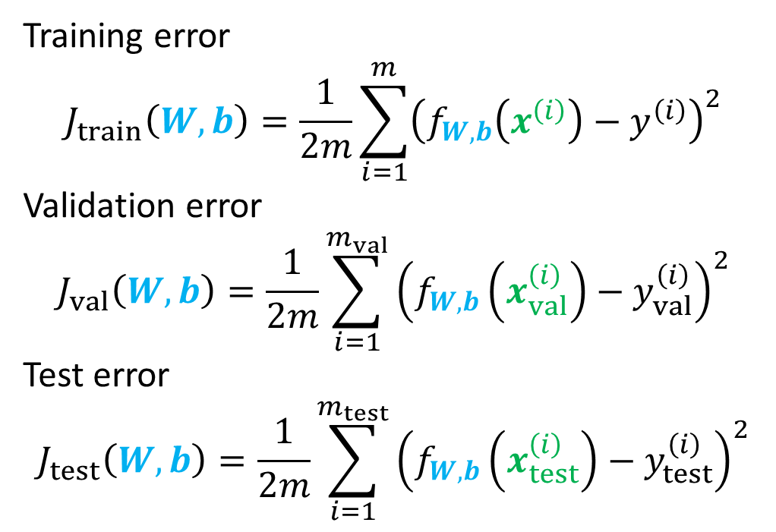
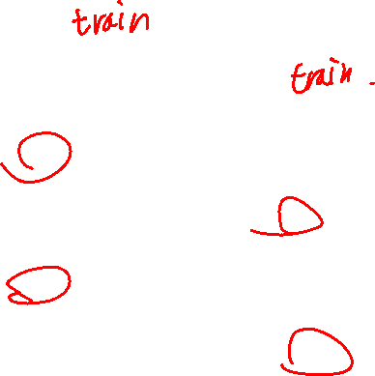
Cost
Training error
$$J_{train}\left(W,b\right)=\frac{1}{2m}\sum_{i=1}^{m}{{\left(f_{W,b}\left(x^{\left(i\right)}\right)−y^{\left(i\right)}\right)}^{2}}$$
Validation error
$$J_{val}\left(W,b\right)=\frac{1}{2m}\sum_{i=1}^{m_{val}}{{\left(f_{W,b}\left(x_{val}^{\left(i\right)}\right)−y_{val}^{\left(i\right)}\right)}^{2}}$$
Test error
$$J_{test}\left(W,b\right)=\frac{1}{2m}\sum_{i=1}^{m_{test}}{{\left(f_{W,b}\left(x_{test}^{\left(i\right)}\right)−y_{test}^{\left(i\right)}\right)}^{2}}$$
Used to get $W,b$
Used to get select model
Used to test the best model

Slide 14



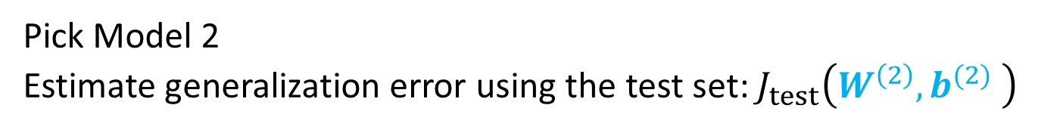







Model Selection
tanh
tanh
1.
$$σ$$
$$J_{val}\left(W^{\left(1\right)},b^{(1)} \right)$$
$$X$$
…
…
$$W^{\left(1\right)},b^{(1)}$$
1 units
15 units
25 units
ReLU
tanh
ReLU
2.
$$σ$$
$$X$$
…
…
…
$$W^{\left(2\right)},b^{(2)}$$
$$J_{val}\left(W^{\left(2\right)},b^{(2)} \right)$$
1 units
15 units
25 units
25 units
Lowest
ReLU+BN
tanh
ReLU+BN
3.
$$σ$$
$$X$$
…
…
…
$$W^{\left(3\right)},b^{(3)}$$
$$J_{val}\left(W^{\left(3\right)},b^{(3)} \right)$$
1 units
15 units
25 units
25 units
Pick Model 2
Estimate generalization error using the test set: $J_{test}\left(W^{\left(2\right)},b^{(2)} \right)$

Slide 15
Match, or mismatched train/validation/test distribution
Training set:
The experiment data from the best equipment
Validation/test set:
The experiment data from various parts of the world
Depending on your purposes, choose what type of validation and test set you want
Are you applying your model to in-distribution data? or out-of-distribution data?
E.g. I have alkane thermodynamics data, and I will only apply to alkane molecules <- same distribution
E.g. I want to use simulation data but want to compare with experimental value <- out-of-distribution

Slide 16
Early Stopping

Slide 17
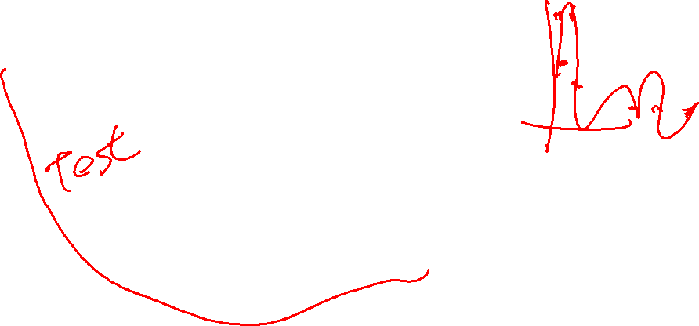
Early Stopping
Just right
Underfitting
Overfitting
Cost function
Use this model
Validation Set Cost
Training Set Cost
Number of iteration

Slide 18

Implementing early stopping
min_val_loss = torch.Tensor([float('Inf')])
for i in range(max_epoch):
for X, Y in dataloader_train:
Z= NN(X)
optimizer.zero_grad()
loss = criterion(Z,Y)
loss.backward()
optimizer.step()
loss_val = 0
for X, Y in dataloader_val:
Z = NN(X)
loss_val += criterion(Z,Y)*Y.shape[0]
loss_val = loss_val/len(data_val)
if loss_val < min_val_loss:
torch.save(NN.state_dict(),'best.pth.tar')
min_val_loss = loss_val
loss_test = 0
NN.load_state_dict(torch.load('best.pth.tar'))
for X, Y in dataloader_test:
Z = NN(X)
loss_test += criterion(Z,Y)*.Y.shape[0]
loss_test = loss_test/len(data_test)
Initialize minimum validation loss
Parameter training via back propagation
Validation loss calculation
Update the best model
Loading the best model
Testing the final model

Slide 19
Bias/Variance

Slide 20
Model complexity and the bias and variance
Just right
High bias
High Variance
Cost function
Validation Set Cost
Training Set Cost
Model complexity

Slide 21






























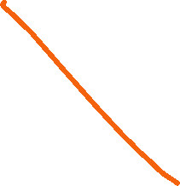


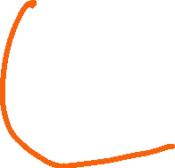





Bias and Variance example
Underfitting
Just right
Overfitting
y
y
y
x
x
x
$$x_{2}$$
$$x_{2}$$
$$x_{2}$$
$$x_{1}$$
$$x_{1}$$
$$x_{1}$$
High bias
High Variance

Slide 22
Bias and Variance Example
Training set error
2 kcal/mol
25 kcal/mol
25 kcal/mol
1 kcal/mol
Validation set error
20 kcal/mol
26 kcal/mol
40 kcal/mol
2 kcal/mol
High variance
High bias
High bias &
High Variance
Low bias
Low variance
Experimental error ~ 1 kcal/mol

Slide 23






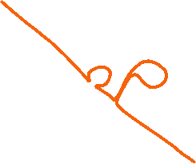
High bias and variance example
$$x_{2}$$
$$x_{2}$$
$$x_{2}$$
$$x_{1}$$
$$x_{1}$$
$$x_{1}$$
High bias
High bias and
High Variance
High Variance

Slide 24
Learning Curve

Slide 25


Learning Curve
y
y
$$J_{val}\left(W,b\right)$$
x
x
y
y
Cost function
$$J_{train}\left(W,b\right)$$
x
x
m_{train} (training set size)

Slide 26


High Bias
Narrow difference between validation and train
y
$f_{w,b}\left(x\right)=$ $wx+b$
$$J_{val}\left(W,b\right)$$
Cost function
x
$$J_{train}\left(W,b\right)$$
y
m_{train} (training set size)
x
For a model with high bias, getting more data will not help.
More complex model needed.

Slide 27


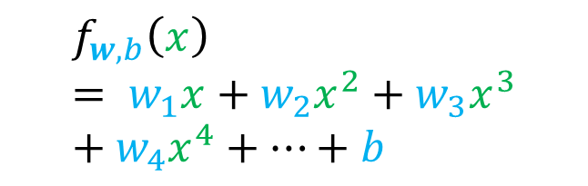
High Variance
$$f_{w,b}\left(x\right)= w_{1}x+w_{2}x^{2}+w_{3}x^{3}+w_{4}x^{4}+…+b$$
y
$$J_{val}\left(W,b\right)$$
Cost function
x
$$J_{train}\left(W,b\right)$$
y
m_{train} (training set size)
x
For a model with high bias, getting more data will likely help.

