Slide 1
Recurrent Neural Network

Slide 2
Recurrent Neural Network
Same model
Recurrent
Dense
Recurrent
Dense
Recurrent
Dense
Dense
h_{t}
h_{t+1}
h_{t+2}
h_{t+3}
y
x_{t}
x_{t+1}
x_{t+2}
Hello
World
!

Slide 3
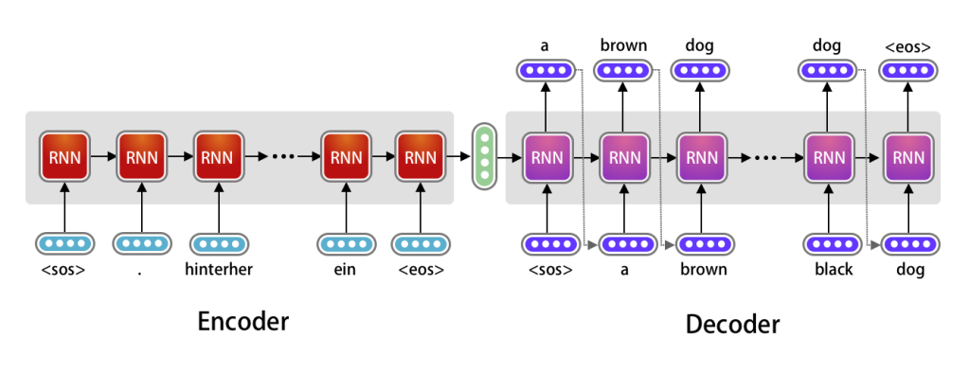
RNN encoder decoder translator
shorturl.at/CDJU4

Slide 4
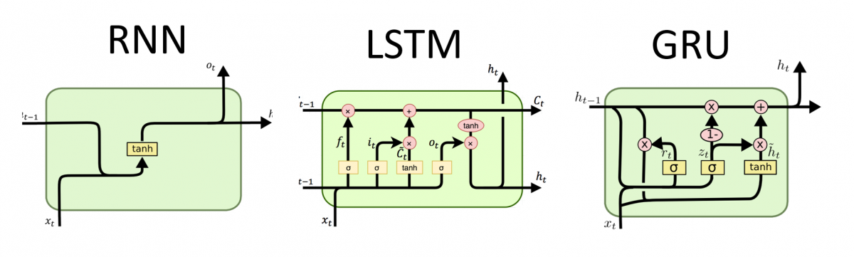
Various RNN Architectures
Long short-term memory
Gated recurrent unit
Carrying information so we can understand the context

Slide 5
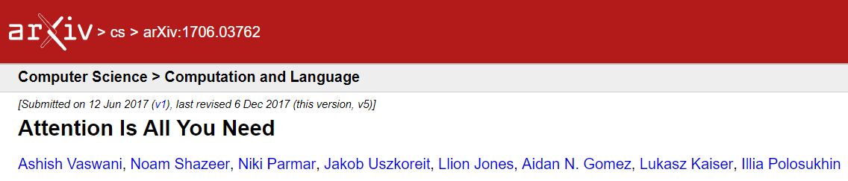
~60,000 citations

Slide 6
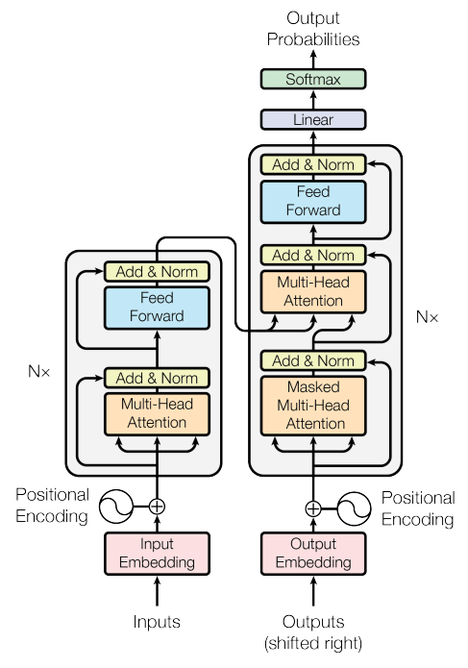
The transformer model architecture

Slide 7
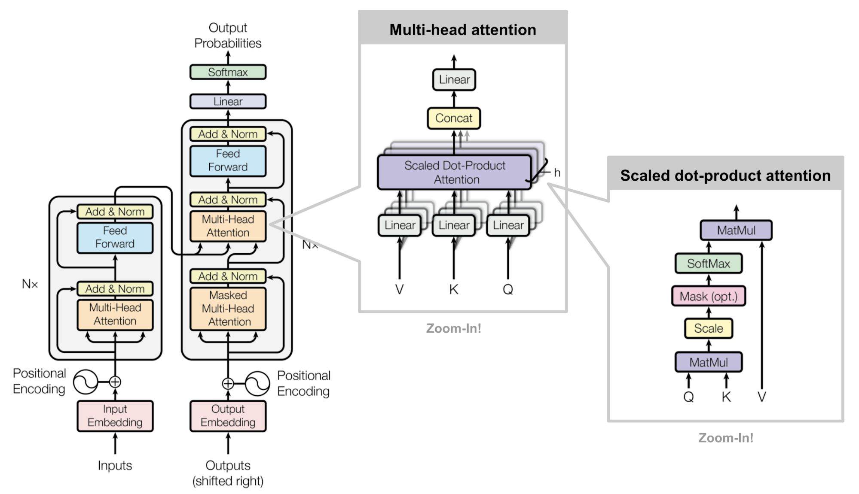
The transformer model architecture

Slide 8
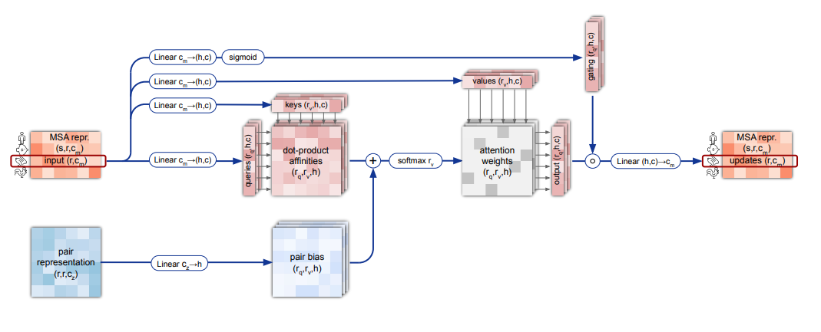
Attention is Used in Most Deep Models
Alpha Fold2

Slide 9
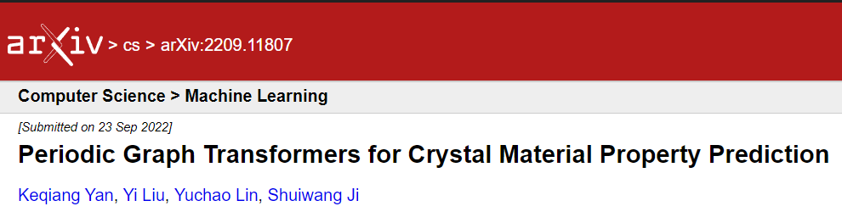
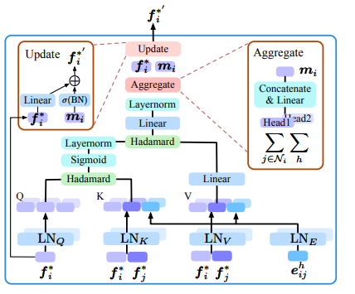
Attention is Used in Most Deep Models
MatFormer – new leader for Materials Project database energy prediction

Slide 10
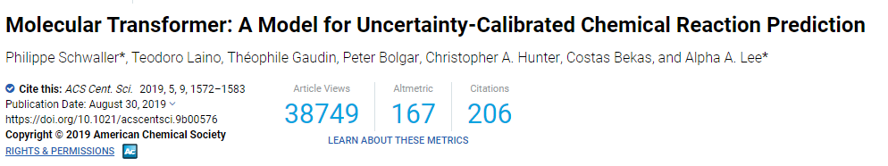
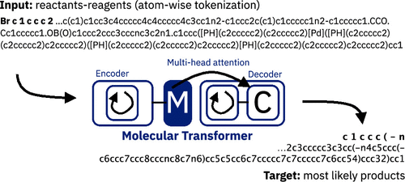
Attention is Used in Most Deep Models
Molecular Transformer

Slide 11
Other Machine Learning Models

Slide 12
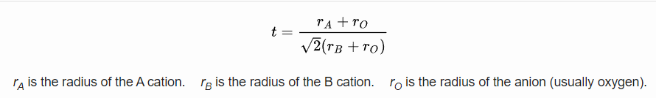
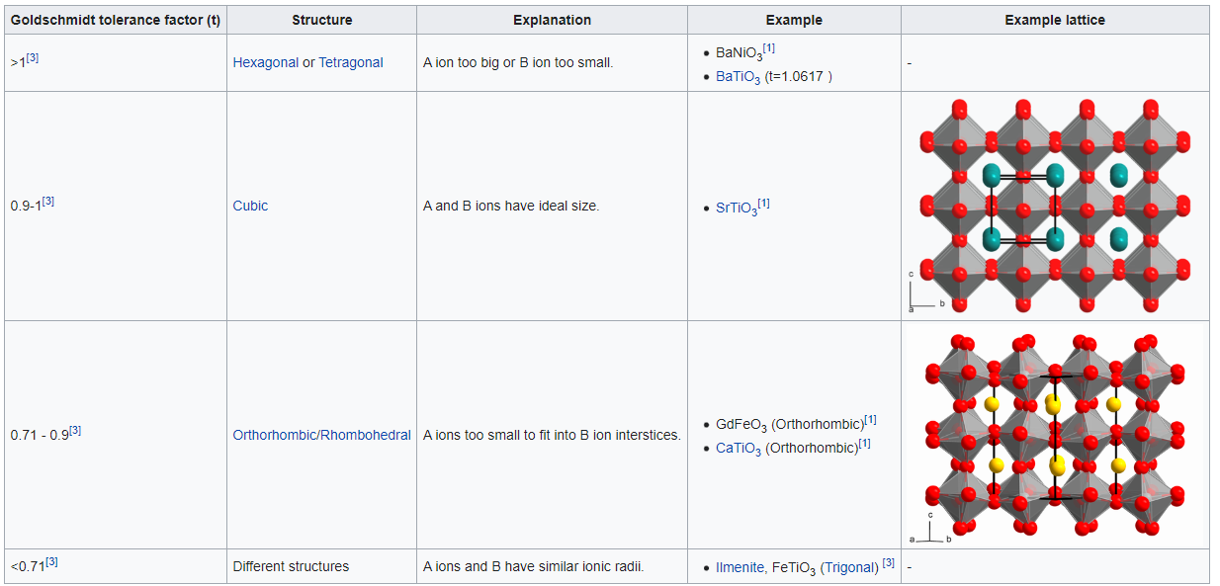
Descriptor Selection
Heuristically developed Goldschmidt factor
Goldschmidt, Victor M. (1926). "Die Gesetze der Krystallochemie". Die Naturwissenschaften. 14 (21): 477–485

Slide 13
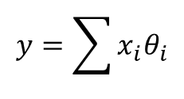
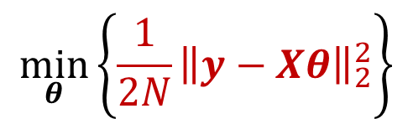
Back to Basic: Linear Regression
θ₂
Minimum least square cost
5
10
30
90
200
θ₁
$$y=\sum{x_{i}θ_{i}}$$
$$\min_{θ}\left\{\frac{1}{2N}{\left\|y−Xθ\right\|}_{2}^{2}\right\}$$

Slide 14
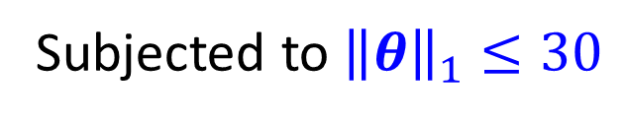
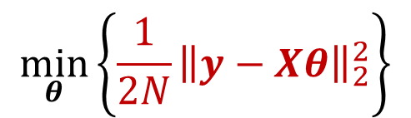
Lagrangian
θ₂
Minimum least square cost
Minimal cost
satisfying constraint
5
10
30
90
200
θ₁
30
θ₁ = 0; θ₂ is more important and is selected
$$\min_{θ}\left\{\frac{1}{2N}{\left\|y−Xθ\right\|}_{2}^{2}\right\}$$
Subjected to${\left\|θ\right\|}_{1}≤30$

Slide 15
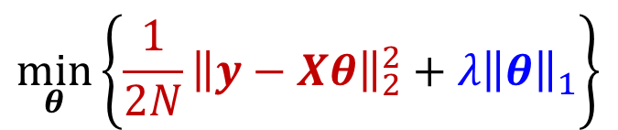
Least absolute shrinkage and selection operator (LASSO)
θ₂
Minimum least square cost
Solution minimizing
the sum of two
5
10
30
90
200
0
θ₁
10
20
30
λ is a tunable parameter
Large λ → Less parameters selected
Small λ → More parameters selected
Minimum L₁ penalty
$$\min_{θ}\left\{\frac{1}{2N}{\left\|y−Xθ\right\|}_{2}^{2}+λ{\left\|θ\right\|}_{1}\right\}$$

Slide 16
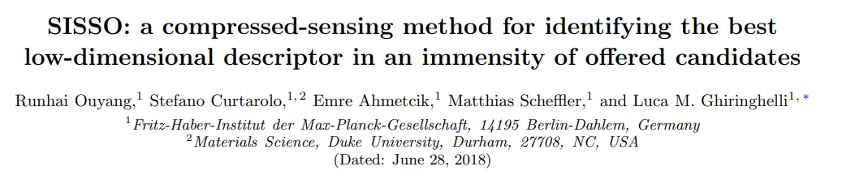
Used advanced version of LASSO

Slide 17
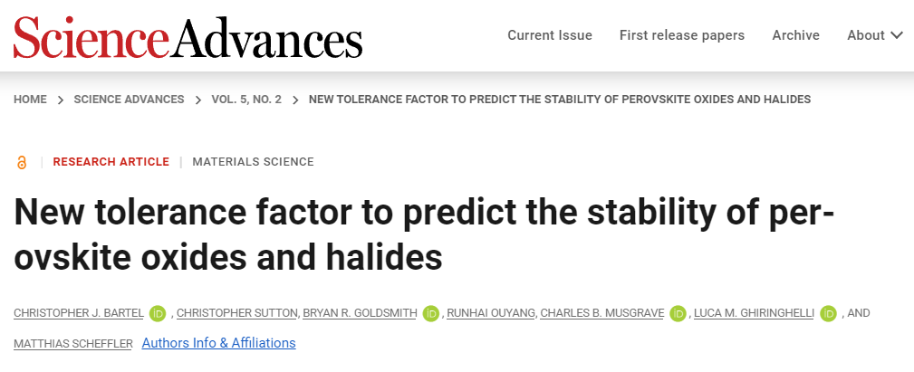

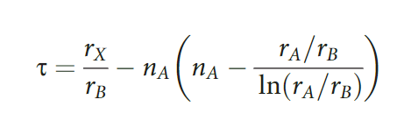
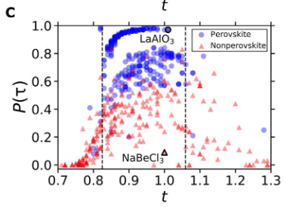
Improving Over Goldschmidt Factor
Goldschmidt Factor
SISSO found descriptor

Slide 18
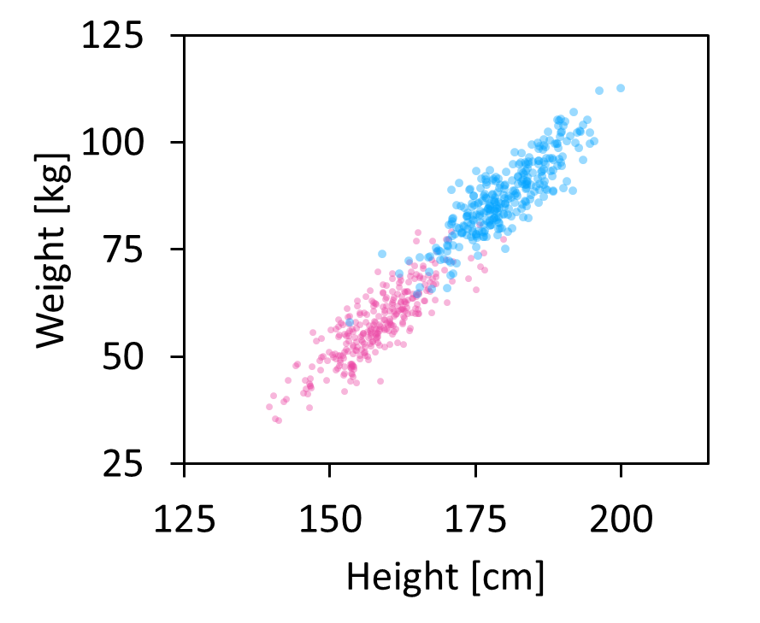
Support Vector Machine
Predict gender
Male
Optimal hyperplane that separates the two class
Female

Slide 19
Decision Tree
Color = Green
Yes
No
Electric
Color = White
Yes
No
Yes
No
Buy
< $90000
Ferrari
Don’t buy
Yes
Yes
No
No
Buy
Don’t buy
Buy
Don’t buy

Slide 20
Unsupervised Learning

Slide 21
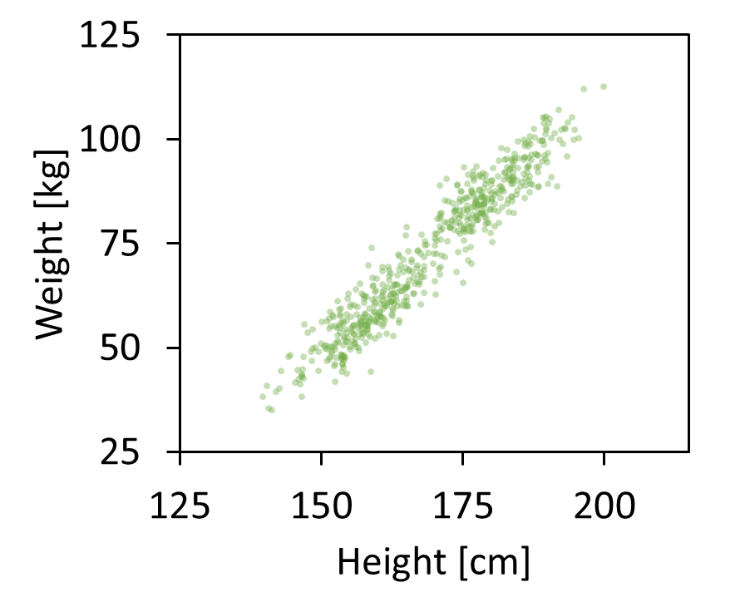
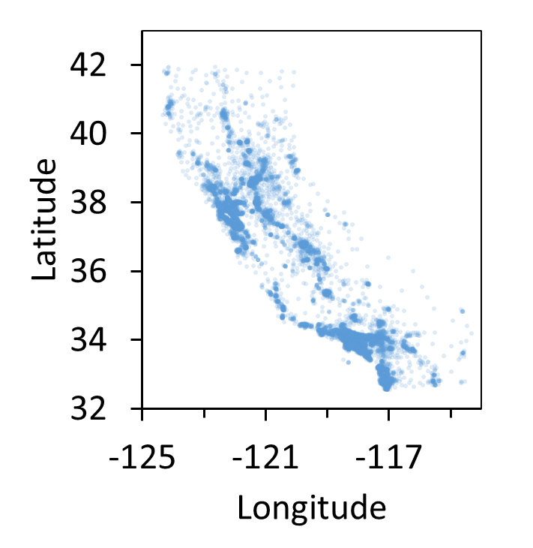
Supervised Learning and Unsupervised Learning
Find clusters in Data
Predict weight given height
Sacramento
San Francisco
San Diego
Los Angeles
Supervised Learning
Right answers given
Unsupervised Learning
Find patterns in the data

Slide 22
Principal Component Analysis

Slide 23
T-SNE
https://www.youtube.com/watch?v=NEaUSP4YerM

Slide 24
K-means Clustering

Slide 25
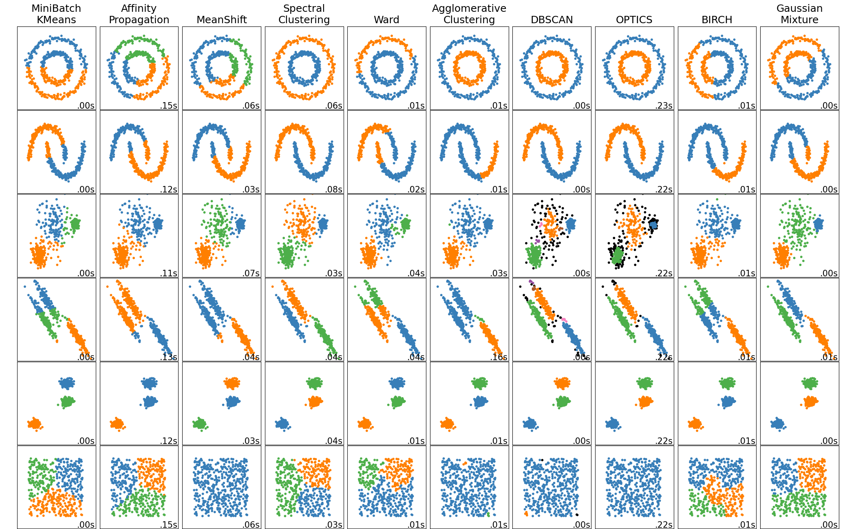
Unsupervised learning algorithms in scikit-learn

