Slide 1
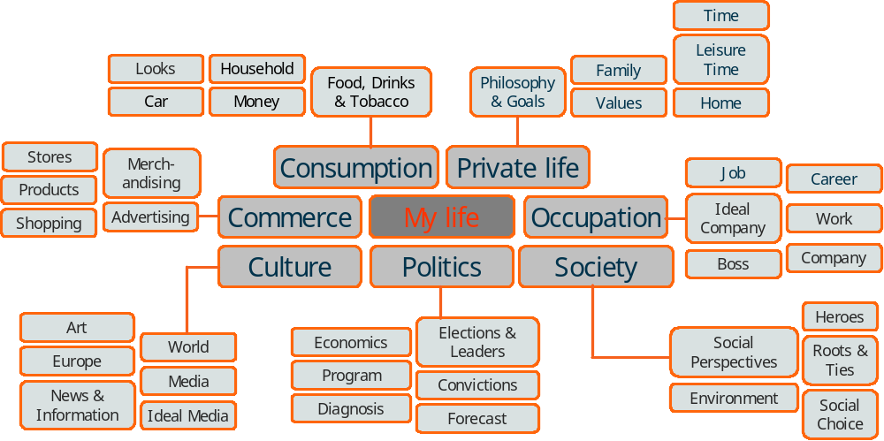
History and methodological background of the Euro-Socio-Styles®
…based on extensive basic research
International survey with 24.000 respondents in two waves.
Started in 1989; since then measurement of value changes.
Up to 6.000 questions in the basic survey(s) to identify
value dimensions
lifestyles
a battery of indicators (Key Questions)
Link of the Euro-Socio-Styles® with ad-hoc studies and consumer panels for additional measurement and analysis of real consumer behaviour.

Slide 2

Method of analyses to develop Euro-Socio-Styles® lifestyle map and key questions
Background Questionnaire (3.500 items)
Factor Analyses
Canonic Analyses
Discriminance
Analysis
Typological Analysis
(17 Lifestyles)
Correspondence Analysis
Second Wave
n = 20.000
Key Questions
Euro-Socio-Styles® Lifestyle Map
Information on sector-specific attitudes and behaviour
(cars, leisure, etc.)
Omnibus/
Ad-Hoc
Consumer Panel

Slide 3
Euro-Socio-Styles® - a short characterization
need: to have
Mirage
Magic World
intuitive young people
materialistic
dreaming to hit the jackpot
fatalistic attitude
hedonistic consumption
Crafty World
dynamic young people
Presentation of self
search for success and material independence
limited budget
Secure World
hedonistic, simple families
traditional oriented
search for security and financial independence
hunt for the buy of the century
Steady World
seniors in retirement
regional and traditional oriented
search for calmness and domestic contentment
deliberated consumption of proven brands
Cosy Tech World
active couples, middle age
stability, quality of life
search for personal development
ratio driven consumption
need: to live a passionate life
need: peace and security
Metamorphosis
Permanence
Authentic World
rational, moral cocooner-families
dedicated, search for a harmonic and balanced life
pragmatic consumption
New World
hedonistic, tolerant intellectuals
feel like cosmopolitans
search for personal harmony and new experiences
more sophisticated living standard
leisure time oriented consumption
Standing World
cultured, knowing the duties of citizens
moral principals of life, but open for new things
prefer traditional brands
Reality
need: to be

Slide 4


Table of contents country and regional reports 2005
INTRODUCTION
Preface and Glossary
CHAPTER 1: Value orientations and consumer preferences in …
General value orientations
Consumption related value orientations
Product and brand preferences
Ideal brand characteristics
Ideal drink of the future
Ideal food of the future
Ideal fabric of the future
General media preferences *
Preferred TV genres **
CHAPTER 2: Value orientations according to lifestyle
The pattern of value orientations of European consumers (map)
Lifestyle target groups in WEC and CEEC
Euro-Socio-Styles® lifestyle target groups in the marketing process
Description of the 8 Euro-Socio-Styles® lifestyle target groups
Steady World
Secure World
Magic World
Crafty World
Cosy Tech World
New World
Authentic World
Standing World
The pattern of product/ brand preferences and lifestyles
Size of the lifestyle groups in Europe (and country)
./.
./.CHAPTER 2: Value orientations according to lifestyle
General value orientations according to lifestyle
Consumption related value orientations according to lifestyle
Product and brand preferences according to lifestyle
Ideal brand characteristics
Ideal drink of the future
Ideal food of the future
Ideal fabric of the future
General media preferences * according to lifestyle
Preferred TV genres ** according to lifestyle
CHAPTER 3: Value orientations according to age /gender
General value orientations according to age / gender
Consumption related value orientations according to age/ gender
Product and brand preferences according to age/ gender
Ideal brand characteristics
Ideal drink of the future
Ideal food of the future
Ideal fabric of the future
General media preferences * according to age/ gender
Preferred TV genres ** according to age/ gender
CHAPTER 4: Design of the survey
Contact
© Copyright GfK Group, Lifestyle Research 2005
*partly available **not available in WEC and Poland

Slide 5
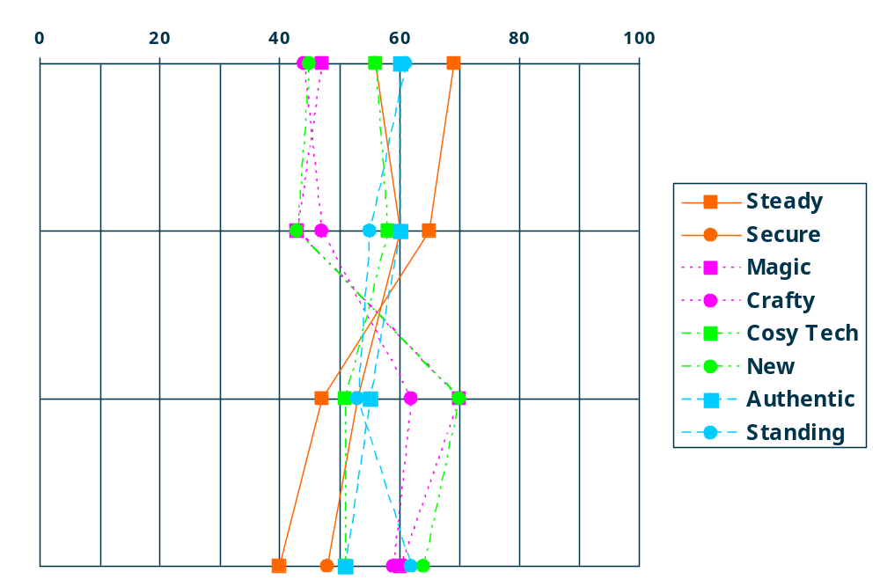
Output example: Which target groups in COUNTRY/REGION X enjoy shopping and spending money most/least?
Value Orientation
Consumption Reduction (vs. Consumption Expansion)
Activeness (vs. Passiveness)
Shopping Pleasure (vs. Shopping Burden)
Quality Orientation (vs. Price Orientation)
Percentages
Modern lifestyle segments, Magic, Crafty and New World, report consumption expansion, shopping pleasure and orientation to quality, while the biggest lifestyle segment in CEEC, Steady World. reports stronger orientation to price and to reduction of consumption
¹ Question: What is your personal attitude towards each opposite worded statement?

Slide 6

Euro-Socio-Styles® in the coffee market
Output example: Usage and attitudes on the lifestyle map
Appeal of new products
Plain Coffee as preventive measure
Industrial product
Quantity
not expensive
brands at a relatively low price
supermarket
Waking you up
Physical
stimulus
Friendly hospitality
In the morning
Fast life
Coffee
as stimulating whip lash
Healthy life
Coffee as practical cultural rite
Quality
expensive
authentic product
coffee shop
Due to pleasure
Intellectual stimulus
Quality of life
Due to loyalty
Return to roasting based on the old recipe
Brand loyalty concerning prestige brands
Excellent coffee
for demanding gourmets

