Slide 1

SP3 By: -----------------
Andreas, Olivia, Daud, Nestor & Jonas

Slide 2

Presentation
Expert Area - Samarbejde & Kommunikation
In this presentation - Fælles forståelse (UML, Wiki, Issues) #Andreas? - Discord #Olivia - TextUI #Jonas - Github Project Overview #Jonas - Code With Me #Olivia - Merge, Commit, Push (Branches) #Jonas - Something - Something - Something

Slide 3




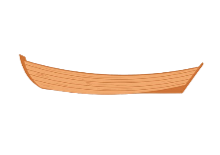




Teamwork
Issues (Github)
Contact

Slide 4

Something
Text here
Text here Text here Text here

