Slide 1
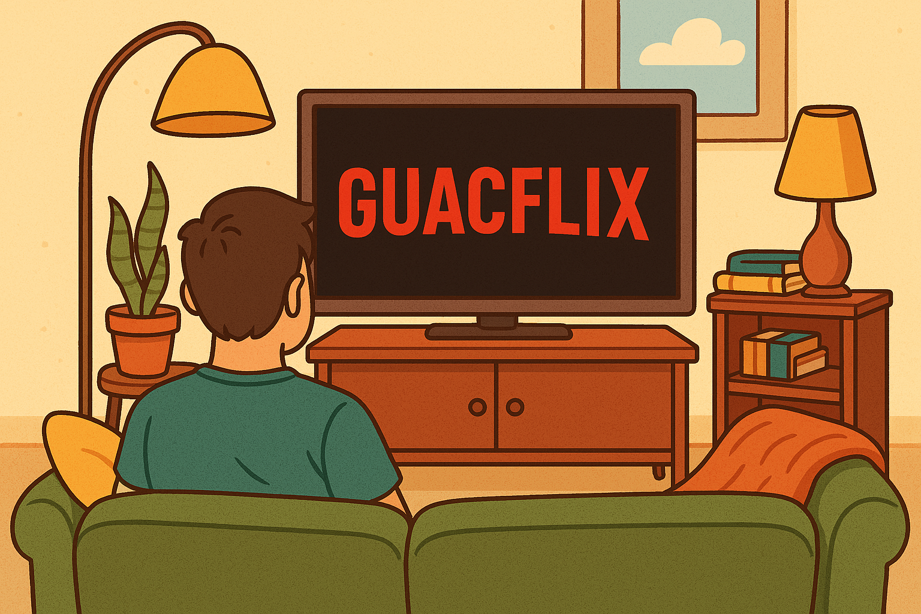
SP3 By: -----------------
Andreas, Olivia, Daud, Nestor & Jonas

Slide 2

Presentation
Expert Area - TEXT
In this presentation: - Something - Something - Something - Something - Something

