Slide 1
Knowledge representation
2

Slide 2
Knowledge Representation using structured objects

Slide 3
Knowledge Representation using structured objects
Semantic nets

Slide 4
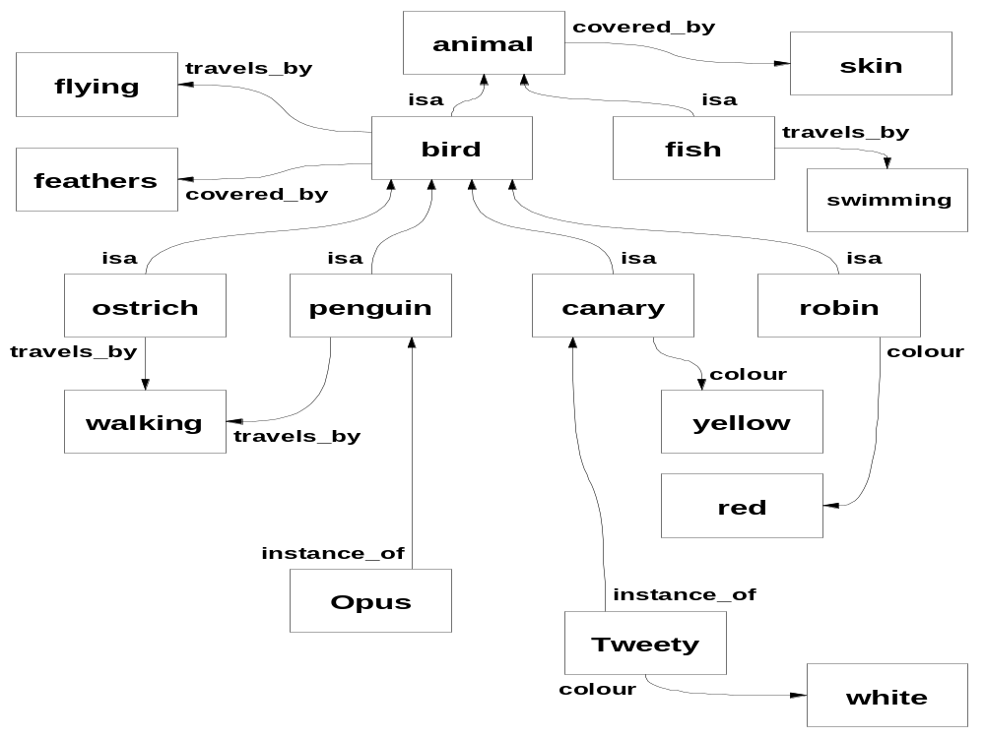

Slide 5
Semantic nets
knowledge is represented as a collection of concepts, represented by nodes (shown as boxes in the diagram), connected together by relationships, represented by arcs (shown as arrows in the diagram).
certain arcs - particularly isa arcs - allow inheritance of properties.

Slide 6
Semantic nets
Problems with semantic nets
  logical inadequacy - vagueness about what types and tokens really mean.
  heuristic inadequacy – finding a specific piece of information could be chronically inefficient.
  trying to establish negation is likely to lead to a combinatorial explosion.
  "spreading activation" search is very inefficient, because it is not knowledge-guided.

Slide 7
Semantic nets
Attempted improvements
  building search heuristics into the network.
  more sophisticated logical structure, involving partitioning.
  these improvements meant that the formalism’s original simplicity was lost.

Slide 8
Semantic nets
Developments of the semantic nets idea:
  psychological research into whether human memory really was organised in this way.
  used in the knowledge bases in certain expert systems: e.g. PROSPECTOR.
  special-purpose languages have been written to express knowledge in semantic nets.

Slide 9
Knowledge Representation using structured objects
Frames

Slide 10
Frames
Devised by Marvin Minsky, 1974.
Incorporates certain valuable human thinking characteristics:
  Expectations, assumptions, stereotypes. Exceptions. Fuzzy boundaries between classes.
The essence of this form of knowledge representation is typicality, with exceptions, rather than definition.

Slide 11
Frames
The idea of frame hierarchies is very similar to the idea of class hierarchies found in object-orientated programming.

Slide 12
How frames are organised
A frame system is a hierarchy of frames
Each frame has:
  a name.
  slots: these are the properties of the entity that has the name, and they have values. A particular value may be:
    a default value
    an inherited value from a higher frame
    a procedure, called a daemon, to find a value
    a specific value, which might represent an exception.

Slide 13
How frames are organised
In the higher levels of the frame hierarchy, typical knowledge about the class is stored.
  The value in a slot may be a range or a condition.
In the lower levels, the value in a slot may be a specific value, to overwrite the value which would otherwise be inherited from a higher frame.

Slide 14
How frames are organised
An instance of an object is joined to its class by an 'instance_of' relationship.
A class is joined to its superclass by a 'subclass_of' relationship.
Frames may contain both procedural and declarative knowledge.
  Slot values normally amount to declarative knowledge, but a daemon is in effect a small program. So a slot with a daemon in it amounts to procedural knowledge.

Slide 15
How frames are organised
Note that a frames system may allow multiple inheritance but, if it does so, it must make provision for cases when inherited values conflict.

Slide 16
Frames: some examples
The following is an exploration of Minsky's frames, using simple examples.
Note that this is not exactly the way Minsky described frames in his original paper, but it is the way the idea has come to be used in practice.

Slide 17
Frames: some examples
First I provide a verbal description of some concept;
then I show a diagram representing the resulting frame;
beside this is a bit of programming which implements this frame in a suitable knowledge representation programming language - in this case, the MIKE package written by knowledge engineering specialists at the Open University.

Slide 18
Frames: some examples
We will start with a simple piece of information: there is a category of things called cars.
Given this information, we can start to build a frame:

Slide 19
Name: car Subclass of: thing

Slide 20
More information: a car has 4 wheels, is moved by an engine, and runs on petrol or diesel.
We can now add three slots to the frame.
The last of these has a restriction rather than a specific value.

Slide 21
“a car has 4 wheels, is moved by an engine, and runs on petrol or diesel.”
car subclass_of
thing
with
wheels: 4,
moved_by: engine,
fuel:
[value:
unknown,
type:
[petrol,diesel]].
Name: car Subclass of: thing
Slots:
Name: Value: Restrictions:
wheels 4
moved by engine
fuel ? petrol or diesel

Slide 22
More information: there is a particular type of car called a VW, manufactured in Germany.
We can add a second frame to our system, with one slot. We don’t need to repeat the slots and values in the previous frame: they will be inherited.

Slide 23
“there is a particular type of car called a VW, manufactured in Germany.”
‘VW’ subclass_of
car
with
made_in:
‘Germany’.
Name: VW Subclass of: car
Slots:
Name: Value: Restrictions:
made in Germany

Slide 24
More information: there is a particular type of VW called a Golf, which has a sun-roof.
We can add a third frame to our system, with one slot. Once again, we don’t repeat the slots in the previous frames, because they will be inherited.

Slide 25
“there is a particular type of VW called a Golf, which has a sunroof.”
‘Golf’ subclass_of
VW
with
top: sunroof.
Name: Golf Subclass of: VW
Slots:
Name: Value: Restrictions:
top sunroof

Slide 26
More information: there is a particular type of Golf called a TDi, which runs on diesel. A TDi has 4 cylinders, and an engine capacity of 1.8 litres.
We can add a fourth frame to our system, with three slots. One of the slots (fuel) was already in the system, but appears here because it now has a specific value rather than a restriction.

Slide 27
“there is a particular type of Golf called a TDi, which runs on diesel, has 4 cylinders, and has a 1.8 litre engine.”
‘TDi’ subclass_of
‘Golf’
with
fuel: diesel,
engine_capacity:
1.8,
cylinders: 4.
Name: TDi Subclass of: Golf
Slots:
Name: Value: Restrictions:
fuel diesel
engine
capacity 1.8 litres
cylinders 4

Slide 28
More information: my car, called C637SRK, is a Golf Tdi. It hasn’t got a sun-roof.
We can add a fifth frame to our system, with two slots. Unlike all the previous frames, this one is an instance frame. One of the slots (top) was already in the system, but appears here because the value contradicts (overwrites) the value which would otherwise be inherited.

Slide 29
“There is a car called C637SRK which is an instance of a Golf TDi etc.”
‘C637SRK’
instance_of
‘TDi’
with
owner: jp,
top:
no_sun_roof.
Name: C637SRK Instance of: TDi
Slots:
Name: Value: Restrictions:
owner jp
top no sun-roof

Slide 30
More information: to calculate a car’s cylinder size, you divide the total engine capacity by the number of cylinders.
We can now add another slot to the car frame. It’s a daemon, which discovers the information required, if the user asks what the value in the slot is.

Slide 31
“to calculate a car’s cylinder size, you divide the total engine capacity by the number of cylinders.”
car subclass_of thing
with
wheels: 4,
moved_by: engine,
fuel: [value: unknown,
type: [petrol,diesel]],
cylinder_size:
[value: unknown, access_rule:
(if the engine_capacity of ?self is E & the cylinders of ?self is C & Ans := E/C
then make_value Ans)].
Name: car Subclass of: thing
Slots:
Name: Value: Restrictions:
wheels 4
moved by engine
fuel ? petrol or diesel.
cylinder size ? find total engine
capacity, find
no.of cylinders,
divide first by
second.

Slide 32
Knowledge Representation using structured objects
Other varieties of structured object

Slide 33
Other varieties of structured object
Knowledge representation researchers - particularly Roger Schank and his associates - devised some interesting variations on the theme of structured objects.
In particular, they invented the idea of scripts (1973).
A script is a description of a class of events in terms of contexts, participants, and sub-events.

Slide 34
Scripts
Rather similar to frames: uses inheritance and slots; describes stereotypical knowledge, (i.e. if the system isn't told some detail of what's going on, it assumes the "default" information is true), but concerned with events.
Somewhat out of the mainstream of expert systems work. More a development of natural-language-processing research.

Slide 35
Scripts
Why represent knowledge in this way?
  Because real-world events do follow stereotyped patterns. Human beings use previous experiences to understand verbal accounts; computers can use scripts instead.
  Because people, when relating events, do leave large amounts of assumed detail out of their accounts. People don't find it easy to converse with a system that can't fill in missing conversational detail.

Slide 36
Scripts
Scripts predict unobserved events.
Scripts can build a coherent account from disjointed observations.

Slide 37
Scripts
Commercial applications of script-like structured objects: work on the basis that a conversation between two people on a pre-defined subject will follow a predictable course.
Certain items of information need to be exchanged.
  Others can be left unsaid (because both people know what the usual answer would be, or can deduce it from what's been said already), unless (on this occasion) it's an unusual answer.

Slide 38
Scripts
This sort of knowledge representation has been used in intelligent front-ends, for systems whose users are not computer specialists.
It has been employed in story-understanding and news-report-understanding systems.

Slide 39
Conceptual graphs
In 1984, John Sowa published his conceptual graph approach.
This is something like the semantic net approach described earlier.
It is more sophisticated in the way in which it represents concepts
It is much more precise regarding what the objects in the graphs mean in real-world terms.

Slide 40
Knowledge Representation using structured objects
Practical applications

Slide 41
KBSs using structured objects
Two more examples of KBSs using structured objects for knowledge representation

Slide 42
Explorer
Explorer is a natural-language interface for a database relating to oil-wells:
Contains geological knowledge, organised as structured objects.
Interfaced to a graphics package that can draw oil-exploration maps.
The geologist can converse with the program in unconstrained natural language, and in geological jargon.

Slide 43
Bank customer advisory system
Bank customer advisory system:
Advises customer on opening a bank account, based on customer's needs/characteristics. This is a task that can consume a lot of the bank staff's time.
Deduces customer's intended meaning.
Does not annoy customer by asking for every detail; uses its knowledge about people to deduce what the answers must be.

Slide 44
Knowledge Representation using structured objects
The CYC project

Slide 45
The CYC Project
A very large scale commercial research project designed to represent a large body of common-sense knowledge.
Headed by Lenat and Guha, and based in Austin, Texas
Has been making steady progress since 1984

Slide 46
The CYC Project
It now ‘knows’ a huge collection of fragments of real-world knowledge such as:
  Mothers are older than their children.
  You have to be awake to eat.
  You can usually know people’s noses, but not their hearts.
  If you cut a lump of peanut butter in half, each half is a lump of peanut butter, but if you cut a table in half, neither half is a table.

Slide 47
The CYC Project
The ultimate objective is to give it enough knowledge to understand ordinary books, so that it can read them and expand its own knowledge.
So far, it’s got to a stage where, when asked to find photos of “risky activities”, it located photos of people climbing mountains and doing white-water rafting.

Slide 48
Knowledge Representation using structured objects
Final comments

Slide 49
Structured objects: final comments
A knowledge-representation system with property inheritance should make a distinction between essential properties ('universal truths') and accidental properties.
  Some don't: some allow unrestrained overwriting of inherited properties.
  It's possible to generate incoherent structures in any of these systems.
  It's particularly easy when multiple inheritance is involved.

Slide 50
Structured objects: final comments
At best, structured objects provide data & control structures which are more flexible than those in conventional languages, and so more suited to simulating human reasoning.

