Slide 1





Feb 26 7:58 AM

Slide 2
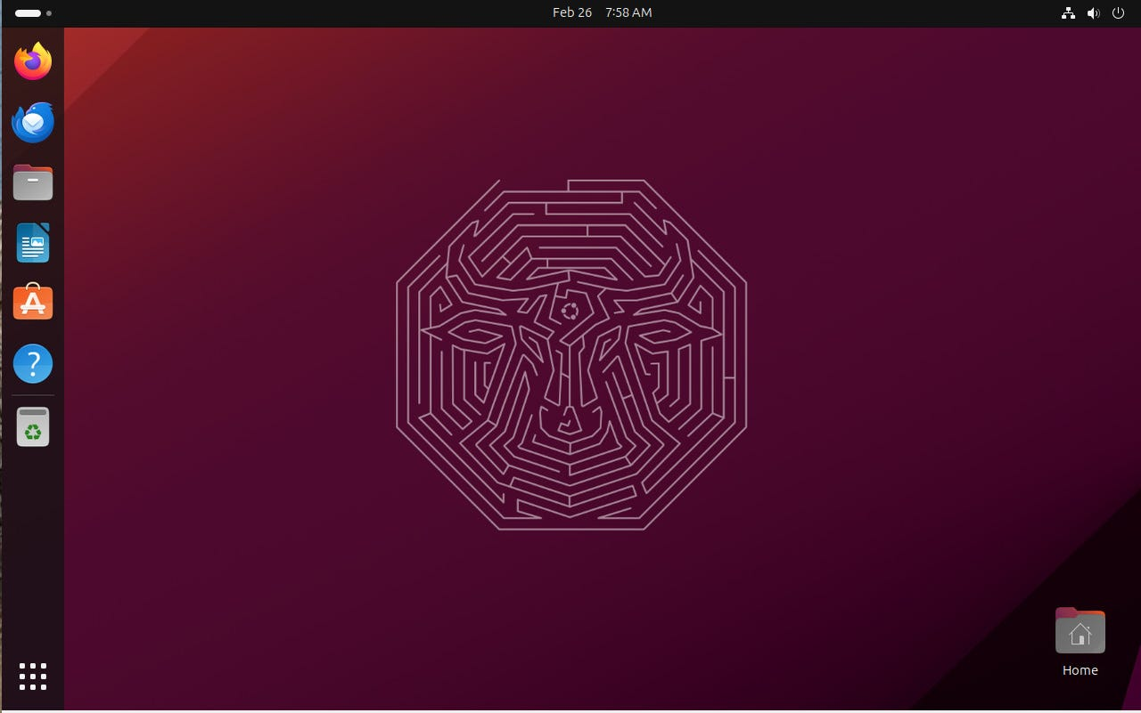

Slide 3

https://149366088.v2.pressablecdn.com/wp-content/uploads/2024/03/ubuntu-24.04-wallpaper.jpg
Boxicons.com
Cuadricula de 9 Grid
Power off

