Slide 1

PhD Research: Elements of Excellence
Ness B. Shroff
Electrical and Computer Engineering & Computer Science and Engineering

Slide 2
Outline
Expectations
Integrity in Research
Strategies for success

Slide 3
Expectations
Excellence in course-work is not sufficient
  Nobody is going to give you a PhD for getting a 4.0
  Need to do more than simply absorb information
Need to create new knowledge
  Impact either in theory or in practice
  Other researchers/practitioners can build on
Need to work extremely hard
  Making progress is difficult
  Our areas are highly competitive
    Others may have more experience or be smarter than you
  But you can out-work them
Adhere to the highest ethical standards

Slide 4
Outline
Expectations
Integrity in Research
Strategies for Success

Slide 5
Integrity in Research
Plagiarism
Proper citations
Mistakes versus Fraud
Precedence
Reporting Results…
Notes:
These are the various items I’m going to talk about for ensuring integrity in research

Slide 6
Plagiarism
Using an idea that does not belong to you
  You can use someone’s ideas with appropriate citation
Using text that does not belong to you
  E.g., “borrowing” text from someone’s introduction without quotes and citation
Using software that you do not own
Is self plagiarizing wrong?
  Yes
Plagiarism is a very serious offense
and goes to the heart of academic integrity
More details can be found on: http://www.plagiarism.org/
Notes:
So, what is plagiarism in research?
Give examples

Slide 7
Proper Citations
Important to cite appropriately
  Gives credit where it is due
  Helps to clarify & position one’s contribution
  Increases value of your own contribution
Citations should not be vague
  E.g., you shouldn’t say “this work looks at a similar problem to [1],[2],[3]
  Clarify particular similarities and differences
Do not bury prior work with greatest similarity in a long list of citations
  Tantamount to plagiarism!
Notes:
Not only does it give credit where it is due

Slide 8
Mistake versus Fraud
“To err is human…”
  Occasionally, mistakes can occur
  Mistakes should almost always be caught before publication (submission) and should only be the exception
Fraud:
  Knowingly committing a “mistake” and not correcting it.
  Misleading your advisor (he/she becomes a victim)
  Not correcting a genuine mistake
    Cold fusion (1991), Cloning (2006)…
If mistake occurs in publication:
  Admit it and make sure correction is either posted or published
  “My advisor didn’t let me” is NOT an excuse
  Real-life Example …
Notes:
When does a mistake become a fraud?

Slide 9
Precedence
Precedence is very important
  You spent 12 months on a problem & solved it
  “Bob” published a paper with the exact same solution before you submitted the work
  What do you do?
    Try to publish it because it is independent work
    Give up
    Throw a tantrum and leave PhD program
    Extend/modify and find a new angle and publish
  Real-Life example
You may choose not to enforce it on others
  Real-Life example
Notes:
Precedence is all important in research.

Slide 10
Reporting Results
Results should be reported accurately
  Fudging of data is a serious offense (fraud)
  Sloppy simulations/experiments are unacceptable
    You and your ADVISOR lose all credibility
Present the entire picture
  If there are scenarios where your solution performs poorly or less efficiently, do not hide it
  Provides more credibility to your conclusions
Feel free to emphasize scenarios of strength
  Explain why these scenarios are important
  You are the salesman/saleswoman of your work

Slide 11
Outline
Expectations
Integrity in Research
Strategies for success

Slide 12
Strategies for Success
Self Examination
Advisor
Preparation
Problem
Solution
Writing Papers
Intellectual Climate

Slide 13
Self-Examination
Questions you should ask yourself:
  Are you doing this for the right reasons?
    Parents want you to earn PhD
    PhD will get you a good or well paying job…
  Do you enjoy solving problems/puzzles?
    Much of what you do for a PhD is working out intricate puzzles
  Are you tenacious?
    A PhD is a long-term commitment
    With very few highs and lots of lows…
If you answered “No” to the above questions
  A PhD is not for you
  Find a more suitable vocation
Notes:
The right reasons are not

Slide 14
Strategies for Success
Self Examination
Advisor
Preparation
Problem
Solution
Writing Papers
Intellectual Climate

Slide 15
Advisor
Find an advisor who fits your style
  Hands on/Hands off
  Experimentalist/Theorist/Mixture…
  Junior/Senior
Give your advisor confidence in you
  If he/she suggests a problem or solution
    Think deeply
    Find alternatives if original idea doesn’t work
    My best students…
  Do the work at hand, rather than trying to impress
    Impress with deeds
    Go well beyond the minimum and superficial

Slide 16
Advisor
Challenge your advisor
  Feel free to provide opposing points of view
  My students are not shy to tell me I’m wrong
Build trust
  If you haven’t done any work this week, say so…
  If you need time off, just ask…
  Communicate and don’t try to deceive
_x0012_Good relationship for life
  Recommendations
  Career opportunities
  Friendship

Slide 17
Strategies for Success
Self Examination
Advisor
Preparation
Problem
Solution
Writing Papers
Intellectual Climate

Slide 18
Preparation
Take a large variety of courses
  Not only facilitates research but makes you a well rounded scholar (not merely a technician)
  Classes have been “optimized” to make them efficient tools of learning
    Hard work is done by someone else
    Your last opportunity ➔ Make the most of it
  Challenge yourself
    Don’t shy away from difficult classes in your department and others…
    Ex. All my PhD students take several advanced Math classes
Notes:
A very important aspect of your preparation is to take …

Slide 19
Preparation
Teach yourself how to self-learn
  Should be able to pick up any book/paper and work through it
  Ex. My own graduate students taught themselves advanced optimization techniques, stochastic control, large deviations, & are now experts themselves
Read voraciously
  Journals/Conferences
  Tutorials/Magazines
  Scientific American
  Nature…
Learn by osmosis

Slide 20
Strategies for Success
Self Examination
Advisor
Preparation
Problem
Solution
Writing Papers
Intellectual Climate

Slide 21
The Problem
Most important part of a PhD
  Finding a good problem is half the battle
Salient features of a good problem:
  Potential for high and long-term impact
  Fills an important deficiency or charts a new direction
  Not minor perturbations of existing systems (802.11, Wireless TCP, HDR, etc.)
  Is highly challenging
    No matter how smart you are, the problem should take you time to solve
    Advisors: Give students the time it takes to struggle through a really difficult problem
    Real-Life Example

Slide 22
The Problem
A good understanding of the literature is important in defining the right problem
  The right problem may find a unique angle or direction that is missing in existing works
Sometimes helps to think of two problems intermittently
  Helps get a fresh perspective, when progress on one is not forthcoming
  However, juggling too many problems simultaneously is usually counter-productive
Problems can, will, & should get refined once solutions are proposed
  Assumptions are relaxed or restricted
  Trivialities found and removed…

Slide 23
The Problem
A PhD should not be a union of inconsequential loosely attached problems
  Must be an overall vision to your thesis
  Which you should be ready to articulate by the time you are ½ - ¾ of the way done…

Slide 24
Strategies for Success
Self Examination
Advisor
Preparation
Problem
Solution
Writing Papers
Intellectual Climate

Slide 25
Solution
Ask your advisor for examples of high-quality papers
  Get a taste for high quality problems and solutions
  But don’t base your problems or solutions on others’ work
There are no Gods in Academia
  Learn to read papers written by good people
  Read strategically & don’t become a clone of others’
  Don’t be afraid of solving problems that other top researchers have looked at and failed or only partially succeeded.

Slide 26
Solution
Begin with a highly simplified “toy problem”
  At this stage, it may be better to ignore the literature
“Own” the simplified problem and its solution completely
  Incrementally add complexity
Do not be satisfied with a superficial result
  Push the problem as far as you can to obtain important theoretical and/or practical results, e.g.
  Impact of imperfect control in system
  Implementable, yet provably efficient distributed algorithms…

Slide 27
Solution
Search for elegance
  A complex unwieldy solution does not make good academic research
  Even in industry, the elegant ideas are the drivers of innovation
    Ex., Viterbi algorithm; CDMA, Opportunistic scheduling; Separation theorem, OFDM…
Search for insights
  Cross-Layer components can be designed independently
  Use of queue length information is valuable…
Never fall in love with the tool (or methodology)
  Always remember: The problem is King

Slide 28
Strategies for Success
Self Examination
Advisor
Preparation
Problem
Solution
Writing Papers
Intellectual Climate

Slide 29
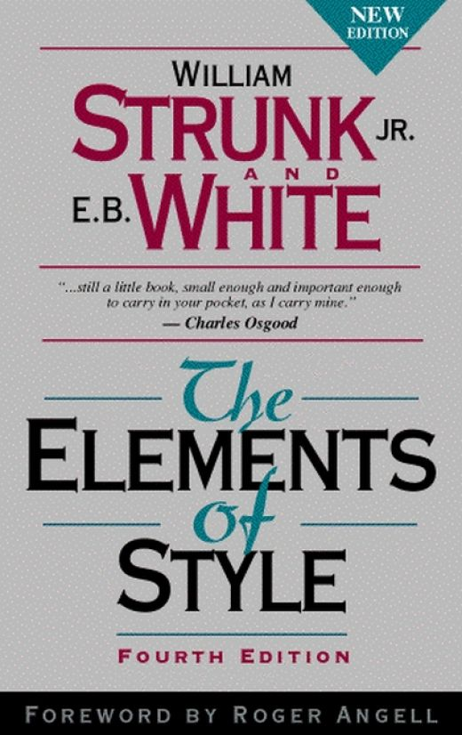
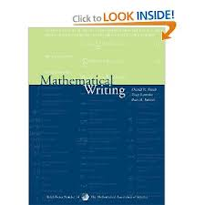
Writing Papers
Learn about good writing from high-quality examples in the field
Read books on writing
  “The Elements of Style” by Strunk and White for style and grammar
  “Mathematical Writing” by Knuthe, Larabee, Roberts.
Write simply and directly
  Don’t use cliché’s or arcane/flowery/bombastic words
Reduce notational complexity
  Do you really need 3 subscripts and 2 superscripts?
Limit the creation of unnecessary abbreviations
  Remember advice given to Stephen Hawking

Slide 30
Writing Papers
Write to explain and not impress.
  Make the proofs as accessible as possible, supplement with figures
  Describe main idea before launching into details of system or proof
  Many excellent technical works out there that never get cited because no one understands them
Make the paper interesting:
  Most papers are read by only one other person besides the authors themselves
  Have a powerful introduction and conclusion
  What is the one key idea that you want others to take away!
  You are the salesman or saleswoman of your own work

Slide 31
Strategies for Success
Self Examination
Advisor
Preparation
Problem
Solution
Writing Papers
Intellectual Climate

Slide 32
Create an Intellectual Environment
Go and seek out seminars and presentations
  Even if they are not in your PhD field of research
  You are here to be a scholar not just a researcher
  Push your advisors to give periodic talks, and to invite speakers from industry and academia
Create your own student-run seminar series
  Thematic or non-thematic
  Present/Discuss interesting papers with other students
  Create an environment where questioning is the norm
Strive for the highest level of scholarship & excellence in whatever you do…

Slide 33
Epilogue
“The power of instruction is seldom of much efficacy except in those happy dispositions where it is almost superfluous”
-- Original quote by Gibson, obtained from Richard Feynman’s Lectures on Physics.
Notes:
Use this advice as guidelines and tailor according to your own unique circumstances.

Slide 34
Thank you!

