Slide 1
Homework-03
陳冠諺
309613067

Slide 2
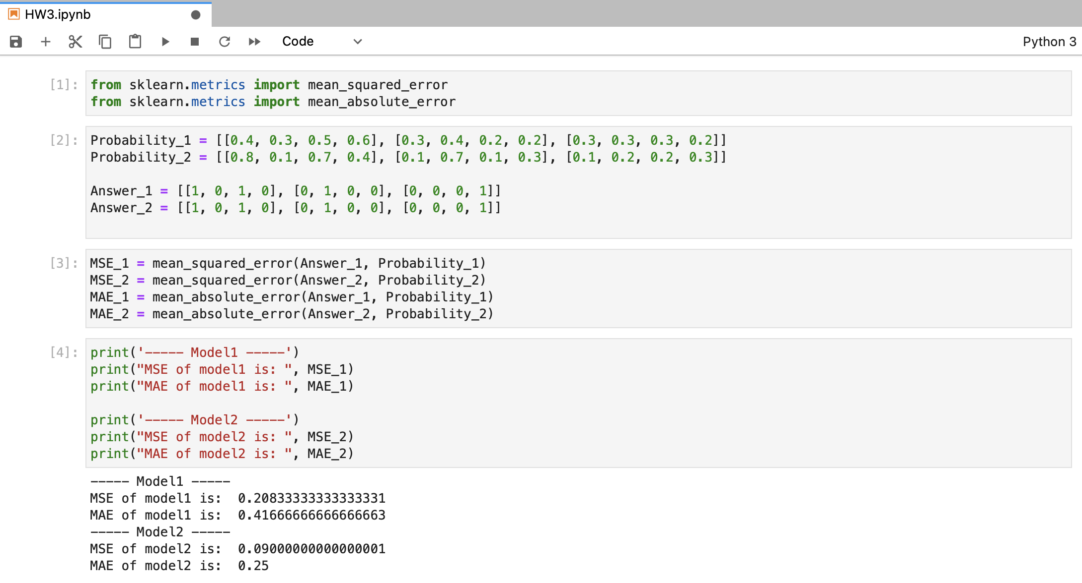
MSE&MAE—計算結果
使用scikit-learn的模組計算
Model 1
Mse = 0.20833
Mae = 0.41666
Model 2
Mse = 0.09000
Mae = 0.25

Slide 3
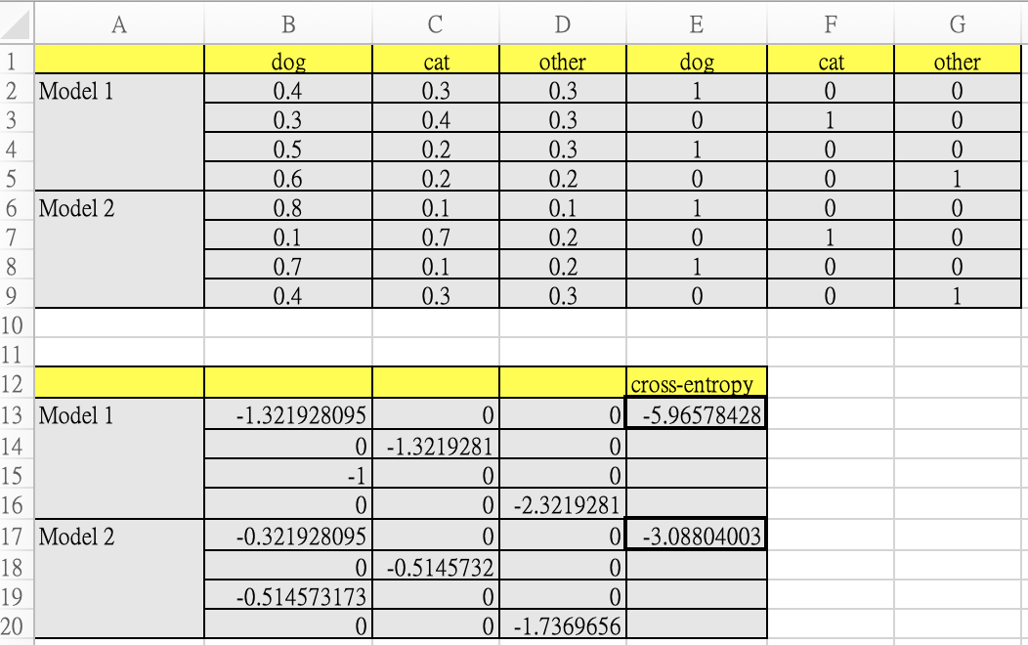
Cross-entropy—計算結果
使用excel計算
Model 1
Cross-entropy = -5.96578428
Model 2
Cross-entropy = -3.08804003

