Slide 1
DataCo Supply Chain
Documentation
Loo Guan Yee
October 2024

Slide 2
Documentation Content
Installing PostgreSQL 17
Creating the SQL file from scratch (Optional)
Getting and preprocessing the DataCo Supply Chain Dataset
Creating the sql file in PostgreSQL 17
Backing up the sql file into PostgreSQL 17
Loading the sql file into PostgreSQL 17
Connecting the PostgreSQL database to PowerBI

Slide 3
Installing
PostgreSQL 17
01
Installing
PostgreSQL 17
02
Creatting
PostgreSQL
File (Optional)
03
Loading SQL file
Into PostgreSQL 17
04
PostgreSQL 17 to
PowerBI connection

Slide 4
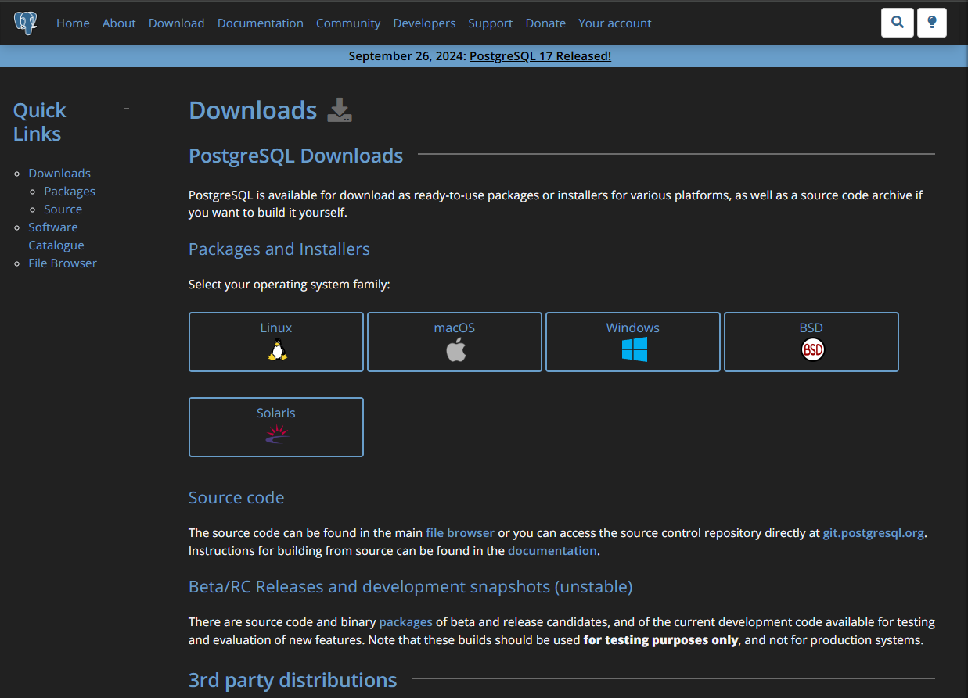
PostgreSQL 17 Installation
This documentation focuses on the installation of PostgreSQL 17 realised on 26 September 2024
Go to https://www.postgresql.org/download
Click on the your OS under Packages and Installers

Slide 5
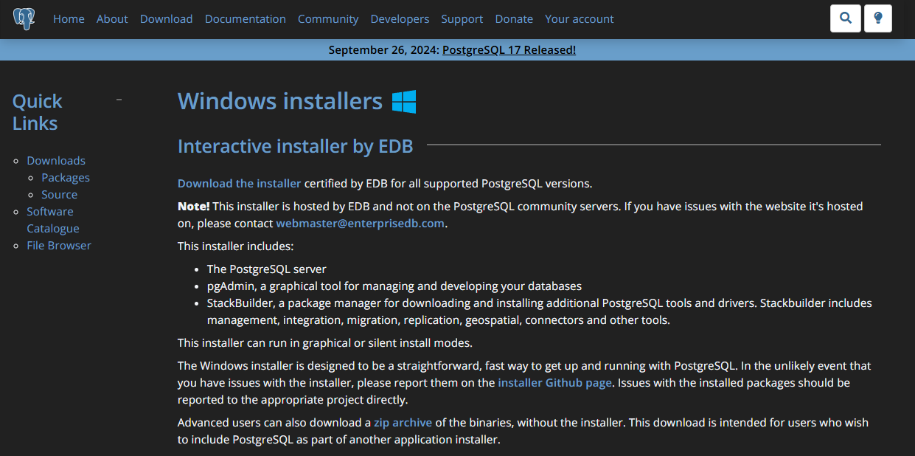
PostgreSQL Windows Installation
For Windows, Click on the “Download the Installer” icon
01

Slide 6
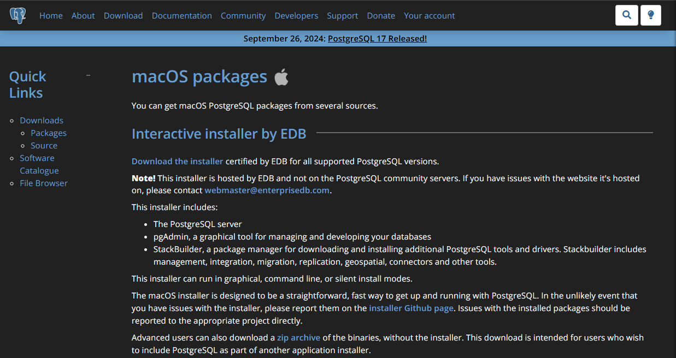
PostgreSQL MacOS Installation
For MacOS, Click on the “Download the Installer” icon
01

Slide 7
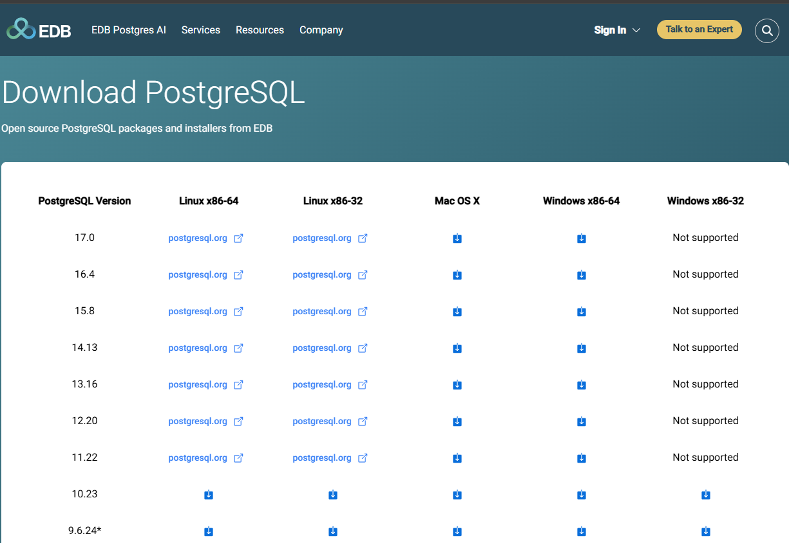
PostgreSQL Windows and Mac OS Installation
You will be redirected to a new page hosted by EDB
For Windows, click on this.
For Mac OS, click on this
Download will start shortly

Slide 8
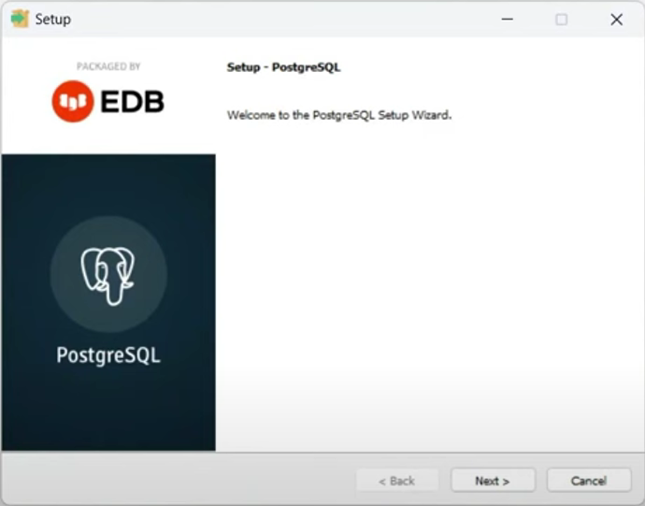
PostgreSQL.exe installation
Open the postgresql-17.0-windowsx64.exe found in your download folder
Click on next
01

Slide 9
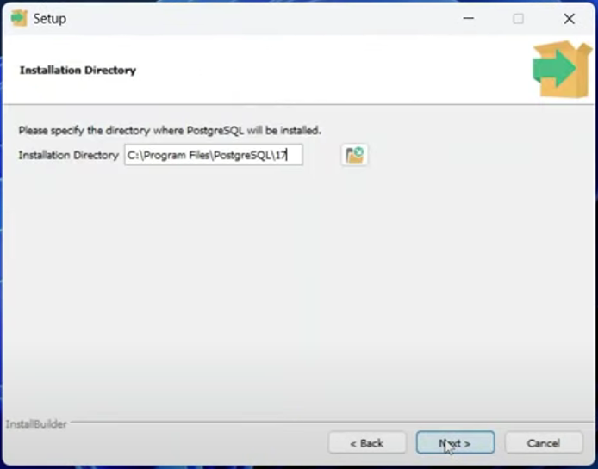
PostgreSQL.exe installation
Click on next
01

Slide 10
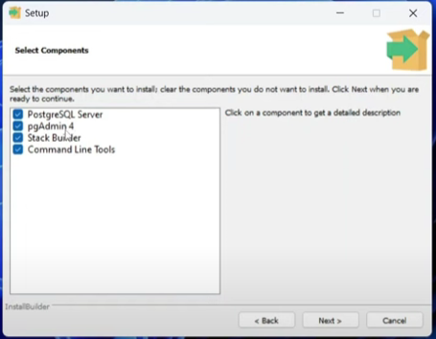
PostgreSQL.exe installation
Check all the ticks available in the screen
Click on next
01

Slide 11
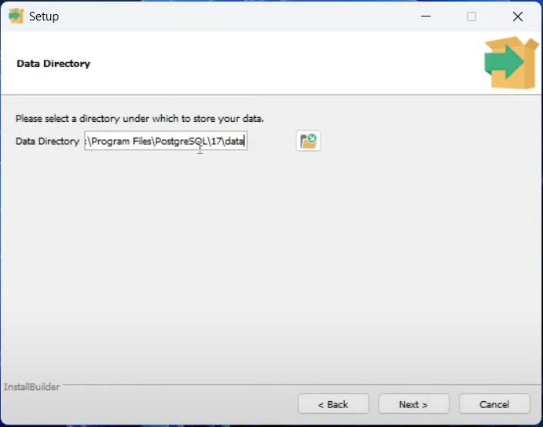
PostgreSQL.exe installation
Click on next
01

Slide 12
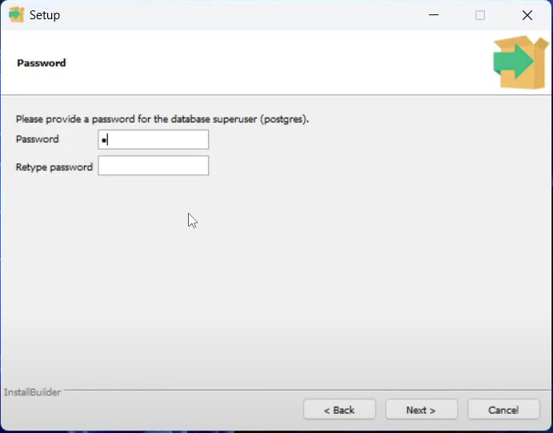
PostgreSQL.exe installation (Important!)
Type in your password and Retype password
Then, click on “Next”
This step is important for the connecting PostgreSQL to PowerBI
01

Slide 13
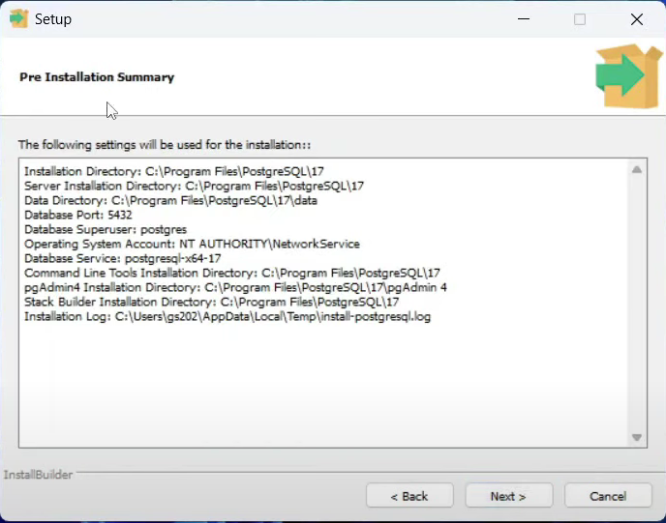
PostgreSQL.exe installation
Click on “Next”
Wait for the installation to complete
01

Slide 14
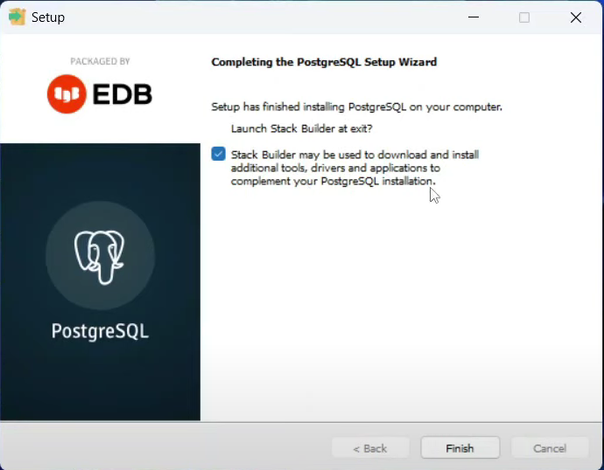
PostgreSQL.exe installation
Click on “Finish”
01

Slide 15
Open Pg admin4
Click on “Finish”
01

Slide 16
SQL File creation
01
Installing
PostgreSQL 17
Getting the DataCo Supply Chain Dataset
02
Creatting
PostgreSQL
File (Optional)
03
Load SQL file
Into PostgreSQL 17
04
PostgreSQL 17 to
PowerBI connection

Slide 17
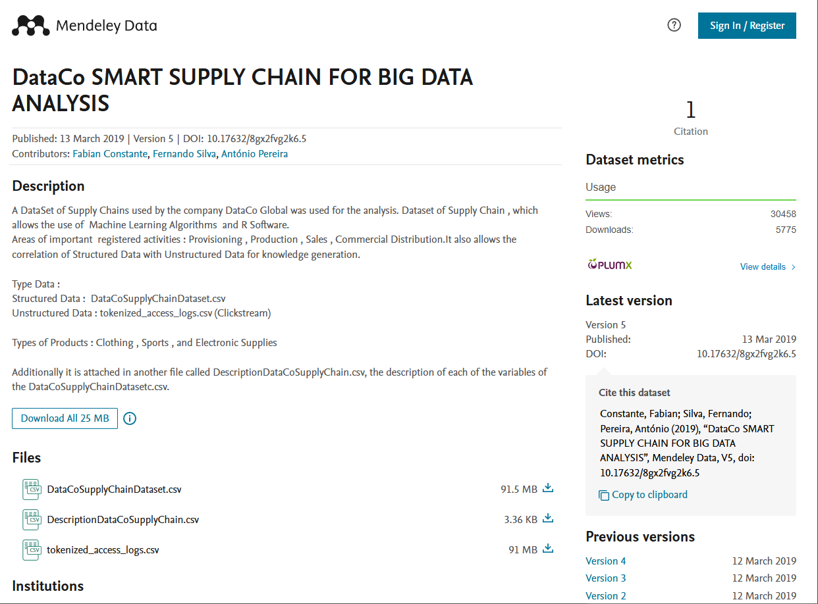
Obtaining the DataCo Supply Chain dataset
Two methods
First method:
Download from this link and click on
91.5MB “DataCoSupplyChainDataset.csv: file
Second method (Recommended):
Open Powershell or Git Bash
Use cd to navigate to the directory where you want to clone the repository
Clone the repository with this command
git clone https://github.com/Guan-Yee/DataCo-Supply-Chain
01

Slide 18
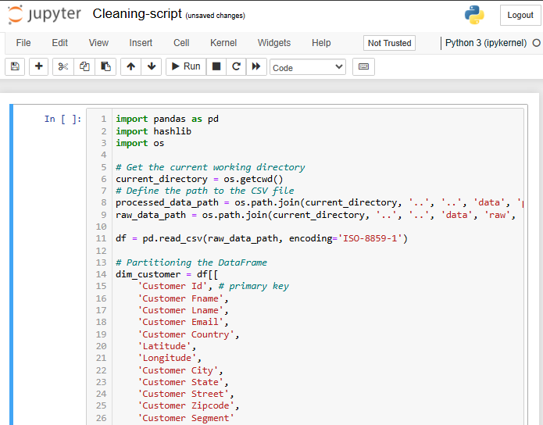
Cleaning the DataCo Supply Chain dataset
Open your Powershell or Git Bash
Navigate to the folder where you git clone the DataCo-supply-chain repository
Cd to scripts/python
Open the ipynb folder and click on run for this cell
It should take about 30 seconds to run this cell
01

Slide 19
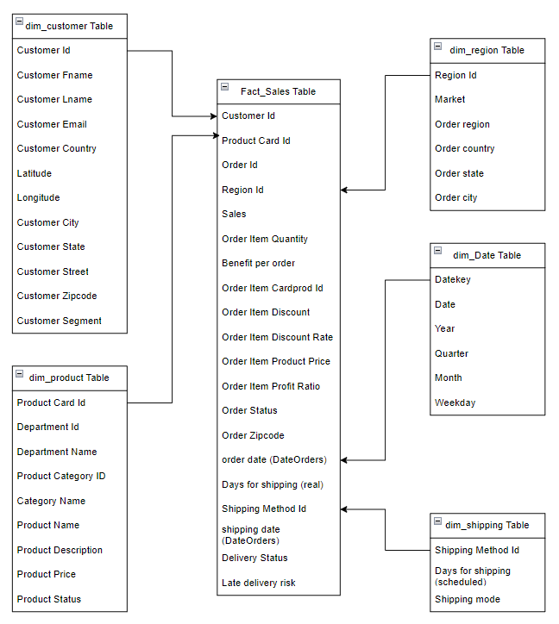
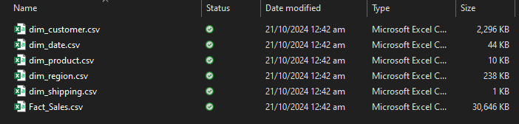
Cleaning the DataCo Supply Chain dataset
You should be able to see the dimension and fact files based on this star schema in the data/processed directory
*Shipping Method Id, Datekey, and Region Id are new columns created from this python script
01

Slide 20
SQL File creation
01
Installing
PostgreSQL 17
Creating the SQL Database
02
Creating
PostgreSQL
File (Optional)
03
Load SQL file
Into PostgreSQL 17
04
PostgreSQL 17 to
PowerBI connection

Slide 21
PostgreSQL.exe installation
Click on “Finish”
01

Slide 22
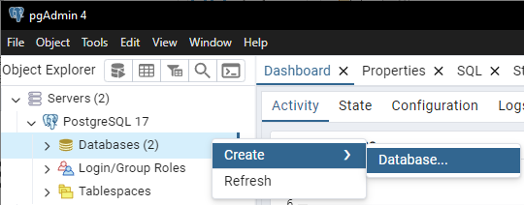
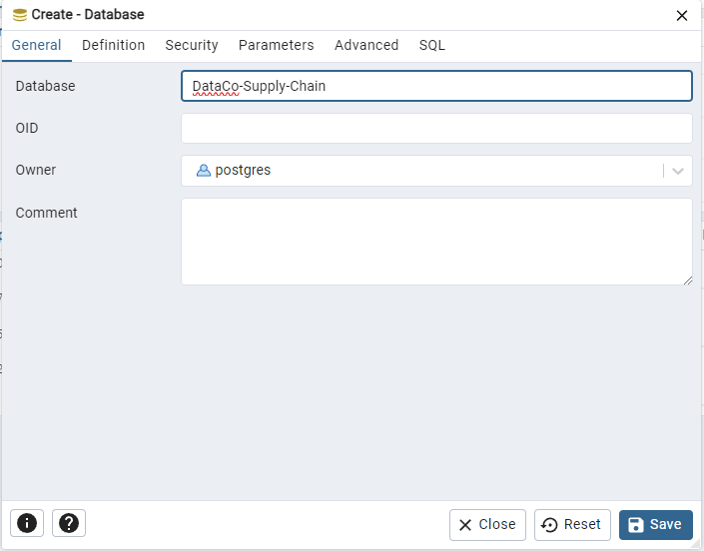
Creating the Database
Right click on “Databases”
Click on “Create”
Then click on “Database”
A Create-Database window will appear
Type in “DataCo-Supply-Chain”
Click on “Save”
01

Slide 23
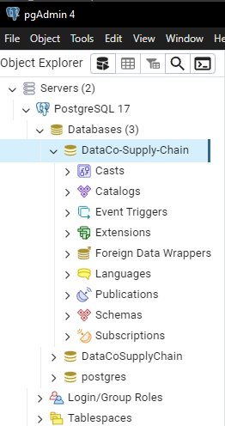
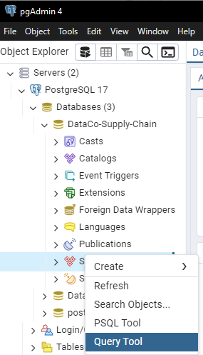
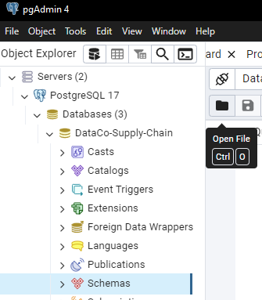
Creating the Dimension and Fact Tables
Click on DataCo-Supply-Chain arrow to expand the list
Right click on Schemas and then click on Query Tool
01

Slide 24
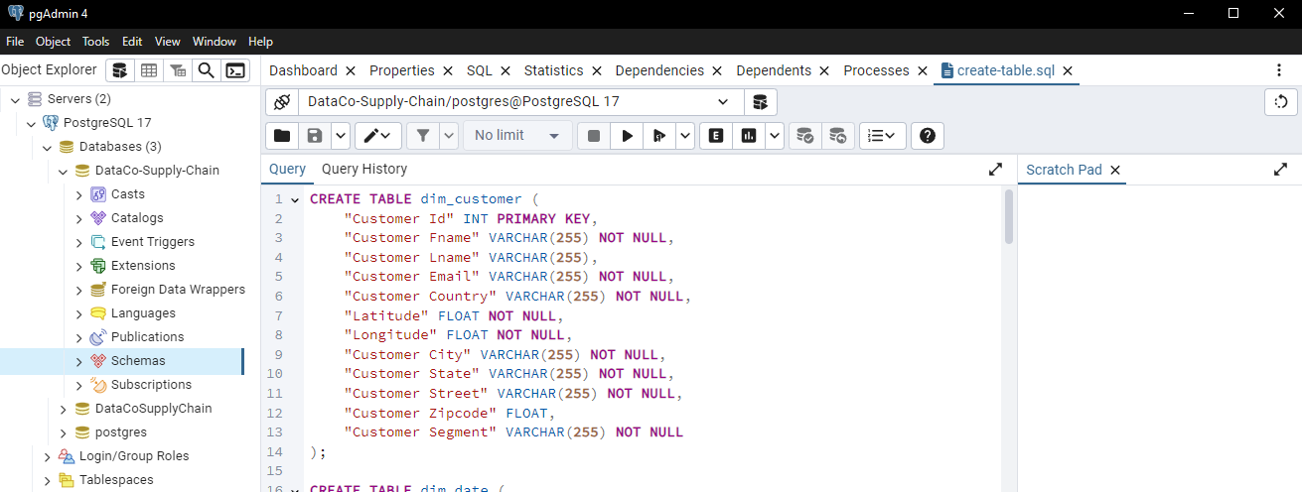
Creating the Dimension and Fact tables
Click on Open File
Navigate to DataCo-Supply-Chain/Scripts/Sql/Create_Table.sql file
Click on the play button to execute the script
01

Slide 25
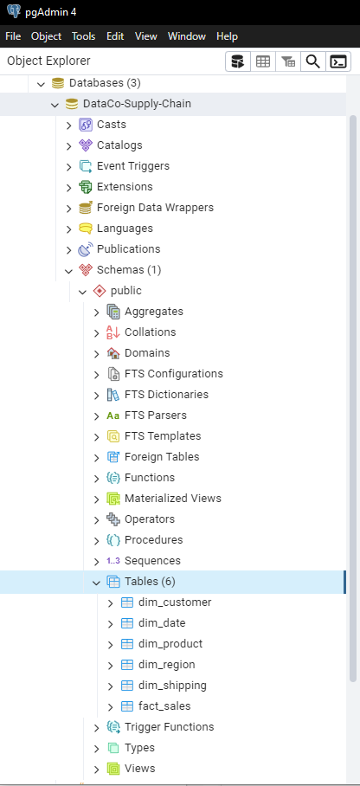
Creating the Dimension and Fact tables
Click on Schemas arrow
Expand the Tables (6) button
You will see 6 dimension and fact tables present
01

Slide 26
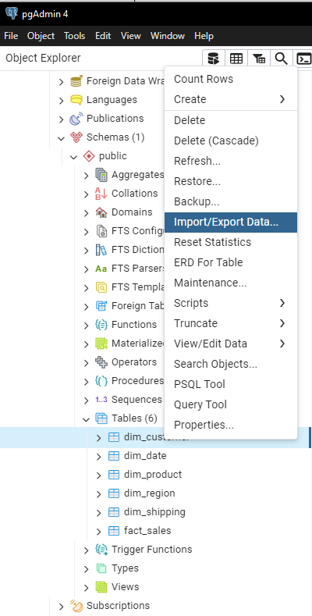
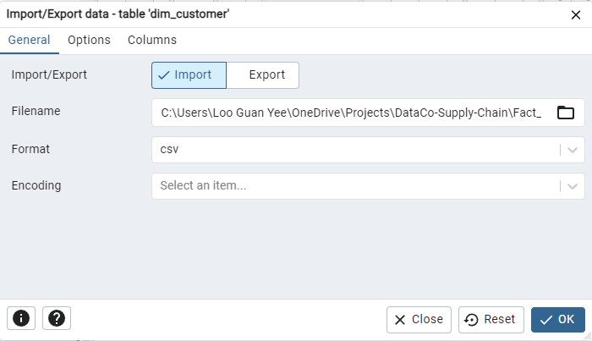
Loading the Dimension and Fact data into the tables
Right click on each dim and Fact table
Right click on Import/Export Data
Type in the following file name for Dimension/Fact tables
Dim_customer
Yourpath\DataCo-Supply-Chain\data\processed\dim_customer.csv
Dim_date
Yourpath\DataCo-Supply-Chain\data\processed\dim_date.csv
Dim_product
Yourpath\DataCo-Supply-Chain\data\processed\dim_product.csv
Dim_region
Yourpath\DataCo-Supply-Chain\data\processed\dim_region.csv
Dim_shipping
Yourpath\DataCo-Supply-Chain\data\processed\dim_shipping.csv
Fact_sales
Yourpath\DataCo-Supply-Chain\data\processed\FactSales.csv
01

Slide 27
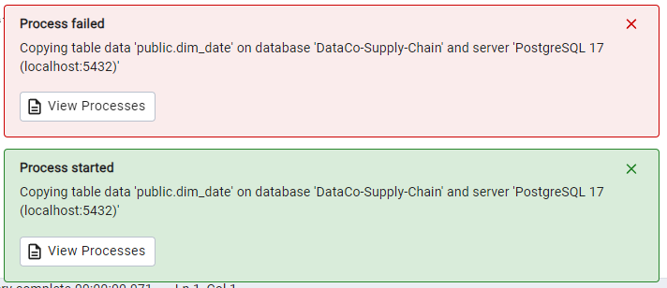
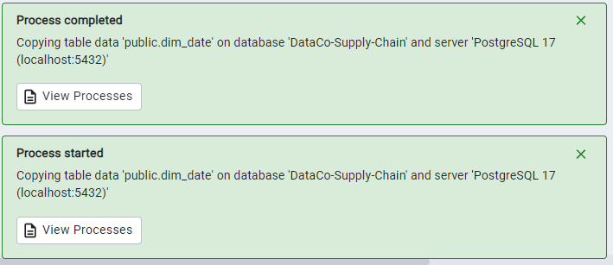
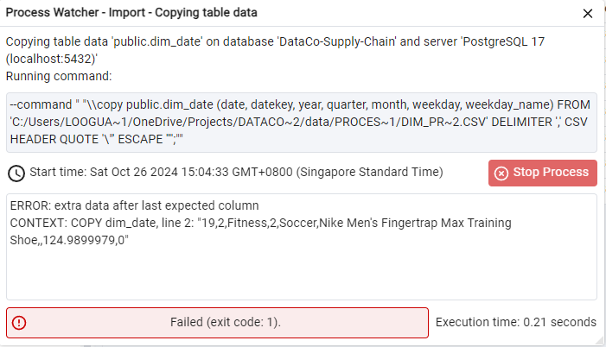
Loading the Dimension and Fact data into the tables
You should be able see double green status with the process completed for the 6 tables
If red status, check if the loaded data columns match with the dimension table columns
01

Slide 28
SQL File creation
01
Installing
PostgreSQL 17
Backing up the SQL database
02
Creatting
PostgreSQL
File (Optional)
03
Load SQL file
Into PostgreSQL 17
04
PostgreSQL 17 to
PowerBI connection

Slide 29
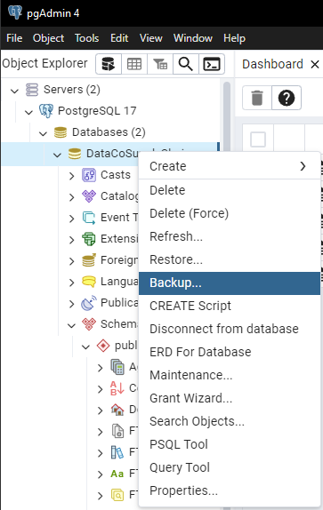
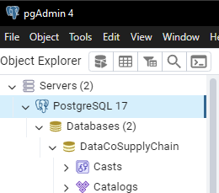
Backing up the SQL folder
Click on “DataCoSupplyChain” database
Click on the backup button
01

Slide 30
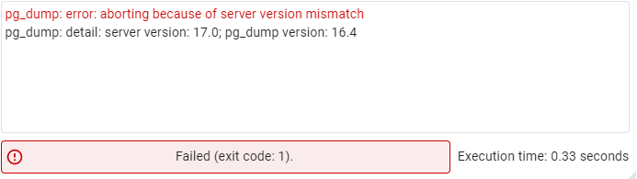
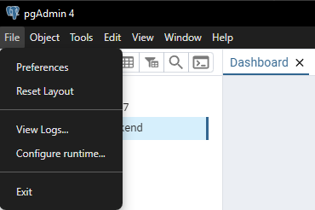
Open Pg admin4
Rationale to prevent server mismatch error
Click on “File”
Click on “Preferences”
01

Slide 31
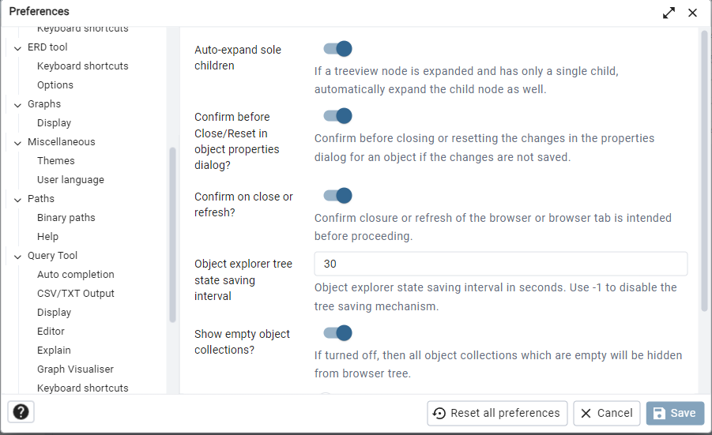
Setting PostgreSQL 17 as the default binary path
Click on “Binary path”
01

Slide 32
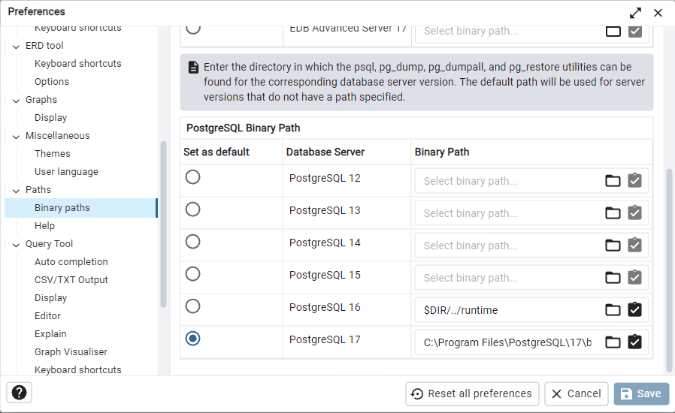
Setting PostgreSQL 17 as the default binary path
Scroll down and click on empty space.
Type in “C:\Program Files\PostgreSQL\17\bin:
Then click on the button “Set as default”
Click on the “Save” button
01

Slide 33
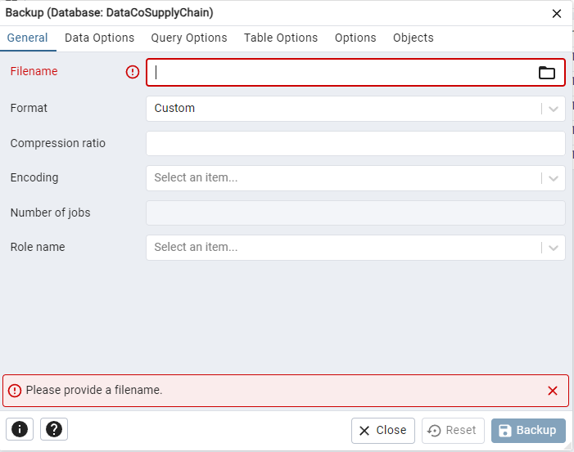
Backing up the SQL folder
Type in the file name for this backup file
Then click “Backup” button
You should see double green rectangles if the process is successful
The sql file will now appear in your directory where you save it
01

Slide 34
Load SQL file into PostgreSQL
01
Installing
PostgreSQL 17
02
Creatting
PostgreSQL
File (Optional)
03
Load SQL file
Into PostgreSQL 17
04
PostgreSQL 17 to
PowerBI connection

Slide 35
Creating the Database
If you completed the steps in slide 22, skip this step.
Right click on “Databases”
Click on “Create”
Then click on “Database”
A Create-Database window will appear
Type in “DataCo-Supply-Chain”
Click on “Save”
01

Slide 36
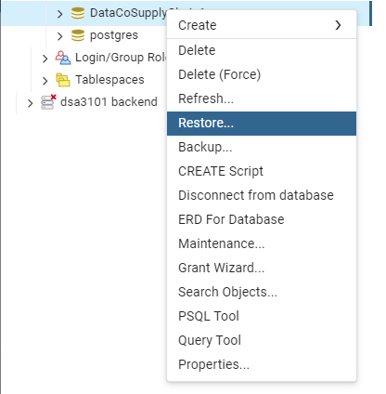
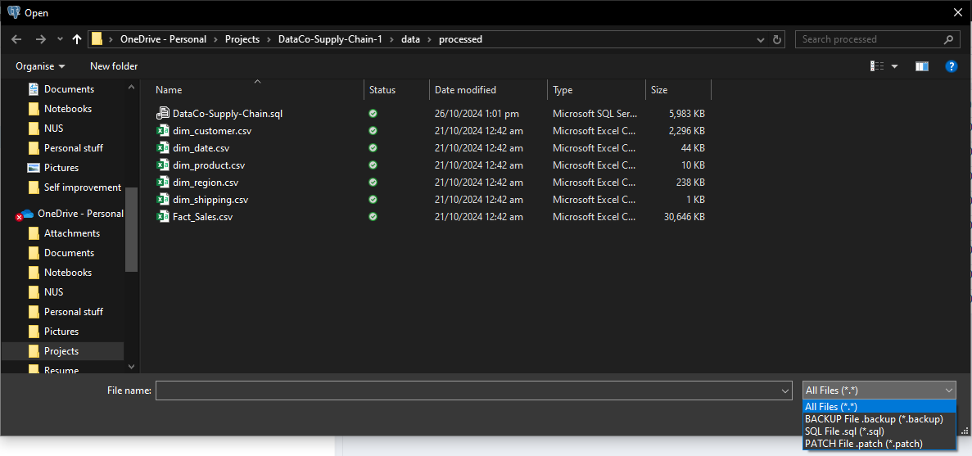
Restoring the database
Right Click on DataCoSupplyChain database
Click on the “Restore” button
Go to the directory where you stored your repository.
Cd to C:\<your directory>\ data\processed\DataCo-Supply-Chain.sql
Click on All Files (*.*) to view all the files
01

Slide 37
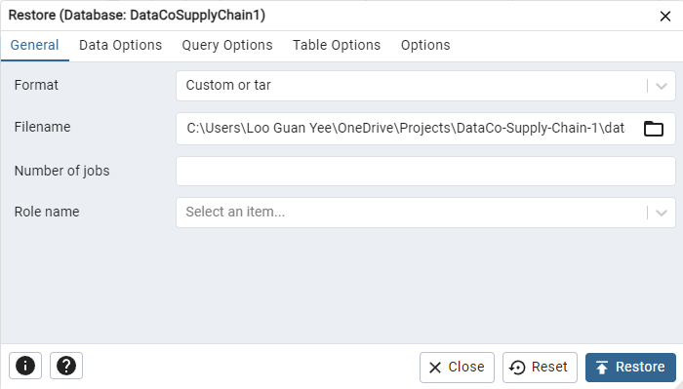
Restoring the database
Click on ”Restore”
01

Slide 38
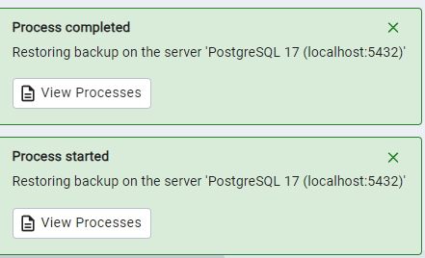
Check if you have double green status upon restoring the database
01

Slide 39
Connecting PostgreSQL to PowerBI
01
Installing
PostgreSQL 17
DataCo Eccomerce
Platfrom Sales
02
Creatting
PostgreSQL
File (Optional)
03
Load SQL file
Into PostgreSQL 17
04
PostgreSQL 17 to
PowerBI connection

Slide 40
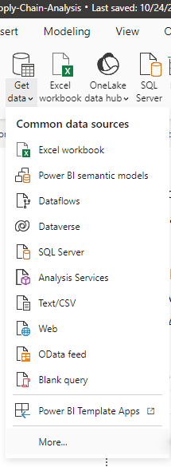
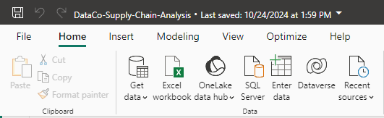
Open the Power Bi file from PowerBI folder
Open the DataCo-Supply-Chain.pbix file from the PowerBI folder
Click on Get data button
Click on more button
01

Slide 41
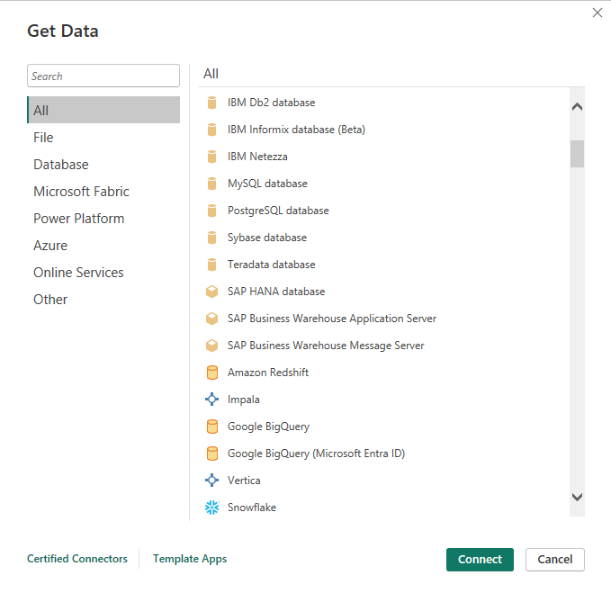
Connecting PostgreSQL to PowerBI
Scroll down the Get Data window
Click on PostgreSQL database
Click on “Connect”
01

Slide 42
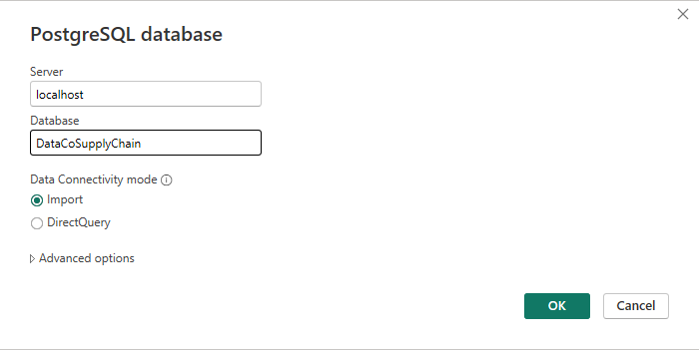
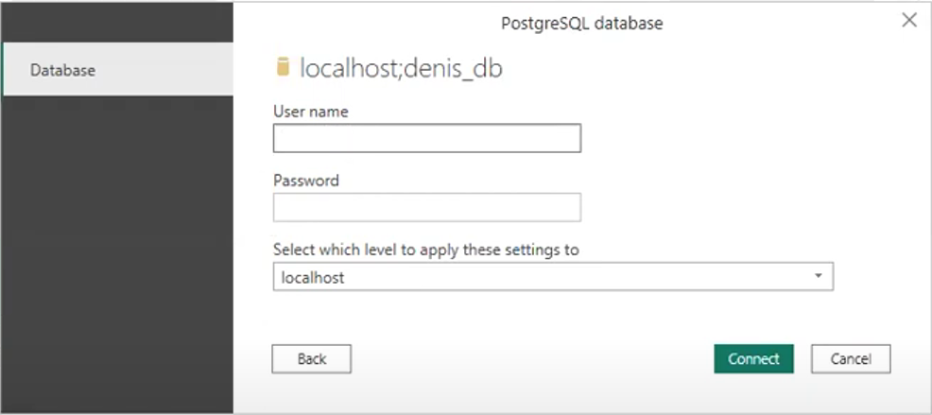
Open the Power Bi file from PowerBI folder
For Server: Type in “localhost”
For Database: Type in “DataCoSupplyChain”
For User name: Type in “postgre”
For Password: Type in the password that you set when installing PostgreSQL earlier.
Then click on Connect
DataCoSupplyChain

Slide 43
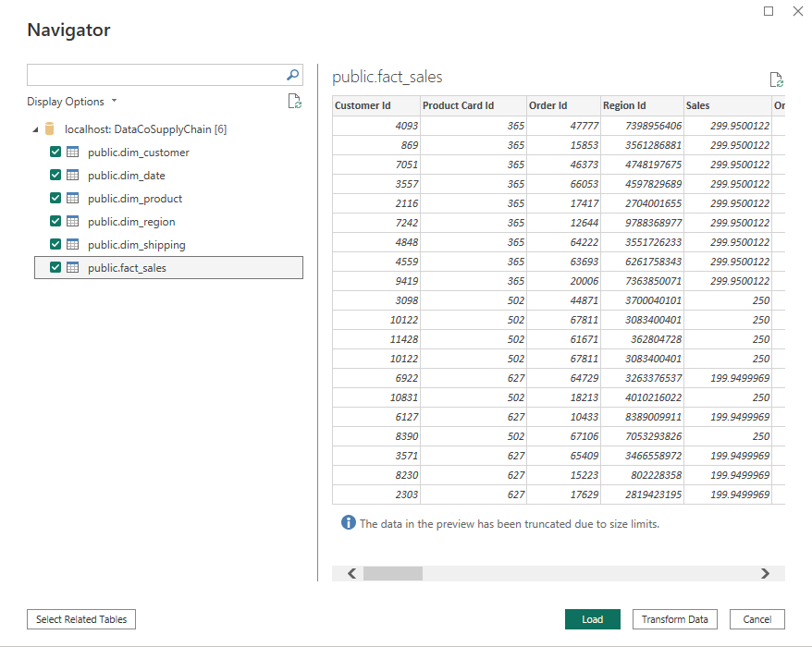
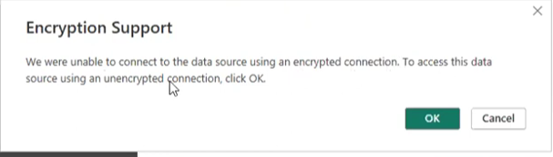
Open the Power Bi file from PowerBI folder
For Encryption Support, Click on Ok
Check all the ticks for the boxes under the localhost:DataCoSupplyChain
Click on the Load button

