Slide 1
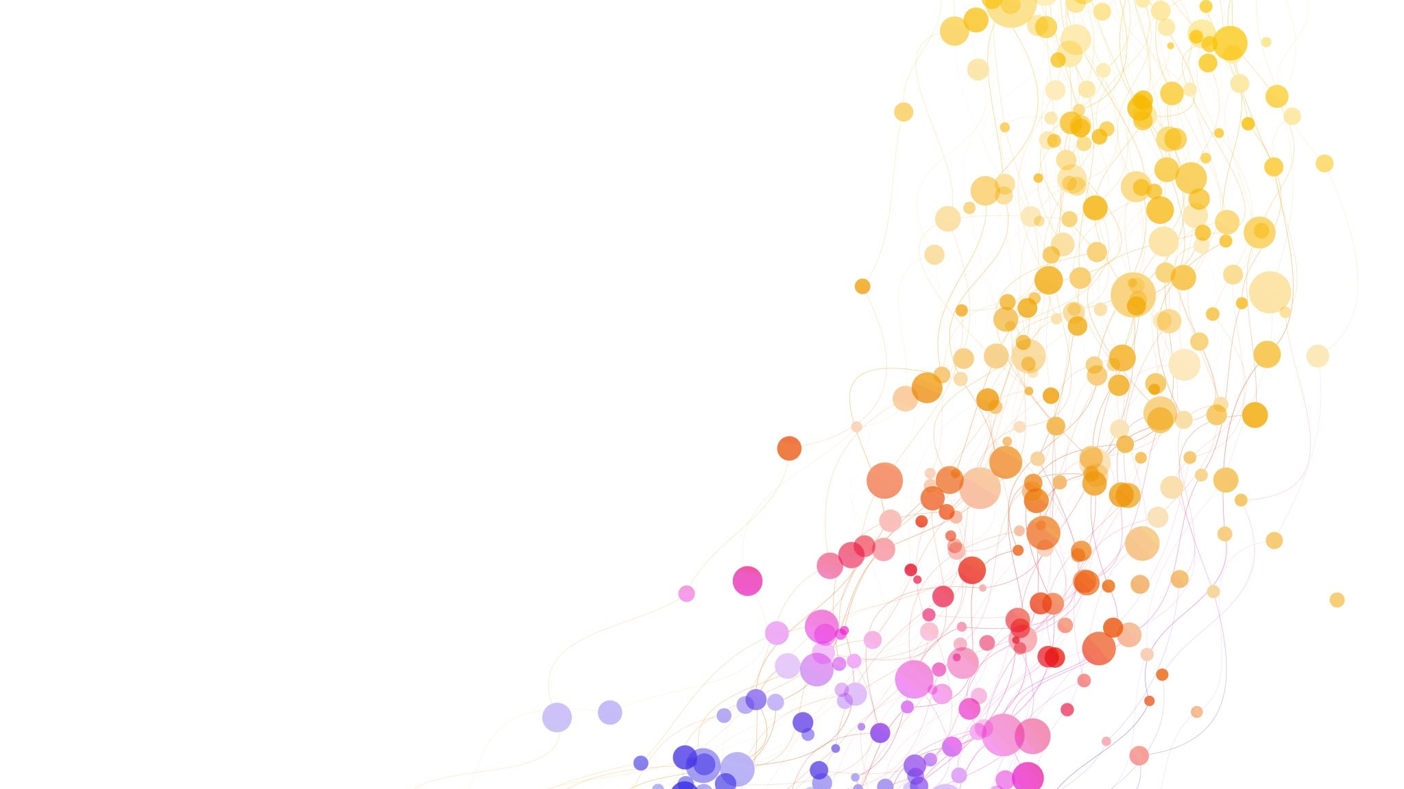

EPPS 6354 Project Proposal
Guan Chen
Feb 22, 2024

Slide 2
background
Do you like to spend money???

Slide 3
Expenditure Tracker
Data Collection:
Bank statements from the 2023 year
Goal:
Identify and track spending habits

Slide 4
Methods
POSTGRE SQL
Shiny in R

Slide 5
Database Schema
Statement Relation
statement_id
category_total
total
Transaction Relation
transaction_id
statement_id
date
vendor
amount
category
Vendor Relation
vendor
category

Slide 6
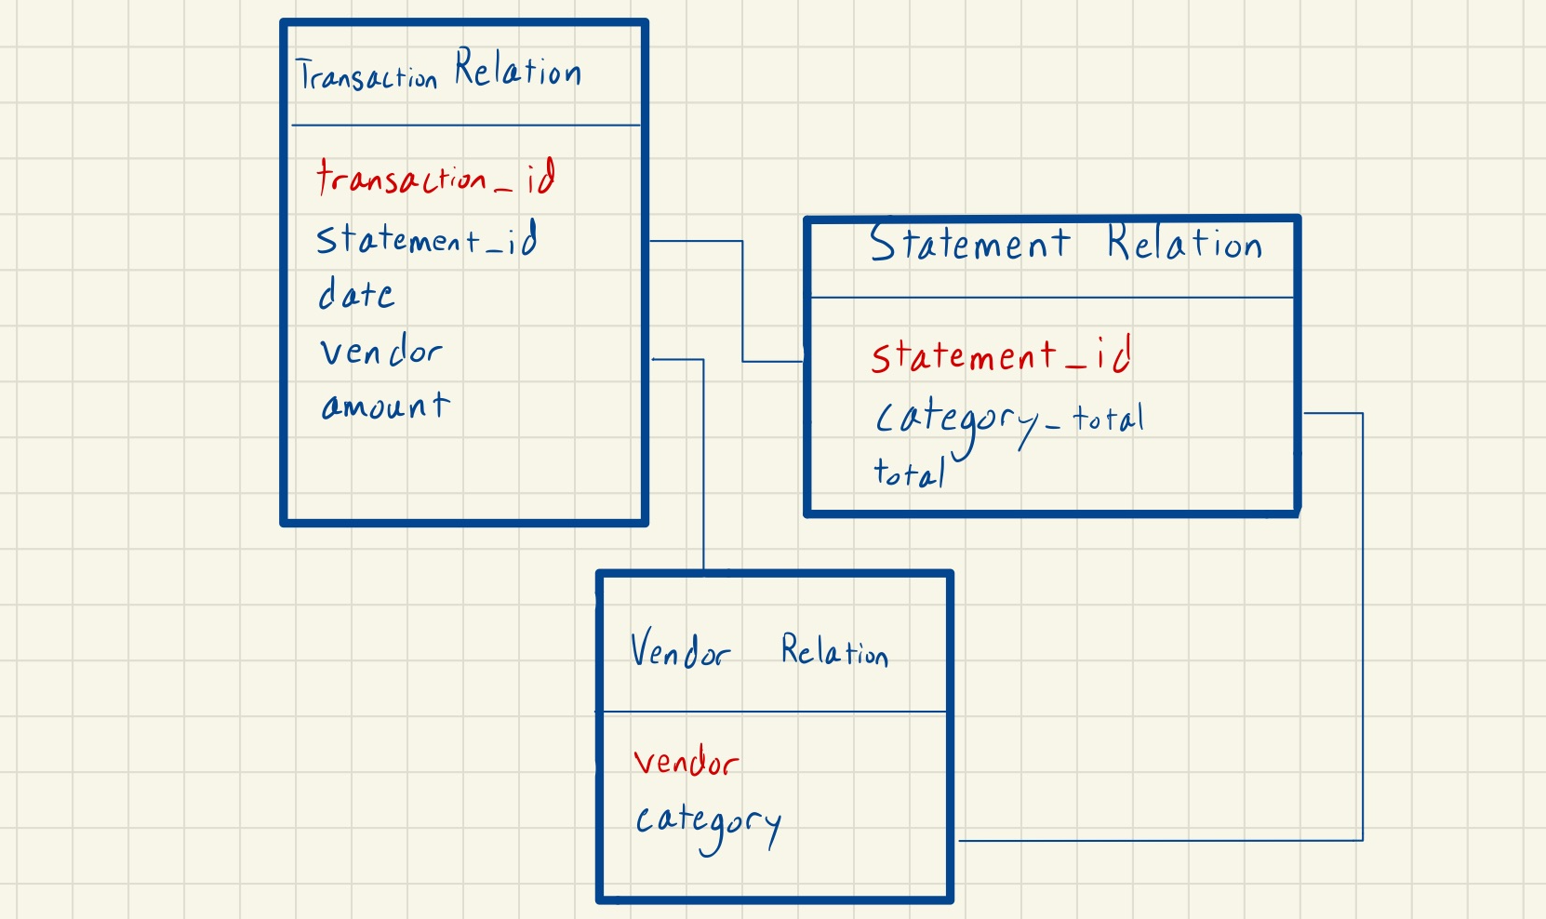

Slide 7
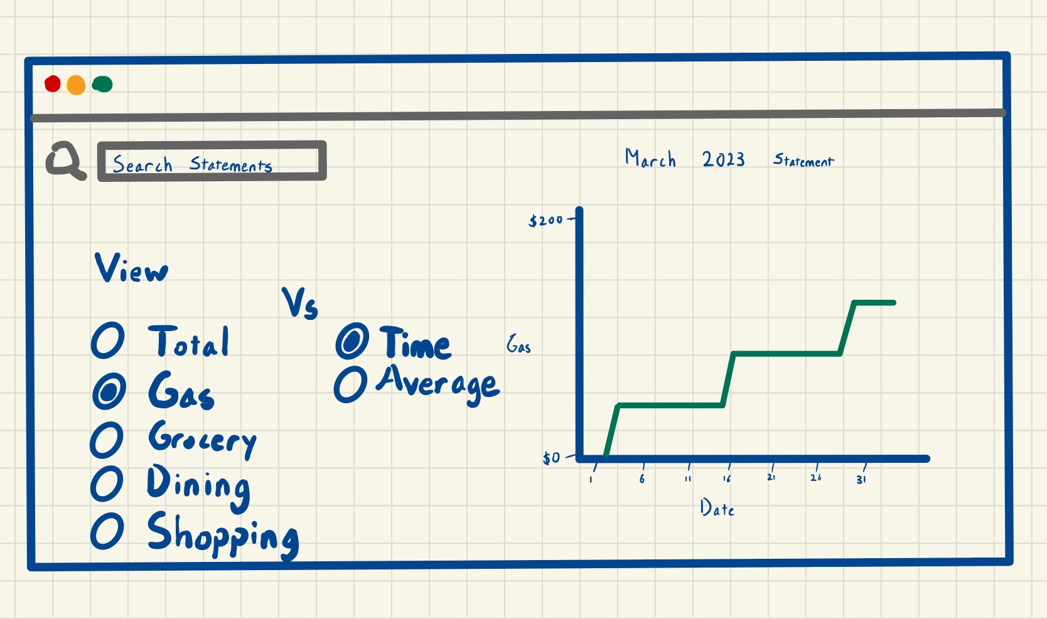
Database Interface

