Slide 1

SpecStyle
Executable StyleOps for AMD Radeon
Compile a visual contract. Run local generation. Record evidence. Route, repair, and replay without mixing controls with gates.
Submitted by guan | AMD AI DevMaster | Track 1
Radeon + ROCm | candidate fd4e45b

Slide 2

SPECSTYLE | AMD AI DEVMASTER
Creative direction is hard to reproduce when it lives in sliders
A source is easy to share
The missing object is the execution contract: exact model supply, reference assets, generation controls, applicable rules, output profiles, and bounded repair policy.
Executable Style Spec - schema, migration, pins, and compiler graphs
Layered QA contract - deterministic L1 and versioned L2/L3 states
Guardrailed repair - allow-listed actions, limits, history, re-verification
Auditable delivery - approved/rejected routing, manifest, QA, replay
SpecStyle | Track 1
2

Slide 3
SPECSTYLE | AMD AI DEVMASTER
One Style Spec drives a complete local workflow
01
02
03
04
05
Define
Compile
Generate
Verify + repair
Export + replay
Model, asset, profile, rule, and repair pins
Separate Preview and Production execution graphs
SDXL + IP-Adapter + Canny ControlNet on ROCm
Measure rules, apply bounded actions, re-verify
Approved/rejected isolation, manifest, QA
GENERATION CONTROLS
VERIFICATION
REPAIR POLICY
Change pixels; never declare acceptance.
Measure rules; never mutate generation.
Select bounded actions; re-verify affected rules.
SpecStyle | Track 1
3

Slide 4
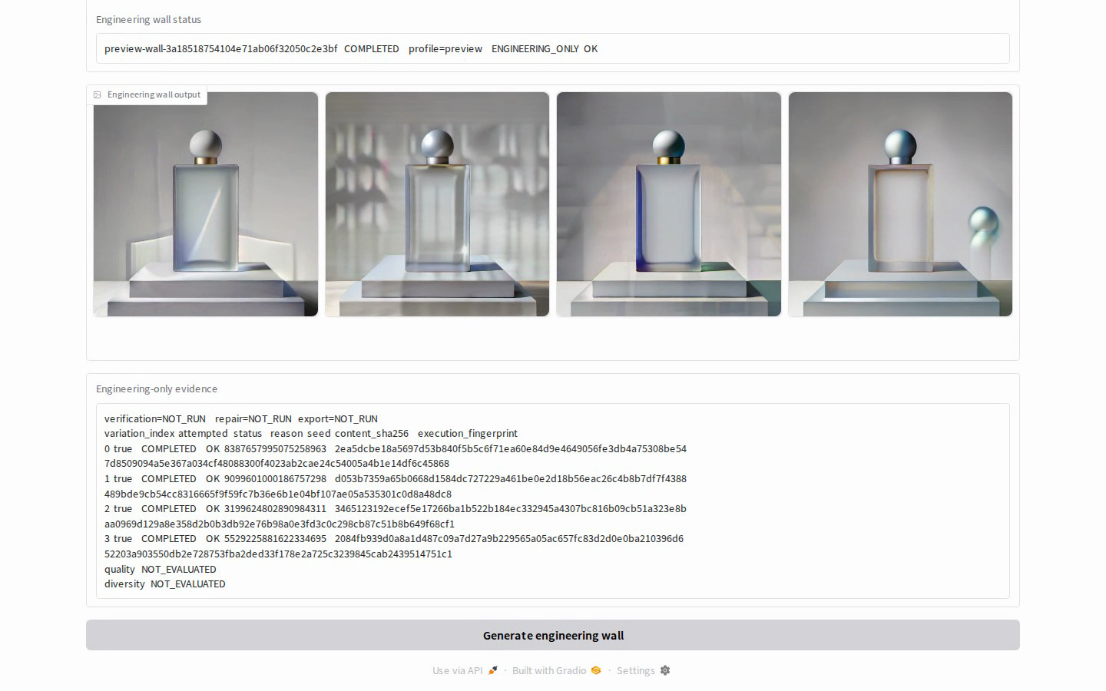
SPECSTYLE | AMD AI DEVMASTER
The product UI executes the workflow, not a mock
ACTUAL AMD CAPTURE
Browser-driven
Input upload
Readiness gate
Queued GPU run
Four visible outputs
Seed/hash/fingerprint evidence
candidate fd4e45b | Gradio 6.15.1 | HTTP 200 before and after
SpecStyle | Track 1
4

Slide 5




SPECSTYLE | AMD AI DEVMASTER
Four deterministic attempts completed on Radeon
4
requested
4
completed
4
unique hashes
0
failed
variation 0
variation 1
variation 2
variation 3
seed 8387657995075258963
seed 9099601000186757298
seed 3199624802890984311
seed 5529225881622334695
ENGINEERING_ONLY
quality NOT_EVALUATED | diversity NOT_EVALUATED
wall 38.45 s
SpecStyle | Track 1
5

Slide 6
SPECSTYLE | AMD AI DEVMASTER
The Radeon path is pinned, local-only, and fail-closed
ROCm 7.2.1
1,009 + 1
65.38 s
AMD runtime
passed + capability skip
browser end-to-end
Runtime stack
Supply integrity
PyTorch 2.9.1+gitff65f5b
Immutable model descriptors, revisions, manifests, and file hashes
HIP 7.2.53211-e1a6bc5663
Local-only loading with role, family, topology, scheduler, and dtype checks
Diffusers 0.39.0 | Gradio 6.15.1
Guarded installer uses --no-deps and rejects generic Torch packages
Stable service 657ac0b remained HTTP 200 during candidate validation.
SpecStyle | Track 1
6

Slide 7
SPECSTYLE | AMD AI DEVMASTER
Repair is implemented as policy, not random retry
Rule failure
Action
Guardrail
Re-verify
Named rule_id and priority
Allow-listed parameter or post-process
Bounds, conflicts, protected metrics
All affected rules run again
Implemented and tested
Empirical claim remains blocked
Action whitelist and parameter bounds
No Radeon repair uplift is claimed without approved held-out assets, a trusted Production threshold package, independent labels, and a frozen equal-budget study.
Conflict priority, retry limits, history
Stop reasons and affected-rule re-verification
SpecStyle | Track 1
7

Slide 8
SPECSTYLE | AMD AI DEVMASTER
The evidence package is auditable and deliberately limited
Evidence
Status
Artifact
External inputs
Actual Gradio Radeon run
PROVEN
radeon_ui_capture.json
Approved held-out assets
N=4 execution wall
PROVEN
radeon_preview_wall.json
Independent human labels
Pinned AMD environment
PROVEN
amd_environment.json
Reveal and approval receipts
Perceptual quality/diversity
NOT_EVALUATED
explicit manifest fields
Trusted Production threshold
Frozen blind evaluation
Calibrated L2/L3 and repair uplift
NOT CLAIMED
external approved evidence required
The code fails closed when these are absent.
SpecStyle | Track 1
8

Slide 9
Inspect the evidence, not a marketing claim
Source, pinned setup, Project Profile, editable deck, raw Radeon capture, 3-5 minute demo, sanitized manifests, and media provenance are included.
github.com/GuanJHCode/lookfile
submission/track1-specstyle/
SpecStyle | Submitted by guan | AMD AI DevMaster Track 1 | candidate fd4e45b

