Slide 1
Missing Protein Imputation by Supervised Learning
Jiaxin Wang
Undergraduate
Computer Science

Slide 2
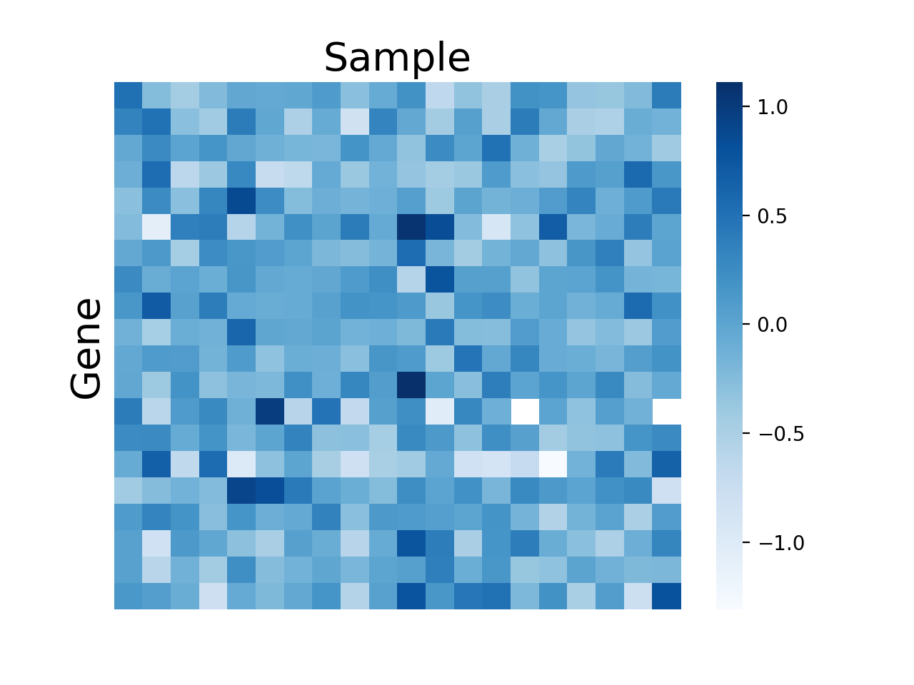


Background
Proteomics matrix
Notes:
subchallenge

Slide 3
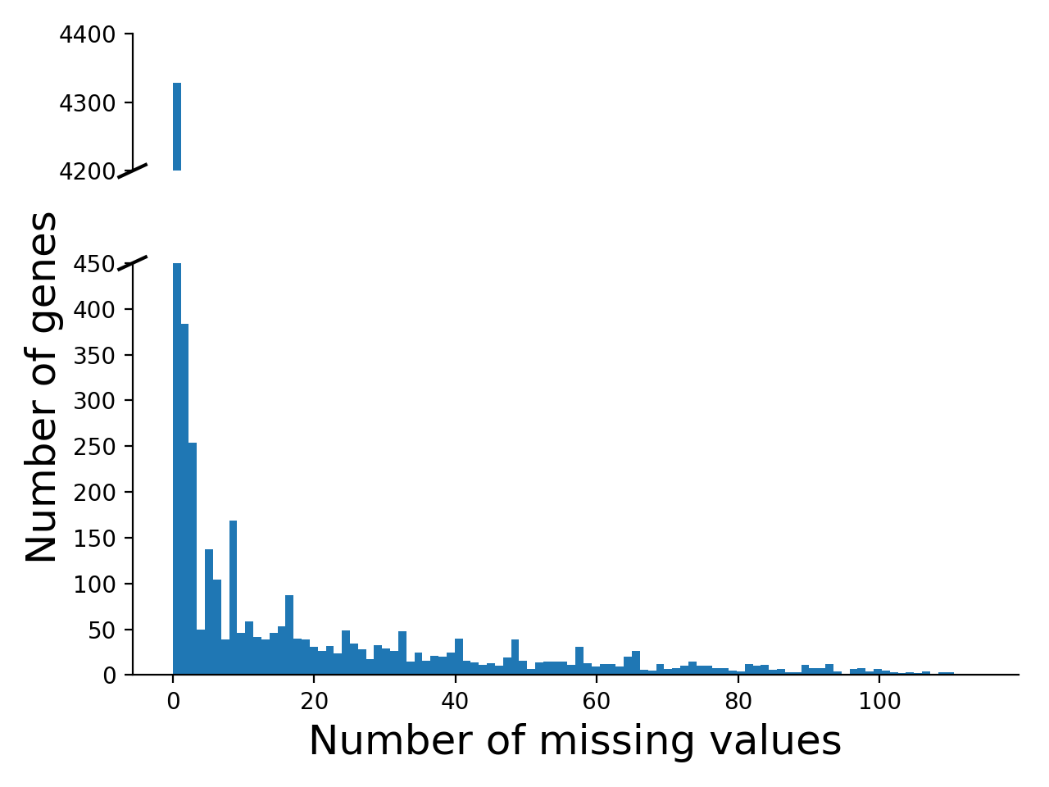
Data Collection
7061 genes
X
122 samples
Notes:
simulate

Slide 4
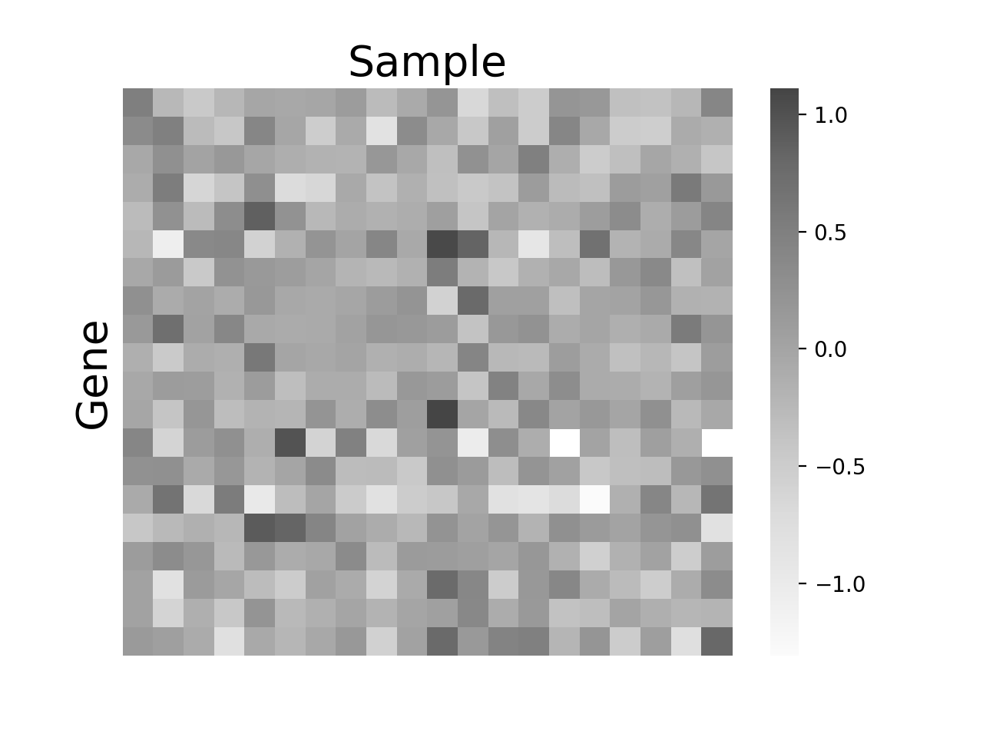
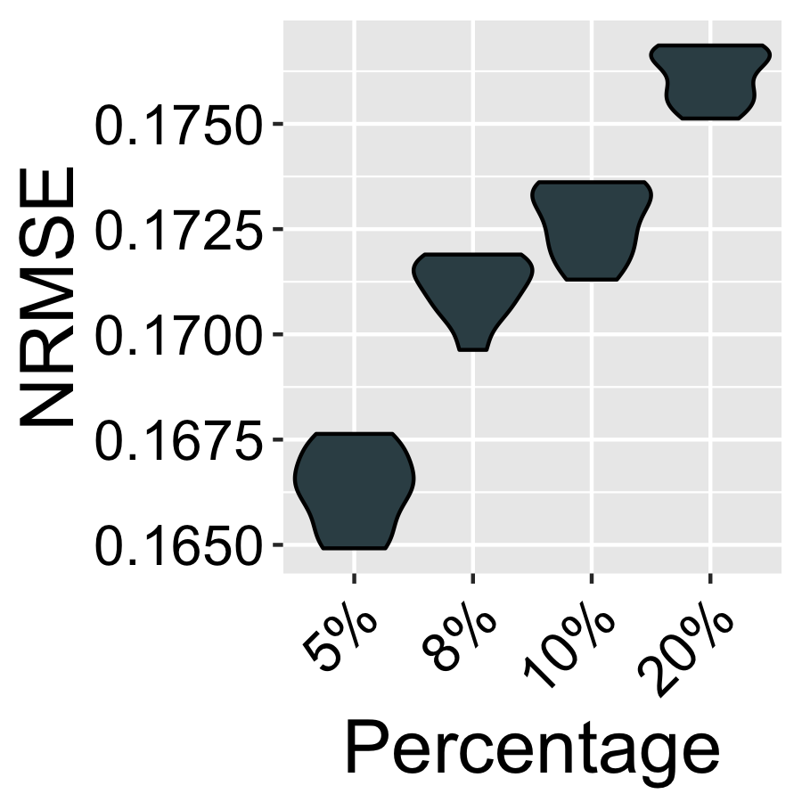
Average Imputation

Slide 5
Supervised Learning
Training
Testing
Notes:
Missing in feature

Slide 6
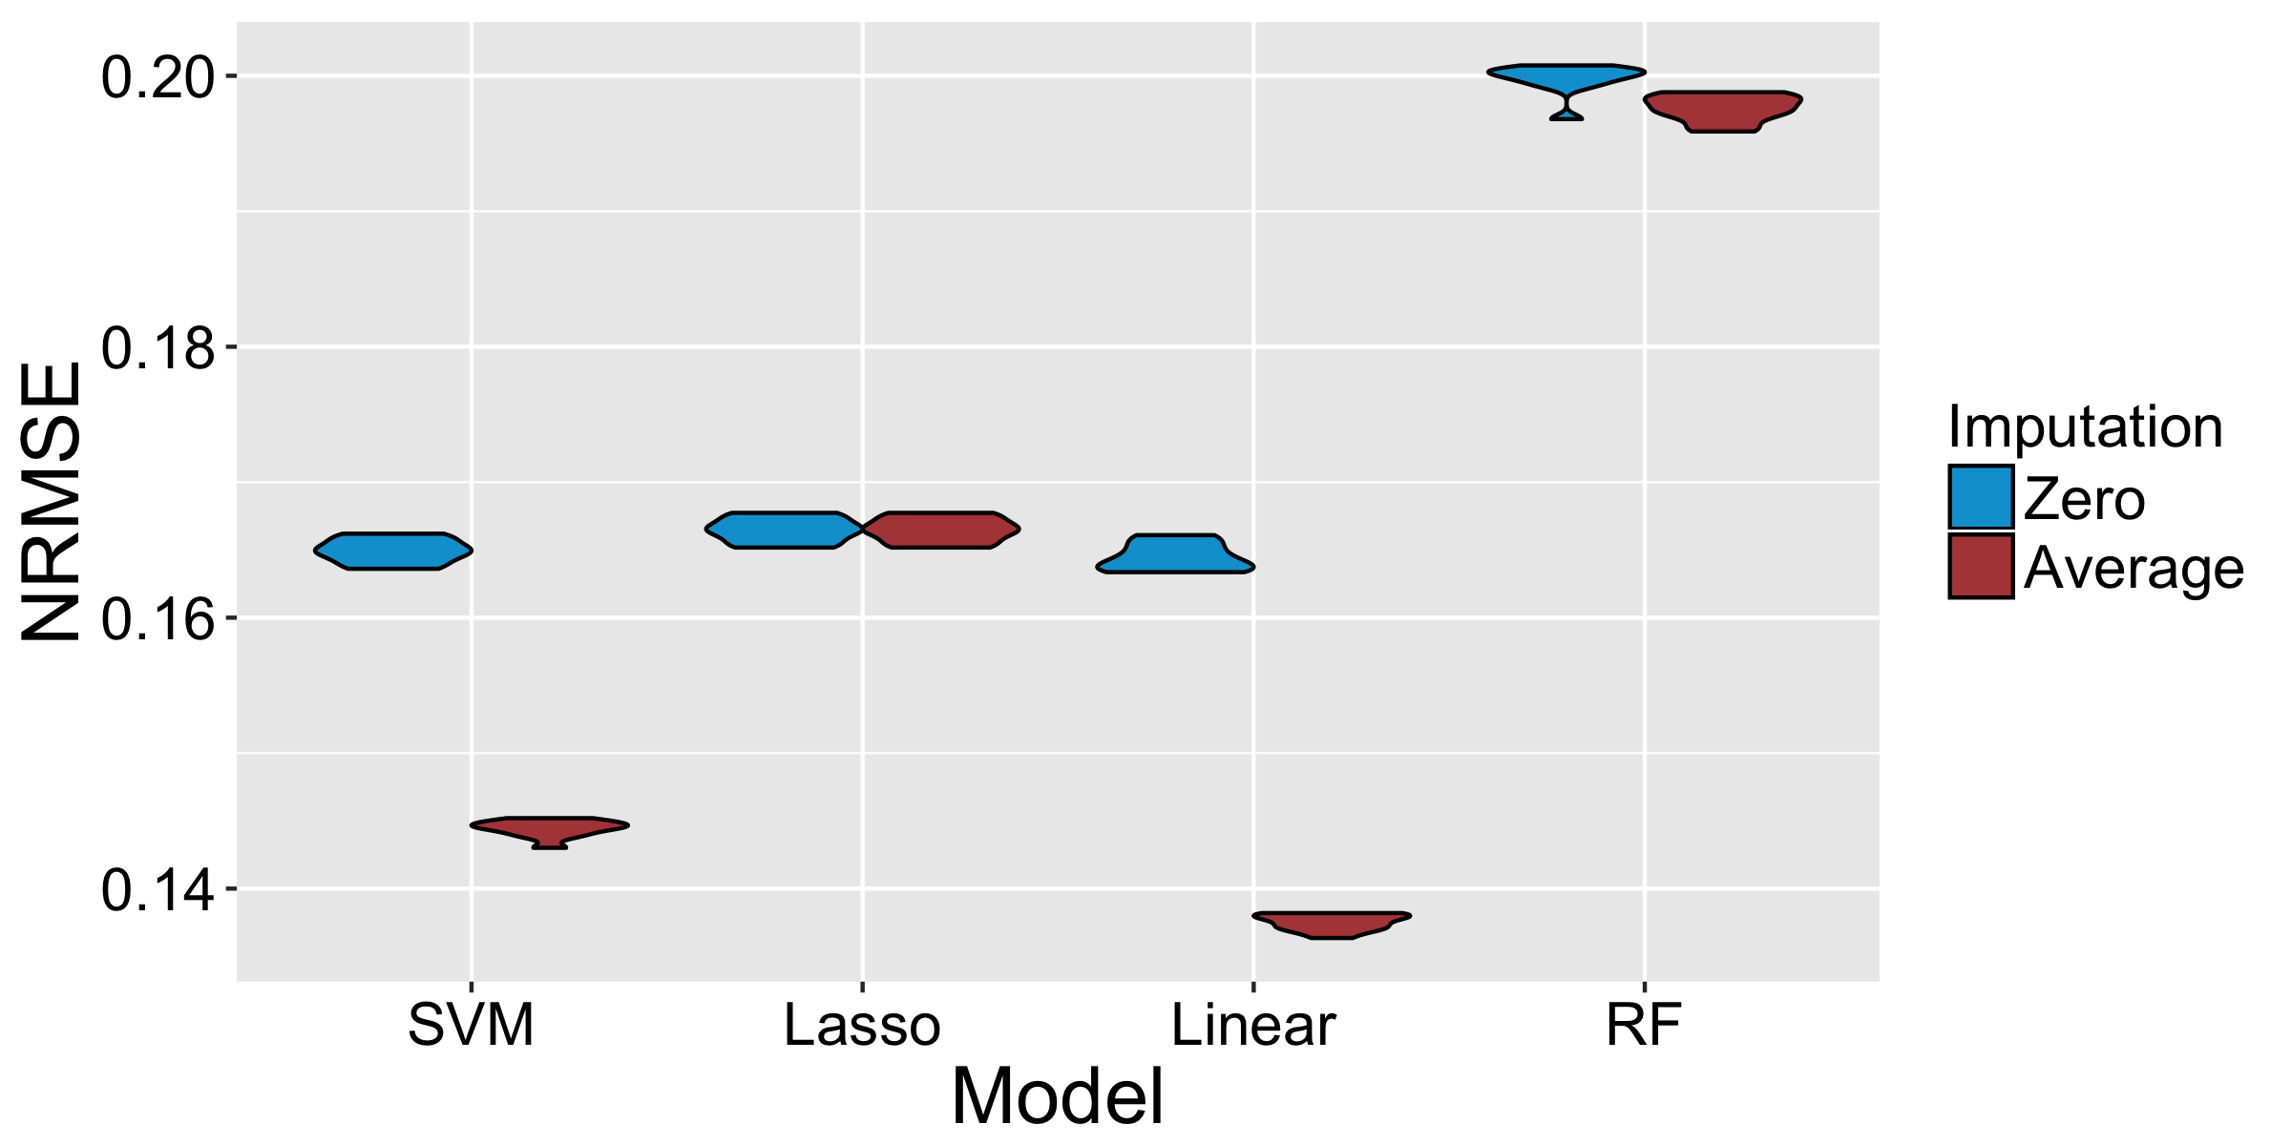
Supervised Learning

Slide 7
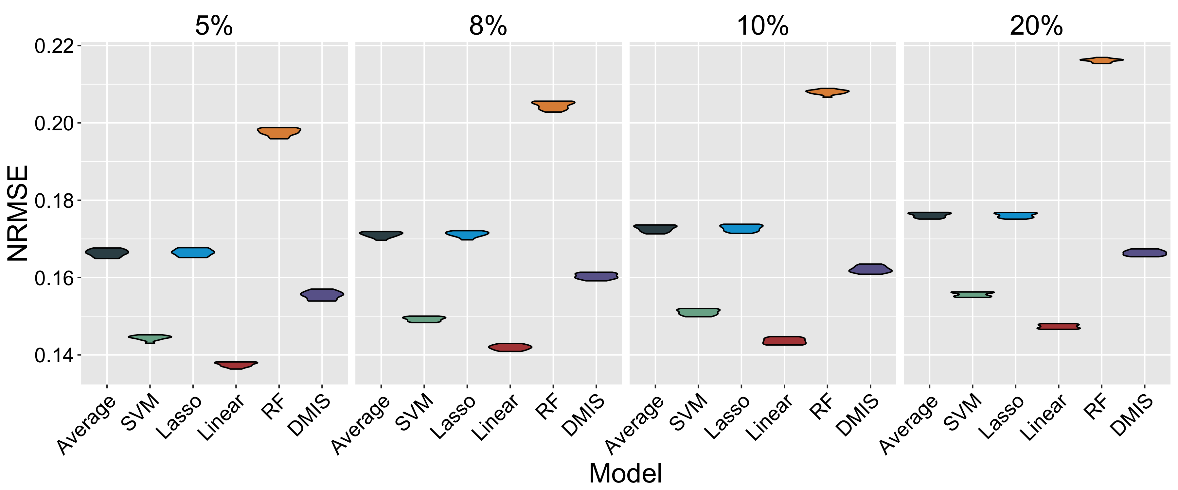
Performance

Slide 8
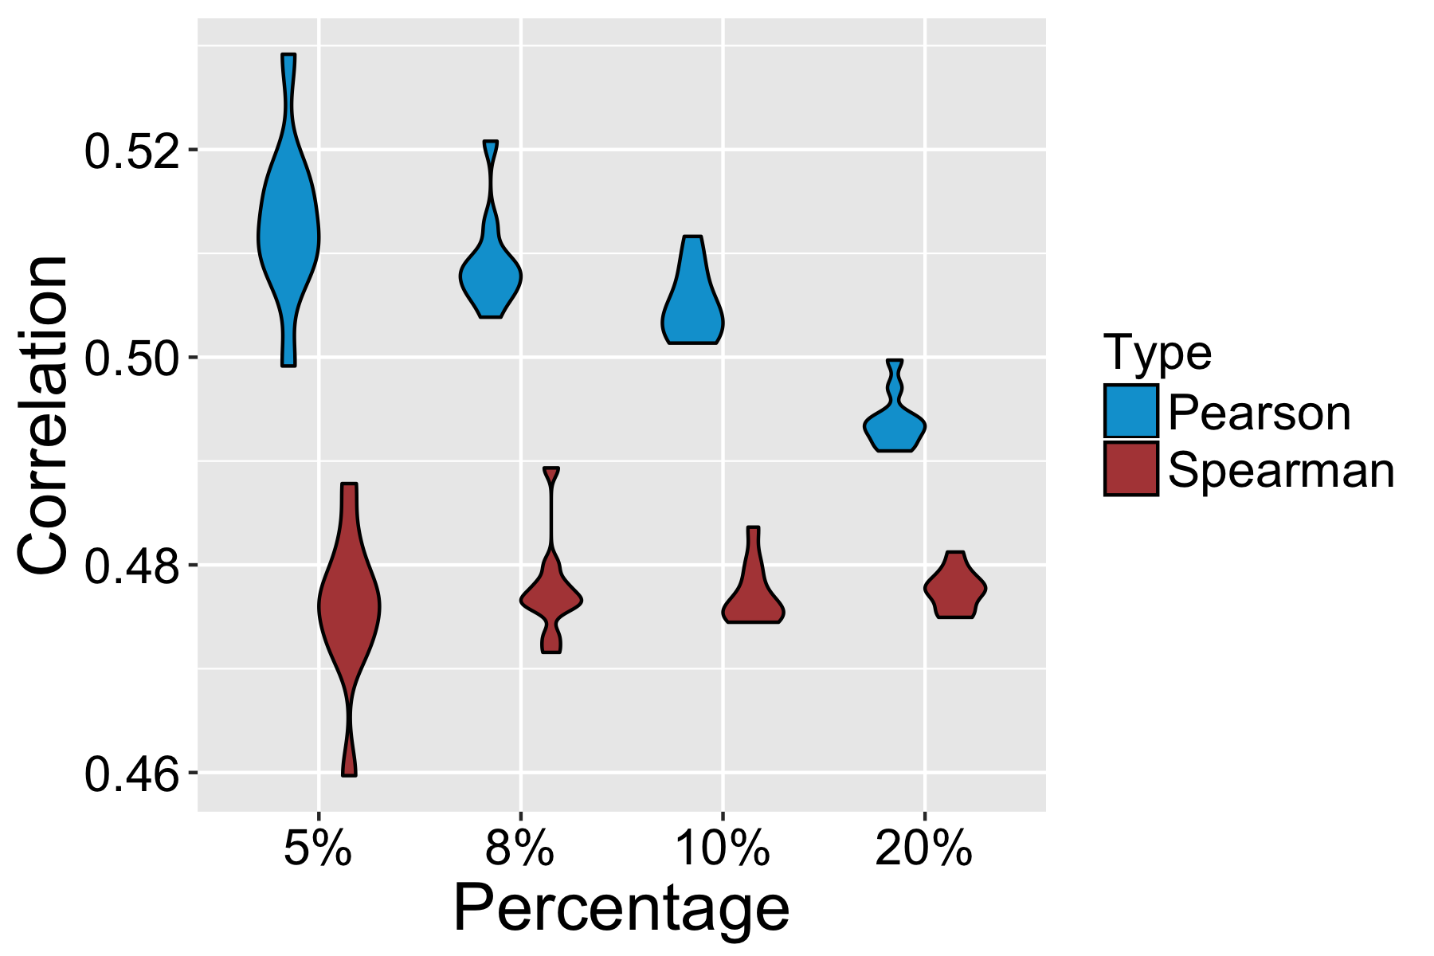
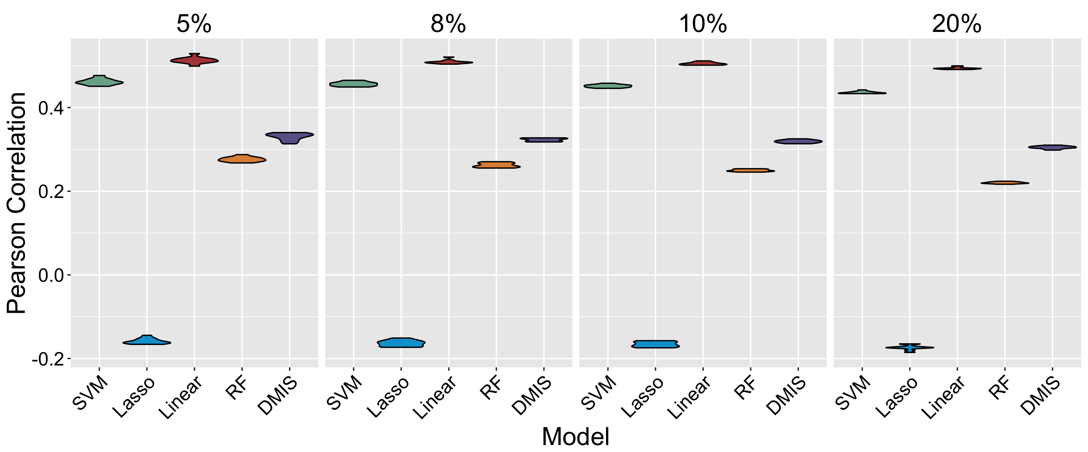
Performance

Slide 9
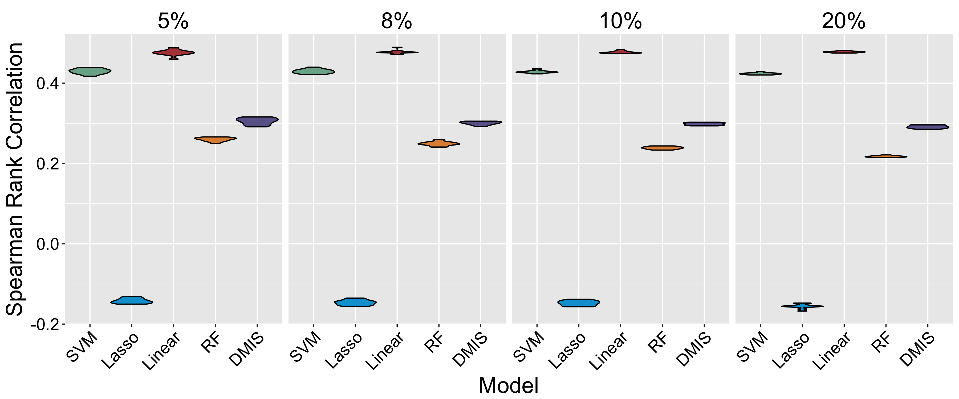
Performance

Slide 10
Further Study
Analysis of performance on gene category, average expression etc.
Try predicting on other cohorts.

