Slide 1
Lab 6: Performing Rate & Operations
Examples and Deliverables
MAE 405, 2025 Spring
TA: Xinlei Zhang

Slide 2
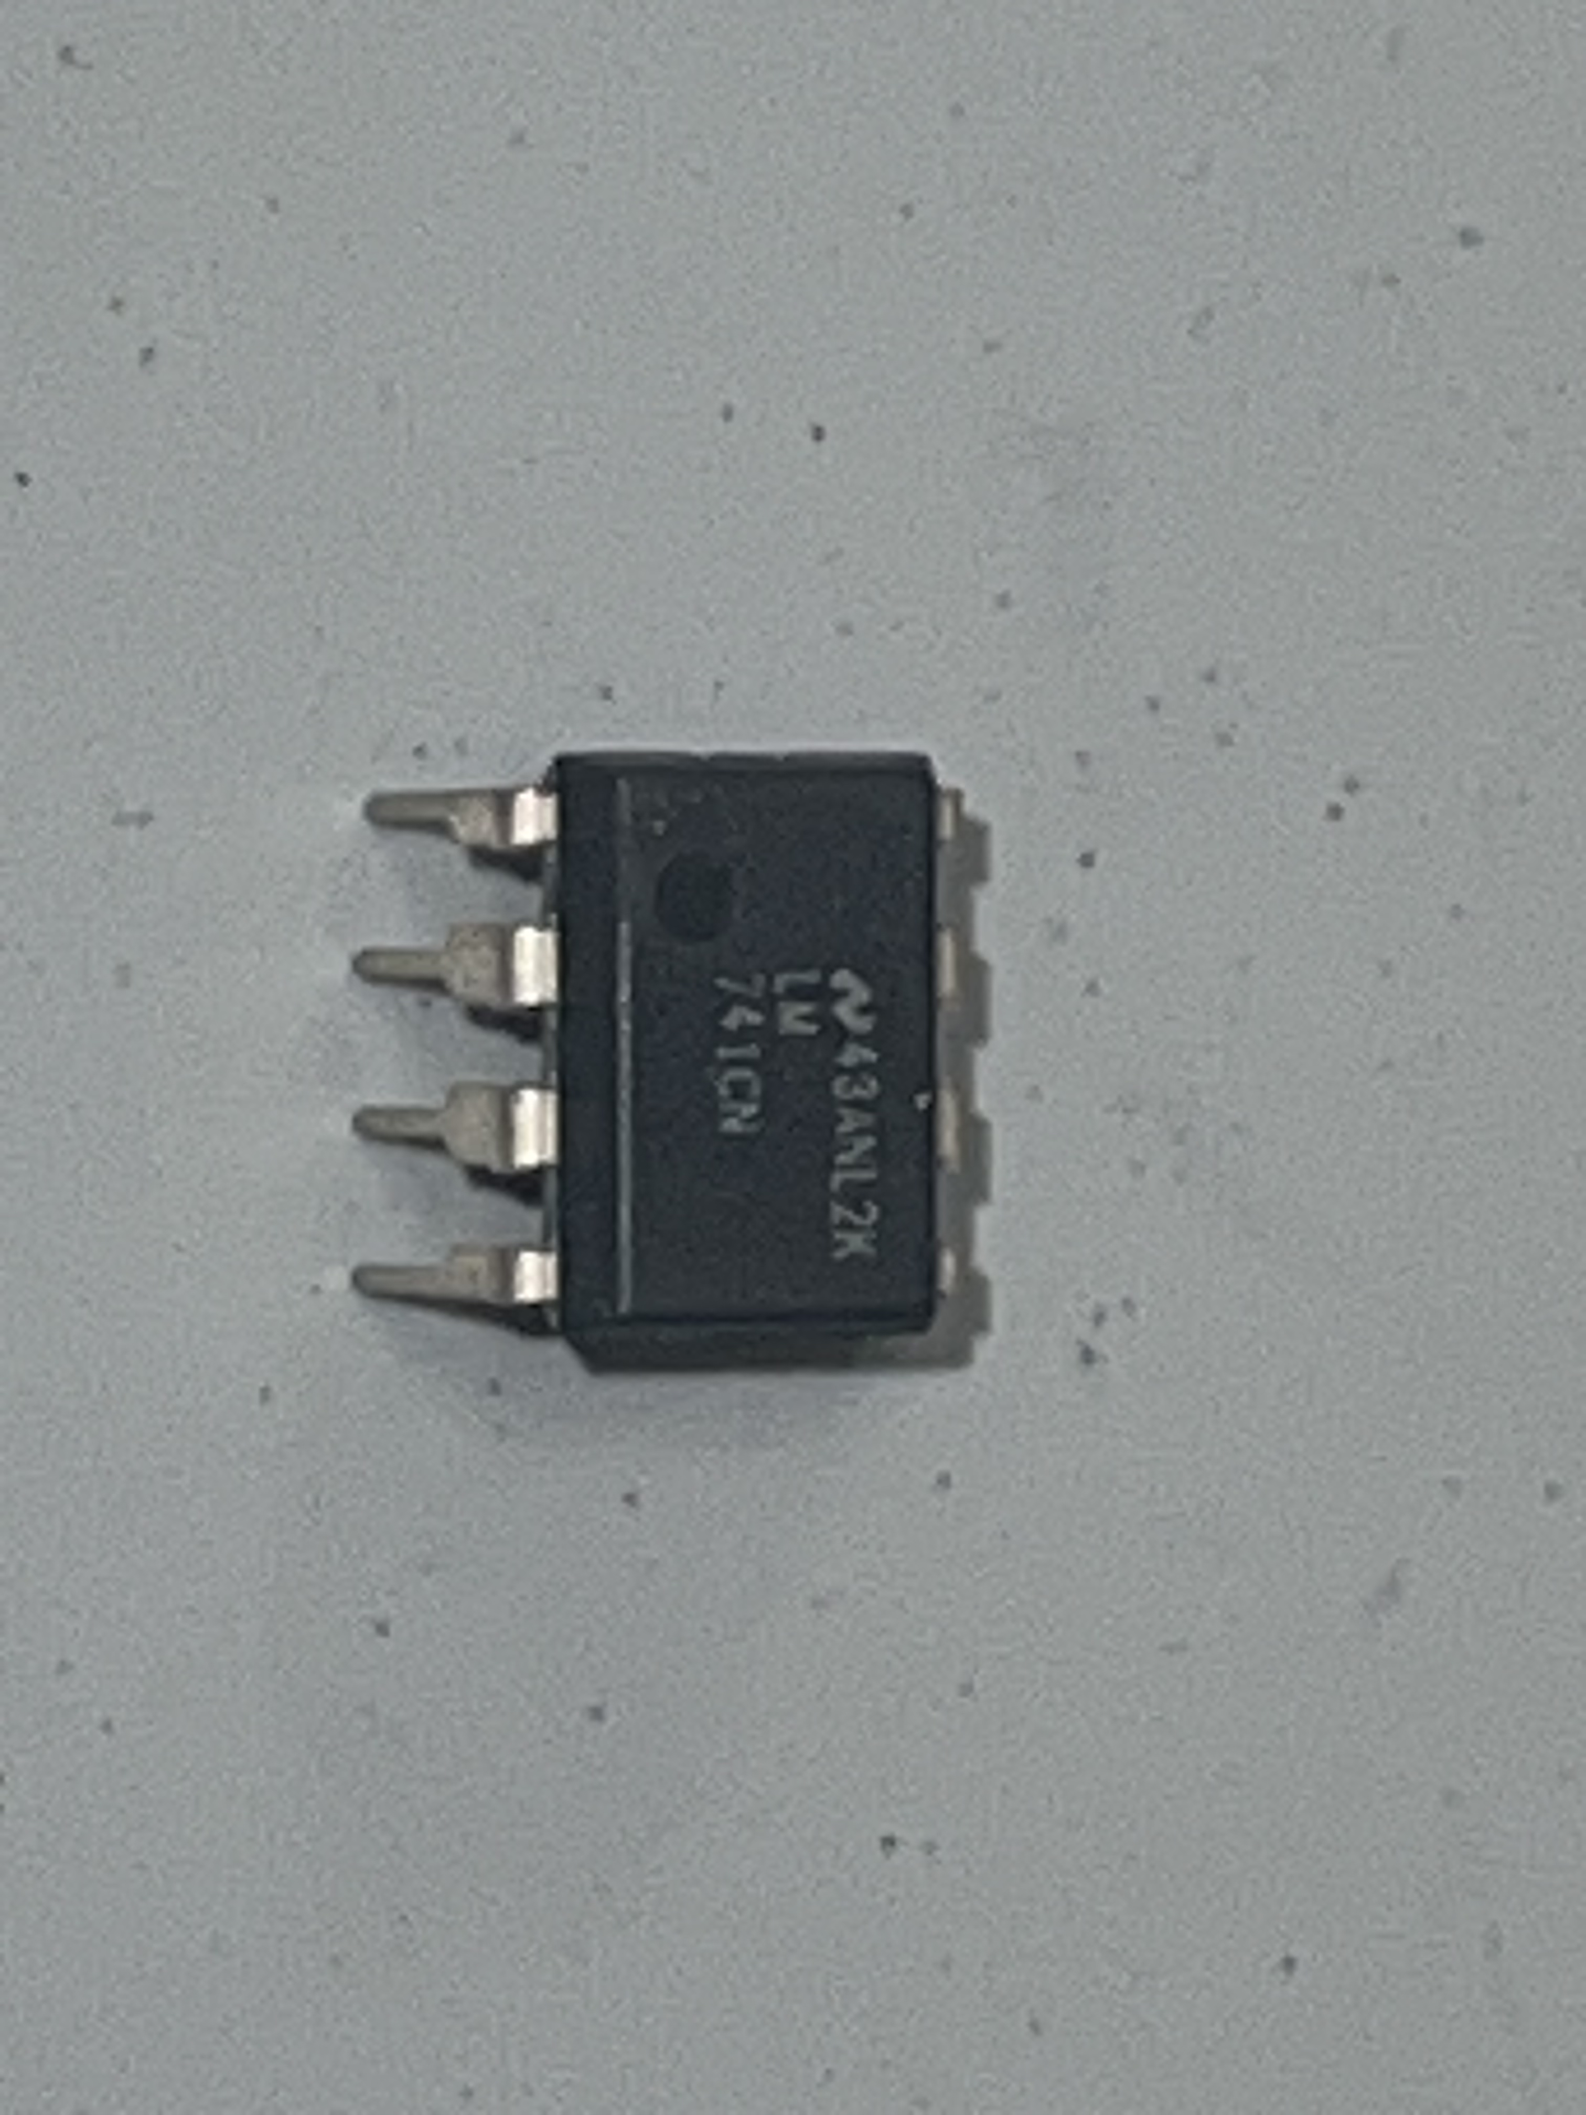
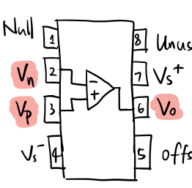
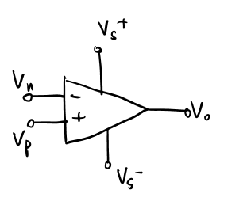








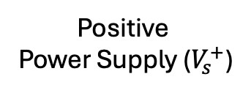

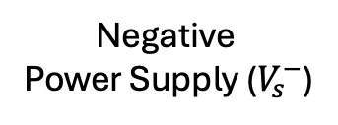




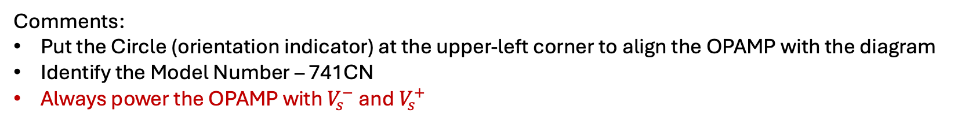
To be prepared with OPAMP
OPAMP (Operational Amplifier)
Orientation
Indicator
Model Number
Positive
Power Supply ($V_{s}^{+}$)
$$V_{s}^{+}$$
Negative Input ($V_{i}^{−}$)
$$V_{i}^{−}$$
$$V_{s}^{+}$$
Positive Input ($V_{i}^{+}$)
$$V_{i}^{−}$$
$$V_{i}^{+}$$
$$V_{o}$$
$$V_{i}^{+}$$
$$V_{o}$$
Negative
Power Supply ($V_{s}^{−}$)
Output ($V_{o}$)
$$V_{s}^{−}$$
$$V_{s}^{−}$$
OPAMP 741CN
OPAMP Diagram
Comments:
Put the Circle (orientation indicator) at the upper-left corner to align the OPAMP with the diagram
Identify the Model Number – 741CN
Always power the OPAMP with $V_{s}^{−}$ and $V_{s}^{+}$

Slide 3
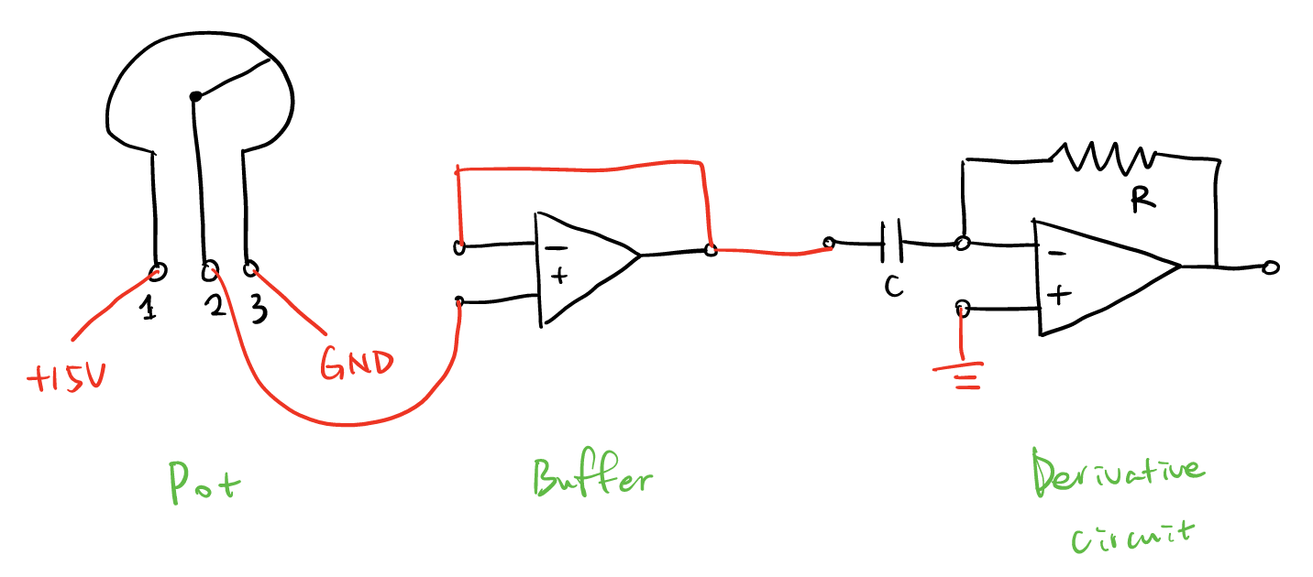
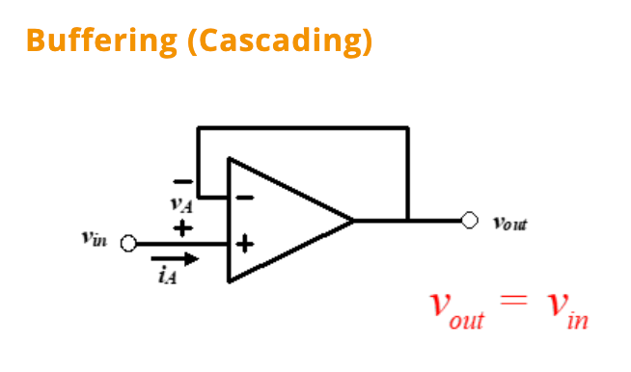
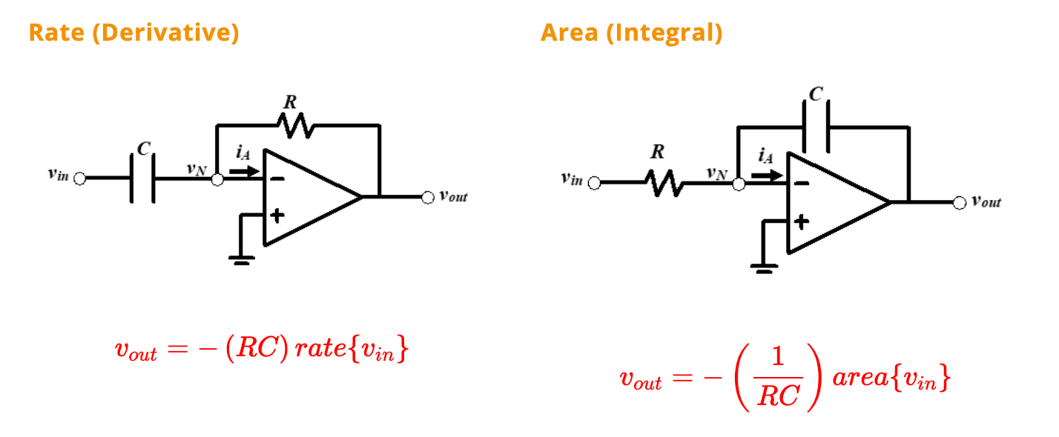
Circuits will be used
Deliverable
Photo of the Derivative & Integral Circuits
Connection diagram for the derivative circuit
Comment:
Swap the position of resistor and capacitor to switch between Derivative and Integral Circuit
Suggestion:
Always compare the diagram and your circuit connection if anything goes wrong

