Slide 1
Real-time Identification and Prediction of Danger Zones in Extreme Events
March 30, 2020

Slide 2
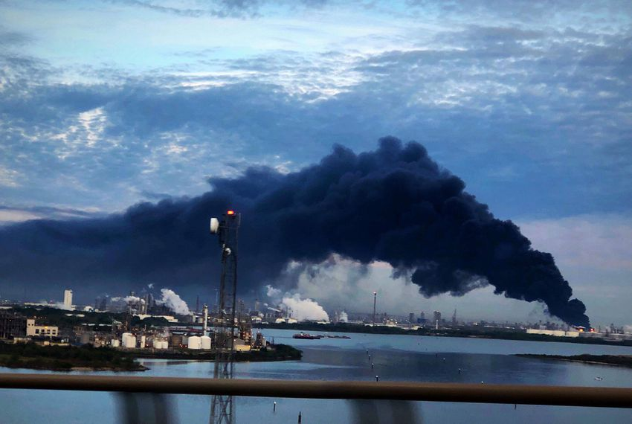
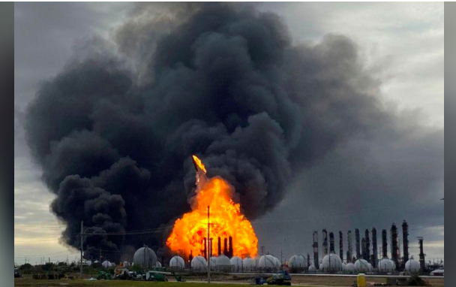

Motivation
Smoke plume from chemical fire at Deer Park

Slide 3
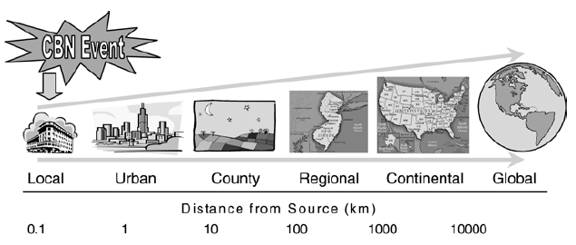
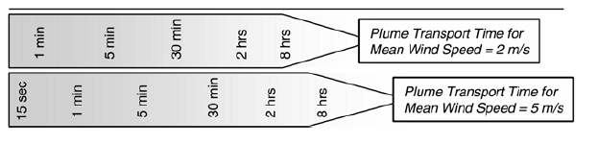
What happens after the event?
Hazardous release
Quickly spreads (~Kilometers in few minutes)
Immediate first response : 0-2 Hours
National Research Council 2003. Tracking and Predicting the Atmospheric Dispersion of Hazardous Material Releases: Implications for Homeland Security. Washington, DC: The National Academies Press.

Slide 4
Area survey using drone networks
Quick
Reliable
Generalizable
Easy to deploy
Discussion of previous work after problem formulation.

Slide 5
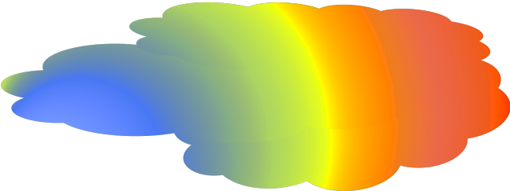
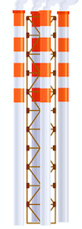
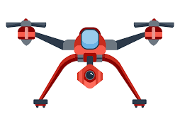

System Description
Spatial Range
Contains Plume
Average wind speed is also known.
Source location in Known.
Gas Sensing Drone
Initialize from GCS
Equipped with Gas Sensors
Gas Sensors are point sensors.
Plume
Plume : conc. > Safe threshold conc.
Single Emission Source
Moving
time | loc | Conc.
t1 | u1 | c1
t1 | u2 | c2
t2 | u3 | c3
GCS
Notes:
Why not camera?
Talk about sources: fire, accident, industrial emission

Slide 6

Representation of Plume
$$\left[\begin{aligned}0 \\ c_{1} \\ c_{2} \\ 0 \\ 0 \\ c_{3} \\ . \\ . \\ . \\ . \\ c_{5}\end{aligned}\right]$$
Snapshot at some time t
Discretized Snapshot at some time t : 2D Matrix
State of the system at time ‘t’

Slide 7
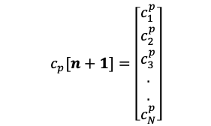





Problem Statement
 | 1 | 2 | … | n
$$c_{e}[1]=\left[\begin{aligned}c_{1} \\ c_{2} \\ c_{3} \\ . \\ . \\ c_{N}\end{aligned}\right]$$
$$c_{e}[2]=\left[\begin{aligned}c_{1} \\ c_{2} \\ c_{3} \\ . \\ . \\ c_{N}\end{aligned}\right]$$
$$c_{e}\left[n\right]= \left[\begin{aligned}c_{1} \\ c_{2} \\ c_{3} \\ . \\ . \\ c_{N}\end{aligned}\right]$$
$$c_{p}[2]=\left[\begin{aligned}c_{1}^{p} \\ c_{2}^{p} \\ c_{3}^{p} \\ . \\ . \\ c_{N}^{p}\end{aligned}\right]$$
$$c_{p}[3]=\left[\begin{aligned}c_{1}^{p} \\ c_{2}^{p} \\ c_{3}^{p} \\ . \\ . \\ c_{N}^{p}\end{aligned}\right]$$
$$c_{p}[n+1]=\left[\begin{aligned}c_{1}^{p} \\ c_{2}^{p} \\ c_{3}^{p} \\ . \\ . \\ c_{N}^{p}\end{aligned}\right]$$
End Goal
For each time window, Identify unsafe regions and Predict regions at risk in future.

Slide 8
Problem Statement
 | 1 | 2 | … | n
$$c_{e}[1]=\left[\begin{aligned}c_{1} \\ c_{2} \\ c_{3} \\ . \\ . \\ c_{N}\end{aligned}\right]$$
$$c_{e}[2]=\left[\begin{aligned}c_{1} \\ c_{2} \\ c_{3} \\ . \\ . \\ c_{N}\end{aligned}\right]$$
$$c_{e}\left[n\right]= \left[\begin{aligned}c_{1} \\ c_{2} \\ c_{3} \\ . \\ . \\ c_{N}\end{aligned}\right]$$
Goal
For each time window, Identify unsafe regions and Predict regions at risk in future.
$$c_{p}[2]=\left[\begin{aligned}c_{1}^{p} \\ c_{2}^{p} \\ c_{3}^{p} \\ . \\ . \\ c_{N}^{p}\end{aligned}\right]$$
$$c_{p}[3]=\left[\begin{aligned}c_{1}^{p} \\ c_{2}^{p} \\ c_{3}^{p} \\ . \\ . \\ c_{N}^{p}\end{aligned}\right]$$
$$c_{p}[n+1]=\left[\begin{aligned}c_{1}^{p} \\ c_{2}^{p} \\ c_{3}^{p} \\ . \\ . \\ c_{N}^{p}\end{aligned}\right]$$
Objectives
For each given set of initial measurements:
1- Estimate the state of system (Gas Distribution Map (GDM)) for current time such that :
$$L_{1}=\min_{c_{e}[n]}{ }\left\| c_{e}\left[n\right]−c_{true}\left[n\right]{\left. \right\|}_{2}\right.$$
2- Predict the state for next time window such that :
$$L_{2}= \min_{c_{p}[n]}{ }\left\| c_{p}\left[n+1\right]−c_{true}\left[n+1\right]{\left. \right\|}_{2}\right.$$
For each given set of initial measurements:
1- Estimate the state of system (Gas Distribution Map (GDM)) for current time such that :
𝑳_𝟏=(𝐦𝐢𝐧)┬(𝒄_𝒆 [𝒏])⁡ ‖ 𝒄_𝒆 [𝒏]−𝒄_𝒕𝒓𝒖𝒆 [𝒏] ├ ┤‖_𝟐 ┤
2- Predict the state for next time window such that :
𝑳_𝟐= (𝐦𝐢𝐧)┬(𝒄_𝒑 [𝒏])⁡ ‖ 𝒄_𝒑 [𝒏+𝟏]−𝒄_𝒕𝒓𝒖𝒆 [𝒏+𝟏] ├ ┤‖_𝟐 ┤
Choose next sampling locations based on error between predictions and actual measurements.
Focus of today’s presentation
Reliability + Generalizability
Quick
Notes:
Decoupling Space and Time

Slide 9
Problem Statement
 | 1 | 2 | … | n
$$c_{e}[1]=\left[\begin{aligned}c_{1} \\ c_{2} \\ c_{3} \\ . \\ . \\ c_{N}\end{aligned}\right]$$
$$c_{e}[2]=\left[\begin{aligned}c_{1} \\ c_{2} \\ c_{3} \\ . \\ . \\ c_{N}\end{aligned}\right]$$
$$c_{e}\left[n\right]= \left[\begin{aligned}c_{1} \\ c_{2} \\ c_{3} \\ . \\ . \\ c_{N}\end{aligned}\right]$$
Goal
For each time window, Identify unsafe regions and Predict regions at risk in future.
$$c_{p}[2]=\left[\begin{aligned}c_{1}^{p} \\ c_{2}^{p} \\ c_{3}^{p} \\ . \\ . \\ c_{N}^{p}\end{aligned}\right]$$
$$c_{p}[3]=\left[\begin{aligned}c_{1}^{p} \\ c_{2}^{p} \\ c_{3}^{p} \\ . \\ . \\ c_{N}^{p}\end{aligned}\right]$$
$$c_{p}[n+1]=\left[\begin{aligned}c_{1}^{p} \\ c_{2}^{p} \\ c_{3}^{p} \\ . \\ . \\ c_{N}^{p}\end{aligned}\right]$$
Objectives
For each given set of measurements and previous predictions :
Estimate the Gas Distribution Map (GDM) for current time such that :
$$L_{1}=\min_{c_{e}[n]}{ }\left\| c_{e}\left[n\right]−c_{true}\left[n\right]{\left. \right\|}_{2}\right.$$
Predict the GDM for next time step such that :
$$L_{2}= \min_{c_{p}[n]}{ }\left\| c_{p}\left[n+1\right]−c_{true}\left[n+1\right]{\left. \right\|}_{2}\right.$$
For each given set of measurements and previous predictions :
Estimate the Gas Distribution Map (GDM) for current time such that :
𝑳_𝟏=(𝐦𝐢𝐧)_(𝒄_𝒆 [𝒏])⁡ ‖ 𝒄_𝒆 [𝒏]−𝒄_𝒕𝒓𝒖𝒆 [𝒏] ├ ┤‖_𝟐 ┤
Predict the GDM for next time step such that :
𝑳_𝟐= (𝐦𝐢𝐧)┬(𝒄_𝒑 [𝒏])⁡ ‖ 𝒄_𝒑 [𝒏+𝟏]−𝒄_𝒕𝒓𝒖𝒆 [𝒏+𝟏] ├ ┤‖_𝟐 ┤
Choose next sampling locations that based on error between predictions and actual measurements.
Strictly limited amount of measurements
Constraints
1- Drone Flight Time
2- Drone Speed
3- Sensor Response Time
Notes:
Decoupling Space and Time

Slide 10

State Space System Representation
$$c\left[n+1\right]=Ac\left[n\right]+u\left[n\right]+w[n]$$
$$y\left[n\right]=I_{n} c\left[n\right]+n$$
Transition Matrix nxn
Process noise/uncertainty about A
Input/Source
Transition Model
Measurement Model
Indicator Matrix
mxn
Measurement noise

Slide 11
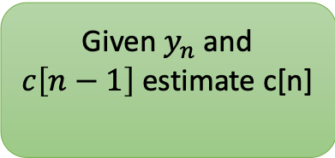
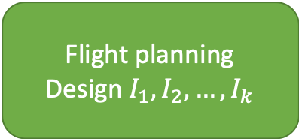
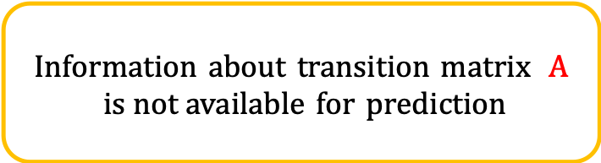
Framework
Information about transition matrix $A$
$is not available$ for prediction
Initialization
Flight planning
Design $I_{1}, I_{2},…,I_{k}$
Given $y_{n}$ and $c\left[n−1\right]$estimate c[n]
Predict c[n+1] =A*c[n]
Decoupling Space and Time extrapolation

Slide 12


System Identification : Learning A
Purely Data Driven Approach
Time-stamped conc. measurements
$$\tilde{A_{d}}$$
Data+ Domain Knowledge Approach
$$\tilde{A_{m}}$$
Source location, Average wind velocity

Slide 13
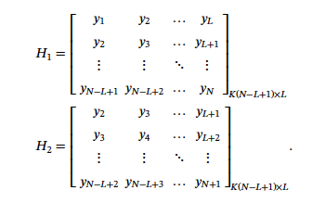




Purely Data-Driven System Identification
Matrix-Pencil Method
Constructs dynamical systems based on time-series data $y_{1} ,y_{2},…$
Computationally cheap.
Commonly used for reduced order system-models
Construct shifted Hankel matrices
Take SVD of $H_{1}$
Estimate A
$$H_{1}=USV^{T}$$
$\tilde{A_{d}}=S^{−1/2}U^{T}H_{2}V$ $S^{−1/2}$
[1] : Ionita A.C. and Antoulas A.C., Matrix pencils in time and frequency domain system identification, in Developments in Control Theory, towards Glocal Controlº, edited by Qiu L., Chen J., Iwasaki T., and Fujioka H., IET Control Engineering Series, vol. 76, pages 79±88 (2012).

Slide 14
Domain Knowledge : Physical Model
The emission from source is transported in the space by
1- Diffusion
2- Advection
How can we express this transport phenomenon mathematically?
Wind
Source
Convection-Diffusion Partial Differential Equation
Notes:
Source of a heat, gas, chemical

Slide 15
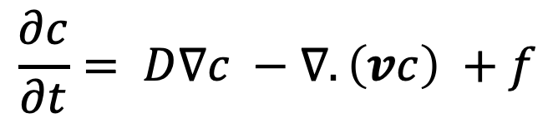
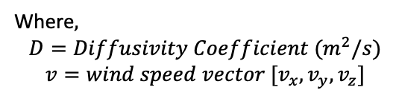
Transport Equation
Convective flux :Transported by wind
$$\frac{∂c}{∂t}= D∇c −∇.\left(vc\right) +f$$
Where$,$
$$D=Diffusivity Coefficient (m^{2}/s)$$
$$v=wind speed vector [v_{x}, v_{y}, v_{z}]$$
Change in concentration due to diffusion
Source term
Closed form solution do not exist.
Numerical Solution → Discretize in Space and time
Instantaneous source
Notes:
Talk about INSTANTANEOUS SOURCE

Slide 16


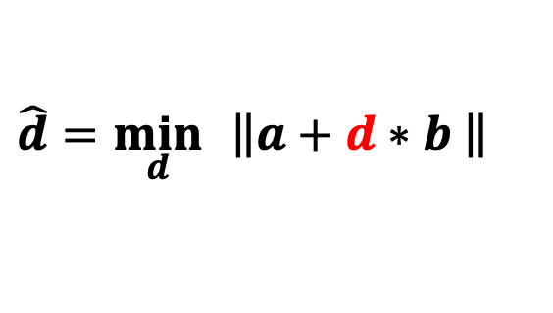

Discretized Transport Equation
Diffusivity coefficient
$$c\left[n+1\right]= \frac{M−(1−θ)∗dt∗(v∗C+d∗K)}{M+θ∗dt∗(v∗C+d∗K)} c[n]$$
Diffusion field
A
Mass matrix (comes from numerical scheme)
$∈${0,2/3,1}
From time integration scheme
Convection field
Given that wind magnitude and diffusivity coefficient are constant in space.
$$c\left[n+1\right]=A(d)∗c[n]$$
$$\hat{d}=\min_{d}{ }\left\|a+d∗b\right.\left. \right\|$$
$a=M\left(c\left[n+1\right]−c\left[n\right]\right)+θ∗dt∗\left(v∗C\right)∗c\left[n+1\right]−$ $\left(1−θ\right)∗dt∗u∗C∗c[n]$
$$b=θ∗dt∗K∗c\left[n+1\right]+\left(1−θ\right)∗dt∗K∗c[n]$$

Slide 17

Putting everything together
1- Initialize and collect some data
2- Estimate A:
3- Estimation Step :
$$c_{e}\left[n\right]=c_{p}\left[n\right]+w∗({y\left[n\right]−I∗c}_{p}\left[n\right]])$$
Update transition matrix $A$.
4- Prediction Step :
$$c_{p}\left[n+1\right]=A\left(d\right)∗c_{e}\left[n\right]$$
5- Repeat 3-4 ‘K’ times.
6- Design $I_{n}.$ (In progress)
Kalman gain provides optimum way to combine prediction with error assuming Gaussian process noise.
prediction
correction

Slide 18

Previous Work
 | Reliability | Generalizability | Quick & Easy to deploy
Simplified model obtained from ideal assumptions
Extremely complex Models that require geographical & weather data
Steady state Plume (conc. fixed over time)
Source Localization
Very few works incorporate drone constraints with a time-varying plume and design an end-to-end system and evaluate over field experiment.

Slide 19
Evaluate performance of purely Data-driven method(1) and Model-based method(2) with experimental data

Slide 20
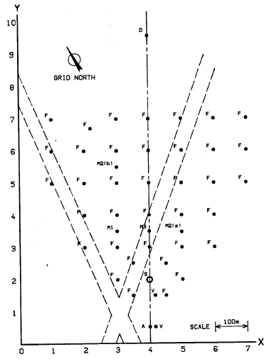
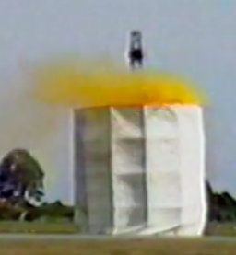
Experimental Data
Thorny Island Dataset (1982-84)
Instantaneous gas source
Different group of sensors recorded data for different trials
Per second conc. Data recorded

Slide 21
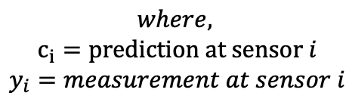
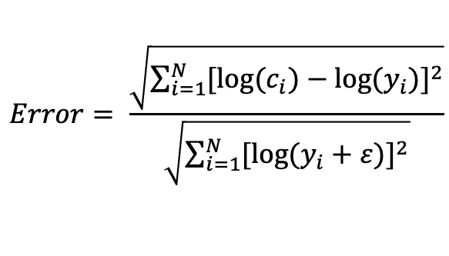
Part 1: Evaluate Prediction Accuracy
Do not extrapolate sensor data (40-50 positions) in space. Evaluation performed at true values only.
Use all measured values at one time instance to predict the next.
Performance metric :
%False Negative
%False Positive
Log Error Norm[1]
Still looking for better metric
$$Error= \frac{\sqrt{\sum_{i=1}^{N}{{[log⁡(c}_{i})−log⁡(y_{i})]^{2}}}}{\sqrt{\sum_{i=1}^{N}{[log⁡(y_{i}+ε)]^{2}}}}$$
$$where,$$
$$c_{i}=prediction at sensor i$$
$$y_{i}=measurement at sensor i$$
[1] : Schmehl, Kerrie J., Sue Ellen Haupt, and Michael J. Pavolonis. "A genetic algorithm variational approach to data assimilation and application to volcanic emissions." Pure and applied geophysics 169.3 (2012): 519-537.

Slide 22
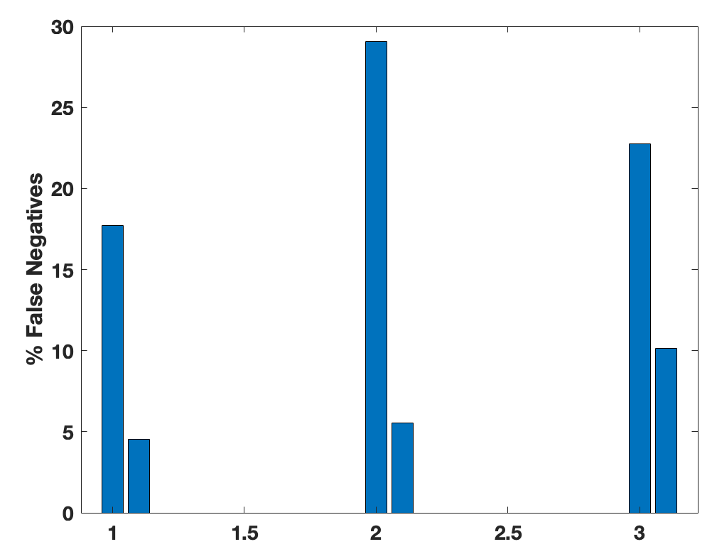
Results
Data-Driven
Model-based
Mean % Error over the time window
Note that purely data-driven has an addition offset of first 50—60 samples needed to construct Hankel Matrix.
Trial 1
Trial 2
Trial 3

Slide 23
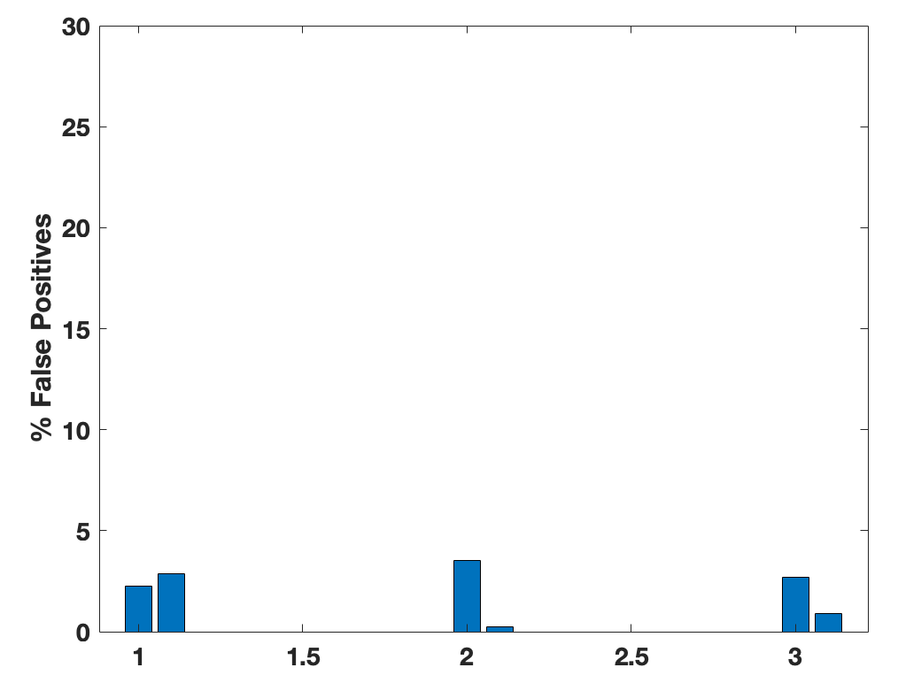
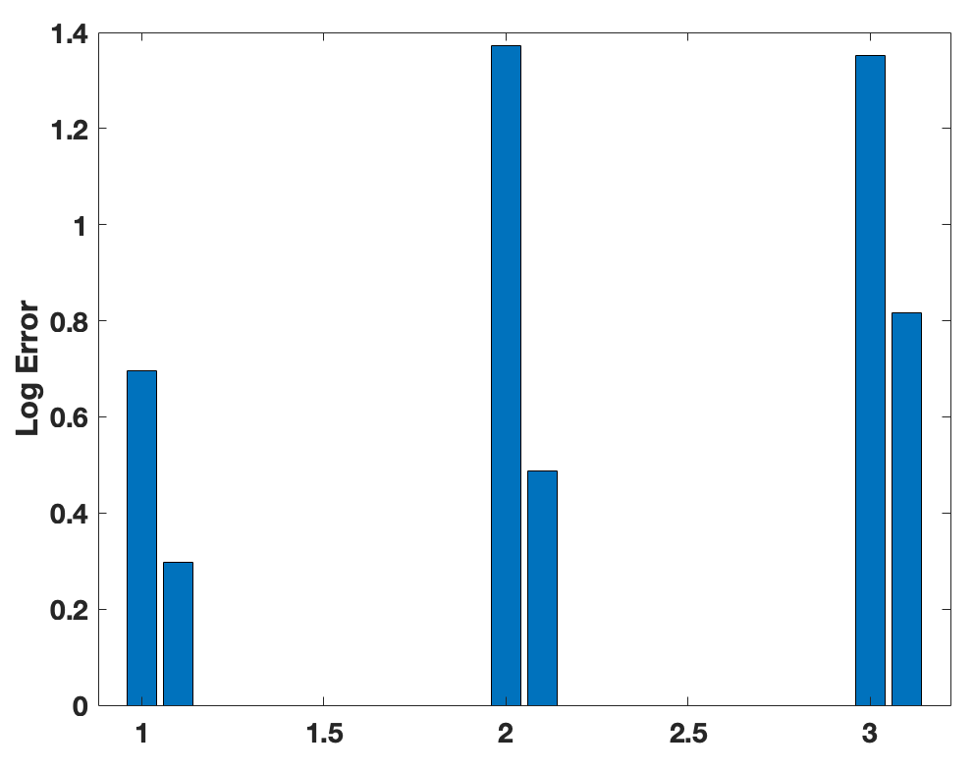
Results
Data-Driven
Model-based
Trial 1 Trial 2 Trial 3
Trial 1 Trial 2 Trial 3

Slide 24
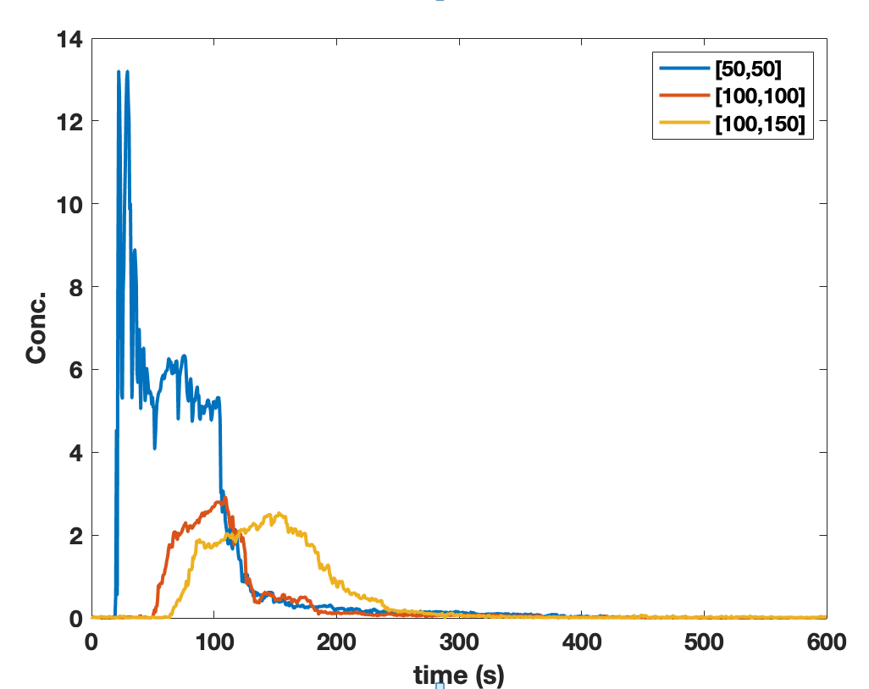
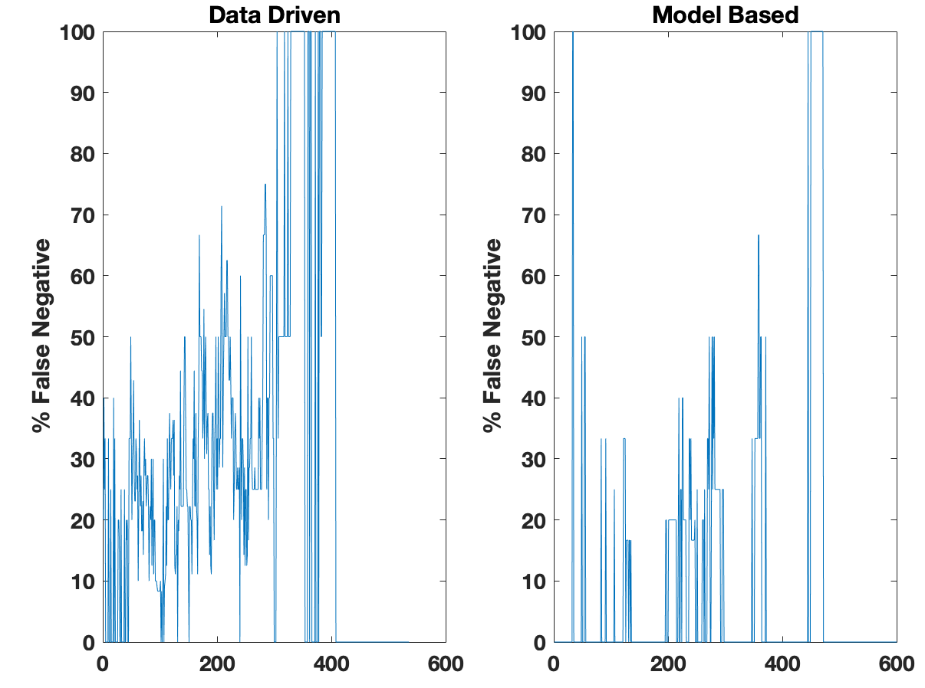
Explanation
The data-driven method doesn’t anticipate the impact generated by one sensor on the other in future.
The model-based exploits spatial connectivity while extrapolating in time.

Slide 25
Future Objectives
Design the feedback loop to adaptively sample using drone.
Evaluate the performance over different initializations.
Revisit Spatial Extrapolation/State estimation.

