Slide 1
CS 435: Cloud Networking
Programming Assignment 2
Unicast Routing

Slide 2
Agenda
What should be done?
How it should be done?
Environment Setup
Implementation
Testing
Grading
Tips

Slide 3
Complete Workflow
iptables
VIRTUAL NETWORK
Node1
Node4
Manager
Send msg to node4
5
4
10
Change cost b/w node2 & node1
8
Node2
Node3

Slide 4
What should be done?
Implement a shortest path routing algorithm
Either Distance Vector/Path Vector OR Link State Routing
Route packets (messages) from source to destination
Update routes based on configuration changes – link cost changes, failures
What will be the routers/nodes?
Individual processes bound to a virtual interface & assigned a Virtual IP address
How links are set up between routers/nodes
Virtual network interfaces using Linux iptables
Where will be doing this?
Should be done inside VM from MP1 (Ubuntu 20.04 LTS)

Slide 5
Environment Setup
iptables
VIRTUAL NETWORK
Node1
Node4
Manager
Send msg to node4
5
4
10
Change cost b/w node2 & node1
8
Node2
Node3

Slide 6
Environment Setup - iptables
Wikipedia: “iptables is a user-space utility program that allows a system administrator to configure the IP packet filter rules of the Linux kernel firewall.”
References:
https://linux.die.net/man/8/iptables
https://www.thegeekstuff.com/2011/06/iptables-rules-examples/

Slide 7
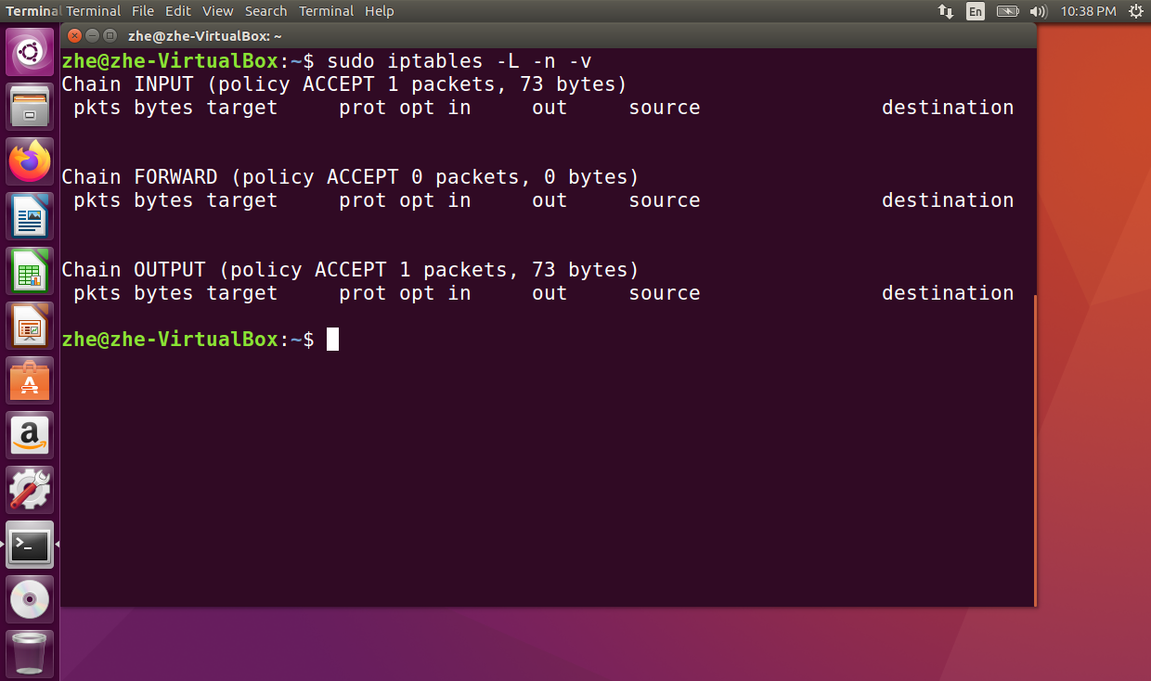
Environment Setup - iptables
Example: list incoming/outgoing traffic
Notes:
73 packets arrived, 0 packets forwarded, 73 packets outgoing

Slide 8
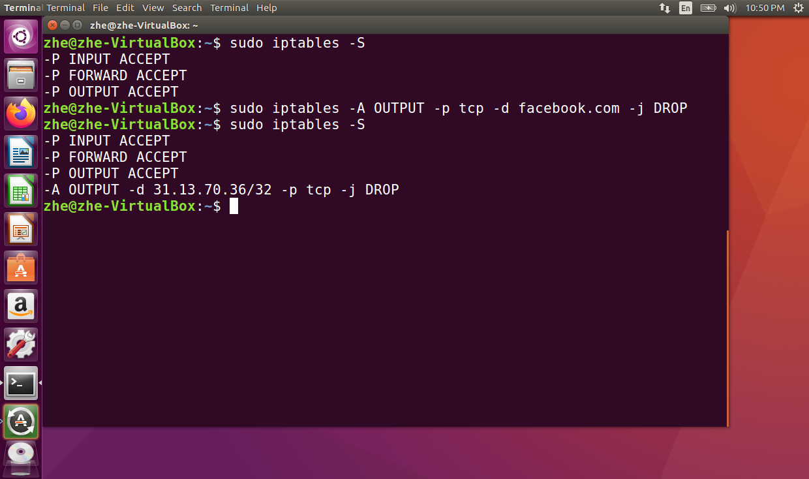
Environment Setup - iptables
Example: show rules – block outgoing traffic to FB – show rules
Notes:
73 packets arrived, 0 packets forwarded, 73 packets outgoing

Slide 9
Environment Setup - iptables
We will use Linux iptables to setup & enforce communication rules in the virtual network
A virtual interface (e.g. eth0:1, eth0:2, etc.) & a virtual IP address will be created & assigned to each node/process in the system
A node with ID n gets address 10.1.1.n. IDs from 0 through and including 255 are valid.
iptables rules will be applied to restrict which of these addresses can talk to which others. 10.1.1.30 and 10.1.1.0 can talk to each other if and only if they are neighbors in the emulated topology.
To create a link
sudo iptables -I OUTPUT -s <node1_ip_addr> -d <node2_ip_addr> -j ACCEPT &&
sudo iptables -I OUTPUT -s <node2_ip_addr> -d <node1_ip_addr> -j ACCEPT
To take down a link
sudo iptables -D OUTPUT -s <node1_ip_addr> -d <node2_ip_addr> -j ACCEPT &&
sudo iptables -D OUTPUT -s <node2_ip_addr> -d <node1_ip_addr> -j ACCEPT

Slide 10
Environment Setup (cont.)
Use make_topology.pl file provided in the assignment files
run “perl make_topology.pl test_topology.txt”
The topology file contains a pair of node ids on each line, which will become neighbors in the virtual topology.
In make_topology.pl, you must replace eth0 with the name of the VM’s network interface.
Accessed by running ifconfig in the terminal (e.g., enp0s3 or a variant of it)

Slide 11
Implementation
iptables
VIRTUAL NETWORK
Node1
Node4
Manager
Send msg to node4
5
4
10
Change cost b/w node2 & node1
8
Node2
Node3

Slide 12
C++
You can use C++ and compile it with g++.
Compile with “-g” flag to add debug information for gdb debugging.
Using C++ string methods and you can get a c-style pointer by calling “c_str()”
Using std::thread might be easier than pthread.
You can use std::atomic and std::mutex for synchronization.

Slide 13
Implementation - Your Router’s Key Tasks
Control Plane
Detect the state of links using heartbeat.
Run the link state (LS) or distance/path vector (DV/PV) protocols to communicate between routers, find shortest paths and construct forwarding table
Data Plane
Receive the “send” command from Manager and follows its instructions.
Transmit/Relay the message in “send” command from source to destination using the forwarding table at each hop, and write the activities to a log file.

Slide 14
Implementation - Your code
Starter code in the assignment files (main.c & monitor_neighbors.h).
Running the code: ./<router_binary> nodeid initial_costs_file logfile
nodeid is the virtual interface number for this node.
initial_costs_file is the cost file.
On each line, the node id and cost is provided.
Missing entry means cost is 1.
Neighbor link might not exist at that time.
logfile is where your program writes the events it was a part of. All the nodes must make a log file even if no event happens.

Slide 15
Implementation – Neighbor discovery
Every node periodically sends heartbeats to all the nodes (ping every node). This code is given.
If node a receives a heartbeat from node b, node a knows node b is its neighbor, puts node b into its neighbor list.
If node a doesn’t receive HBs from node b for some time, node a learns the link is down, removes node b from neighbor list.
Notes:
Heartbeat will be discussed further in later slides

Slide 16
Implementation - Heartbeat
Use UDP heartbeat to detect link changes.
Each node keeps periodically broadcasting heartbeat to its neighbors.
Separate thread in starter code.
pthread_t announcerThread;
pthread_create(&announcerThread, 0, announceToNeighbors, (void*)0);
…
void* announceToNeighbors(void* unusedParam){
…
while(1) {
…
}
}

Slide 17
Implementation - Heartbeat
Link a<->b is up:
Node a and b receives each other’s heartbeats.
a
b

Slide 18
Implementation - Heartbeat
Now, suppose link a<->b is down:
Node a and b will detect this event from heartbeat times out.
a
b

Slide 19
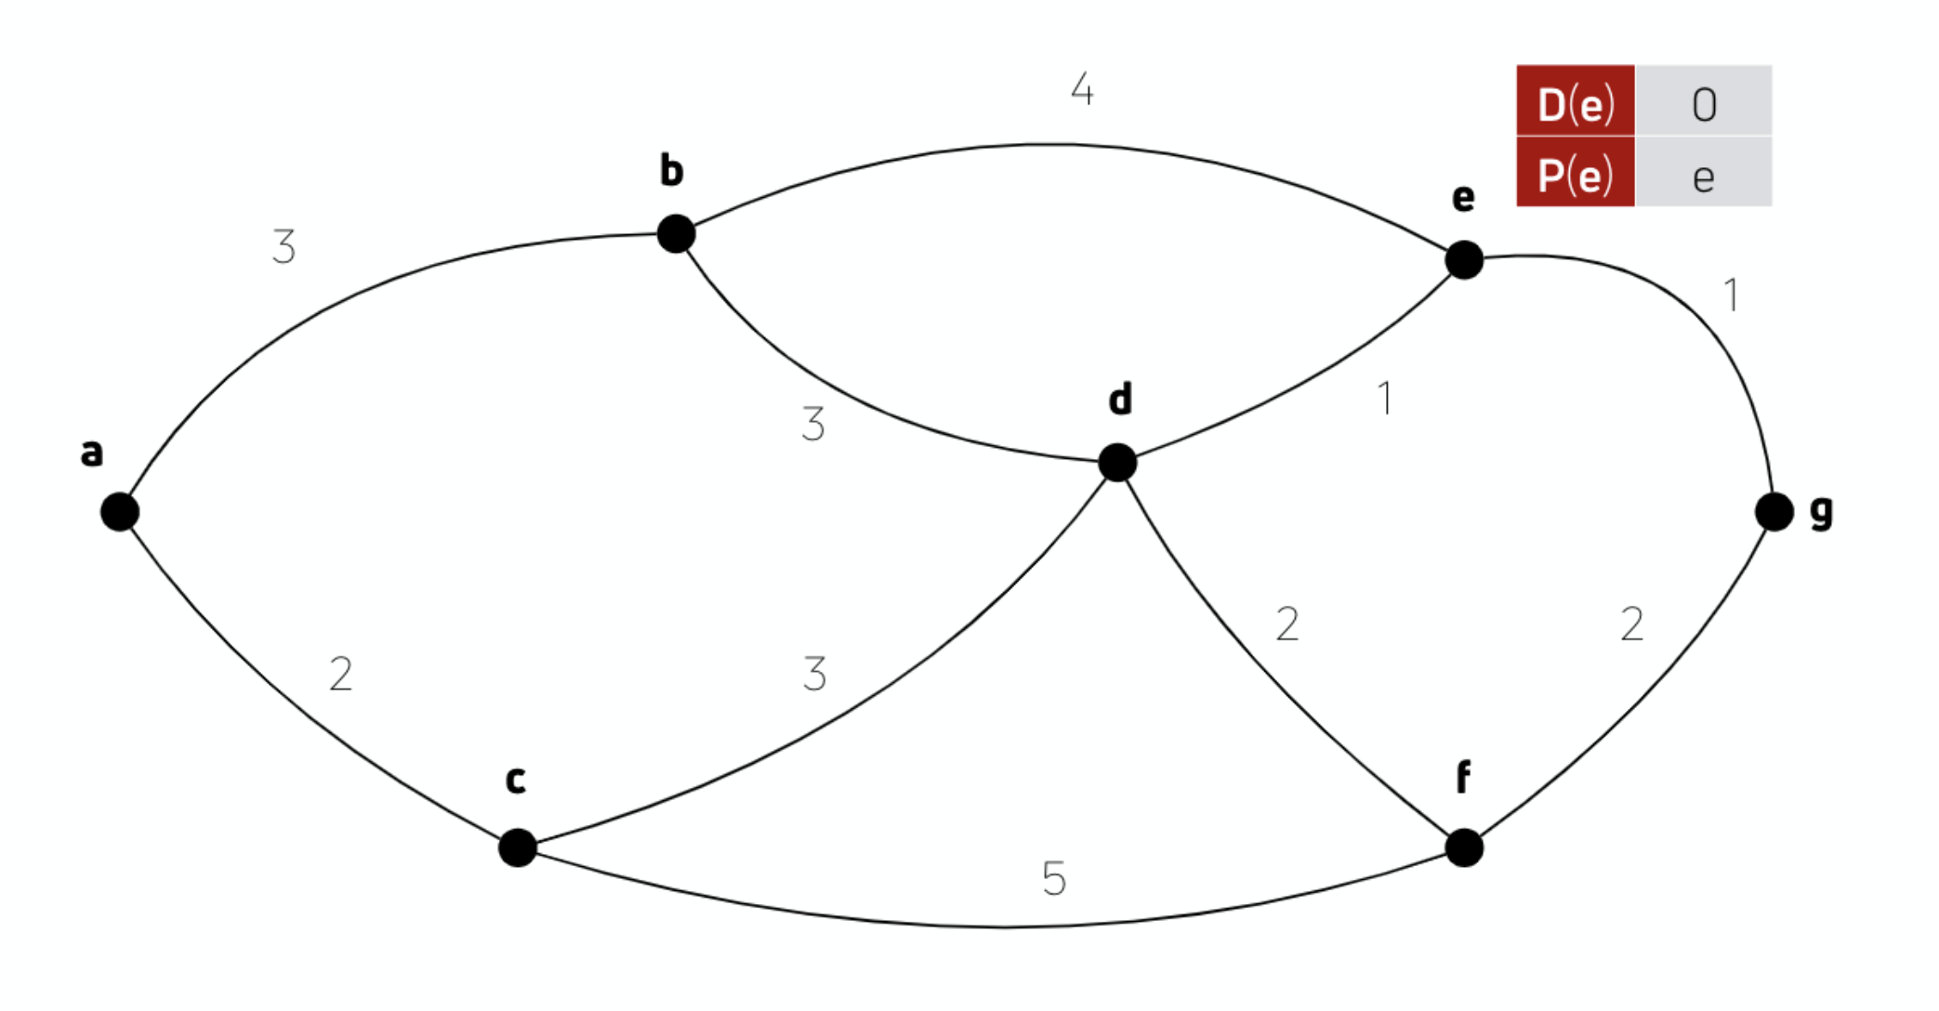
Implementation – Link Cost
First, a node reads values from the initial cost file
Can have costs between nodes where the link is currently down!!
Cost is 1 for a neighbor which is not specified
E.g. the cost file input to node a:
b 3
c 2
d 100
e 40
…
Node a and d,e are not neighbors. Ignore them!

Slide 20
Implementation – Link Cost
Now, suppose the link b/w a<->d is up.
Cost will be 100 which is last recorded
…
E.g. the cost file input to node A:
b 3
c 2
d 100
e 40
…
Node A and E are not neighbors. Ignore it!
100
Link a<->d is up

Slide 21
Implementation - Logging
Send a packet (source node)
sending packet dest [nodeid] nexthop [nodeid] message [text text]
e.g. sending packet dest 11 message hello there!
Forwarded a packet (intermediate nodes)
forward packet dest [nodeid] nexthop [nodeid] message [text text]
e.g. forward packet dest 56 nexthop 11 message Message1
Received a packet (destination node)
receive packet message [text text text]
e.g. receive packet message Message2!
Unreachable Node (source node)
unreachable dest [nodeid]
e.g. unreachable dest 12
Note: It must be exact as described since it is used by autograder. Be careful!!

Slide 22
Recommended Development Steps
UDP functions
You can send one string from one node to another using UDP.
You can receive and print it out using debug macro.
Pass JSON payload around
You can dump a stl container into a JSON style string.
The byte stream format can be a 10-byte header followed by a JSON string.
Header format: 2-byte magic number 0xffff and 8-byte size
Magic number helps identifying the start of message.
Size is just like content-length in MP1.
Test: You can build a vector in one node, send it to another node and reconstruct one in another node.
Note: A UDP payload cannot exceed 65507 bytes in IPv4.

Slide 23
Recommended Development Steps
Implement Router Algorithm
Define a data structure to store informations of the graph.
Link State: What neighbors does each node in the network currently connected to.
Path Vector: What are the paths that my neighbors have to all other reachable nodes.
Define a data structure to store the forwarding table.
Given a defined graph, solve the shortest route problem.
Check it in one node.
Play with std::thread and implement heartbeating.
Put everything together.

Slide 24
JSON Library
#include "json.hpp"
using json = nlohmann::json;
// example to use json
void json_example() {
using std::pair;
std::map<int, pair<int, int>> record = {{1, {1,1}}};
map<int, map<int, pair<int, int>>> records = {{4, record}};
json j_map(records);
string map_dump = j_map.dump();
std::cout << j_map << std::endl; // print json out
json j_map(map_dump); // from string to json
// json object to actual stl container object
auto output = j_map.get<map<int, map<int, pair<int, int>>>>();
}

Slide 25
Debug Macro
#define DEBUG 1
#define DEBUG_PRINTF(fmt, ...) \
do { if (DEBUG) fprintf(stderr, "node%d:%s:%d:%s(): " fmt "\n", globalMyID, __FILE__, \
__LINE__, __func__, __VA_ARGS__); } while (0)
#define DEBUG_PRINT(text) \
do { if (DEBUG) fprintf(stderr, "node%d:%s:%d:%s(): " text "\n", globalMyID, __FILE__, \
__LINE__, __func__); } while (0)

Slide 26
Testing
How do you go about testing the code you have developed?
1st option, use the test topology in mp2_code/ files
Setup the test topology
Run the code binary for multiple nodes
Open multiple terminals.
One terminal per node/router
Command to start router process:
./<router_binary> mynodeid initial_costs_file logfile
Use manager from another terminal to send various commands
Command to execute a manager command:
./<manager_binary> destnode command [args]
2nd option, use the autograder
When you’ve done testing with 1st option, use autograder to test your code automatically under more complicated network topologies

Slide 27
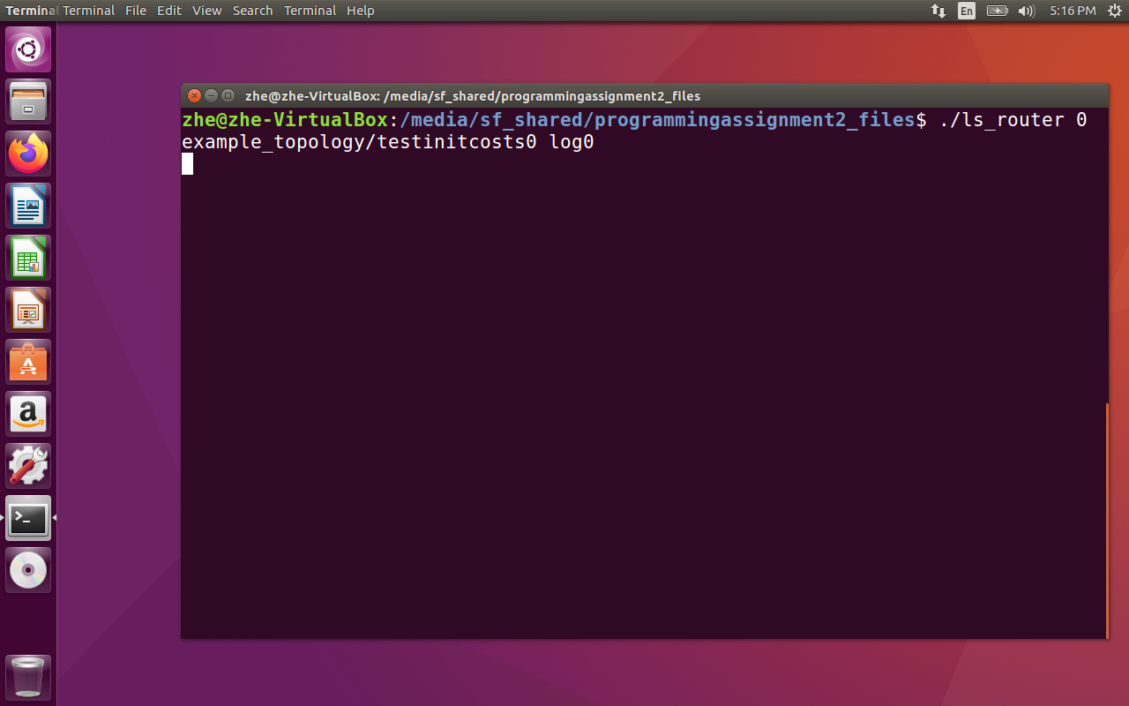
Testing – ScreenShot1
To start a router process

Slide 28
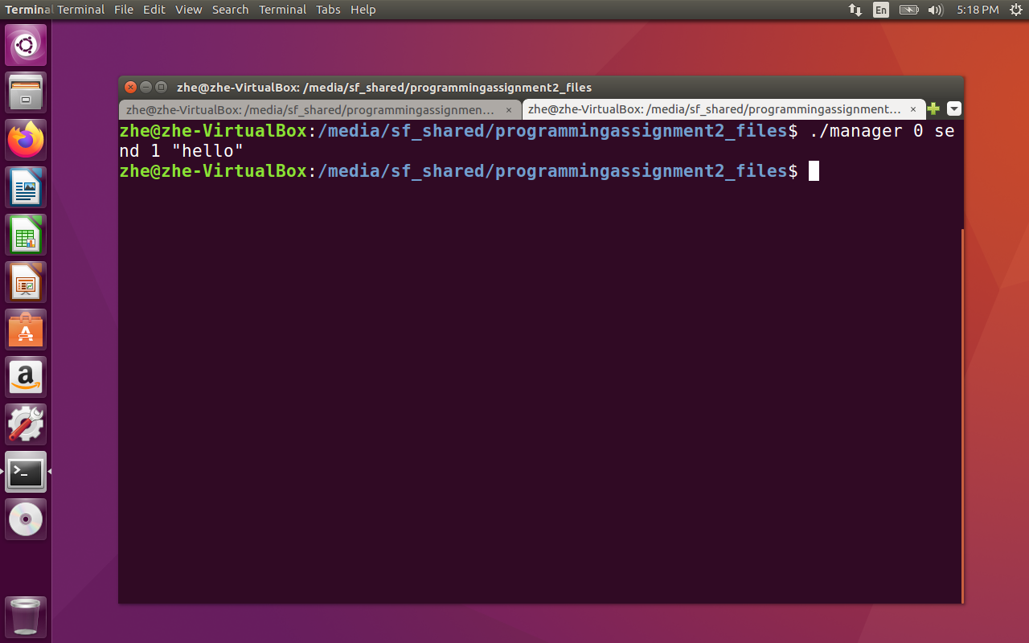
Testing – ScreenShot2
To send a manager command

Slide 29
Manager
iptables
VIRTUAL NETWORK
Node1
Node4
Manager
Send msg to node4
5
4
10
Change cost b/w node2 & node1
8
Node2
Node3

Slide 30
Testing - Manager
Used to send commands to nodes in the virtual network.
Two commands sent in UDP packets:
Send a packet
./<manager_binary> <source_node> send <dest_node> <message>
Change costs
./<manager_binary> <node1> cost <node2> <new_cost>
./<manager_binary> <node2> cost <node1> <new_cost>
Source code & binary for the manager is provided. You are welcome to read it to have a better understanding of what it does.

Slide 31
Testing - Manager (continued)
Examples:
Example1: Request Node 12 to send a message “this_message” to Node 23: ./manager_send 12 send 23 this_message
Example2: Set the new cost between Node 12 and 30 as 2: ./manager_send 12 cost 30 2
./manager_send 30 cost 12 2

Slide 32
Aside – Manager Msg Handling in Node
Two types of messages are received by nodes from manager
Send a packet: senddestIDmessage
Change costs: costdestIDnewCost
4 ASCII bytes
ASCII message
(<= 100 bytes)
Net order 2 bytes
Net order 4 bytes

Slide 33
Aside – Manager Msg Handling in Node
Examples:
Example1: destination Id is 4 and message is “hello”. Message from manger will be
“send4hello”
where 4 occupies 2 bytes and is in the network order. You need to convert it to the host order to get the correct destID. Note that there is no space delimiter among "send", destID and the message body.
Example2: the manager informs node 2 that the cost to node 5 is set to 33. The command received by node 2 will be:
“cost533”
where 5 occupies 2 bytes and 33 occupies 4 bytes. Both of them are in the network order. You need to convert them to the host order to get the correct destID and newCost. Note that there is no space delimiter among "cost", destID and newCost.
Notes:
The source code of the manager is included in the attachment. You can read it to gain a better understanding.

Slide 34
Aside – note about autograder
Autograder only tests sending packets (”send” msg) and bringing a link up/down. It does not include changing costs
However, we recommend handling “cost” msgs in your code
Ease of testing for bringing link up/down – can just change the cost to some special value, like -1 to signal infinite link cost
Additional code change to handle these msgs is minimal as one must handle link state changes

Slide 35
Aside – Network Order
Network order – big endianness
the most significant byte at the smallest
memory address
Host order – Depends on the host
Common case: little endianness
the least significant byte at the smallest
address
Need to convert when sending ints to network!
Look up htons(), htonl(), ntohs(), ntohl() for information.

Slide 36
Testing
Can also modify the given topology dynamically
How – Remember iptables!
To create a link
sudo iptables -I OUTPUT -s <node1_ip_addr> -d <node2_ip_addr> -j ACCEPT &&
sudo iptables -I OUTPUT -s <node2_ip_addr> -d <node1_ip_addr> -j ACCEPT
To take down a link
sudo iptables -D OUTPUT -s <node1_ip_addr> -d <node2_ip_addr> -j ACCEPT &&
sudo iptables -D OUTPUT -s <node2_ip_addr> -d <node1_ip_addr> -j ACCEPT

Slide 37
Grading
autograde.py is in MP2.zip, provided on Coursera.
1. Copy your code and its compiled version into the directory where you unzip.
2. Run “python autograde.py <program_name> < VM_network_interface>”
Example: python autograde.py vec_router enp0s3
3. If successful, an out.zip file will be generated. Unzip the out.zip file ”unzip –r out.zip”
4. Create a new directory called “code/”. Copy your .c files, .h files and Makefile to the folder.
5. Zip both folders “zip –r out.zip results/ code/“

Slide 38
Grading
Notes
Eight progressively hard test cases.
Use testcases as a guideline to add features to your program incrementally.

Slide 39
Tips
When sending a message, your node should send it via the path with the lowest cost.
Pay attention to cost ties, choose lowest ID next hop
Once link state changes, the routing should converge quickly.
You need to design the message format between your routers.
Be careful! Avoid flooding too many messages to the network.
Adjust the interval between periodic messages.
Avoid the loop: A sends update to B, B sends back to A, A sends back to B …
Flush the file buffer after fwrite

