Slide 1
Heterojunctions
Jinling Yu

Slide 2
Definition of heterojunction
A heterojunction is an interface between two different types of semiconductor.
For example, GaAs/AlGaAs
A crystal of AlGaAs is very similar in structure to one of GaAs, except that some of the gallium (Ga) sites are occupied by aluminum (Al) atoms.
The band gap of AlGaAs is dependent on the concentration of Al.

Slide 3
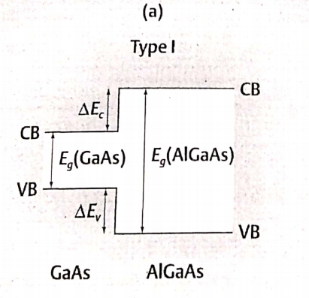
Example of GaAs/AlGaAs heterojuntion
So at a GaAs/AlGaAs heterojunction, there is a change in the band gap over a distance of a few atomic spacing.
Eg(AlGaAs)=Eg(GaAs)+ΔEv+ ΔEc
ΔEc: conduction band offset
ΔEv: valence band offset

Slide 4
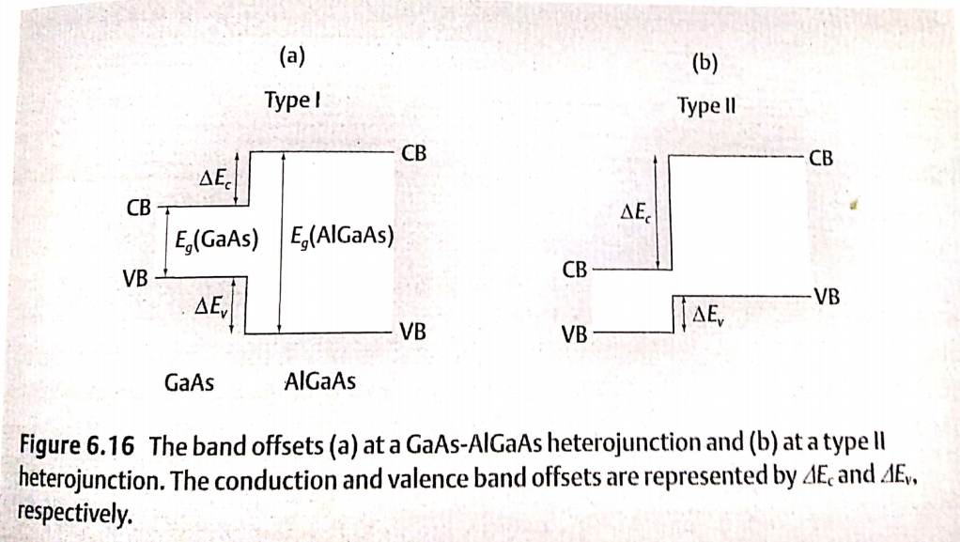

Slide 5
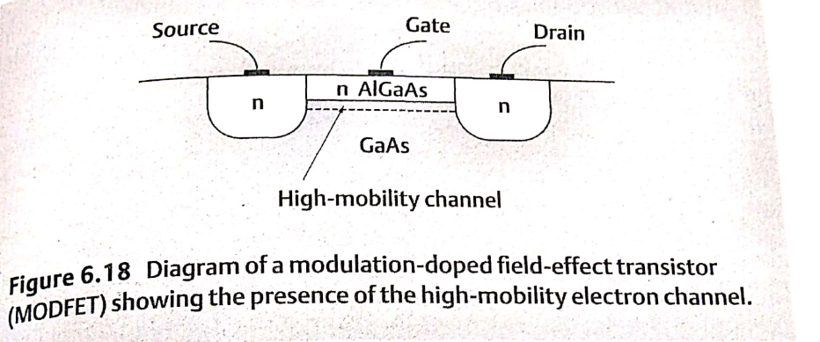
Application of heterojunction
One application is the modulation-doped field-effect transistor, or MODFET.

Slide 6
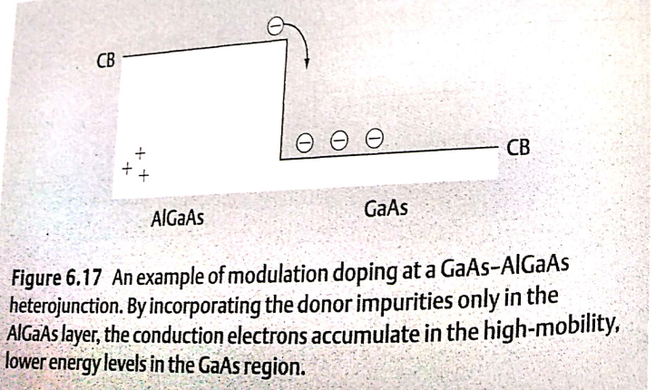
What is modulation doping?
Modulation doping:
donor impurities only introduce in an large band gap material of the heterojunction, and the electrons introduced by the donor will diffuse into the other side of the heterojunction, which has smaller band gap.

Slide 7
The advances of modulation doping
All of the conduction electrons start off initially in the AlGaAs region, some of them soon diffuse into the GaAs region. Once the electrons enter the lower energy conduction states in the GaAs, they on longer have sufficient energy to get back into the AlGaAs layer.
Consequently, we end up with a high concentration of conduction electrons in the GaAs layer. Since the GaAs layer is undoped, there are no ionized impurities to affect the motion of the electrons, and so at low temperature the drift velocity is much higher than in a doped semiconductor.

Slide 8
The impact factors of the drift velocity
It depends on the mean free path (the average length of the carrier goes before collision) of the carriers, which is influenced by the following factors:
Thermal vibrations of atoms
The presence of the impurities and imperfections in the crystal
The influence of the first factor can be reduced by reducing the temperature.

Slide 9
The impact factors of the drift velocity
For the second factor, its influence can be understood in this way.
The impurities which provide the conduction electrons and holes are also the main culprit in reducing the drift velocity of the carriers. This is because the ionized impurities are charged, which will scattering the carriers, thus decreasing the drift velocity.

Slide 10
The principle of operation of this device differs slightly from that of the MOSFET because of the absence of the oxide layer.
However, the important point is that a high-mobility channel in the undoped GaAs links the source and drain, and so the device can operate much faster than a conventional FET.

