Slide 1

Reading Files
Chapter 7
Python for Everybody
www.py4e.com
Notes:
Note from Chuck. If you are using these materials, you can remove the UM logo and replace it with your own, but please retain the CC-BY logo on the first page as well as retain the acknowledgement page(s) at the end.

Slide 2
File Processing
We will primarily focus on reading and writing text files such as those we create in a text editor. A text file can be thought of as a sequence of lines
From stephen.marquard@uct.ac.za Sat Jan 5 09:14:16 2008
Return-Path: <postmaster@collab.sakaiproject.org>
Date: Sat, 5 Jan 2008 09:12:18 -0500
To: source@collab.sakaiproject.org
From: stephen.marquard@uct.ac.za
Subject: [sakai] svn commit: r39772 - content/branches/
Details: http://source.sakaiproject.org/viewsvn/?view=rev&rev=39772
http://www.py4e.com/code/mbox-short.txt

Slide 3
Opening a File
When we want to read or write a file (say on your hard drive), we first must open the file. Opening the file communicates with your operating system, which knows where the data for each file is stored. When you open a file, you are asking the operating system to find the file by name and make sure the file exists.

Slide 4
Opening a File
Before we can read the contents of the file, we must tell Python which file we are going to work with and what we will be doing with the file. This is done with the open() function
If the open() is successful, it will return a “file handle” - a variable used to perform operations on the file. You are given a handle if the requested file exists and you have the proper permissions to read the file.

Slide 5
Using open()
fhand = open('mbox.txt', 'r')
handle = open(filename, mode)
returns a handle use to manipulate the file
filename is a string
mode is optional and should be 'r' if we are planning to read the file and 'w' if we are going to write to the file

Slide 6
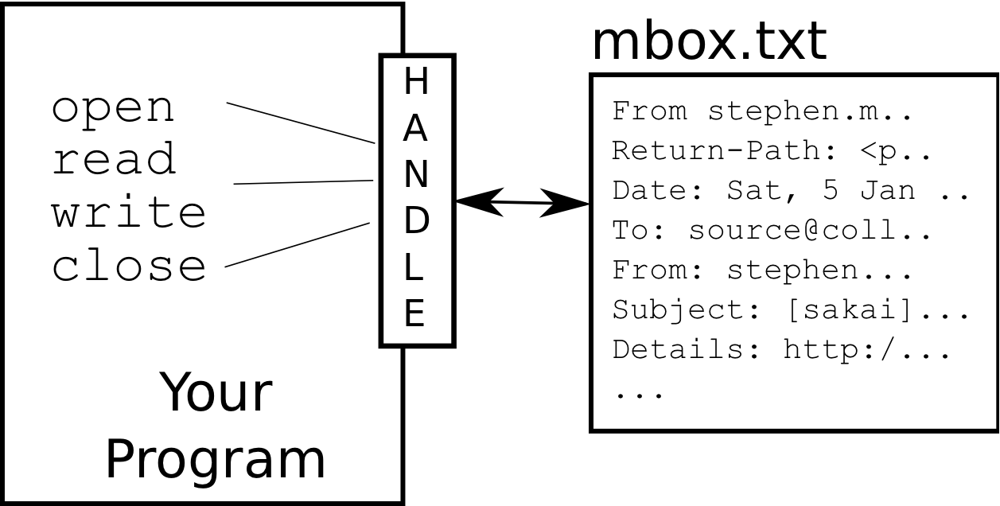
What is a Handle?
>>> fhand = open('mbox.txt')
>>> print(fhand)
<_io.TextIOWrapper name='mbox.txt' mode='r' encoding='UTF-8'>
The file handle is not the actual data contained in the file, but instead it is a “handle” that we can use to read the data.

Slide 7
When Files are Missing
>>> fhand = open('stuff.txt')
Traceback (most recent call last):
File "<stdin>", line 1, in <module>
FileNotFoundError: [Errno 2] No such file or directory: 'stuff.txt'
If the file does not exist, open will fail with a traceback and you will not get a handle to access the contents of the file.

Slide 8
The newline Character
A text file can be thought of as a sequence of lines
To break the file into lines , we use a special character called the “newline” to indicate when a line ends
We represent it as \n in strings
Newline is still one character - not two
From stephen.marquard@uct.ac.za Sat Jan 5 09:14:16 2008
Return-Path: <postmaster@collab.sakaiproject.org>
Date: Sat, 5 Jan 2008 09:12:18 -0500
To: source@collab.sakaiproject.org
From: stephen.marquard@uct.ac.za
Subject: [sakai] svn commit: r39772 - content/branches/
Details: http://source.sakaiproject.org/viewsvn/?view=rev&rev=39772

Slide 9
The newline Character
To break the file into lines , we use a special character called the “newline” to indicate when a line ends
We represent it as \n in strings
Newline is still one character - not two
A text file has newlines at the end of each line
From stephen.marquard@uct.ac.za Sat Jan 5 09:14:16 2008\n
Return-Path: <postmaster@collab.sakaiproject.org>\n
Date: Sat, 5 Jan 2008 09:12:18 -0500\n
To: source@collab.sakaiproject.org\n
From: stephen.marquard@uct.ac.za\n
Subject: [sakai] svn commit: r39772 - content/branches/\n
\n
Details: http://source.sakaiproject.org/viewsvn/?view=rev&rev=39772\n

Slide 10
The newline Character
When we look at the variable by entering “stuff” in the interpreter, it shows us the \n in the string, but when we use print to show the string, we see the string broken into two lines by the newline character.
>>> stuff = 'Hello\nWorld!'
>>> stuff
'Hello\nWorld!'
>>> print(stuff)
Hello
World!
>>> stuff = 'X\nY'
>>> print(stuff)
X
Y
>>> len(stuff)
3

Slide 11
Reading Files in Python

Slide 12
File Handle as a Sequence
While the file handle does not contain the data for the file,A file handle open for read can be treated as a sequence of strings where each line in the file is a string in the sequence
We can use the for statement to iterate through a sequence
Remember - a sequence is an ordered set
xfile = open('mbox.txt')
for cheese in xfile:
print(cheese)

Slide 13
Counting Lines in a File
Open a file read-only, use a for loop to read each line
the open function does not read the entire file is that the file might be quite large, The open statement takes the same amount of time regardless of the size of the file. The for loop actually causes the data to be read from the file.
Count the lines and print out the number of lines
fhand = open('mbox.txt')
count = 0
for line in fhand:
count = count + 1
print('Line Count:', count)
$ python open.py
Line Count: 132045

Slide 14
Reading Lines in a File
When the file is read using a for loop in this manner, Python takes care of splitting the data in the file into separate lines using the newline character.
Python reads each line through the newline and includes the newline as the last character in the line variable for each iteration of the for loop
Because the for loop reads the data one line at a time, it can efficiently read and count the lines in very large files without running out of main memory to store the data.
Count the lines and print out the number of lines
fhand = open('mbox.txt')
count = 0
for line in fhand:
count = count + 1
print('Line Count:', count)
$ python open.py
Line Count: 132045

Slide 15
Reading the *Whole* File
If we know the file is relatively small compared to the size of your main memory, we can read the whole file (newlines and all) into a single string using the read method on the file handle
>>> fhand = open('mbox-short.txt')
>>> inp = fhand.read()
>>> print(len(inp))
94626
>>> print(inp[:20])
From stephen.marquar
In this example, the entire contents (all 94,626 characters) of the file mbox-short.txt are read directly into the variable inp. We use string slicing to print out the first 20 characters of the string data stored in inp

Slide 16
Reading the *Whole* File
When the file is read in this manner, all the characters including all of the lines and newline characters are one big string in the variable inp.
Remember that this form of the open function should only be used if the file data will fit comfortably in the main memory of your computer. If the file is too large to fit in main memory, you should write your program to read the file in chunks using a for or while loop
>>> fhand = open('mbox-short.txt')
>>> inp = fhand.read()
>>> print(len(inp))
94626
>>> print(inp[:20])
From stephen.marquar

Slide 17
Searching Through a File
When you are searching through data in a file, We can combine the pattern for reading a file with string methods to build simple search mechanisms
We can put an if statement in our for loop to only print lines that meet some criteria
fhand = open('mbox-short.txt')
for line in fhand:
if line.startswith('From:') :
print(line)

Slide 18
Searching Through a File
From: stephen.marquard@uct.ac.za
From: louis@media.berkeley.edu
From: zqian@umich.edu
From: rjlowe@iupui.edu
...
What are all these blank lines doing here?

Slide 19
Searching Through a File
Each line from the file has a newline at the end
The print statement adds a newline to each line
What are all these blank lines doing here?
From: stephen.marquard@uct.ac.za\n
\n
From: louis@media.berkeley.edu\n
\n
From: zqian@umich.edu\n
\n
From: rjlowe@iupui.edu\n
\n
...

Slide 20
Searching Through a File (fixed)
We can strip the whitespace from the right-hand side of the string using rstrip() from the string library
The newline is considered “white space” and is stripped
fhand = open('mbox-short.txt')
for line in fhand:
line = line.rstrip()
if line.startswith('From:') :
print(line)
From: stephen.marquard@uct.ac.za
From: louis@media.berkeley.edu
From: zqian@umich.edu
From: rjlowe@iupui.edu
....

Slide 21
Skipping with continue
The basic idea of the search loop is that you are looking for “interesting” lines and effectively skipping “uninteresting” lines
We can conveniently skip a line by using the continue statement
fhand = open('mbox-short.txt')
for line in fhand:
line = line.rstrip()
if not line.startswith('From:') :
continue
print(line)

Slide 22
Using find to Select Lines
We can use the find string method to finds lines where the search string is anywhere in the line.
find looks for an occurrence, of a string within another string and either returns the position of the string or -1 if the string was not found,
fhand = open('mbox-short.txt')
for line in fhand:
line = line.rstrip()
if lines.find('@uct.ac.za‘)== -1:
continue
print(line)

Slide 23
Using in to Select Lines
fhand = open('mbox-short.txt')
for line in fhand:
line = line.rstrip()
if not '@uct.ac.za' in line :
continue
print(line)
We can look for a string anywhere in a line as our selection criteria
From stephen.marquard@uct.ac.za Sat Jan 5 09:14:16 2008
X-Authentication-Warning: set sender to stephen.marquard@uct.ac.za using –f
From: stephen.marquard@uct.ac.za
Author: stephen.marquard@uct.ac.za
From david.horwitz@uct.ac.za Fri Jan 4 07:02:32 2008
X-Authentication-Warning: set sender to david.horwitz@uct.ac.za using -f...

Slide 24
Prompt for File Name
fname = input('Enter the file name: ')
fhand = open(fname)
count = 0
for line in fhand:
if line.startswith('Subject:') :
count = count + 1
print('There were', count, 'subject lines in', fname)
read the file name from the user and place it in a variable named fname and open that file.
It would be more usable to ask the user to enter the file name string each time the program runs so they can use our program on different files without changing the Python code. We can read the file name from the user using input
Enter the file name: mbox.txt
There were 1797 subject lines in mbox.txt
Enter the file name: mbox-short.txt
There were 27 subject lines in mbox-short.txt

Slide 25
Bad File Names
fname = input('Enter the file name: ')
try:
fhand = open(fname)
except:
print('File cannot be opened:', fname)
quit()
count = 0
for line in fhand:
if line.startswith('Subject:') :
count = count + 1
print('There were', count, 'subject lines in', fname)
If a user types something that is not a file name, the program will trigger a traceback and exits.
we can elegantly fix it using the try/except structure. We need to assume that the open call might fail and add recovery code when the open fails.
Enter the file name: mbox.txt
There were 1797 subject lines in mbox.txt
Enter the file name: na na boo boo
File cannot be opened: na na boo boo

Slide 26
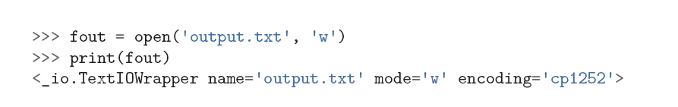
Writing Files
To write a file, you have to open it with mode “w” as a second parameter
If the file already exists, opening it in write mode clears out the old data and starts fresh, so be careful! If the file doesn’t exist, a new one is created

Slide 27
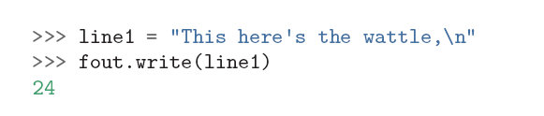
Writing Files
write method of the file handle object puts data into the file, returning the number of characters written. The default write mode is text for writing (and reading) strings.
the file object keeps track of where it is, so if we call write again, it adds the new data to the end
We must make sure to manage the ends of lines as we write to the file by explicitly inserting the newline character when we want to end a line. The print statement automatically appends a newline, but the write method does not add the newline
automatically.

Slide 28

Writing Files
you are done writing, you have to close the file to make sure that the last bit of data is physically written to the disk so it will not be lost if the power goes off.
We could close the files which we open for read as well. But Python makes sure that all open files are closed when the program ends
When we are writing files, we want to explicitly close the files so as to leave nothing to chance.

Slide 29
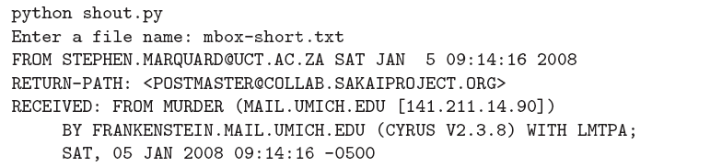
Exercise
Exercise 1: Write a program to read through a file and print the contents of the file (line by line) all in upper case. Executing the program will look as follows:

Slide 30
Exercise
Exercise 2: Write a program to prompt for a file name, and then read through the file and look for lines of the form:
X-DSPAM-Confidence: 0.8475
When you encounter a line that starts with “X-DSPAM-Confidence:”
pull apart the line to extract the floating-point number on the line. Count these lines and then compute the total of the spam confidence values from these lines. When you reach the end of the file, print out the average spam confidence.

