Slide 1
EE113 PN Junctions Formation
Jinling Yu

Slide 2
What’s in Lecture
How PN junctions are formed.
Formation of Depletion Layer.
The Diode equation
Characteristic IV curve of a diode.
Diode under bias
Diode breakdown mechanisms.

Slide 3
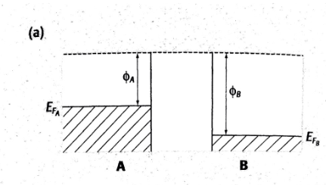
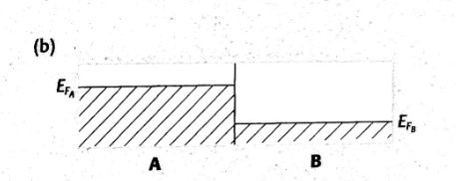
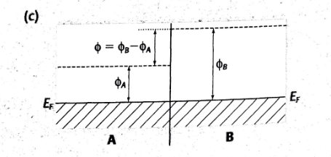
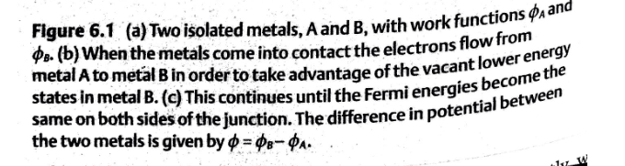
Junctions between two metals- the contact potential

Slide 4
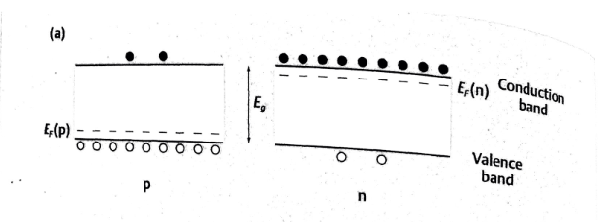
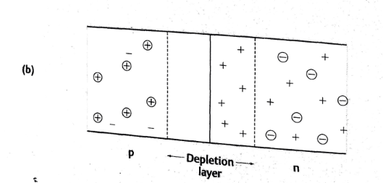
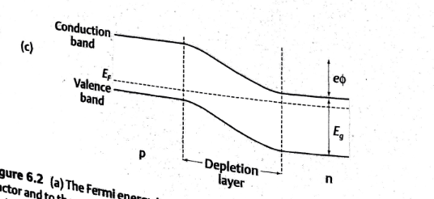
PN junction

Slide 5
Diode Formation
We can dope a material and change its conductivity but metal can do this better so why not use that?
Interesting things happen when you mix differently doped semiconductors.
Lets take a n-type, lots of extra electrons, and a p-type, lots of extra holes, and put them together.
This combination is called a diode, they come in many different forms but basically can be considered as one-way valves letting current flow only in the one direction.

Slide 6
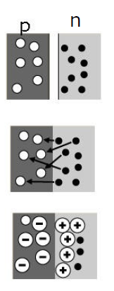
Depletion Region formation
The n-type electrons diffuse across the junction and combine with the p-type holes.
The n-type material is now positively charged as it has lost electrons.
At the same time, the holes in the p-type region will diffuse into the n-type region, and combine with the electrons.
The electrons diffuse from the n-type region into the p-type region, and the holes diffuse from the p-type region into the n-type region. They form diffusion current.
The p-type material is now negatively charged as it has gained electrons! The n-type is positive charged as it has gained holes.
This will introduce a built-in electric field pointing from n-type region to the p-type region.
The white dots are the holes and the black dots are the electrons.

Slide 7
In the middle there is now a region that has NO charges, as they have all recombined, and it called a DEPLENTION region.
Under this built-in electric field, the holes in the n-type region will drift to the p-type region, and the electrons in the p-type region will drift to the n-type region. They form drift current in PN junction.
At the beginning, the diffusion current is larger than the drift current, because at the beginning, the concentration difference is large, and the built-in electric field is weak. As time goes, the built-in electric field increases, which enhance the drift current. And the built-in electric field will decrease the diffusion current. When the drift current is equal to the diffusion current, a dynamic equilibrium is achieved. At this time, stable space charge region is formed.
Therefore, there are two current mechanisms in the PN junction. One is the drift current, an the other is the diffusion current.
Drift current is due to the minority carriers, i.e., electrons in the p-type or the holes in the n-type region, drift across the depletion region under the built-in electric field.

Slide 8
Diffusion current is due to the majority carriers, i.e., electrons in the n-type or the holes in the p-type region, diffuse across the depletion region because of the concentration gradient.

Slide 9

主观题
10分
答案解析
Please describe how a PN junction is form?
A depletion layer is formed when a P and N material come into physical contact with each other. The electron and hole charge carriers recombine with each other as they diffuse from one side to the other thus removing free charge from that area, which is called depletion layer. (3 marks) At the same time, in the depletion layer, the positive charged ions in the n-type region and the negative charged ions in the p-type region generate a built-in electric field, which will induce a drift current flowing from n-type region to the p-type region. The drift current will suppress the diffusion current. When the two currents are equal, a dynamic equilibrium is achieved, and a stable depletion layer is formed.
正常使用主观题需2.0以上版本雨课堂
作答
可为此题添加文本、图片、公式等解析，且需将内容全部放在本区域内。正常使用需3.0以上版本

Slide 10
A depletion layer is formed when a P and N material come into physical contact with each other. The electron and hole charge carriers recombine with each other as they diffuse from one side to the other thus removing free charge from that area, which is called depletion layer.
At the same time, in the depletion layer, the positive charged ions in the n-type region and the negative charged ions in the p-type region generate a built-in electric field, which will induce a drift current flowing from n-type region to the p-type region.
The drift current will suppress the diffusion current. When the two currents are equal, a dynamic equilibrium is achieved, and a stable depletion layer is formed.

Slide 11
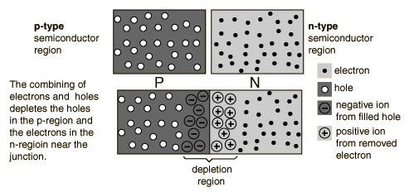
Depletion region - image
In this particular example we have what is called a symmetrical junction,
that is the amount of dopant in each side is the same.
The bit in the middle is the depletion region

Slide 12
Depletion region - symmetrical
What do you think happens to the ability of current to flow in this scenario?
We can see that there is a build-up of positive charges in the n-type side and of negative charges for the positive side.
This repels any electrons that are coming over and the same for the holes.
So in an equilibrium state there is no net current.
It does have another effect that we will discuss in a little bit.
but first, what happens when the dopant levels are not the same?

Slide 13
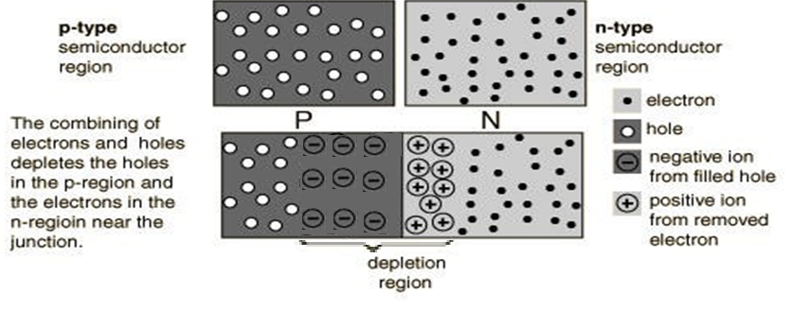
Depletion region - asymmetrical
This is a much more interesting setup, where there is more dopant in one side than the other. The depletion region is still formed but it moves further into one side than the other.
There is still no net current flow at equilibrium but it creates something called the Contact Potential, V₀.

Slide 14
Contact Potential, V₀
This is the amount of energy that has to be supplied to reduce the size of the depletion region so that current can flow easily.
This is what can be controlled by the level of doping and the base material chosen.
The typical diode that you will use in the lab, IN7001, needs about 0.6 V to ‘turn’ on. We will look at the characteristics of a diode in a while.
Now a more detailed explanation of contact potential.

Slide 15
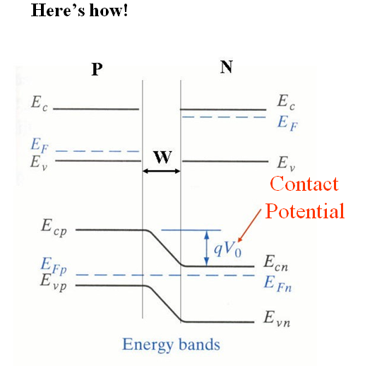
Contact Potential, V₀, - energy bands.
A little complicated this picture.
The top half shows how the energy levels stack up for the P and N
doped silicon.
The Fermi energy, E_{F}, has moved due to the doping.
W, is the width of the depletion region, which is dependant
on the level of doping.
Clearly the Fermi level are NOT aligned.
The contact potential, V₀, which is the difference between the Fermi levels, effectively allows the conduction and valance bands to Bend, which in turn allows for the movement of charge.
Naturally it is actually a LOT more complicated than this, but this
is fine for what we need.

Slide 16
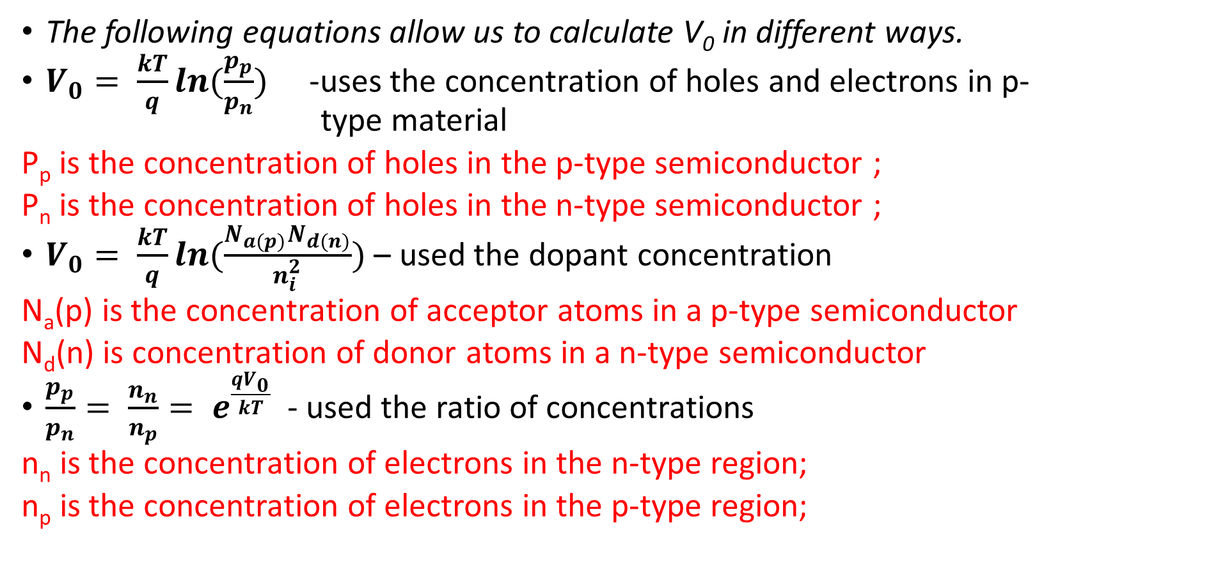
Calculation of Contact Potential, V₀
The following equations allow us to calculate V₀ in different ways.
$V_{0}= \frac{kT}{q}ln(\frac{p_{p}}{p_{n}})$ -uses the concentration of holes and electrons in p- type material
P_{p} is the concentration of holes in the p-type semiconductor ;
P_{n} is the concentration of holes in the n-type semiconductor ;
$V_{0}= \frac{kT}{q}ln(\frac{N_{a(p)}N_{d(n)}}{n_{i}^{2}})$ – used the dopant concentration
N_{a}(p) is the concentration of acceptor atoms in a p-type semiconductor
N_{d}(n) is concentration of donor atoms in a n-type semiconductor
$\frac{p_{p}}{p_{n}}= \frac{n_{n}}{n_{p}}= e^{\frac{{qV}_{0}}{kT}}$ - used the ratio of concentrations
n_{n} is the concentration of electrons in the n-type region;
n_{p} is the concentration of electrons in the p-type region;

Slide 17
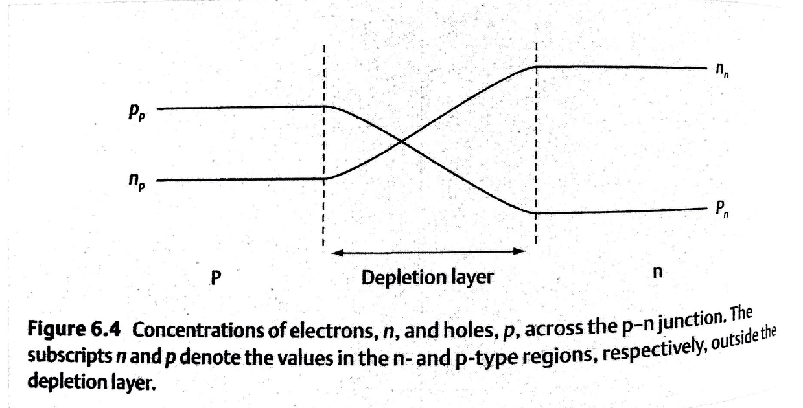
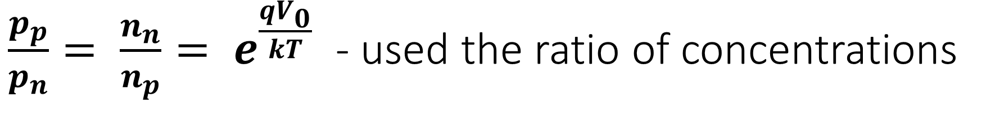
$\frac{p_{p}}{p_{n}}= \frac{n_{n}}{n_{p}}= e^{\frac{{qV}_{0}}{kT}}$ - used the ratio of concentrations

Slide 18
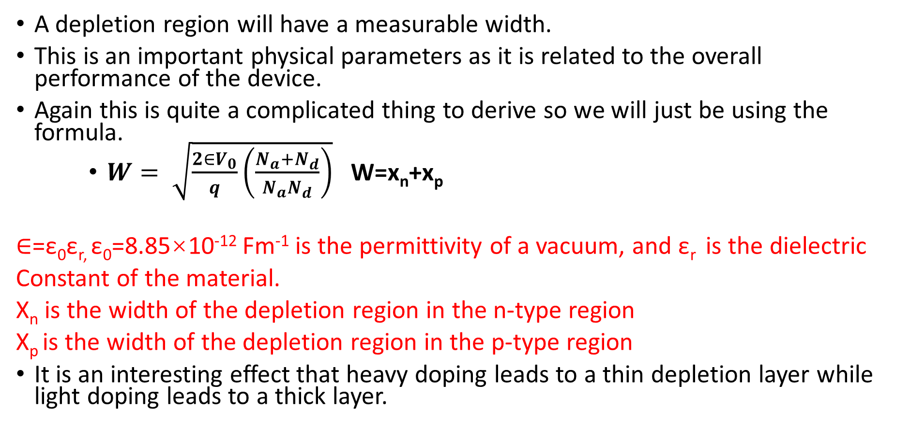
Depletion Region Width
A depletion region will have a measurable width.
This is an important physical parameters as it is related to the overall performance of the device.
Again this is quite a complicated thing to derive so we will just be using the formula.
$W= \sqrt{\frac{2∈V_{0}}{q}\left(\frac{N_{a}{+N}_{d}}{N_{a}N_{d}}\right)}$ W=x_{n}+x_{p}
$∈$=ε₀ε_{r,} ε₀=8.85×10⁻¹² Fm⁻¹ is the permittivity of a vacuum, and ε_{r} is the dielectric
Constant of the material.
X_{n} is the width of the depletion region in the n-type region
X_{p} is the width of the depletion region in the p-type region
It is an interesting effect that heavy doping leads to a thin depletion layer while light doping leads to a thick layer.

Slide 19
多选题
10分
Which statements below are right?
A
Light doping semiconductor has wider depletion layer.
B
heavy doping semiconductor has wider depletion layer.
C
There is no free charges in the depletion layer.
D
The contact potential is due to the different fermi levels of the two materials that form the PN junction.
提交

Slide 20
PN junction as a capacitor
There is now a situation where a PN junction has 2 conductive layers, the n and p types, separated by an insulation layer, the depletion region.
This gives rise to something called a capacitor, which will be dealt with at a later stage.
Suffice it to say that a capacitor stores electrical charge so it takes energy to charge up.
In effect our contact potential, V₀, is the amount of energy that is needed to charge the capacitor.
The capacitance of the junction is dependant on the area of contact of the 2 sides, A, the type of material and of course, the width of the junction, W.

Slide 21
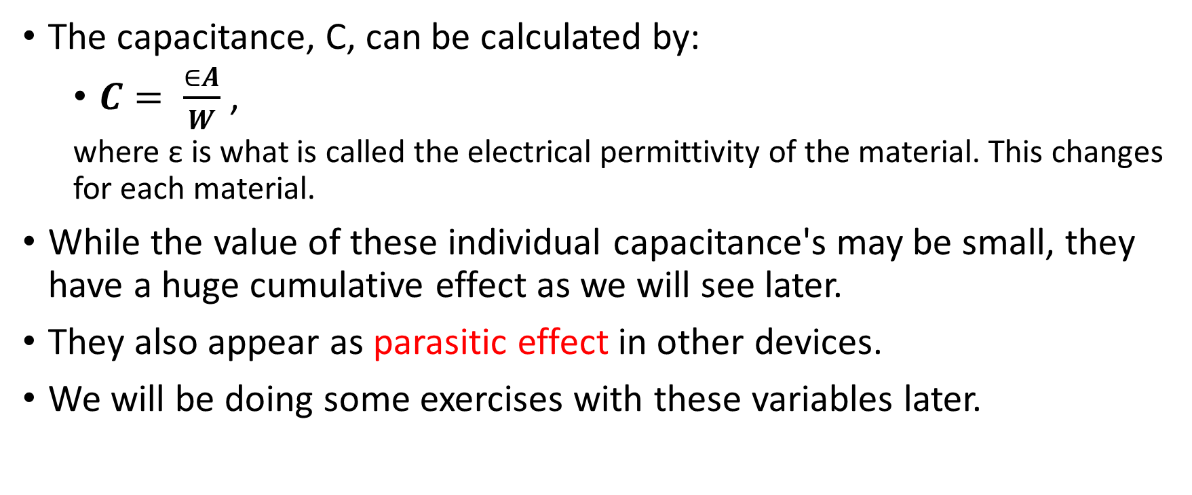
PN junction as a capacitor
The capacitance, C, can be calculated by:
$C= \frac{∈A}{W}$ ,
where ε is what is called the electrical permittivity of the material. This changes for each material.
While the value of these individual capacitance's may be small, they have a huge cumulative effect as we will see later.
They also appear as parasitic effect in other devices.
We will be doing some exercises with these variables later.

Slide 22
PN Junctions under Bias
Thus far all of the PN junctions have been under equilibrium, that is they have not been affected by some sort of external influence.
That is kind of boring so let’s apply an external stimulus to our PN junction.
This stimulus is called bias.
2 types of bias can be applied:
Forward bias, where the applied voltage is greater than 0 V, i.e. a positive voltage,
Reverse bias, where the applied voltage is less than 0 V, i.e. a negative voltage.
These different biases give very different behaviours.

Slide 23
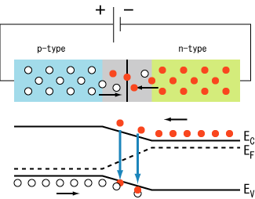
PN junctions under Forward Bias
In forward bias the applied voltage makes the depletion layer smaller and allows current to flow.
Once the applied voltage is greater than the contact potential, V₀, lots of current flows as there is little to prevent it doing so.

Slide 24
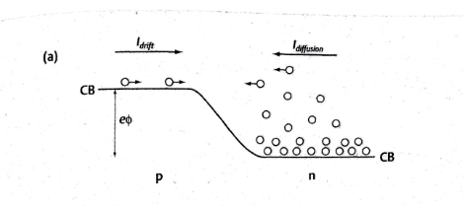
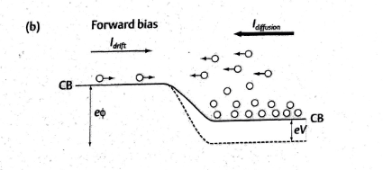
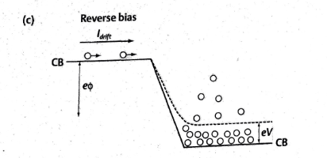
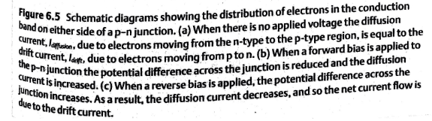

Slide 25
Under reverse bias, the potential difference (or the barrier) increases. The diffusion current decreases, and so the drift current is larger than diffusion current. So the net current is due to the drift current.
However, the drift current is not affected by the external voltage, so although there is a net flow of electrons from the p-type to the n-type side, the magnitude of the current is very small. This is because the drift current comes from the minority carriers.

Slide 26
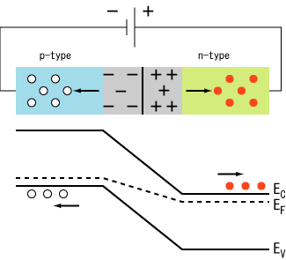
PN junctions under Reverse Bias.
In reverse bias the applied voltage makes the depletion layer look much bigger.
Current will only flow in the reverse direction under very limited condition's and normally results in the breakdown of the junction.

Slide 27
主观题
10分
答案解析
Why can we consider a depletion region to be a capacitor? What is the main driver of this capacitance? Defend your answer.
The depletion region has width and requires energy to allow charge to move. In other words, it stores charge which is the definition of a capacitor. The contact potential is a key driver, and this is the term that affects the width of the junction.
正常使用主观题需2.0以上版本雨课堂
作答
可为此题添加文本、图片、公式等解析，且需将内容全部放在本区域内。正常使用需3.0以上版本

Slide 28
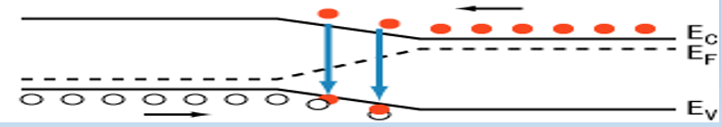
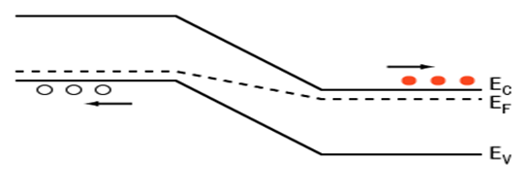
多选题
10分
Under the reverse bias, which statements are right?
A
The potential difference increases.
B
The drift current plays the dominant role.
C
The diffusion current plays the dominant role.
D
The current in the PN junction is quit large.
E
The current in the PN junction is quit small
F
The energy diagram is like this:
G
The energy diagram is like this:
提交

Slide 29
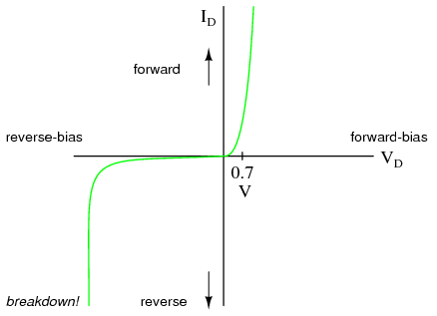
Diode Characteristic under bias
Our PN junction, diode, behaves very differently depending on its bias conditions.
It has what is called an ‘IV’ curve which describes how much current will flow under different voltage conditions.
Under positive, i.e., forward bias, little current flows until V₀ is passed.
Under negative, i.e., reverse bias, no current or very low current flows until breakdown.
Naturally there is an equation to describe this behaviour which we will look at now ☺
rectification effect （整流效应）
The current flows under positive bias, and little current flows under reverse bias.

Slide 30
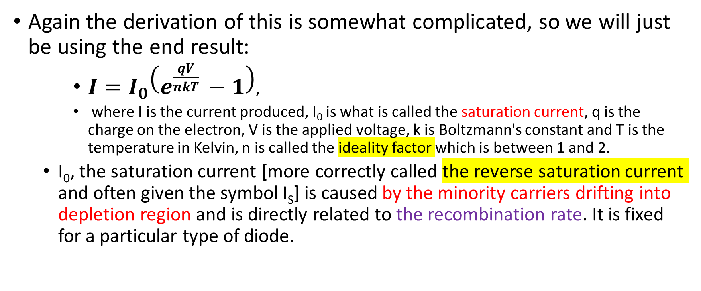
Diode Current Equation
Again the derivation of this is somewhat complicated, so we will just be using the end result:
$I=I_{0}\left(e^{\frac{qV}{nkT} }−1\right)$,
where I is the current produced, I₀ is what is called the saturation current, q is the charge on the electron, V is the applied voltage, k is Boltzmann's constant and T is the temperature in Kelvin, n is called the ideality factor which is between 1 and 2.
I₀, the saturation current [more correctly called the reverse saturation current and often given the symbol I_{S}] is caused by the minority carriers drifting into depletion region and is directly related to the recombination rate. It is fixed for a particular type of diode.

Slide 31
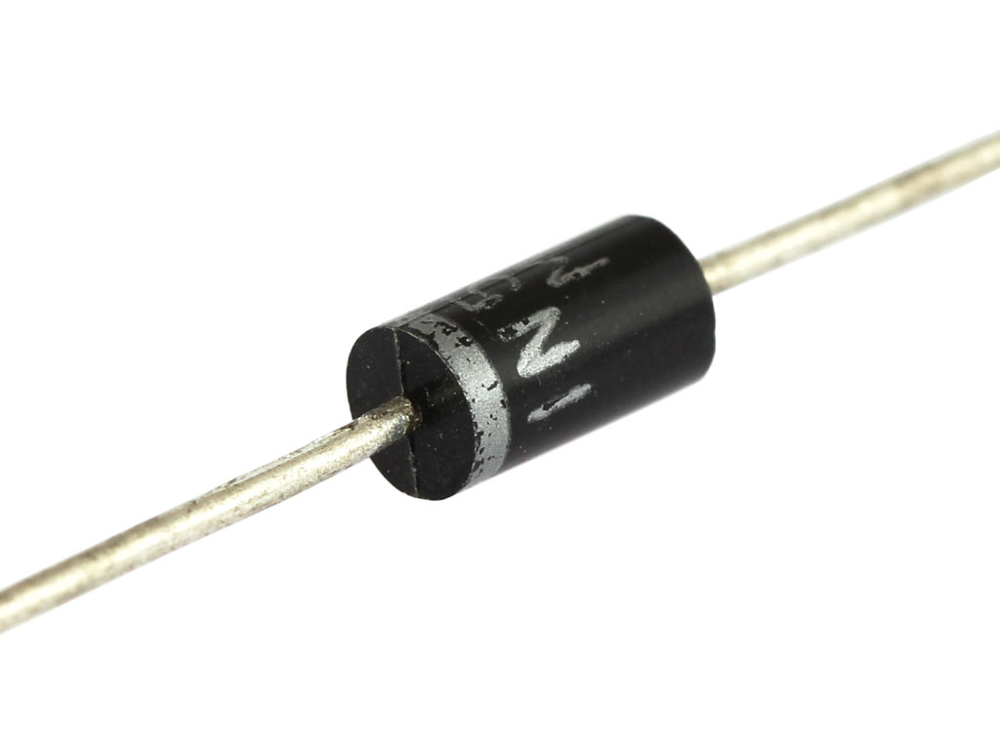
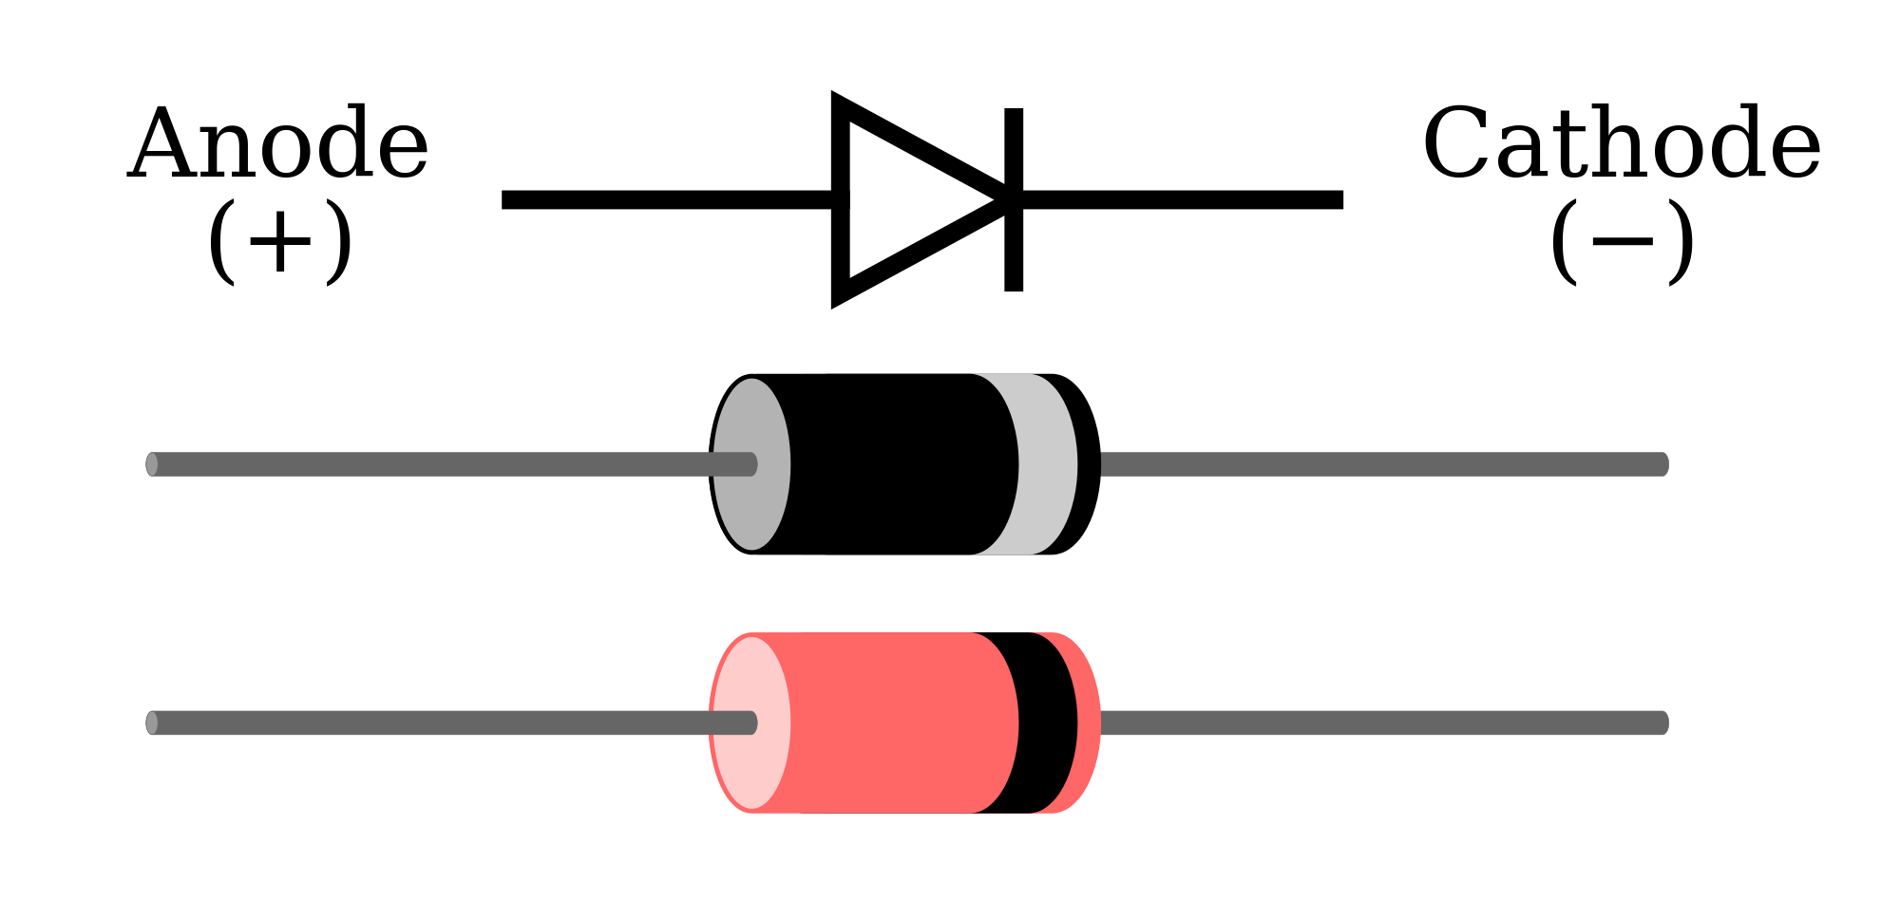
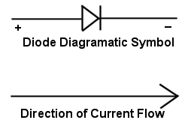
Typical Diodes
This is a standard diode,
the silver band indicates the
direction of current flow.
This has the circuit symbol for a diode, the vertical bar at the end Of the triangle point indicates the direction of current.

Slide 32
Reverse Bias Breakdown Methods
For standard diodes, large current only flows under reverse bias under certain effects. These are called:
Zener Breakdown
Avalanche Breakdown
We will look at both of these in a little detail but as mentioned previously, this is normally a destructive condition for standard diodes.

Slide 33
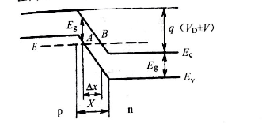
Zener Breakdown(齐纳击穿)
For this to occur, the following conditions must be meet:
The material is heavily doped,
There is a large reverse bias field applied, which causes the conduction and valence bands to align,
Quantum mechanical tunnelling then occurs leading to large current flow.
This process is undistinguishable from avalanche breakdown.
There are special diodes called Zener diodes which are designed to allow current to flow as part of a protection mechanism and will function in a standard way also.
Use as a device to obtain stable voltage, because this process is reversable
Notes:
齐纳二极管
稳压二极管，英文名称Zener diode，又叫齐纳二极管。利用pn结反向击穿状态，其电流可在很大范围内变化而电压基本不变的现象，制成的起稳压作用的二极管。此二极管是一种直到临界反向击穿电压前都具有很高电阻的

Slide 34
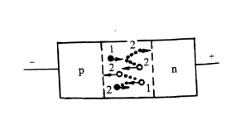
Avalanche Breakdown（雪崩击穿）
This is a more common breakdown mechanism and occurs when:
There is light doping of the material,
There are thermally generated charge carriers present,
There is a big enough reverse bias field to accelerate these charge carriers across the depletion layer.
These moving charge carriers then strike electrons orbiting the atoms and knock these out of their shells.
As they are in a field they also begin to move and strike other electrons knocking them out too.
This process continues until you have an increasing, avalanche, effect of moving charge, leading to high current and ultimately the destruction of the device.

Slide 35
So we have covered our first semiconductor device, the diode or PN junction.
Please see the tutorial questions for more detail and for the use of the various equations.
This device forms the basis of many other semiconductor devices and so your ability to explain its operation and do calculations is important.

Slide 36
多选题
10分
What are the characteristics of avalanche breakdown?
A
Light doping
B
Heavy doping
C
High reverse bias
D
There are thermally generated free carries at first
提交

Slide 37
多选题
10分
What are the characteristics of Zener breakdown?
A
Light doping
B
Heavy doping
C
High reverse bias
D
Tunnelling effect occurs
提交

Slide 38
$$I=I_{0}\left(e^{\frac{qV}{nkT} }−1\right)$$
where I is the current produced, I₀ is what is called the saturation current, q is the charge on the electron, V is the applied voltage, k is Boltzmann's constant and T is the temperature in Kelvin, n is called the ideality factor which is between 1 and 2

Slide 39
主观题
10分
Please write down the diode equation and draw the characteristic curve of a diode.
正常使用主观题需2.0以上版本雨课堂
作答

Slide 40
Summation
How PN junctions are formed.
Formation of Depletion Layer.
The Diode equation
Characteristic IV curve of a diode.
Diode under bias
Diode breakdown mechanisms.

